Slide 1


What about the FA in FAIR?
Image repositories for findable and accessible imaging data
Trainers: Christian Schmidt, Michele Bortolomeazzi, Ksenia Krooß
Data Steward
Center for Advanced imaging (CAi), Heinrich-Heine-Universität Düsseldorf
ksenia.krooss@hhu.de
Zenodo DOI: 10.5281/zenodo.15026373
With the exception of logos and cited third-party content, the content of these slides is shared under the terms of the Creative Commons Attribution License (CC-BY 4.0) unless the content is marked otherwise.
E-Science Tage
12.03.2025

Slide 2
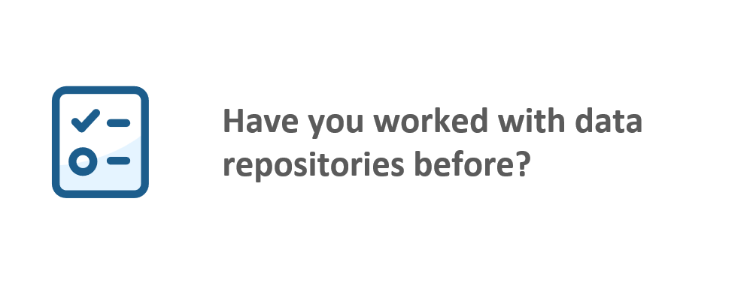

Slide 3
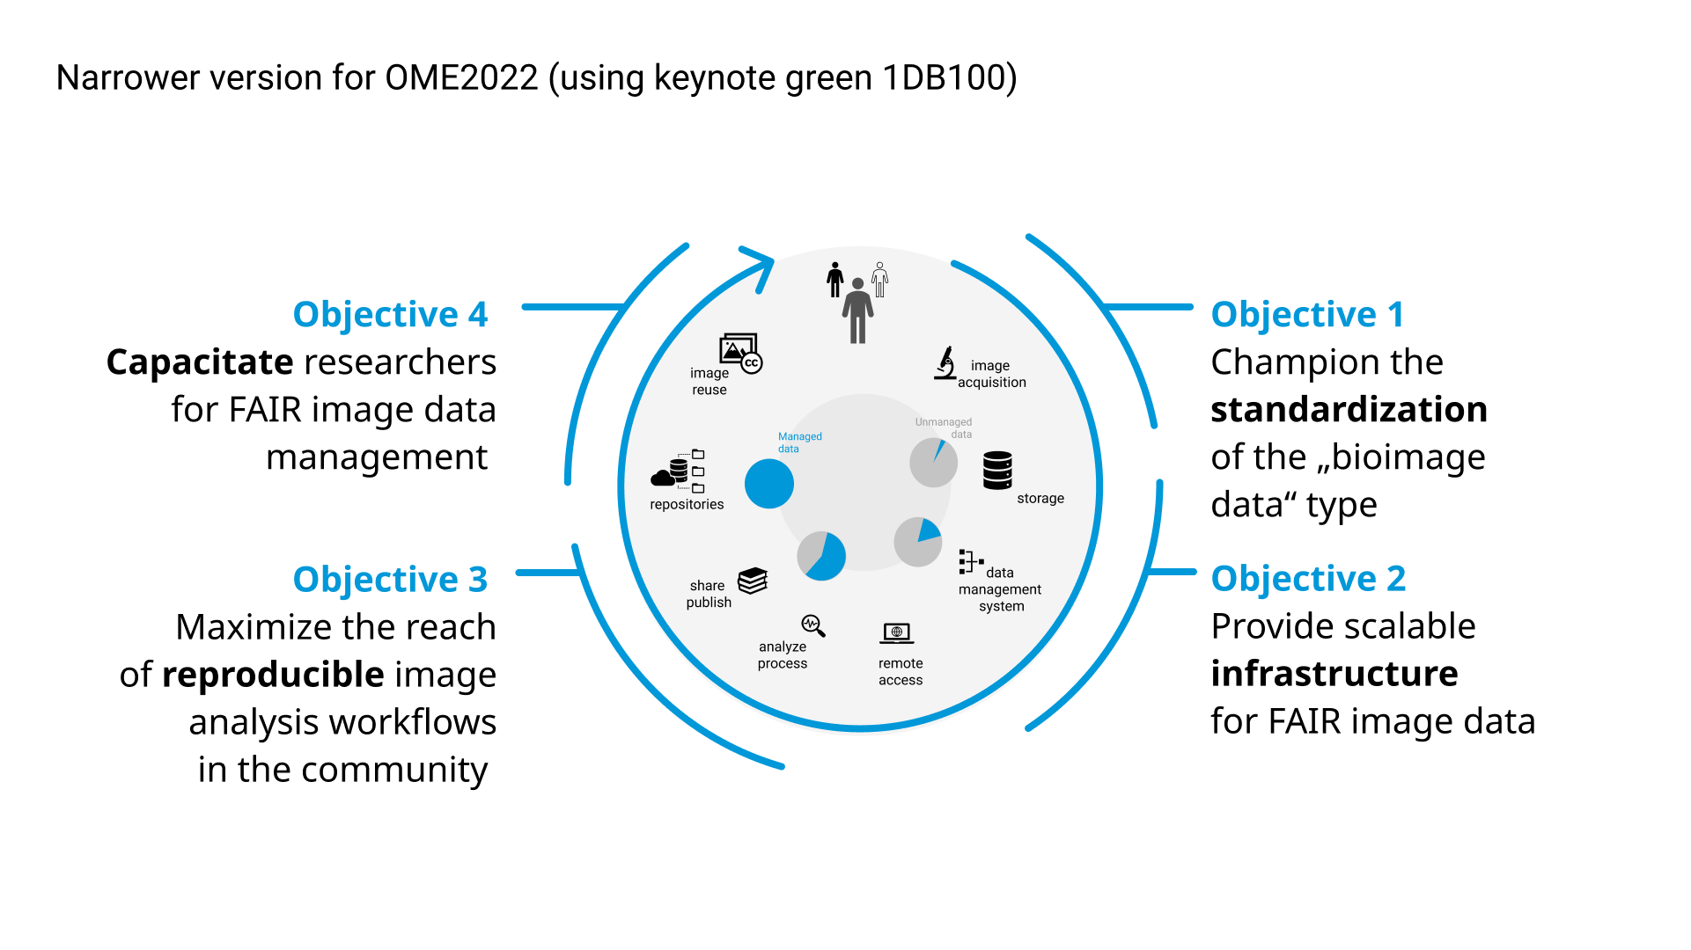
What are data repositories?
Digital storage space for data (and metadata) with the goal of
preserving the data
making data findable
making data accessible
Paper publication and data publication to a suitable repository should go hand in hand
DOI of the data publication can be put into the data availability statement of the paper
https://nfdi4bioimage.de/about-us/goals-and-task-areas/
Ellenberg, J., Swedlow, J.R., Barlow, M. et al. A call for public archives for biological image data. Nat Methods 15, 849–854 (2018). https://doi.org/10.1038/s41592-018-0195-8
"Data is available upon request", NFDI4BIOIMAGE Consortium (2024): NFDI4BIOIMAGE data management illustrations by Henning Falk, Zenodo, https://doi.org/10.5281/zenodo.14186100, is used under a CC-BY 4.0 license.
March 2025
Workshop 134 – E-Science Tage
Notes:
At which state of the bioimage lifecycle do repositories come into focus
Explain the concept of repositories
Highlight data publication as part of scientific work
Comic should show what we try to avoid by using repositores

Slide 4
Why using data repositories?
Depositing data on a repository will
increase trust in your (published) findings
help understand your results
help reproduce your results
save resources
enable reuse of data
makes your data FAIR!
https://nfdi4bioimage.de/about-us/goals-and-task-areas/
Wilkinson et al. (2016), Nature
12.03.2025
Workshop 134 – E-Science Tage
Notes:
Data on a repository will save ressources by eliminating the need to perform the exact same experiments or enable analysis without the need to perform imaging
At best, data deposition is done during the submission process so the information where to find the data can be added to the publication
Funding agencies and journals might demand deposition of data to a repository

Slide 5



How to find a suitable data repository?
Repositories have to comply with some general criteria (from Practical Guide to the International Alignment of Research Data Management), such as
  persistent identifiers for data
  metadata
  access and licenses regulations
  data preservation
You can use these repository registries:
re3data.org - Registry of Research Data Repositories
https://www.re3data.org/
FAIRsharing.org - Standards, Databases, Policies
https://fairsharing.org/
OpenAIRE - Explore
https://explore.openaire.eu/
https://zenodo.org/records/4915862
12.03.2025
Workshop 134 – E-Science Tage
Notes:
Re3data.org is a global registry of research data repositories. The registry covers research data repositories from different academic disciplines. re3data presents repositories for the permanent storage and access of data sets to researchers, funding bodies, publishers and scholarly institutions. re3data is funded by the DFG.
FAIRsharing.org is a resource on data and metadata standards, inter-related to databases and data policies. More than a repository registry but it also allows to search for suitable repositories based on subject, method, and more. FAIRsharing team precisely curates information on standards employed for the identification, citation and reporting of data and metadata, via four standards subtypes. FAIRsharing monitors the evolution of these standards, their implementation in databases and repositories, and recommendation by journal and funder data policies.
OpenAIRE is a service that is part of the EU-funded OpenAIRE project. The OpenAIRE explore service harvests information about data sources, licenses, publications, research software items, etc. Among those, you can search for repositories.

Slide 6
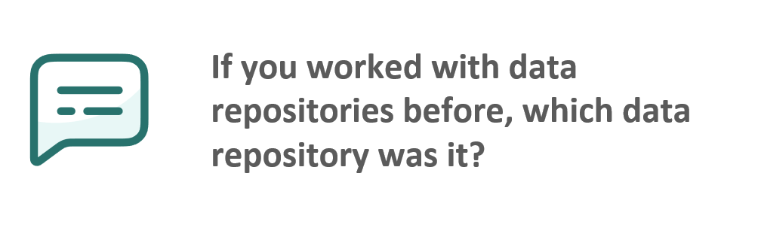

Slide 7




Which repository fits to my (bioimage) data?
You have to decide, do you want to use a
generic repository, e.g. Zenodo
discipline-specific or domain-specific repository, e.g. Electron Microscopy Public Image Archive (EMPIAR)
archive-type data repository, e.g. BioImage Archive (BIA)
added-value databases, e.g. Image Data Resource (IDR)
Community-developed checklists for publishing images and image analyses, Schmied et al. (2023), Nat Methods
12.03.2025
Workshop 134 – E-Science Tage
Notes:
EMPIAR - Electron Microscopy Public Image Archive

Slide 8
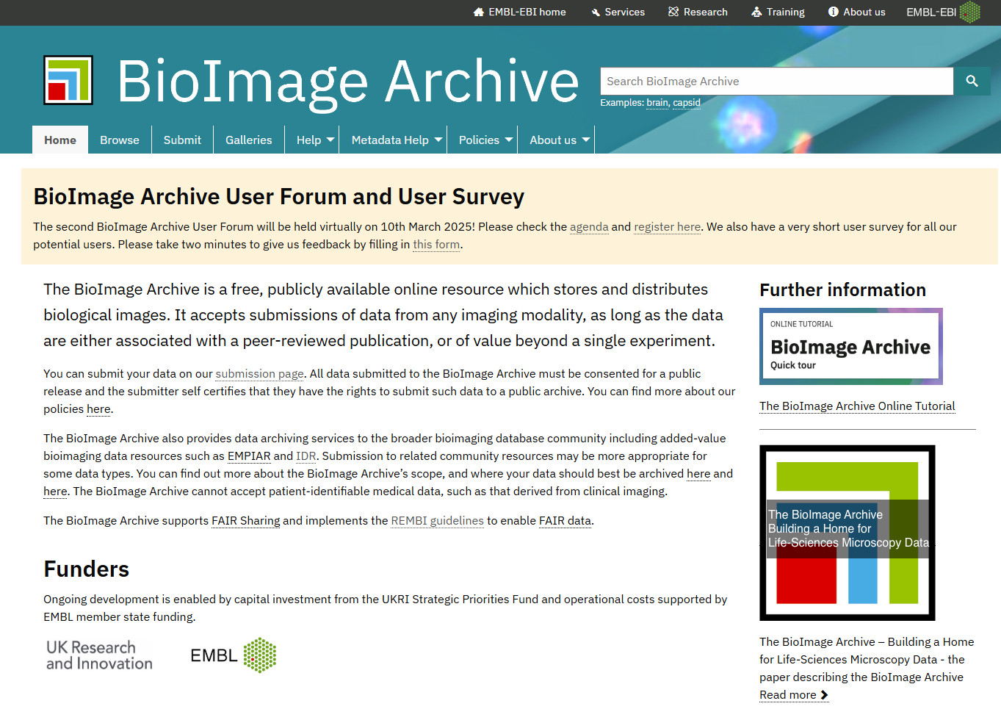
BioImage Archive (BIA)
Type:
archive image data repository
Location:
implemented at the European Molecular Biology Laboratory – European Bioinformatics Institute (EMBL-EBI) at Hinxton, UK
Data uploaded:
as of January 2025 600 TB was deposited
in over 800 studies
https://www.ebi.ac.uk/bioimage-archive/
March 2025
Workshop 134 – E-Science Tage
Notes:
Introduce BIA
BIA does not accept patient-identifiable data.

Slide 9
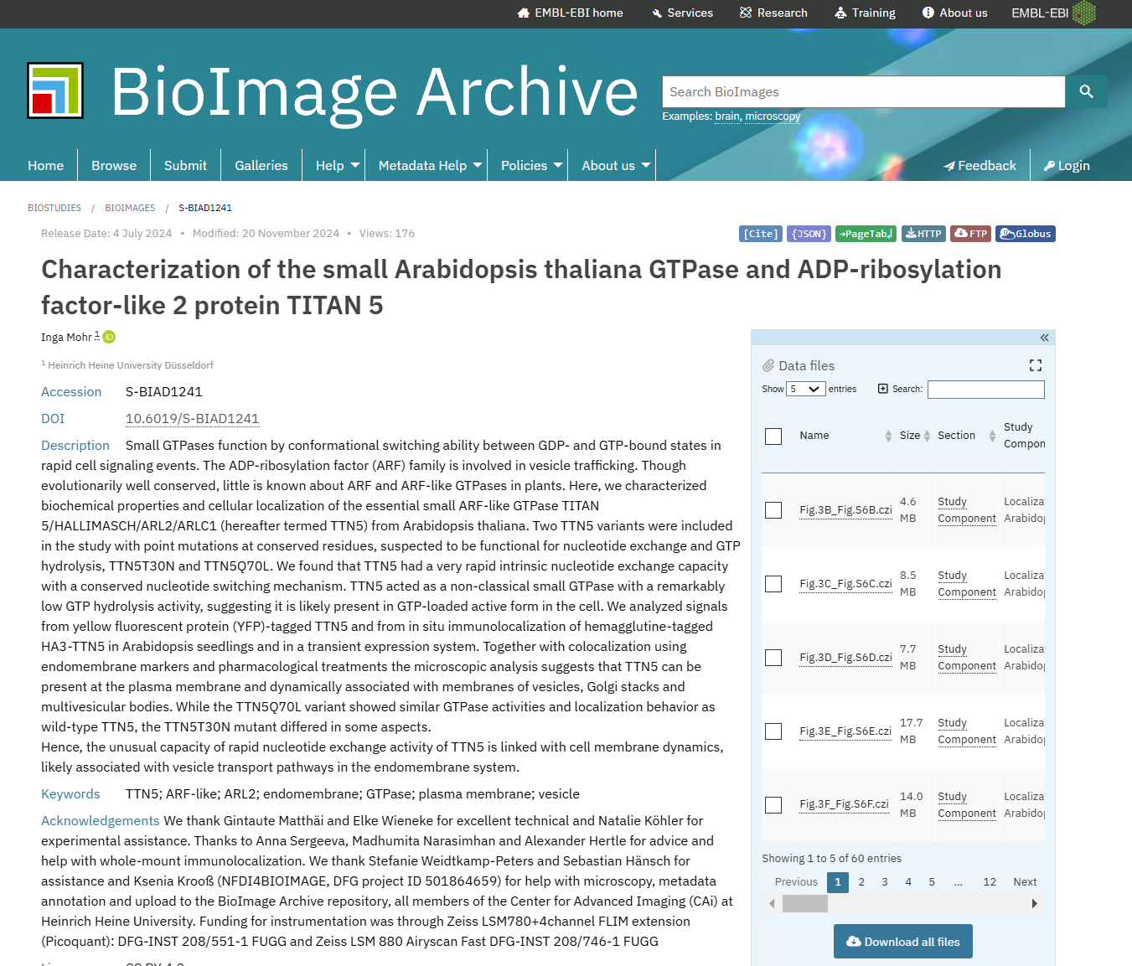
BioImage Archive (BIA)
Image preview:
working on alpha version of image preview using OME-Zarr
Type of data:
BIA accepts bioimaging data in general
Metadata requirements:
minimal mandatory metadata requirements
Example of a data publication
https://www.ebi.ac.uk/biostudies/bioimages/studies/S-BIAD1241
https://alpha.bioimagearchive.org/bioimage-archive/study/S-BIAD1241/
https://www.ebi.ac.uk/bioimage-archive/
12.03.2025
Workshop 134 – E-Science Tage

Slide 10
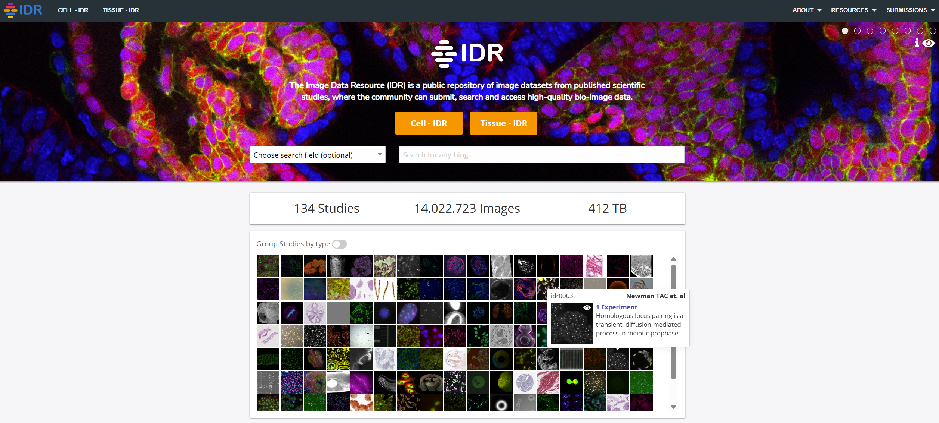
Image Data Resource (IDR)
Type:
added-value database
Location:
developed as a collaboration of the EMBL-EBI at Hinxton, UK, and the Open Microscopy Environment consortium (OME) at University of Dundee
Data uploaded:
as of January 2025 411 TB was deposited
in over 130 studies
https://idr.openmicroscopy.org/
12.03.2025
Workshop 134 – E-Science Tage

Slide 11
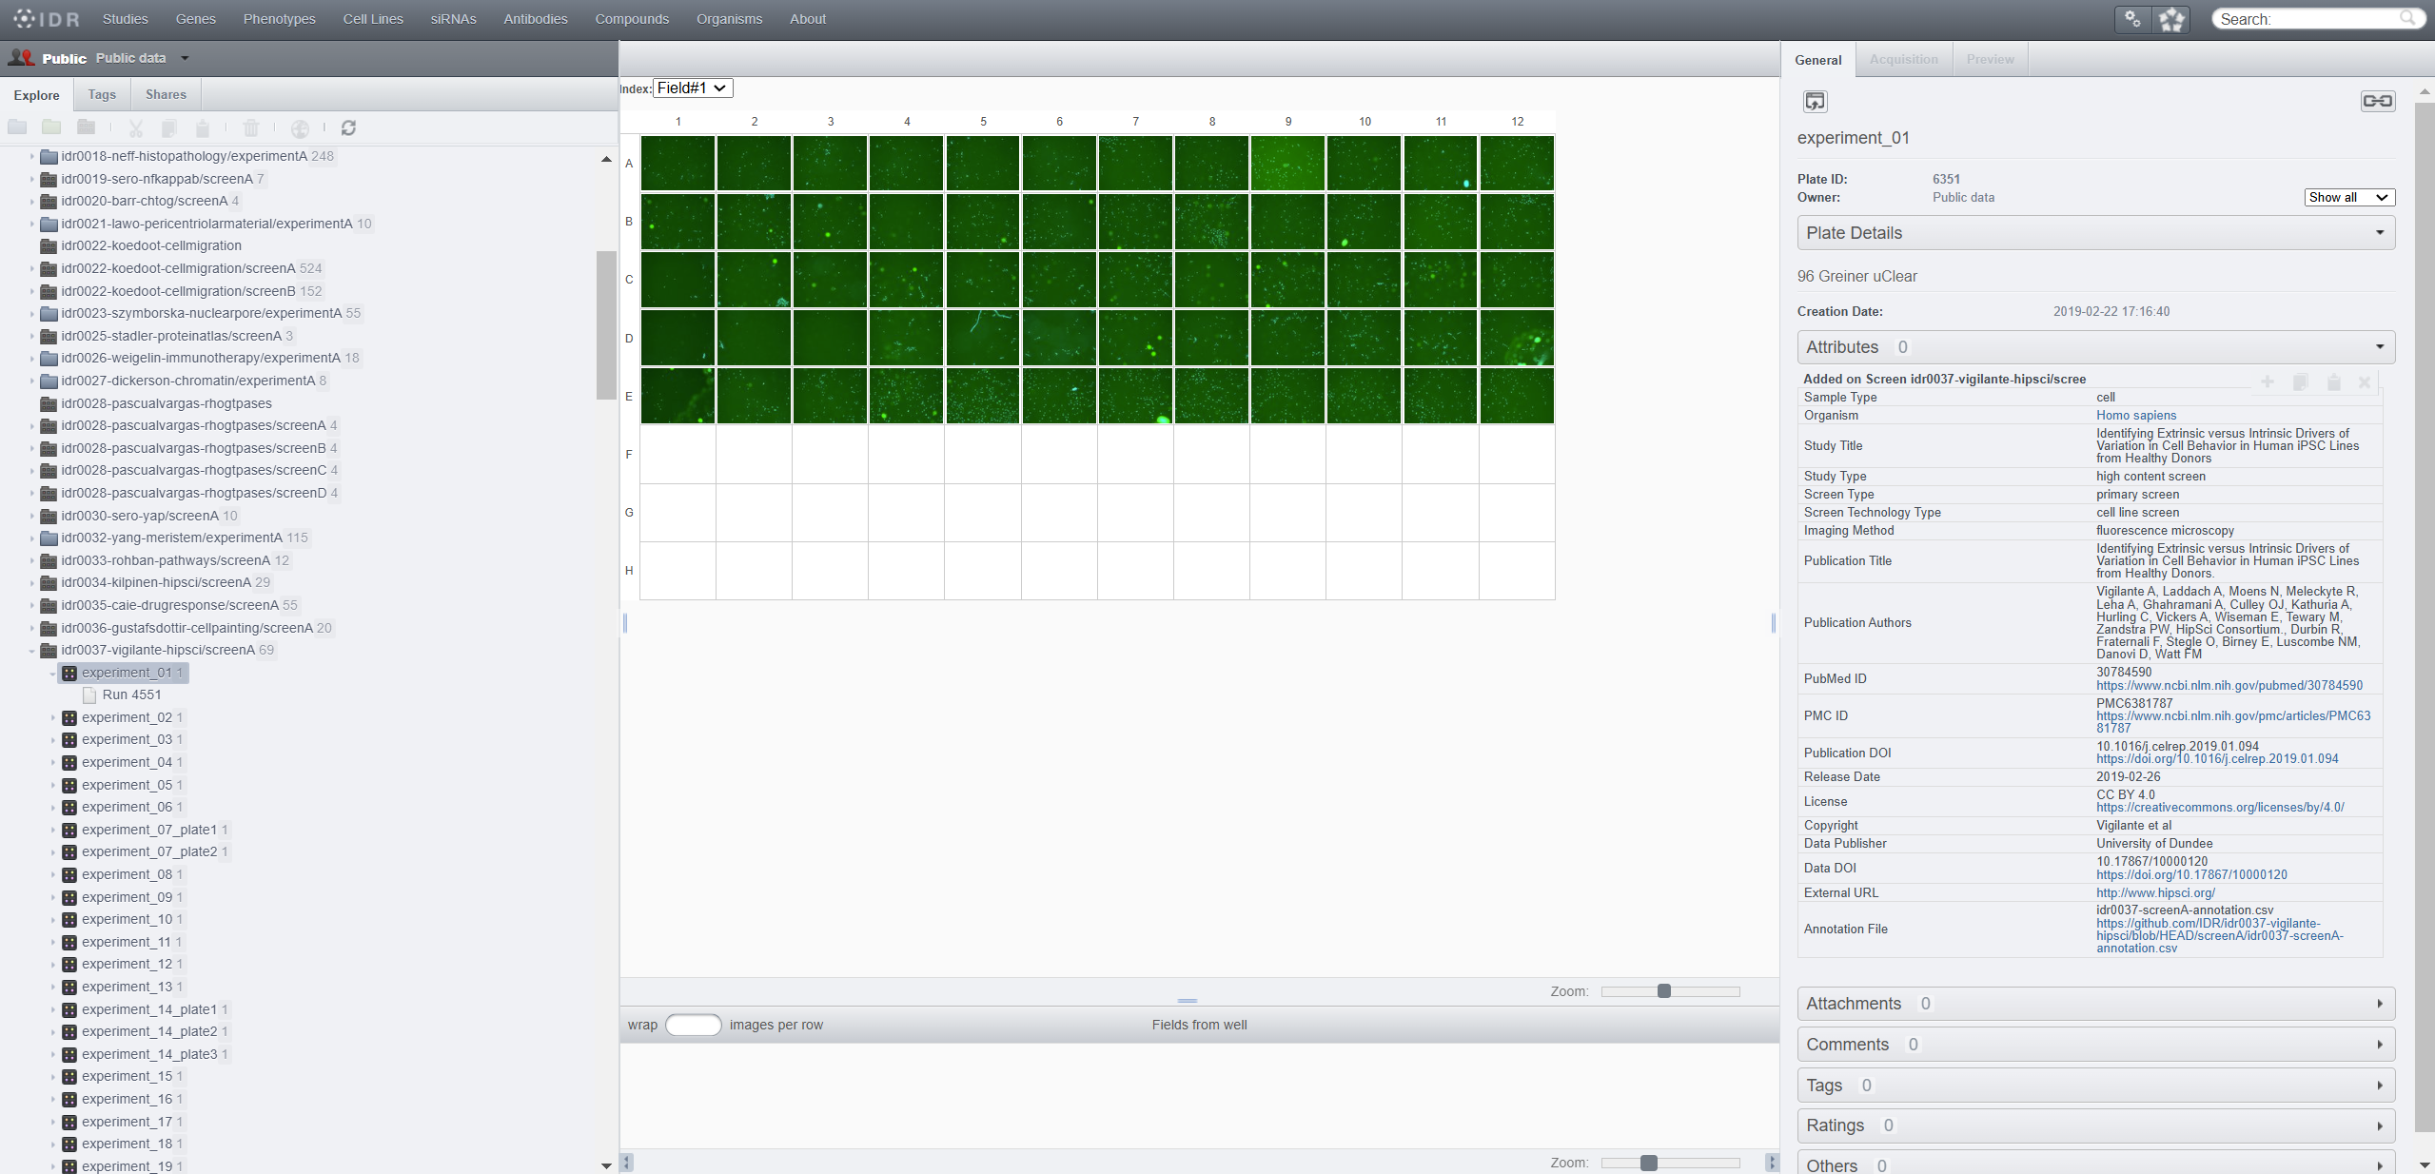
Image Data Resource (IDR)
Image preview:
image preview possible with BIO-FORMATS plugin (as in OMERO)
Type of data:
curated datasets that will be valuable to broad scientific audience, cell- and tissue-centric
Metadata requirements:
moderate mandatory metadata requirements
Example of a data publication
https://idr.openmicroscopy.org/webclient/?show=screen-2051
https://idr.openmicroscopy.org/
12.03.2025
Workshop 134 – E-Science Tage

Slide 12
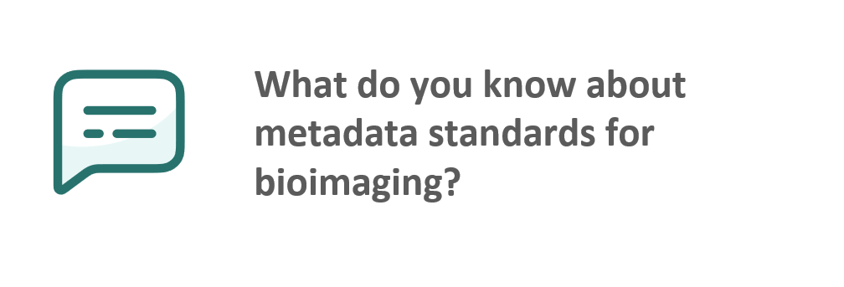

Slide 13
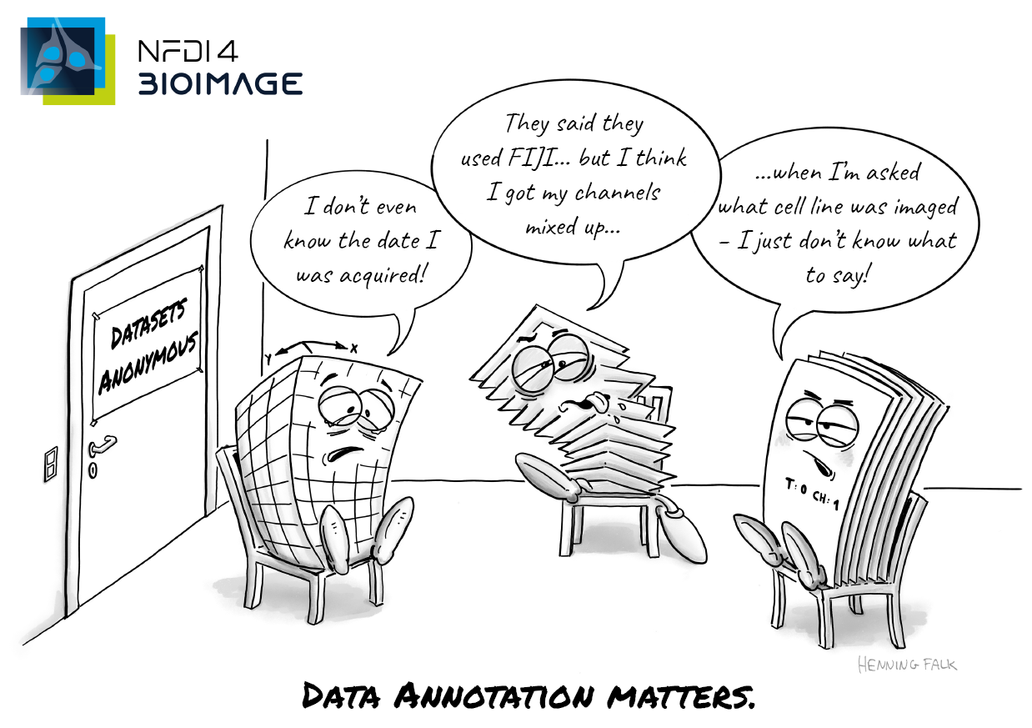
Metadata – data about data
Two types of metadata:
technical metadata – stored with the image
biological metadata – needs to be annotated
Adequate data management tool like OMERO will give access to both:
automatic read-out of technical metadata (via BIO-FORMATS plugin)
using key-value pairs for biological metadata annotation by hand or via scripts
Bonus: depositing data to a repository will be less effort
"Data annoation matters", NFDI4BIOIMAGE Consortium (2024): NFDI4BIOIMAGE data management illustrations by Henning Falk, Zenodo, https://doi.org/10.5281/zenodo.14186100, is used under a CC-BY 4.0 license.
12.03.2025
Workshop 134 – E-Science Tage

Slide 14
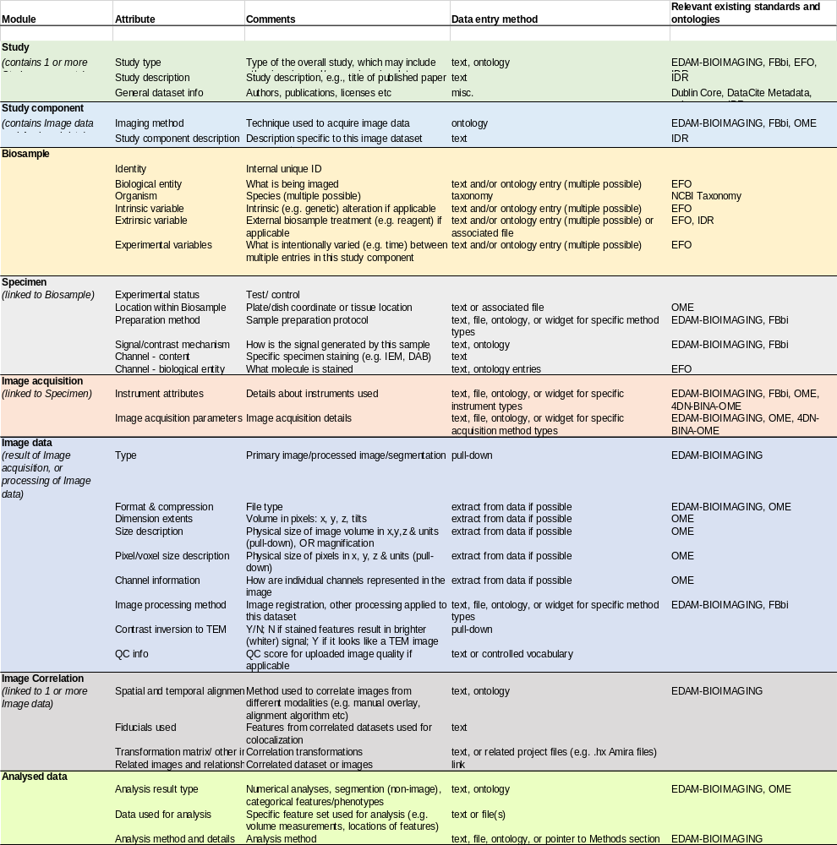
Metadata for biological images
Metadata annotation depends on the discipline or data repository
IDR has same layout as OMERO
BIA metadata schema is based on REMBI
Recommended Metadata for Biological Images (REMBI)
is a widely used collection of metadata
provides examples to look up
recommends ontology databases
REMBI is used as a metadata guideline for biological images, but not set in stone!
https://doi.org/10.1038/s41592-021-01166-8
12.03.2025
Workshop 134 – E-Science Tage

Slide 15
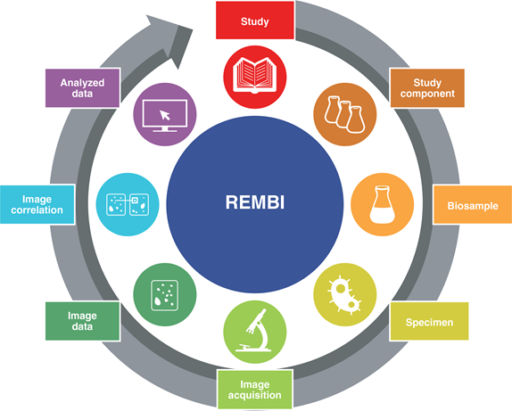
Modules of REMBI
General information
Description
Authors
License
Analysis workflow
Information on the respective data set
Analysis software
Analysed parameter
Description
Imaging method
Related data sets
Biological metadata
Other related modalities
Species
Tissue
Variables
Technical metadata
Biological metadata
Size
Pixel/Voxel
Channels
Preparation
Fluorophores
Technical metadata
Instrument
Acquisition parameter
https://doi.org/10.1038/s41592-021-01166-8, rights reserved!
https://www.ebi.ac.uk/bioimage-archive/rembi-help-overview/
12.03.2025
Workshop 134 – E-Science Tage

Slide 16
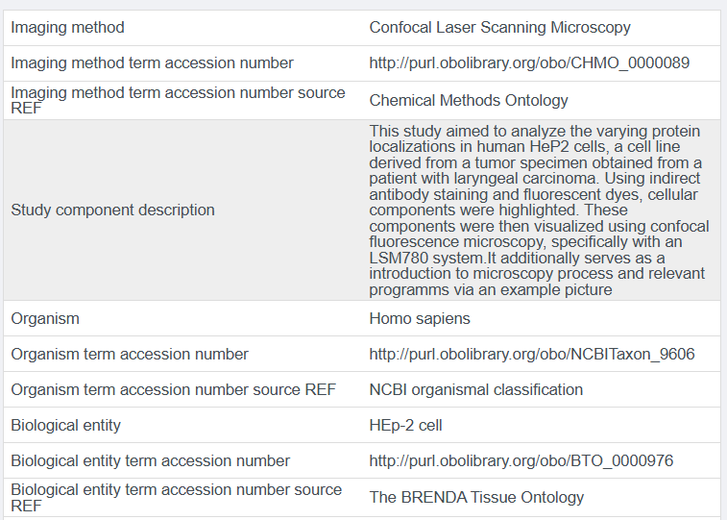
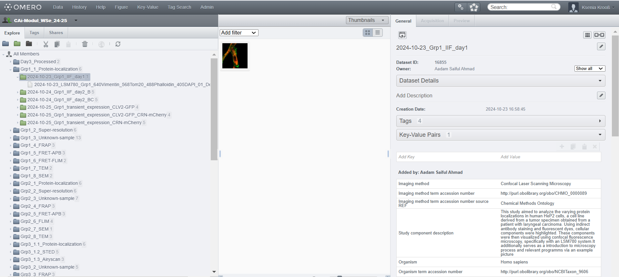
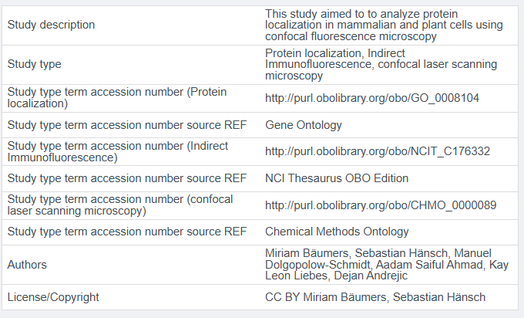
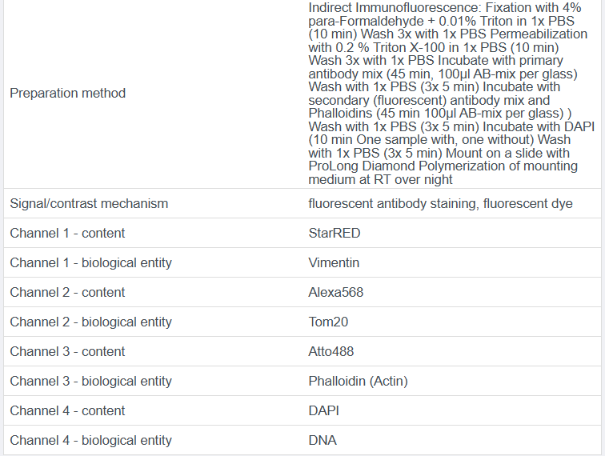
What annotation can look like in OMERO
12.03.2025
Workshop 134 – E-Science Tage

Slide 17
What annotation can look like
https://www.ebi.ac.uk/biostudies/bioimages/studies/S-BIAD1241
https://idr.openmicroscopy.org/webclient/?show=screen-2051
12.03.2025
Workshop 134 – E-Science Tage

Slide 18
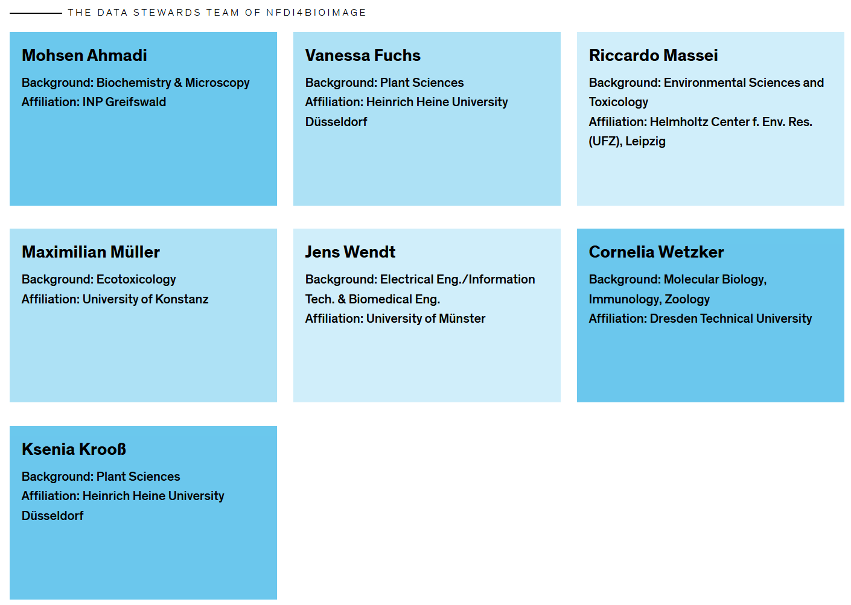







NFDI4BIOIMAGE – Data Stewards
Contact:
help request form https://nfdi4bioimage.de/help-desk
e-mail helpdesk@nfdi4biomage.de
https://nfdi4bioimage.de/about-us/data-stewardship-team/
12.03.2025
Workshop 134 – E-Science Tage

Slide 19
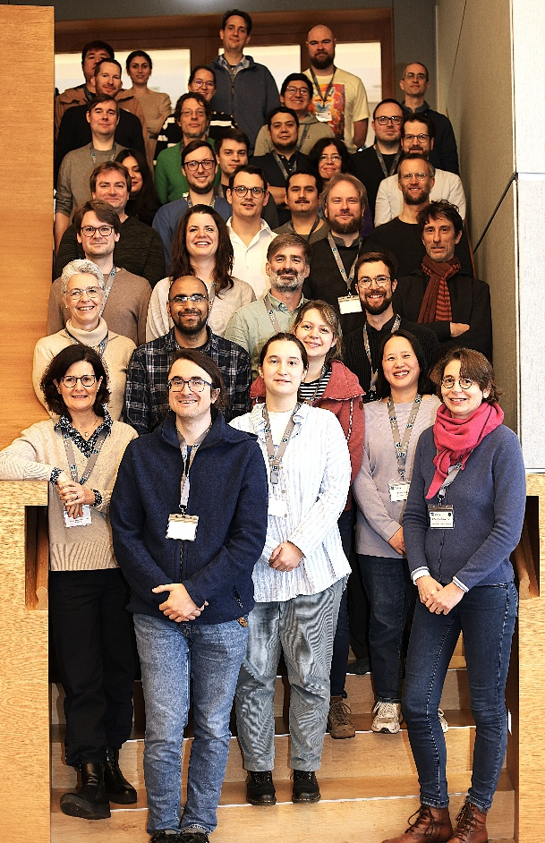




Acknowledgments
NFDI4BIOIMAGE Coordination Office
Christian Schmidt
Inga Mohr
office@nfdi4bioimage.de
NFDI4BIOIMAGE Help Desk and Data Stewardship Team
helpdesk@nfdi4biomage.de
https://nfdi4bioimage.de/help-desk
https://nfdi4bioimage.de/about-us/data-stewardship-team/
I3D:bio
https://gerbi-gmb.de/i3dbio/
NFDI4BIOIMAGE partners
I3D:bio partners
GerBI-GMB community
All-hands Meeting NFDI4BIOIMAGE, 06.02.2025, Düsseldorf
Funded by the Deutsche Forschungsgemeinschaft (DFG, German Research Foundation) under the National Research Data Infrasstructure – NFDI 46/1 – 501864659
The NFDI4BIOIMAGE consortium comprises legally independent partners and does not act autonomously towards third parties. The authors represent the contributions from their respective affiliated institutions and work together for the project.
12.03.2025
Workshop 134 – E-Science Tage

Slide 20
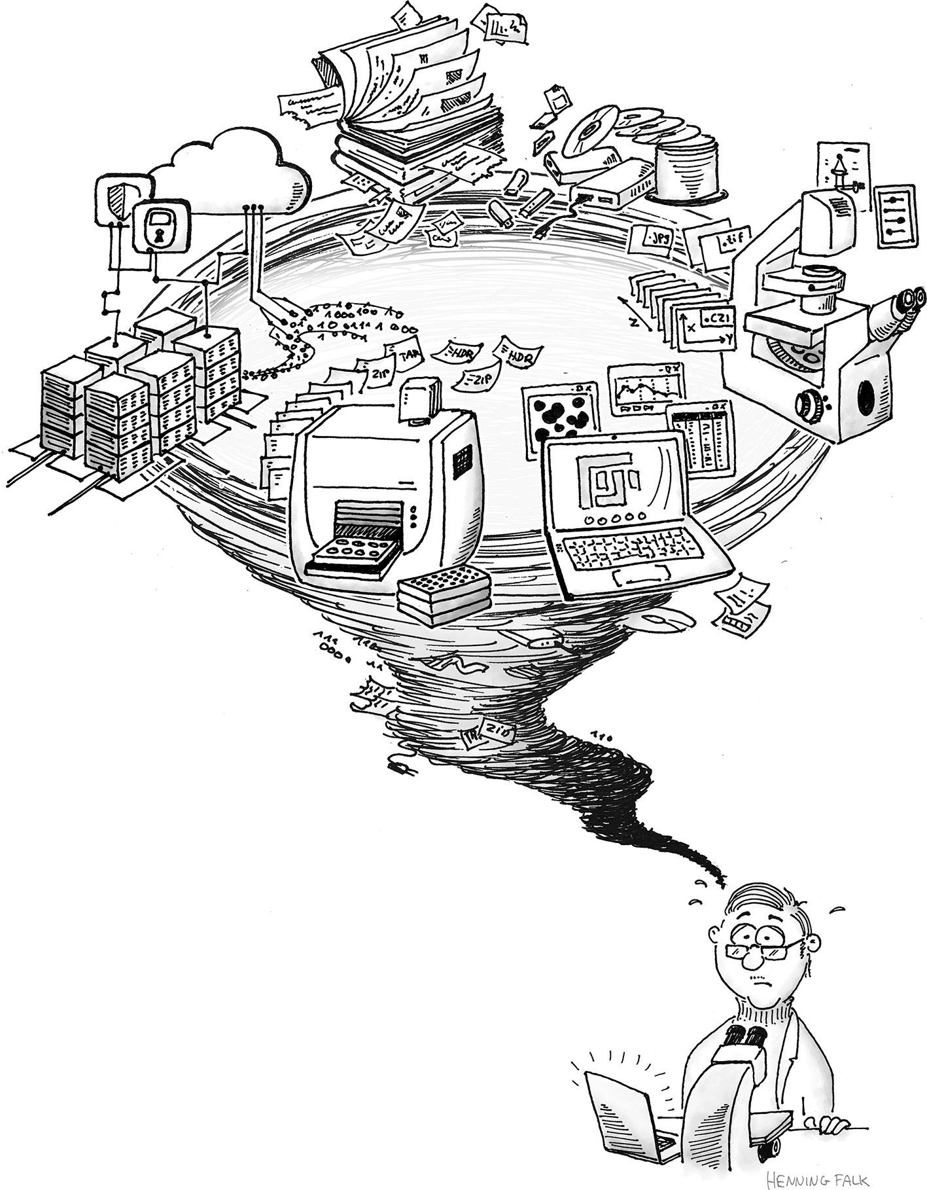
https://f1000research.s3.amazonaws.com/manuscripts/138717/652a4b5e-e5ed-4bb9-a190-631334fd8660_figure9.gif
12.03.2025
Workshop 134 – E-Science Tage

