Slide 1




CENTER FOR SCALABLE DATA ANALYTICS AND ARTIFICIAL INTELLIGENCE
Explainable AI for
Computer Vision
Robert Haase
These slides can be reused under the terms of the CC-BY4.0 license.
https://doi.org/10.5281/zenodo.14996127

Slide 2



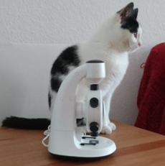


Image Classification
Quiz: What could be the result of image classification?
Cat: 30%
Microscope: 20%
Dog: 5%
Car: 0%
…
?
“The picture shows a cat sitting next to a microscope.”

Slide 3
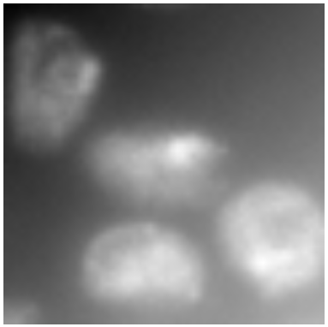

Pixel Classification
Quiz: How is this task calledie bezeichnet man diesen Task?
?
Combinatorial Segmentation
Semantic Segmentation
Instance- Segmentation
Connected-Component Segmentation

Slide 4
Explainable Artificial Intelligence (XAI)
Active field of research
Key Points: Giving people the opportunity to
  develop trust in AI systems,
  interact effectively with AI systems, and
  predict the outcomes of AI systems.

Slide 5
Explainable Artificial Intelligence (XAI)
What is explainable?
How is it explainable?
AI Algorithm
Reading+understanding of equations and source code
Decision-making in an AI system
Visualization of intermediate results
Contribution of underlying data
Measurement of relation between input and output data
Meaning of underlying data

Slide 6
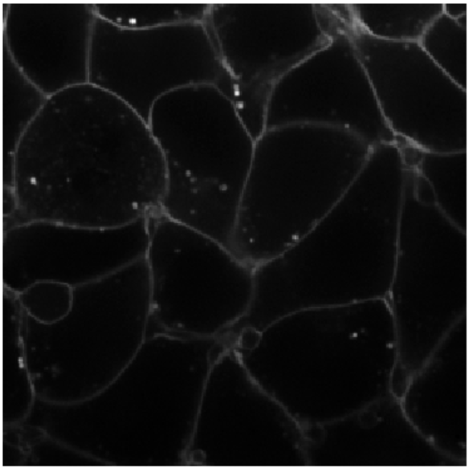
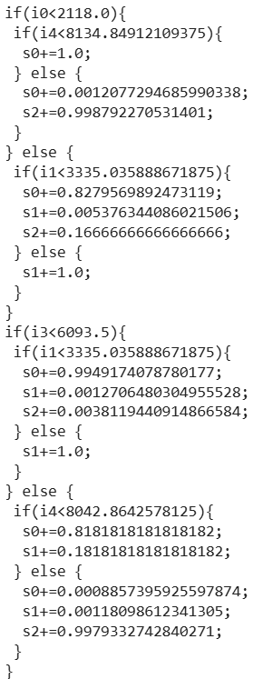
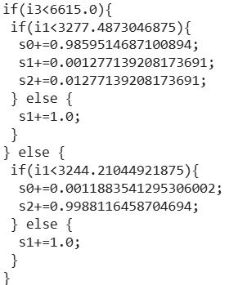
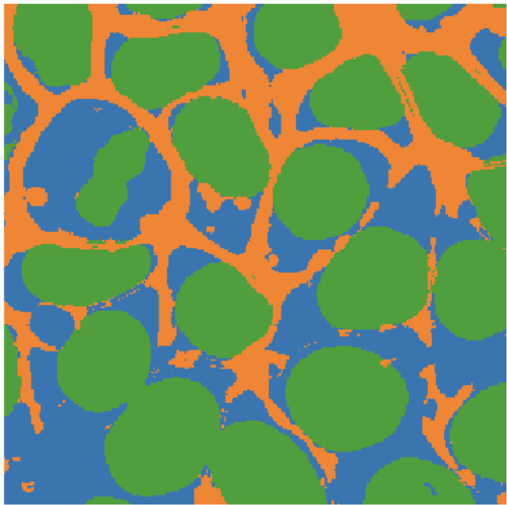
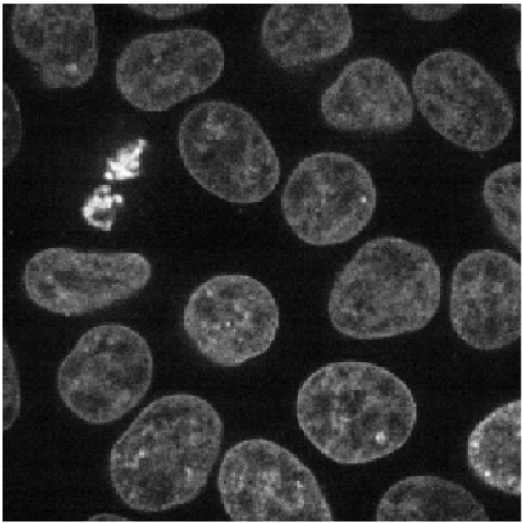
Explanation of Random Forest Classifiers
… by reading code
… is quite useless
Input
images
Feature
images
Decision trees
(OpenCL)
Classification result
images
https://github.com/haesleinhuepf/apoc/blob/main/demo/mutlichannel_images.ipynb

Slide 7

Explainability
A coherent chain of argumentation that depicts a fact or an algorithm in a completely transparent way.
Intrinsically explainable AI-algorithms
Example: Linear Regression
Model explainable
$$f\left(x_{1},x_{2}\right)=w_{1}x_{1}+w_{2}x_{2}$$
If w1 is much larger than w2, the overall result is highly dependent on x1. The influence of x2 is rather small.
Results predictable

Slide 8
Explainability
A coherent chain of argumentation that depicts a fact or an algorithm in a completely transparent way.
Intrinsically explainable AI-algorithms
Example: Linear Regression
Black-Box AI-Algorithms
Example : Deep Neural Networks (DNN)
$$f\left(x_{1},x_{2}\right)=w_{1}x_{1}+w_{2}x_{2}$$
If w1 is much larger than w2, the overall result is highly dependent on x1. The influence of x2 is rather small.
“sewing machine” [1]
Nicht ohne Weiteres erklärbar und Ergenisse auch nicht solide vorhersagbar
https://github.com/haesleinhuepf/git-bob-playground/issues/241

Slide 9
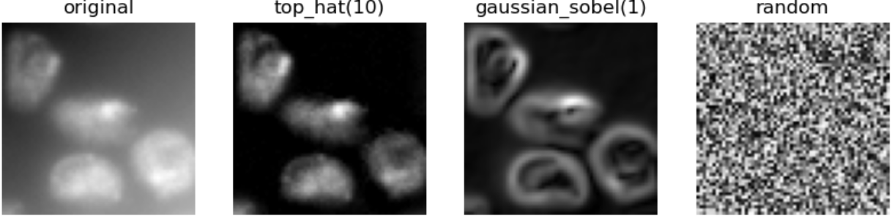
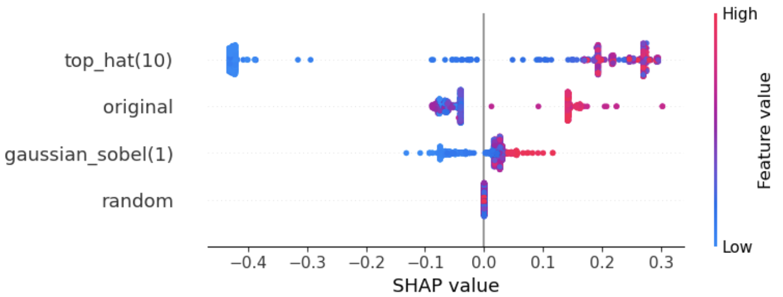
Interpretability
Visualization of intermediate results and their influence on results
Model-agnostic methods
Example: Shapley’s Additive exPlanations (SHAP)
https://haesleinhuepf.github.io/xai/30_shap/pixel_classifier.html

Slide 10
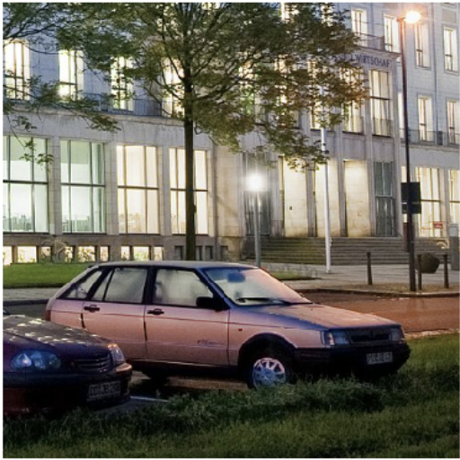
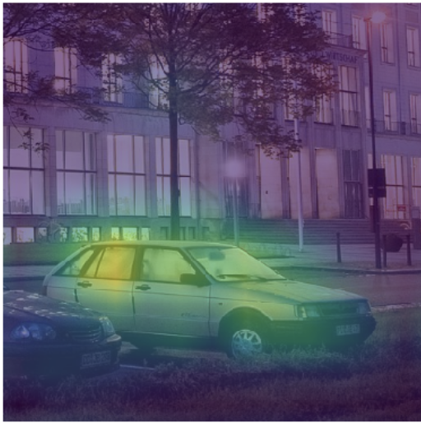
Interpretability
Visualization of intermediate results and their influence on results
Model-agnostic methods
Example: Shapley’s Additive exPlanations (SHAP)
Modell-specific Methods
Example : Gradient Class Activation Maps (Grad-CAM)
“beach wagon”
https://haesleinhuepf.github.io/xai/30_shap/pixel_classifier.html https://haesleinhuepf.github.io/xai/60_grad-cam/classification_resnet.html
Image source: Cropped from HTW Dresden (Fotograf: Peter Sebb) licensed CC BY-SA 3.0, https://commons.wikimedia.org/w/index.php?curid=15652763

Slide 11
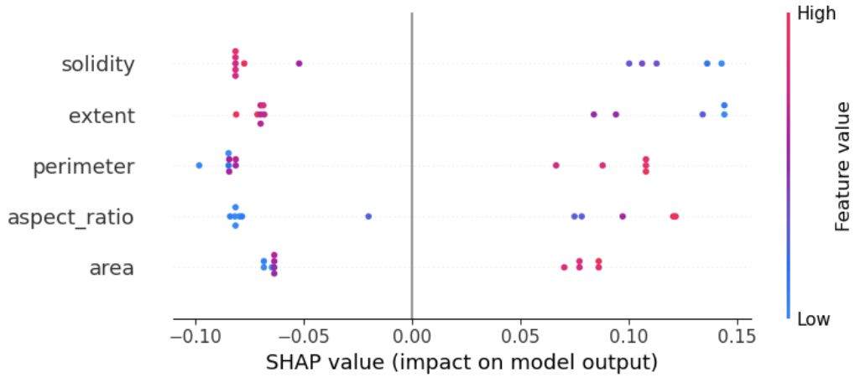
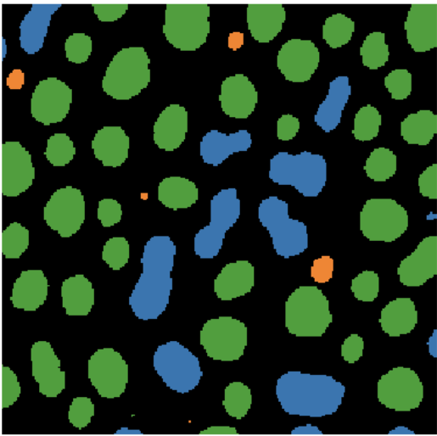
Target groups
Depending on the target group [for the explanation], the influence of data is more important than how AI algorithms work.
Many computer scientists want to explain and understand AI methods.
Biologists use AI as a method to explain biological processes.
Example: "What parameters distinguish round objects from elongated ones?"
https://haesleinhuepf.github.io/xai/30_shap/object_classification.html

Slide 12
Gradient Class-Activation Maps (Grad-CAM)
Works only with NN algorithms that first process input data with convolutional layers. (model-specific)
Independent of right half of the NN (model-agnostic)
Visualizes intermediate results to make decision-making in the AI system interpretable
Image-classification
conv.
…
conv.
Image-description
convolutional
convolutional
Image-segmentation
Image source: Cropped from HTW Dresden (Photographer: Peter Sebb) licensed CC BY-SA 3.0, https://commons.wikimedia.org/w/index.php?curid=15652763
https://www.youtube.com/watch?app=desktop&v=Y8mSngdQb9Q&t=559s

Slide 13
Gradient Class-Activation Maps (Grad-CAM)
Is applied to existing network ; no modification of the architecture necessary (post-hoc method).
Input image
Convolutional layers of a DNN such as ResNet
Output: a vector of probabilities.
conv.
0.7
Beach wagon
goldfish
palace
conv.
convolutional
0.1
convolutional
0.1
Image source: Cropped from HTW Dresden (Fotograf: Peter Sebb) licensed CC BY-SA 3.0, https://commons.wikimedia.org/w/index.php?curid=15652763

Slide 14
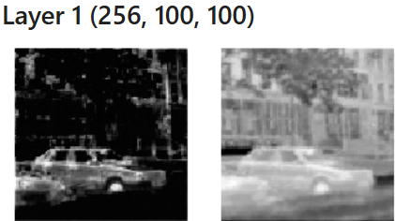
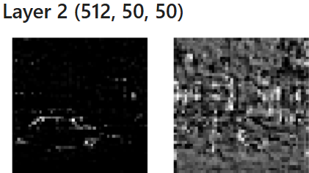
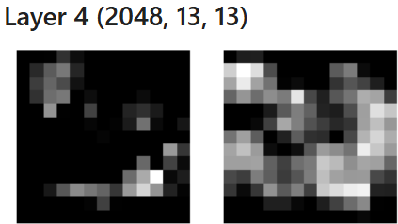
Gradient Class-Activation Maps (Grad-CAM)
Applied to existing network; no adaptation of the architecture necessary (post-hoc method).
“2028 feature images with each 13x13 pixels”
400x400
conv.
Beach wagon
goldfish
palace
conv.
convulutional
convulutional
Image source: Cropped from HTW Dresden (Fotograf: Peter Sebb) licensed CC BY-SA 3.0, https://commons.wikimedia.org/w/index.php?curid=15652763

Slide 15
Quiz
What is this part of a DNN typically called?
Reducer
Increaser
400x400
Encoder
Decoder
conv.
Beach wagon
goldfish
palace
conv.
convulutional
convulutional
Image source: Cropped from HTW Dresden (Fotograf: Peter Sebb) licensed CC BY-SA 3.0, https://commons.wikimedia.org/w/index.php?curid=15652763

Slide 16
Gradient Class-Activation Maps (Grad-CAM)
Applied to existing network; no adaptation of the architecture necessary (post-hoc method).
None of these images directly says anything about image content. There is no feature image “Beach wagon”
400x400
conv.
Beach wagon
goldfish
palace
conv.
convolutional
convolutional
Grad-CAM happens here
Image source: Cropped from HTW Dresden (Fotograf: Peter Sebb) licensed CC BY-SA 3.0, https://commons.wikimedia.org/w/index.php?curid=15652763

Slide 17
Gradient Class-Activation Maps (Grad-CAM)
Back-propagation of a perfect classification (1,0,0) gives us gradients (weight changes) to improve the classification.
features
gradients
vector of probabilities
0.1
0.2
1
0.1
0
0.5
0
Back-propagation
These gradients tell us, how weights would need to be adjusted to produce the desired classification

Slide 18
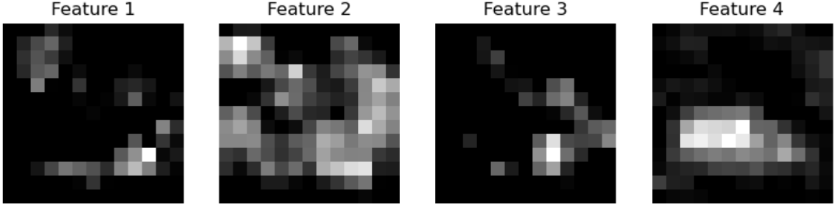

Gradient Class-Activation Maps (Grad-CAM)
Back-propagation of a perfect classification (1,0,0) gives us gradients (weight changes) to improve the classification.
From Inference
Features
Gradients
Vector of probabilities
0.1
0.2
1
0.1
0
0.5
From Backprop.
Feature map * Gradient
0
Maximum- projection
Image source: Cropped from HTW Dresden (Photographer: Peter Sebb) licensed CC BY-SA 3.0, https://commons.wikimedia.org/w/index.php?curid=15652763

Slide 19
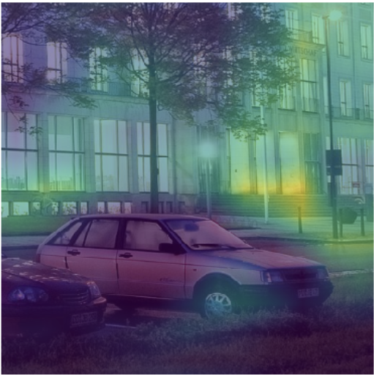
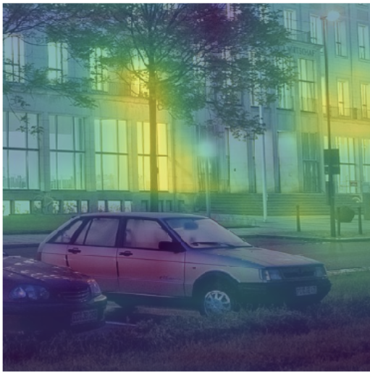
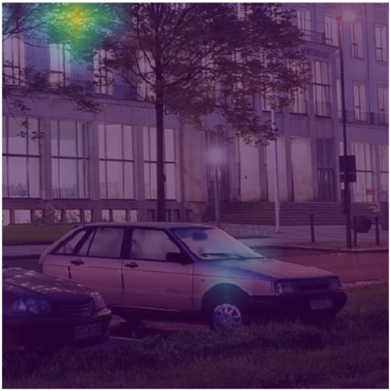
Gradient Class-Activation Maps (Grad-CAM)
Back-propagation of a perfect classification (1,0,0) gives us gradients (weight changes) to improve the classification.
This also works with other possible classifications, e.g. (0,1,0).
“beach waggon”
“palace”
“flagpole”
“great white shark”
Image source: Cropped from HTW Dresden (Fotograf: Peter Sebb) licensed CC BY-SA 3.0, https://commons.wikimedia.org/w/index.php?curid=15652763

Slide 20
Quiz
Assuming, this layer has 2048x13x13 outputs. What does the 2048 stand for?
Number of
features
Width of the
feature maps
Number of classes
Number of
layers
conv.
conv.
convolutional
convolutional
Image source: Cropped from HTW Dresden (Photographer: Peter Sebb) licensed CC BY-SA 3.0, https://commons.wikimedia.org/w/index.php?curid=15652763

Slide 21
Quiz
Assume this vector has 1000 elements. What does the 1000 stand for?
Number of
features
Width of the
feature maps
Number of classes
Number of
layers
conv.
conv.
convulutional
convulutional
Image source: Cropped from HTW Dresden (Fotograf: Peter Sebb) licensed CC BY-SA 3.0, https://commons.wikimedia.org/w/index.php?curid=15652763

Slide 22
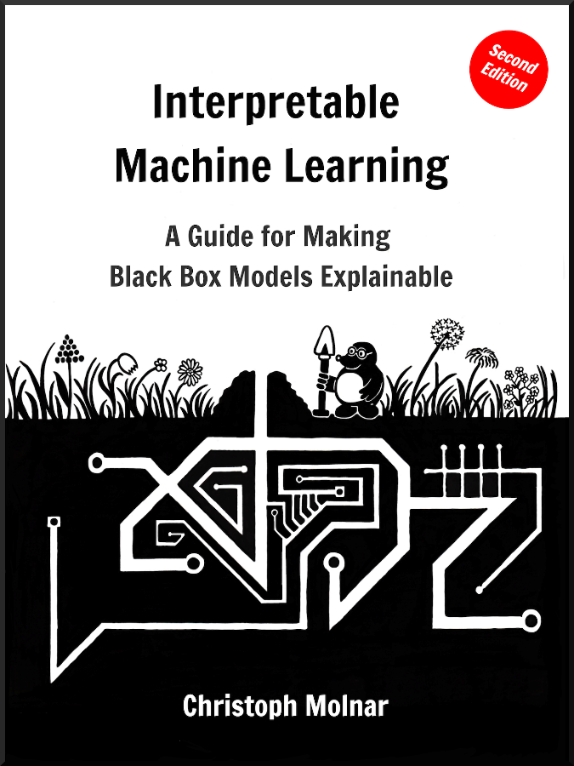
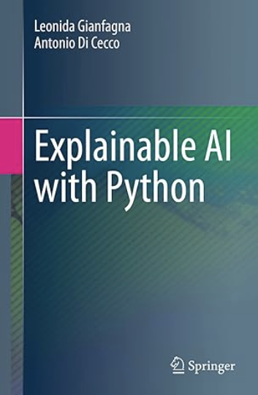
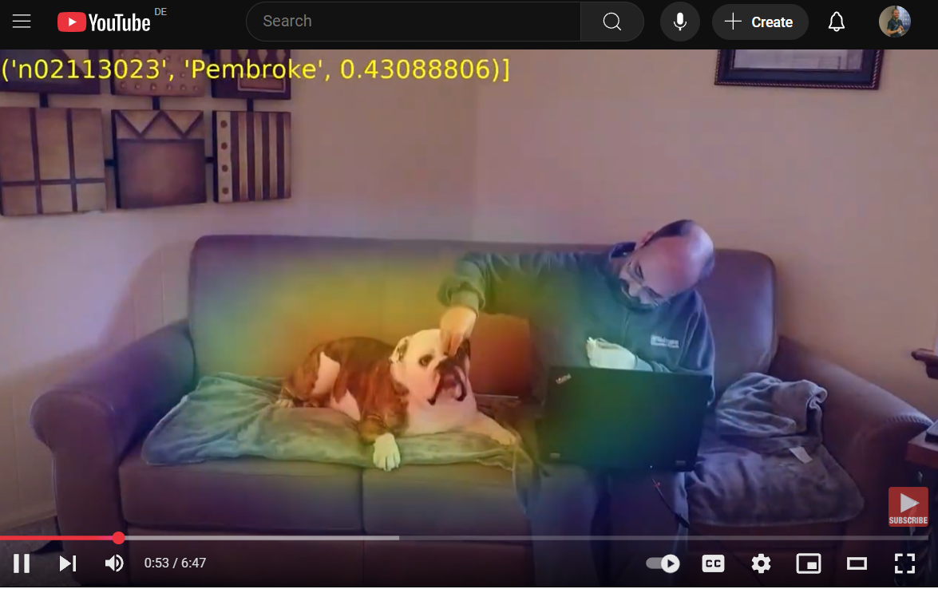
Read more…
https://christophm.github.io/interpretable-ml-book/
https://www.amazon.de/dp/3030686396
https://www.youtube.com/watch?v=dw63QH_b3Jo

Slide 23
Summary: Explainable AI
Methods of XAI can be classified on different scales
Explainability
Intrinsically explainable
Meaning of data
Influence of data
Model-specific
Model-agnostic
Functionality of algorithms
Black-Box
Interpretability

Slide 24
CENTER FOR SCALABLE DATA ANALYTICS AND ARTIFICIAL INTELLIGENCE
Exercises

Slide 25
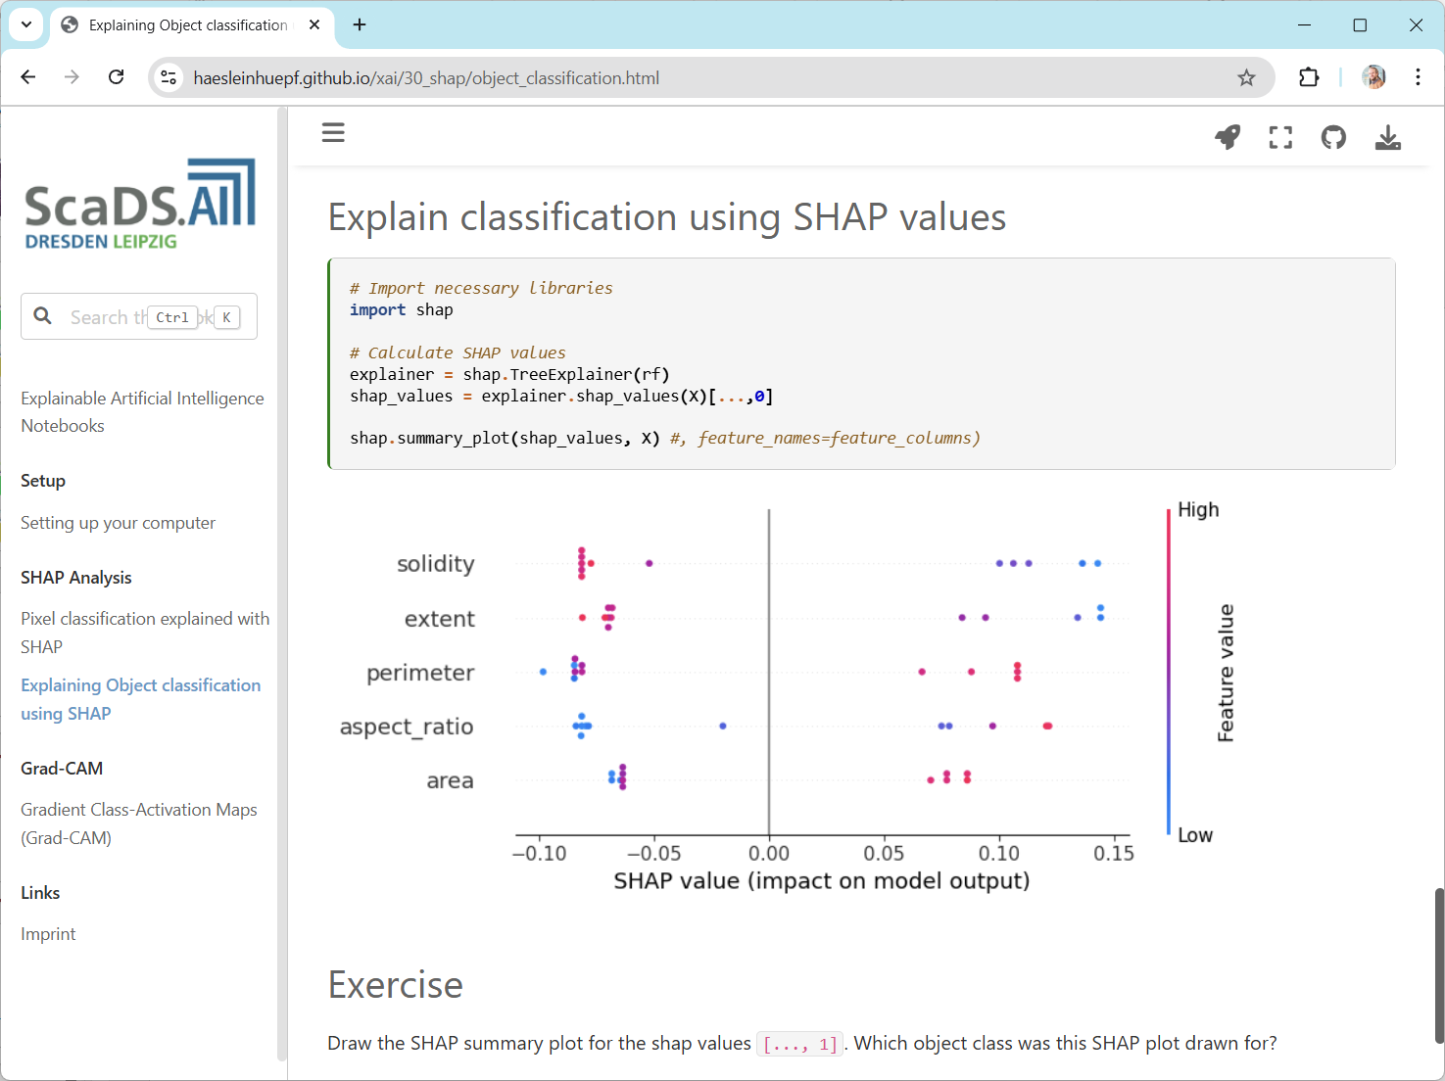
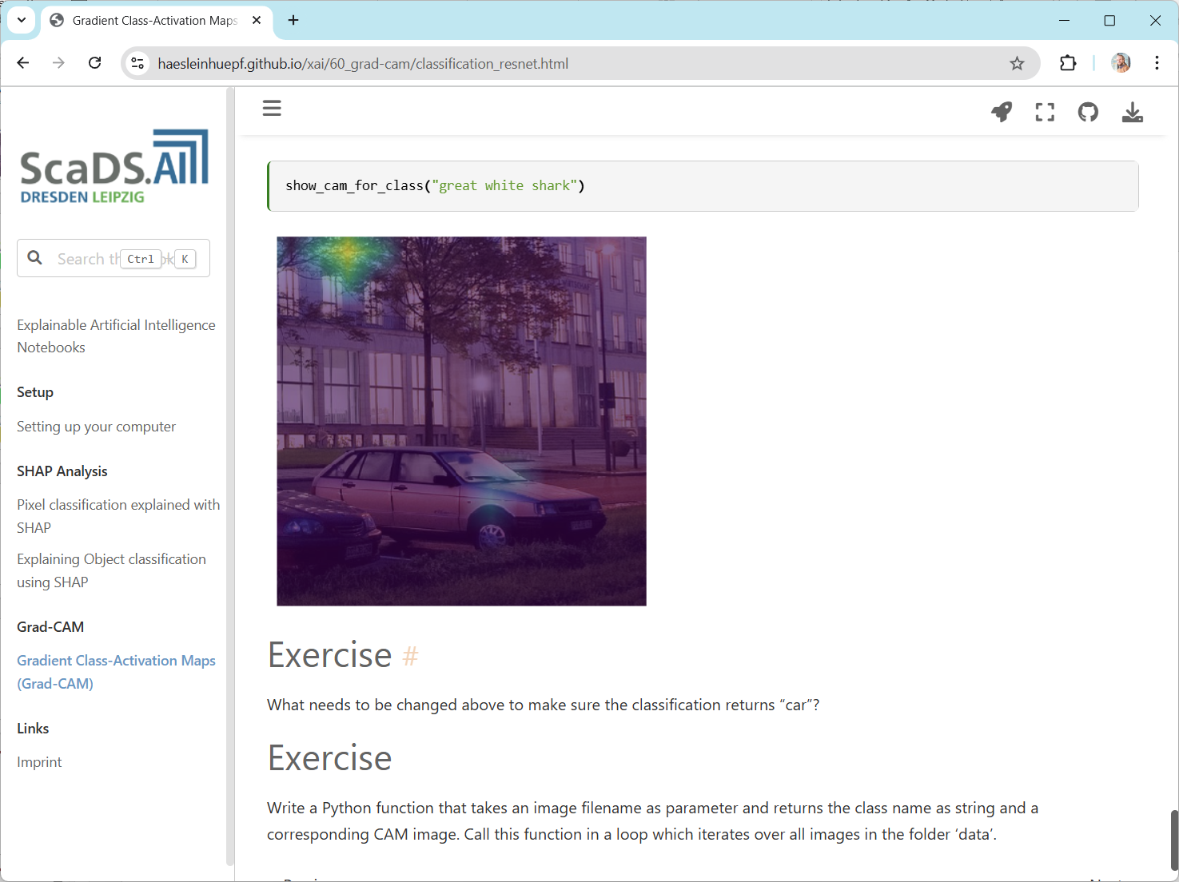
Exercises
SHAP-values
Grad-CAM
https://haesleinhuepf.github.io/xai/30_shap/object_classification.html
https://haesleinhuepf.github.io/xai/60_grad-cam/classification_resnet.html

Slide 26

Example: Pixel classification
Goal: Classifying individual pixels into foreground (nuclei) and background.
?
Global intensity thresholds…
don’t work here.

Slide 27
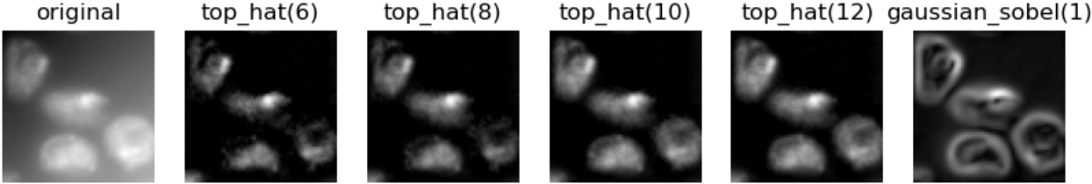
Random Forest Classifiers
Combining preprocessing (feature images) and decision trees.
?

Slide 28
Recap: Random Forest Classifier
After selecting random set of data points, build a tree that divides the classes optimally.
X₂ > 0.8
X₂
Yes
No
X₁ > 0.6
No
Yes
X₁

Slide 29
Recap: Random Forest Classifier
Many trees are combined to make decisions in a democratic way.
Prediction
Features of a single pixel
Majority

Slide 30
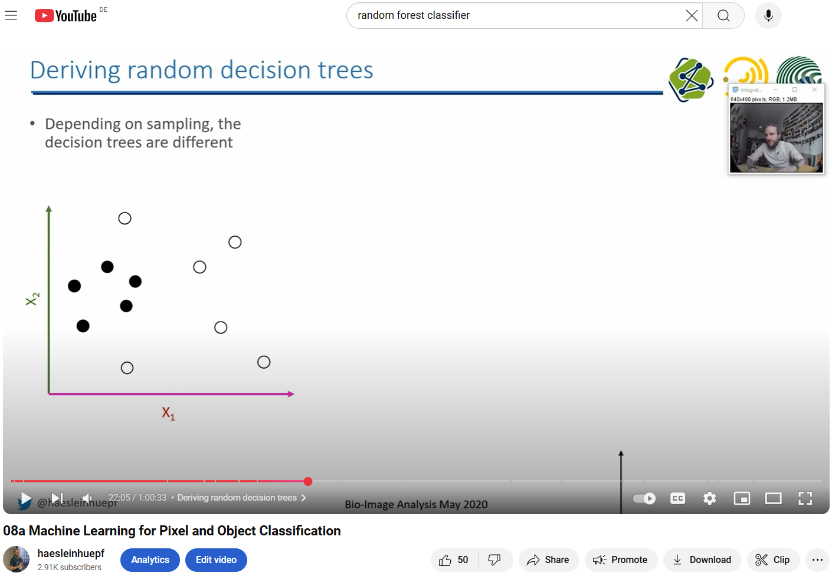
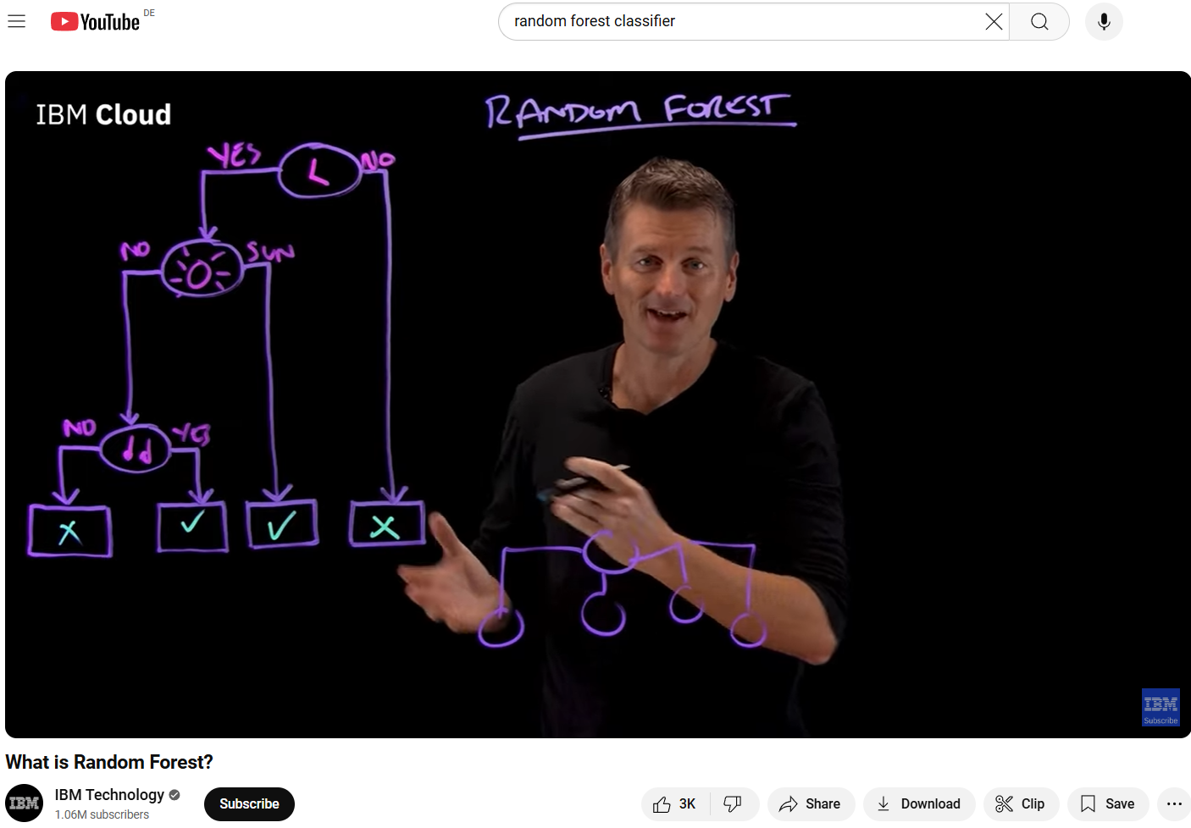
Recap: Random Forest Classifier
https://www.youtube.com/watch?v=dstjhCPBDOY
https://www.youtube.com/watch?v=gkXX4h3qYm4

Slide 31
Explaining a Random Forest Classifier
… by looking at code
… is quite useless.
Input
images
Feature
images
Decision trees
(OpenCL)
Classification result
images
https://github.com/haesleinhuepf/apoc/blob/main/demo/mutlichannel_images.ipynb

Slide 32
Feature importance
How often does feature � appear in the Random Forest?
How much impact does feature � have on decisions?
What does it mean if feature � does not appear in our Random Forest?
Explain contribution of underlying data on decision making

Slide 33
Collaborative game theory
If players collaborate, how is the impact on a team if another player joins?
Example game goal: maximize cards of the same colour.
?
Value for both teams: 0

Slide 34
Collaborative game theory
If players collaborate, how is the impact on a team if another player joins?
Example game goal: maximize cards of the same colour.
?
Value for team green: 0.1
Value for team blue: 0.3

Slide 35
Collaborative game theory
If players collaborate, how is the impact on a team if another player joins?
Example game goal: maximize cards of the same colour.

Slide 36

SHAP
Analogously, this can be done with data points instead of features.
SHapley’s Additive exPlanations
$\phi_i = \sum_{S \subseteq F \setminus \{i\}} \frac{|S|!(|F|-|S|-1)!}{|F|!} [f_x(S \cup \{i\}) - f_x(S)]$
SHAP value of feature i
Sum over all Subsets of Features not including i
Weight related to number of used features in relation all players
Quality of classifier using feature i
Quality of classifier not using feature i
Game theory
SHAP value of player i
Sum over all Subsets of Players not including i
Weight related to number of players in a coalition in relation to undecided players and all players
Chance to win game of coalition without player i
Chance to win game of coalition including player i

Slide 37
SHAP
Allows interpreting classification results
?

Slide 38
SHAP
“If intensity in the top-hat image is high, the classifier tends to select the positive class (orange).”
Allows interpreting classification results
?

Slide 39
SHAP
“If intensity in the top-hat image is low, the classifier needs to take other features into account.”
Allows interpreting classification results
?

Slide 40
SHAP
“The random feature has no value for classification.”
Allows interpreting classification results
?

Slide 41
Pitfall: Correlation
Correlated features may harm interpretability

Slide 42
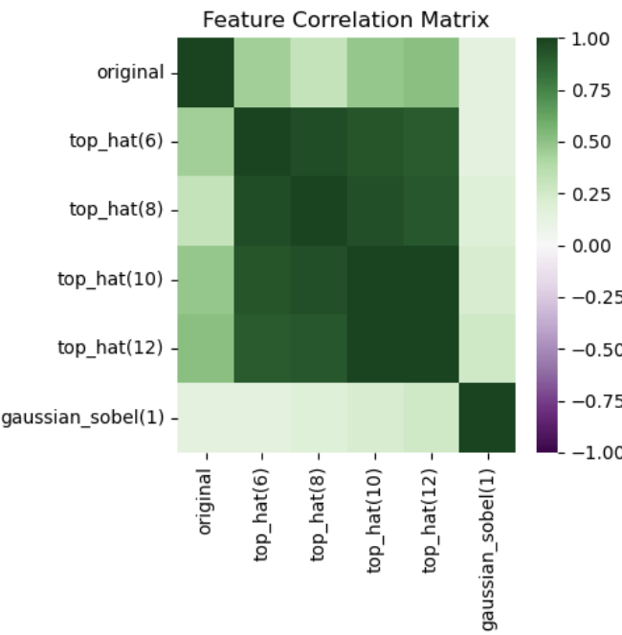
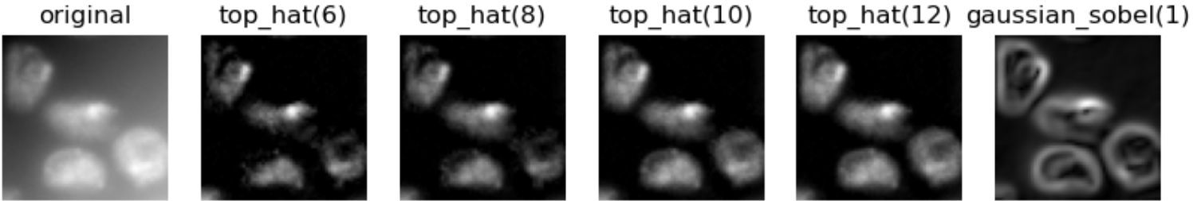
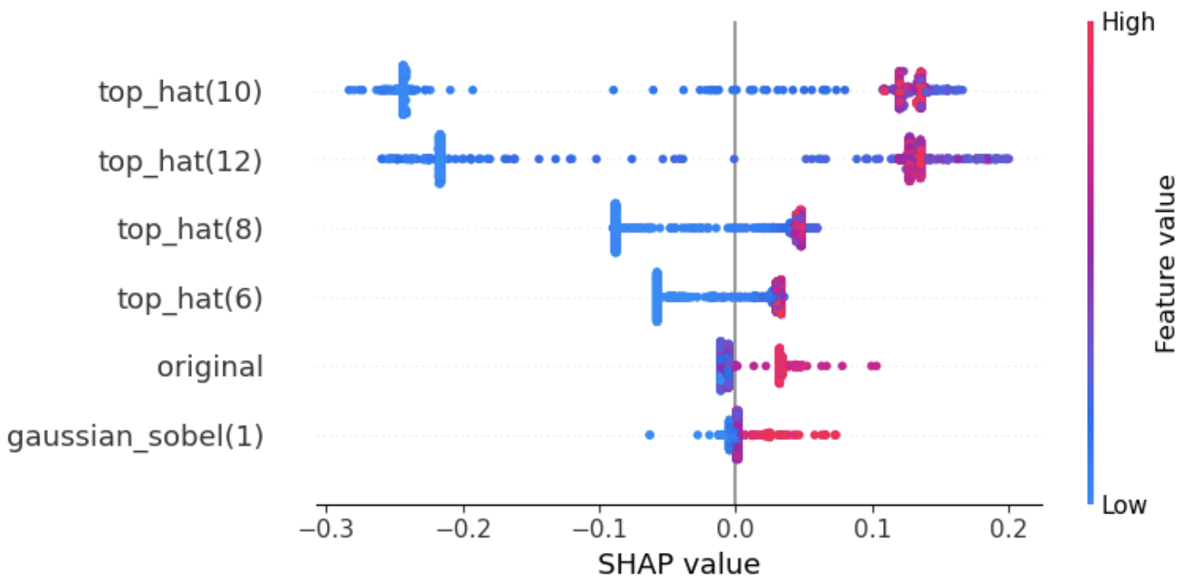
Pitfall: Correlation
Correlated features may harm interpretability
Features may appear less valuable.
Features may appear less valuable.

