Slide 1
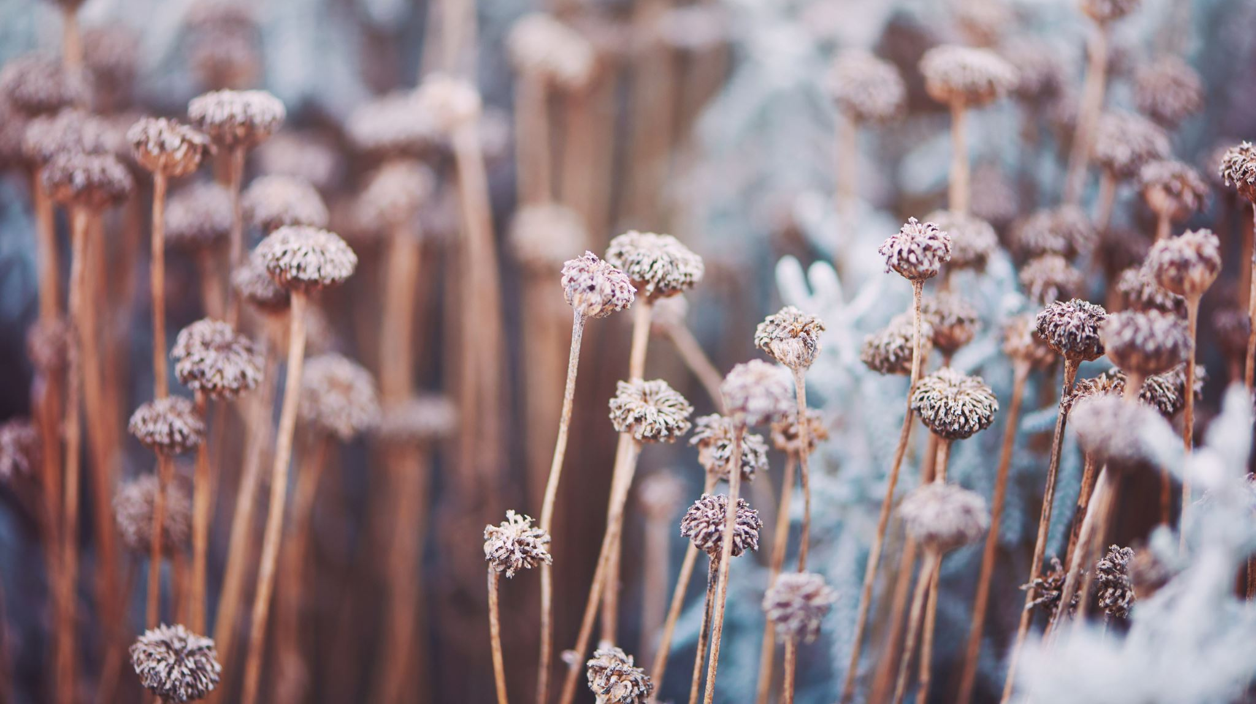
Perfect perennials!
Permahaven Workshop Thursday 16 November

Slide 2
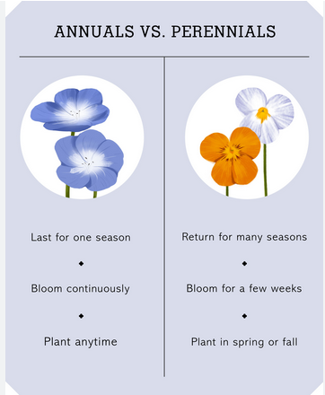
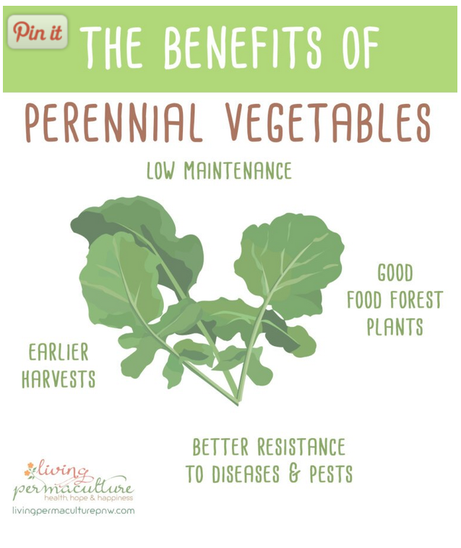

Slide 3
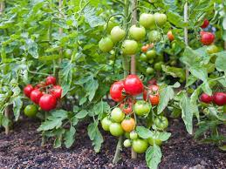
Annuals vs perennials
A fluid boundary
Climate zones
Some plants need ‘winter rest’

Slide 4
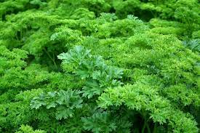
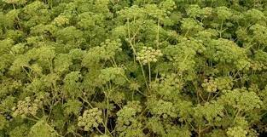
Biennials
Complete their life cycle in two seasons
Typically grow a rosette of leaves in the first year, followed by flowers the following year

Slide 5
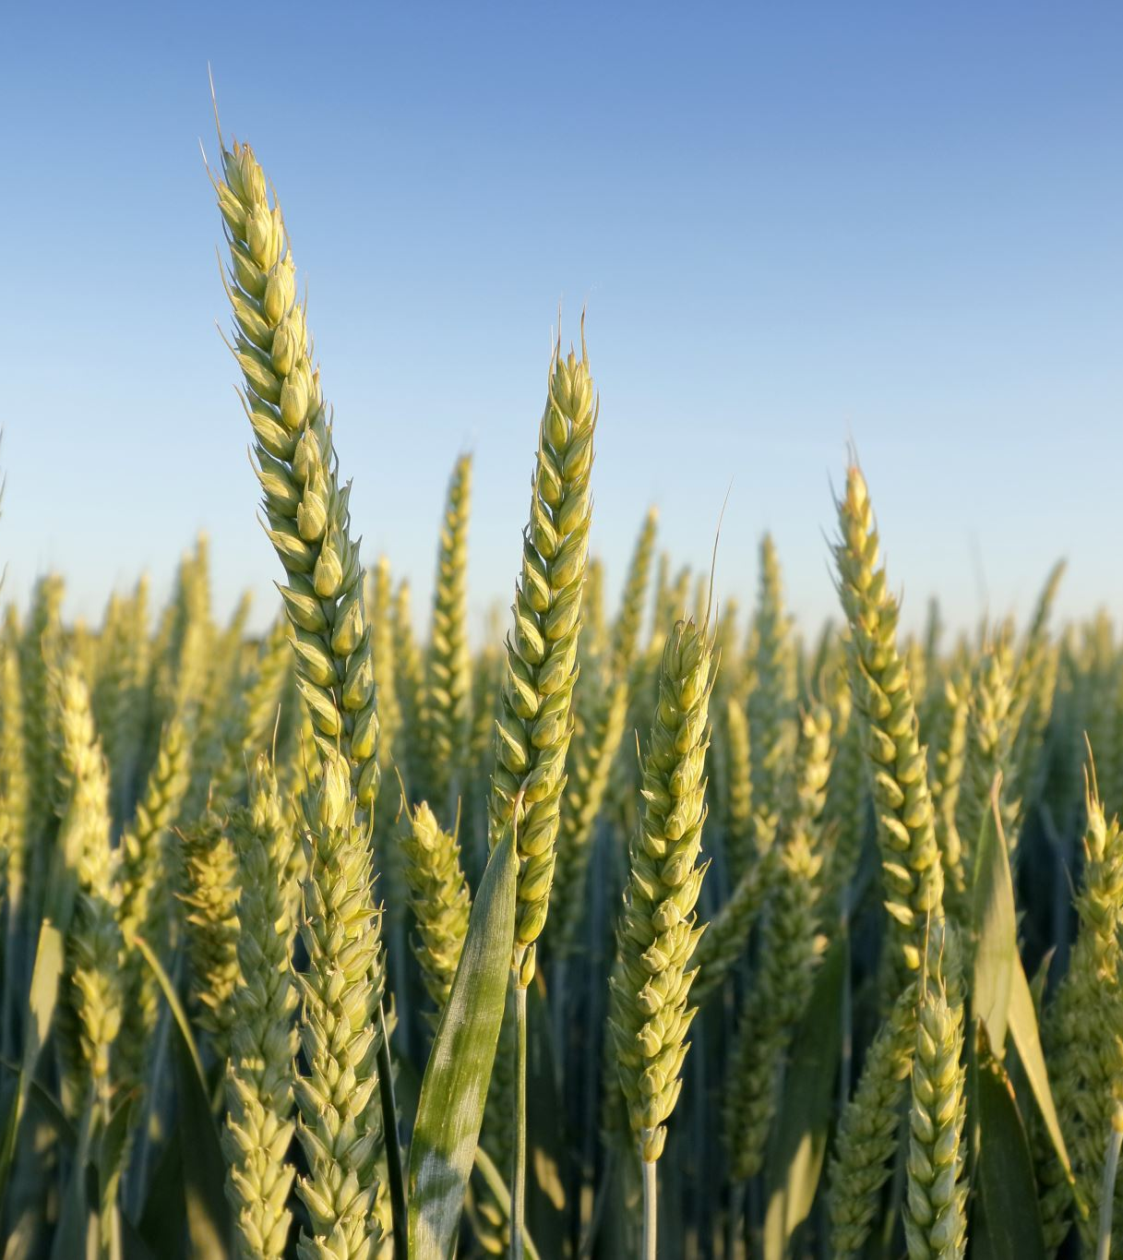
Around 80% of the food crops grown in the world are annual plants

Slide 6
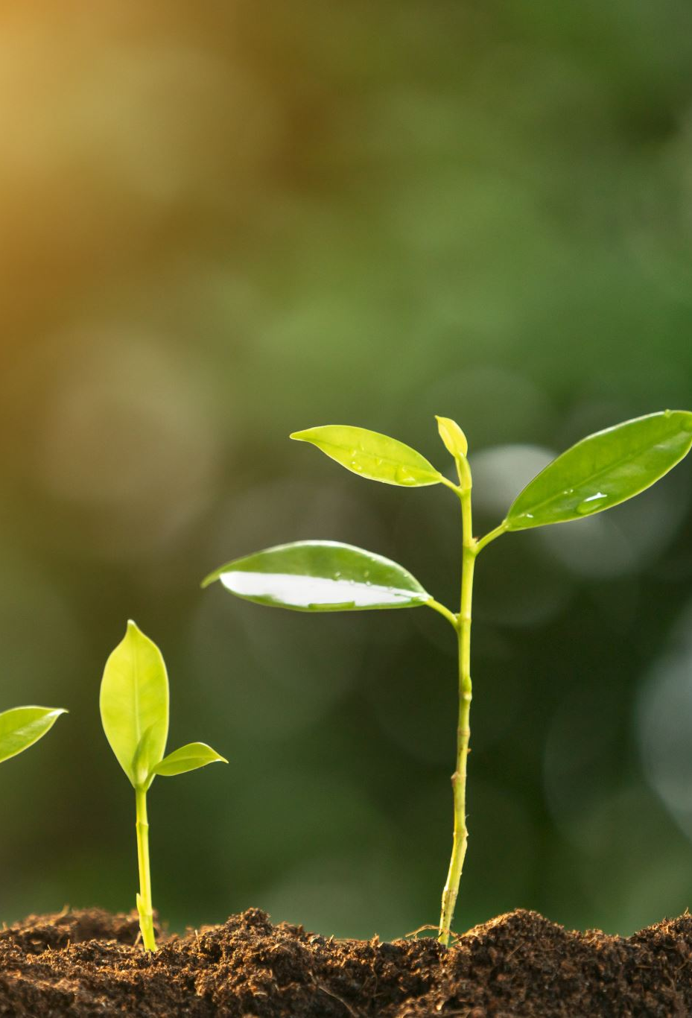
Permaculture: ‘permanent agriculture’
Perennial plants for a permanent system
  Compare annual plants that create temporary systems
    They are there for one season, but return to bare earth the next and do not return

Slide 7
Perennials: benefits
Flower and fruit more than once
Are often productive for many years
Require less energy and maintenance after planting than annuals
Perennial systems are inherently no-dig after initial planting
Perennials tend to have deeper, more extensive roots
Longer growing seasons
Intercept more rainfall due to their deeper roots
Access water and nutrients from deeper in the soil
Advantages:
Reduced soil erosion
Improved soil fertility and help to create below-ground soil webs
Less effort and costs for farmers and growers
Contribute to climate resilience and food security
Disadvantages:
Some perennials are water-hungry and may require more consistent water-availability than annuals
Pest and disease control requires thoughtful planning since they are often grown for a long time in one place and usual crop rotation practices do not apply

Slide 8
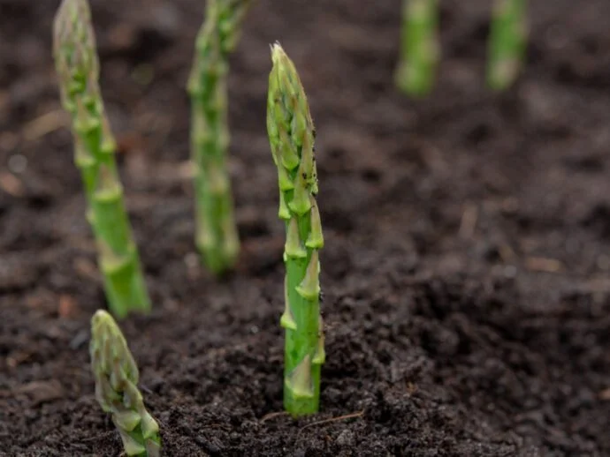
Examples of perennials
Asparagus
Rhubarb
Berry bushes
Artichokes
Many herbs, e.g. oregano, bay, mints, wild garlic and chives.

Slide 9
Perennials now planted in our garden
(in addition to our original planting)
Fig tree
English tree cabbage 'Taunton Deane'
Perennial cabbage 'Homesteaders Kaleidoscop/Kallaidoskop'
Cardoon
Yarrow
Sage, savoury
Turkish rocket
Good King Henry
Sorrel 'De Belleville'
Mallow 'Fastigiata'
Marshmallow
Comfrey Bocking
Gooseberry
Angelica
Bronze fennel
Diverse perennial onions and chives
Rhubarb x 3
Horseradish
Strawberries

Slide 10

Onboarding of new members

