Slide 1
Research Objects for Everyday Use
Carl Kesselman
Dean’s Professor, Industrial and Systems Engineering
University of Southern California

Slide 2
What does it mean to have a scientific “result”
Others have to “know” about it
Others have to be able to validate it
  Reproduce the method and achieve the same result
  Achieve the same result via a different method
  Reuse the result in a new method
“Non-reproducible single occurrences are of no significance to science.”
  Karl Popper, 1959. The logic of scientific discovery. Hutchinson, London, United Kingdom.

Slide 3
Science must be reproducible..
Nature May 25, 2016
“More than 70% of researchers have tried and failed to reproduce another scientist's experiments, and more than half have failed to reproduce their own experiments. Those are some of the telling figures that emerged from Nature's survey of 1,576 researchers who took a brief online questionnaire on reproducibility in research."

Slide 4
Where are we now?
Only 10% of published results are reproducible

Slide 6
Lets focus on the data…
Reproducibility of data
Data is only useful if we can figure out:
  Where it is
  What it is
  How it was created
Process and product: the data lifecycle
  Initial data acquisition (perhaps from experiment)
  Computing, and analysis
  Publication

Slide 7
Reproducible Data is FAIR
Findable
  identified by a unique identifier, characterized by rich metadata
Accessible
  standard protocol with access control, metadata accessible even when the data is not,
Interoperable
  by standardized terms to describe it
Reusable
  Accurate and relevant attributes.

Slide 8
GOAL: FAIR Collaboration
Lets make all data produced in an investigation FAIR
  Not just final “published” result, but all results
  Need to scale application of FAIRness principals down to level of daily practice
Requires accurate descriptions of data
  Characteristics of data element
  Relationships between data elements
Requires robust naming of the data products

Slide 9
Knowledge Turns and Publication
Publication
  Slow turn around, polished content and presentation
  Human processes and audience
μPublication
  Rapid turn around, incremental raw data exchange
  Human and machine processes and audience

Slide 10
What does it mean to have research objects in daily use
Get users thinking about lots of publication events
Prepare information for sharing
Package it up so that its accessible
Name the package so that it can be identified.
What can we do to make these things easier?

Slide 11
Identifiers are important, but too hard!!
Lets consider a range of identifier user cases
We need to separate out issues of naming from persistence
Digital Object Identifiers (DOIs) are designed for archival objects
  You don’t mind a DOI unless you really “mean it”
What about identifying intermediate and temporary data
  Can also benefit from unambiguous naming
Two options:
  Local identifiers, e.g. assession numbers (often not actionable)
  Alternative identifier systems such as ARK

Slide 12
Minimal Identifiers (Minids)
Lightweight identifiers that support simple creation and use
Unique identifier (ARK)
  E.g., /ark:/57799/b9040f
  Or compact identifier (minid:b9040f)
Minimal metadata (creator, date, name)
Checksum ensures data is verifiable
Service to provide the landing page
Easy to use: CLI, Python SDK, R SDK, JSON-based REST API

Slide 13
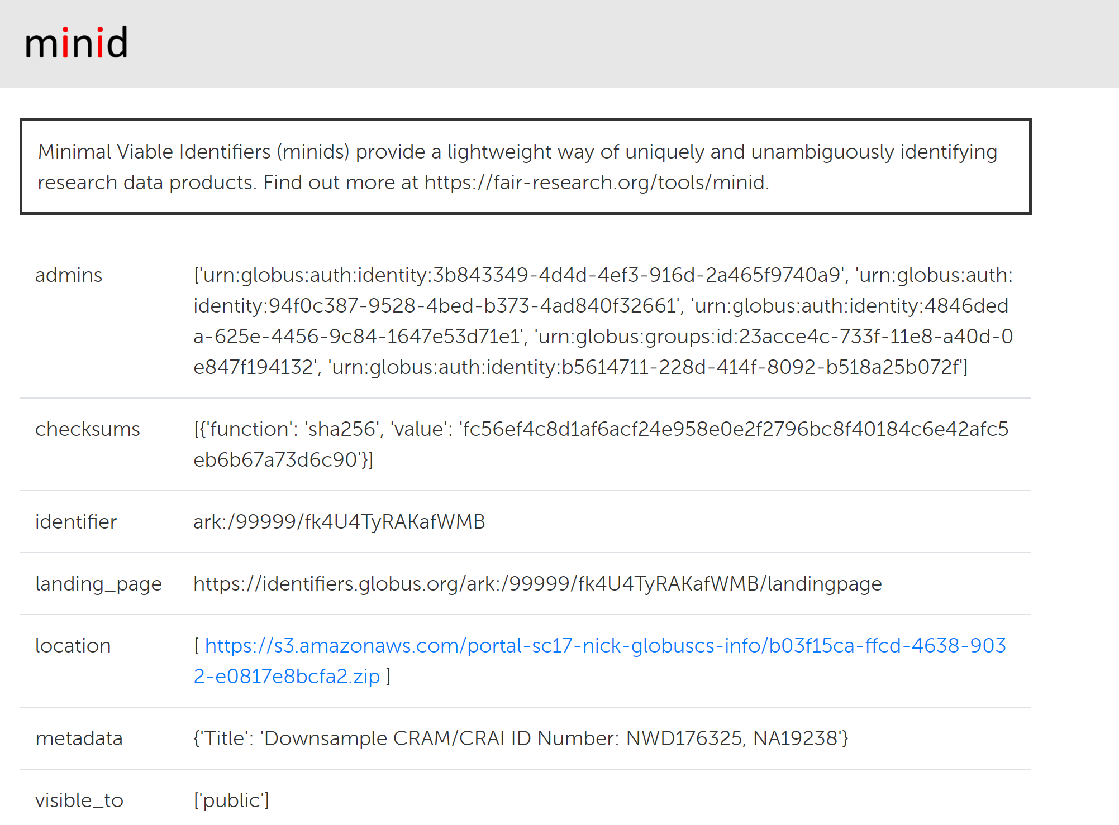
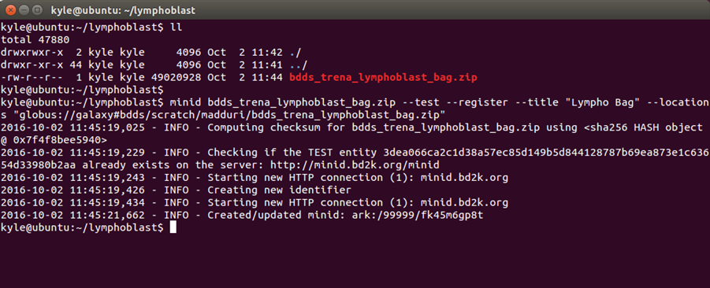
Why and When use Minids?
Naming intermediate data
Quickly associate a lightweight identifier
Validate data integrity
Lookup identifiers based on checksum
CLI or Python/R client

Slide 14
Large Multi-File Datasets: Big Data Bags
Profile on the BagIt specification
  Payload: arbitrary content
  Tags: metadata describing payload
  Checksums: to verify content
Content may be “missing”
  Missing content must be listed in “fetch.txt”
  Fetch entries list local name in data directory, and URL of where to fetch data
Enhancements to support big data
  Different data access protocols (Globus, HTTP, iRODS, S3)
  Research Object metadata

Slide 15
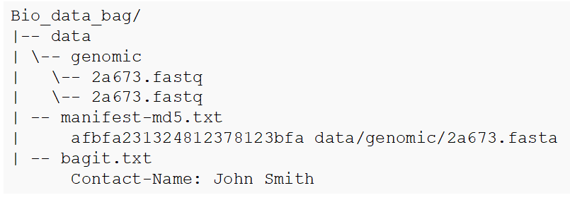

Slide 16
Research Objects: rich metadata for bags
{
"@context": {
"@vocab": "http://purl.org/dc/terms/",
"dcmi": "http://purl.org/dc/dcmitype/Dataset"
},
"@id": "../../data/numbers.csv",
"@type": "dcmi:Dataset",
"title": "CSV files of beverage consumption",
”description": "A CSV file listing the number of cups consumed per person.”
}

Slide 17
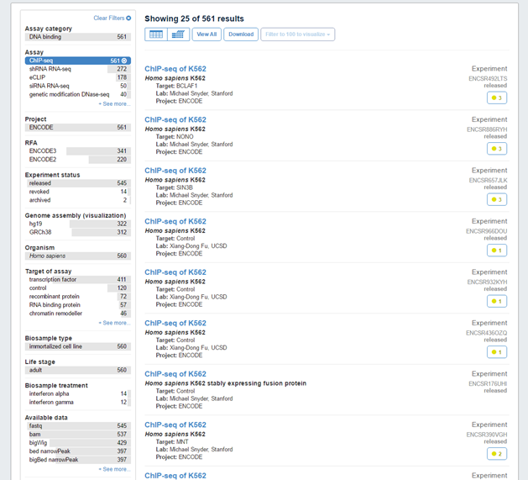
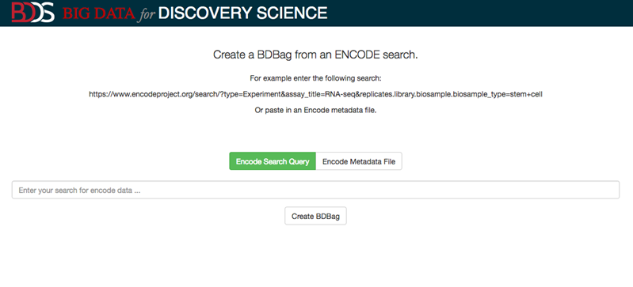
Why and When use Minids?
Large, multi-file datasets
Integration with BDBag allows for content independent verification (i.e., holey bags)
Streamline download and references to complex multi-file datasets
Example: Encode2Bag

Slide 18
Scientific Digital Asset Management
Discovery Environment for Relational Information and Versioned Assets (DERIVA)
Discovery as process of creating and updating contextualized digital assets.
Adaptive and extensible

Slide 19
Scientific Asset Management System
Discovery Environment for Relational Information and Versioned Assets (DERIVA)
DERIVA promotes FAIR data production by:
  F: providing rich metadata using an Entity-Relationship model to express relationships between diverse data elements;
  A: offering rich access control and access to metadata via standard HTTP web service interfaces;
  I: integrating with standardized terms defined by collaborators, consortium or communities; and
  R: supporting dynamic model evolution so that the data presented accurately represents the current structure and state of knowledge within an investigation.

Slide 20
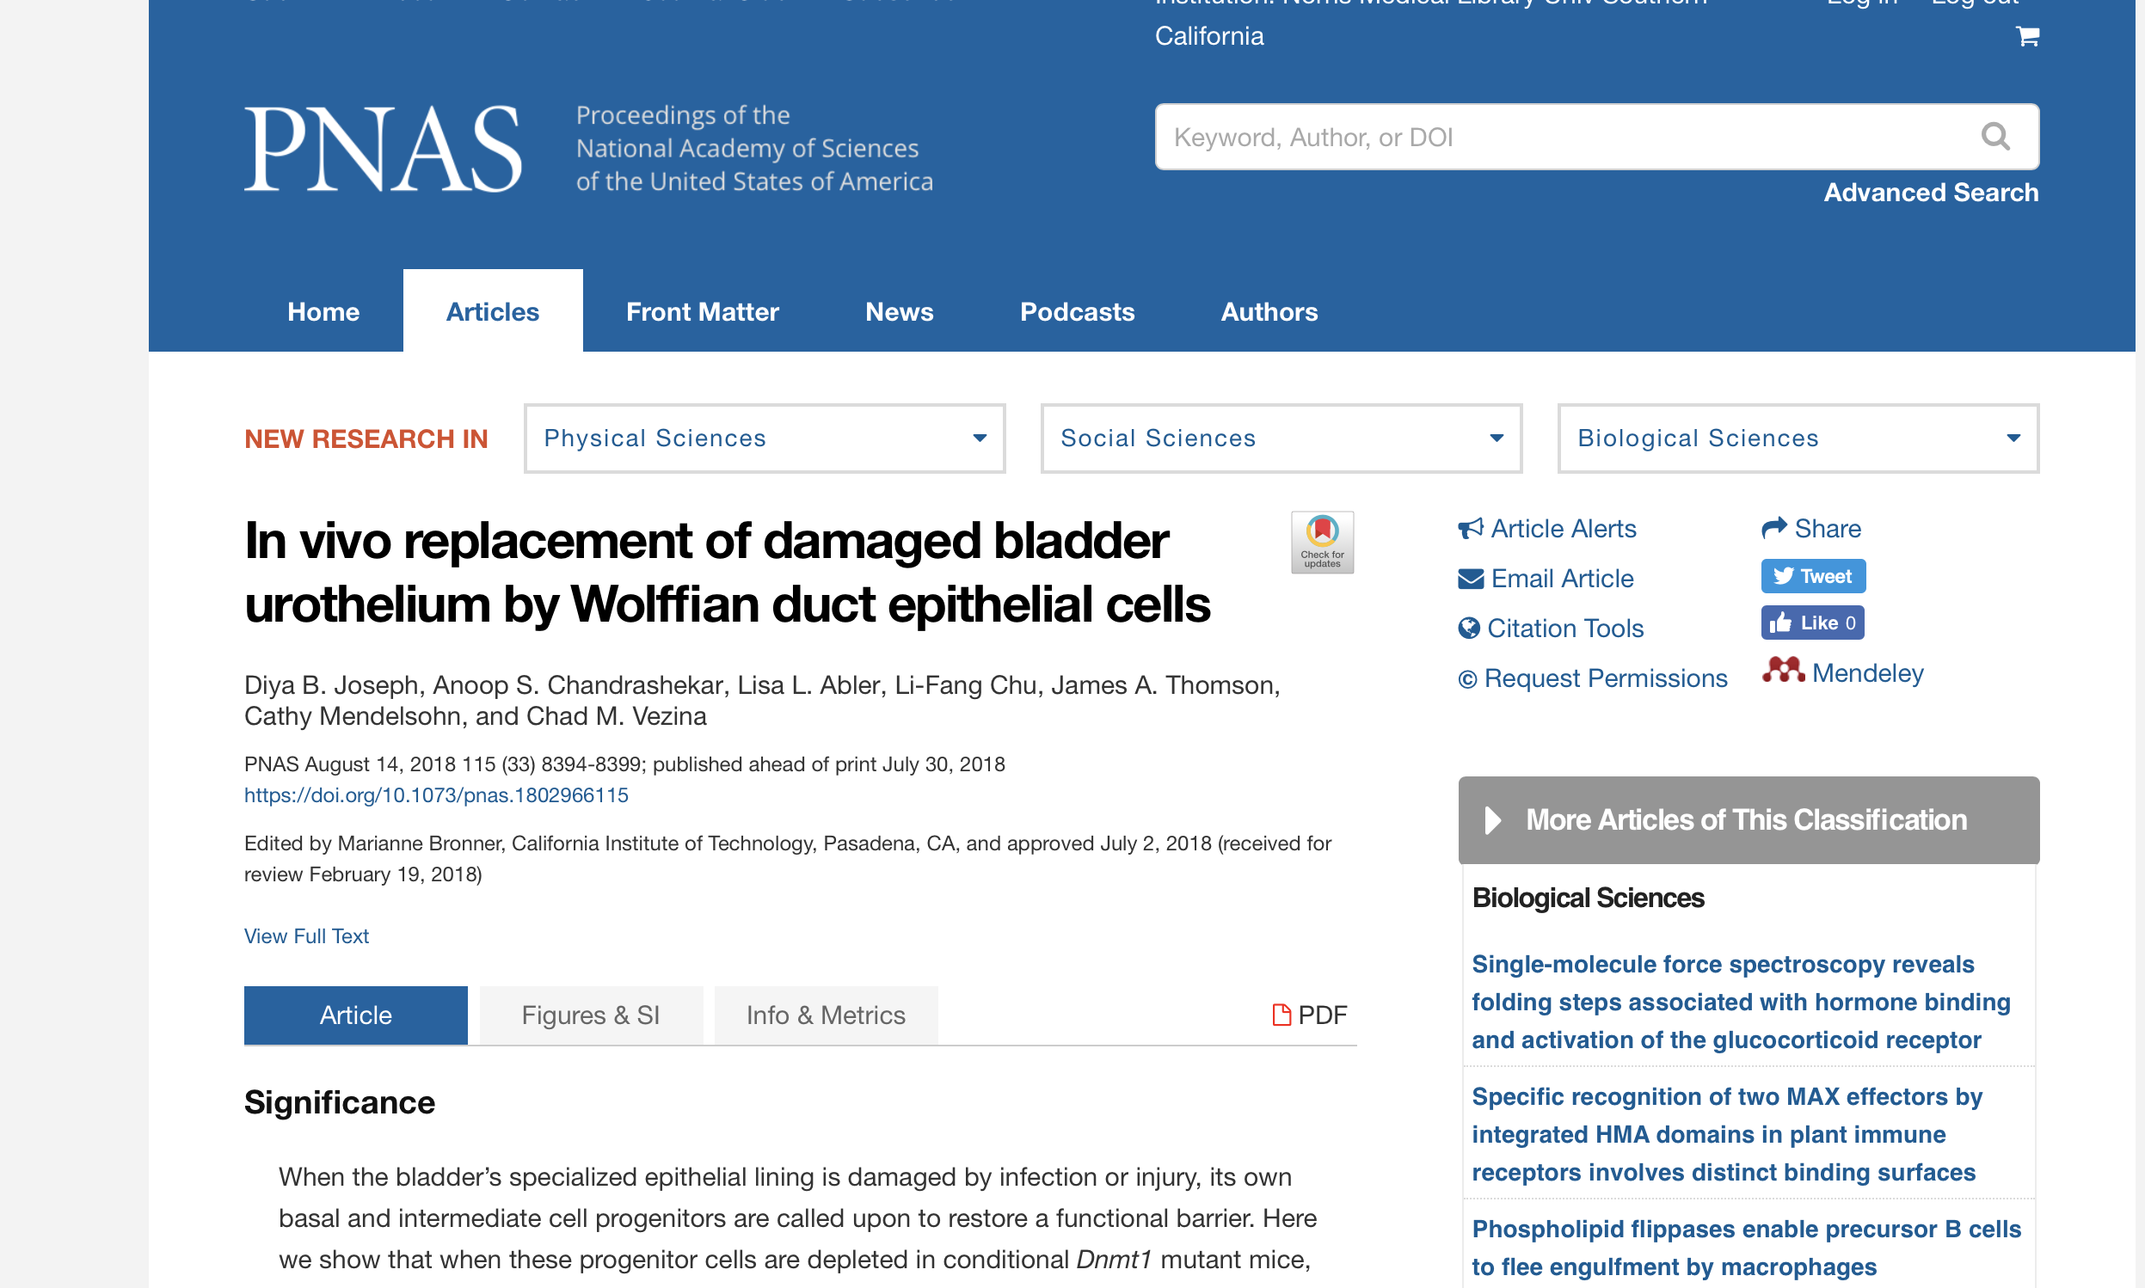

Slide 21
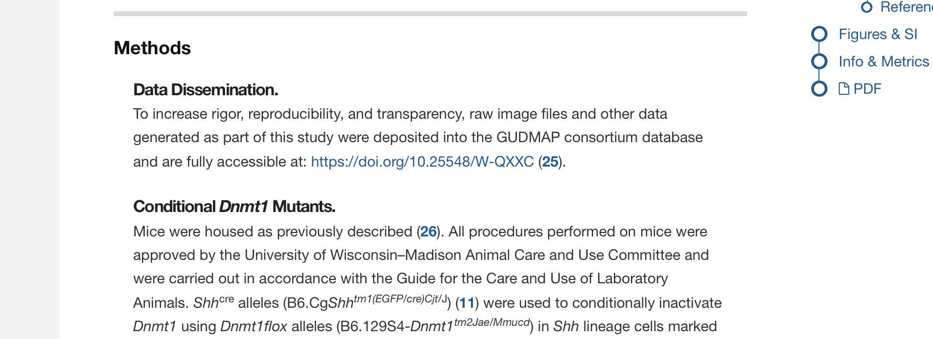

Slide 22
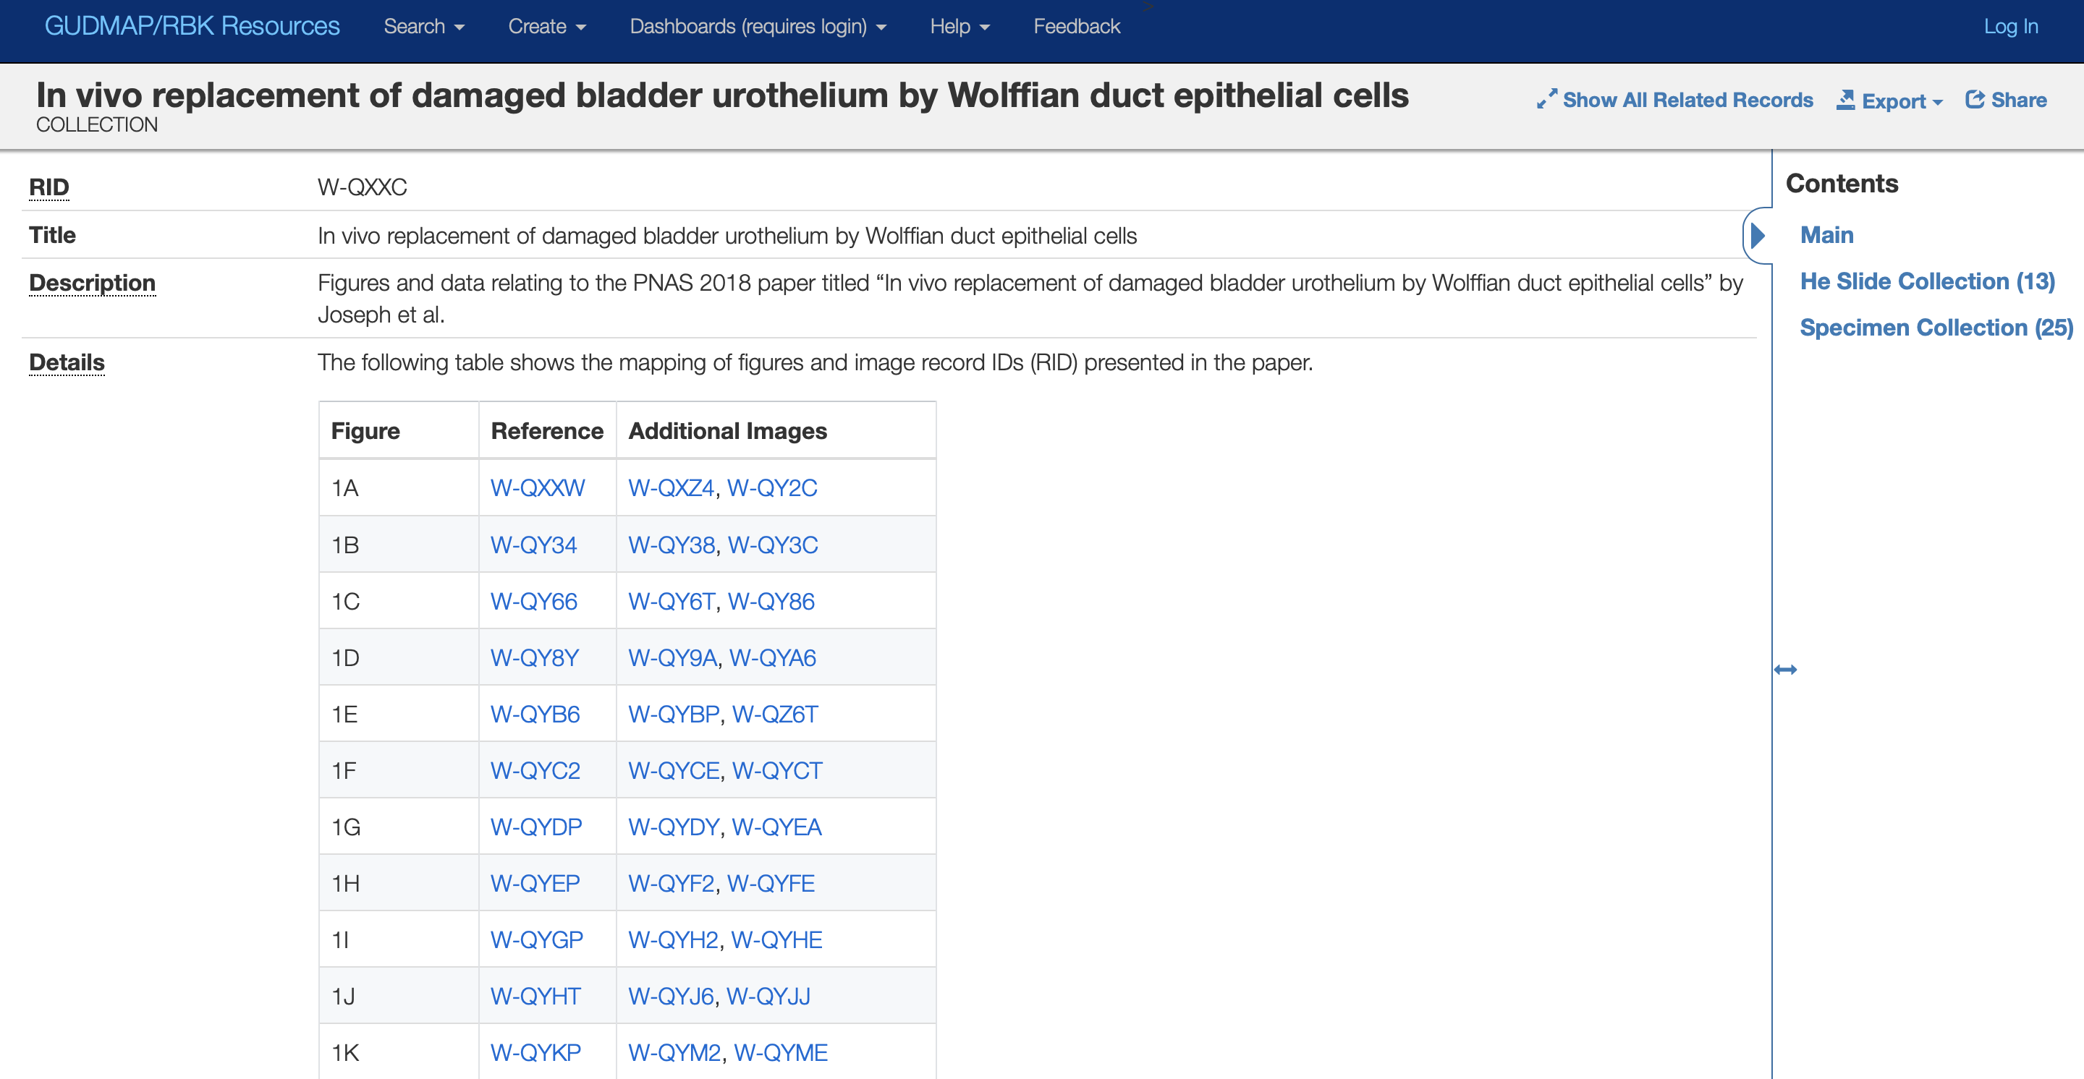

Slide 23
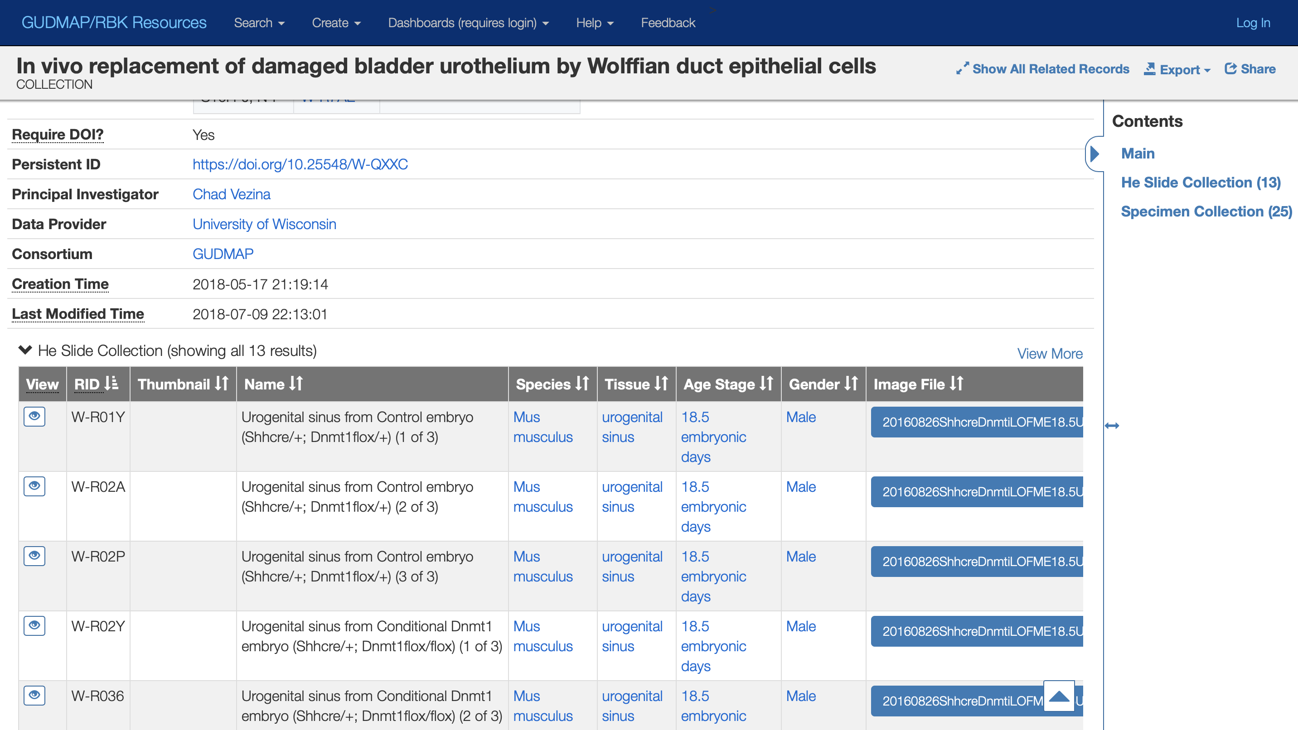

Slide 24
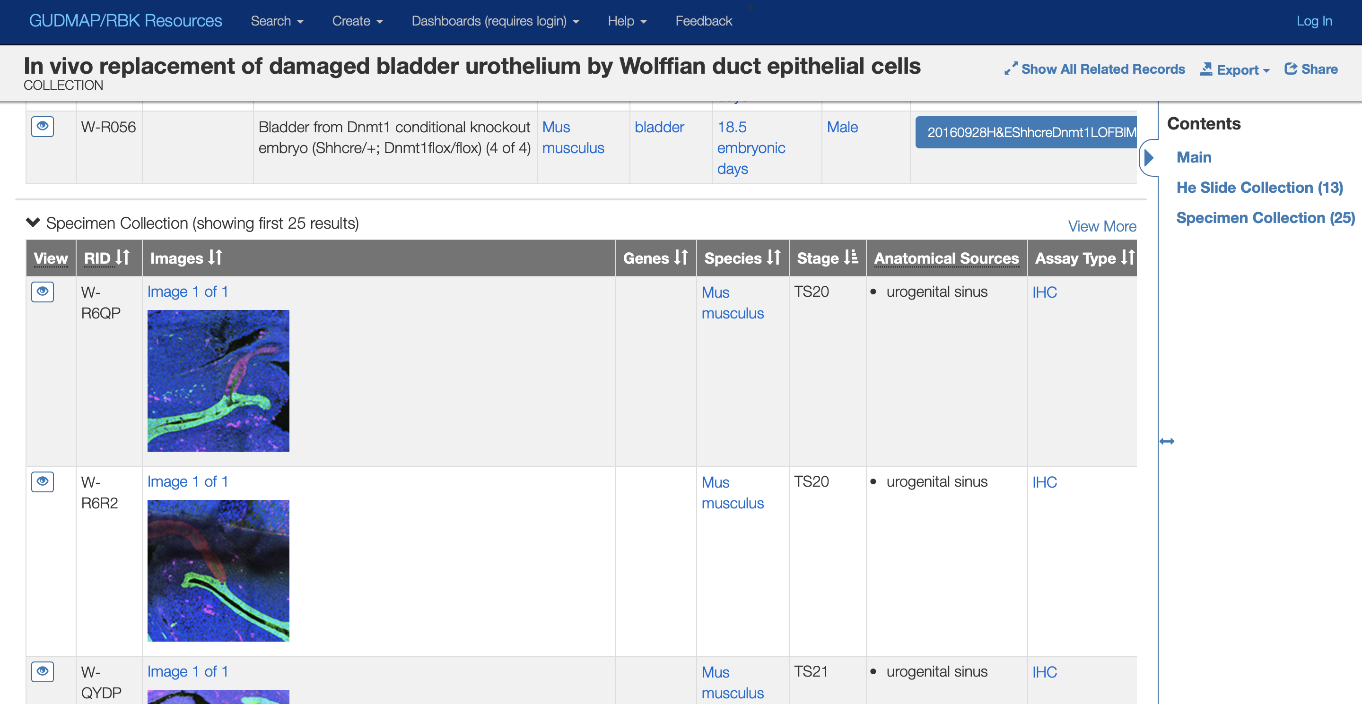

Slide 25
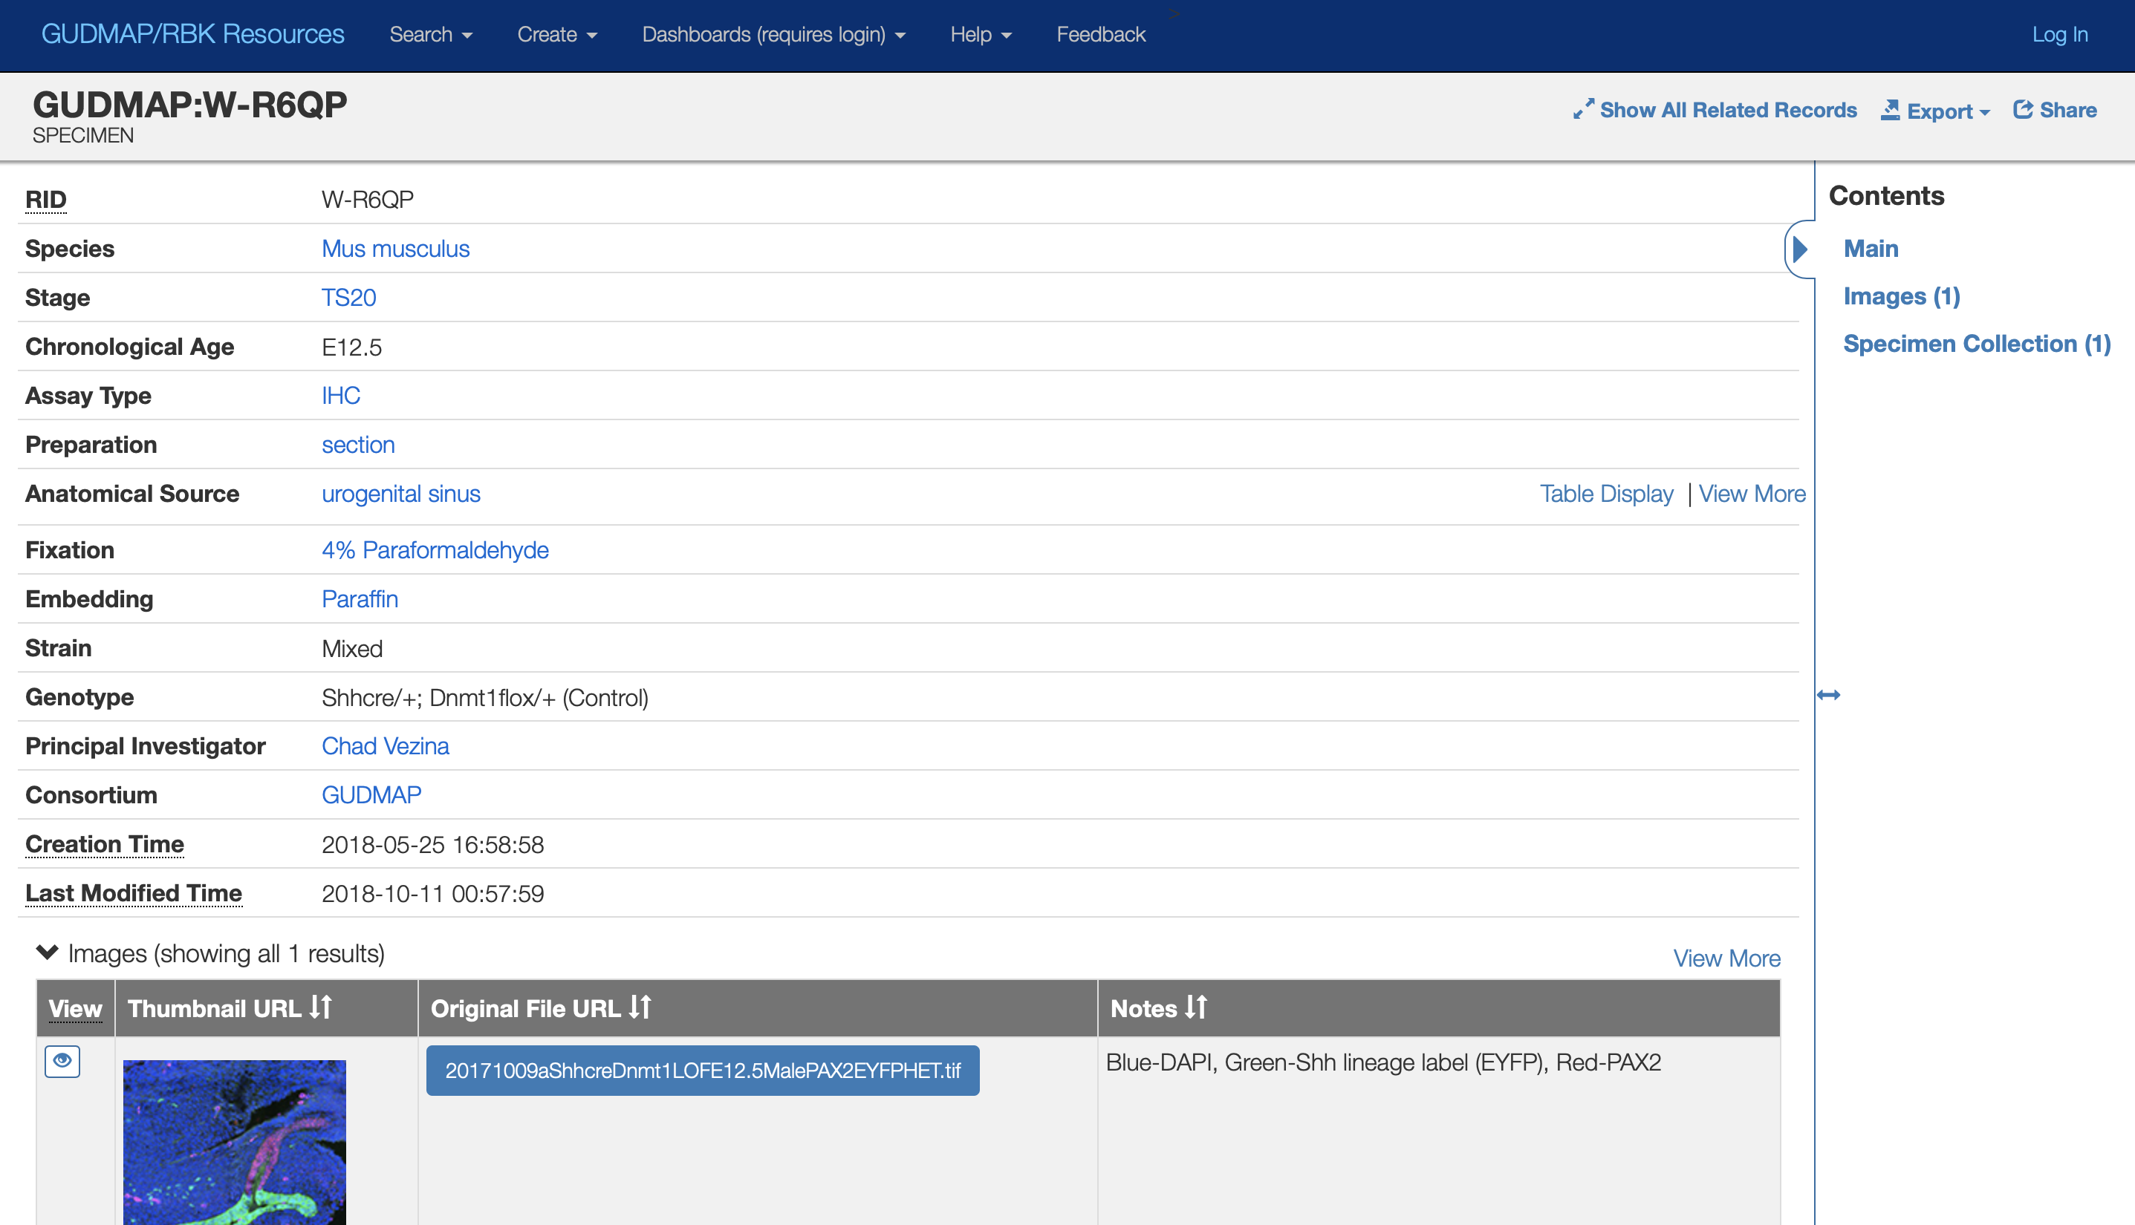

Slide 26
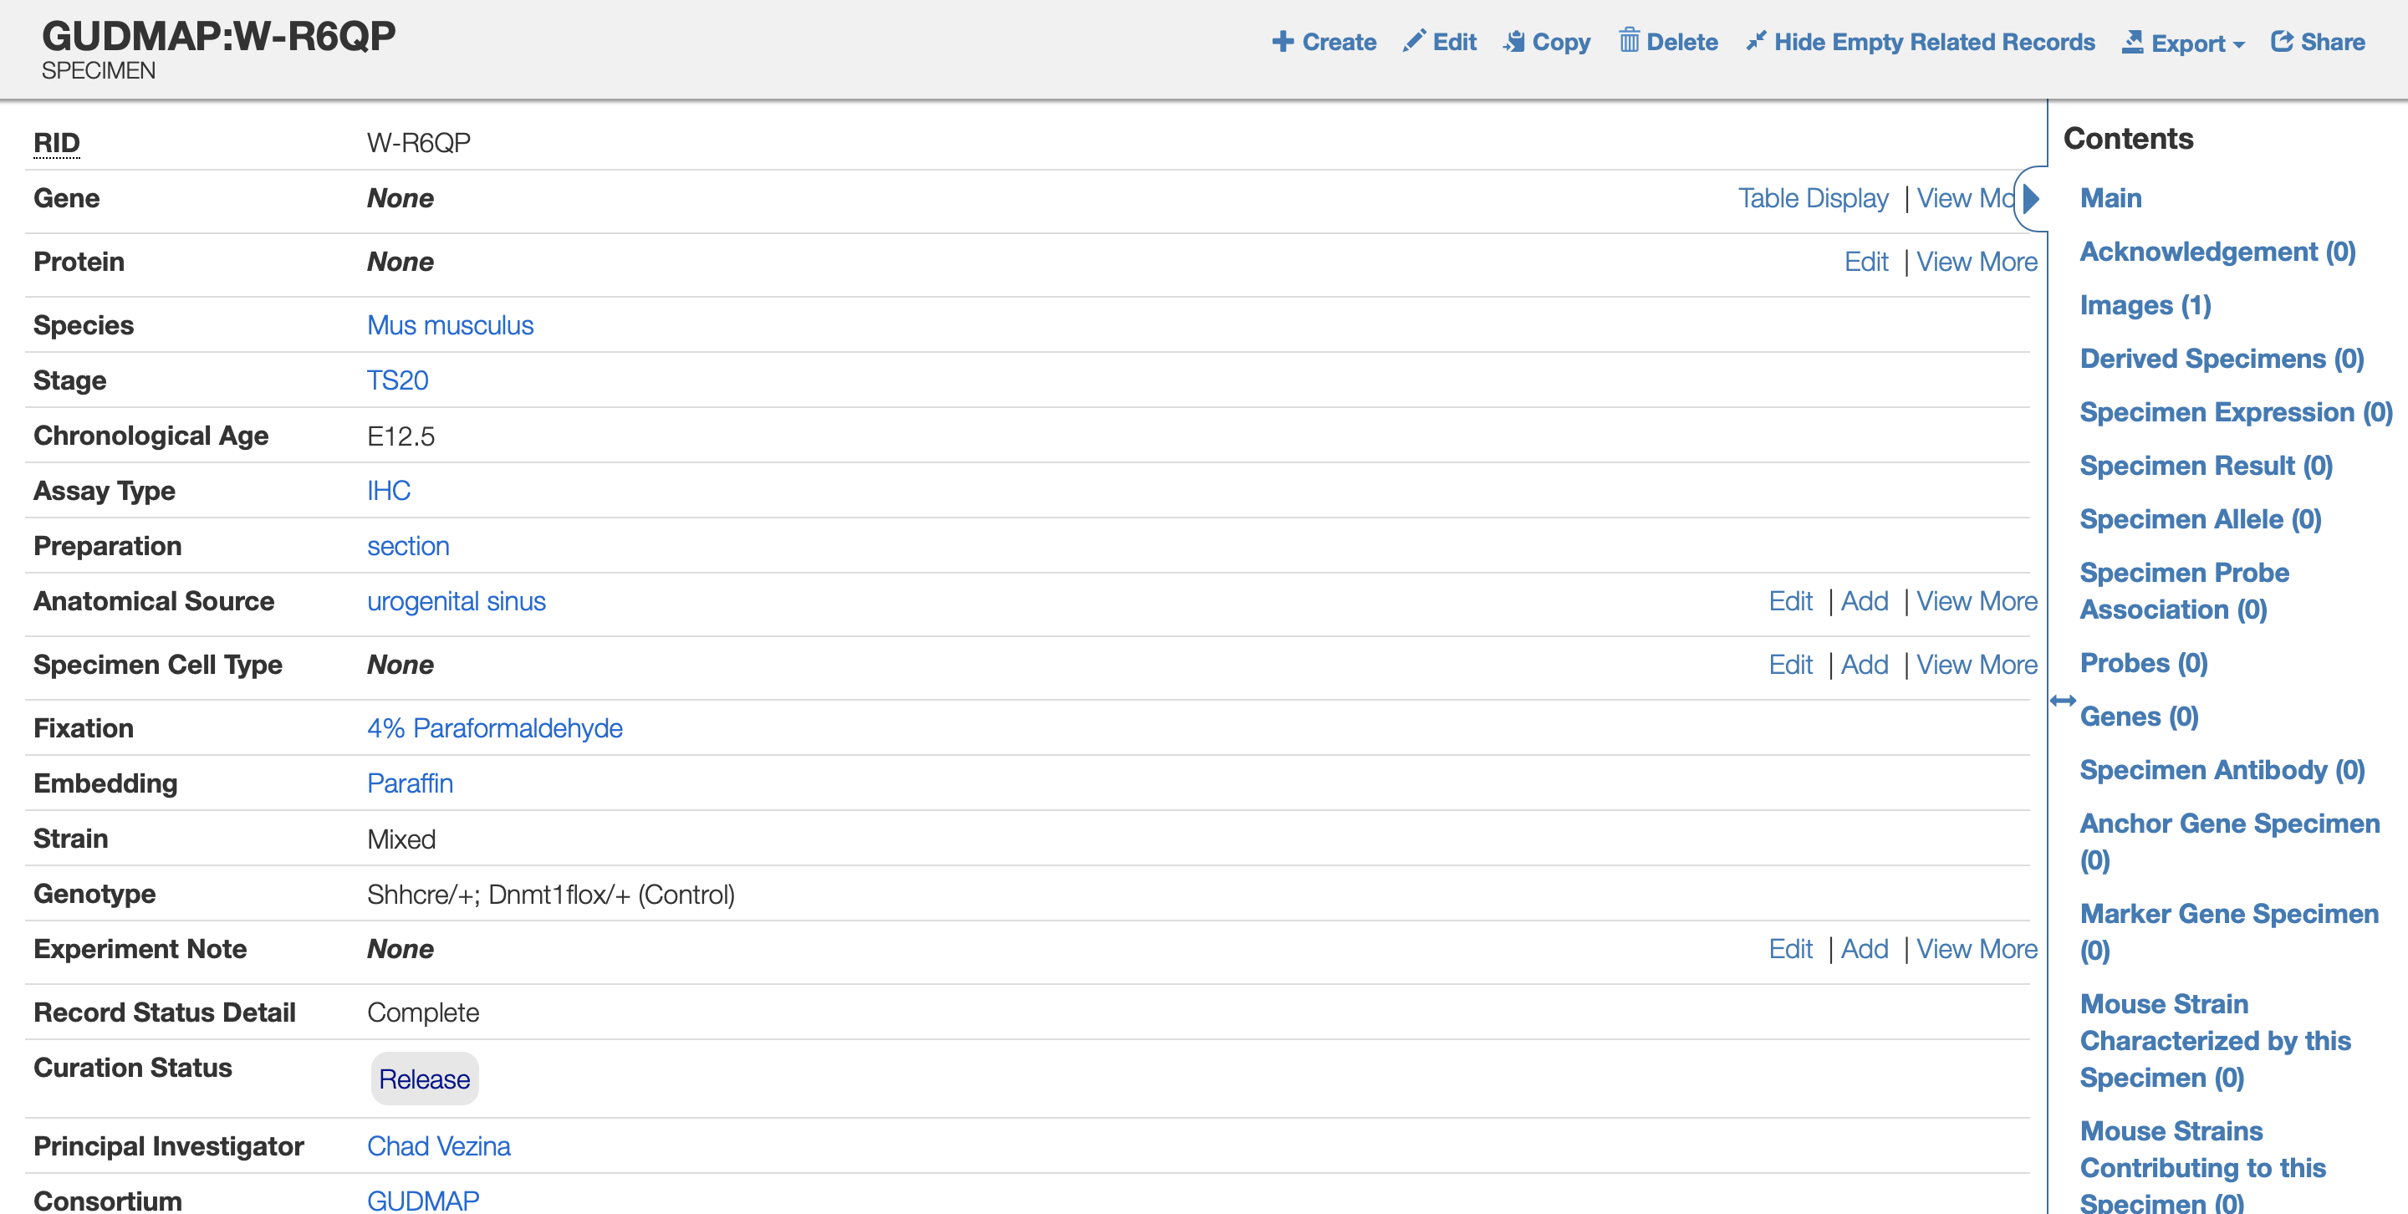

Slide 27
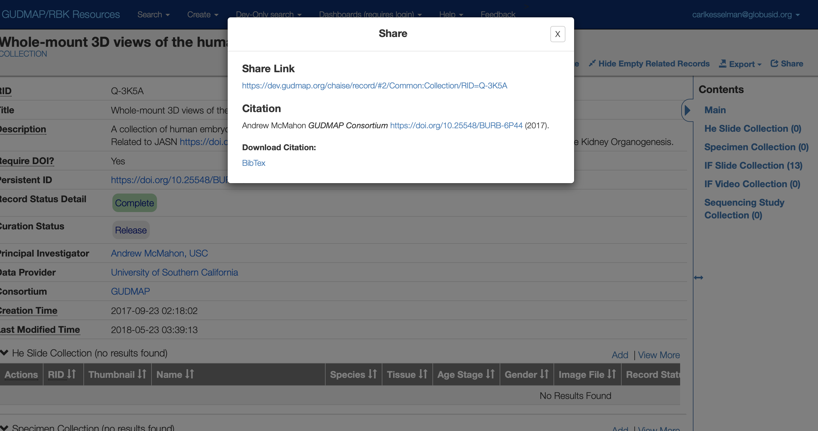

Slide 28
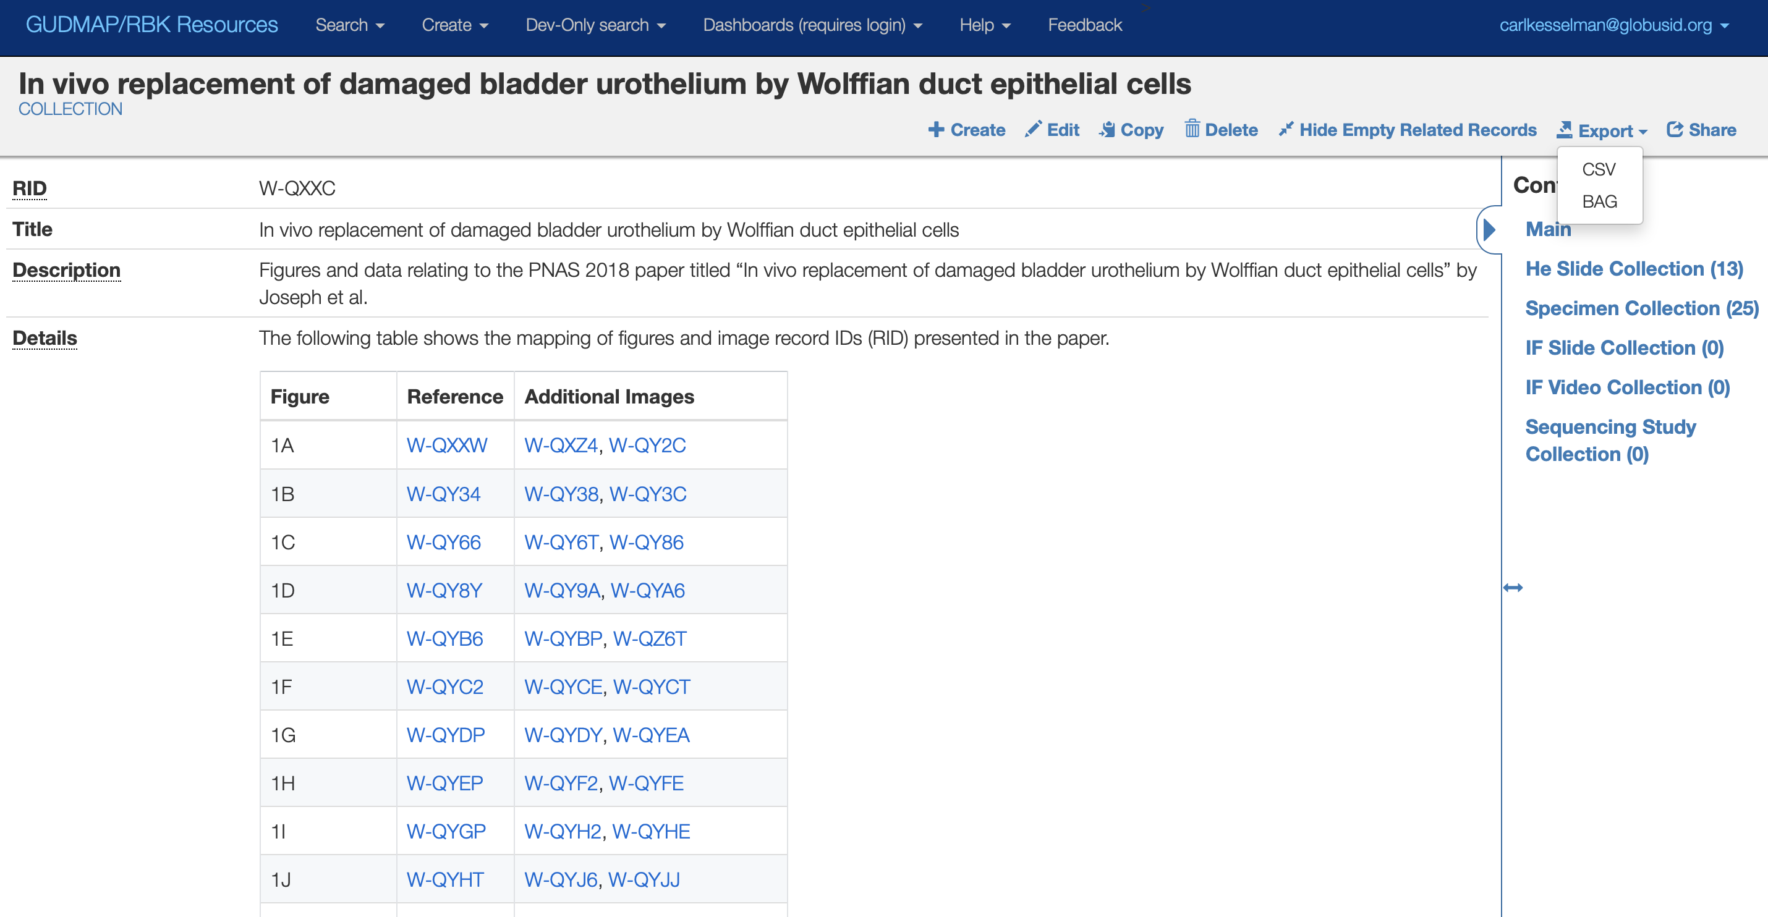

Slide 29
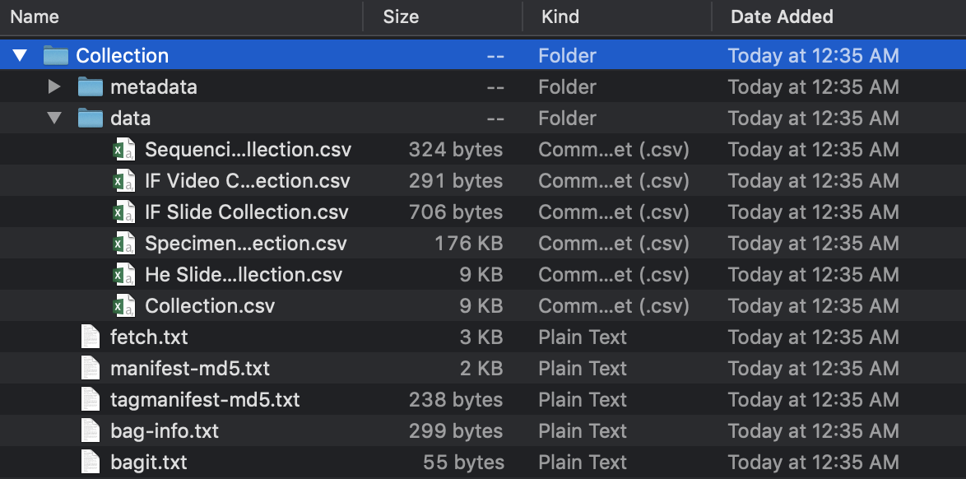

Slide 31
Summary
derivacloud.org
https://fair-research.org
Carl@isi.edu

