Slide 1
Research to Operations Visualization for WSA Coronal and Solar Wind Predictions
Jaime A. Landeros^{1,2}, Daniel E. da Silva^{3,4},
C. Nick Arge³, Shaela I. Jones³
¹California State Polytechnic U of Pomona, CA
³NASA Goddard Space Flight Center, MD
²ADNET Systems Inc, Bethesda, MD
⁴LASP, University of Colorado Boulder, CO
Notes:
Undergrad
Year round intern at GSFC Solar physics
Intern with HAO to help with space physics model viz
Grad interest
Image > Crown of Sun > corona
Discuss a model of upper solar atmosphere
How we validate it
Specifically by segmenting

Slide 2
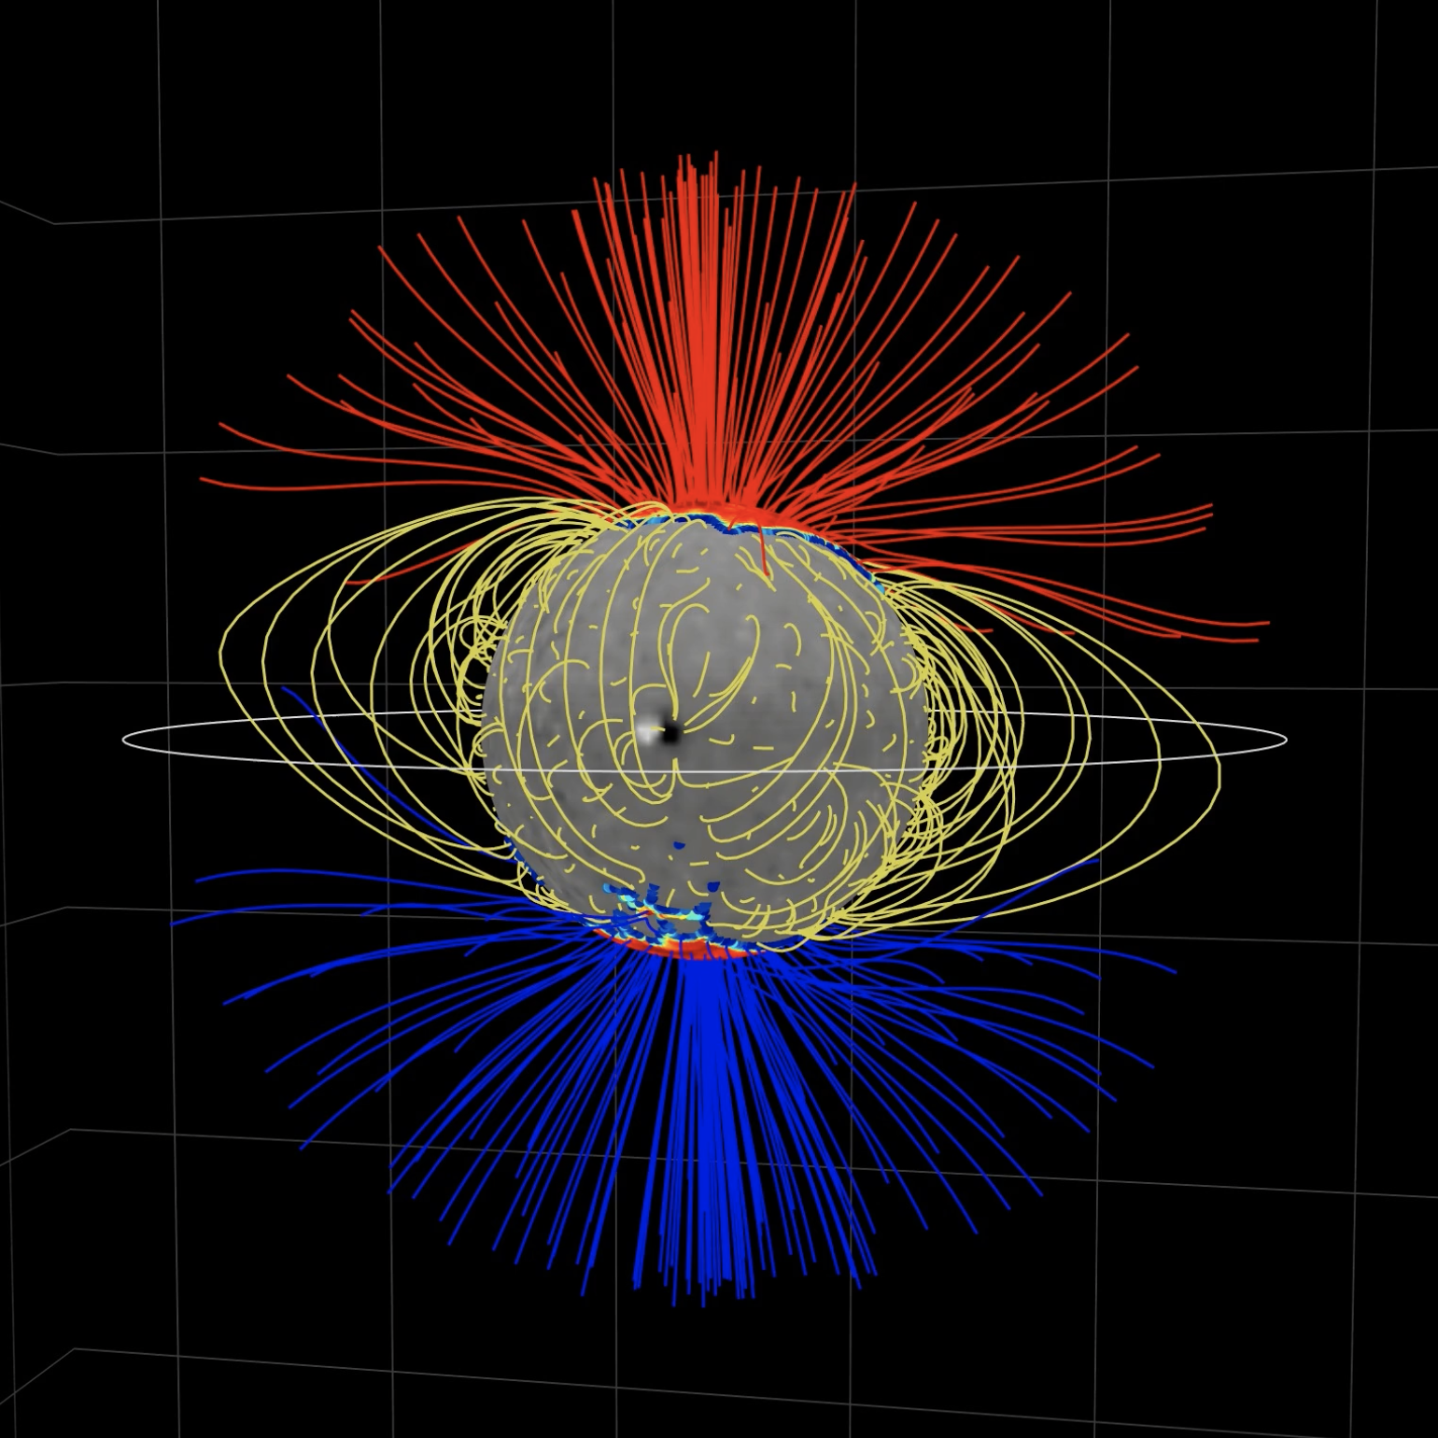
WSA Model: Coronal Predictions
  Potential Field Source Surface Model
    Ingests modeled radial magnetic field on the solar surface
    Extrapolate to the source surface
  The source surface models the source of the solar wind
Notes:
Many modeling approaches, but the most common due to relative simplicity is PFSS
From a modeled map of the radial B field on the solar surface
Extrapolate the field assuming a potential field up to the source surface, serving as the source of the solar wind
Image: 3D field line plot
Developed for educational activity at the 2023 Heliophysics summer school
Key property of CHs is predominant unipolarity, with most magnetic field lines being of one direction

Slide 3
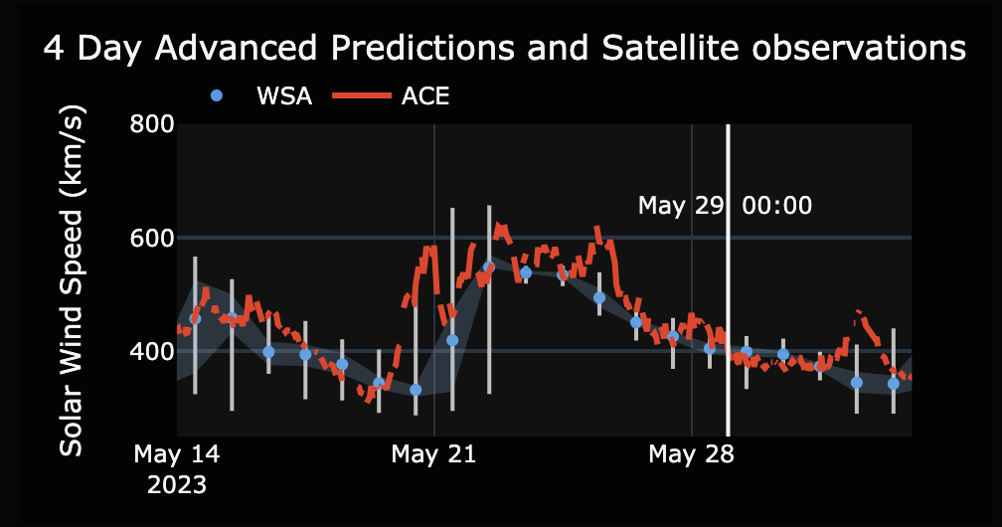
WSA Model: Solar Wind Predictions
  Wang-Sheeley-Arge model targets the missing link between field structure and solar wind speed
    Extrapolation implements 2 potential field models
    Solar wind speed applies an empirical relationship and 1D kinematic model

Slide 4
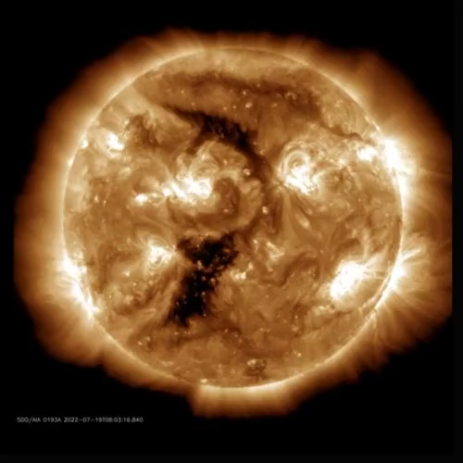
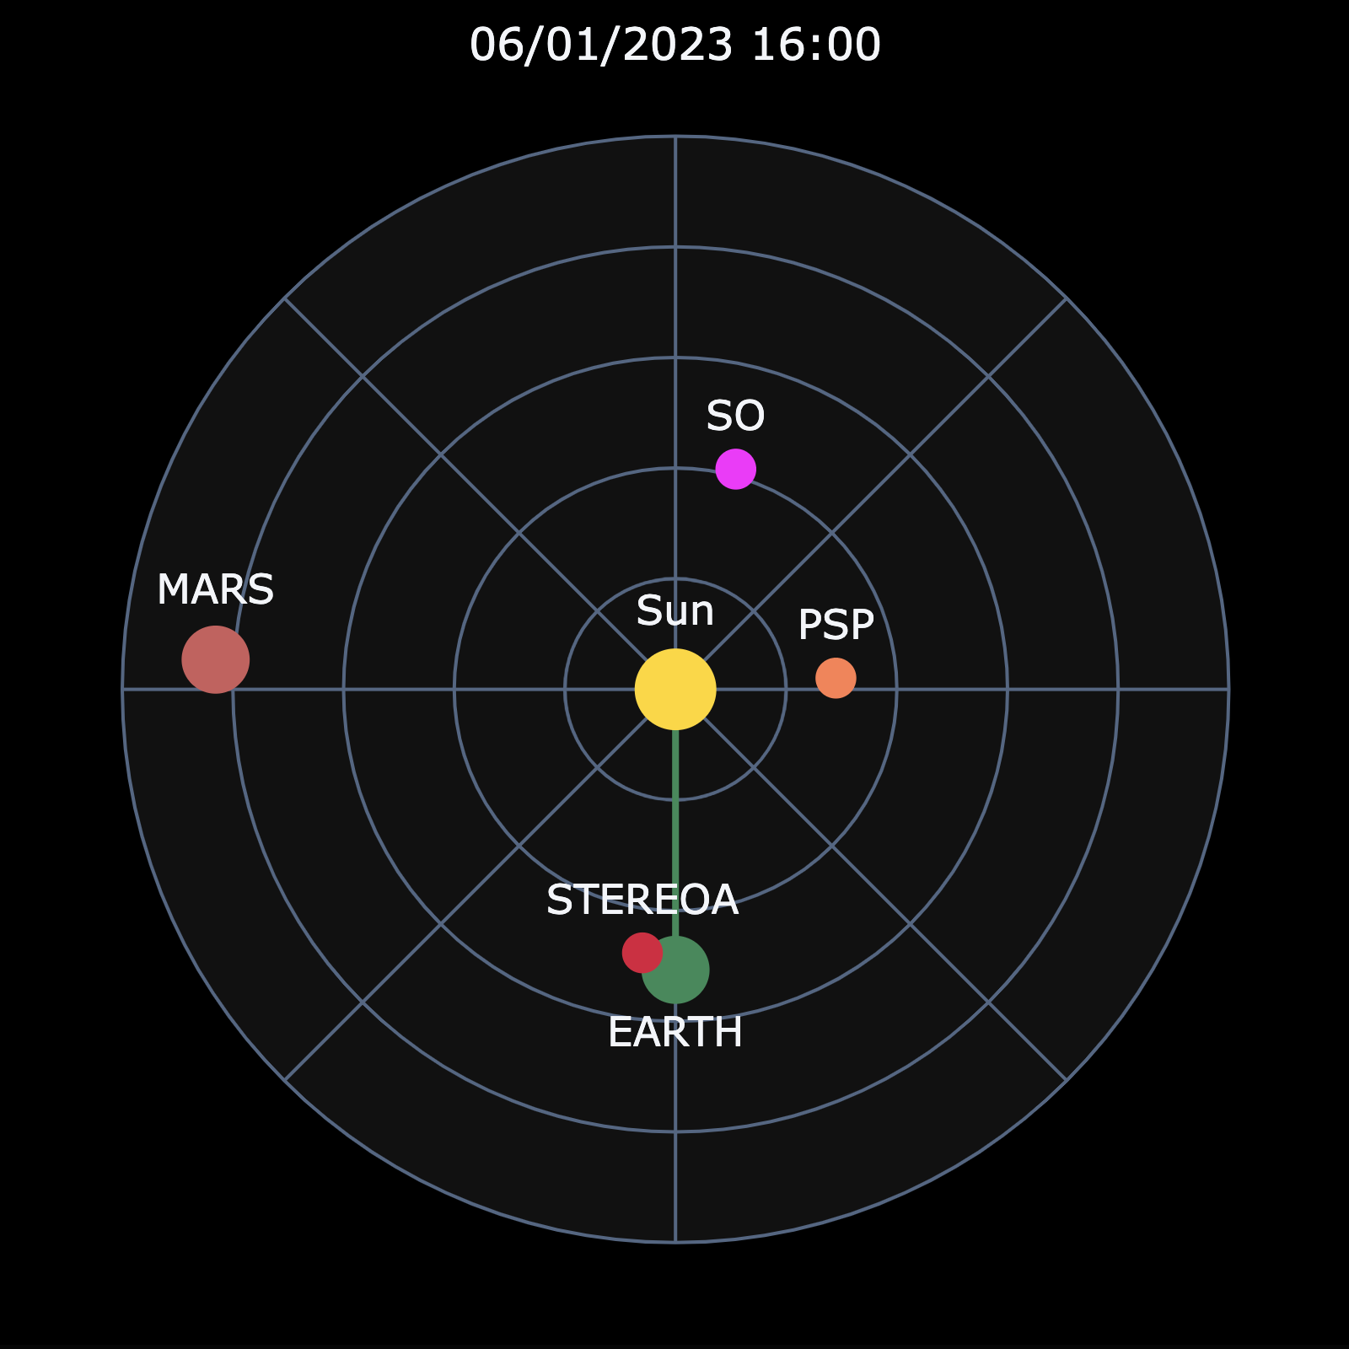
Research to Operations Tooling
Operational Capabilities
    Predictions at satellites across the inner Heliosphere
    Comparison with in situ and remote sensing observations
Notes:
We just made several assumptions about a very complex system
Verify our forecasts by comparing with observations
Solar wind is probed by instruments on satellites around the solar system

Slide 5
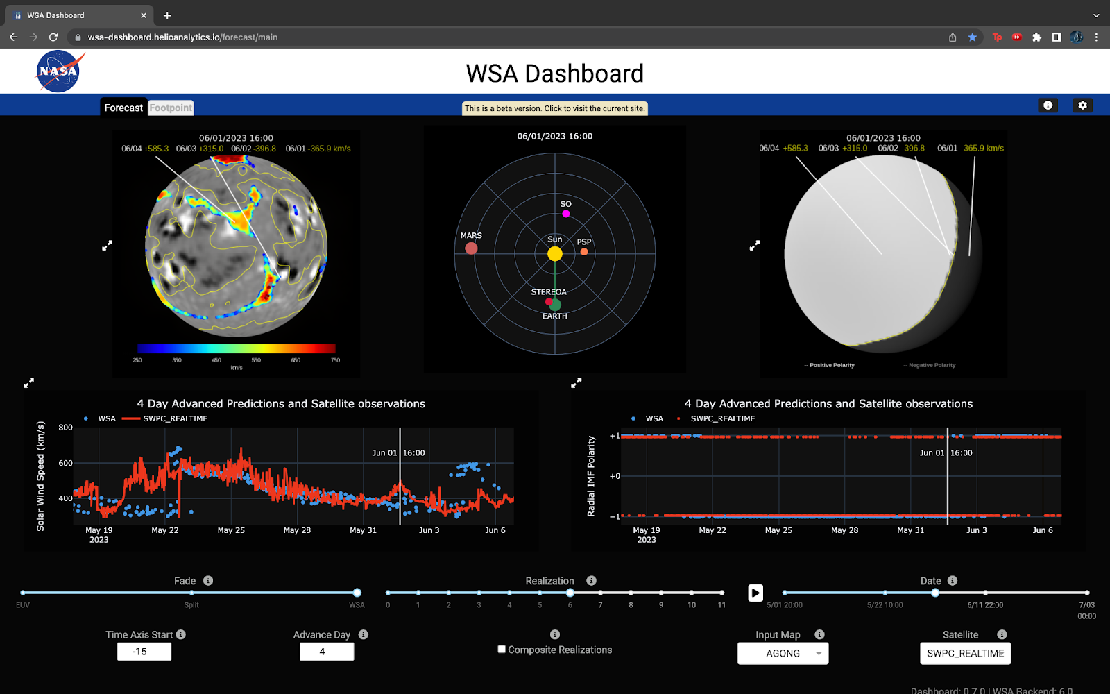
WSA Dashboard
Notes:
The WSA Dashboard is an interactive, browser-based tool providing:​
An operations-oriented centralized snapshot of the solar wind across the solar system.​
A research-oriented dynamic visualization method for satellite observations and ensemble predictions from the established WSA and ADAPT models.​
Derived coronal holes​
Current sheet location​
Time Series Plots​: Solar wind speed​, Interplanetary Magnetic Field (IMF) polarity​
Footpoint connectivity between satellites & the Sun​
Satellite Observations​: ACE & DSCOVR​, STEREO-A​, MAVEN​, SDO​, PSP​, SoIO​

Slide 6
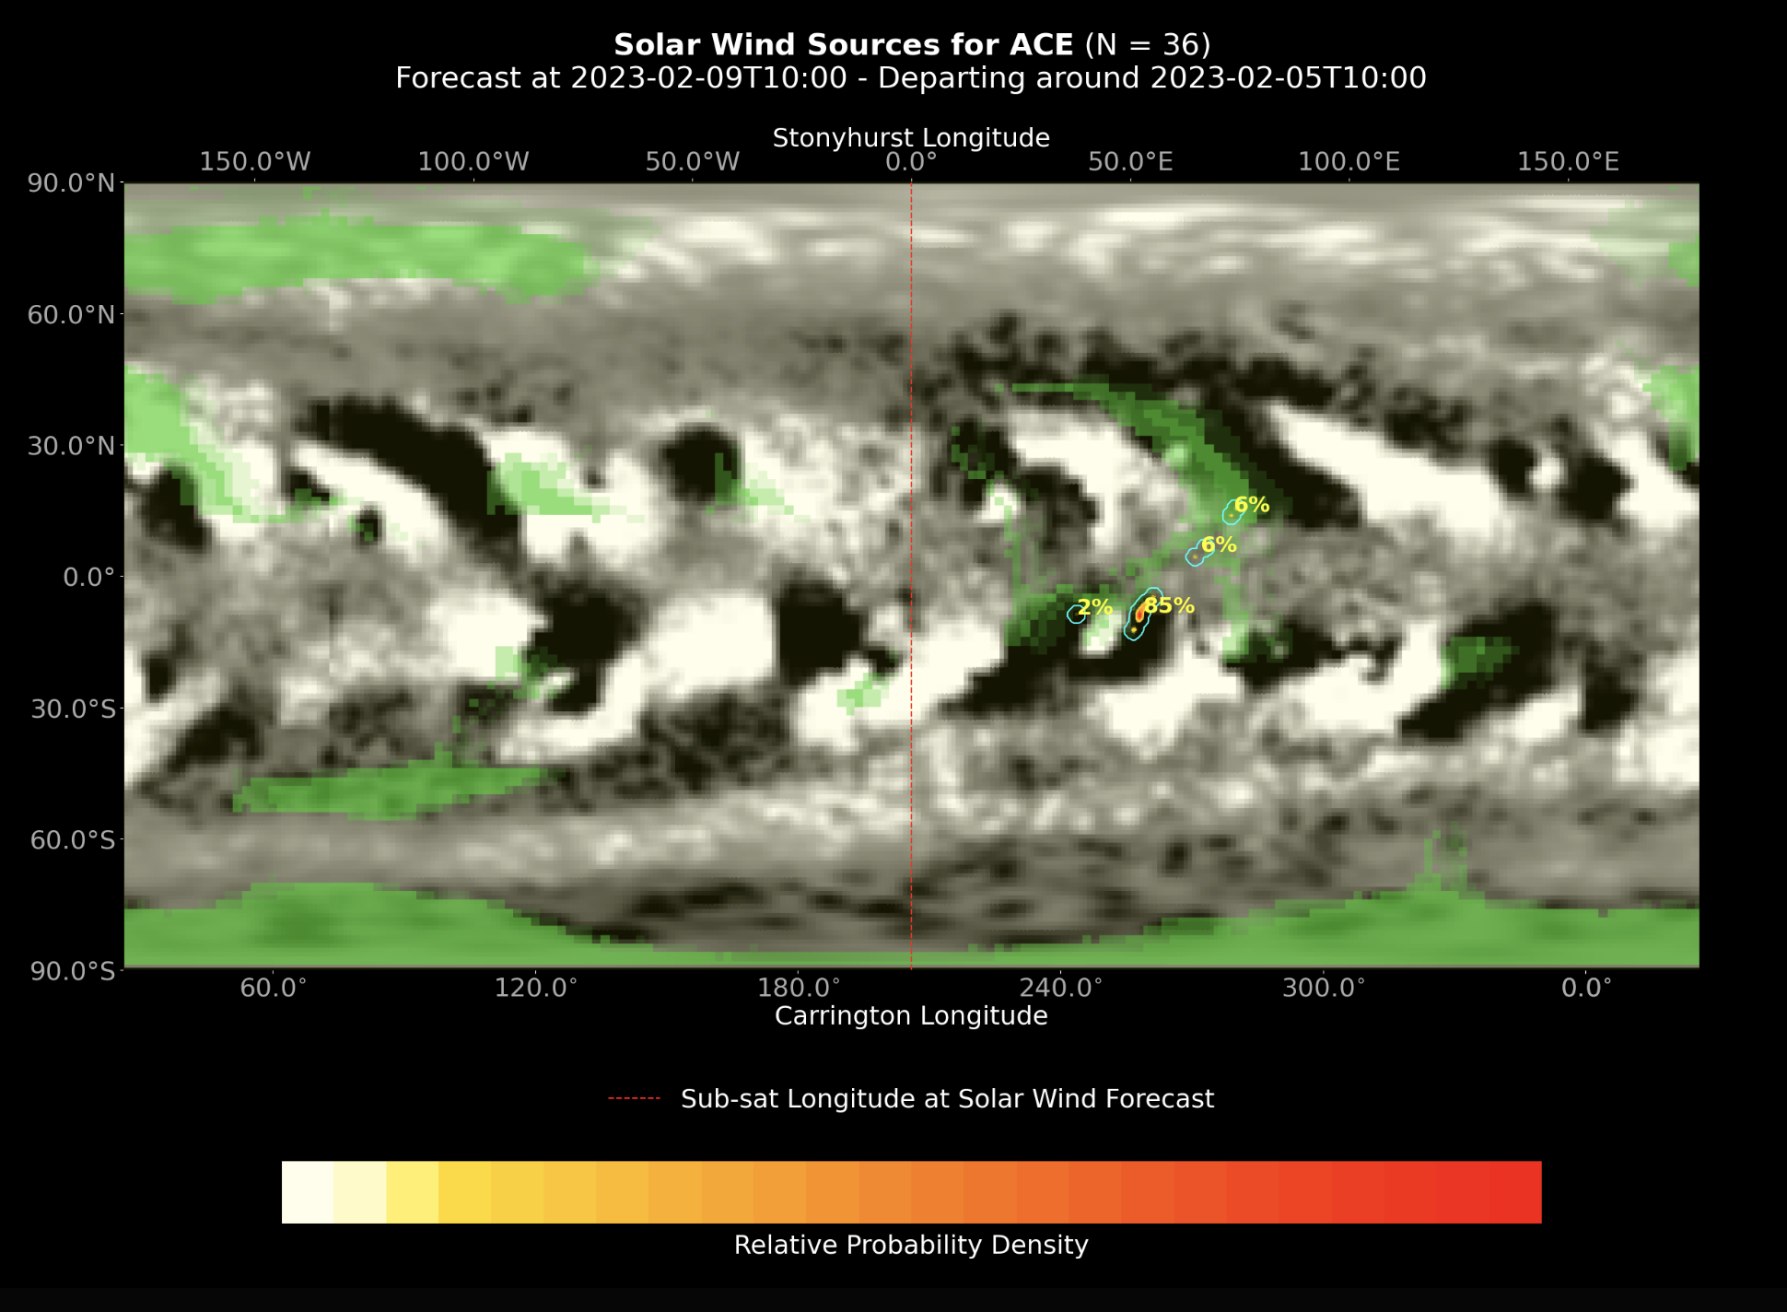
WSA Dashboard

Slide 7

Applications
Educational support at the NASA/UCAR 2023 Heliophysics Summer School
Current Users
    NASA Moon to Mars (M2M) Office
Planned Users
    NOAA SW Prediction Center (SWPC) &
    SW Forecast Office (SWFO)
Potential Users
    NASA Space Radiation Analysis Group (SRAG)
    UK MET Office
    You!
Available now at:
wsa-dashboard.helioanalytics.io/

