Slide 1

CENTER FOR SCALABLE DATA ANALYTICS AND
ARTIFICIAL INTELLIGENCE
Multi-modal Language Models _
[images + text]
Robert Haase
These slides can be reused under the terms of the CC-BY 4.0 license unless mentioned otherwise.

Slide 2
Multi-modal LLMs
Combining image, text and […] data
🔊📄🖼️🧬
🔊📄🖼️🧬

Slide 3
Multi-modal LLMs
Combining image, text and […] data, to gain new [biological] insights.
Chat / translation / text-generation: 📄-> 📄
Voice-chat / -translation: 🔊-> 🔊
Text-to-speech (TTS): 📄 -> 🔊
Speech to text (STT): 🔊 -> 📄
Vision / image classification / image description / image-to-text: 🖼️->📄
Image generation, text-to-image: 📄-> 🖼️
Image variation, inpainting, image segmentation: 🖼️ -> 🖼️
Genotype-phenotype translation:🧬->📄
Sequence-prediction / protein design: 📄-> 🧬
Focus of today’s lecture

Slide 4
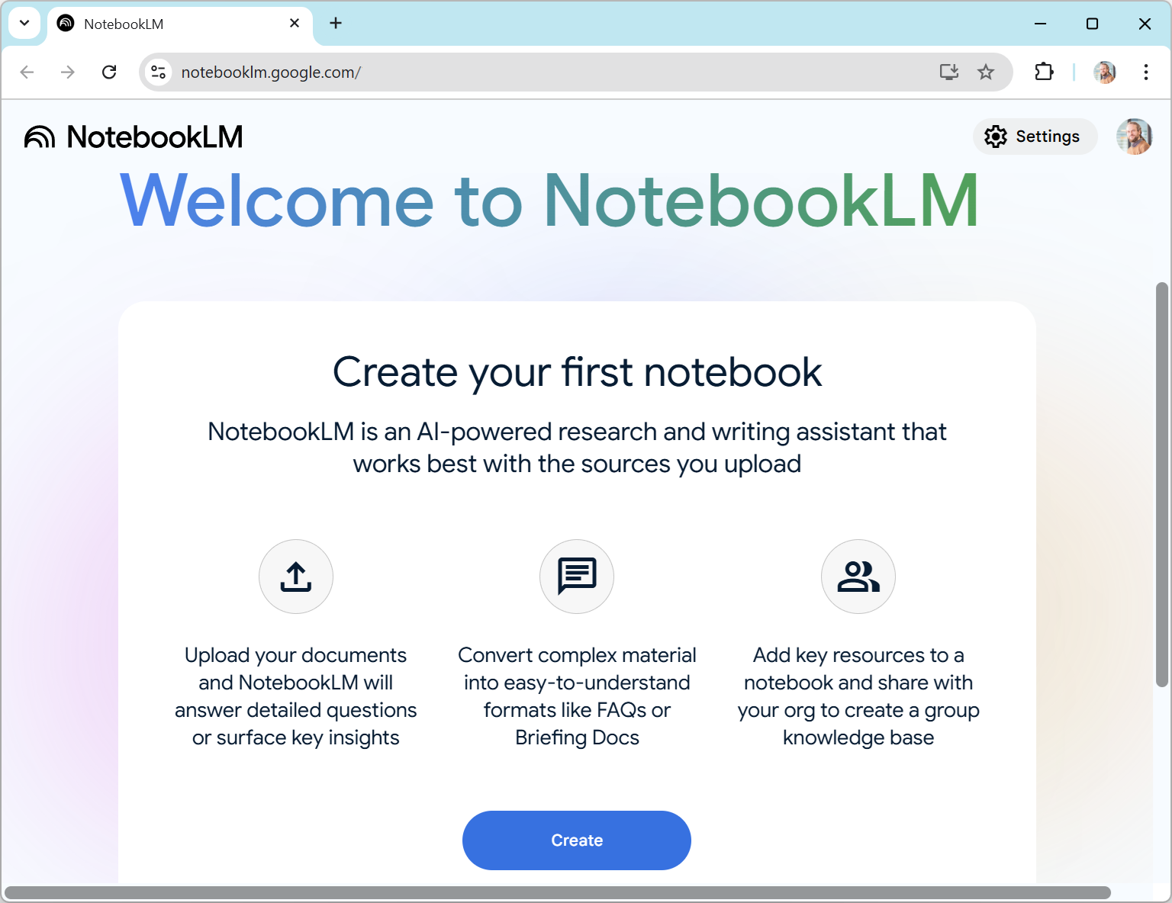
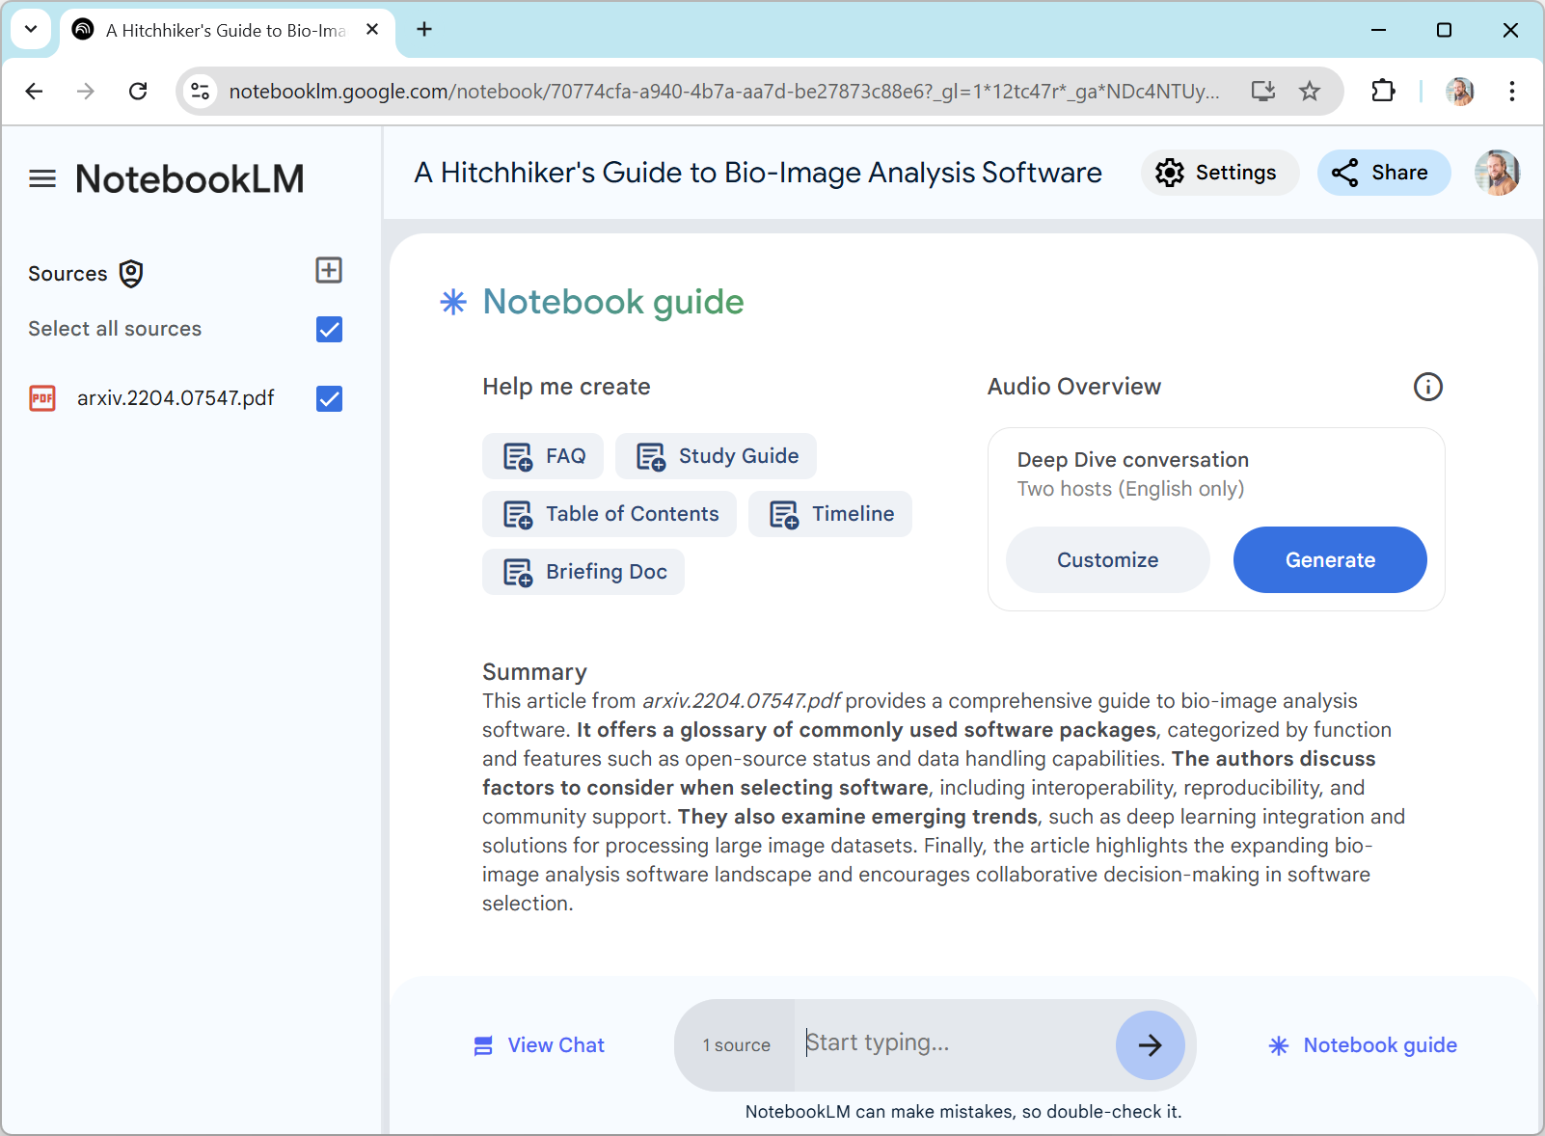
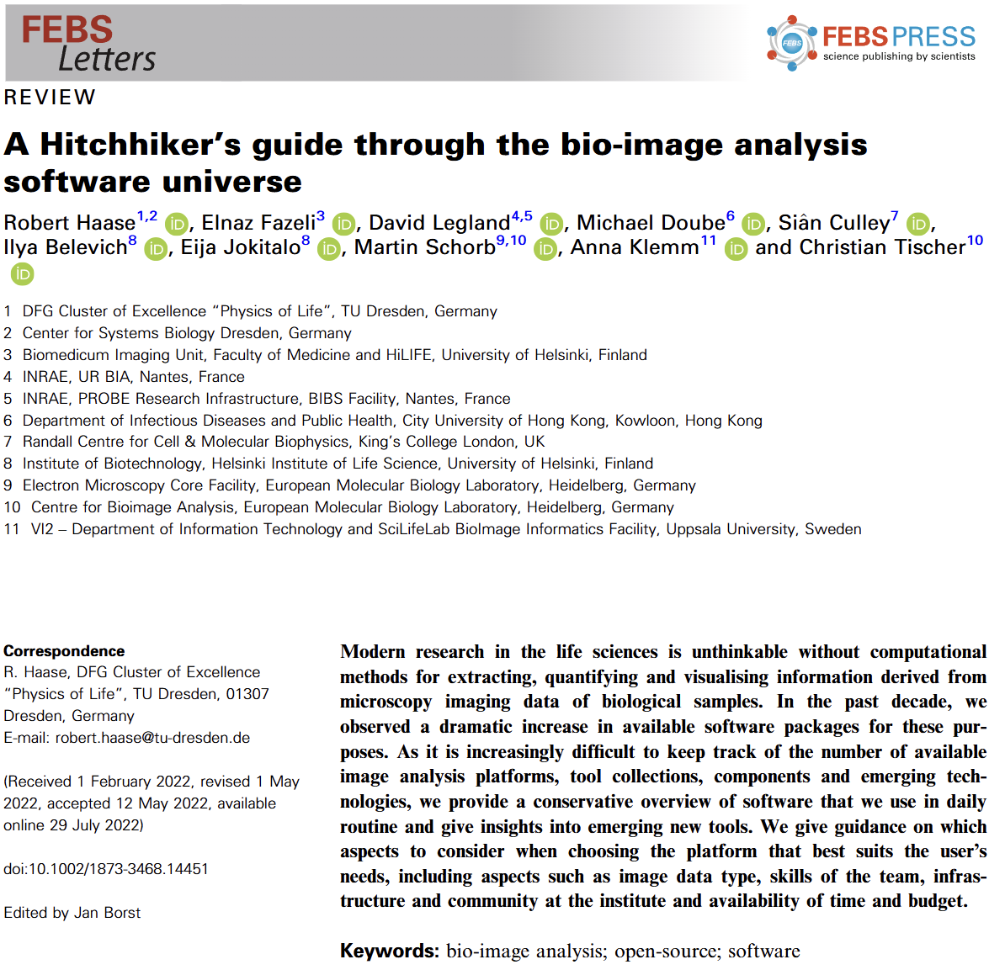
Use case: Paper to Podcast
Text to audio conversion: Google NotebookLM 📄 -> 🔊
Try this with a document you wrote!
https://notebooklm.google.com/notebook/70774cfa-a940-4b7a-aa7d-be27873c88e6/audio

Slide 5
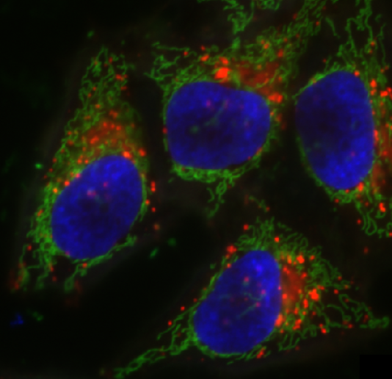
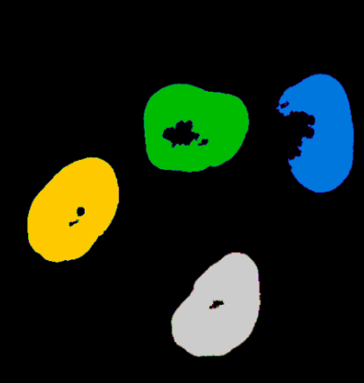
Multi-modal LLMs
Combining image, text and […] data, to gain new [biological] insights.
There are 4 cells.
I just marked their nuclei.
How many cells are there?

Slide 6
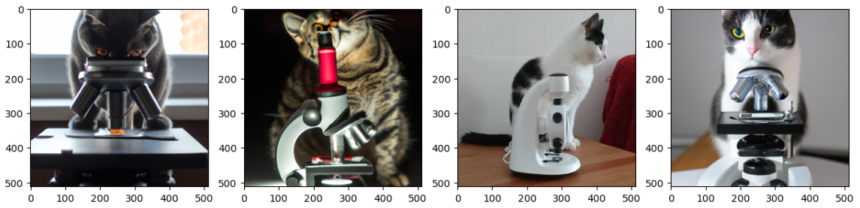
Vision Models
Classifying images (decades old research field🥱)
Typically a fixed number of classes, defined during training
Cat
Dog
House
Microscope
Tree

Slide 7
Vision Language Models
Classifying images
Describing images
“A picture of a cat and a microscope”

Slide 8
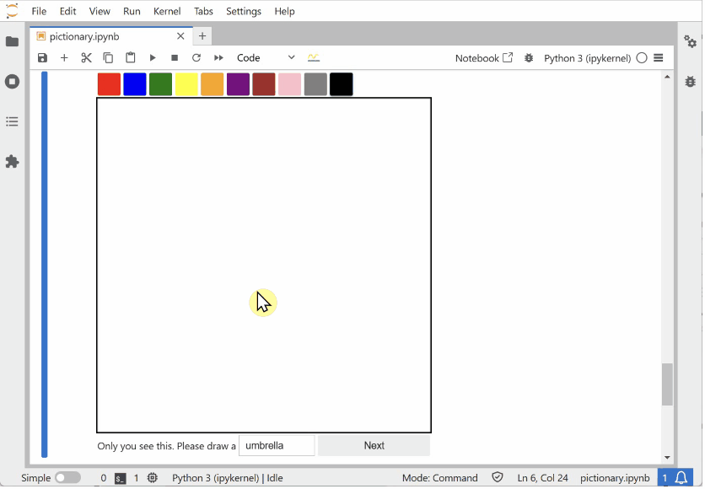
Gamification: VLM-Pictionary
https://github.com/haesleinhuepf/vlm-pictionary

Slide 9
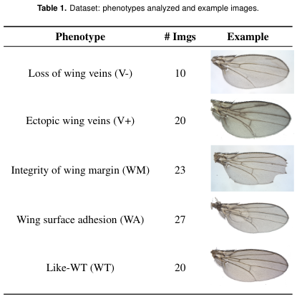
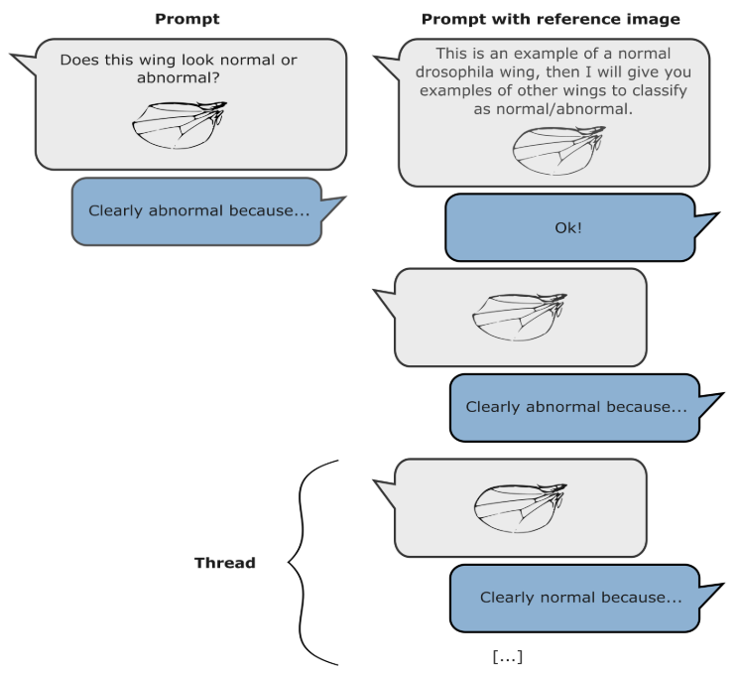
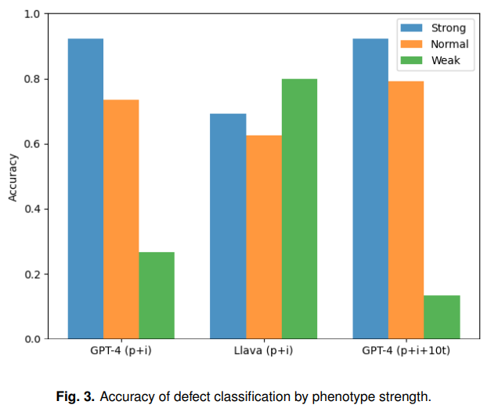
Use case: Descriptive biology
“… while visual language models are in their infancy, they already show potential for multiple applications in automated phenotyping studies. We encourage the community to carefully test them… “
Cropped from Paci & Nanni (2024), licensed CC-BY 4.0
https://www.biorxiv.org/content/10.1101/2024.05.27.594652v1

Slide 10
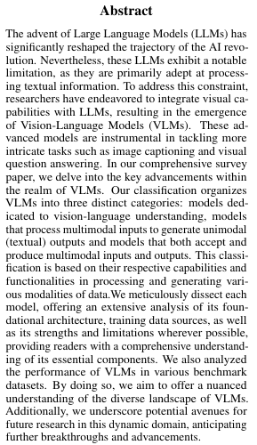
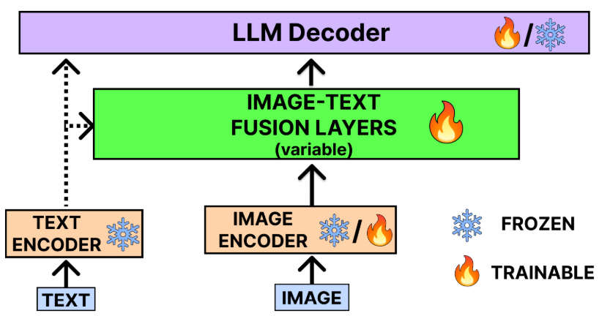
Vision Language Models (VLMs)
Goal: Describe images
Source: Gosh et al 2024, licensed CC-BY 4.0 https://arxiv.org/abs/2404.07214v1

Slide 11
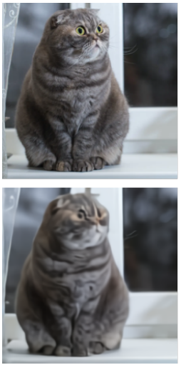
Variational Auto-Encoder
Encoder
Decoder
µ
Input
Sampler
Output
σ
“Bottleneck”, “Embedding”
Cat picture source: Ramesh et al. 2021, licensed CC-BY 4.0 https://arxiv.org/pdf/2102.12092.pdf

Slide 12
Image classification -> image describing
Encoder
Decoder
Large
Language
Model
„Image of a dog“
Input
„Image of a cat“
“Bottleneck”, “Embedding”
Cat picture source: Ramesh et al. 2021, licensed CC-BY 4.0 https://arxiv.org/pdf/2102.12092.pdf

Slide 13
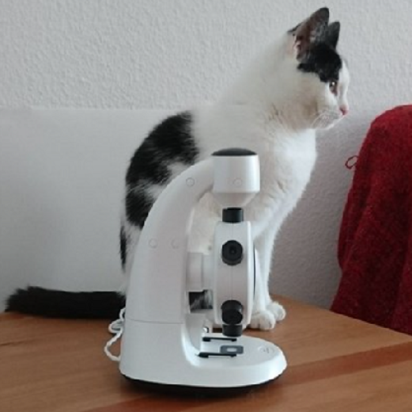
Image classification -> image describing
Encoder
Decoder
Large
Language
Model
„Image of a dog“
Input
„Image of a cat“
„Image of a microscope“
“Bottleneck”, “Embedding”
VLMs can only know terms which were in the training data.
Cat picture source: Ramesh et al. 2021, licensed CC-BY 4.0 https://arxiv.org/pdf/2102.12092.pdf

Slide 14
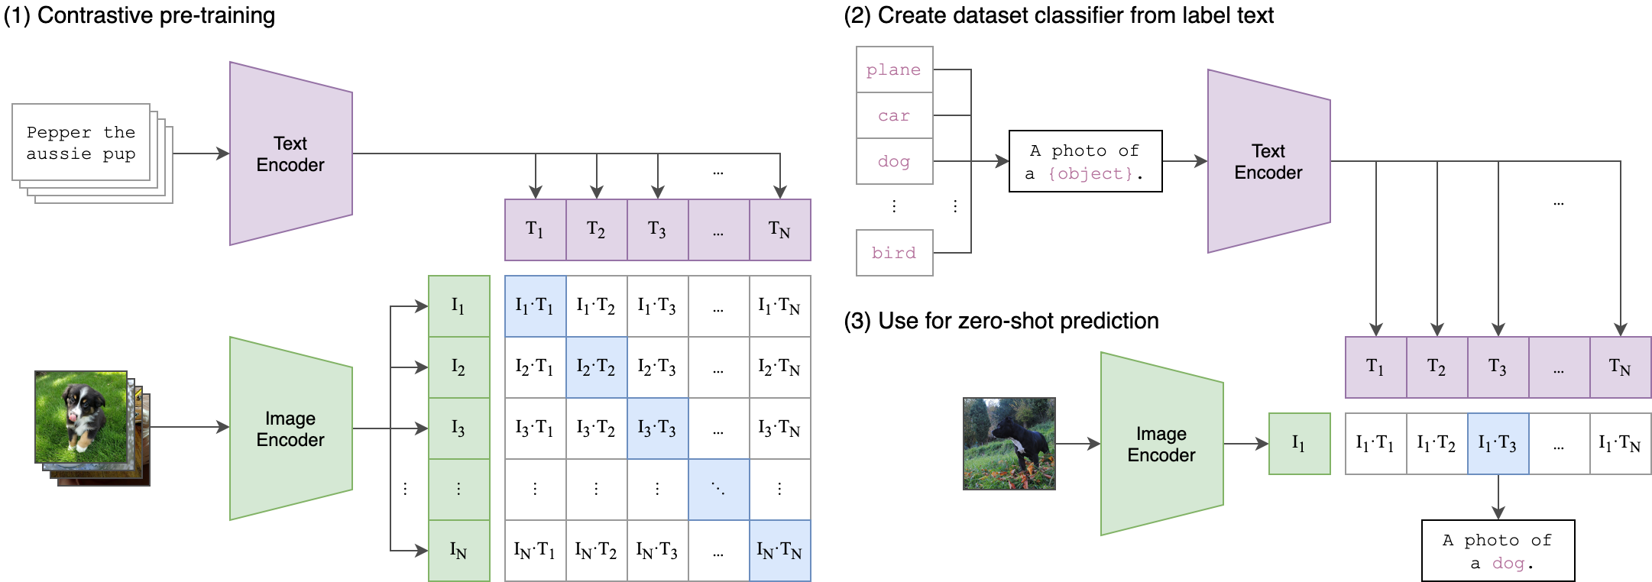
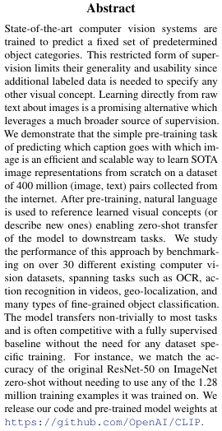
Contrastive Language-Image Pre-Training
„CLIP“ Transformers
Source: Radford et al 2021, License MT
https://arxiv.org/abs/2103.00020
https://github.com/OpenAI/CLIP

Slide 15




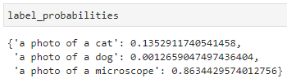
CLIP transformers in Python
Using huggingface 🤗
Downloads 500 MB
…
Code example adapted from: https://huggingface.co/docs/transformers/en/model_doc/clip

Slide 16
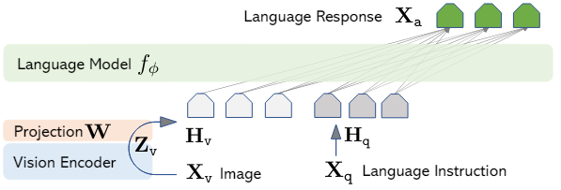
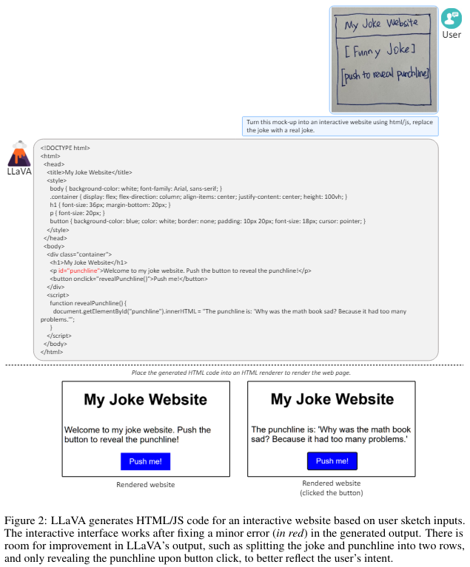
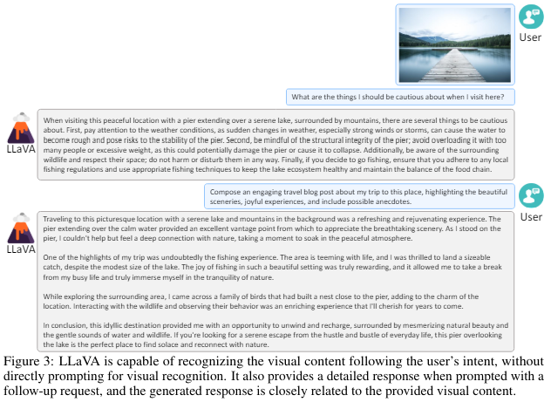
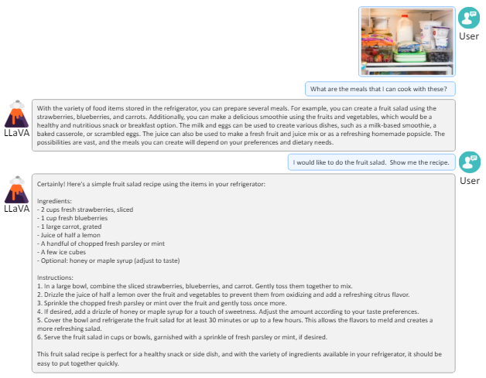
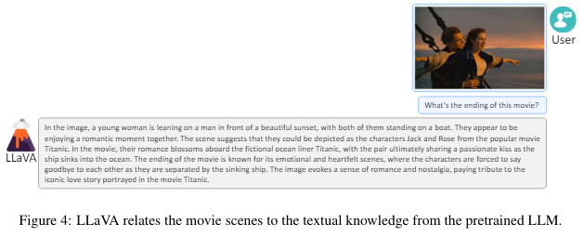
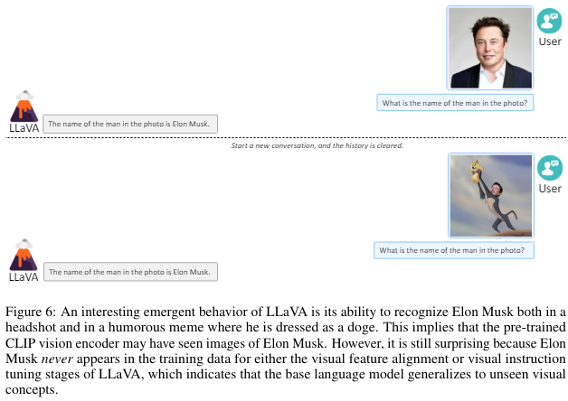
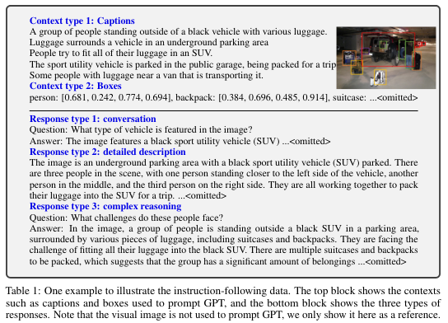
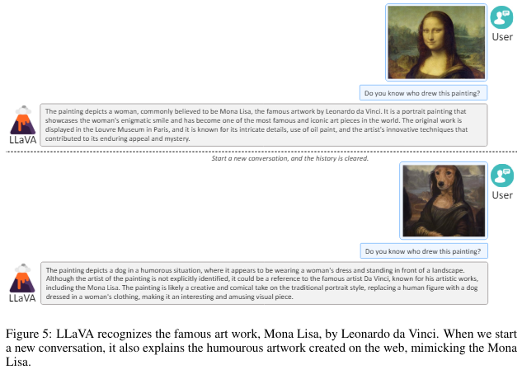
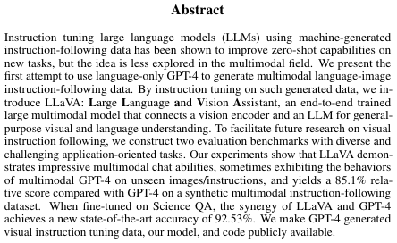
LLAVA
Large Language and Vision Assistant
Source: Hui et al 2023, licensed CC-BY 4.0
https://arxiv.org/abs/2304.08485

Slide 17
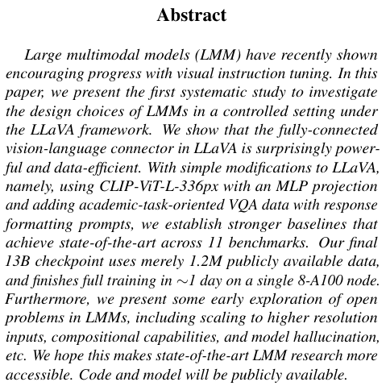
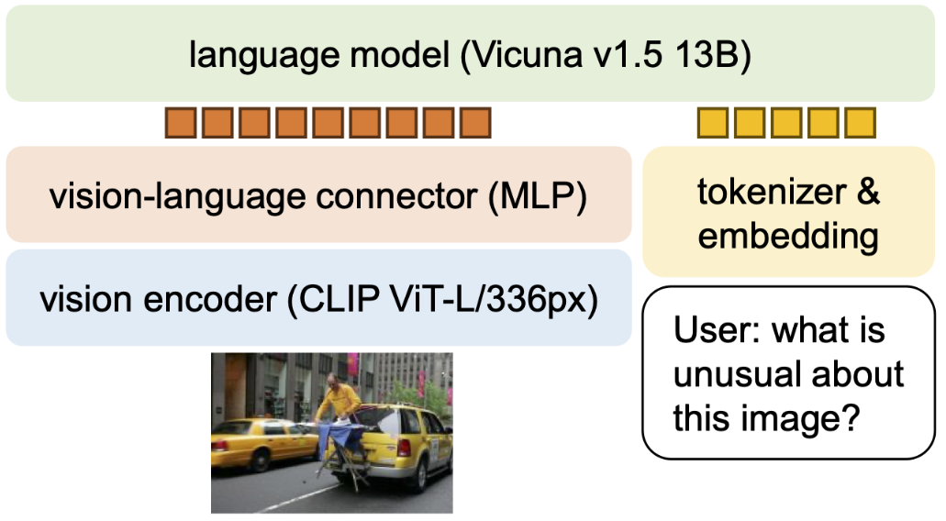
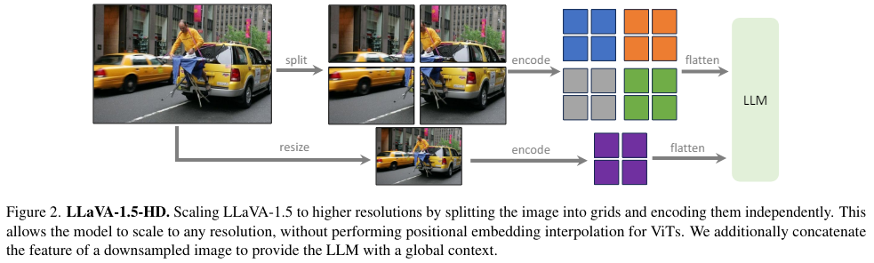
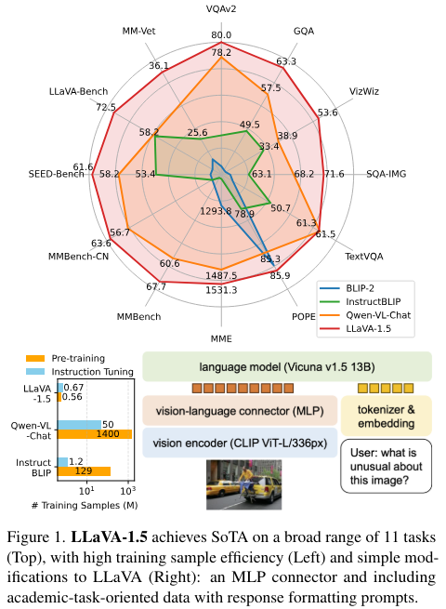
LLAVA 1.5
Combining LLAVA with CLIP
Source: Hui et al 2024, licensed CC-BY 4.0
https://arxiv.org/abs/2310.03744

Slide 18
LLAVA 1.5 HD
Giving the model multiple perspectives on the same scene
Source: Hui et al 2024, licensed CC-BY 4.0
https://arxiv.org/abs/2310.03744

Slide 19
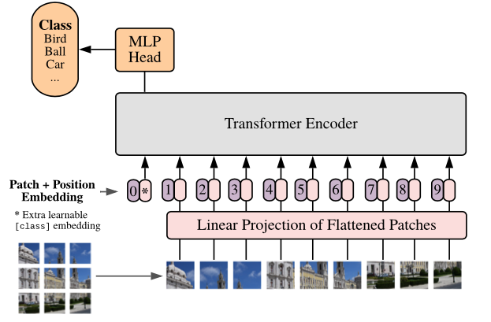
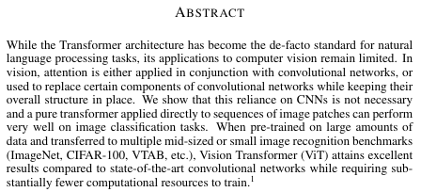
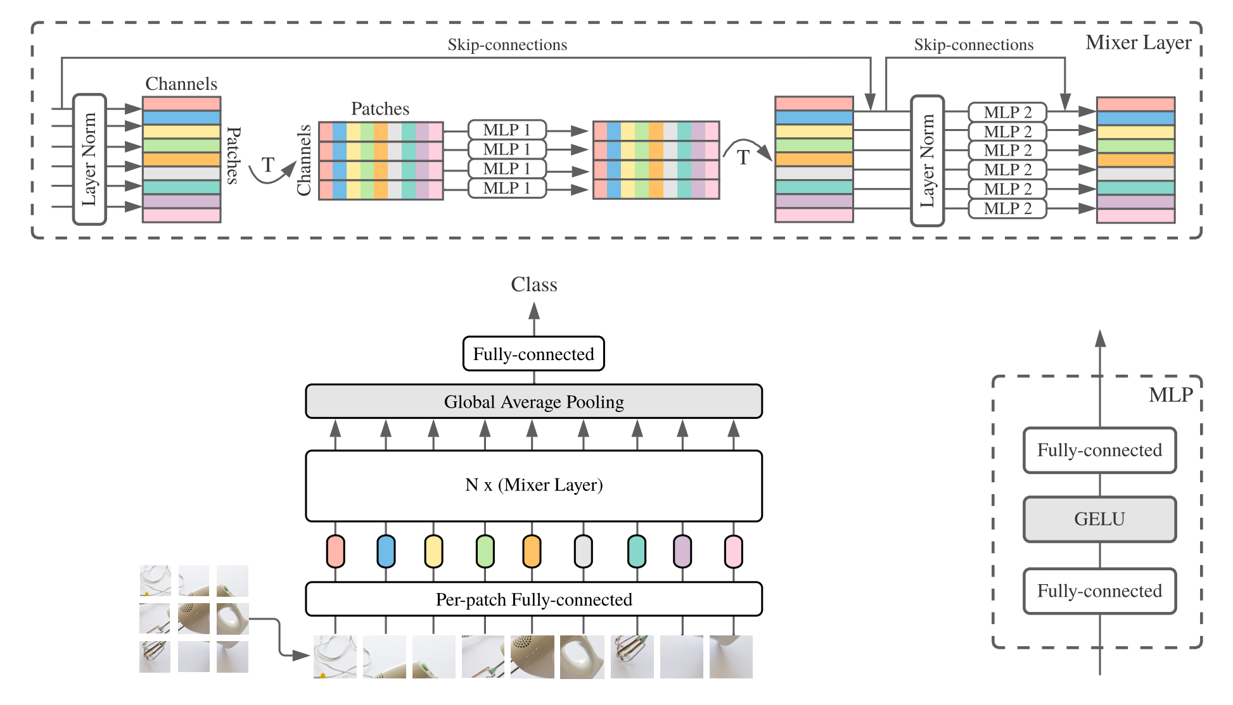
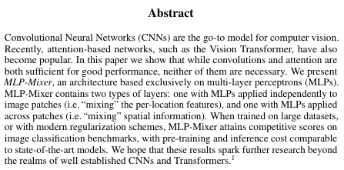
Vision-Transformer (ViT)
Source: Cropped from Dosovitskiy et al 2021. https://github.com/google-research/vision_transformer, license Apache 2
See also: https://arxiv.org/abs/2010.11929 https://arxiv.org/abs/2105.01601

Slide 20
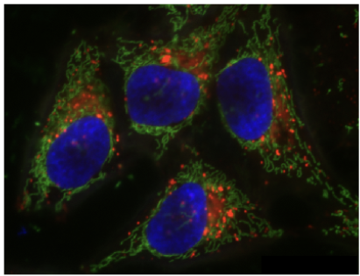
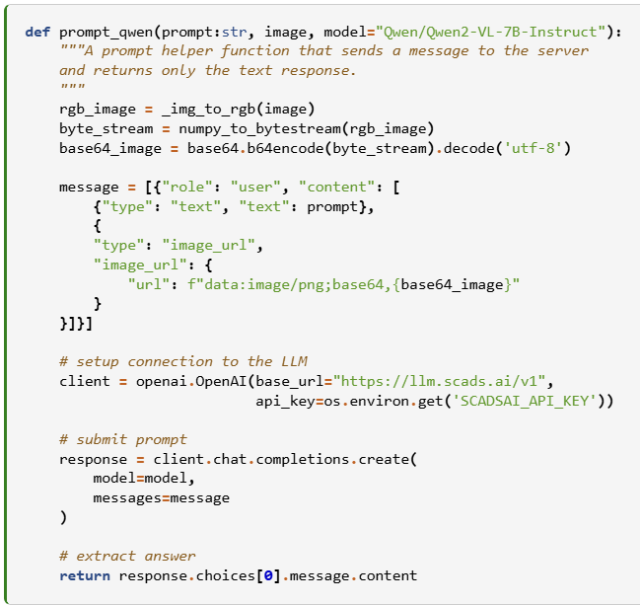
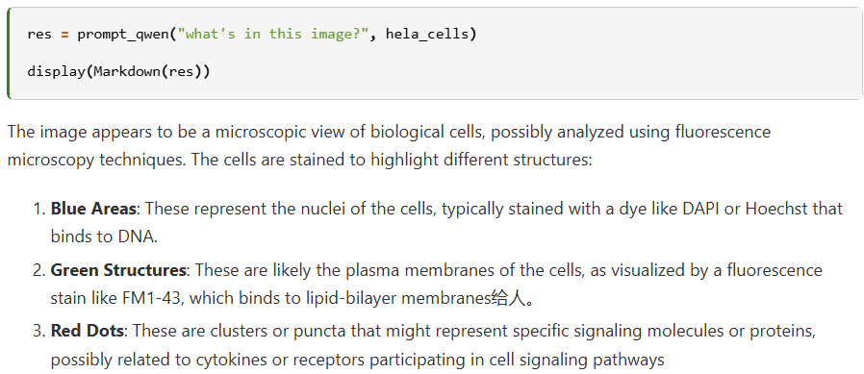
Accessing VLMs using Python
E.g. using ScaDS.AI’s openai-compatible LLM Server
https://scads.github.io/generative-ai-notebooks/47_vision/22_vision_qwen.html

Slide 21
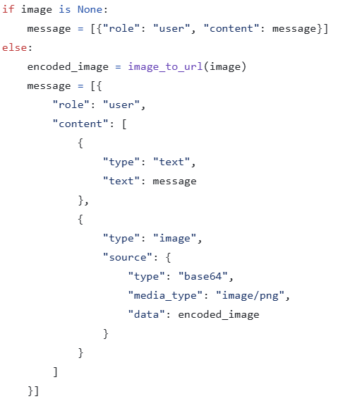
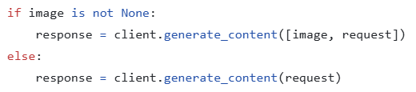
Accessing VLMs using Python: No common API
Google / Gemini
Anthropic / claude
https://github.com/haesleinhuepf/git-bob/blob/main/src/git_bob/_endpoints.py

Slide 22
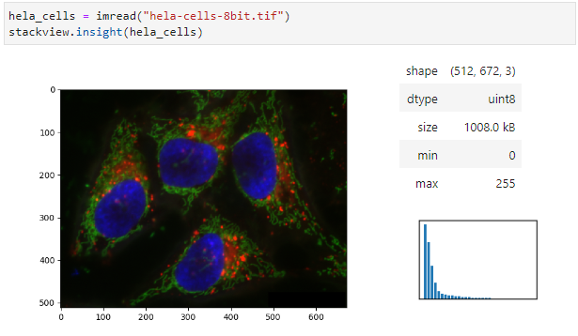
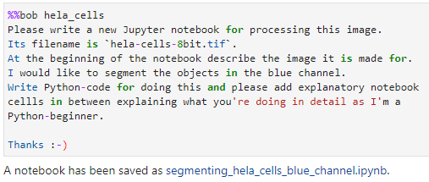
Generating notebooks using vision models
Images have to be turned into text before further processing
Present Bob an image like this
https://github.com/haesleinhuepf/bia-bob/blob/main/demo/generate_notebooks.ipynb

Slide 23
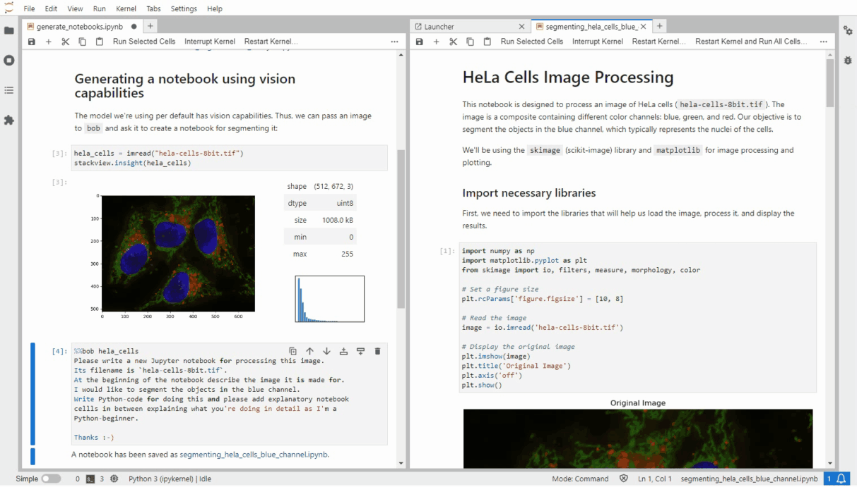
Generating notebooks using vision models
https://github.com/haesleinhuepf/bia-bob/blob/main/demo/generate_notebooks.ipynb

Slide 24

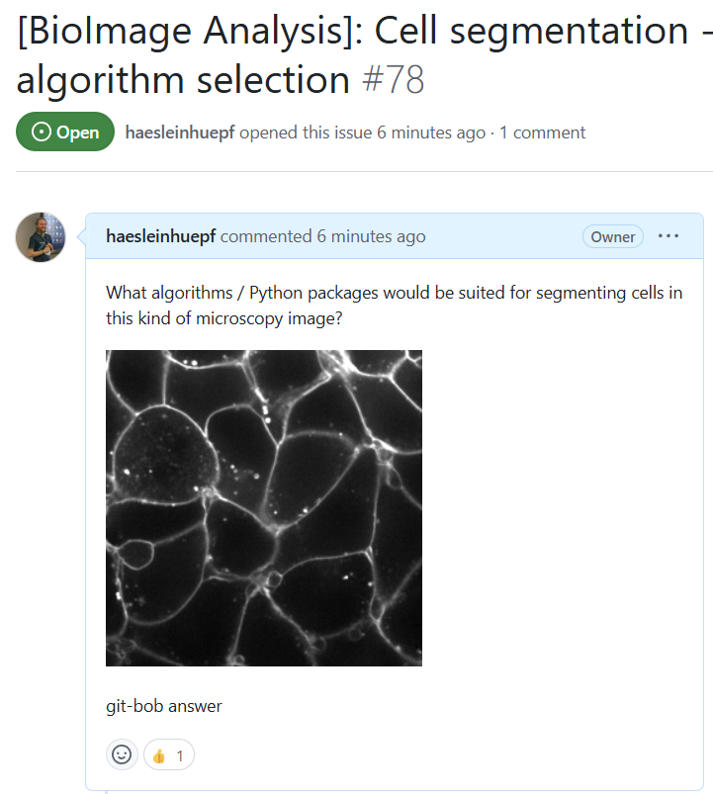
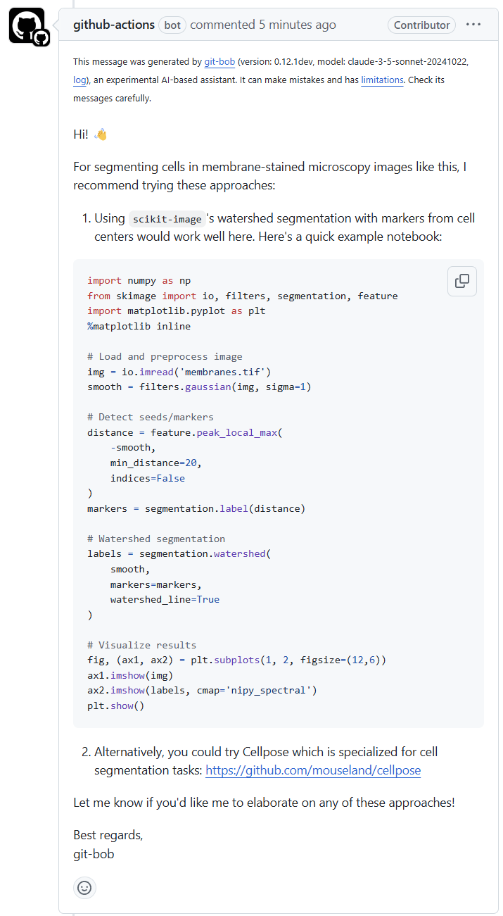
Including vision language models (VLMs)
…
https://github.com/haesleinhuepf/git-bob

Slide 25
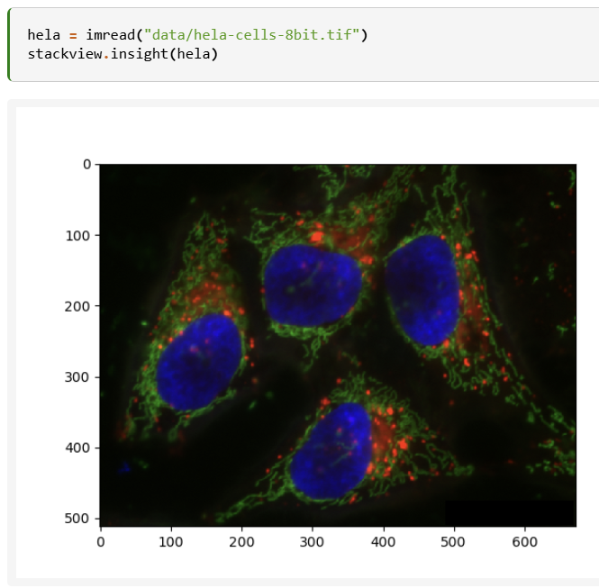
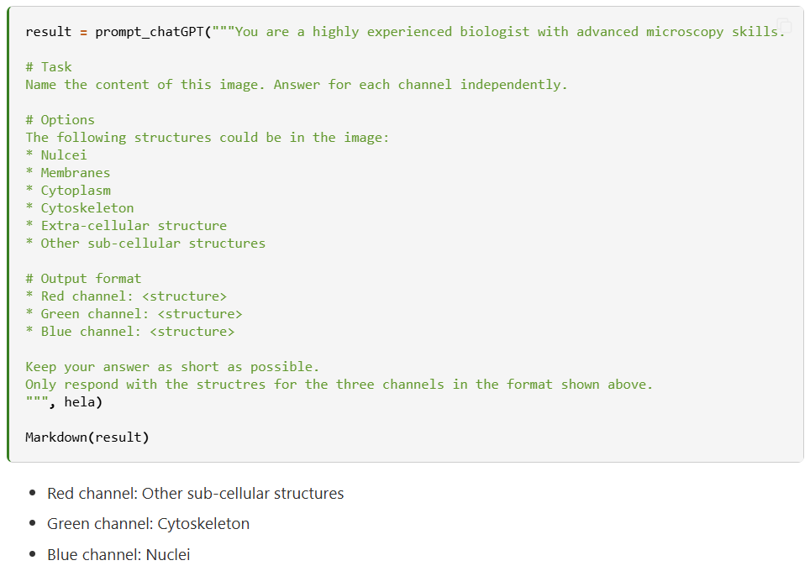
Structured output
Ask VLMs to describe an image and pre-define a structure
https://scads.github.io/generative-ai-notebooks/47_vision/30_vision_models_structred_output.html

Slide 26
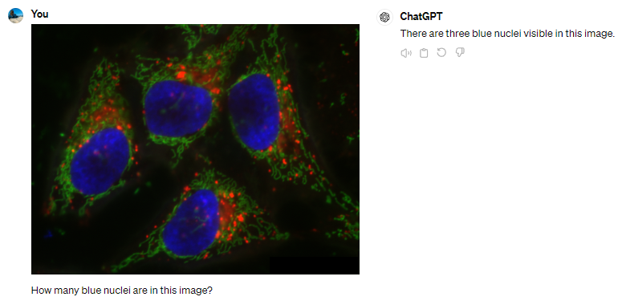
Benchmarking vision models
Single attempts…
are a trap
n=1

Slide 27
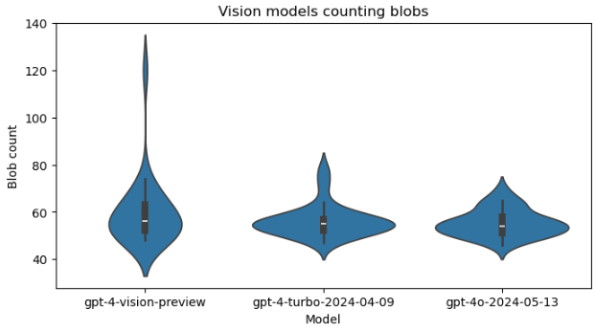
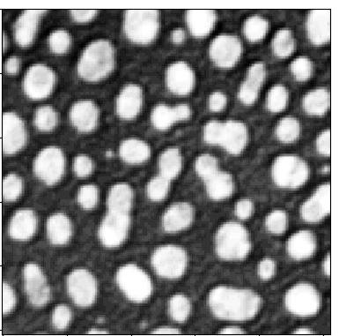
Benchmarking vision models
Prompt: „Analyse the following image by counting the bright blobs. Respond with the number only. “ (n=25)
Nov 2023
Apr 2024
May 2024
https://haesleinhuepf.github.io/BioImageAnalysisNotebooks/20c_vision_models/vision_models.html

Slide 28
Segment Anything Model
New approach to DL-based image segmentation involving prompts
How many cells are there?

Slide 29
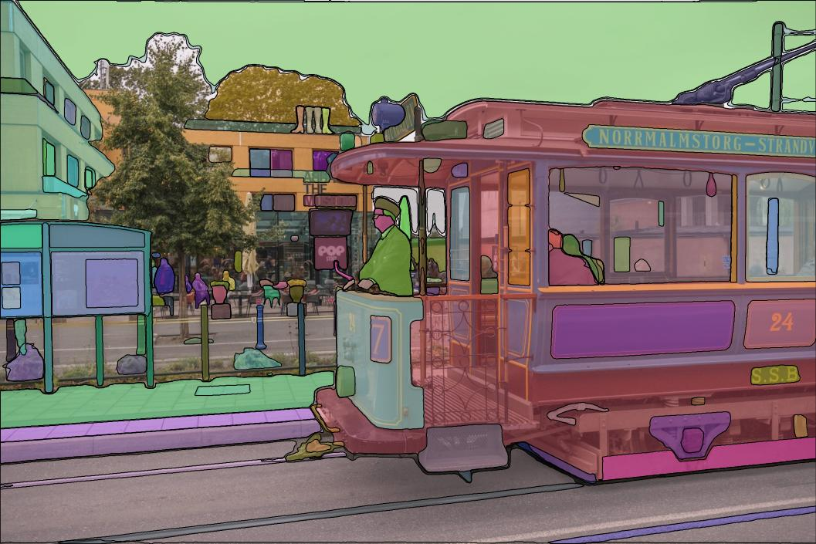
Segment Anything Model
New approach to DL-based image segmentation involving prompts
Source: https://github.com/facebookresearch/segment-anything License: Apache 2

Slide 30

Segment Anything Model
New approach to DL-based image segmentation involving prompts
Source: https://github.com/facebookresearch/segment-anything License: Apache 2

Slide 31

Segment Anything Model
New approach to DL-based image segmentation involving prompts
Source: https://arxiv.org/pdf/2304.02643

Slide 32

Segment Anything Model 2
Extending the approach to videos by introducing memory
Source: https://github.com/facebookresearch/segment-anything License: Apache 2

Slide 33

Segment Anything Model
Mostly natural images used for benchmarking
Source: https://arxiv.org/pdf/2304.02643 https://bbbc.broadinstitute.org/BBBC038

Slide 34




Segment Anything for Microscopy
Popping up napari plugins, some within 24h after SAM was published
https://github.com/hiroalchem/napari-SAM4IS https://github.com/royerlab/napari-segment-anything https://github.com/MIC-DKFZ/napari-sam https://github.com/computational-cell-analytics/micro-sam

Slide 35

Segment Anything for Microscopy
Downsides:
Original code did not contain the procedure for iterative training
Instance segmentation not ideal (watershed-implementation added in micro-sam)
Fine-tuning for microscopy data neccessary
Source: Archit et al (2023) licensed CC-BY 4.0
https://www.biorxiv.org/content/10.1101/2023.08.21.554208v1.article-info
https://github.com/computational-cell-analytics/micro-sam

Slide 36
Segment Anything for Microscopy
Real-world scenarios: human-in-the-loop
Pretrained Microscopy SAM
„Personalized“ Microscopy SAM
Retraining / fine-tuning
Yes
Result good?
Big data?
New microscopy data
Automatic Segmentation
No
Interactive correction
Yes
No
Done! 🎉
Figures modified from slides by C. Pape, licensed CC-BY 4.0
https://zenodo.org/records/11265038

Slide 37

Segment Anything for Microscopy
Source: Archit et al (2023) licensed CC-BY 4.0
https://www.biorxiv.org/content/10.1101/2023.08.21.554208v1.article-info

Slide 38


Image Generation
„text-to-image“
A picture of a cat and a microscope

Slide 39
Variational Auto-Encoder
„image-to-image“
Encoder
Decoder
µ
Input
Sampler
Output
σ
“Bottleneck”, “Embedding”
Cat picture source: Ramesh et al. 2021, licensed CC-BY 4.0 https://arxiv.org/pdf/2102.12092.pdf

Slide 40
Image Generation
Encoder
Decoder
Large
Language
Model
„Image of a cat“
Output
“Bottleneck”, “Embedding”
Cat picture source: Ramesh et al. 2021, licensed CC-BY 4.0 https://arxiv.org/pdf/2102.12092.pdf

Slide 41


Stable Diffusion
Diffusion: iterative, reverse denoising
Latent space
Simplified from: Rombach et al. 2021
https://arxiv.org/abs/2112.10752

Slide 42
Stable Diffusion
Diffusion: iterative, reverse denoising
Source: Rombach et al. 2021
https://arxiv.org/abs/2112.10752

Slide 43

How does it work?
Train a U-Net on data: image + noisy image + description + noise-level
The cat’s fur is black and white.
Input
Output
Noise-level: 1

Slide 44

How does it work?
Train a U-Net on data: image + noisy image + description + noise-level
The cat’s fur is black and white.
Input
Output
Noise-level: 2

Slide 45
How does it work?
Train a U-Net on data: image + noisy image + description + noise-level
The cat’s fur is black and white.
Input
Output
Noise-level: 3

Slide 46
How does it work?
Prediction is iterative denoising of:
Pure noise +
text prompt
The cat’s fur is black and white.
Input
Output
Noise-level: 1,2,3

Slide 47

How does it work?
Reminder:
Word embeddings
Attention
The cat’s fur is black and white.
Self-attention
Word Embedding
1
“microscope”
0
1
4
3
2
1
Input
Output
The
cat’s
is
fur
black
and
white.
“cat”
“black”
“white”
“fur”
0
0
1

Slide 48



Image generation in Python: Huggingface
Most [Huggingface] image-generation models require a GPU.
Downloads 4.8 GB
Needs Nvidia GPU

Slide 49



Image generation in Python: Huggingface
Works well if the prompt overlaps with training data, potentially huge variation between attempts
https://scads.github.io/generative-ai-notebooks/41_image_generation_huggingface/30_generating_images_using_huggingface.html

Slide 50



Dall-E
OpenAI‘s model for image generation based on diffusion models + CLIP transformer
Source: Cropped from Ramesh et al. 2022, licensed CC-BY 4.0 https://arxiv.org/abs/2204.06125

Slide 51

Image generation in Python: Dall-E
No need for a GPU, but costs 💸 💸 💸
Works with Dall-E 2 and 3
May soon also work with gpt-4o

Slide 52

Image Generation LLMs
Interesting challenges for our community ahead
Challenges: fake-images
a histology image of lung cancer cells and some healthy tissue
https://scads.github.io/generative-ai-notebooks/40_image_generation_openai/10_generating_images_dall_e.html

Slide 53


Image generation in Python: Dall-E
Is Dall-E 2 more capable of creating realistic microscopy images than Dall-E 3?
Dall-E 3
Dall-E 2

Slide 54

Image Generation LLMs
Challenges: physical / physiological hallucinations
Prompt: “Draw a close-up picture of people's hands”
Source: https://replicate.com/black-forest-labs/flux-schnell-lora

Slide 55

Image Generation LLMs
Challenges: Text in images
Prompt: ‘please draw a picture of a professor writing "large language models" on a blackboard’
Source: https://replicate.com/black-forest-labs/flux-schnell-lora

Slide 56





Image Generation LLMs
Challenges: Bias
Prompt: ‘please draw a picture of a professor writing "large language models" on a blackboard’
Prompt: “a nice photo of a human”
Source: https://replicate.com/stability-ai/stable-diffusion
Source: https://chatgpt.com/

Slide 57



Image Generation LLMs
Image-to-image prompting, image variations
Blur the image
https://arxiv.org/abs/2211.09800
https://scads.github.io/generative-ai-notebooks/41_image_generation_huggingface/60_image_variations_pix2pix.html

Slide 58




Image variation
Potentially useful to make algorithms more robust
Generate images, e.g. for augmenting data
https://haesleinhuepf.github.io/BioImageAnalysisNotebooks/07_prompt_engineering/60_image_variations_huggingface.html

Slide 59


Inpainting
Replacing regions in images
(also „Gap-filling“, „Replacing“)
Manipulated image
Raw image
Mask image
A black white cat fur

Slide 60


Inpainting in Python: Huggingface
Downloads 4.8 GB
Needs Nvidia GPU
Read more: https://huggingface.co/docs/diffusers/api/pipelines/stable_diffusion/inpaint

Slide 61



Inpainting in Python: Huggingface
Check out the model cards online in the Huggingface hub.
https://huggingface.co/stabilityai/stable-diffusion-2-inpainting

Slide 62

Inpainting in Python: Huggingface
You find the downloaded models cached in your home directory
They are big! Clean up here from time to time.

Slide 63

Inpainting in Python: Dall-E
No need for a GPU, but costs 💸 💸 💸
2D RGB images only
Size must match
Size must match
Supported: 256, 512, 1024 pixels
Result: List of URL(s)

Slide 64

New technologies bring new risks…
If you can generate images,
you can also generate parts of images….
Interesting challenges for our community ahead
https://github.com/haesleinhuepf/darth-d/blob/main/demo/demo_replacing.ipynb

Slide 65

Image manipulation detection
The noise pattern differs between raw and processed images…
„Untouched region“
Original raw image
Manipulated region

Slide 66

Image manipulation detection
e.g. by studying noise-patterns
Local standard deviation filter
„Untouched region“
Manipulated region

Slide 67

Image manipulation detection
e.g. by studying noise-patterns
Sobel filter
„Untouched region“
Manipulated region

Slide 68



Benchmarking image generation
When asking humans to evaluate results, make sure
they are the right target audience
Credit: "Mandarin orange, axial view, MRI." is licensed (CC-BY 4.0) by Alexandr Khrapichev, University of Oxford
https://haesleinhuepf.github.io/BioImageAnalysisNotebooks/07_prompt_engineering/02_generating_mri_images.html
https://twitter.com/haesleinhuepf/status/1659138282641342466

Slide 69

Benchmarking image generation
Prompt engineering to optimize images
One cat
is real.
https://haesleinhuepf.github.io/BioImageAnalysisNotebooks/07_prompt_engineering/02_generating_images.html

Slide 70

Benchmarking image generation
Prompt engineering to optimize images
One cat
is real.
https://haesleinhuepf.github.io/BioImageAnalysisNotebooks/07_prompt_engineering/02_generating_images.html

Slide 71



CLIP scores
Contrastive Language-Image Pre-Training (CLIP)
  For image describing
Here: Similarity between image and prompt

Slide 72

CLIP scores
Example: Prompt optimization
Image generation
Quality measurement
https://scads.github.io/generative-ai-notebooks/80_benchmarking_llms/10_CLIP_scores.html

Slide 73

CLIP scores
Example: Prompt optimization
Always have a control experiment!
https://scads.github.io/generative-ai-notebooks/80_benchmarking_llms/10_CLIP_scores.html

Slide 74
Summary
Multi-modal models combine image, text and […] data
Combination of pre-existing model architectures
APIs not standardized (yet)
Trade-off:
LLM capacity / size limited
Multi-modal LLMs presumably perform worse compared to specialized models.
Example: Ask a vision-language model to write code
Potential for mixture-of-experts and multi-agent systems

Slide 75


CENTER FOR SCALABLE DATA ANALYTICS AND
ARTIFICIAL INTELLIGENCE
Exercises
Robert Haase
Funded by
These slides and the related training materials can be reused under the terms of the CC-BY 4.0 license unless mentioned otherwise.

Slide 76


Image Generation
Challenge: Install everything necessary to generate image on your PC, or on ZIH`s JupyterHub
A pull-request with installation instructions working on ZIH’s Jupyter Hub would be welcome!
https://scads.github.io/generative-ai-notebooks/00_setup/install_paula.html
https://scads.github.io/generative-ai-notebooks/41_image_generation_huggingface/30_generating_images_using_huggingface.html

Slide 77


CLIP Scores
Improve given prompts and measure the improvement
https://scads.github.io/generative-ai-notebooks/80_benchmarking_llms/10_CLIP_scores.html

