Slide 1



The Role of Data Stewardship in Software Sustainability and Reproducibility
Maria J. Cruz, Shalini Kurapati, Yasemin Turkyilmaz-van der Velden
9th International Workshop on Sustainable Software for Science: Practice and Experiences (WSSSPE6.1), 29 October 2018, Amsterdam, The Netherlands
Presentation available via https://doi.org/10.5281/zenodo.1472945

Slide 2
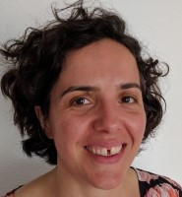
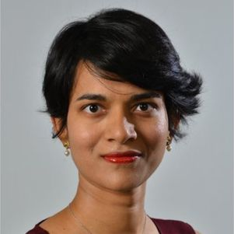
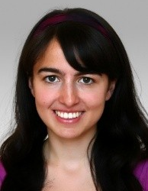
Who we are
Maria J. Cruz
Community Manager RDM
Library VU Amsterdam
Shalini Kurapati
Data Steward
TU Delft Faculty of Technology, Policy and Management
Yasemin Türkyilmaz-van der Velden
Data Steward
TU Delft Faculties of Applied Sciences & Mechanical, Maritime and Materials Engineering

Slide 3
The rationale behind this work
data stewardship and software sustainability and reproducibility

Slide 4
Attitudes towards research data management we commonly encounter
I don’t produce any data. I don’t need to worry about research data management.
I do produce code and algorithms to analyse third-party data, but I only share these codes on request.
I share code via GitHub, but I do not worry about persistent identifiers or code citations.
I shared my data via a certified data repository, but I didn’t include the software I developed to produce the data or models.

Slide 5
Data and software are intrinsically linked
Digital data are completely inaccessible without software – a fact that is often underappreciated.
Data stewardship and software sustainability are distinguished mostly by the notion that data need to be kept as is while software needs to be maintained in order to remain useful.
It is essential for the future use and re-use of data to process and manage data and software on equal footing, policy-wise and practically.
Source: P. Aerts (NLeSC) and P. Doorn (DANS), A conceptual approach to data stewardship and software sustainability, https://dans.knaw.nl/nl/over/organisatie-beleid/informatiemateriaal/AConceptualApproachtoDataStewardshipandSoftwareSustainability_DEF.pdf

Slide 6

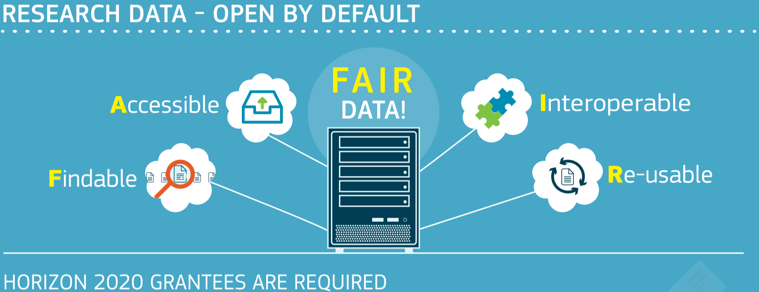
Meanwhile at the policy level….
… the focus is very much on research data.
The FAIR Guiding Principles for scientific data management and stewardship
Scientific Data volume 3, Article number: 160018 (2016) DOI: 10.1038/sdata.2016.18

Slide 7
Data Stewardship at TU Delft
Good data management is a necessary prerequisite to FAIR data

Slide 8
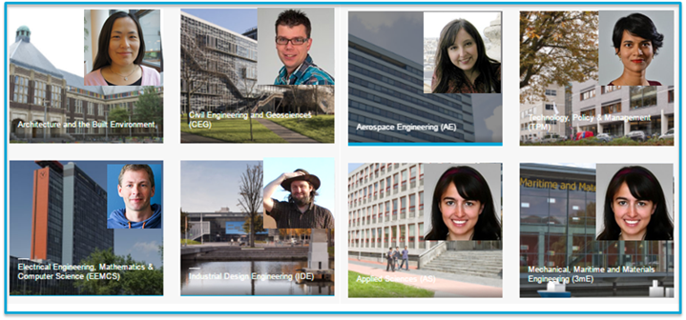
Research is central: importance of disciplinary support
Training in data management provided: https://openworking.wordpress.com/2017/09/18/training-for-data-stewards/

Slide 9

What do the data stewards do?
First contact points for any data questions
Advocacy and training
  Reaching out to researchers who “don’t have data” and who “don’t have any problems”

Slide 10
Focus on reproducible research
Why do we care?

Slide 11
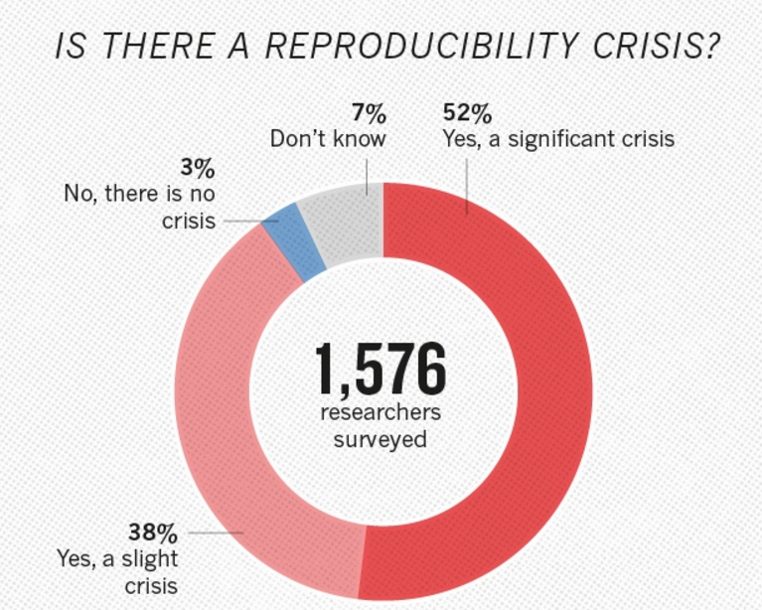
https://www.nature.com/news/1-500-scientists-lift-the-lid-on-reproducibility-1.19970

Slide 12
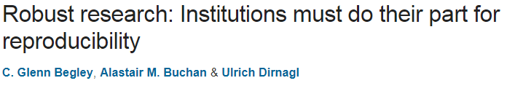
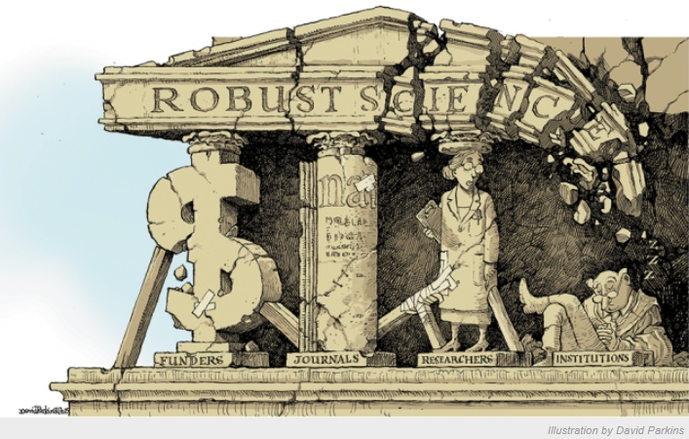
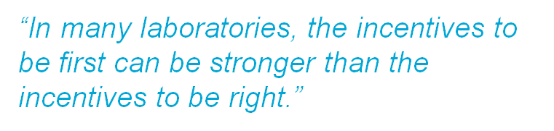
Nature 525, 25–27 (03 September 2015) doi:10.1038/525025a

Slide 13
What factors contribute to irreproducible research?
Selective reporting
Pressure to publish
Supporting data / methods/ code not available
Insufficient oversight and mentoring
https://www.nature.com/news/1-500-scientists-lift-the-lid-on-reproducibility-1.19970

Slide 14
Software reproducibility
Why do we care?

Slide 15
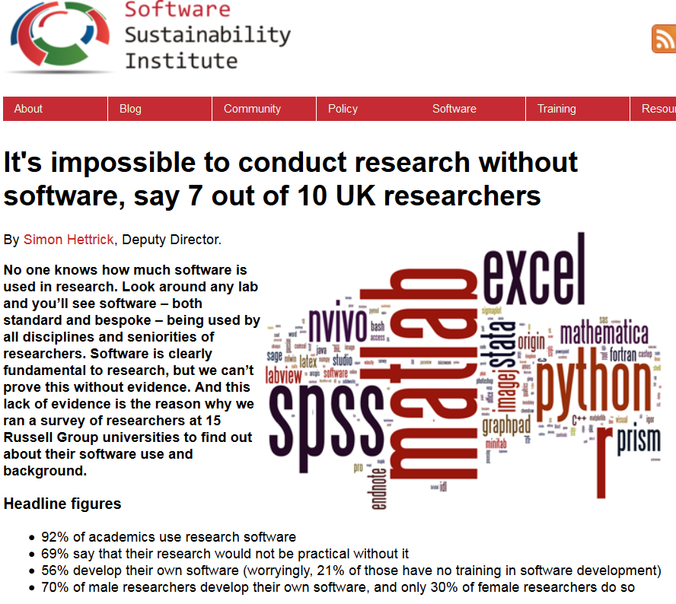
https://www.software.ac.uk/blog/2016-09-12-its-impossible-conduct-research-without-software-say-7-out-10-uk-researchers

Slide 16
Software is fundamental to research
92% of academics use research software
69% say that their research would not be practical without it
56% develop their own software (worryingly, 21% of those have no training in software development)
https://www.software.ac.uk/blog/2016-09-12-its-impossible-conduct-research-without-software-say-7-out-10-uk-researchers

Slide 17
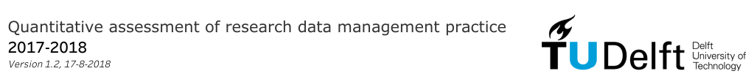
Among the 35.7% respondents who said they used dedicated tools for research data management, ~70% said they used a git based system, such as GitHub and BitBucket for version control.
32% respondents (out of a total of 426) interested in receiving training on software version control and 18% on software carpentry
https://openworking.wordpress.com/2018/02/07/do-as-you-preach-results-of-2017-data-management-survey-now-published/

Slide 18
Software sustainability and reproducibility
How to approach it from a data stewardship perspective?

Slide 19
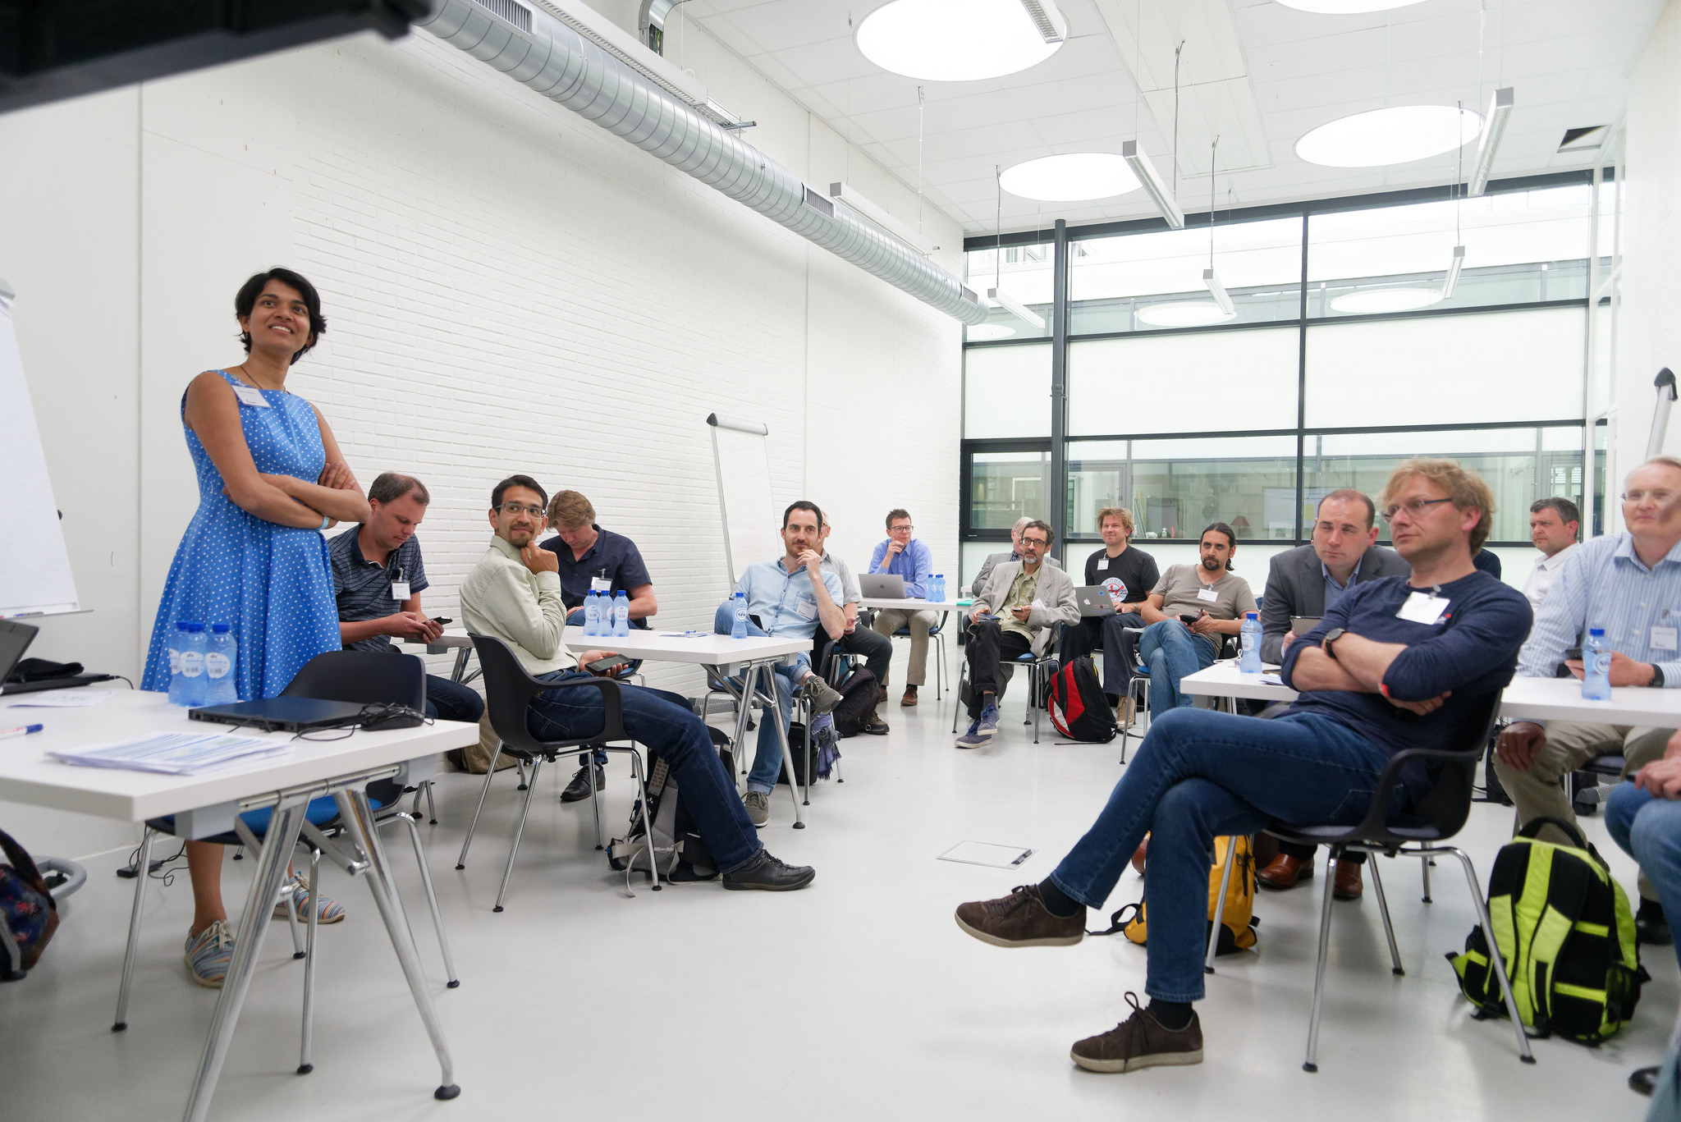
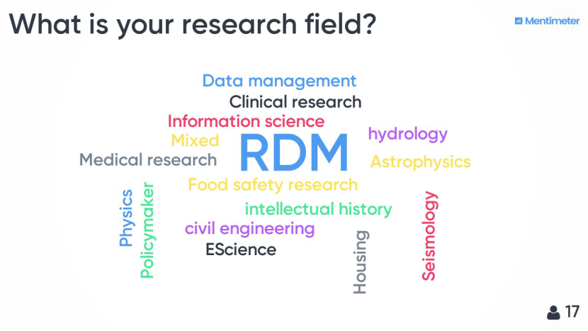
Software Reproducibility Workshop I
24 May - TU Delft
17 participants, good balance between researchers, data stewards & RSEs
https://openworking.wordpress.com/2018/06/26/workshop-report-software-reproducibility-how-to-put-it-into-practice/

Slide 20
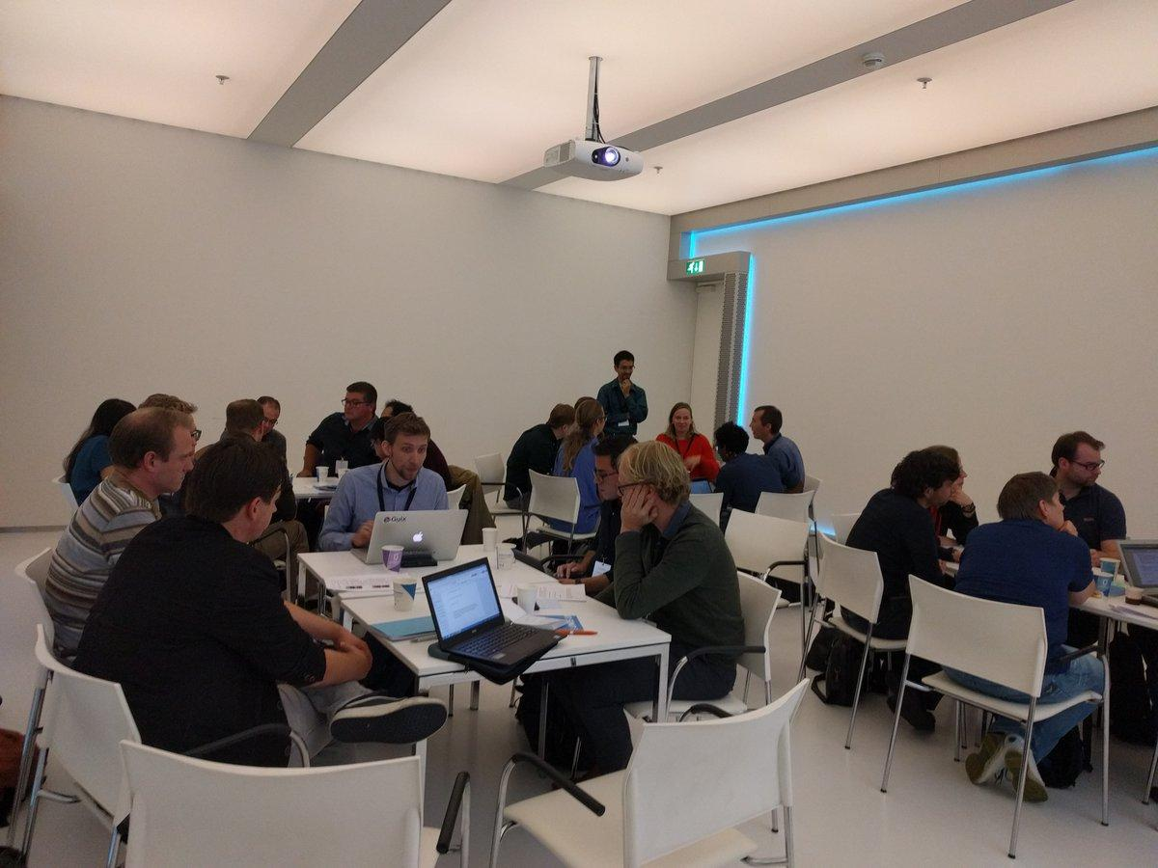
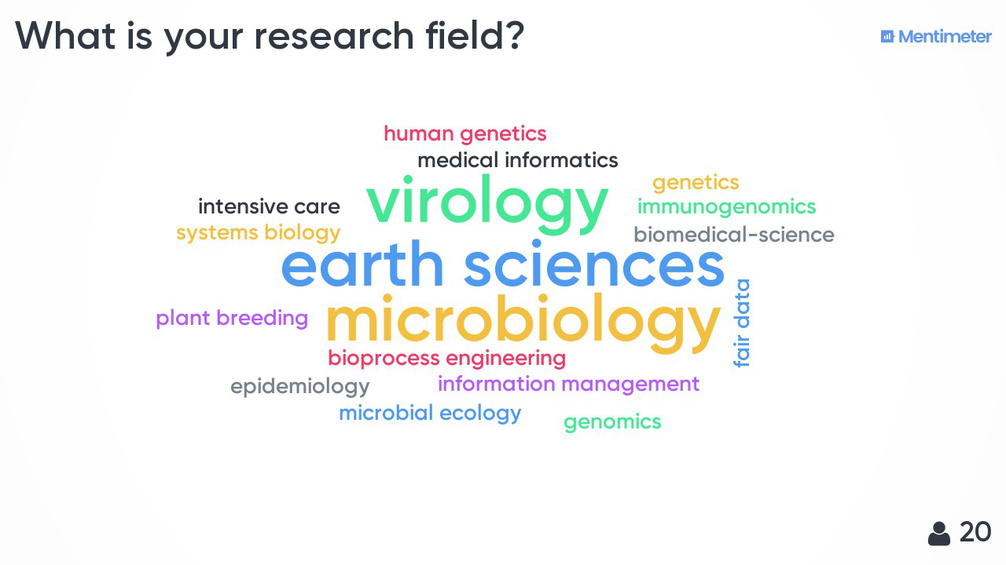
Software Reproducibility Workshop II
2 October - Utrecht
24 participants, good balance between researchers, data stewards & RSEs
Workshop in collaboration with Carlos Martinez Ortiz (NL eScience Center) and Marc Galland (University of Amsterdam)
https://openworking.wordpress.com/2018/10/27/workshop-report-software-reproducibility-the-nuts-and-bolts/

Slide 21
Workshops: Starting Point for Discussion
Carefully documenting and archiving code and research data may not be enough to guarantee the reproducibility of computational results.
Researchers should collaborate more closely with RSEs to ensure they are aware of the latest computational advances, most notably the use of containers (e.g. Docker) and open interfaces.
Paper by Hut, van de Giesen, and Drost (2017) https://agupubs.onlinelibrary.wiley.com/doi/full/10.1002/2017WR020665

Slide 22
What do we mean with reproducibility?
“An article about computational science in a scientific publication is not the scholarship itself, it is merely advertising of the scholarship. The actual scholarship is the complete software development environment and the complete set of instructions which generated the figures.”
Quote of Jonathan Buckheit and David Donoho, paraphrasing Jon Claerbout:
“Wavelab and reproducible research,” in Wavelets and Statistics , vol. 103, A. Antoniadis and G. Oppenheim, Eds. New York, NY: Springer New York, 1995, pp. 55–81

Slide 23
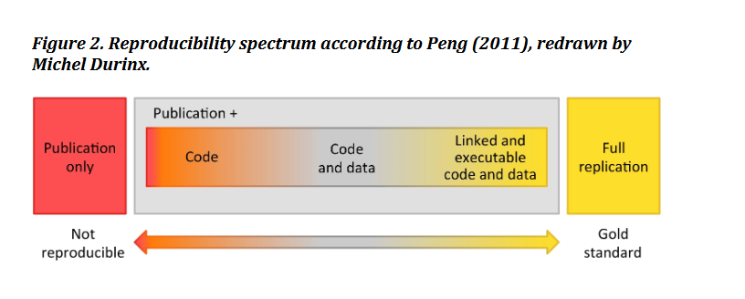

What do we mean with reproducibility?
With the caveat that “reproducibility is NOT always (or even often) a reliable indicator of research excellence.”
Source of image and paper urging a re-think of the reproducibility crisis:
Leonelli, Sabina (2018) Re-Thinking Reproducibility as a Criterion for Research Quality. http://philsci-archive.pitt.edu/14352/

Slide 24
Workshops: Key discussion points I
Lack of funding for Research Software Engineers is a barrier
Sound but too technical advice & there are concerns regarding the use of containers when it comes to reuse
Open source software is not always an option & not all code is equal (not all code needs to be reused and maintained)
Code review and validation & community building around software are important too
Standard advise (i.e. current best practices in software development and management) is valid and has to be reinforced via training and awareness raising

Slide 25
Workshops: Key discussion points I
Lack of funding for Research Software Engineers is a barrier
Sound but too technical advice & there are concerns regarding the use of containers when it comes to reuse
Open source software is not always an option & not all code is equal (not all code needs to be reused and maintained)
Code review and validation & community building around software are important too
Standard advise (i.e. current best practices in software development and management) is valid and has to be reinforced via training and awareness raising

Slide 26
Workshops: Key discussion points II
Data stewards to act as the link between researchers & RSEs
RSEs could do more to promote best practices and should be ambassadors for software reproducibility and sustainability
Universities and research institutions should promote good practice for software engineering as part of open science

Slide 27
What have we learned at the institutional level?
TU Delft initiatives as a result

Slide 28
Support and training for researchers in collaboration with RSEs, with data stewards as facilitators
4TU.Centre for Research Data has acquired Carpentries membership (https://carpentries.org/)
First Software Carpentry Workshop at TU Delft on 29-30 Nov 18, 4 planned in 2019
Community building: Pool of researchers to share best practices and help each other (following the example in “Building a local community of practice in scientific programming for Life Scientists” https://www.biorxiv.org/content/early/2018/05/26/265421)

Slide 29
At the policy level
TU Delft RDM framework policy expects every researcher to publish code and data supporting their publications.
https://d1rkab7tlqy5f1.cloudfront.net/Library/Themaportalen/RDM/researchdata-framework-policy.pdf
TU Delft data stewards are developing faculty-specific policies together with the deans and faculty management teams.

Slide 30
Conclusions I - Value based approach
Through programmes such as Software Carpentry, some RSEs already provide training on software development to researchers.
Data stewards can help accelerate this effort by connecting RSEs to researchers at institutional level, bringing much needed expertise to the research communities they support.
By sharing their knowledge and expertise in this way, RSEs could increase their impact and influence in the research community.
This value based approach may garner the support of researchers to attract the attention of the university executives and may lead to better institutional approaches to funding and recognition for sustainable research software development and training.

Slide 31

Conclusions II - coordinated effort of all stakeholders
Partnerships at inter and intra organizational levels: TU Library, TU ICT, 4TU Federation, RSEs (NL eScience Center, NL-RSE, DTL), The Carpentries, etc.

Slide 32
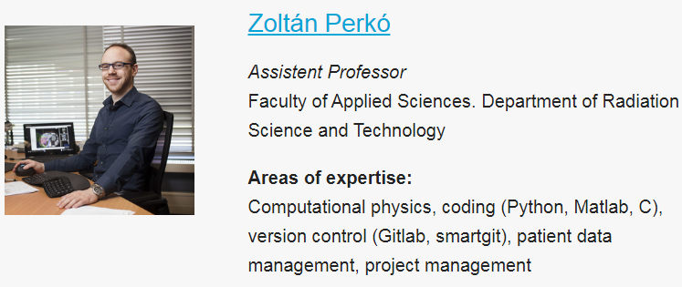
Conclusions III - culture change at the institutional level
Top-down and bottom-up: Institutional policies, and culture shift through data stewardship, data champions
“For increasing the clarity and reproducibility of modern research, best practices in data management, software development and collaboration are crucial.”
https://www.tudelft.nl/library/our-datachampions

Slide 33
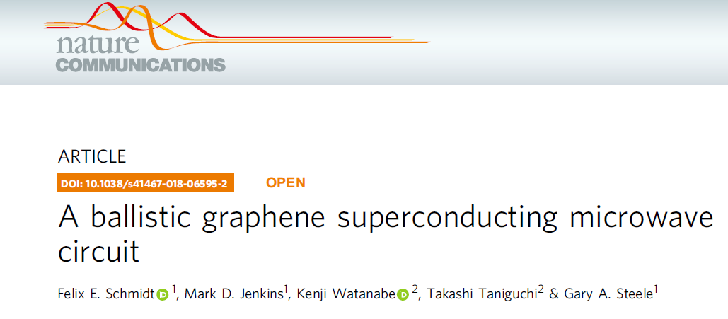
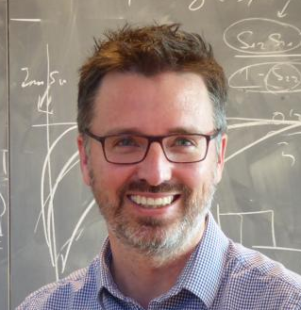
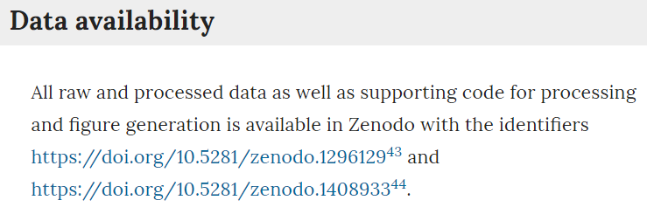
Data Champions: Leading by example
https://doi.org/10.1038/s41467-018-06595-2

Slide 34
Thank you! Questions?
Presentation: https://doi.org/10.5281/zenodo.1472945
Paper pre-print: https://doi.org/10.5281/zenodo.1419085
Our contact details:
m.j.marquesdebarroscruz@vu.nl
S.Kurapati@tudelft.nl
Y.Turkyilmaz-vanderVelden@tudelft.nl

