Slide 1
Data Management
in Open Science
An overview of data management concept in the framework of Open Science.
Presented by
Clémentine Violette & Julien Lebranchu
IRD, Marbec, Ob7
For the SFA staff
How to cite : Violette, C., & Lebranchu, J. (2025). Data Management in Open Science. Zenodo. 10.5281/zenodo.14718818
Notes:
Context :
Hi Everyone, thanks to come today to participate to this seminar.
We know that SFA has a lot of data. It’s a gold mine. So in the context of the deployment of FIMS at SFA and the SORA agenda which one of aims is to develop a National Data Warehouse, we propose to develop with you a series of workshop on data management dedicated to your needs. The objective of these workshop are to develop best practices and a common way to manage the data and at the ends valorise it in FIMS and/or a national data Warehouse.
This is 1st seminar dedicated to the data management. I’m sure that you are aware of the different concept we will present today. Our objectives with this seminar is to expose the key concept of DM to share a common language and concept on what is data and data management, in purpose to discuss how build a common way to manage your data.

Slide 2
Plan
WHAT IS OPEN SCIENCE ?
WHAT IS DATA ?
WHAT IS DATA MANAGEMENT ?
WHAT IS NEXT ?
Notes:
In this presentation, we’ll explore a critical topic that is shaping the future of research
We’ll begin by answering a fundamental question: What is Open Science? You’ll discover how this movement is breaking down barriers to knowledge, fostering global collaboration, and making science more inclusive, transparent, and impactful.
Next, we’ll dive into the concept of data—the backbone of research and decision-making. We’ll explore what data is, its importance in science, and how it powers innovation across disciplines.
From there, we’ll move to data management, a crucial aspect of modern research. We’ll discuss best practices for handling data throughout its lifecycle—from collection to sharing—and how proper management ensures reliability, accessibility, and reusability.
Finally, we’ll look to the future in the section, What’s Next? Here, we’ll discuss your needs regardings the data management and build the next workshop

Slide 3

WHAT IS OPEN SCIENCE?
Notes:
So WHAT IS OPEN SCIENCE

Slide 4
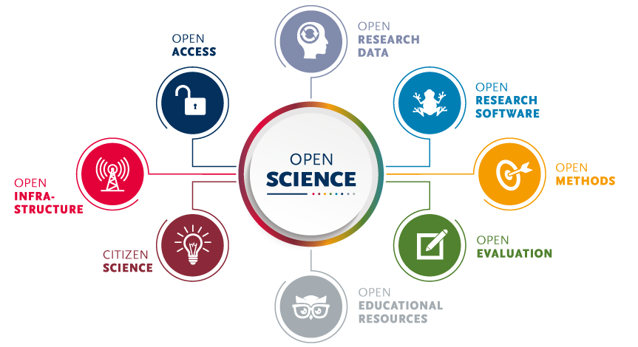
What is Open Science?
Open Science is a movement to make scientific research, data, methods, and dissemination accessible to all levels of society. It seeks to enhance collaboration, reproducibility, and transparency across disciplines.
Open Access: Free and immediate online access to research articles.
Open Data: Sharing research data for validation, reuse, and integration.
Open Methodology: Transparency in research processes, tools, and workflows.
Open Source: Use of and contributions to freely available software and tools.
Notes:
"Open Science is a movement that seeks to make scientific research more transparent, accessible, and inclusive. It’s about breaking down barriers to knowledge by ensuring that research data, publications, and methodologies are freely available to everyone—scientists, policymakers, educators, and the public.
It’s based on many pillars like Open access which aims to get research article free and accessible to the community or Open data which aims to share and reuse data for new project.

Slide 5
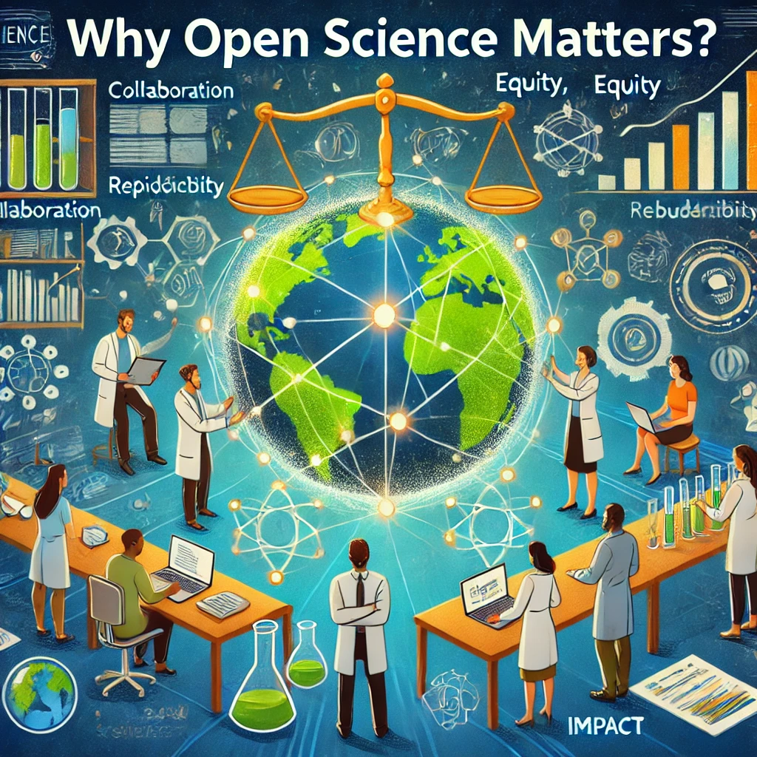
Why Open Science Matters?
Vision :
A more inclusive, efficient, and impactful scientific ecosystem driving global progress.
Key Benefits:
  Collaboration: Facilitates global participation and multidisciplinary innovation.
  Equity: Democratizes access to knowledge.
  Reproducibility: Ensures findings can be validated and built upon.
  Impact: Speeds up knowledge dissemination and application in society.
Notes:
Open Science transforms how we conduct and share research, making it more inclusive, transparent, and impactful.
In a world facing global challenges like climate change, pandemics, and inequality, Open Science fosters collaboration across borders and disciplines, accelerating innovation and finding solutions faster.
It also promotes fairness by empowering researchers from developing countries, who often lack access to expensive journals, to participate in and benefit from the global scientific community.
Moreover, Open Science enhances trust in research. When data and methods are openly shared, it allows others to verify findings, reducing misinformation and ensuring that decisions are based on solid evidence.
Ultimately, Open Science is not just a practice—it’s a movement toward a more equitable, efficient, and impactful way of advancing knowledge for the benefit of all."

Slide 6
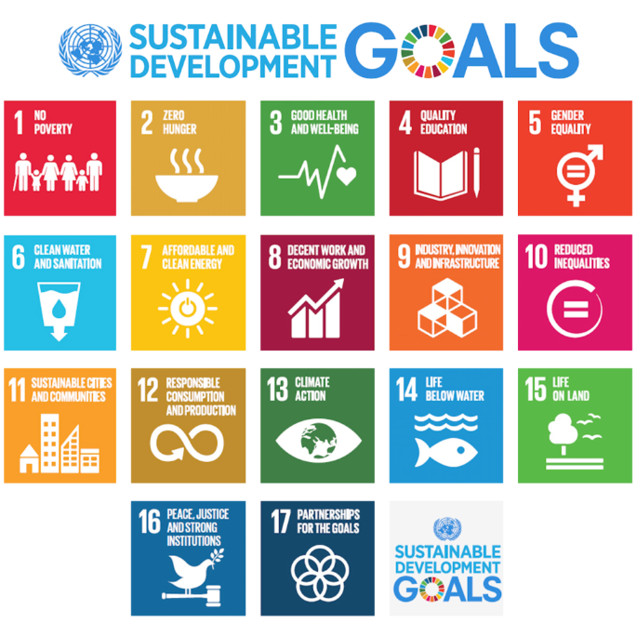
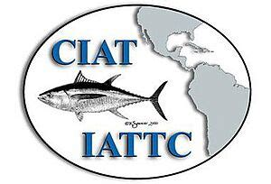




Why Open Science Matters : SDGs
Vision :
A more inclusive, efficient, and impactful scientific ecosystem driving global progress.
Key Benefits:
  Collaboration: Facilitates global participation and multidisciplinary innovation.
  Equity: Democratizes access to knowledge.
  Reproducibility: Ensures findings can be validated and built upon.
  Impact: Speeds up knowledge dissemination and application in society.
Open Science accelerates progress toward achieving the Sustainable Development Goals (SDGs)
Notes:
"Open Science is a powerful enabler of the Sustainable Development Goals, or SDGs, because it accelerates the flow of knowledge and innovation needed to address global challenges. Like for the management of tuna fisheries with the RFMO

Slide 7
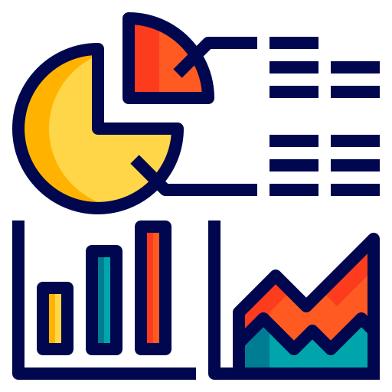
WHAT IS DATA?

Slide 8
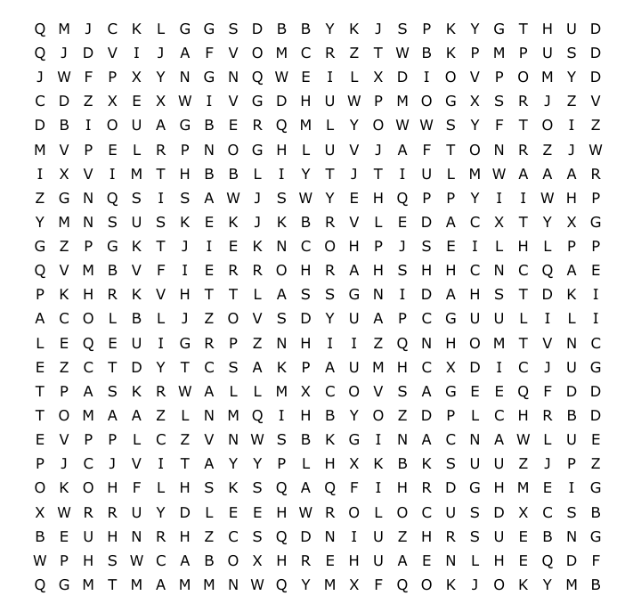
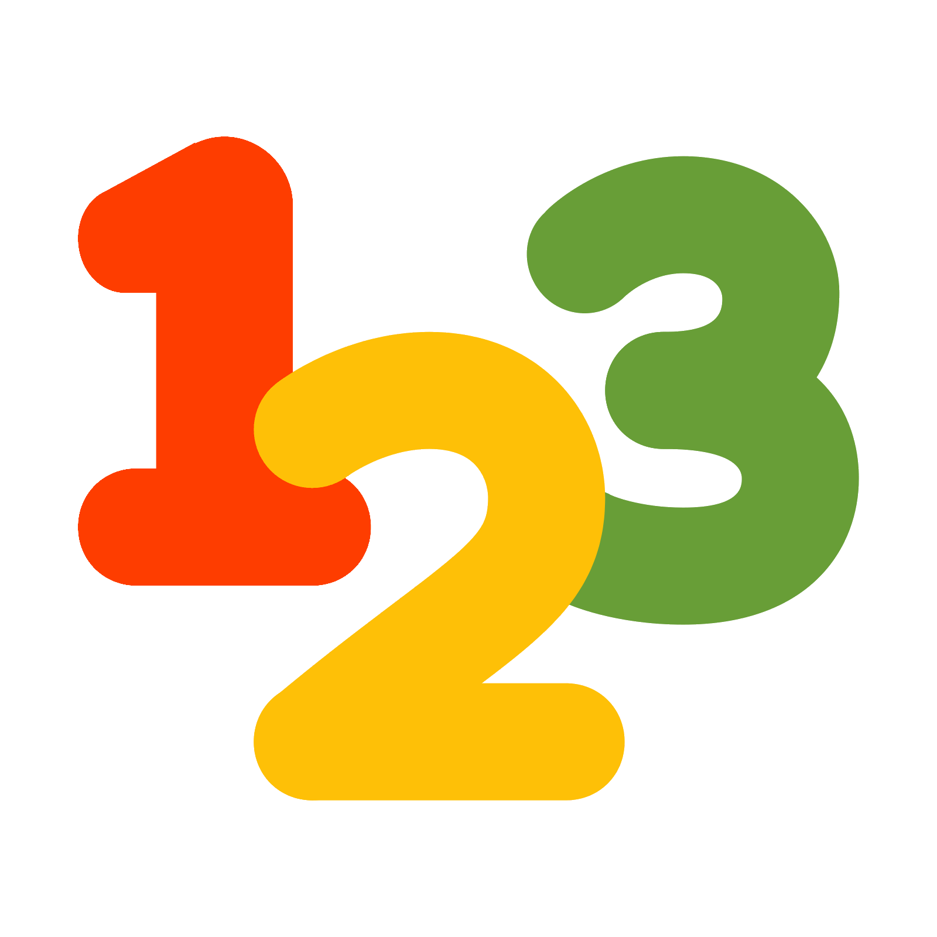




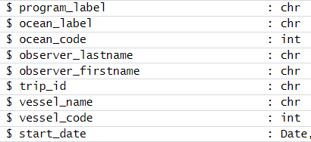
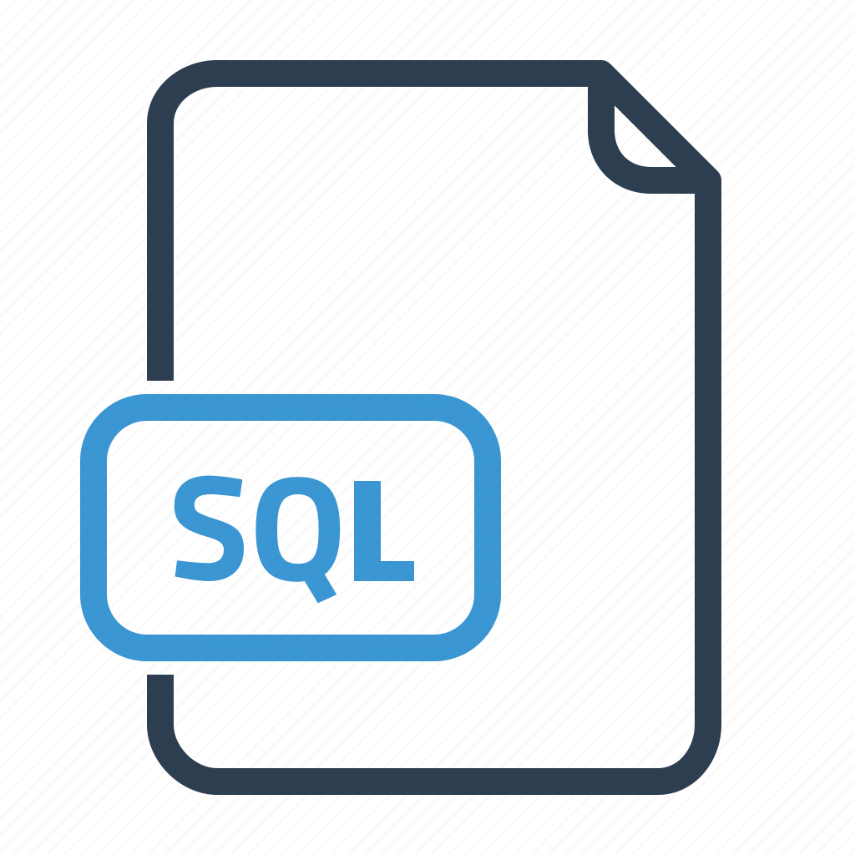
Definition of Data
Data is a collection of facts, numbers, words, observations, images, audio or other useful information.
Data processing and data analysis transform raw data points into valuable insights that improve decision-making.

Slide 9
The types of data
Data comes in many different forms, defined by its unique characteristics, sources and formats.
Some of the most common types of data include:
Quantitative data
Qualitative data
Structured data
Unstructured data
Metadata
Big data
A single data point or data set can fall under multiple categories.
For example, structured and quantitative, unstructured, qualitative and so on.

Slide 10
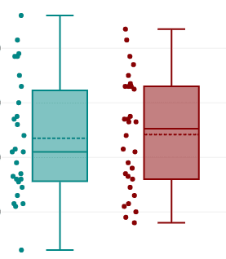
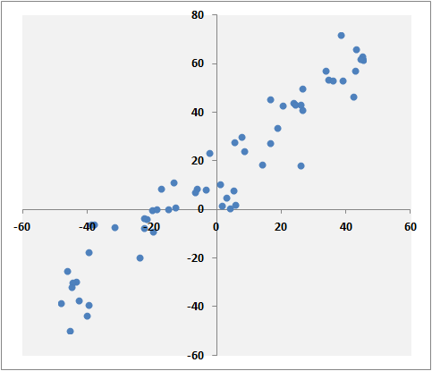
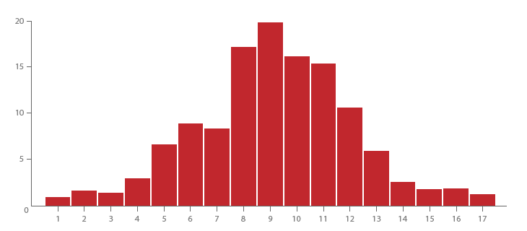
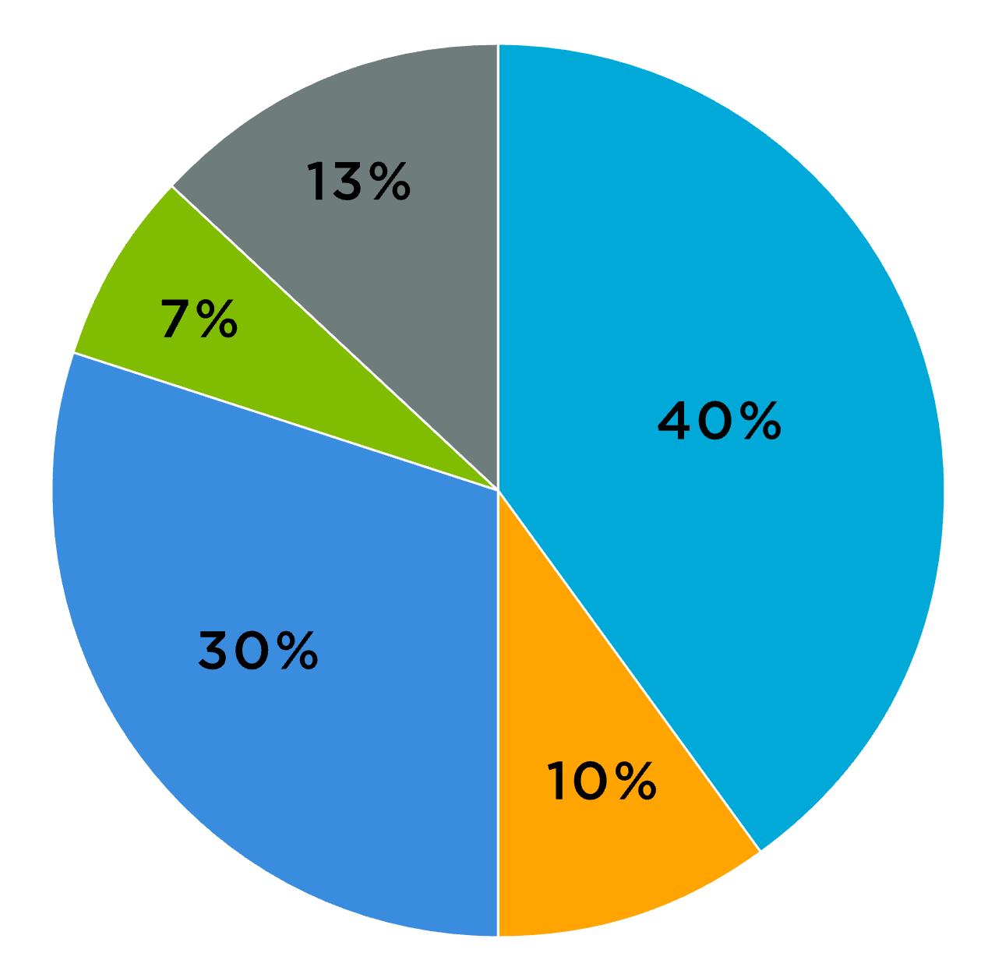
The types of data
Some of the most common types of data include:
Quantitative data
Qualitative data
Structured data
Unstructured data
Metadata
Big data
Quantitative data consists of values that can be measured numerically.

Slide 11
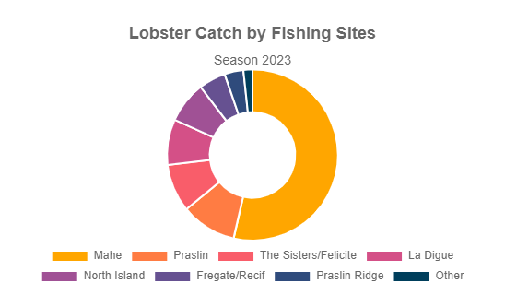
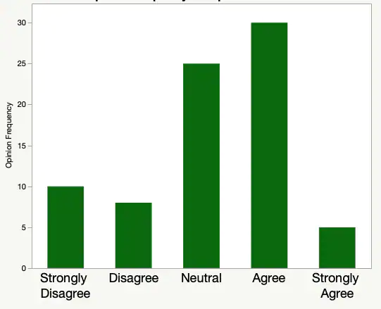
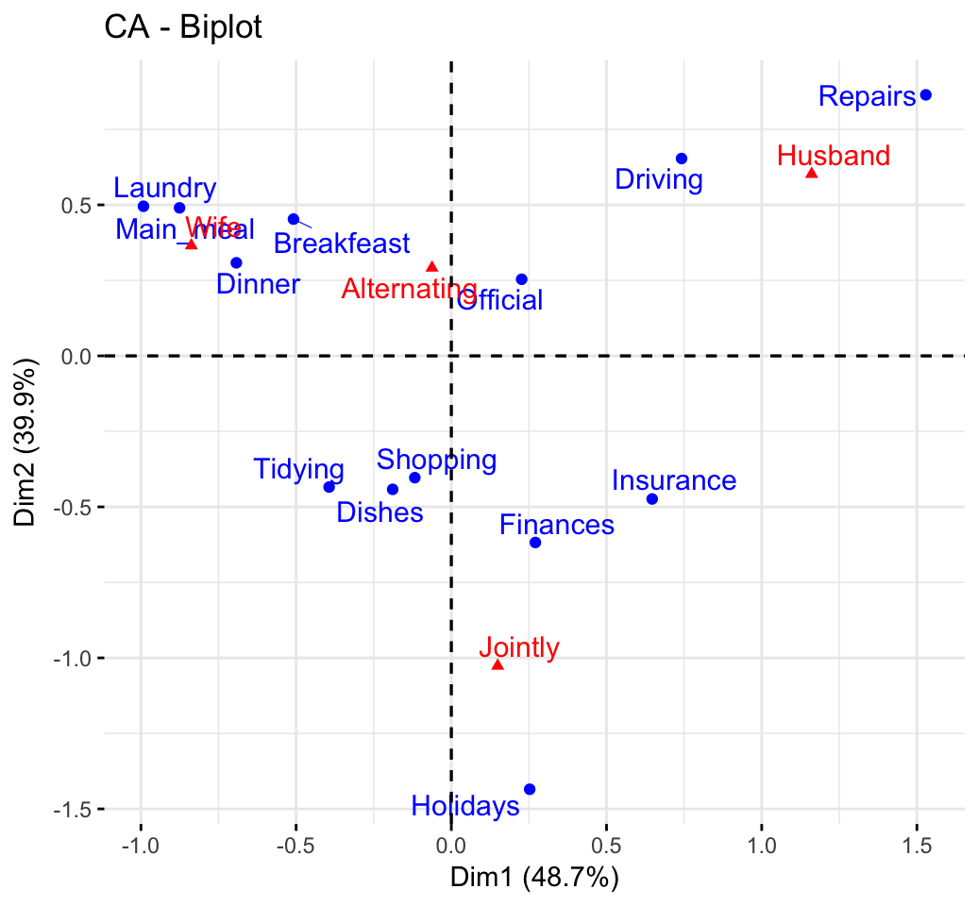
The types of data
Some of the most common types of data include:
Quantitative data
Qualitative data
Structured data
Unstructured data
Metadata
Big data
Qualitative data is descriptive and non-numerical, capturing characteristics, concepts or experiences that numbers cannot measure.

Slide 12
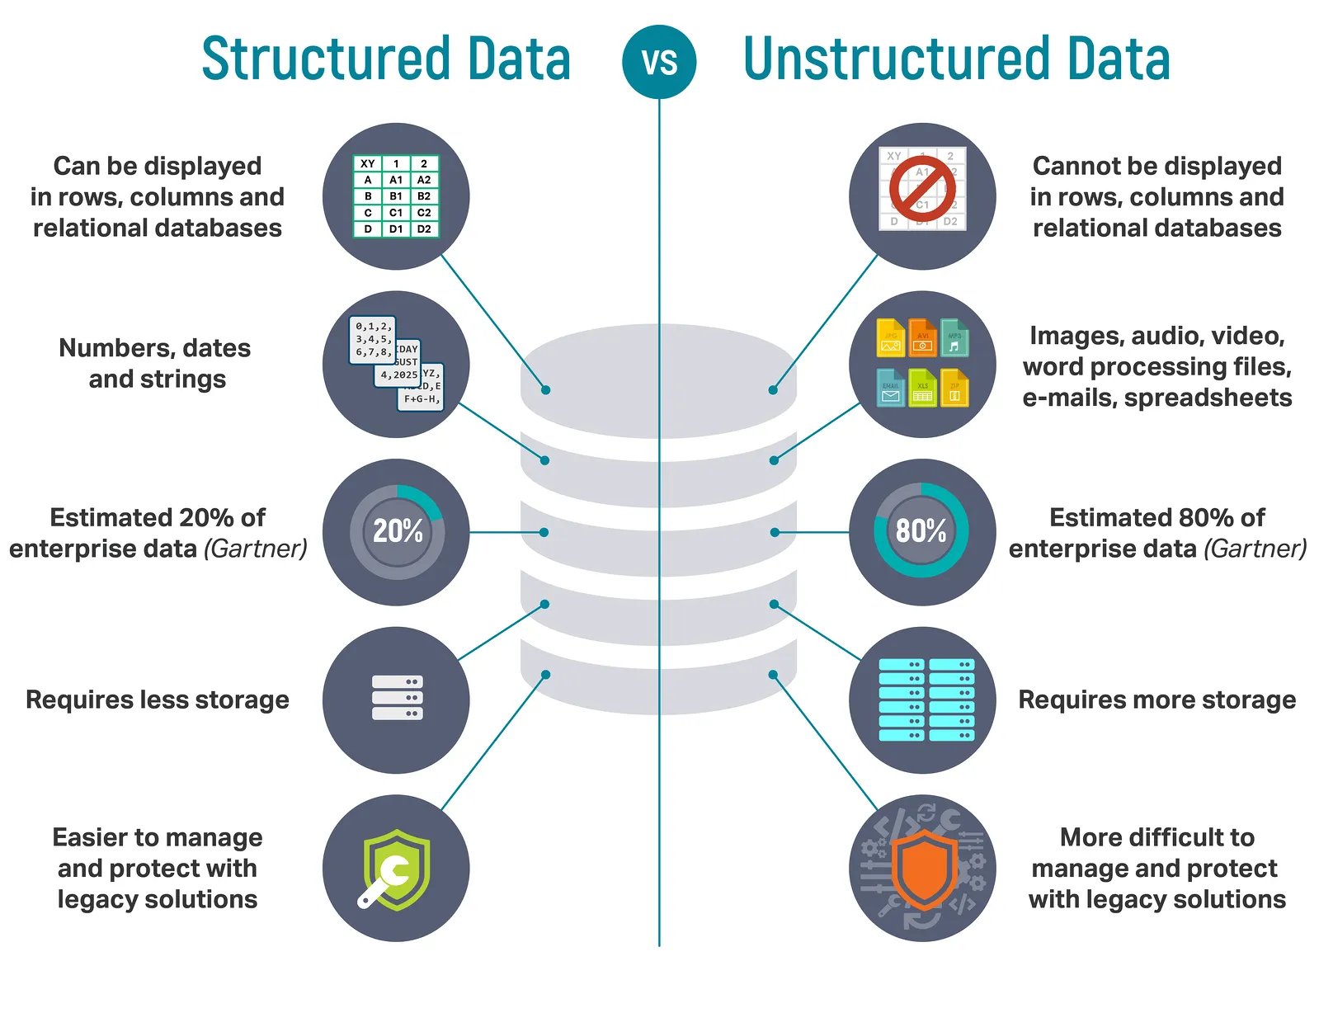
The types of data
Some of the most common types of data include:
Quantitative data
Qualitative data
Structured data
Unstructured data
Metadata
Big data
Structured data is organized in a clear, defined format, often stored in relational databases or spreadsheets
Unstructured data lacks a strictly defined format. It often comes in complex forms such as text documents, images and videos

Slide 13
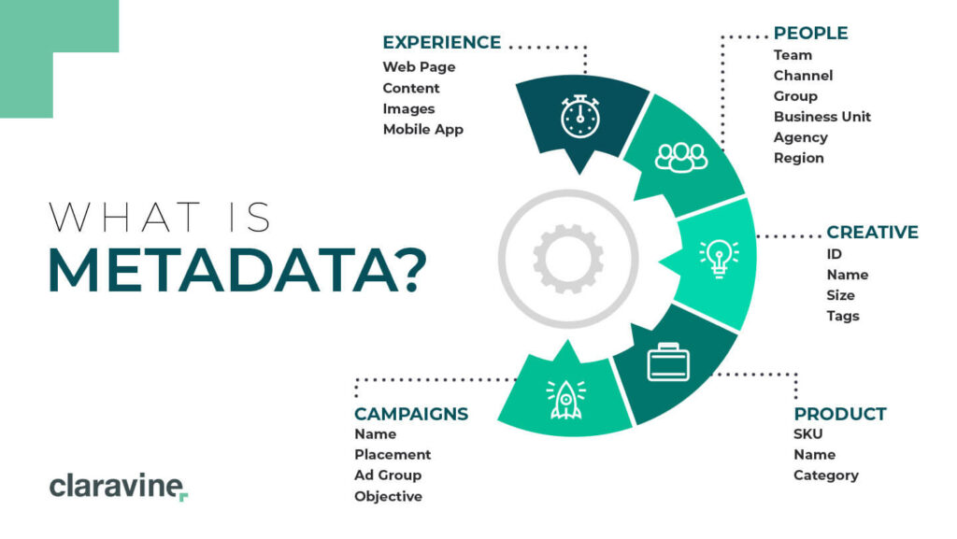
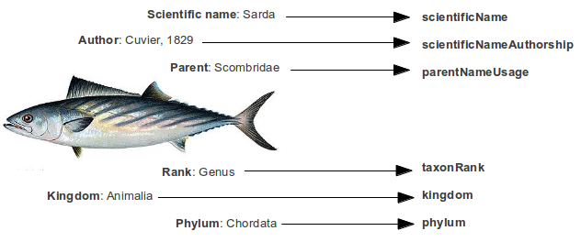
The types of data
Some of the most common types of data include:
Quantitative data
Qualitative data
Structured data
Unstructured data
Metadata
Big data
Metadata is data about data. It’s information about the attributes of a data point or data set, such as file names, authors, creation dates or data types.

Slide 14

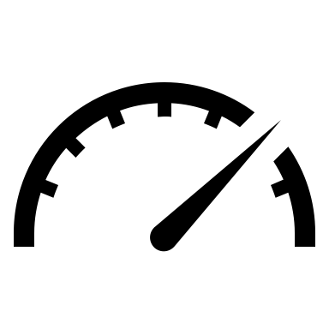

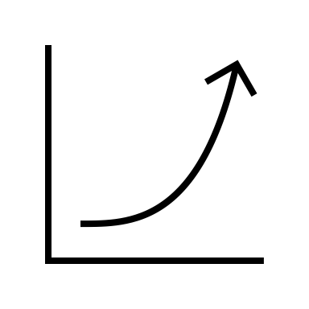
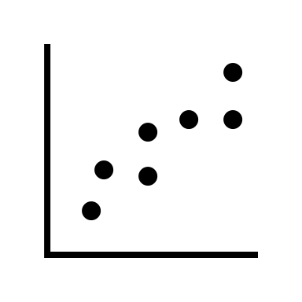
The types of data
Some of the most common types of data include:
Quantitative data
Qualitative data
Structured data
Unstructured data
Metadata
Big data
The speed data appears and disappears
The size of the data
Volume
1
The reliability of the data
Velocity
2
Veracity
3
4
Value
Variety
5
The relevance of the data
The types of data
Notes:
Big Data refers to datasets that are so large, complex, or fast-growing that traditional data processing applications are inadequate to handle them. The 5 V's of Big Data are :
Volume: The amount of data generated.
Velocity: The speed at which data is created and processed.
Veracity: The quality and accuracy of the data.
Value: The relevance of the data
Variety: The different types of data, including structured, semi-structured, and unstructured.
It concerns for example datasets of environmental DNA, or data from social networks

Slide 15
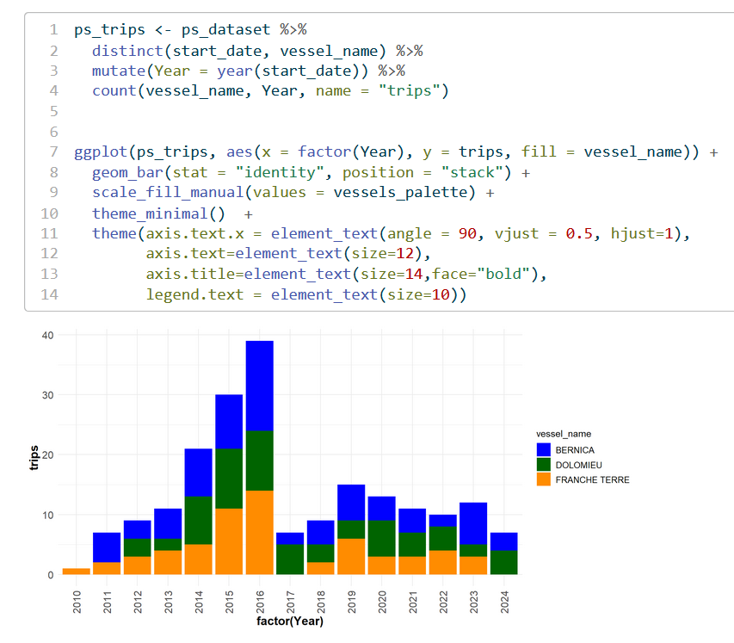
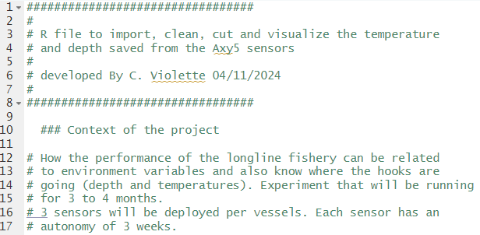
Are Code and script part of data?
Code is not just an action-oriented tool but can itself be treated as a form of data. Code is structured data that can be stored, analyzed, and transmitted.
What are Code and Scripts?
Written instructions (e.g., R, SQL, Python).
Process raw data and produce outputs.

Slide 16
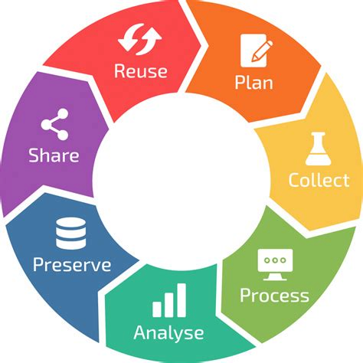
WHAT IS DATA MANAGEMENT ?

Slide 17
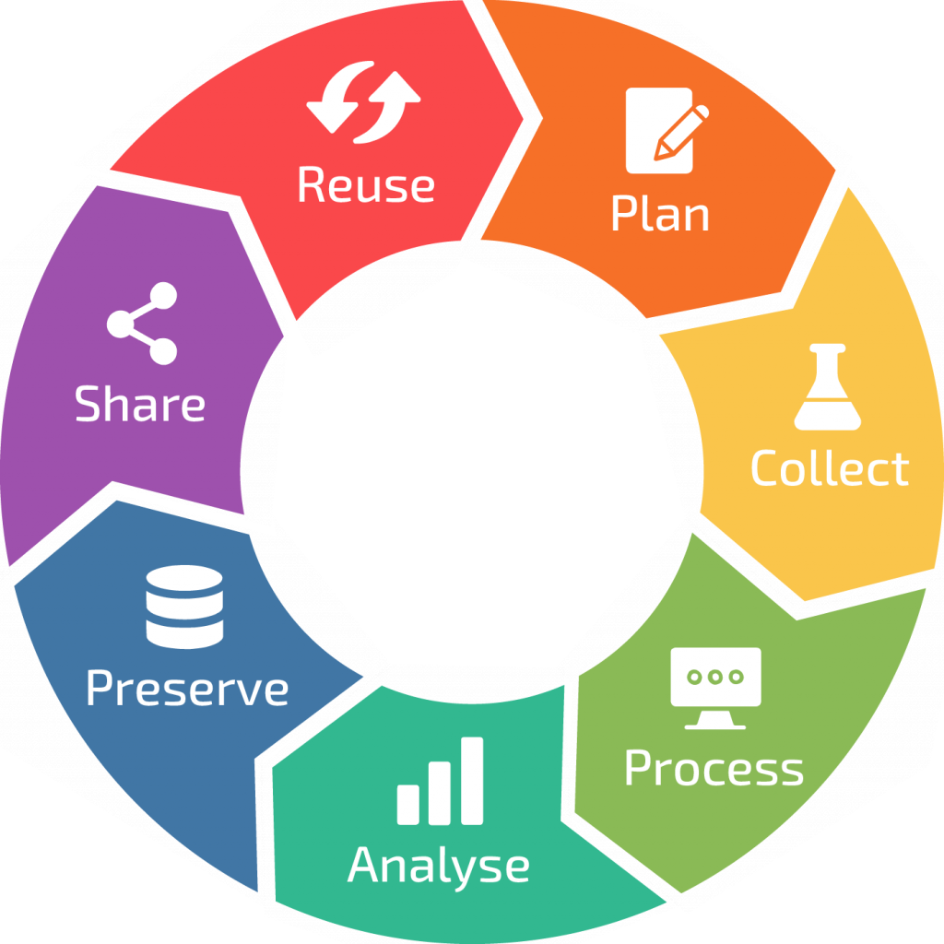
What is Data Management in Science?
Data management is the practice of collecting, processing and using data securely and efficiently for better business outcomes.
Planning
Data Sharing and Publishing
Data Collection
Preservation
Data Processing
Data Analysis
Notes:
Julien: Key Steps for Effective Data Handling is composed of 7 components.
Plan a comprehensive data management
Gathering data using established methods
Develop process to maintain a high quality before analysis
Analyse your data to awnser your question
Preserve data in long-term storage to support ongoing research efforts.
Making data accessible to others promotes collaboration and innovation within the research community.
Finaly, the data management aims the reusability of the data for the research community and the future yourself

Slide 18

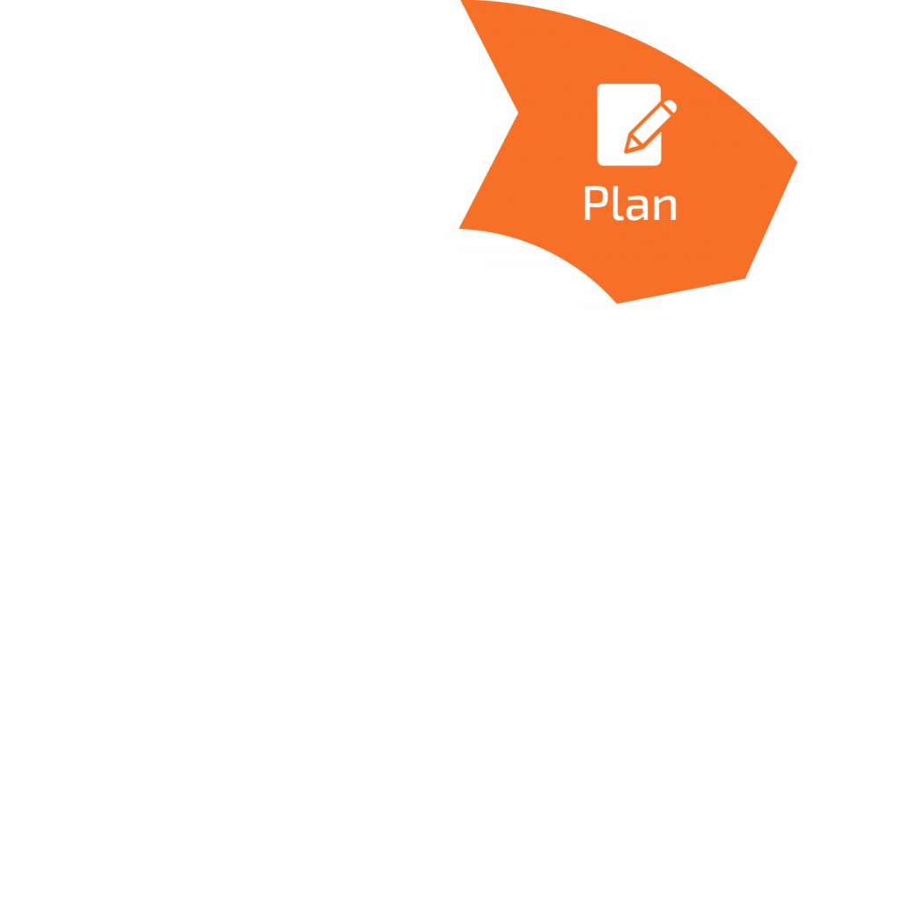
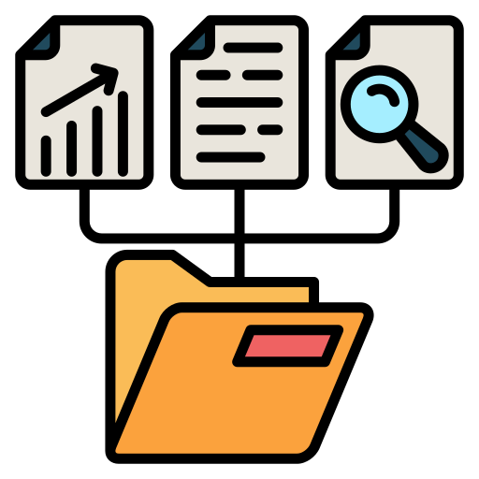

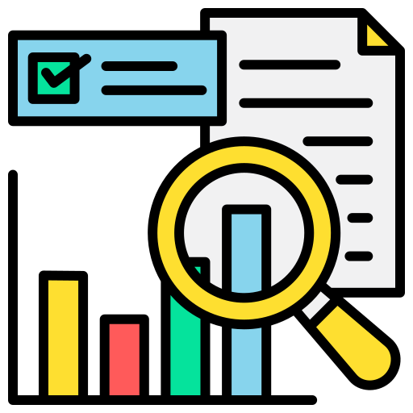



Planning
Planning and write it down in a data management plan. The DMP is going through the processes for collecting, preparing, storing and distributing the data.
COLLECT
PREPARE
What will be your data sources?
How will the data be collected?
Is this a task that will be done manually as needed or will you set up extract scheduling?
What will be the guidelines for naming data, documenting lineage, and adding metadata to increase discoverability?
How will you identify incomplete or disparate data?
ANALYZE AND SHARE
STORE
Which teams or departments need a data access to collaborate?
How can you make access to data and analysis easier for the end-user?
How will you communicate any data insights?
Where will you store your data?
How will you do the versioning?
Will you use XML, CSV, or relational databases for structured data?
How will you keep your data secure?
Lebranchu, Julien et al. (2024). MOOBYF Data Management Plan (Version 2). Zenodo. https://doi.org/10.5281/zenodo.14048788
Notes:
Julien : Planning is the cornerstone of effective data management.
It sets the stage for how data will be collected, organized, stored, and shared throughout its lifecycle. Without a well-thought-out plan, even the most valuable data risks becoming unusable or inaccessible over time.
A robust data management plan (DMP) begins by defining clear objectives:
Which need to ask question to guide every subsequent decision, from file formats and storage solutions to metadata standards and security measures.
SHOW 4 POINTS
Planning also involves anticipating challenges, such as ensuring compliance with ethical guidelines (Nagoya protocol), protecting sensitive information, and selecting trusted repositories for long-term preservation and sharing.
You will find an example with this link, he exist some tools to write a DMP.
I let the floor to Clementine ao presnet the next steps

Slide 19
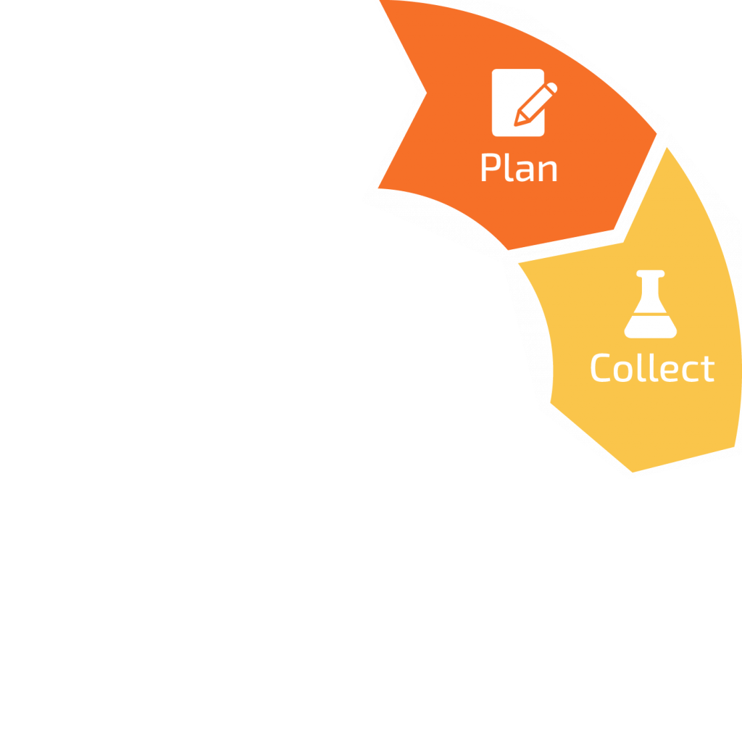
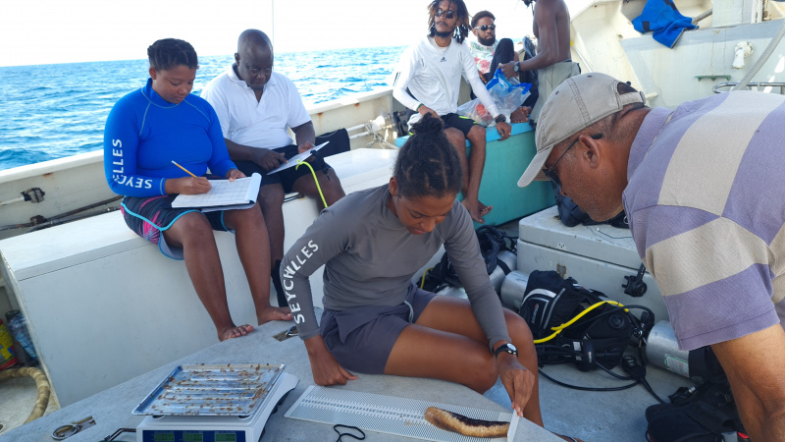
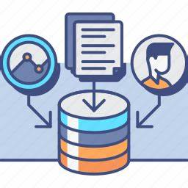
Data collection
Data collection is the process of gathering and measuring information, in an established systematic fashion that enables one to answer stated research questions and test hypotheses.
Seychelles sea cucumber survey 2021/22 -Seychelles Nation
Preserving the data integrity go through the detection of errors in the data collection process, whether they are made intentionally (deliberate falsifications) or not (systematic or random errors).
The two approaches that can preserve data integrity and ensure the scientific validity of study results can be distinguished into :
Quality assurance - activities that take place before data collection begins
Quality control - activities that take place during and after data collection
Notes:
C

Slide 20


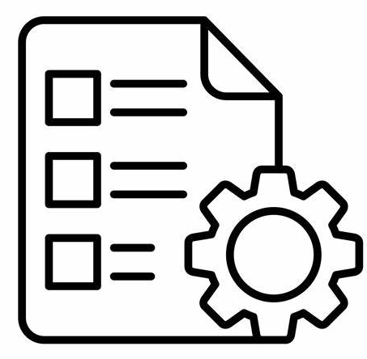



Data collection – Quality assurance
Quality assurance precedes data collection. Its main focus is 'prevention' (i.e., forestalling problems with data collection). This proactive measure is best demonstrated by the standardization of protocol developed in a comprehensive and detailed procedures manual for data collection such as :
Pre-determine the timing, methods, and identify of person(s) responsible for reviewing data
Exhaustive listing of items to be collected
Rigorous step-by-step instructions on administering tests
Train staff members responsible for data collection
Remember to adjust and calibrate the data collection equipment (if appropriate)
Anticipate that the protocol and procedures may evolve during the investigation
Notes:
C

Slide 21
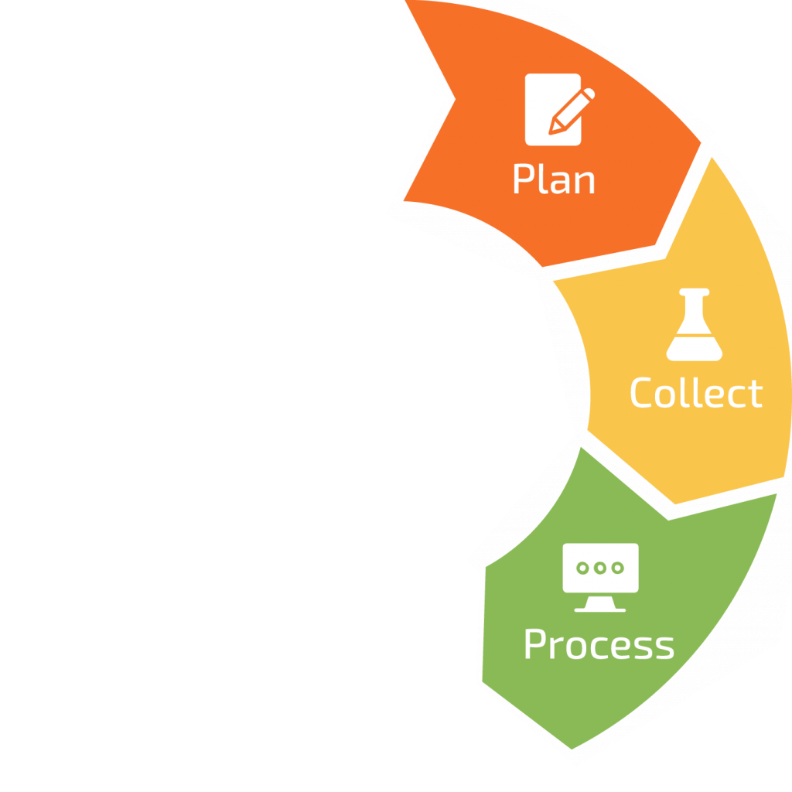
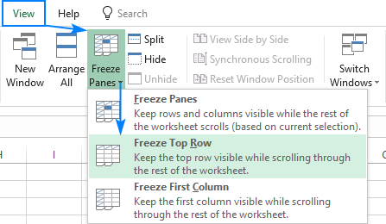
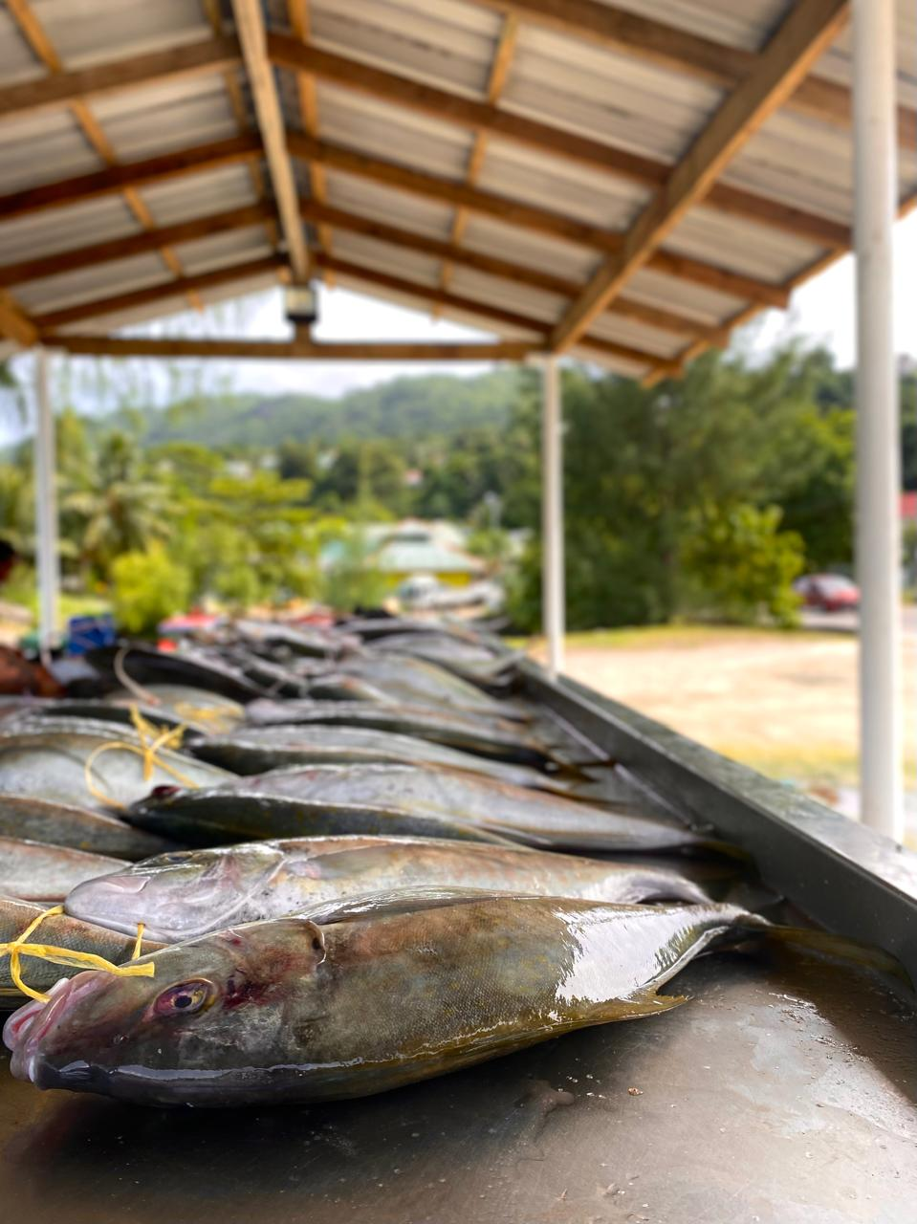
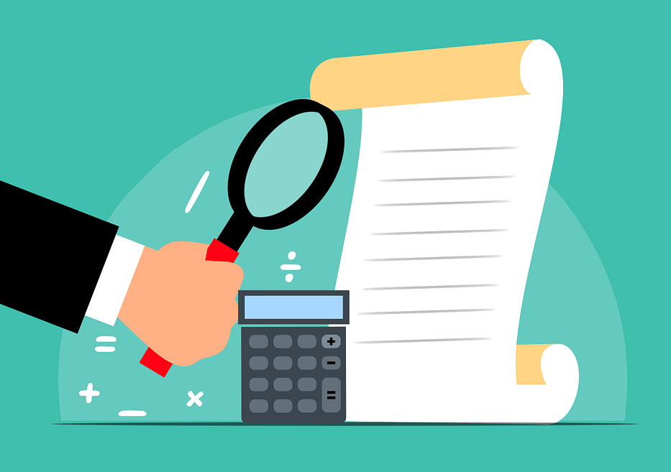
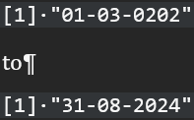
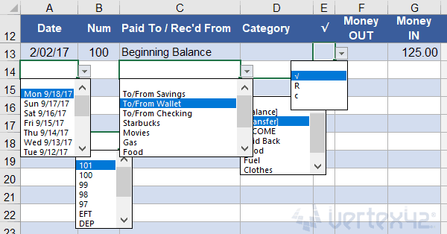
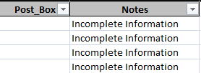
Data collection – Quality control
Quality control activities (detection/monitoring and action) occur during and after data collection, the details should be carefully documented in the procedure manual. Data quality should be addressed for each individual measurement and for the entire data set.
Quality control identifies the required responses, or ‘actions’ necessary to correct faulty data collection practices and minimize future occurrences. Such controls can be :
Detection or monitoring through direct staff observation during site visits or conference calls
Frequent reviews of data reports to identify inconsistencies, extreme values or invalid codes
Regularly audit records to verify that data collection is proceeding according to procedure manual.
Structure and condition the forms to avoid typing mistakes or extreme values
Add a comment cell for the staff to document the unusual configurations
Each field of study has its preferred set of data collection instruments. Regardless of the discipline, comprehensive documentation of the collection process before, during and after the activity is essential to preserving data integrity.
Notes:
C

Slide 22
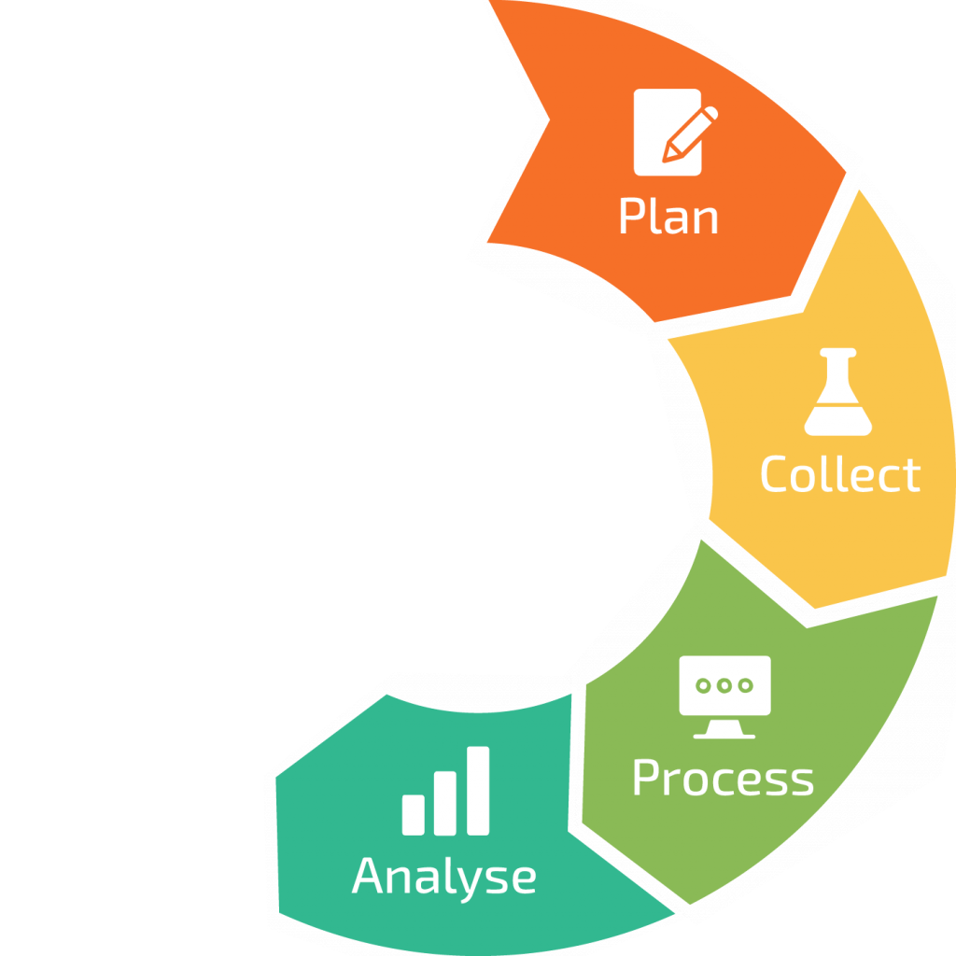
Data analysis
The term refers to the science of analyzing raw data to make conclusions about information.
It can be categorized into 4 main types.
Why did it happen ?
DESCRIPTIVE ANALYSIS
Descriptive analysis describes or summarizes raw data and makes it interpretable. It involves analyzing historical data to understand what has happened in the past. This type of analysis is used to identify patterns and trends over time.
DIAGNOSTIC ANALYSIS
Diagnostic analysis determines why something happened. It involves more detailed data exploration and comparing different data sets to understand the cause of a particular outcome.
What happened ?
How can we make it happen ?
PREDICTIVE ANALYSIS
Predictive analysis uses statistical models and forecasting techniques to understand the future. It involves using data from the past to predict what could happen in the future.
PRESCRIPTIVE ANALYSIS
Prescriptive analysis is the most advanced type of data analysis. It not only predicts future outcomes but also suggests actions to benefit from these predictions. It uses sophisticated tools and technologies like machine learning and artificial intelligence.
What will happen ?
Notes:
C

Slide 23
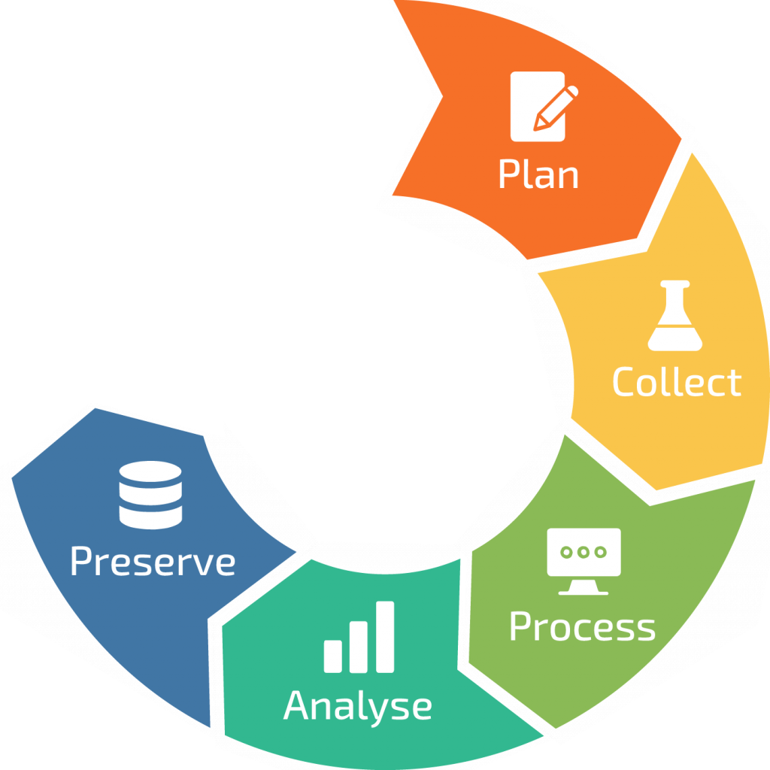
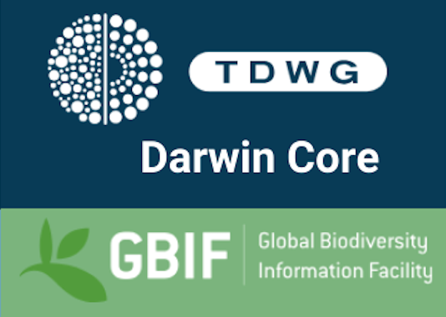

Data Preservation
Ensuring data is securely stored and available for future access and reuse.
Data Backup: Storing multiple copies of data in secure locations (need to plan the backup).
Formats: Using non-proprietary, widely accepted formats to avoid obsolescence.
Metadata: Providing detailed descriptions to ensure understanding of preserved data.
Storage: Employing cloud services or institutional repositories for long-term storage (like FIMS).
Notes:
Julien : Preservation is a critical component of data management that ensures research data remains accessible, usable, and meaningful over time. It’s not just about storing data—it’s about safeguarding its integrity and ensuring that future generations can access and understand it.
Effective preservation starts with choosing the right formats and storage solutions. Non-proprietary, widely supported file formats are key to ensuring data remains readable, even as technology evolves.
Metadata is equally important. Without detailed documentation describing the context, structure, and content of the data, its value diminishes. Preservation ensures that data is not just stored but also usable and interoperable, enabling reuse across disciplines and generations. For that you need to use a standard like Ecology Medatada Language (EML) or DarwinCore which use by the GBIF.

Slide 24

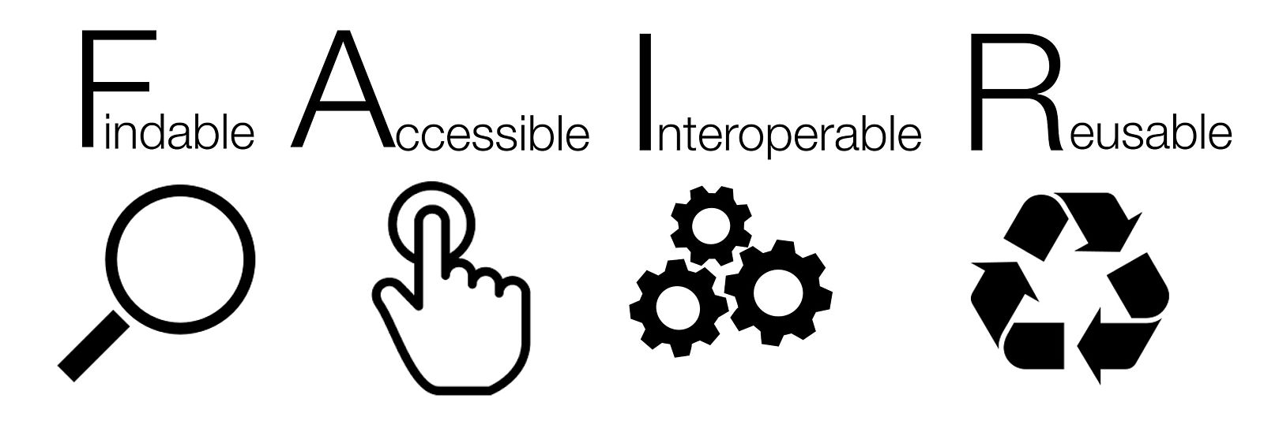



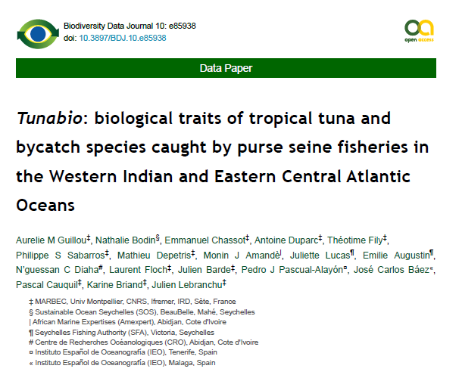
Share & Reuse
Making data publicly available for the broader research community, policy makers, and stakeholders
Findable:
  Assign globally unique and persistent identifiers (e.g., DOIs).
  Use metadata to describe data clearly.
Accessible:
  Store data in secure repositories with clear access protocols.
  Ensure metadata remains accessible even if the data is restricted.
Interoperable:
  Use standard formats and vocabularies for data and metadata.
Reusable:
  Provide sufficient metadata and documentation.
  Use clear data licenses for reuse and citation.
https://doi.org/10.3897/BDJ.10.e85938
Notes:
Julien :
The last component of the data management is the Data Sharing.
When data is shared, it becomes a resource for collaboration. It allows scientists from different disciplines and regions to build on each other’s work, accelerating discoveries and fostering innovation.
It support also the policy maker for a better decision-making. Moreover, reusing existing data minimizes duplication of effort, saving time, resources, and funding while unlocking new insights through secondary analysis.
But to truly support sharing and reuse, data and code must adhere to the FAIR principles: it should be Findable, Accessible, Interoperable, and Reusable.
This means publishing data in trusted repositories (like Zenodo or Github), providing clear licensing, and including rich metadata to ensure others can understand and apply the data correctly.
So you should provide a good documentation with for example a data paper which explain what is you dataset and how you collect it.

Slide 25
What is Data Management in Science?
Data management is the practice of collecting, processing and using data securely and efficiently for better business outcomes.
Data Sharing and Publishing
Data Repositories (Zenodo),
Licensing
Data paper on your (meta)dataset
Planning
Data Management Plans (DMPs),
Ethical Considerations (nagoya,…)
Data Collection
Standardized Methods and Protocols,
Metadata Capture
Preservation
Long-term storage
Regular updates
Data Processing
Cleaning, Transformation
Document your process
Data Analysis
Transparent workflows with a script versioned and shared (Git/Rshiny/Jupyter)
Notes:
We have done with this overview of the data management component
I let the floor to Clementine for the last part

Slide 26
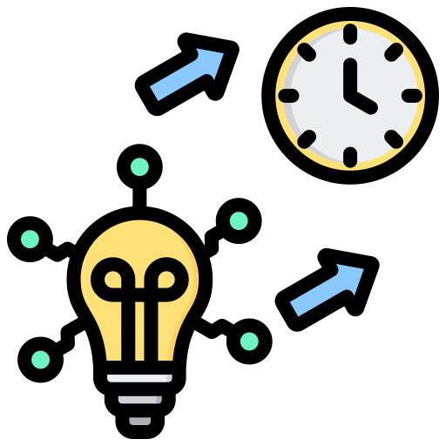
WHAT'S NEXT ?

Slide 27
Next seminar – the week of the 17th of March
Data Management Plan
Data papers methodology
File naming convention
Versioning
Basics R functions
Quarto – generate automatic reports
QGis and visual outputs

Slide 28
THANKS

