Slide 1

CENTER FOR SCALABLE DATA ANALYTICS AND
ARTIFICIAL INTELLIGENCE
Prompt Engineering,
Retrieval Augmented Generation and Agents
Robert Haase
These slides can be reused under the terms of the CC-BY 4.0 license unless mentioned otherwise.

Slide 2
Agenda
Prompt engineering
  Long-context prompting
  Reflexion
  Retrieval-Augmented-Generation (RAG)
  Function-calling
  Agents
  Multi-agent systems
  Long-context prompting

Slide 3
LLM inference
In a nutshell
Black box
LLM
User‘s query
Response

Slide 4
Prompt Engineering
In a nutshell
Prompt Engineering
LLM
User‘s query
Response

Slide 5
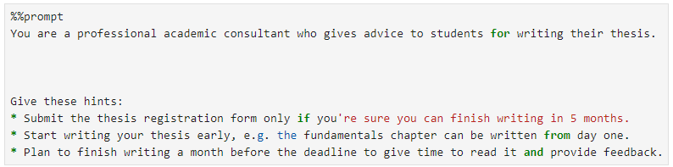
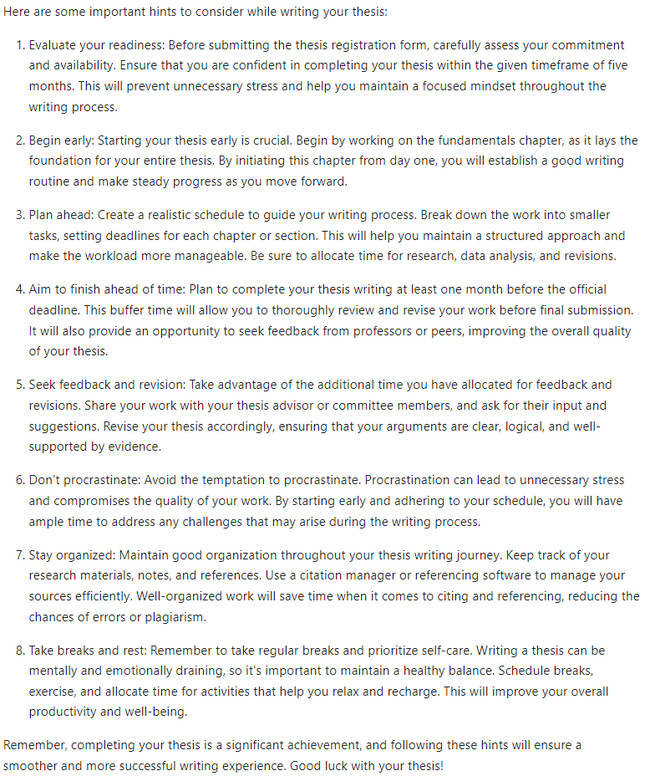
Prompt Engineering
Set context / assign role
Define output style
Give hints / conditions
List tasks
Provide data
https://scads.github.io/prompt-engineering-tutorial-2023/01_prompts/03_prompt_engineering.html

Slide 6
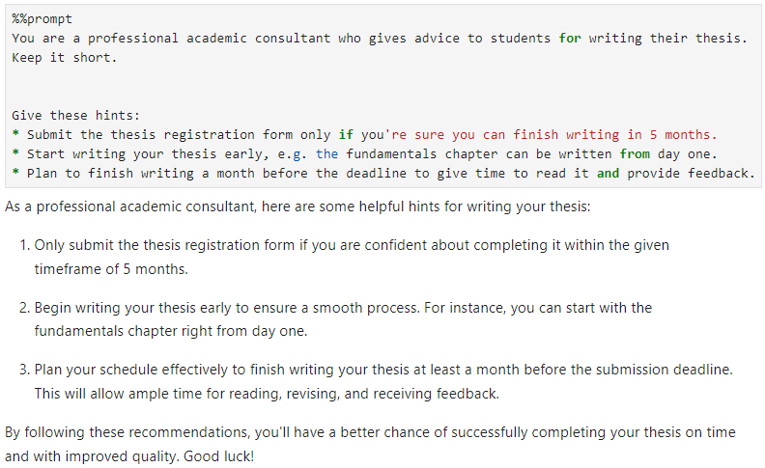
Prompt Engineering
Set context / assign role
Define output style
Give hints / conditions
List tasks
Provide data
https://scads.github.io/prompt-engineering-tutorial-2023/01_prompts/03_prompt_engineering.html

Slide 7
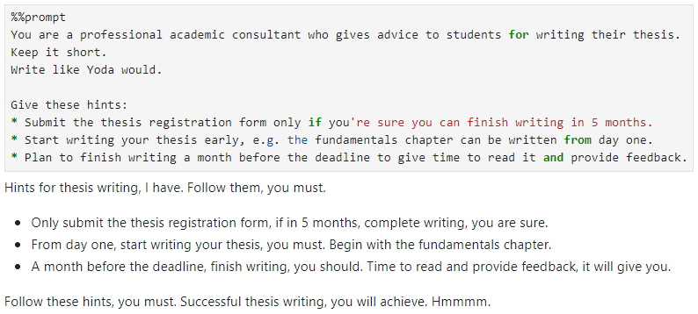
Prompt Engineering
Set context / assign role
Define output style
Give hints / conditions
List tasks
Provide data
https://scads.github.io/prompt-engineering-tutorial-2023/01_prompts/03_prompt_engineering.html

Slide 8
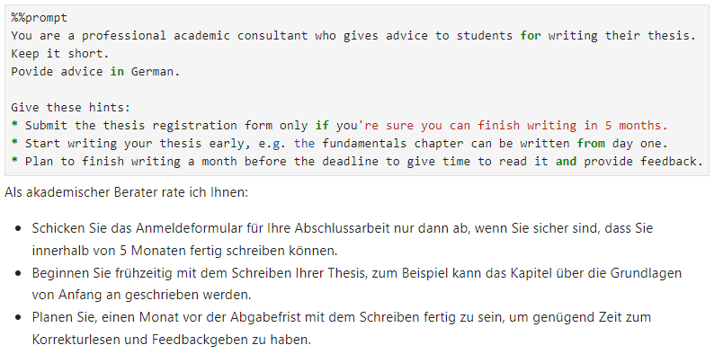
Prompt Engineering
Set context / assign role
Define output style
Give hints / conditions
List tasks
Provide data
https://scads.github.io/prompt-engineering-tutorial-2023/01_prompts/03_prompt_engineering.html

Slide 9
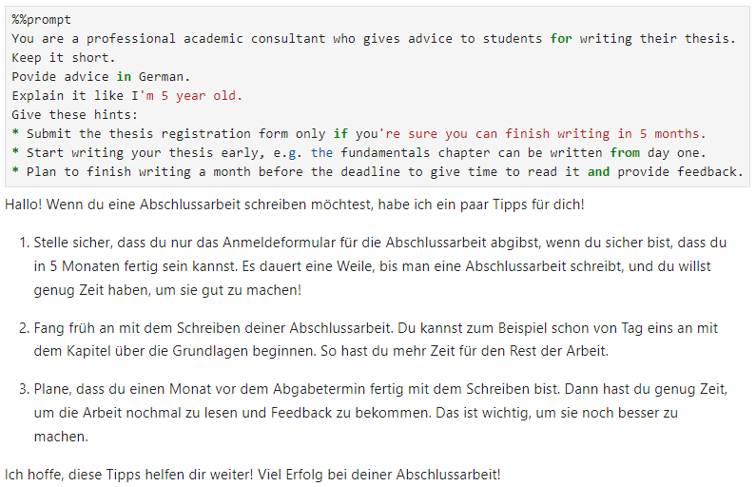
Prompt Engineering
Set context / assign role
Define output style
Give hints / conditions
List tasks
Provide data
https://scads.github.io/prompt-engineering-tutorial-2023/01_prompts/03_prompt_engineering.html

Slide 10
Long-context prompting
Also known as in-context learning
Context with plenty of knowledge provided in system message
System message (1000s of tokens)
Prompt Engineering
LLM
User‘s query
Response

Slide 11
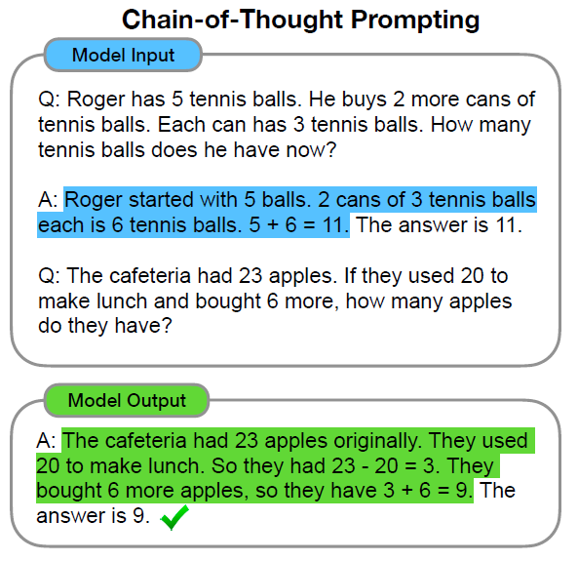
Long-context prompting
Single-shot prompting:
Few-shot prompting:
I’m interested in how to repair a motorcycle tire.
<book about motorcycle repair>
Tell me how to repair a motorcycle tire.
Cropped from Wei et al 2022, licensed CC-BY 4.0 https://arxiv.org/abs/2201.11903

Slide 12
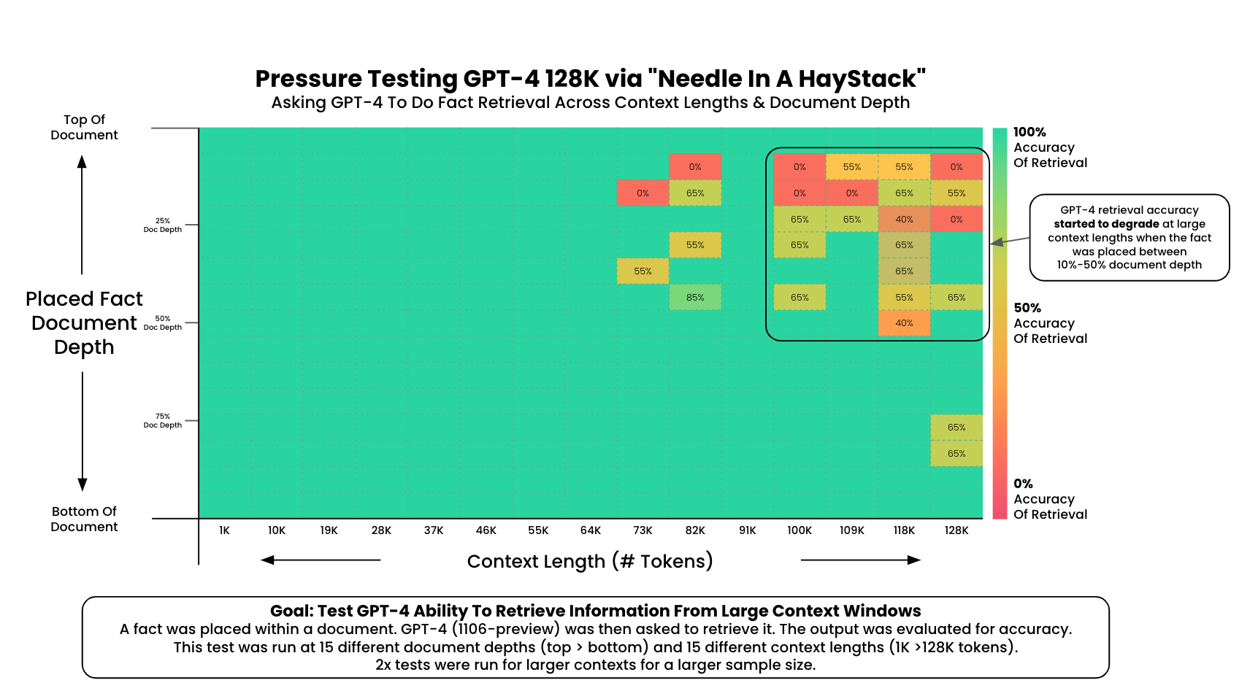
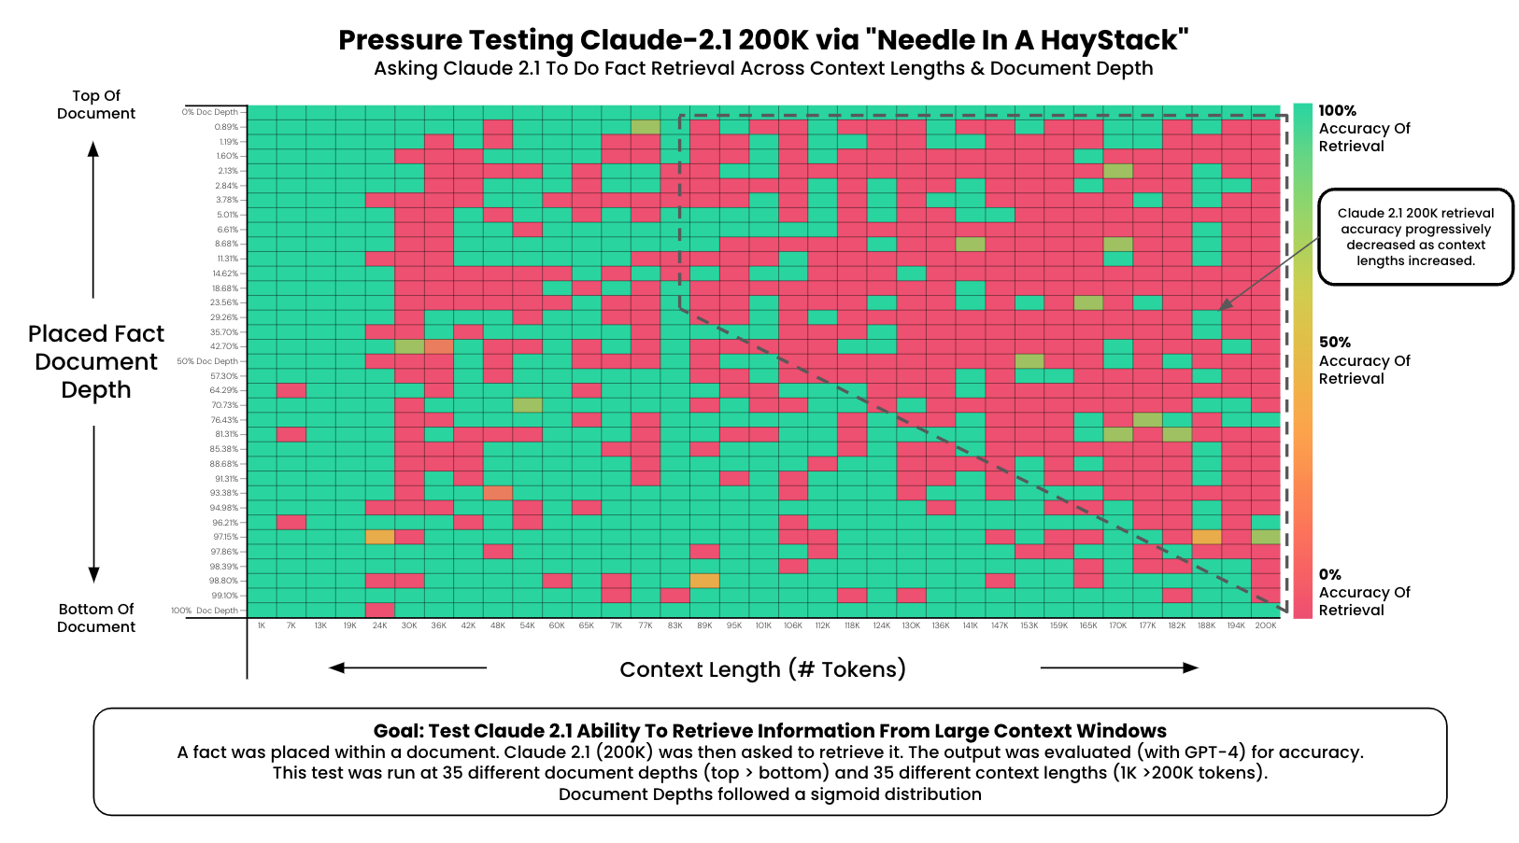
Context length
Visualization by Greg Kamradt, Licensed MIT (modified), Source: https://github.com/gkamradt/LLMTest_NeedleInAHaystack

Slide 13
Context length
Visualization by Greg Kamradt, Licensed MIT (modified), Source: https://github.com/gkamradt/LLMTest_NeedleInAHaystack

Slide 14
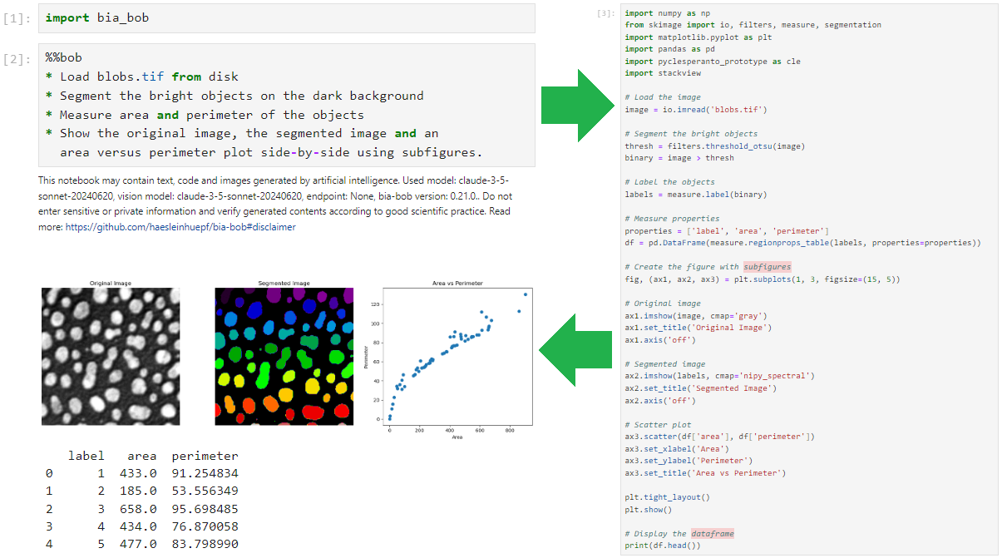

Example: Scientific code writing
bia-bob: long-context prompting for image-analysis code.
https://github.com/haesleinhuepf/bia-bob

Slide 15
Under the hood: long-context prompting
Context-dependent system prompt considering
local variables and functions
installed python libraries
chat history
You are a extremely talented bioimage analyst and you use Python to solve your tasks ...
…
## Python specific code snippets
If the user asks for those simple tasks, use these code snippets.
* Load an image file from disc and store it in a variable:
```
from skimage.io import imread
image = imread(filename)
```
About 6500 tokens
(≈words)
…
## Todos
Answer your response in three sections:
1. Summary: First provide a short summary of the task.
2. Plan: Provide a concise step-by-step plan without any code.
3. Code: Provide the code.
+ your prompt

Slide 16
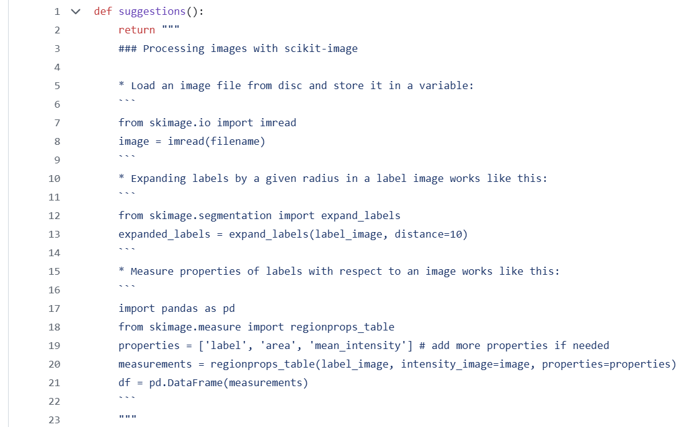
Under the hood: long-context prompting
E.g. giving advice for how to use scikit-image
https://github.com/haesleinhuepf/bia-bob/blob/main/src/bia_bob/suggestions/_scikit_image.py

Slide 17
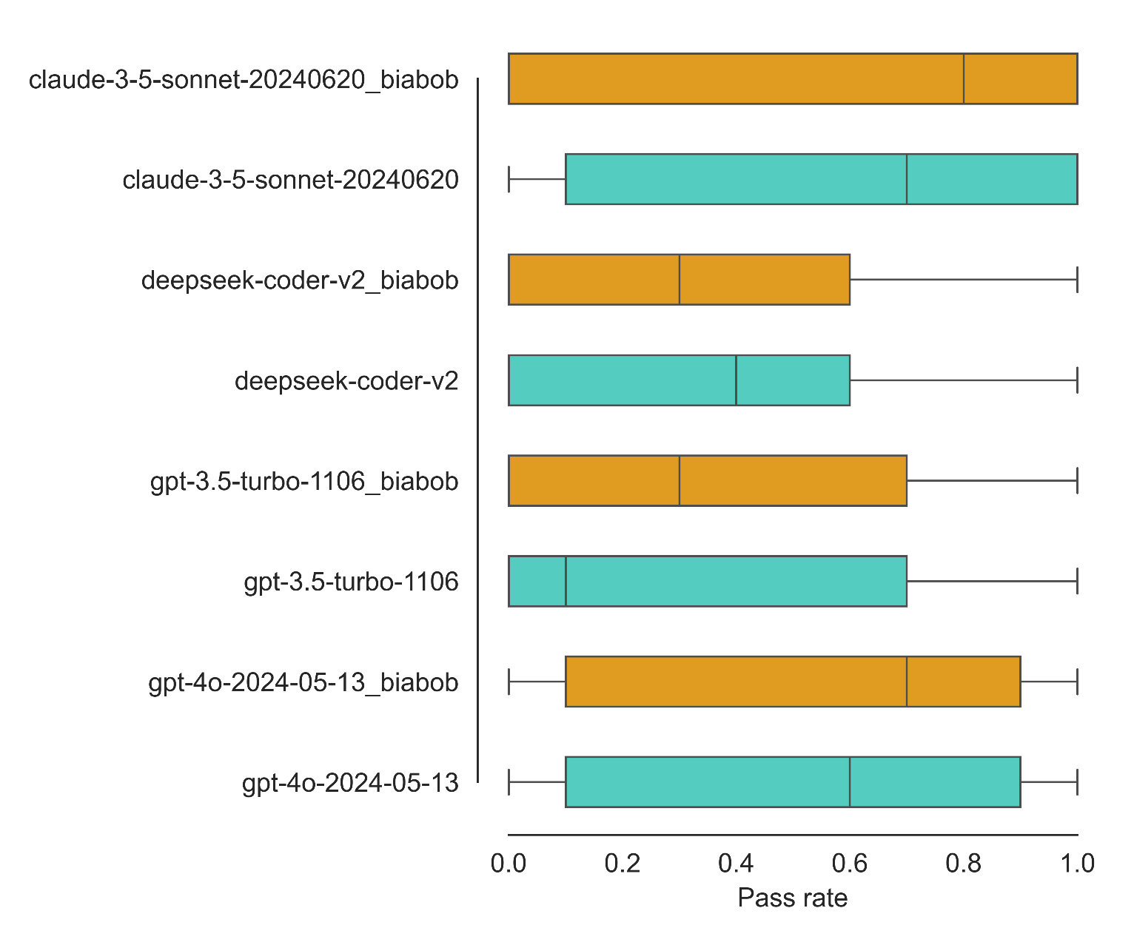
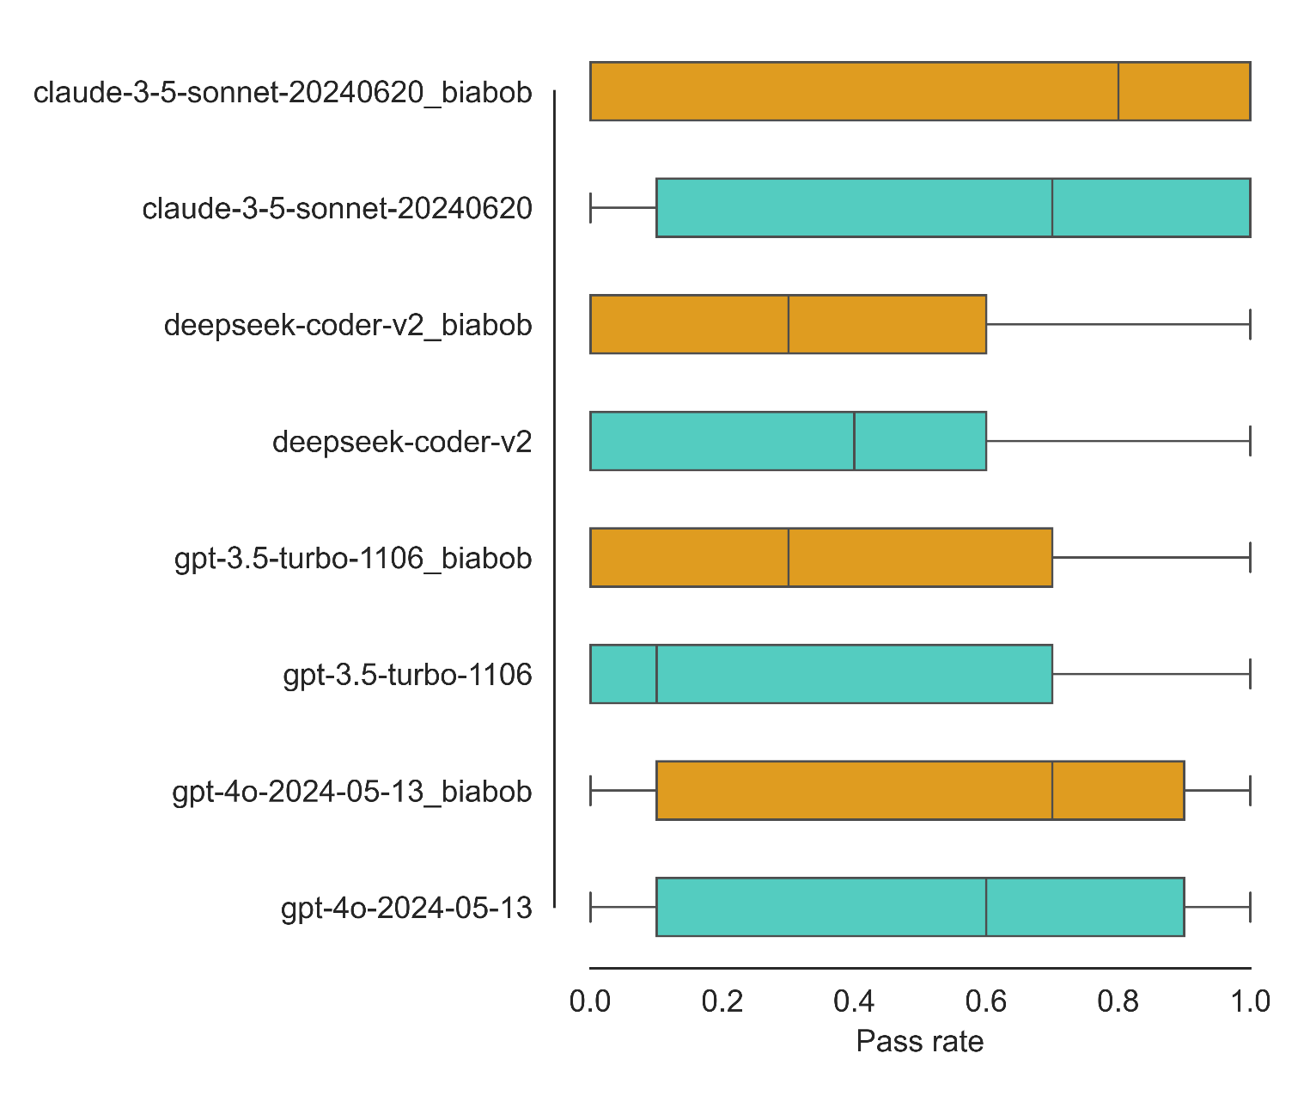
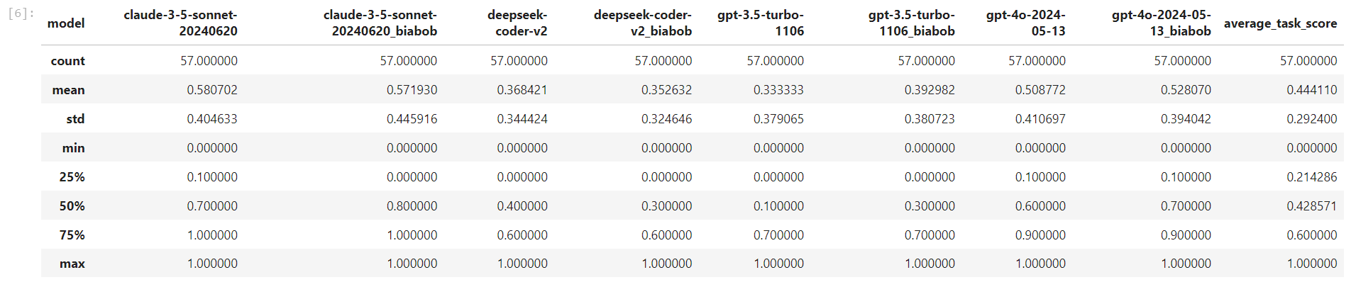
Benchmarking plain LLMs vs. long-context prompting
57 ± 45%
58 ± 40%
35 ± 32%
37 ± 34%
- 1 %
- 2 %
53 ± 39%
51 ± 41%
+ 2 %
39 ± 38%
33 ± 38%
+ 6 %
https://github.com/haesleinhuepf/human-eval-bia
https://github.com/haesleinhuepf/human-eval-bia/blob/biabob/demo/summarize_by_case.ipynb

Slide 18
Prompt Engineering
Combining LLMs
Prompt Engineering
LLM
Prompt Engineering
LLM
User‘s query
Response

Slide 19
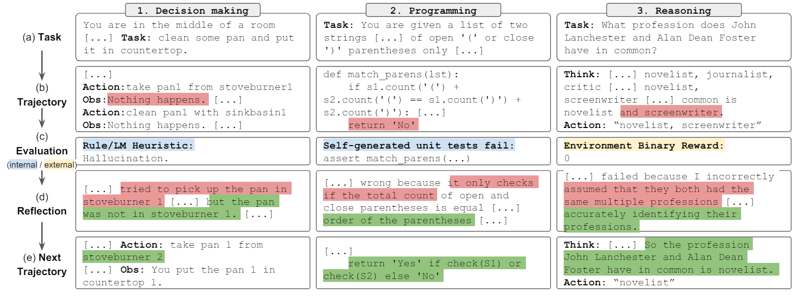
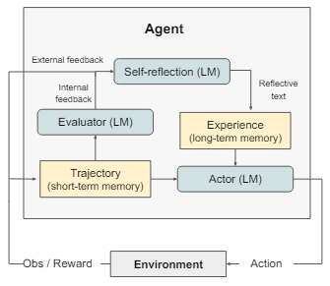
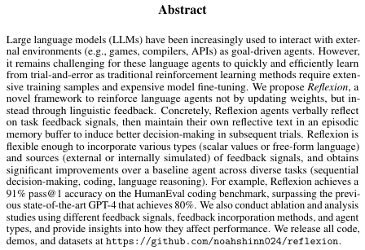
Reflexion / Reflection
Iterating over tasks/solutions
Cropped from Shinn et al 2023, licensed CC-BY 4.0 https://arxiv.org/abs/2303.11366

Slide 20
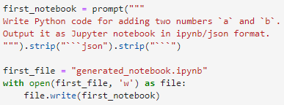
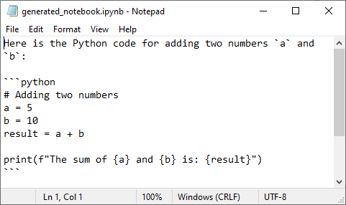

Reflection
Example task: Generate a Jupyter notebook
https://github.com/ScaDS/BIDS-lecture-2024/blob/main/11a_prompt_engineering/10_reflection.ipynb

Slide 21
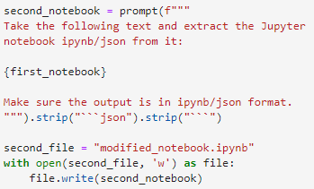
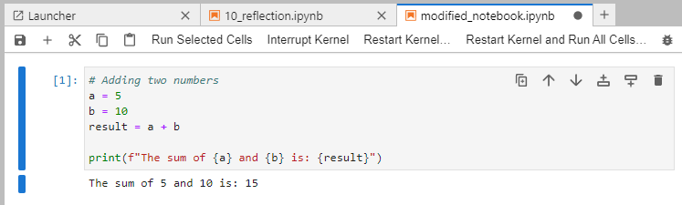
Reflection
Example task: Generate a Jupyter notebook
https://github.com/ScaDS/BIDS-lecture-2024/blob/main/11a_prompt_engineering/10_reflection.ipynb

Slide 22
Retrieval Augmented Generation
Enriching a prompt with relevant context
Knowledge base (billion of documents)
Selection by relevance
Prompt Engineering
LLM
User‘s query
Response

Slide 23

Retrieval Augmented Generation
Enriching a prompt with relevant context
Query encoder
Document index
Generator
Document A
Query
Document B
Prompt
MIPS
Document C
Document C
x₄
q
x₃
Maximum inner product search (MIPS)
x₂
x₁
Read more: Lewis et al 2020
https://arxiv.org/abs/2005.11401

Slide 24
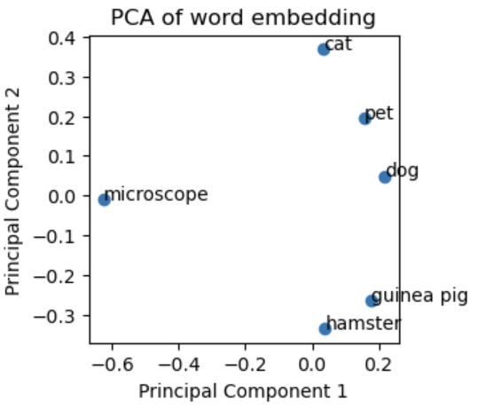
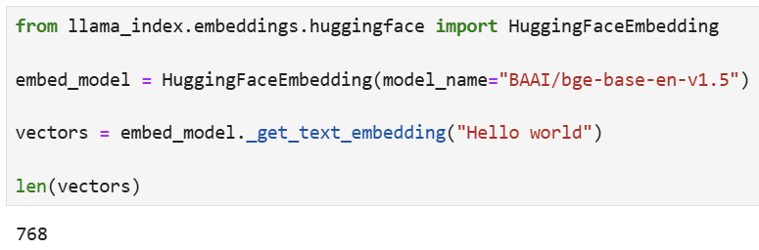
Query encoder: Text-embeddings
Abstract numeric representation of words or text
[or images]

Slide 25
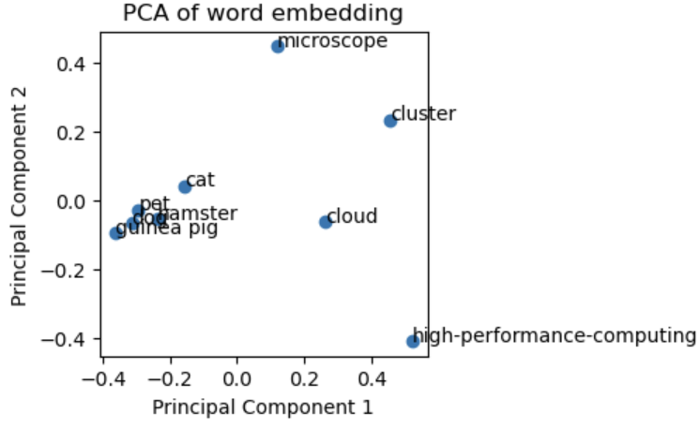
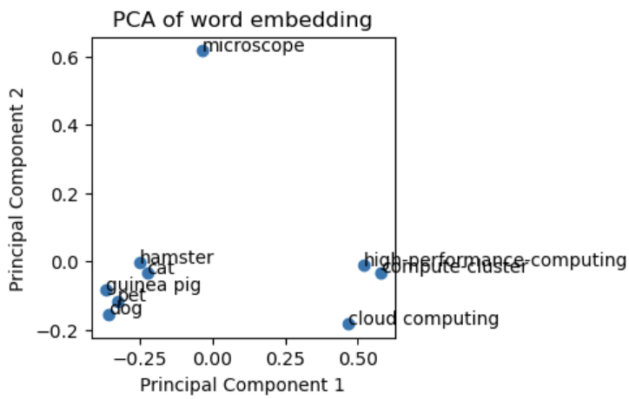
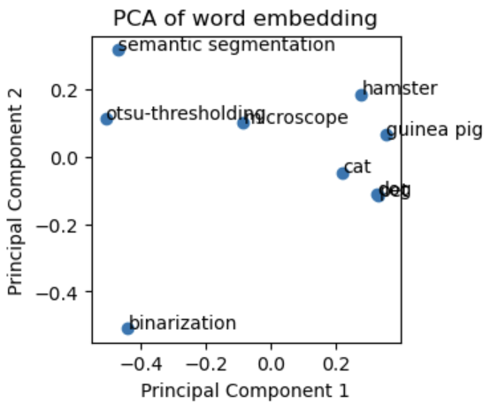
Query encoder: Text-embeddings
Embeddings sometimes do not reflect relationships we have in mind.
.. unless we formulate precisely.

Slide 26

Quiz: Similarity in embedding space
Why might inner product search more common than Euclidean distance?
Nearest neighbor search
(Euclidean distance)
Maximum inner product search
vectors in embedding space:
x_{i} ... document
q ... query
Lewis et al 2020
https://arxiv.org/abs/2005.11401

Slide 27
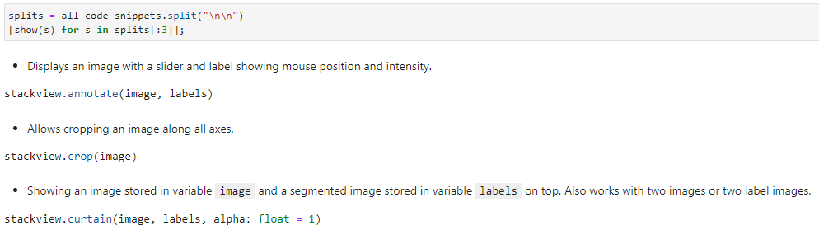

RAG from scratch
0. Encode the knowledge base (code snippets)
…
Should be cached ideally!
https://scads.github.io/generative-ai-notebooks/60_rag/20-simple-rag.html

Slide 28

RAG from scratch
1. Encode the question
https://scads.github.io/generative-ai-notebooks/60_rag/20-simple-rag.html

Slide 29
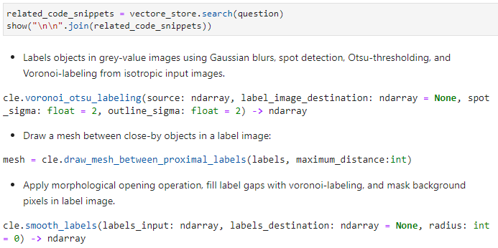
RAG from scratch
2. Identify related code-snippets
Sorted by distance decending

Slide 30
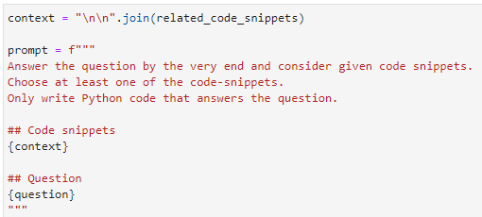
RAG from scratch
3. Generate prompt
https://scads.github.io/generative-ai-notebooks/60_rag/20-simple-rag.html

Slide 31
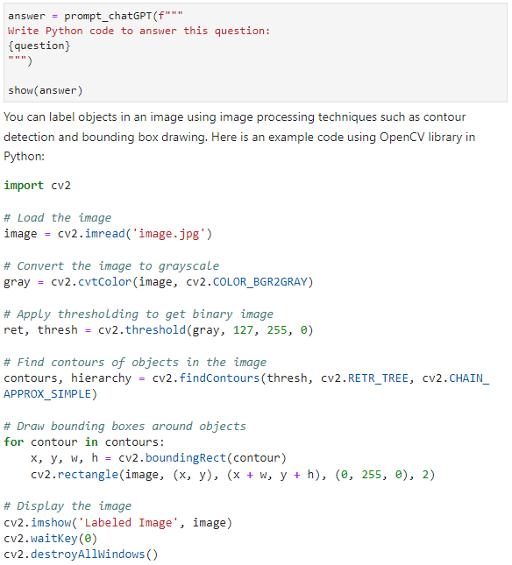
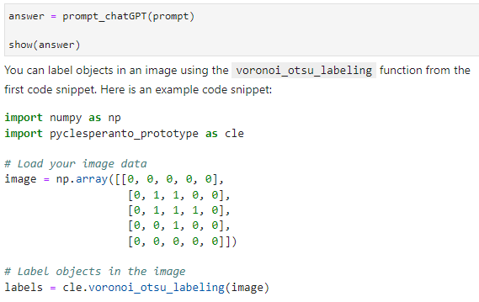
RAG from scratch
Without RAG
4. Retrieve answer
From our knowledge base
https://scads.github.io/generative-ai-notebooks/60_rag/20-simple-rag.html

Slide 32
Use RAG frameworks!
Implementing RAG from scratch only makes sense for academic purposes.
In projects, use frameworks!
  LangChain / LangGraph
  https://github.com/langchain-ai/langgraph/tree/main/examples/rag
  Elastic Search
  https://www.elastic.co/what-is/retrieval-augmented-generation
  Llama-index
  https://docs.llamaindex.ai/en/stable/understanding/rag/
  Smolagents
  https://huggingface.co/docs/smolagents/en/examples/rag
  …
The field is moving fast, revise your decision for a framework from time to time!

Slide 33
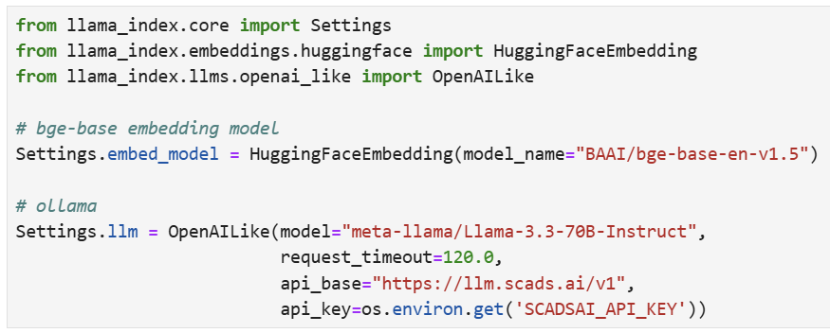
Example: RAG/LLM-based HPC-expert
Step 1: Setup embedding & LLM
Our institutional server. Prompting without limits ☺
Knowledge base source: ZIH HPC compendium, licensed CC-BY 4.0
https://compendium.hpc.tu-dresden.de/

Slide 34
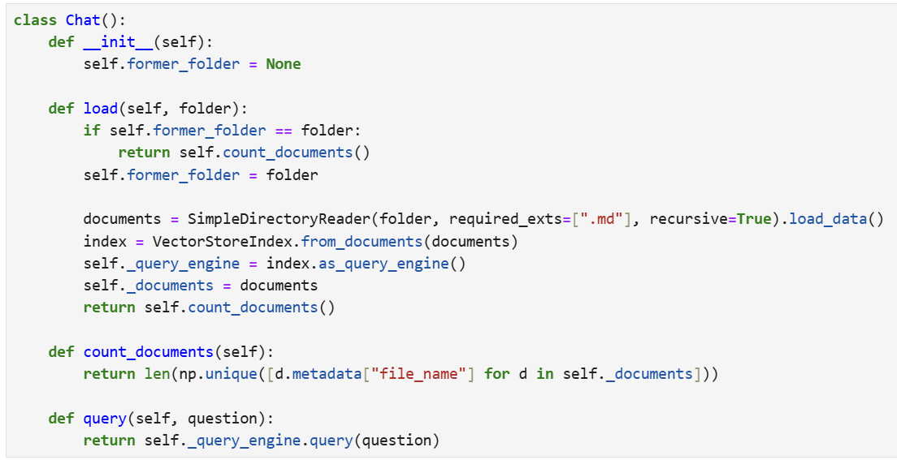
Example: RAG/LLM-based HPC-expert
Step 2: Index knowledge base
Step 3: Query

Slide 35
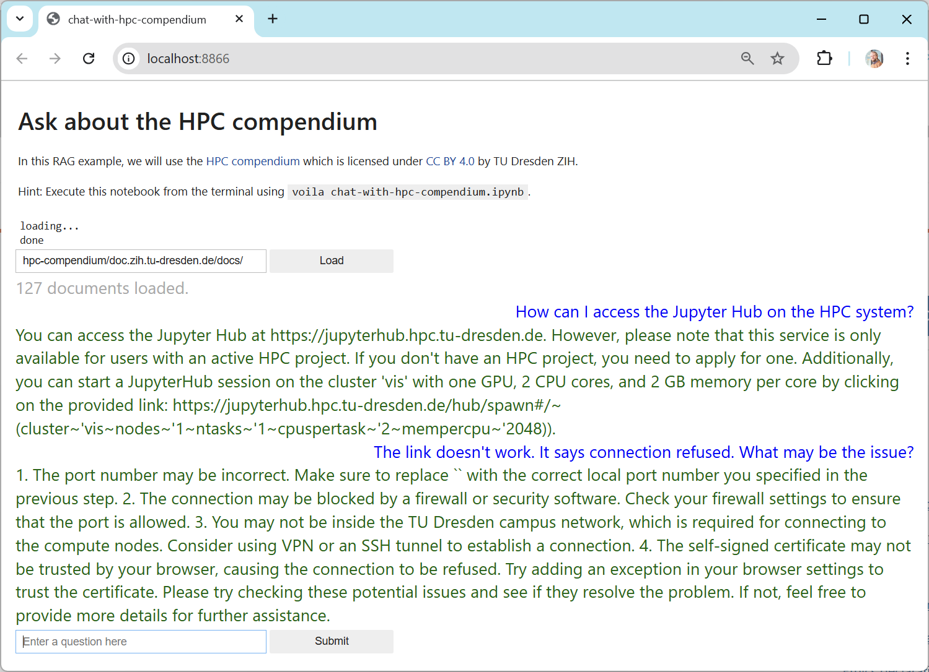
Example: RAG/LLM-based HPC-expert
Common implementation:
RAG
+ Text-based knowledge base
+ Streamlit User interface

Slide 36
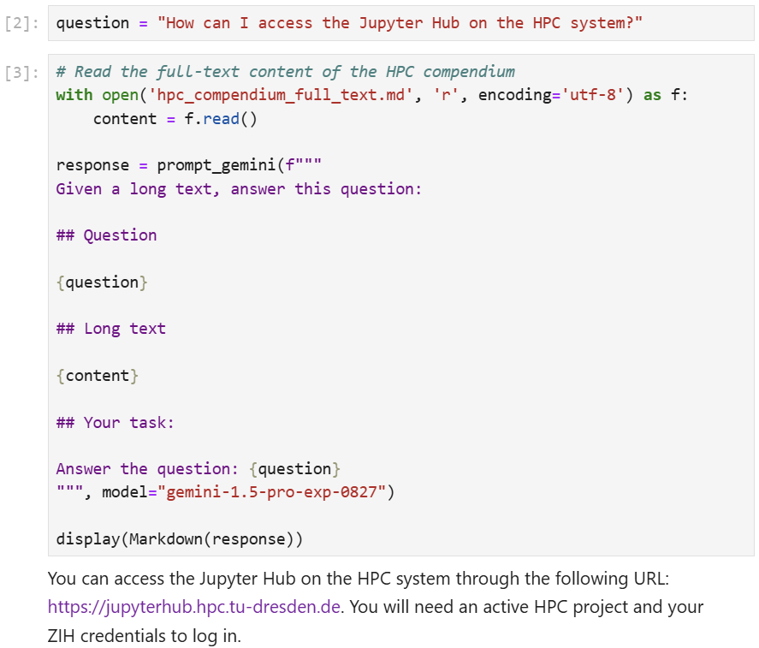
Quiz: Why not long-context prompting?
One can also program an HPC-expert using long-context prompting.
What are advantages / disadvantages?
Hint: These are 800kb
https://scads.github.io/generative-ai-notebooks/63_chat_with_docs/long-context-prompting.html

Slide 37
Retrieval augmented generation
There are various alternate solutions to embedding-
based RAGs
  full / specialised LLM to find relevant documents
  database-queries
  online searches
  …
Best choice depends on requirements (knowledge base quality, response time, costs, …)

Slide 38
Function calling / “tool calling”
Enabling LLMs to interact with the world
Prompt Engineering
LLM
Prompt Engineering
LLM
User‘s query
Function call
Execution result
Response
User is responsible

Slide 39
Function calling / “tool calling”
Enabling LLMs to interact with the world
Function call
Execution result
Prompt Engineering
LLM
Prompt Engineering
LLM
Developer is responsible
User‘s query
Response

Slide 40
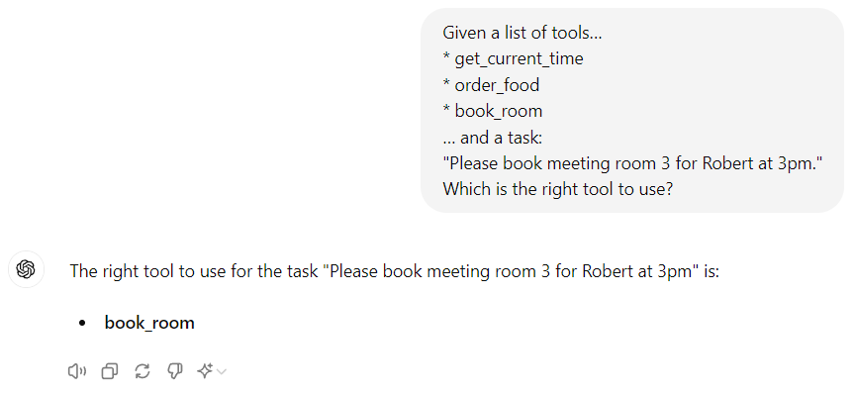
Example applications
Some kind of next-word prediction task
Function calling (choosing a tool)
Given a list of tools…
get_current_time
order_food
book_room
… and a task:
Please book meeting room 3 for Robert at 3pm.
Which is the right tool to use?
book_room

Slide 41
Example applications
Function calling (parameterizing)
Some kind of translation task
Given a function signature…
book_room(room, time, person)
… and a task:
Please book meeting room 3 for Robert at 3pm.
How could I use the tool?
book_room(“Meeting Room 3“,
“3pm“, “Robert“)

Slide 42
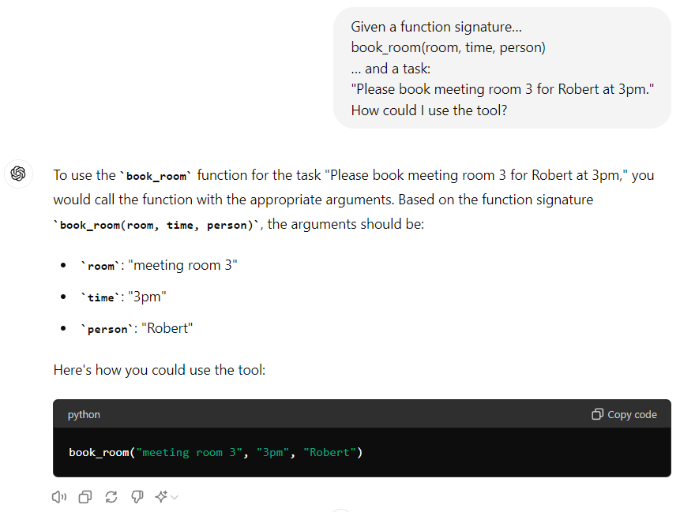
Example applications
Function calling (parameterizing)
Given a function signature…
book_room(room, time, person)
… and a task:
Please book meeting room 3 for Robert at 3pm.
How could I use the tool?

Slide 43
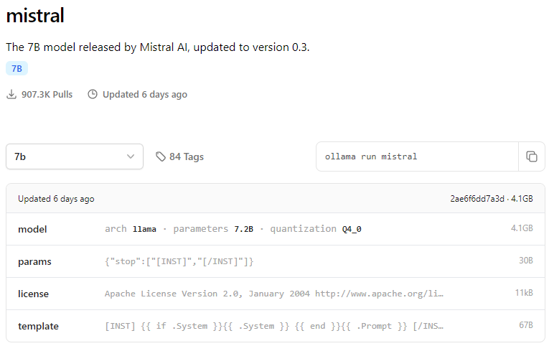
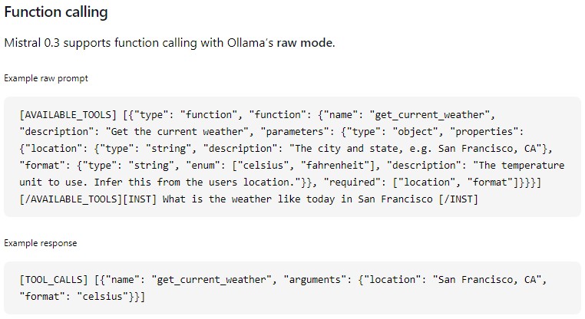
Function calling
That slide is 8 months old
Compatible models are rare
https://ollama.com/library/mistral

Slide 44
Function calling
Compatible models are rare
common
https://ollama.com/library/mistral

Slide 45
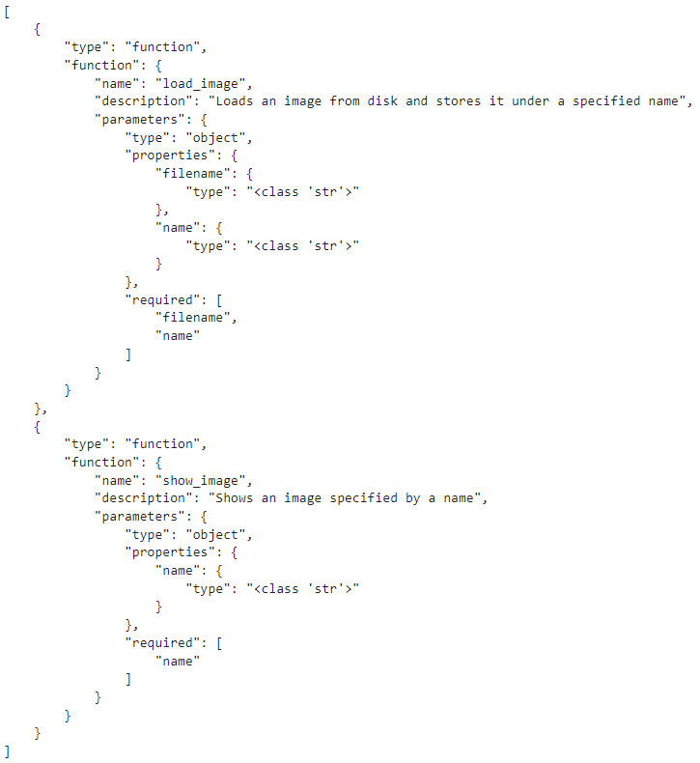
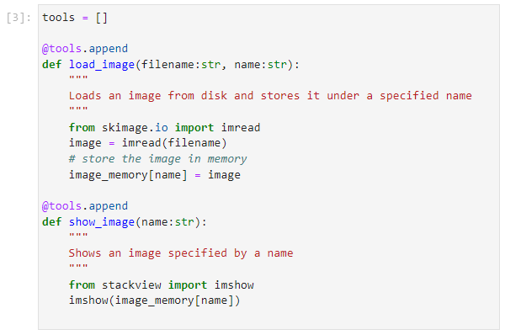
Function calling
Under the hood: JSON

Slide 46
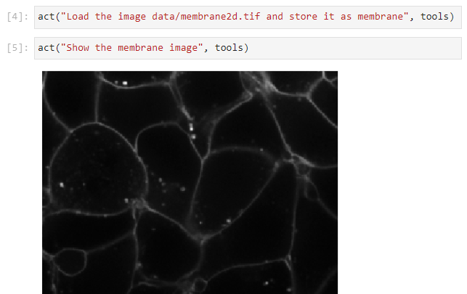
Function calling
In Python / ollama
https://scads.github.io/generative-ai-notebooks/30_function_calling/10_function_calling.html

Slide 47
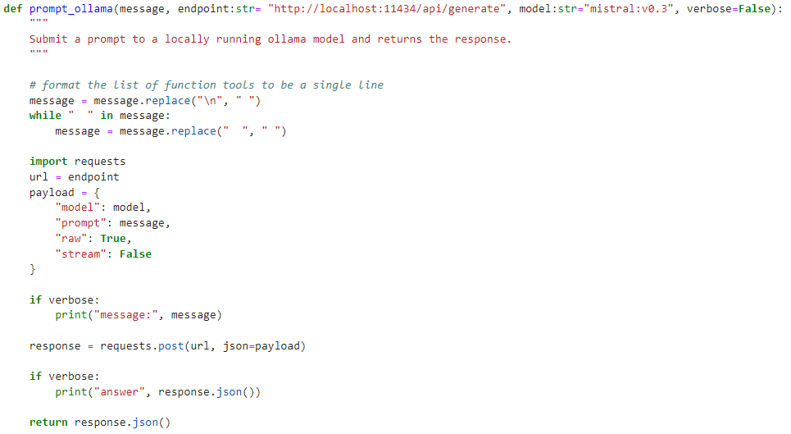
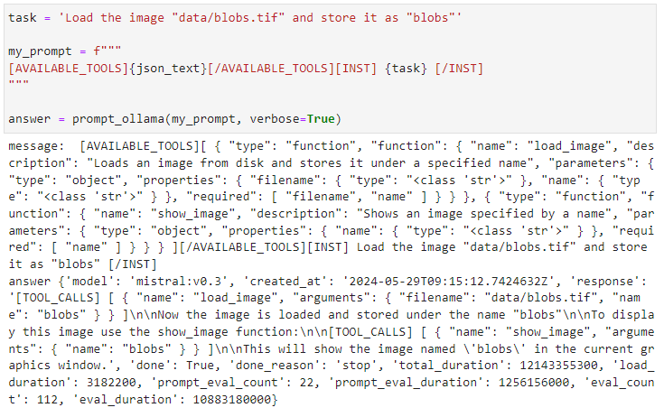
Function calling
That slide is 8 months old
API-compatibility yet challenging (in python)
Directly accessing the REST API
https://github.com/ScaDS/generative-ai-notebooks/blob/main/docs/30_function_calling/function_calling.py
https://scads.github.io/generative-ai-notebooks/30_function_calling/10_function_calling.html

Slide 48
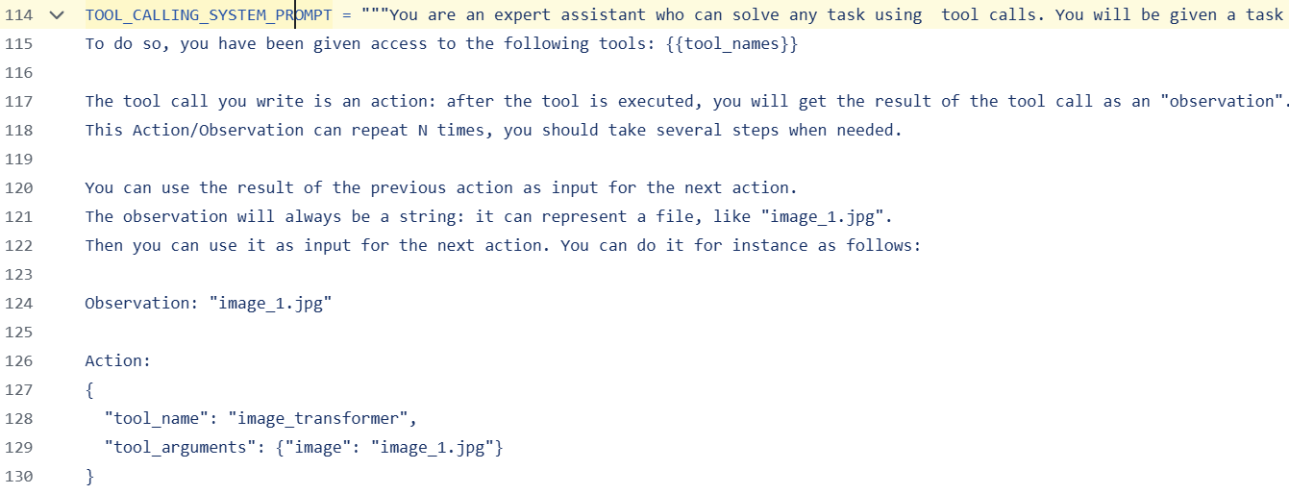
Smolagents Framework
Tool calling system prompts are some kind of long-context prompts
https://github.com/huggingface/smolagents/blob/5991206ae52b1d6d485ffeb918d765c11071cdd1/src/smolagents/prompts.py#L114

Slide 49
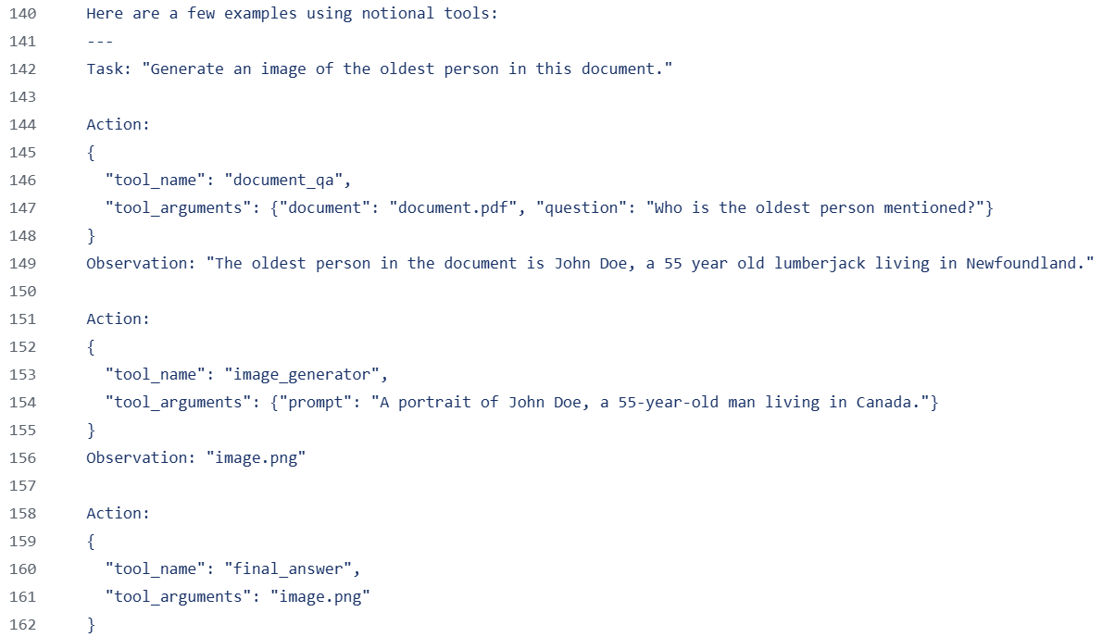
Smolagents Framework
Use lists of actions + observations to drive conversations
https://github.com/huggingface/smolagents/blob/5991206ae52b1d6d485ffeb918d765c11071cdd1/src/smolagents/prompts.py#L140

Slide 50
Use Frameworks!
Implementing Function Calling from scratch only makes sense for academic purposes.
In projects, use frameworks!
  LangChain / LangGraph
  https://python.langchain.com/docs/how_to/tool_calling/#pydantic-class
  Ollama
  https://ollama.com/blog/functions-as-tools
  Llama-index
  https://docs.llamaindex.ai/en/stable/examples/output_parsing/function_program/
  Smolagents
  https://github.com/huggingface/smolagents/blob/main/examples/tool_calling_agent_ollama.py
  …

Slide 51
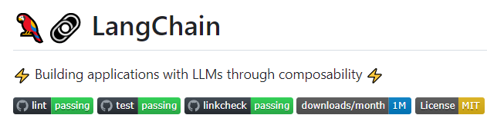
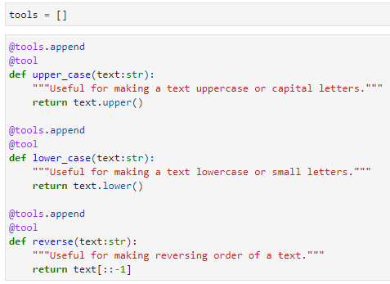
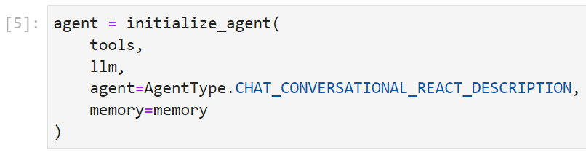
Function Calling using LangChain
LangChain can be used to combine tools.
https://github.com/langchain-ai/langchain
https://scads.github.io/prompt-engineering-tutorial-2023/01_prompts/07_langchain.html

Slide 52




Function Calling using LangChain
After combining tools, large langue model and memory in an agent, you can interact with it.
https://github.com/langchain-ai/langchain
https://scads.github.io/prompt-engineering-tutorial-2023/01_prompts/07_langchain.html

Slide 53
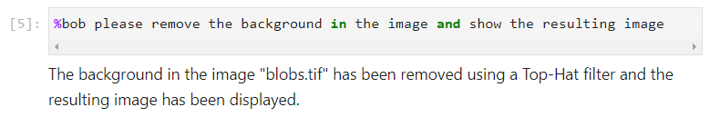
Function calling
Obviously, that’s not true.
Hallucinations

Slide 54

Function calling
Obviously, that’s not true.
Hallucinations

Slide 55



Function calling
Mapping multi-parameter / type functions is challenging when using LangChain
Necessary because of lazy (delayed) evaluation
https://github.com/haesleinhuepf/blablado/blob/4bc55c70f5219a9bcab571e96f09b1cd664baead/src/blablado/_assistant.py#L42

Slide 56
Agents
Agent:
[computer program] that represents a legal entity (e.g. a person)
can interact with the world on behalf of them
LLM-based agent:
Control flow of a program based on an LLM
The LLM decides what action to execution, what function to call

Slide 57
Agents: Shopping assistant
Agent representing a customer buys a product, e.g. in an online store, calling a store application programming interface (API).
“Order Salami Pizza!”
list_products(“pizza”)
Agent
Online store
User
[‘fungi’, ‘salami’, …]
order_product (…)
Customer is responsible

Slide 58
Agents: Customer support
Agent representing a seller communicates with customer on their behalf.
When will my order arrive?
get_order_id(“user”)
Agent
Online store
User
‘292123’
get_delivery_date(‘292123’)
‘Friday’
Store owner is responsible
https://scads.github.io/generative-ai-notebooks/35_agents/react_agent_llama_index.html

Slide 59


Agents: Customer support
https://scads.github.io/generative-ai-notebooks/35_agents/react_agent_llama_index.html

Slide 60


Agents: Customer support
To some degree, the underlying LLM can reason in which order to call the functions
https://scads.github.io/generative-ai-notebooks/35_agents/react_agent_llama_index.html

Slide 61
Limits of agents
An LLM control the program flow -> LLM outputs are non-deterministic!
Long [internal] chat history confuses tool-selection.
Agents with too many diverse tools tend to act confused.
Multi-talent agent
Can:
Read abstracts
Summarize papers
Provide feedback
Write papers
Incorporate feedback
Print the final paper

Slide 62
Multi-agent systems
Scheduler agent
Multiple agents with
  different specialities
  Independent memory (inner chat history)
Scheduler agent distributes tasks
Can:
Split complex tasks in sub-tasks
Distribute tasks
Research assistant
Science writer
Reviewer
Printer
Can:
Read arxiv abstracts
Can:
Write papers
Incorporate feedback
Can:
Read text
Provide feedback
arxiv
Manuscript

Slide 63





Example: Summarizing Arxiv-Papers
Task: Read 5 arxiv papers and write a review about them
https://scads.github.io/generative-ai-notebooks/66_arxiv_agent/multiagent_write_review.html

Slide 64

Example: Summarizing Arxiv-Papers
Scheduler needs this information to decide about which agent can do which tasks
Task: Read 5 arxiv papers and write a review about them
Research assistant
Can:
Read arxiv abstracts
The smolagents framework needs this information to set parameters accordingly
https://scads.github.io/generative-ai-notebooks/66_arxiv_agent/multiagent_write_review.html

Slide 65


Example: Summarizing Arxiv-Papers
Task: Read 5 arxiv papers and write a review about them
Science writer
Can:
Write papers
Incorporate feedback
https://scads.github.io/generative-ai-notebooks/66_arxiv_agent/multiagent_write_review.html

Slide 66

Example: Summarizing Arxiv-Papers
Task: Read 5 arxiv papers and write a review about them
Reviewer
Can:
Read text
Provide feedback
https://scads.github.io/generative-ai-notebooks/66_arxiv_agent/multiagent_write_review.html

Slide 67

Example: Summarizing Arxiv-Papers
Task: Read 5 arxiv papers and write a review about them
Scheduler agent
Can:
Split complex tasks in sub-tasks
Distribute tasks
https://scads.github.io/generative-ai-notebooks/66_arxiv_agent/multiagent_write_review.html

Slide 68

Example: Summarizing Arxiv-Papers
Log
https://scads.github.io/generative-ai-notebooks/66_arxiv_agent/multiagent_write_review.html

Slide 69

Example: Summarizing Arxiv-Papers
Output
https://scads.github.io/generative-ai-notebooks/66_arxiv_agent/multiagent_write_review.html

Slide 70


Solving the same task with long-context prompting
Also possible; less flexible

Slide 71

Solving the same task with long-context prompting
Output

Slide 72
Agentic workflows vs. [long-context] prompting
If agents had a success-rate of 99%, and we chain 5 agents in a workflow, our workflow’s success rate: 0.99⁵ = 95%
  Commercial models may actually have a success-rate of 99% when calling a function.
  Open weight models may not.
If agents had a success-rate of 90%, and we chain 5 agents in a workflow, our workflow’s success rate: 0.9⁵ = 59%
If agents had a success-rate of 50%, and we chain 5 agents in a workflow, our workflow’s success rate: 0.5⁵ = 3%
Many frameworks solve this problem by calling functions in loops and checking results, e.g. for consistency -> high costs!

Slide 73


Example: Customer support
https://github.com/haesleinhuepf/stackview/issues/79

Slide 74

Agents: Customer support
Under the hood: Long-context prompting

Slide 75


Agents: Customer support
https://github.com/haesleinhuepf/stackview/issues/80

Slide 76

Agents: Customer support
Under the hood: Long-context prompting

Slide 77
Summary
Prompt Engineering
  Long-context prompting
  Reflexion / reflection
  Retrieval-Augmented-Generation (RAG)
  Function-calling
  Agents
  Multi-agent workflows
Pros
Simple
Supports big data
(many, long documents)
Flexible / versatile
Most flexible
Cons
Expensive, slow
Often not good / depends on domain
Hard to debug
Even harder to debug
Most expensive

Slide 78


CENTER FOR SCALABLE DATA ANALYTICS AND
ARTIFICIAL INTELLIGENCE
Exercises
Robert Haase
Funded by

Slide 79
Exercise: Chat with documents (llama-index)
Setup the Chat-App(s) for the HPC systems on your computer (or on Jupyter Hub)
Ask it out about HPC systems at TU Dresden.
Ask it out about how to make chocolate cookies.
https://scads.github.io/generative-ai-notebooks/63_chat_with_docs/hpc-compendium-prepare-data.html

Slide 80
Exercise: Multi-agent systems (smolagents)
Setup the multi-agent system on your computer.
Ask it to write a summary about different papers, e.g.:
  https://arxiv.org/abs/2407.18752
  https://arxiv.org/abs/2411.04920
  https://arxiv.org/abs/2204.07547
Try to predict the topic of the review the agents will come up with.
https://scads.github.io/generative-ai-notebooks/66_arxiv_agent/multiagent_write_review.html

