Slide 1

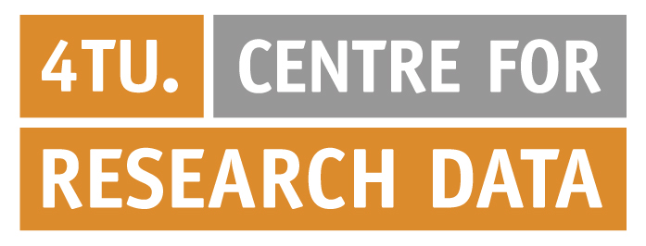



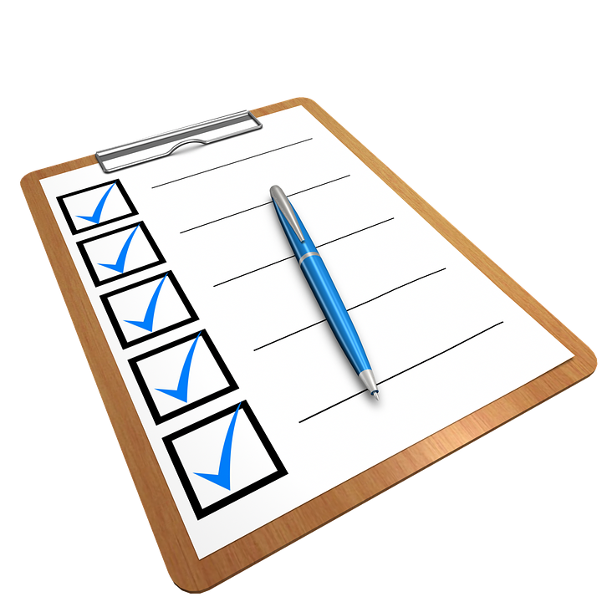
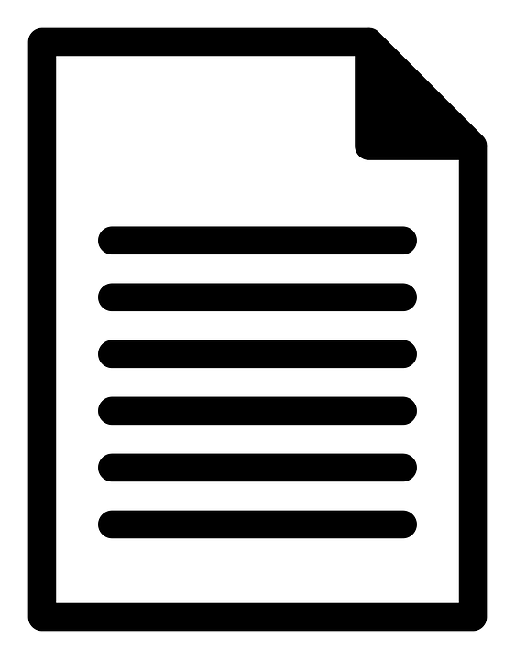


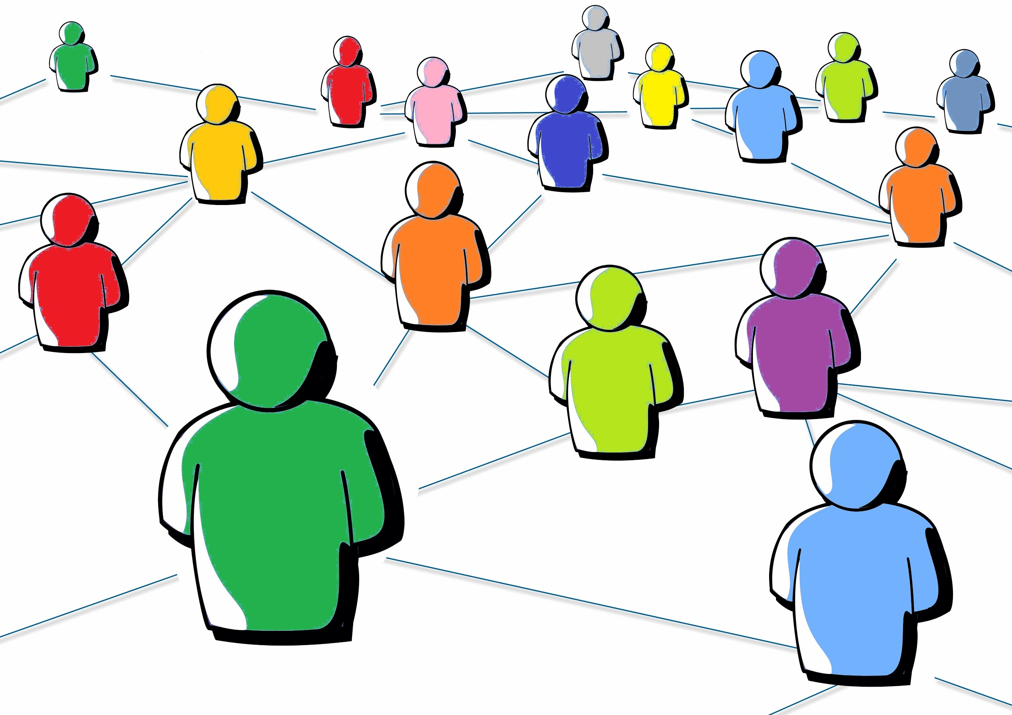
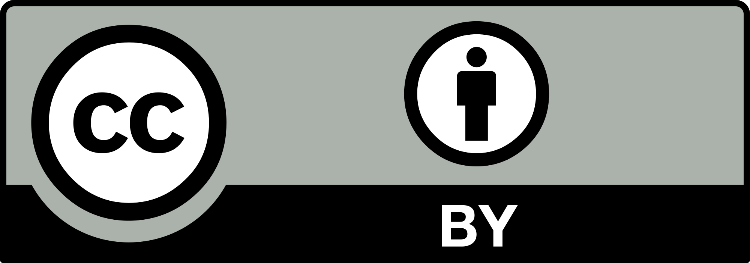
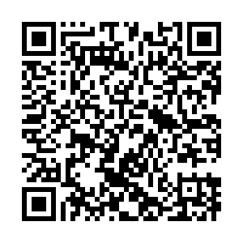
Data Stewardship
at Delft University of Technology
  Overview of Research Data Management Support
Secure data storage, data sharing, citation, impact
For data management in grant proposals
Advice and templates
Request workshops, information sessions
Advice
Archiving
Costs
Compliance
Data Management Plans
Tools
Training
4TU.Centre for Research Data or disciplinary repositories
With funders' and journals’ policies
For data and software management
  Community Building
Data Stewards
Discipline specific
RDM experts.
Dedicated go-to persons at faculty level.
Bridging researchers with other support services.
Facilitating development of RDM policies.
Data Champions
Researchers with
good RDM practices.
Local advocates at departmental level.
Bottom-up community formation.
Front runners implementing RDM policies.
14-05-2018
  DOI: 10.5281/zenodo.1466927
  For more information: http://tudelft.nl/library/datastewards
  Contact information: datastewards@tudelft.nl

