Slide 1
Creating an Open, Decolonial, Health Inequalities Journal
Sohail Jannesari
Senior Teaching Fellow, Research Fellow
sohail.jannesari@kcl.ac.uk, www.sohailj.com

Slide 2
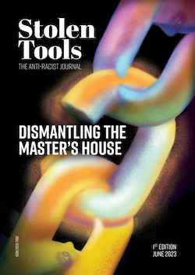
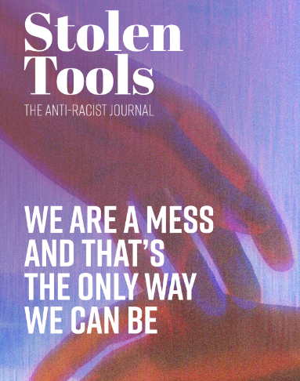
What does our journal look like?
First issue explored the ethics of knowledge production, art as knowledge, the critical role of professional services in academia, and acknowledgement in decolonisation.
Second issue looked at the shifting and intersecting identities around racialised people, critiqued EDI’s fixation on metrics and charters, and racism in publishing.
We’re doing special issues to move away from centralising power (neurodiversity, anti-colonial struggle, and a student take-over).

Slide 3
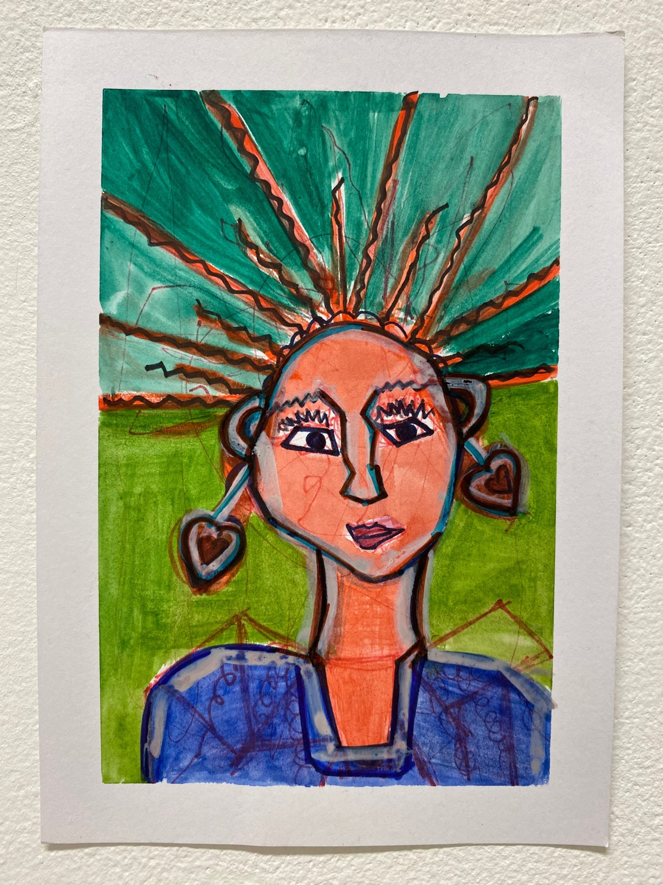
Aim 1: Promoting Racialised Voices
Putting people before papers and working with people for as long as it takes.
A mentor system and open peer review process.
Reducing bureaucratic obstacles, e.g., flexible referencing.
Payment throughout and open access articles.
Artwork from Bjar Art

Slide 4
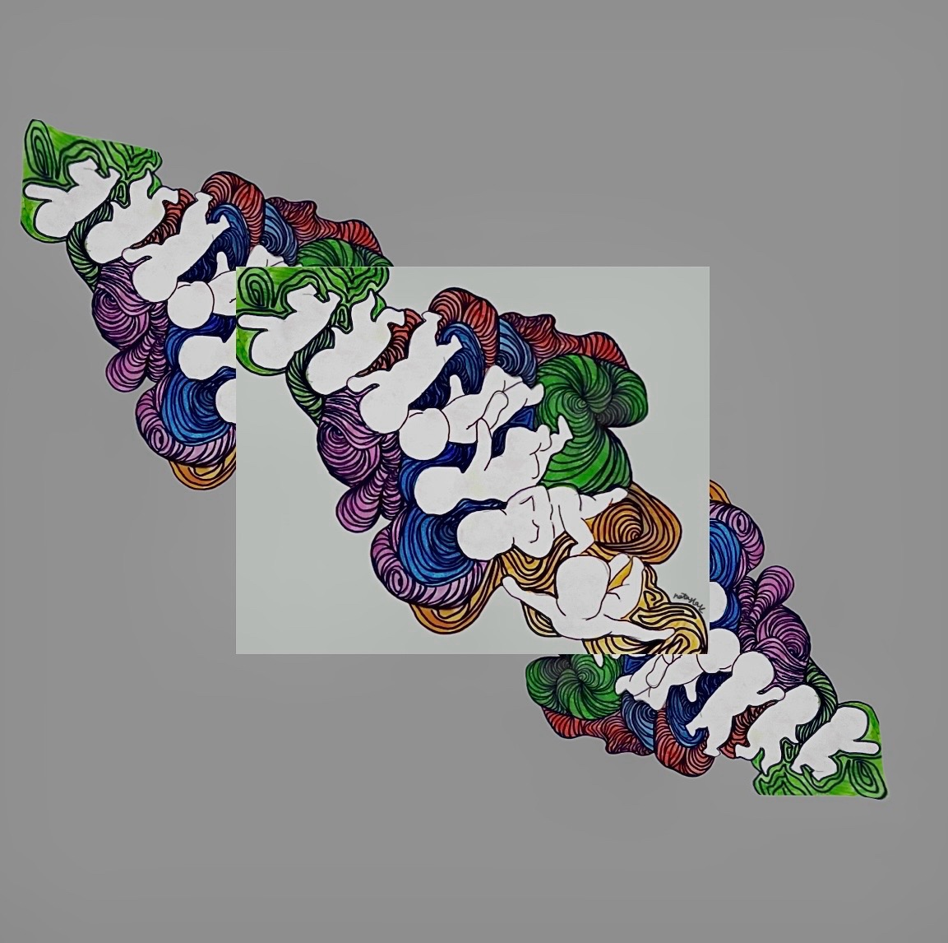
Aim 2: Challenging what counts as knowledge
Space to be emotionally and politically expressive. Challenging our self-censorship.
Sharing knowledge in as many ways as possible (poems, stories etc.)
Involving non-university researchers in knowledge production.
Challenging other journals to change their practices.
Artwork from Natasha Katashila

Slide 5
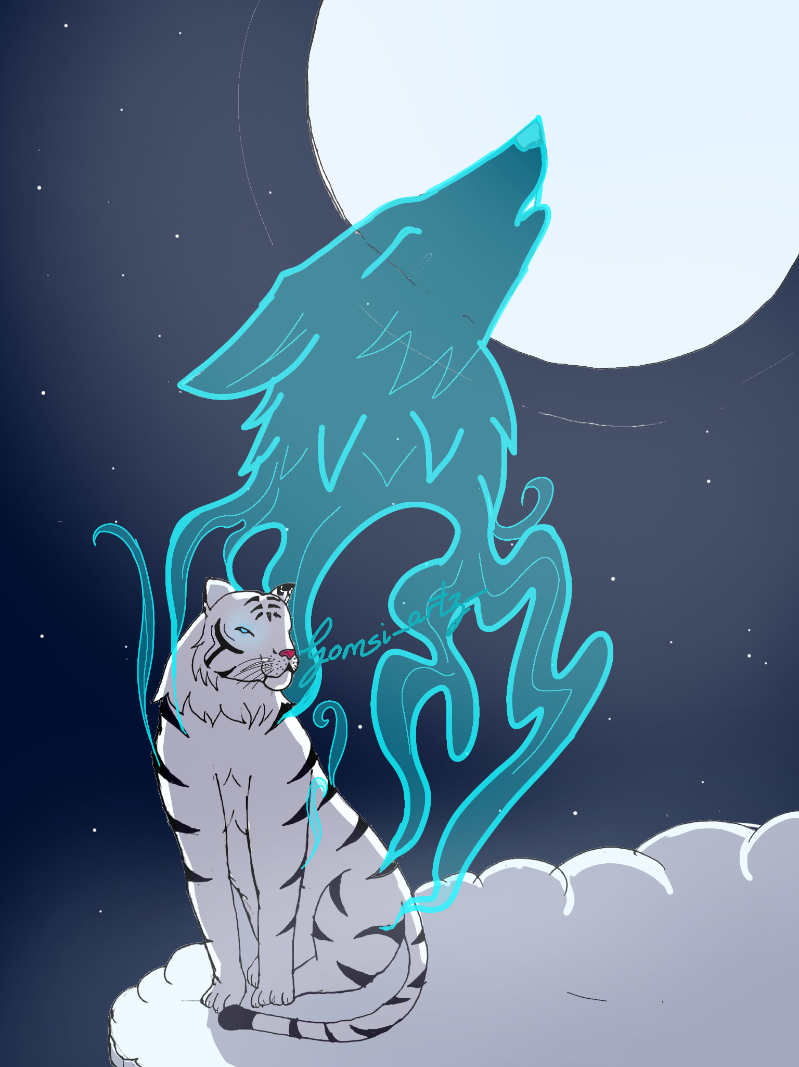
Building for the long-term
Library partnerships have led to fundings, improved reach etc.
Build international links through forthcoming special issues and talks!
Refine and improve our model (open peer review, language, AI, mentorship, submission mediums etc.).
Artwork from Ugomsinachi Agu

Slide 6


Thank you! Any questions?
@stolentools_
@stolentools

