Slide 1
Open Scientific Code in Research
Aleks Nenadic
Software Sustainability Institute
@aleks_nenadic
8 October 2020
Based on "How to contribute to open source" workshop for researchers by Yo Yehudi, @yoyehudi
http://bit.ly/github-for-researchers
Notes:
Credit also to Andrew Stewart and his OLS-1 talk: https://ajstewartlang.github.io/talks/OLS_talk/assets/player/

Slide 2
What is Open Source?
http://bit.ly/github-for-researchers

Slide 3
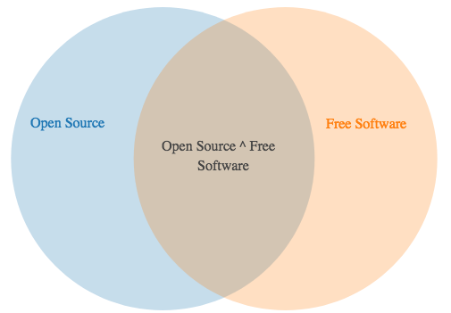
Open source isn’t the same thing as free
Some free software isn’t open source (no one can see, modify, or re-used its code)
Sometimes open source software isn’t free
http://bit.ly/github-for-researchers

Slide 4
Open Source is simply sharing the design for your work so it can be re-used and re-mixed by others
http://bit.ly/github-for-researchers
Notes:
It can be anything - code, methodology, algorithm, data, photos

Slide 5
Why Use and Promote Open Source?
http://bit.ly/github-for-researchers
Notes:
A bit on motivation...

Slide 6
Why open source?
Open source research code can be peer-reviewed and re-used
Hacker ethic - nobody should have to reinvent the wheel. If you have benefitted from other’s work, you should give back to the community
Distributed collaborative innovation: share your work, and others will share back
Document for others and for you: If you include documentation to help others set it up, it’ll be easier for you to come back to the project when you’ve forgotten what you did
http://bit.ly/github-for-researchers
Notes:
You want to expose your code so you can collaborate on it with others
You want wider community to have a look at your code, test it and help improve it
Ultimately, you want to have users for your code and help others not reinvent the wheel and advance the science faster
You want your work/research to be reproducible and this is the first step to it

Slide 7
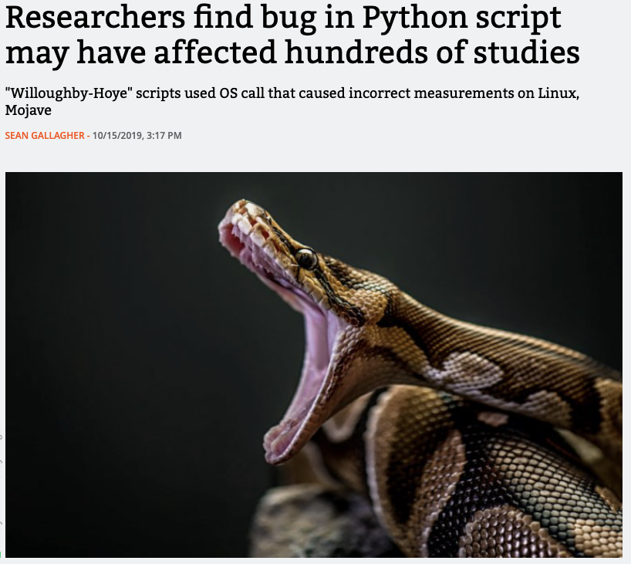

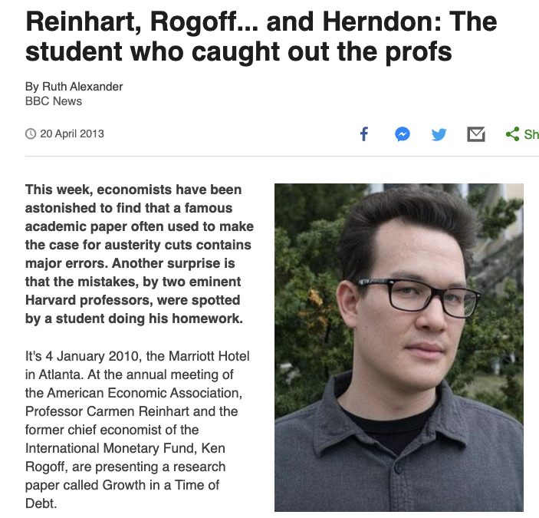
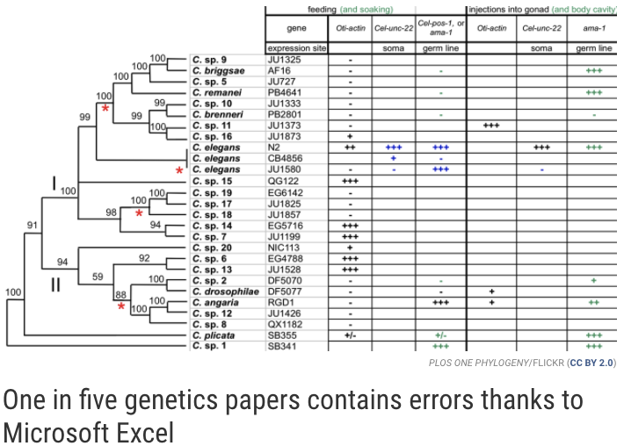
Risk of closed code
Notes:
Let’s look deeper into the motivation…
Had these been open source from the beginning - errors could have been avoided and reputations saved
By no means a criticism of people’s code - we have all made mistakes
COVID-19 put (open) research software in spotlight - Neil Ferguson, academic from Imperial
Release early and often, do not be afraid to make a mistake

Slide 8
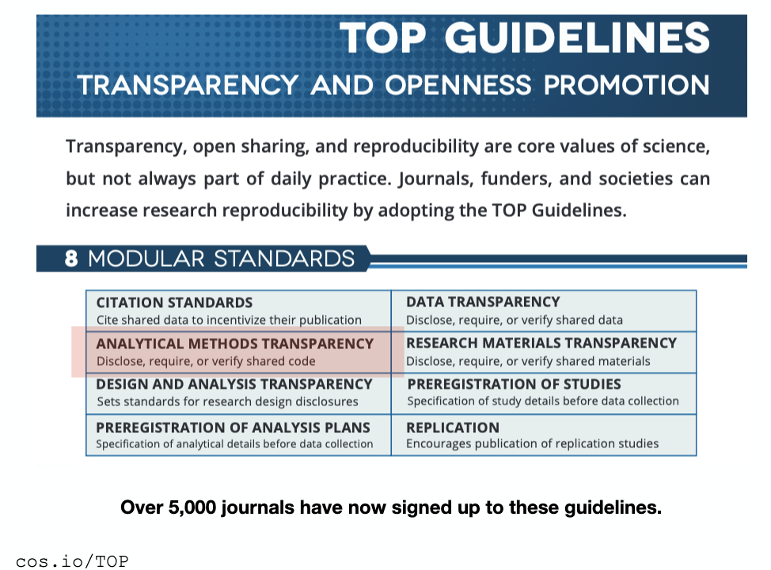
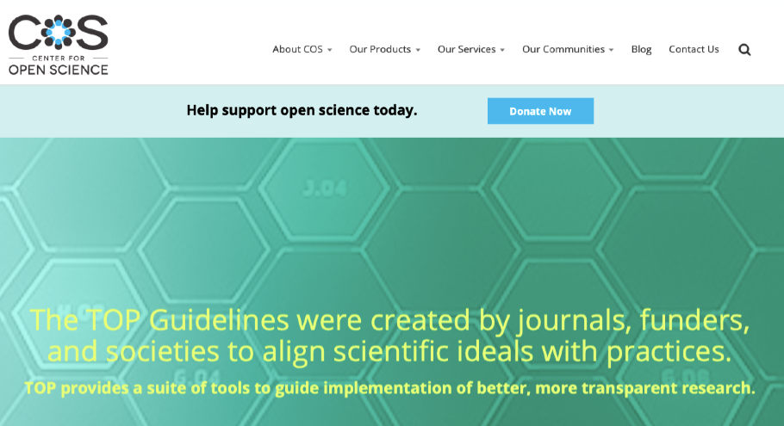
Transparency in research

Slide 9
How do I know if software is open source?
Even if code is viewable online (the source of the code is technically open), unless there is a licence, it’s not legal to re-use it.
Open source software should have a licence stating that it is in fact legal to be re-used, re-mixed, etc. There are a lot of difference licence types, usually found in an open source repository under the file LICENSE, LICENSE.txt, or LICENSE.md
Always add a license to your software! Or data! Or photos!
http://bit.ly/github-for-researchers

Slide 10
Publishing and Sharing Open Code
http://bit.ly/github-for-researchers

Slide 11
What is Version Control?
Easy way to publish and share code with others so they can download, re-use, contribute
You can view all of your files and effectively jump back in time to any save point
http://bit.ly/github-for-researchers

Slide 12
Why use Version Control?
Never mess up again… okay - you will still mess up, but it means you can recover from your mistakes.
It makes collaborating on code much easier
Offsite backups (so long as you push your work to a remote server). We’ve all heard stories of people who had their hard-drives corrupted or computers stolen before. With version control tool this never needs to happen again!
http://bit.ly/github-for-researchers

Slide 13
Git and GitHub
Git is one type of version control software, alongside GitHub, a central site that hosts Git repositories
Other tools similar to Git/GitHub:
Mercurial/BitBucket: https://bitbucket.org/
Git/GitLab: https://gitlab.com
http://bit.ly/github-for-researchers
Notes:
Have a look at Yo’s Git workshop for researchers: http://bit.ly/github-for-researchers linked at the bottom of the slide.
Also a good place to start is SWC’s git workshop. It is also possible to use git from GitHub only for a quick start - as it hides all complexities of git. (difficult for serious code development - you may have to learn some git)
We strongly recommend learning some version control system. And everyone seems to be using Git and Github these days. It is worthwhile and will pay off tenfold.

Slide 14
A Few Steps to Make Your Work Open Source
http://bit.ly/github-for-researchers

Slide 15
Open Source Software: Add the basics
Licence file - unless there is a licence, it’s not legal to re-use it
Avoid jargon - or at least expand it into plain English if possible
README file - create a README.md file to explain what your project is, how it is used, and how to contribute and report bugs
Roadmap - a roadmap file allows others to see what you have planned in the future, and helps you to set priorities.
Contributing guide - make a file called CONTRIBUTING.md and guidelines for contributors so they know what they should do if they want to help you out.
http://bit.ly/github-for-researchers

Slide 16
LICENSE.md - how to choose?
Here are some ways to help you choose:
https://choosealicense.com/ - does what it says on the tin and helps you choose a licence
https://tldrlegal.com/ - plain english explanations of licences in bullet form
Some licences are very permissive and allow you to re-use the software in any way you like, others require that the software is only re-used in open contexts
http://bit.ly/github-for-researchers
Notes:
Special attention to licences! One of

Slide 17
Open Source Software: Add the basics
Issues - use GitHub issues to record your bugs and planned new features. GitHub tags can make it easy to sort the issues
Code of Conduct - good projects have codes of conduct to make sure that people are treated well, and state how violations will be handled. Github has a Code of Conduct wizard to make it easy to add one.
Citation: add CITATION.md to your repo with a suggested citation for the project. You can also add a cff (citation file format) file.
Contact: Who are you and how can you be contacted? Add your contact details
http://bit.ly/github-for-researchers

Slide 18
Cite others and make your code/data citeable
At its simplest - you need to cite software, its version and associated packages and dependencies to be able to do reproducible research
Researchers are often measure by their citation count - you would not use someone else’s work without citing it - the same goes for their code
Get a DOI for your code/data (support versioning too!)
  With Zenodo
  With FigShare
CITATION.md
http://bit.ly/github-for-researchers

Slide 19
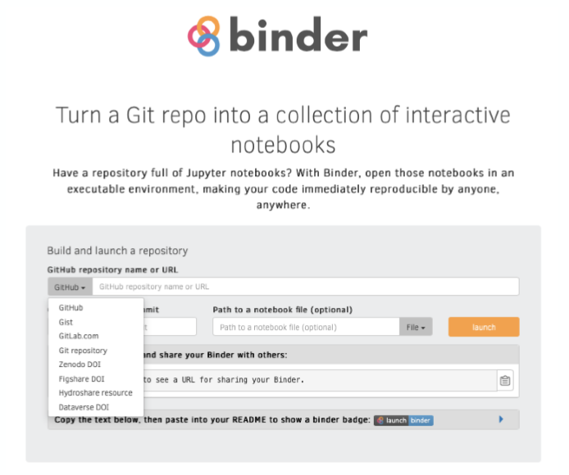
Ultimate goal - full reproducibility
Many powerful open computational tools exist:
R/Python
Jupyter Notebook/Lab
R Studio
Git/GitHub
Binder - containerising your software, code & data to allow for full reproducibility
Notes:
Putting it all together

Slide 20
Taking it further...
http://bit.ly/github-for-researchers
Notes:
Some further reading and activities to follow up and where to go from here

Slide 21
Contribute to open source yourself
A good way to learn about working with Git and open source projects is to contribute to someone else’s project yourself, and there are a lot of open scientific projects out there. Here are a few ways to get started:
Go to your favourite project libraries and look for guides
Try the first-timers-only tag on GitHub, or visit firsttimersonly.com
Participate in Hacktoberfest (October), the Mozilla Global Sprint (May), and/or 24 Pull Requests (December)
JOSS, the Journal of Open Science Software - if you’re making good quality research software, you deserve credit for it! You can also volunteer to review software papers
http://bit.ly/github-for-researchers

Slide 22

A great training resource...
https://www.turing.ac.uk/research/research-projects/turing-way-handbook-reproducible-data-science

Slide 23
Thank you!
a.nenadic@software.ac.uk

