Slide 1
Open Seeds by OLS
Tooling for Collaboration: Open-source software in practice

Slide 2


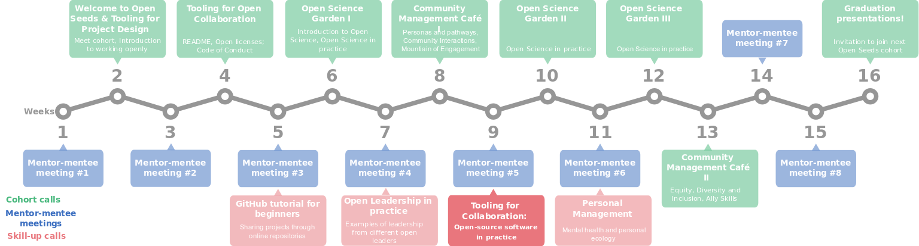

Slide 3
Tooling for Project Design
Aim: Learn about Open-source software from a practical perspective
Learning objectives
At the end of this session, we will be able to
Apply good coding practices to your software
Review code
Identify package management for your software
Make your software ready for open-source

Slide 4
Tooling for Project Design
Content
3 Talks for the current cohort
  Good coding practices
  Code review
  Package management
Talks in previous cohorts, available on the Open Seeds Video Library

