Slide 1
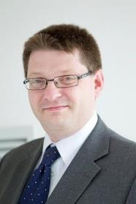




The UK’s European university
From authorship to contributor roles:
adoption of the CRediT taxonomy
Time for open science skills to count in academic careers!
26th Sept 2018, Delft
Simon Kerridge
Director of Research Services
Chair
Immediate Past Chair, ARMA
The Association of Research Managers and Administrators
orcid.org/0000-0003-4094-3719
@SimonRKerridge #OpenSkills18
raaapworldwide.wordpress.com
Notes:
Programme
9.30 - 10.00 - Registrations, coffee
10.00 - 10.15 - Welcome remarks - Valentino Cavalli, LIBER & EOSCPilot
10.15 - 11.15 - Opening talks:
10.15 - 10.30 - Anne de Vries, PhD students Network Netherlands
10.35 - 10.50 - Bartel Van de Walle, TU Delft
10.55 - 11.10 - Rinze Benedictus, UMC Utrecht
11.15 - 11.30 - Introduction to the workshop format - Maria Cruz, VU Amsterdam
11.30 - 13.00 - Workshop part 1: Defining open science skills for researchers at different career levels
13.00 - 14.00 - Lunch break
14.00 - 15.00 - Workshop part 2: Joint review and assessment of all the skills and workshop summary - Marta Teperek, TU Delft and workshop facilitators
15.00 - 15.30 - Simon Kerridge, CRediT
15.30 - 16.00 - Coffee break
16.00 - 16.30 - Closing keynote - Anette Björnsson, European Commission
16.45 - 17.00 - Next steps & closing remarks - Angus Whyte, Digital Curation Center & EOSCPilot
17.00 - 18.00 - Drinks reception

Slide 2




The Presenter
Simon Kerridge
  Director, Research Services, University of Kent (UK)
  Chair, CASRAI; Immediate Past Chair, ARMA
Lead of INORMS RAAAP TaskForce
Chair of the EARMA Awards Committee
UK Government Open Standards Board
Former Chair of ARMA
NCURA Global Faculty
Johns Hopkins Res. Admin. Faculty
#OpenSkills18
@SimonRKerridge
RAAAPworldwide.wordpress.com
casrai.org

Slide 3

What I am going to talk about
1. Origins of the Contributor Roles Taxonomy (CRediT)
2. Adoption & implementation
3. First insights into its value!
4. Where next …
#OpenSkills18
@SimonRKerridge
RAAAPworldwide.wordpress.com
casrai.org

Slide 4
What I am going to talk about
1. Origins of the Contributor Roles Taxonomy (CRediT)
#OpenSkills18
@SimonRKerridge
RAAAPworldwide.wordpress.com
casrai.org

Slide 5
Established problems with authorship: increasingly outdated
Authorship criteria doesn’t reflect range of contributions …
… nor supports accountability
#OpenSkills18
@SimonRKerridge
RAAAPworldwide.wordpress.com
casrai.org
Notes:
Refer to :
1 → Pub: CRediT
2 → Pub: ORCID in publications
3 → Funders and employers – interoperability of applications, grant reporting, CRIS systems
4 → Pub: engage in debate with researchers about phasing out

Slide 6
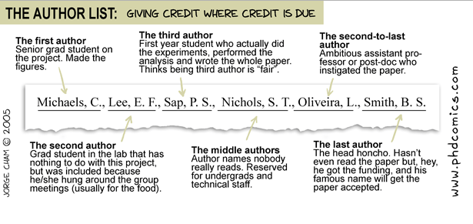
Authorship doesn’t (often) reflect contribution …
#OpenSkills18
@SimonRKerridge
RAAAPworldwide.wordpress.com
casrai.org

Slide 7
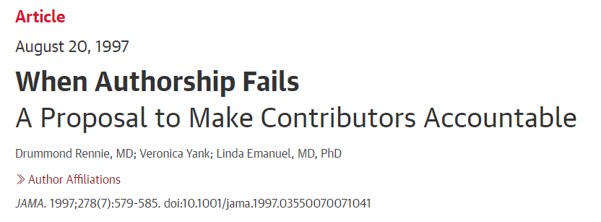

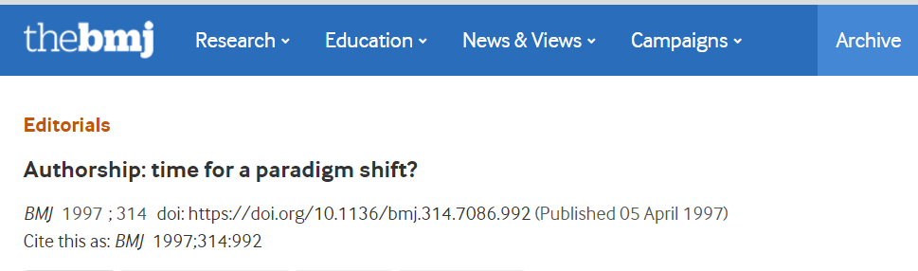
#OpenSkills18
@SimonRKerridge
RAAAPworldwide.wordpress.com
casrai.org

Slide 8
Established problems with authorship: increasingly outdated
Authorship criteria doesn’t reflect range of contributions …
… nor supports accountability
Demise of the lone author
#OpenSkills18
@SimonRKerridge
RAAAPworldwide.wordpress.com
casrai.org
Notes:
Refer to :
1 → Pub: CRediT
2 → Pub: ORCID in publications
3 → Funders and employers – interoperability of applications, grant reporting, CRIS systems
4 → Pub: engage in debate with researchers about phasing out

Slide 9
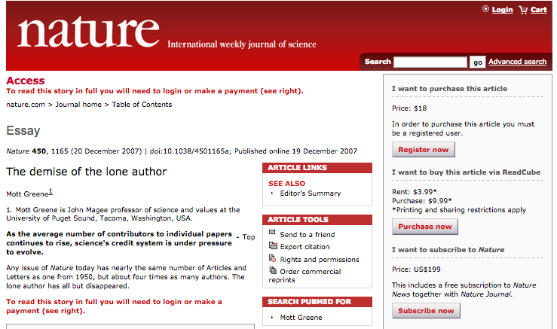
Demise of the lone author
#OpenSkills18
@SimonRKerridge
RAAAPworldwide.wordpress.com
casrai.org

Slide 10
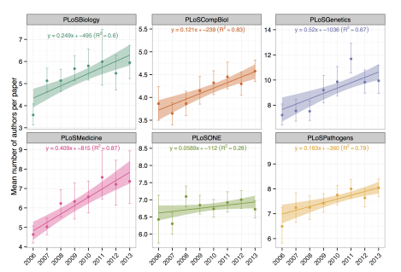

Demise of the lone author
#OpenSkills18
@SimonRKerridge
RAAAPworldwide.wordpress.com
casrai.org

Slide 11
Established problems with authorship: increasingly outdated
Authorship criteria doesn’t reflect range of contributions …
… nor supports accountability
Demise of the lone author
Team science – lots of ‘authors’
#OpenSkills18
@SimonRKerridge
RAAAPworldwide.wordpress.com
casrai.org
Notes:
Refer to :
1 → Pub: CRediT
2 → Pub: ORCID in publications
3 → Funders and employers – interoperability of applications, grant reporting, CRIS systems
4 → Pub: engage in debate with researchers about phasing out

Slide 12
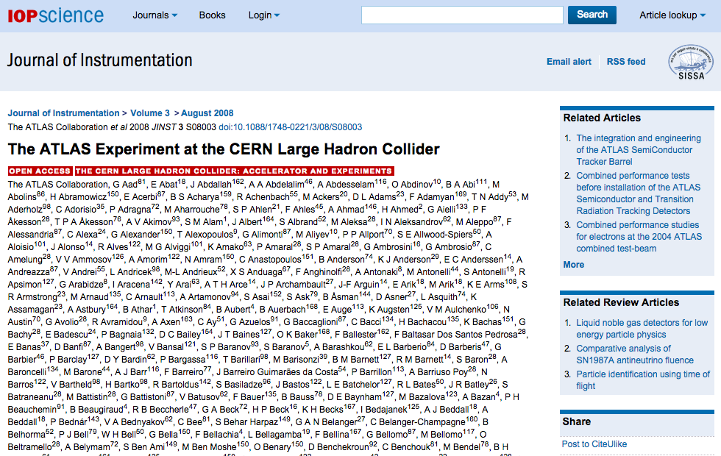
Extreme team science!
2,926 authors from
169 research institutions!
#OpenSkills18
@SimonRKerridge
RAAAPworldwide.wordpress.com
casrai.org

Slide 13
Demand to support & incentivise
team science
Included recommendations for
Open, transparent, standardized and structured contribution information.
Open and transparent research information infrastructure which links all research inputs and outputs to individual contributors
Minimise researchers’ administrative burden and should be interoperable.
https://acmedsci.ac.uk/policy/policy-projects/team-science
#OpenSkills18
@SimonRKerridge
RAAAPworldwide.wordpress.com
casrai.org
Notes:
Refer to :
1 → Pub: CRediT
2 → Pub: ORCID in publications
3 → Funders and employers – interoperability of applications, grant reporting, CRIS systems
4 → Pub: engage in debate with researchers about phasing out

Slide 14
Established problems with authorship: increasingly outdated
Authorship criteria doesn’t reflect range of contributions …
… nor supports accountability
Demise of the lone authors
Team science – lots of ‘authors’
More information needed to support research/researcher assessment
Systematic drivers to ‘publish’ – games & incentives …
Recognising & finding expertise
Space limitations gone away
#OpenSkills18
@SimonRKerridge
RAAAPworldwide.wordpress.com
casrai.org
Notes:
Refer to :
1 → Pub: CRediT
2 → Pub: ORCID in publications
3 → Funders and employers – interoperability of applications, grant reporting, CRIS systems
4 → Pub: engage in debate with researchers about phasing out

Slide 15
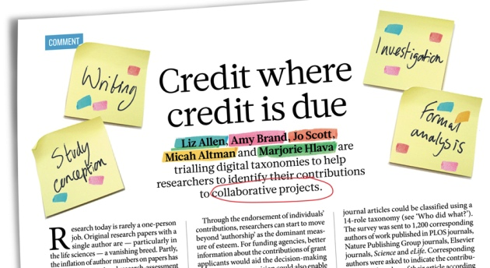
Nature 508, 312–313 (17 April 2014) doi:10.1038/508312a
#OpenSkills18
@SimonRKerridge
RAAAPworldwide.wordpress.com
casrai.org

Slide 16
Term | Definition
Conceptualization | Ideas; formulation or evolution of overarching research goals and aims.
Methodology | Development or design of methodology; creation of models.
Software | Programming, software development; designing computer programs; implementation of the computer code and supporting algorithms; testing of existing code components.
Validation | Verification, whether as a part of the activity or separate, of the overall replication/reproducibility of results/experiments and other research outputs.
Formal Analysis | Application of statistical, mathematical, computational, or other formal techniques to analyse or synthesize study data.
Investigation | Conducting a research and investigation process, specifically performing the experiments, or data/evidence collection.
Resources | Provision of study materials, reagents, materials, patients, laboratory samples, animals, instrumentation, computing resources, or other analysis tools.
Data Curation | Management activities to annotate (produce metadata), scrub data and maintain research data (including software code, where it is necessary for interpreting the data itself) for initial use and later re-use.
Writing – Original Draft | Preparation, creation and/or presentation of the published work, specifically writing the initial draft (including substantive translation).
Writing – Review & Editing | Preparation, creation and/or presentation of the published work by those from the original research group, specifically critical review, commentary or revision – including pre- or post-publication stages.
Visualization | Preparation, creation and/or presentation of the published work, specifically visualization/data presentation.
Supervision | Oversight and leadership responsibility for the research activity planning and execution, including mentorship external to the core team.
Project Administration | Management and coordination responsibility for the research activity planning and execution.
Funding Acquisition | Acquisition of the financial support for the project leading to this publication.

Slide 17
What I am going to talk about
1. Origins of the Contributor Roles Taxonomy (CRediT)
2. Adoption & implementation
#OpenSkills18
@SimonRKerridge
RAAAPworldwide.wordpress.com
casrai.org

Slide 18
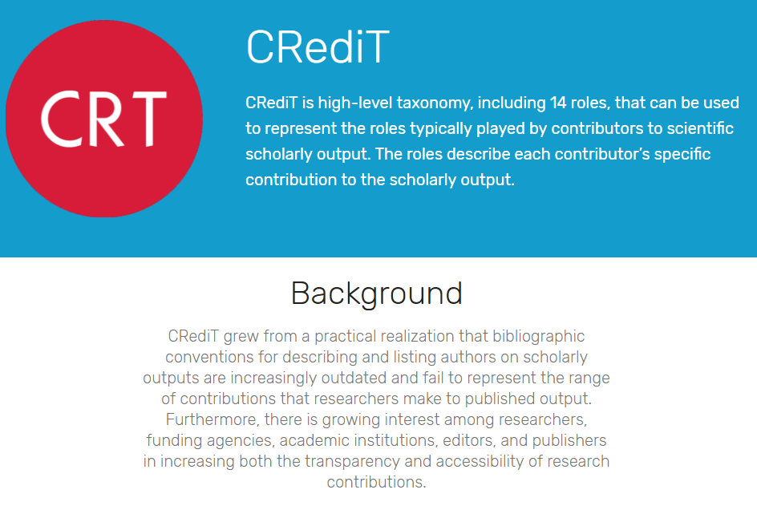

https://casrai.org/credit/
#OpenSkills18
@SimonRKerridge
RAAAPworldwide.wordpress.com
casrai.org

Slide 19
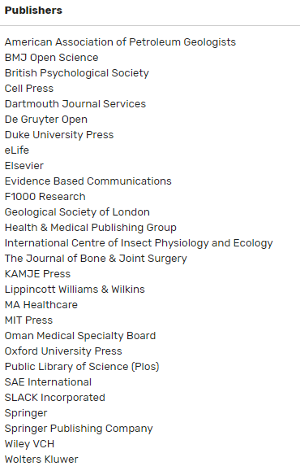
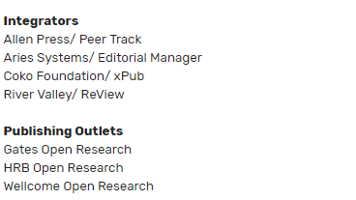
CRediT implemented across increasing number of outlets
#OpenSkills18
@SimonRKerridge
RAAAPworldwide.wordpress.com
casrai.org

Slide 20


CRediT taxonomy at
Implementation June 2016 – requirement
Author interface:
  Replacement of 5-term contributions list
  Each author must have at least one contribution
  Assigned by corresponding author
  For PLOS Medicine: mapping to ICMJE criteria
Human- and machine-readable:
  JATS draft
https://casrai.org/credit/
Source: Veronique Kiermer, PLOS 2018
#OpenSkills18
@SimonRKerridge
RAAAPworldwide.wordpress.com
casrai.org
Notes:
Display flexibility

Slide 21
#OpenSkills18
@SimonRKerridge
RAAAPworldwide.wordpress.com
casrai.org

Slide 22
#OpenSkills18
@SimonRKerridge
RAAAPworldwide.wordpress.com
casrai.org
Notes:
Dozen authors from 3 research groups

Slide 23
#OpenSkills18
@SimonRKerridge
RAAAPworldwide.wordpress.com
casrai.org
Notes:
First author is corresponding author – broad contributions to all aspects of the study

Slide 24
#OpenSkills18
@SimonRKerridge
RAAAPworldwide.wordpress.com
casrai.org
Notes:
Middle author from same group – important contributions incl software and validation

Slide 25
#OpenSkills18
@SimonRKerridge
RAAAPworldwide.wordpress.com
casrai.org
Notes:
Author tab lists all contributions org by authors

Slide 26

CRediT taxonomy at
Implementation across all F1000 Open Research Platforms since 2017
Author interface:
  Within submission process
  Each author must have at least one contribution
  Assigned by corresponding author
Human- and machine-readable:
  JATS draft
https://casrai.org/credit/
Source: Veronique Kiermer, PLOS 2018
#OpenSkills18
@SimonRKerridge
RAAAPworldwide.wordpress.com
casrai.org
Notes:
Display flexibility

Slide 27
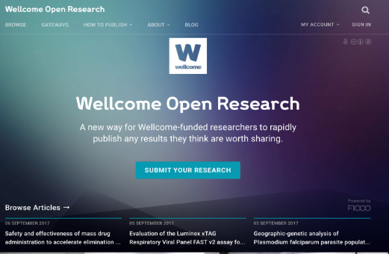
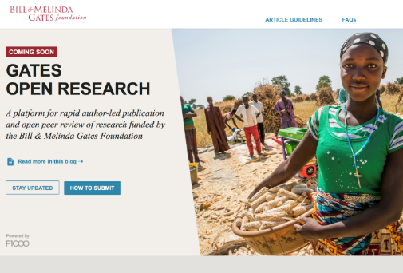
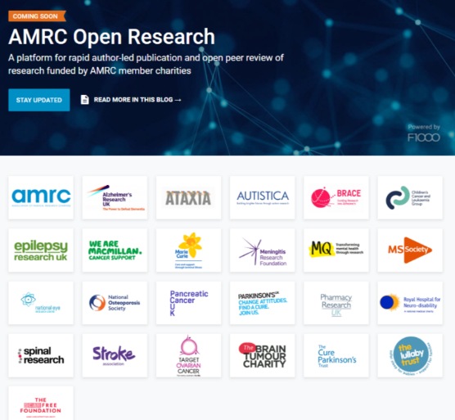

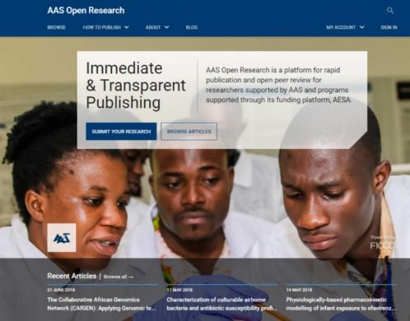



Slide 28
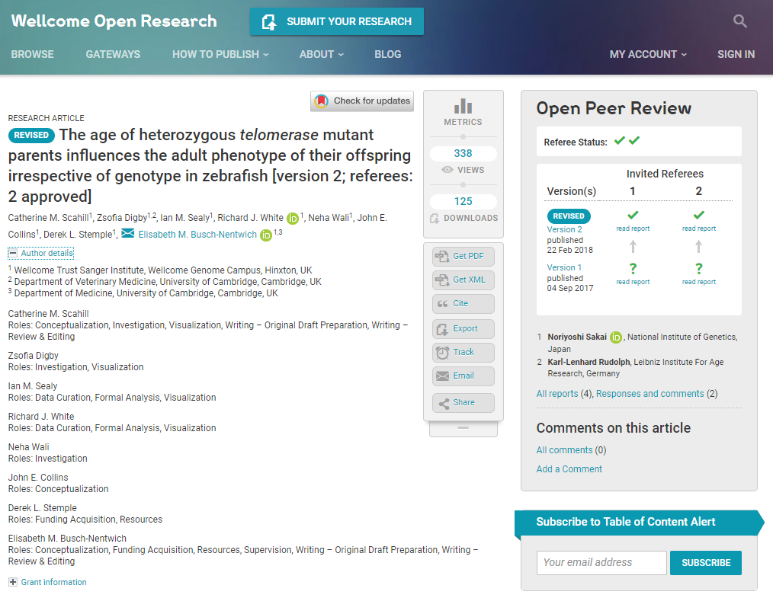
#OpenSkills18
@SimonRKerridge
RAAAPworldwide.wordpress.com
casrai.org
Notes:
PDF lists organized differently – flexibility of display

Slide 29
#OpenSkills18
@SimonRKerridge
RAAAPworldwide.wordpress.com
casrai.org
Notes:
^{b}Science Journals, American Association for the Advancement of Science, Washington, DC 20005;
^{c}New England Journal of Medicine, Boston, MA 02115;
^{d}American Geophysical Union, Washington, DC 20009;
^{e}SAGE Publishing, Thousand Oaks, CA 91320;
^{g}PLOS (Public Library of Science), San Francisco, CA 94111;
^{h}Cell Press, Cambridge, MA 02139;
^{i}The National Academies of Sciences, Engineering, and Medicine, Washington, DC 20418;
^{k}eLife, Cambridge CB2 1JB, United Kingdom;
^{l}Nature Research, San Francisco, CA 94104;

Slide 30
What I am going to talk about
1. Origins of the Contributor Roles Taxonomy (CRediT)
2. Adoption & implementation
3. First insights into its value!
#OpenSkills18
@SimonRKerridge
RAAAPworldwide.wordpress.com
casrai.org

Slide 31
First insights into CRediT value
Vincent Larivière, Université de Montréal
Cassidy R. Sugimoto, Indiana University Bloomington
#OpenSkills18
@SimonRKerridge
RAAAPworldwide.wordpress.com
casrai.org

Slide 32
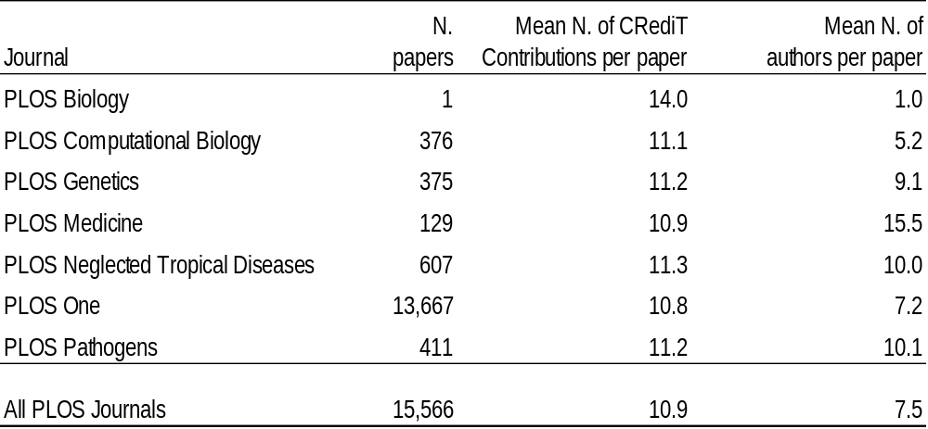
Dataset: PLOS contributions July 2017-June 2018
Vincent Larivière, Cassidy Sugimoto, preliminary results
#OpenSkills18
@SimonRKerridge
RAAAPworldwide.wordpress.com
casrai.org

Slide 33
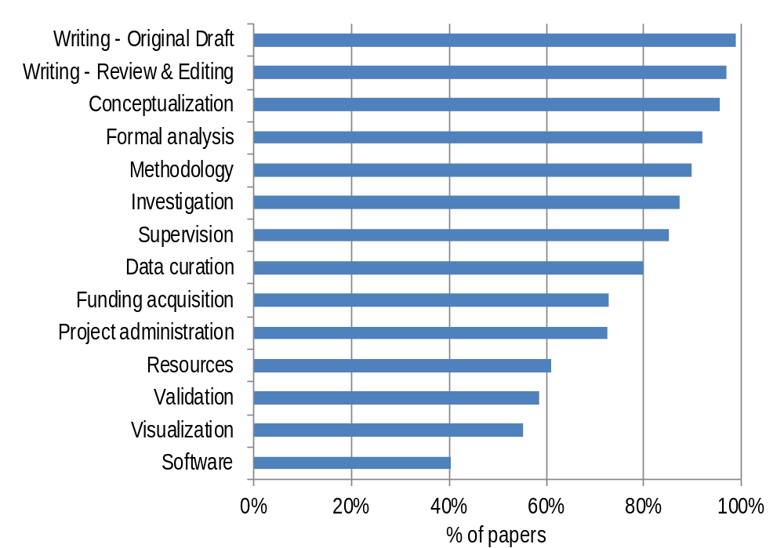
Percentage of papers with specific CRediT role
Each role reported in >50% articles (except software 40%)
Vincent Larivière, Cassidy Sugimoto, preliminary results
#OpenSkills18
@SimonRKerridge
RAAAPworldwide.wordpress.com
casrai.org
Notes:
When software is used ~1/3 of authors contribute software

Slide 34
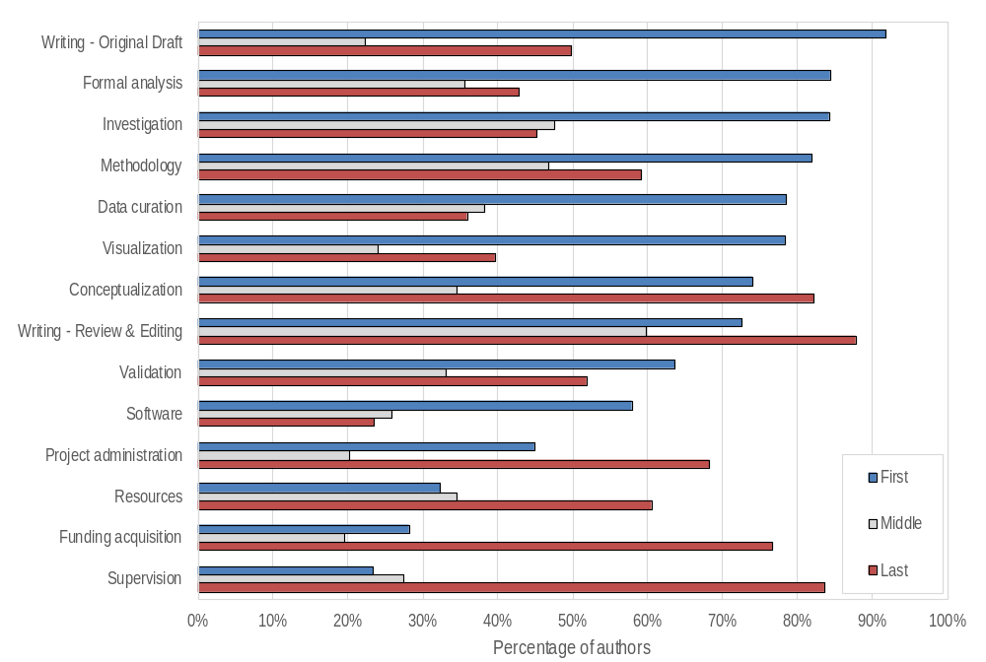
What do ‘middle authors’ do?
% authors performing contribution by author’s order
Vincent Larivière, Cassidy Sugimoto, preliminary results; subset data: n=11k
#OpenSkills18
@SimonRKerridge
RAAAPworldwide.wordpress.com
casrai.org

Slide 35
What do ‘middle authors’ do?
% authors performing contribution by author’s order
1/3 contribute to:
Formal analysis
Data curation
Conceptualization
Validation
Resources
Vincent Larivière, Cassidy Sugimoto, preliminary results; subset data: n=11k
#OpenSkills18
@SimonRKerridge
RAAAPworldwide.wordpress.com
casrai.org
Notes:
25% of middle authors contribute to software

Slide 36
What I am going to talk about
1. Origins of the Contributor Roles Taxonomy (CRediT)
2. Adoption & implementation
3. First insights into its value!
4. Where next …
#OpenSkills18
@SimonRKerridge
RAAAPworldwide.wordpress.com
casrai.org

Slide 37

Where next …
Building awareness of CRediT – significant interest
Duraspace/CASRAI supporting implementations of CRediT
Feedback routes – working to future versions/keeping CRediT current (while practical)
More analysis & usage
Links to ORCID & Crossref – metadata
https://casrai.org/credit/
#OpenSkills18
@SimonRKerridge
RAAAPworldwide.wordpress.com
casrai.org

Slide 38
DORA 2.0
#OpenSkills18
@SimonRKerridge
RAAAPworldwide.wordpress.com
casrai.org

Slide 39
CrossRef ORCID auto-update
#OpenSkills18
@SimonRKerridge
RAAAPworldwide.wordpress.com
casrai.org
Notes:
Cross Ref sent 335k requests for permission (back file) in late 2015/early 2016
11% have denied permission
41% have given permission
= 52% responses
2016 works:
- 81k DOI-ORCID pairs that CrossRef has updated with 2016 publication date.

Slide 40

Some other things
International Research Data Management Glossary (IRiDiuM)
Open Access Glossary
Research Impact Glossary
Career Levels Glossary / Taxonomy
Notice of Award Definition
CVs
https://casrai.org/
#OpenSkills18
@SimonRKerridge
RAAAPworldwide.wordpress.com
casrai.org

Slide 41
Career Levels
The CASRAI-UK community has identified a number of issues related to the lack of an accurate and consistent way to classify researchers and scholars by the stage they are at in their career. There is fragmentation in this level of information - across research institutions, research funders, disciplines and countries. In short, how does the community denote ‘research age’? This classification is needed in multiple stages of research information collection: eligibility for funding opportunities, Athena SWAN and the Race and Equality Charter Mark. This activity will look at what definitions are currently in place in the UK context to start (REF, ECR, HESA categories, etc.) and what commonalities exist across these contexts them? The output will be a first-draft standard agreed taxonomy.
https://forum.casrai.org/c/standards/career-levels
#OpenSkills18
@SimonRKerridge
RAAAPworldwide.wordpress.com
casrai.org

Slide 42
Overall areas
Notice of Opportunity
Proposal
Budget
CV
Notice of Award
Compliance Reporting
Financial/Progress Reporting
Data Management Plans
Impacts
Metrics
https://casrai.org/
#OpenSkills18
@SimonRKerridge
RAAAPworldwide.wordpress.com
casrai.org

Slide 43
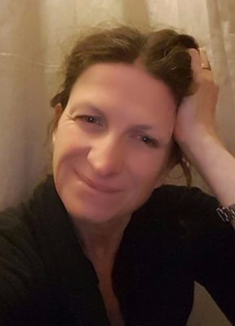
Questions / Discussion
With thanks to
Liz Allen: Director of Strategic Initiatives, F1000
And CRediT Co-Chair
@allen_liz
@4TUResearchData
@EOSCPilot.eu #OpenSkills18
https://casrai.org/credit/
#OpenSkills18
@SimonRKerridge
RAAAPworldwide.wordpress.com
casrai.org

