Slide 1






CENTER FOR SCALABLE DATA ANALYTICS AND ARTIFICIAL INTELLIGENCE
NATIONAL RESEARCH DATA MANAGEMENT INFRASTRUCTURE FOR MICROSCOPY AND BIOIMAGE ANALYSIS
GLOBAL BIOIMAGE ANALYST’S SOCIETY
Large Language Models:
An Introduction for Life Scientists
Robert Haase
These slides can be reused under the terms of the CC-BY4.0 license.
https://doi.org/10.5281/zenodo.14412107

Slide 2
Large Language Models (LLMs)
Text-to-text, translation
Hello world
Hallo Welt
English
German
Neural network (simplified)

Slide 3
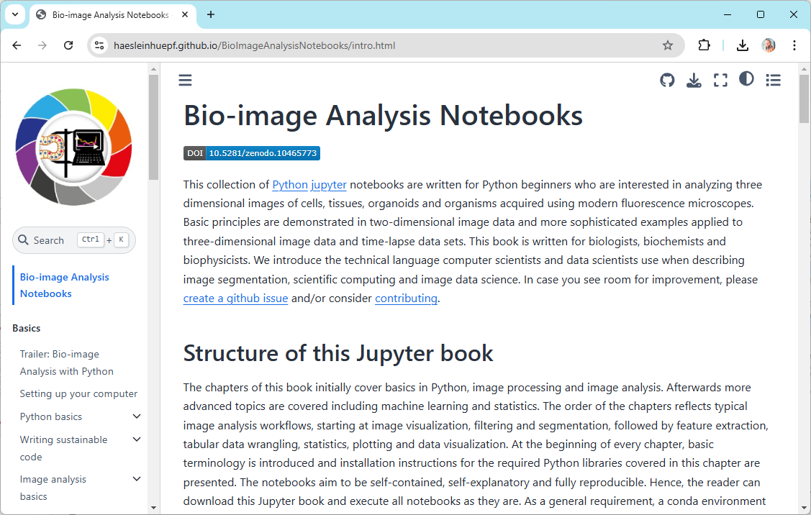
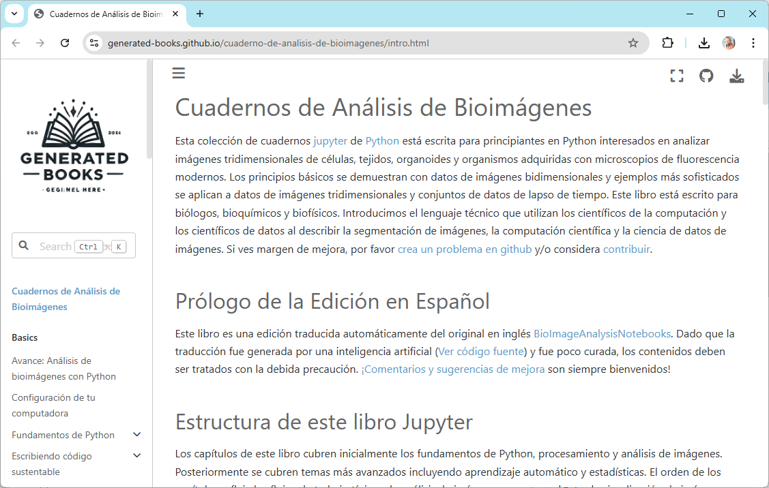
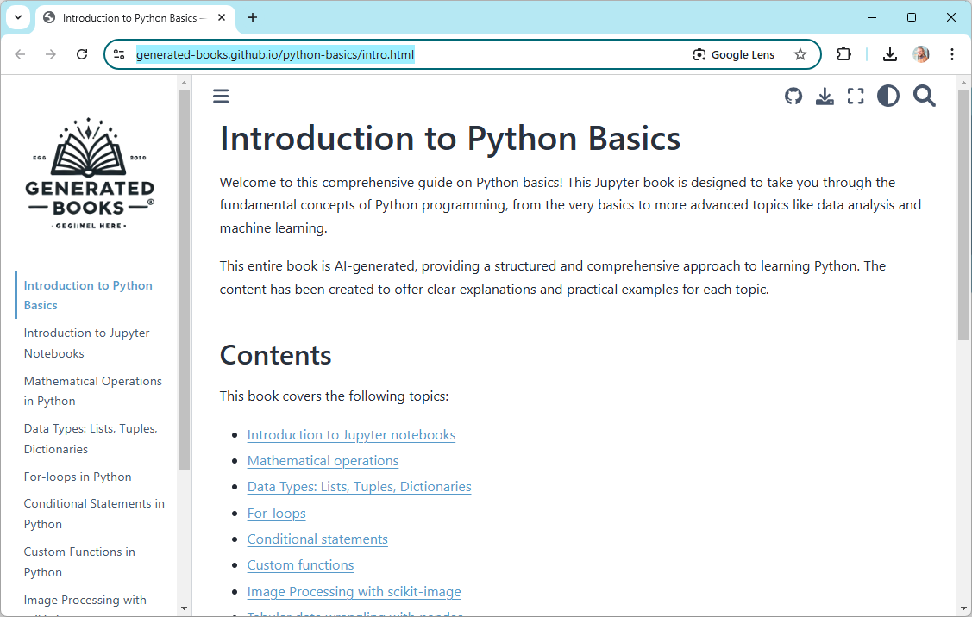





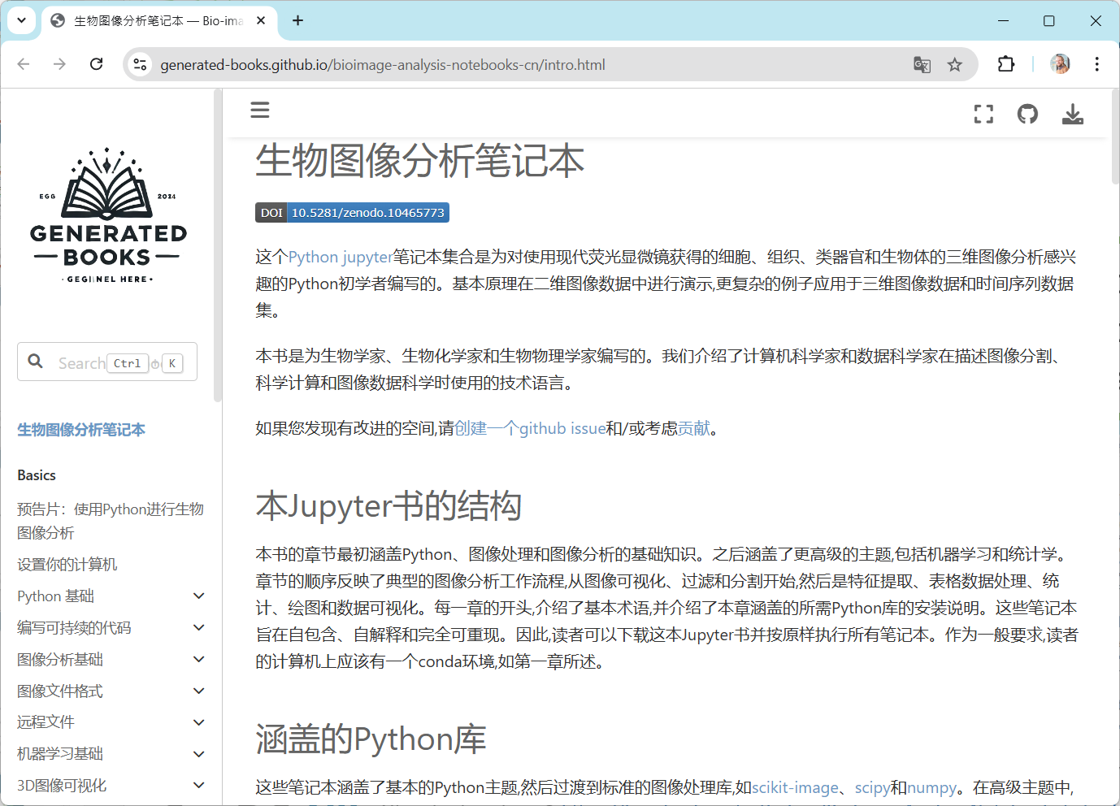
AI-generated training materials
• AI-translated + generated training materials
AI-based, automatic translation of training materials
AI-based, automatic generation of training materials
https://haesleinhuepf.github.io/BioImageAnalysisNotebooks/
https://generated-books.github.io/

Slide 4
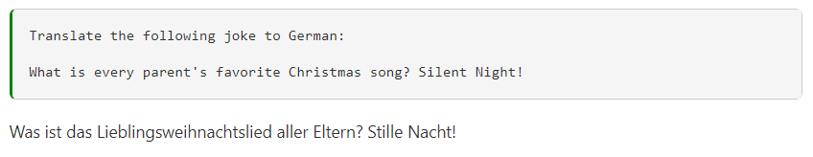
What are large language models good in?
Translation tasks
https://scads.github.io/prompt-engineering-basics-2024/20_use_cases.html

Slide 5
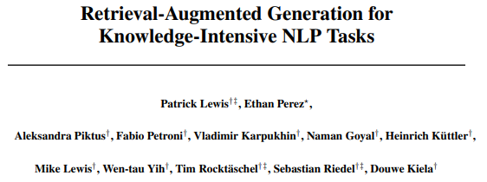
Large Language Models (LLMs)
Text-to-text, translation, knowledge retrieval
Answer
↑↓?
Question
Hallucinations
https://arxiv.org/abs/2408.06292 https://youtu.be/CFewReJ1Eyo?si=BNRoqYrtNVXF9Tzj

Slide 6
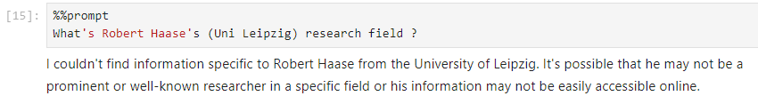

What are large language models not so good in?
Querying knowledge
(in particular recent information)
https://scads.github.io/prompt-engineering-tutorial-2023/01_prompts/02_use_cases.html

Slide 7
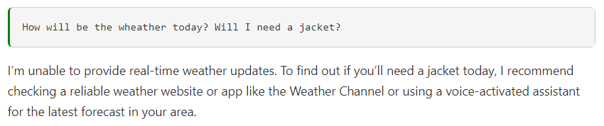
What are large language models not so good in?
Querying knowledge (e.g. for recent information)
https://scads.github.io/prompt-engineering-basics-2024/20_use_cases.html

Slide 8
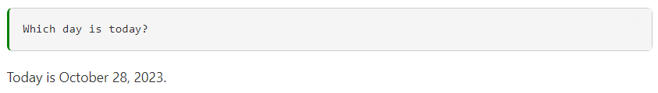
What are large language models not so good in?
Querying knowledge (e.g. for recent information)
https://scads.github.io/prompt-engineering-basics-2024/20_use_cases.html

Slide 9
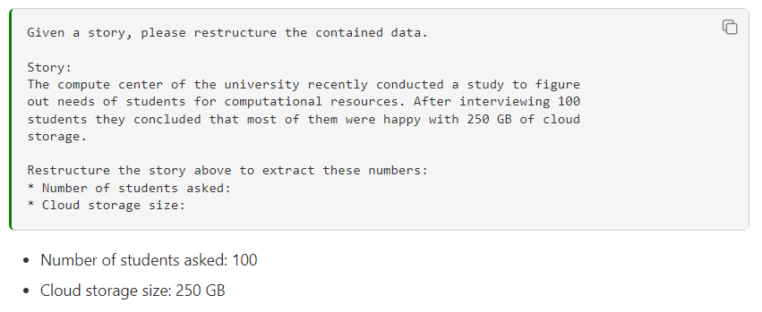
What are large language models good in?
Restructuring data / information retrieval
The more relevant context you provide, the more current the answer will be.
https://scads.github.io/prompt-engineering-basics-2024/20_use_cases.html

Slide 10
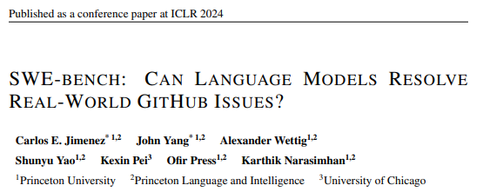
Large Language Models (LLMs)
Text-to-text, translation, code generation
from skimage.io import imread
image = imread(“hela-cells.tif”)
Open hela-cells.tif
English
Python
https://arxiv.org/abs/2310.06770

Slide 11
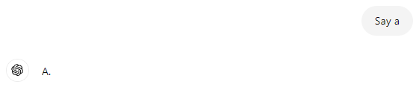
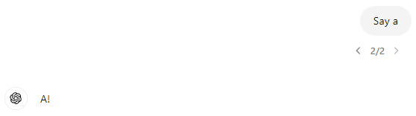
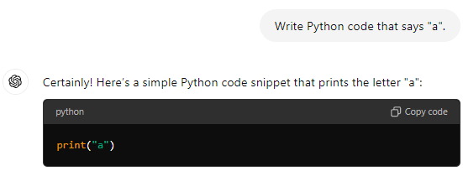
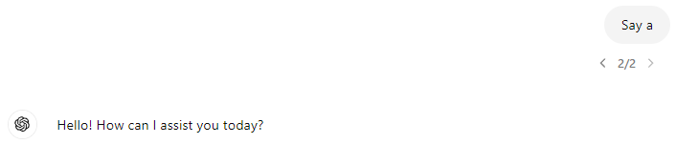
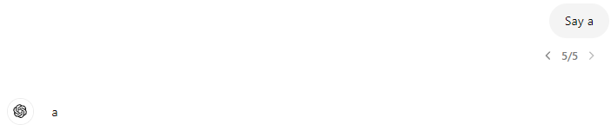
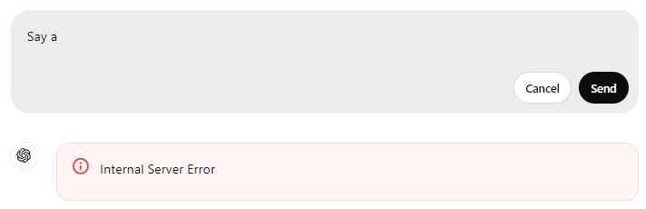
Why code generation using LLMs?
Output of LLMs is often criticized for
Limited reproducibility
Hard to evaluate (automatically)
Output of LLM-generated code is
Reproducible
Can be executed and evaluted (automatically)
No matter how often you execute this code, the output is always garanteed to be „a“.

Slide 12

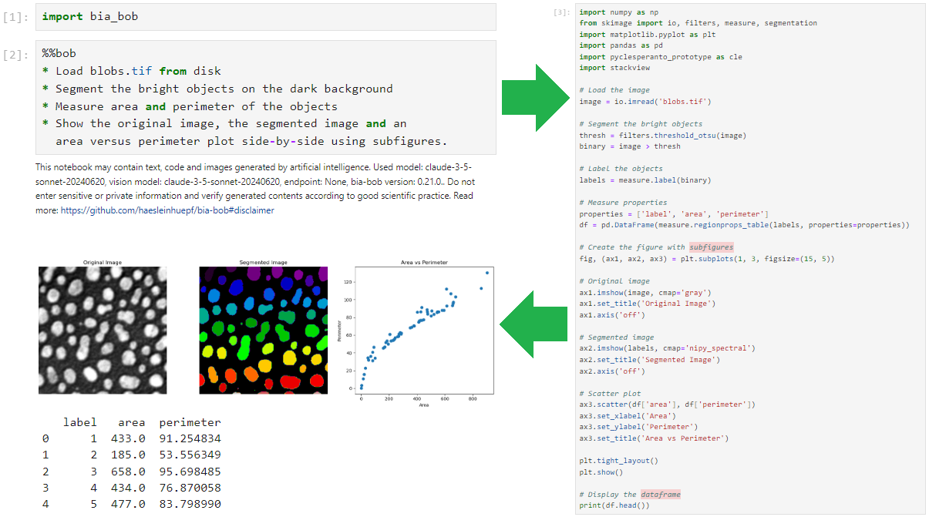
Scientific code writing: bia-bob
Code-generation, specifically:
  Python
  BioImage analysis
https://github.com/haesleinhuepf/bia-bob

Slide 13
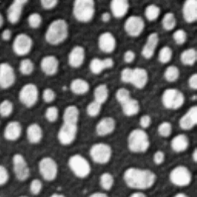
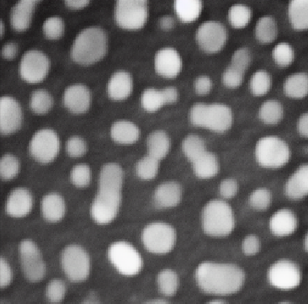

Image Generation LLMs
Image-to-image prompting, image variations
Blur the image
https://arxiv.org/abs/2211.09800
https://scads.github.io/generative-ai-notebooks/41_image_generation_huggingface/60_image_variations_pix2pix.html

Slide 14
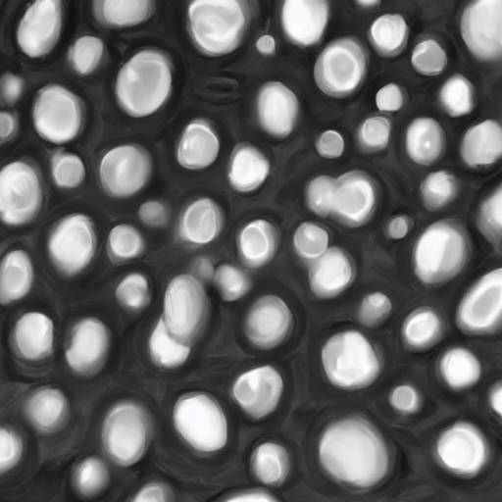
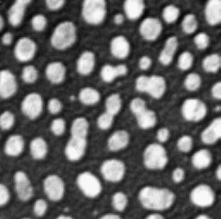


Image Generation LLMs
Image-to-image prompting, image variations
Image Variation
https://haesleinhuepf.github.io/BioImageAnalysisNotebooks/07_prompt_engineering/60_image_variations_huggingface.html

Slide 15
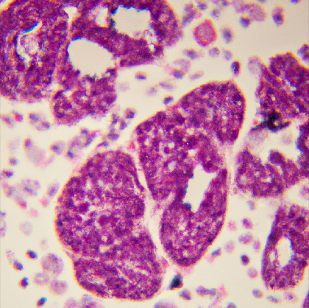
Image Generation LLMs
Interesting challenges for our community ahead
Text-to-image prompting
a histology image of lung cancer cells and some healthy tissue
https://scads.github.io/generative-ai-notebooks/40_image_generation_openai/10_generating_images_dall_e.html

Slide 16
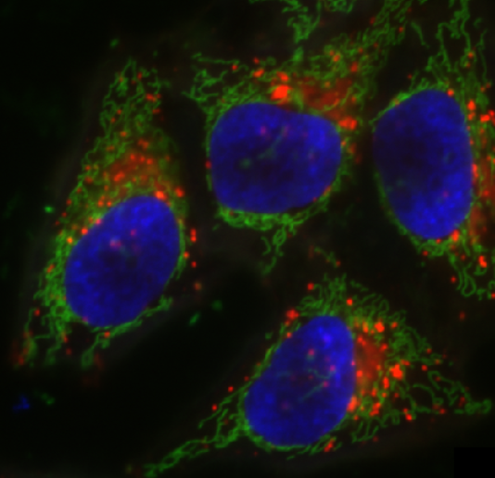
Vision Langage Models VLMs
Combining image and text: Multi-Modal LMs
There are nuclei, presumably stained with DAPI and imaged using a fluorescence microscope.
What’s in the blue-channel of this image?

Slide 17
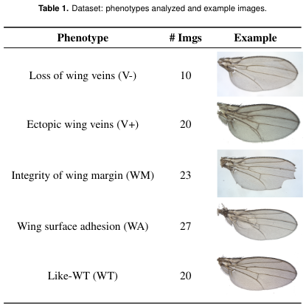
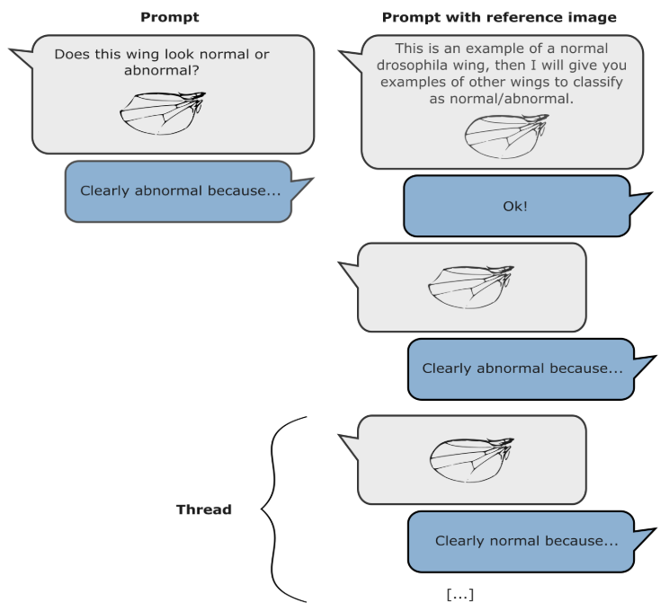
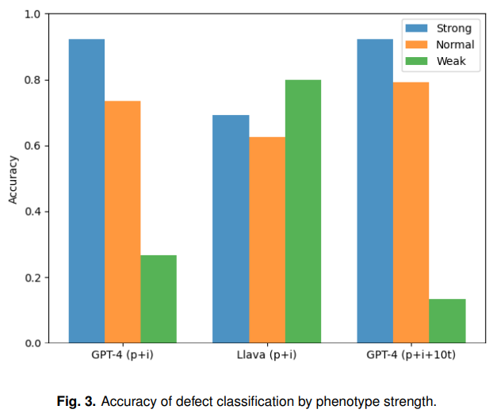
Use case: Descriptive biology
“… while visual language models are in their infancy, they already show potential for multiple applications in automated phenotyping studies. We encourage the community to carefully test them… “
Cropped from Paci & Nanni (2024), licensed CC-BY 4.0
https://www.biorxiv.org/content/10.1101/2024.05.27.594652v1

Slide 18

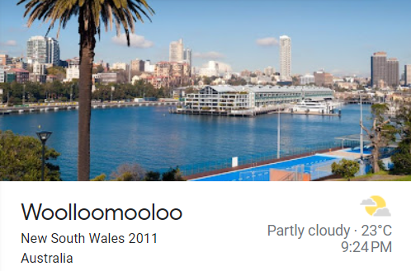
What are large language models not so good in?
Math (in particular counting)
https://scads.github.io/prompt-engineering-tutorial-2023/01_prompts/02_use_cases.html

Slide 19
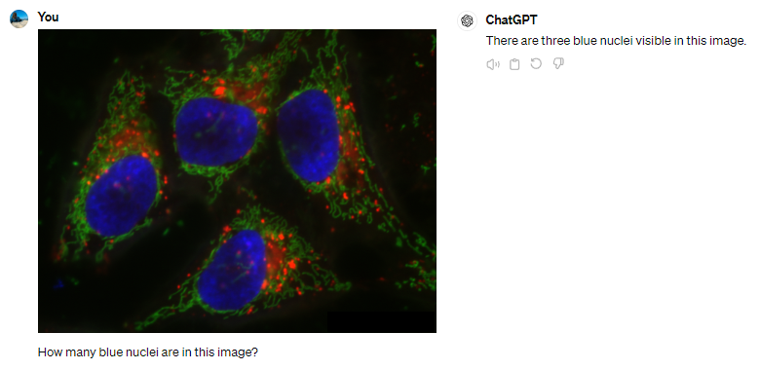
Use case: Quantitatively biology
VLMs were not exactly built for this use-case…
n=1

Slide 20
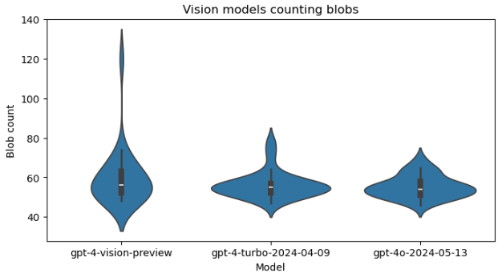
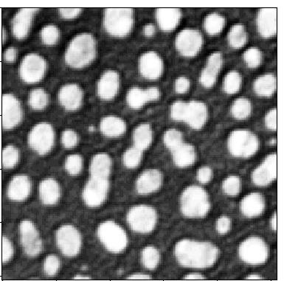
Vision language models for counting objects
Prompt: „Analyse the following image by counting the bright blobs. Respond with the number only. “ (n=25)
Nov 2023
Apr 2024
May 2024
https://scads.github.io/generative-ai-notebooks/80_benchmarking_llms/20_vision_models.html

Slide 21
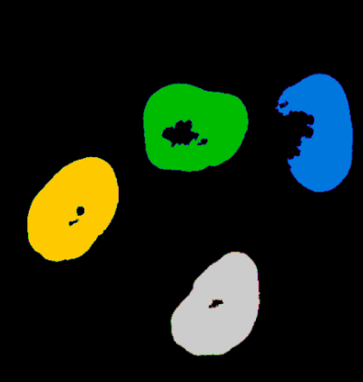
Multi-modal LLMs
Combining image, text and […] data, to gain new insights.
There are 4 cells.
I just marked their nuclei.
How many cells are there?
I‘m not aware of any implementation of this (yet).

Slide 22
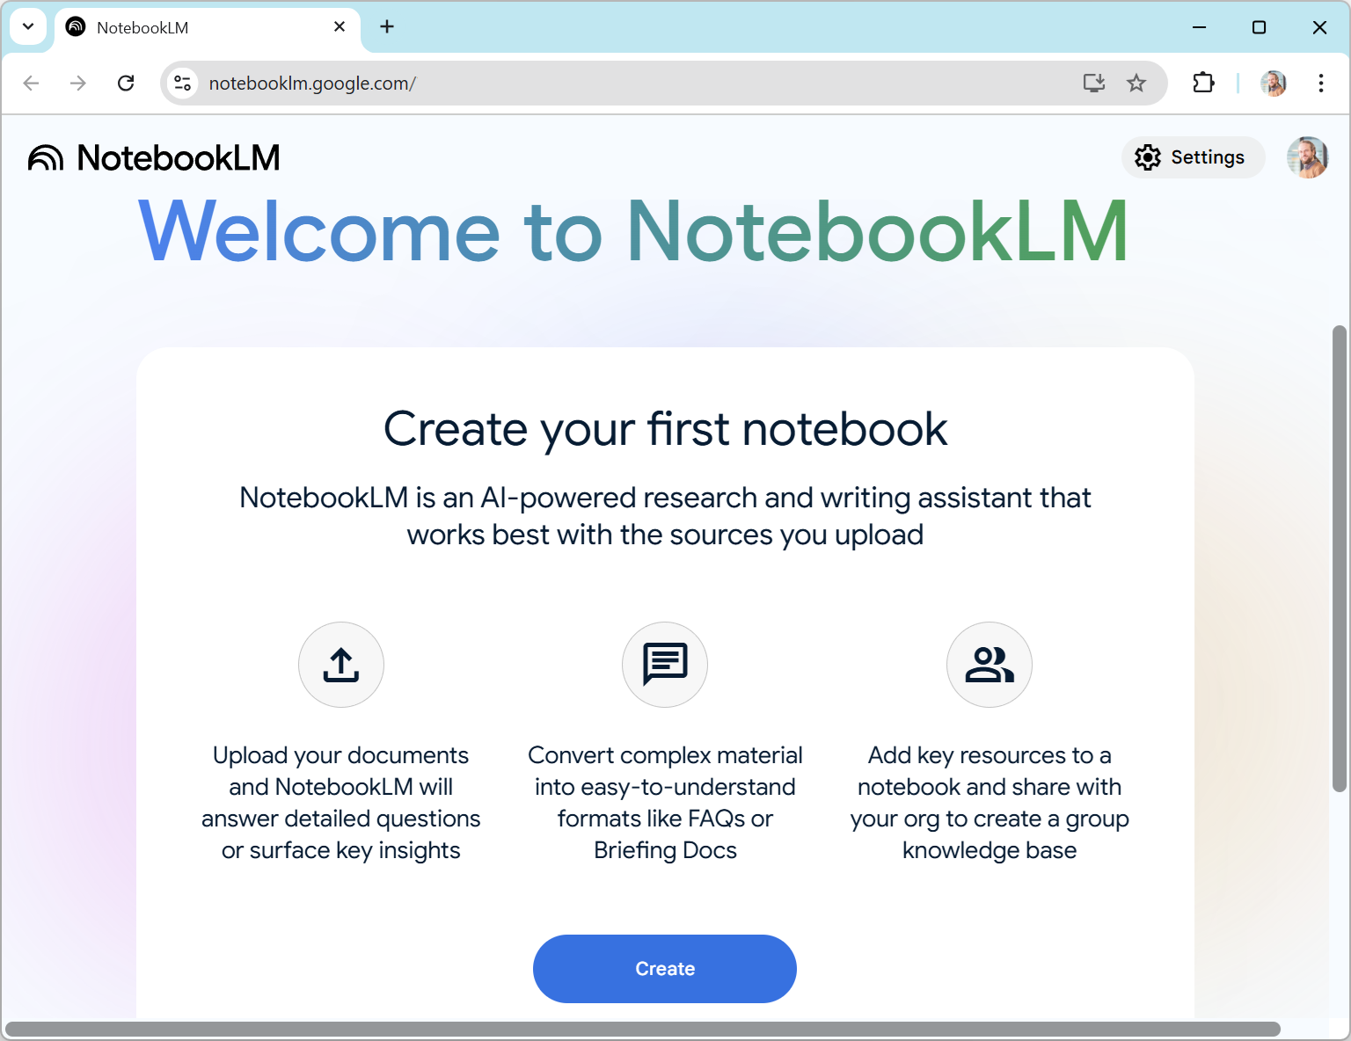
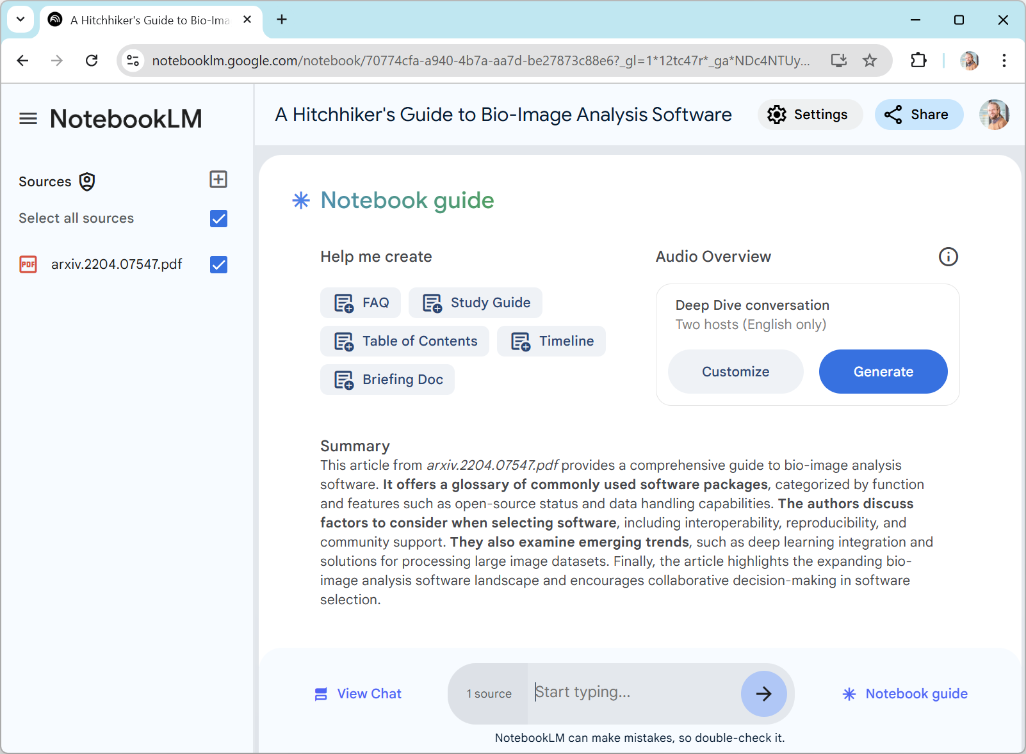
Multi-modal LLMs
Text to audio: Generating Podcasts about papers using NotebookLM
Try this with your most recent paper!
https://notebooklm.google.com/notebook/70774cfa-a940-4b7a-aa7d-be27873c88e6/audio

Slide 23
Outlook / optional slides
Neural
networks
LLMs
Prompt engineering
Tools for scientists
Retrieval Augmented Generation (RAGs)
Good scientific practice
Benchmarking / Quality assurance

Slide 24
Transformer neural networks

Slide 25
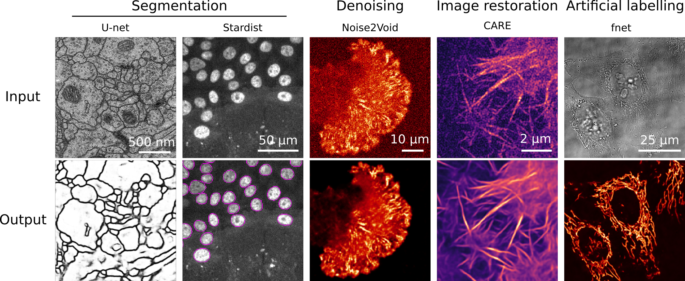
Traditional architecture: Encoder-Decoder Networks
Related: „Auto-encoder“, „Variational Auto-Encoder“, „U-Net“
Encoder
Decoder
Skip-connections (optional)
Input
Output
Input:
noisy image
“Bottleneck”, “Embedding”,
“Latent space”
Input:
denoised image
1
2
Images demonstrating noise2void, cropped from https://github.com/HenriquesLab/ZeroCostDL4Mic/blob/master/Wiki_files/FigureS2.png license: MIT

Slide 26
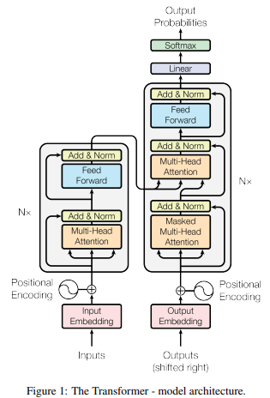
What‘s new? Transformers
LLMs use the transformer neural network architecture
Related: Generative Pretrained Transformer (GPT)
Figure source: Ashish et al 2017. "Attention is all you need". License: Provided proper attribution is provided, Google grants permission to reproduce the tables and figures in this paper solely for use in journalistic or scholarly works.
https://arxiv.org/abs/1706.03762

Slide 27
What‘s new? Transformers
LLMs use the transformer neural network architecture
Related: Generative Pretrained Transformer (GPT)
Encoder
Decoder
Output
2
To avoid cheating while training
Masking
1
3
Input
[Shifted] Output

Slide 28
What‘s new? Transformers
LLMs were originally developed for translation tasks and next-word prediction.
Encoder
Decoder
Output
„[…] Microscope“
2
„Die Katze sitzt neben dem Mikroskop.“
Masking
„The cat sits next to the […]“
1
3
Input
Output

Slide 29
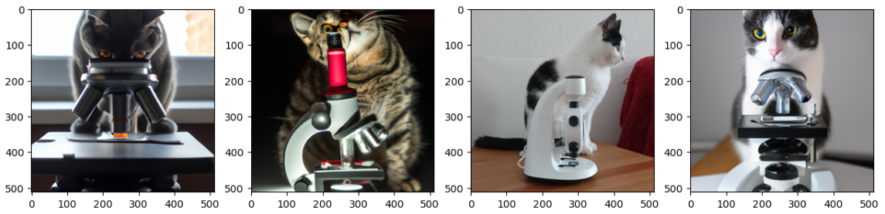
What‘s new? Transformers
VLMs use combinations of traditional neural network architectures and transformers.
Encoder
Decoder
Output
„[…] Microscope“
2
Input
Masking
„The cat sits next to the […]“
“Embedding”,
“Latent space”
3
Input image
1
Output

Slide 30
Benchmarking

Slide 31

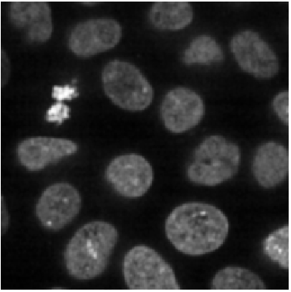
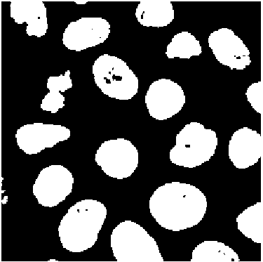
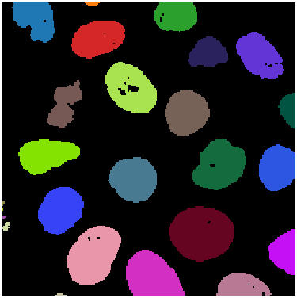
Benchmarking LLMs for Bio-image Analysis
Use case: segment the image and measure the average area of objects.
858.04
…
https://www.biorxiv.org/content/10.1101/2024.04.19.590278v1
https://github.com/haesleinhuepf/human-eval-bia

Slide 32
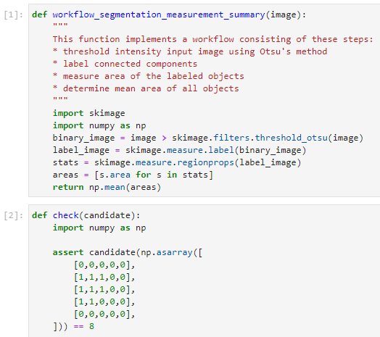
Benchmarking LLMs for Bio-image Analysis Code Generation
Example test-case inspired by HumaEval (Chen et al 2021)
Prompt
Open for your (!) contributions
Reference solution
14 more currently on their way…
Unit test (excerpt)
We formulated 57 of such test-cases (yet)
Chen at al 2021: https://arxiv.org/abs/2107.03374
https://www.biorxiv.org/content/10.1101/2024.04.19.590278v3
https://github.com/haesleinhuepf/human-eval-bia

Slide 33
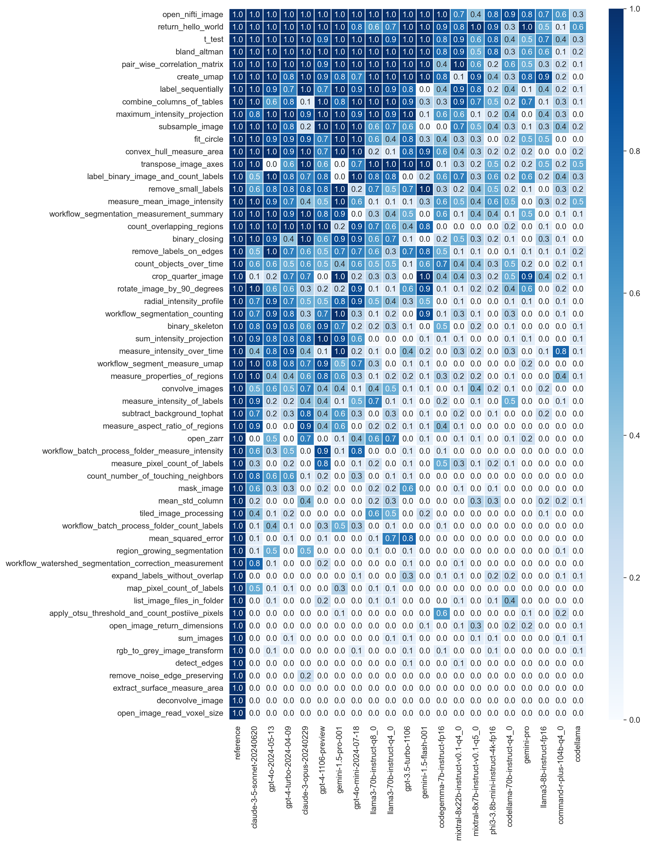
Benchmarking LLMs for Bio-image Analysis
Use case: segment the image and measure the average area of objects.
858.04
…
Unit-test pass-rate (n=10):
https://www.biorxiv.org/content/10.1101/2024.04.19.590278v1
https://github.com/haesleinhuepf/human-eval-bia

Slide 34

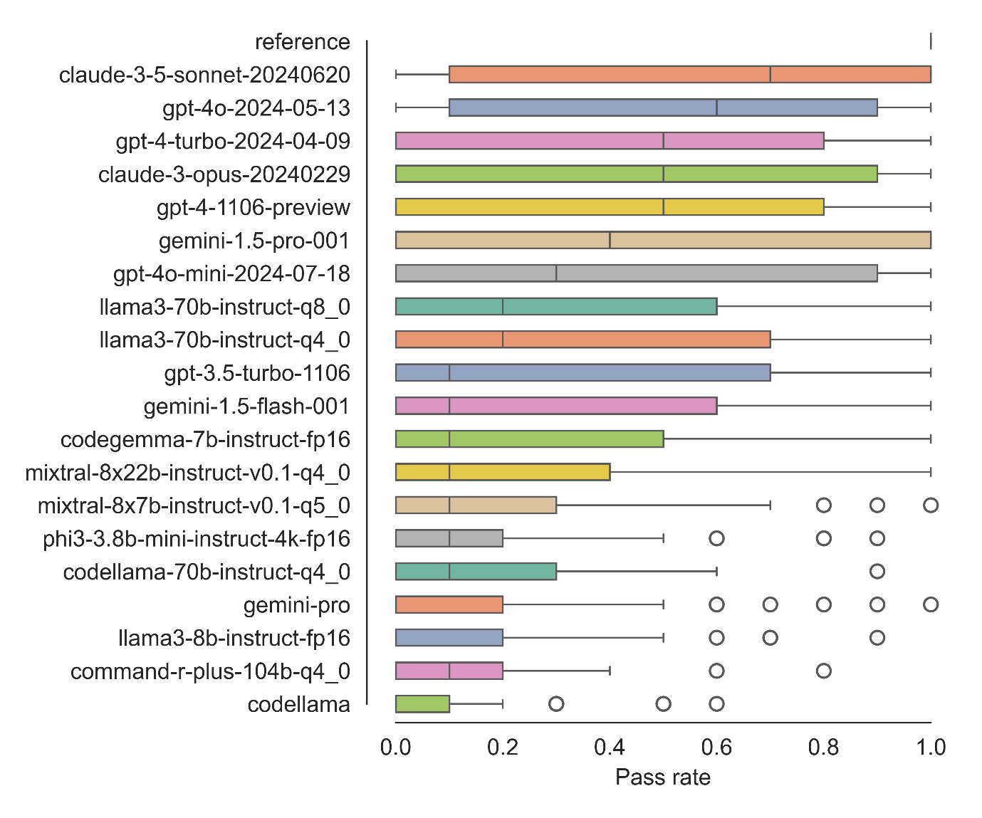
Benchmarking LLMs for Bio-image Analysis
Summary: 57 use-cases (yet), 20 LLMs (yet), n=10
https://www.biorxiv.org/content/10.1101/2024.04.19.590278v3
https://github.com/haesleinhuepf/human-eval-bia/

Slide 35
Prompt Engineering

Slide 36
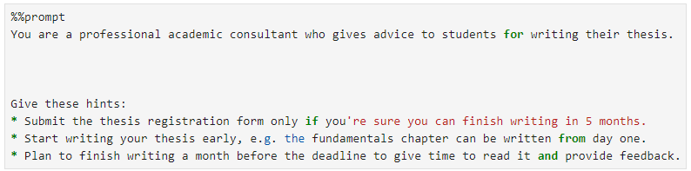
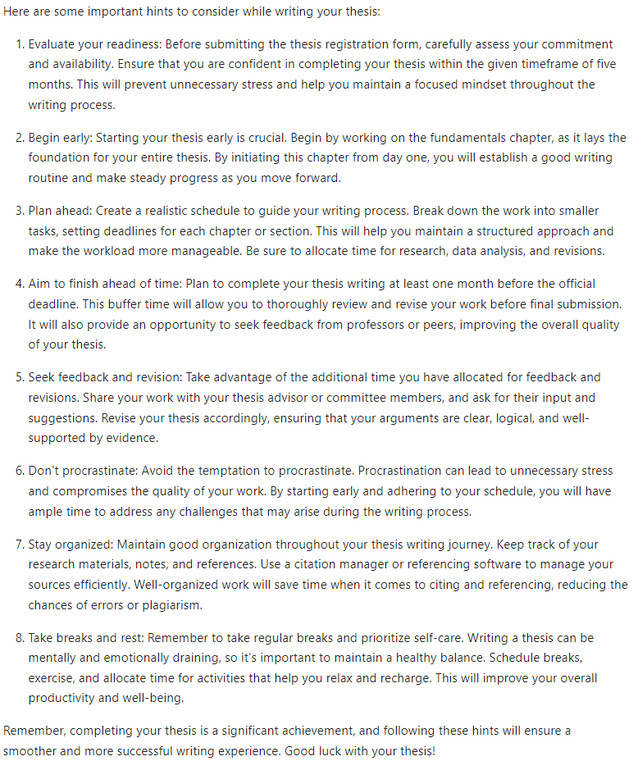
Prompt Engineering
Set context / assign role
Define output style
Give hints / conditions
List tasks
Provide data
https://scads.github.io/prompt-engineering-tutorial-2023/01_prompts/03_prompt_engineering.html

Slide 37
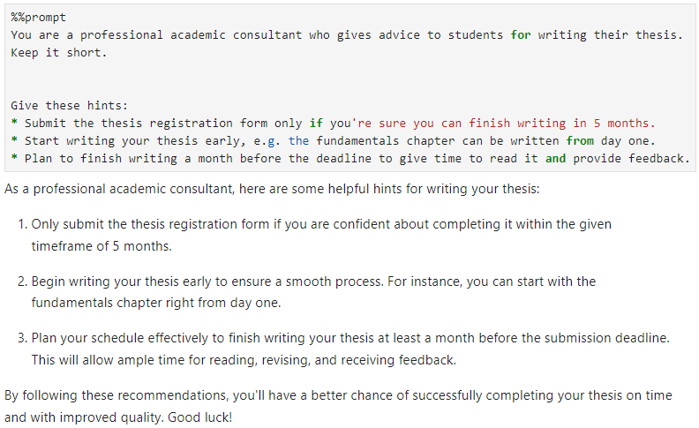
Prompt Engineering
Set context / assign role
Define output style
Give hints / conditions
List tasks
Provide data
https://scads.github.io/prompt-engineering-tutorial-2023/01_prompts/03_prompt_engineering.html

Slide 38
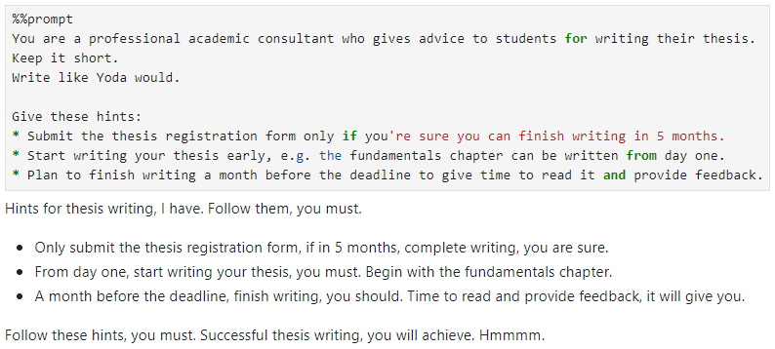
Prompt Engineering
Set context / assign role
Define output style
Give hints / conditions
List tasks
Provide data
https://scads.github.io/prompt-engineering-tutorial-2023/01_prompts/03_prompt_engineering.html

Slide 39
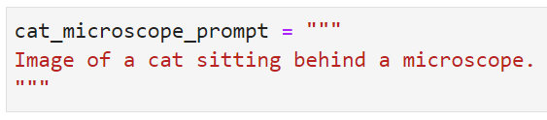
Prompt engineering
Prompts can be used to write code, but also to generate images, e.g. with DALL-E.
One can generate quite realistic images given a detailed prompt.
One cat
is real.
https://haesleinhuepf.github.io/BioImageAnalysisNotebooks/07_prompt_engineering/02_generating_images.html

Slide 40
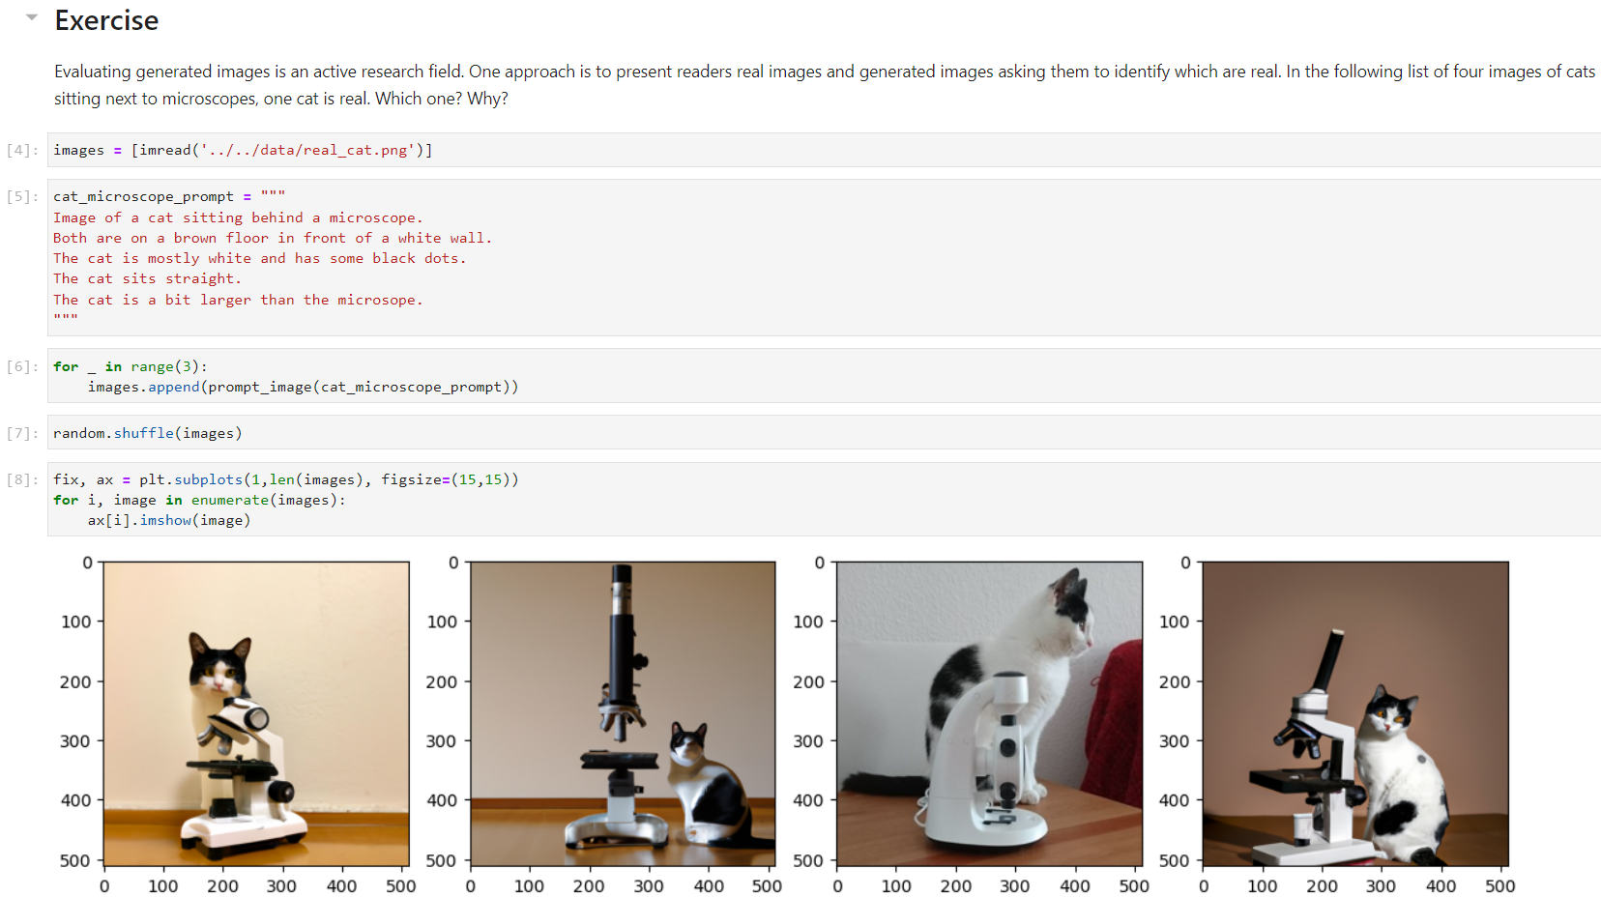
Prompt engineering
Prompts can be used to write code, but also to generate images, e.g. with DALL-E.
One can generate quite realistic images given a detailed prompt.
One cat
is real.
https://haesleinhuepf.github.io/BioImageAnalysisNotebooks/07_prompt_engineering/02_generating_images.html

Slide 41
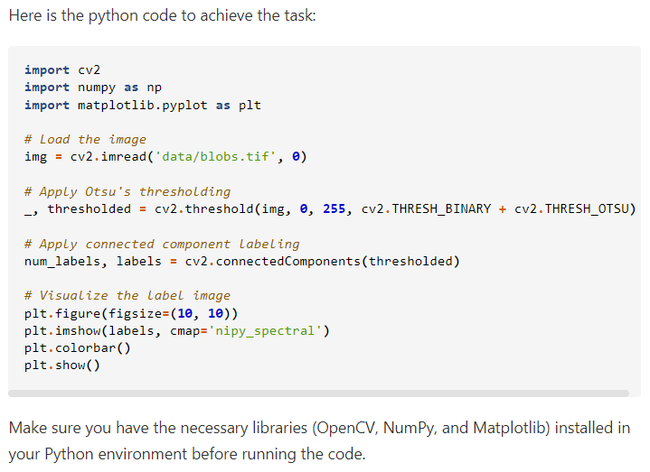
Prompt Engineering
Modify a prompt until it works.
Write python code to open the image file 'data/blobs.tif'
and threshold it using Otsu's method.
Apply connected component labeling to the result to
retrieve a label image. Visualize the label image.
https://scads.github.io/generative-ai-notebooks/50_code_generation/03_generating_code.html

Slide 42

Prompt Engineering
Modify a prompt until it works.
Write python code to open the image file 'data/blobs.tif'
and threshold it using Otsu's method.
Apply connected component labeling to the result to
retrieve a label image. Visualize the label image.
Do not explain the solution.
Only write Python code and short comments are ok.
https://scads.github.io/generative-ai-notebooks/50_code_generation/03_generating_code.html

Slide 43

Prompt Engineering
Modify a prompt until it works.
Write python code to open the image file 'data/blobs.tif'
and threshold it using Otsu's method.
Apply connected component labeling to the result to
retrieve a label image. Visualize the label image.
Do not explain the solution.
Only write Python code and short comments are ok.
Assume the code is executed in a Jupyter notebook.
Do not use any of these Python libraries:
* OpenCV
* PIL
* Pillow
„Long“ Context
https://scads.github.io/generative-ai-notebooks/50_code_generation/03_generating_code.html

Slide 44
Retrieval Augmented Generation

Slide 45
Retrieval Augmented Generation (RAG)
An attempt to make LLMs answer more accurate / truthful
Cellpose: cells, nuclei, cytoplasm
StarDist: nuclei
Otsu: well-separated nuclei
Watershed: cells with membrane staining
[Domain]-specific knowledge
Try Cellpose, it‘s well suited.
Selection
How can I segment cells in a microscopy image?
Prompt engineering
Pretrained
LLM

Slide 46

Retrieval Augmented Generation
Enriching a prompt with relevant context
Query encoder
Document index
Generator
Document A
Query
Document B
Prompt
MIPS
Document C
Document C
x₄
q
x₃
Maximum inner product search (MIPS)
x₂
x₁
Read more: Lewis et al 2020
https://arxiv.org/abs/2005.11401

Slide 47




Retrieval Augmented Generation (RAG)
uses embeddings to identify
related documents
https://scads.github.io/generative-ai-notebooks/60_rag/10_word-embeddings.html

Slide 48


Exercise: Chat With Docs!
Run this chatbot locally and load your documents
Explore the code. It is surprisingly simple!
https://scads.github.io/generative-ai-notebooks/63_chat_with_docs/chat-with-docs.html

Slide 49
LLMs are everywhere

Slide 50



LLMs are everywhere
ChatGPT
Claude
Open models
https://chatgpt.com/
https://claude.ai/
https://huggingface.co/chat/

Slide 51








LLMs are everywhere
If it’s for free, you are part of the product
Many institutes have a local LLM Server
  Great for teaching
  Privacy preserving
Cross-institutional infrastructure, in Germany:
  Helmholtz Blablador
  KISSKI ChatAI
Public, commercial, [free] infrastructure:
  BioImage.IO Chatbot
  Github Models Marketplace
https://helmholtz-blablador.fz-juelich.de/
https://chat-ai.academiccloud.de/chat
https://bioimage.io/chat/
https://github.com/marketplace/models

Slide 52


LLMs are everywhere
LLMs + advanced [academic] search
https://www.perplexity.ai/
https://scite.ai/

Slide 53
LLMs are everywhere
Documents -> Podcats
Try this with your most recent paper!
https://notebooklm.google.com/

Slide 54



LLMs are everywhere
Napari-chatGPT / Omega
Bioimage-io ChatBot
https://github.com/royerlab/napari-chatgpt
https://www.nature.com/articles/s41592-024-02310-w
https://bioimage.io/chat/ https://www.nature.com/articles/s41592-024-02370-y
https://www.globias.org/activities/bia-seminar-series

Slide 55


LLMs are everywhere
Jupyter-AI
bia-bob
https://jupyter-ai.readthedocs.io/
https://github.com/haesleinhuepf/bia-bob

Slide 56


LLMs are everywhere
aider
git-bob
https://github.com/paul-gauthier/aider/
https://github.com/haesleinhuepf/git-bob

Slide 57



LLMs are everywhere
Github Copilot [Workspace]
Cursor
https://copilot-workspace.githubnext.com/
https://www.cursor.com/

Slide 58



LLMs are everywhere
https://chatgpt.com/g/g-FGdNx7MIl-microscope-image-analysis-gpt
http://chat.openai.com/gpts
https://chatgpt.com/g/g-psAohb1OY-bio-image-analysis-gpt

Slide 59


LLMs are everywhere
Fiji‘s Script Editor
https://forum.image.sc/t/ai-assisted-code-generation-in-fijis-script-editor/100877/3

Slide 60
Good Scientific Practice

Slide 61

Challenges
Generative artificial intelligence imposes a risk to science
https://x.com/MicrobiomDigest/status/1825963342822793400

Slide 62

Rules…
„When making their results publicly available, researchers should, in the spirit of research integrity, disclose whether or not they have used generative models, and if so, which ones, for what purpose and to what extent.“
Check your institutions’ and funders’ guidelines.
Source: DFG (2023) https://www.dfg.de/resource/blob/289676/89c03e7a7a8a024093602995974832f9/230921-statement-executive-committee-ki-ai-data.pdf

Slide 63

Documenting prompts
Good scientific practice (disclosure)
Knowledge transfer to the next scientist working with the code.
Keep prompts in your code / notebooks, e.g. by turning the cell into a „Raw“ cell.

Slide 64


Good scientific practice
Use LLMs to understand code,
and to question results.
…
…
This is your responsibility!

Slide 65
Good scientific practice
https://www.perplexity.ai/

Slide 66


Documenting conversations with AI
LLM service
provider 1
Github / Gitlab CI
Joint chat of multiple humans and multiple LLMs
-> the experts handle hallucinations better together
Prompts documented / reproducible
Transparent
Open source
Criticised for too complicated for the target audience
Hi! I have data and would like to measure x.
LLM
I propose to try algorithm alg.
git-bob comment on how to do this with Python
H
gpt-4o
Certainly! Try this:
from algorithms import alg
x = alg(data)
boxplot(x)
Domain expert
LLM service
provider 2
AI
H
LLM
For result visualization let’s better use a violinplot.
git-bob ask claude to try this!
claude
git-bob
Data analyst
I created a
notebook for
using alg and
drawing a
violinplot:
LLM service
provider 3
LLM
That looks ok/correct!
gemini
Nice! Thanks!
https://github.com/haesleinhuepf/git-bob/ https://doi.org/10.5281/zenodo.13928831

Slide 67
Good scientific practice
If you use custom code written by …
a human expert an expert LLM
You should …
Understand the code (roughly)
Question used methods
Check results carefully
Test code on samples the
expert didn‘t see

Slide 68
Good scientific practice
If you use custom code written by …
a human expert an expert LLM
You should …
Pay the expert
Mention the expert
Share responsibility
Ask the expert endless
questions
Share how you prompted the expert
$100/h
$0.1/h
co-author
in methods

Slide 69

Summary & outlook
LLMs can generate code to analyze biological microscopy images
Open-source benchmarks can help targeting further improvement
Challenges:
  Identify best strategy (fine-tuning, prompt-engineering, RAGs)
  Good scientific practice -> trustworthy AI
  We are responsible for AI-generated contents
How many cells are there?
There are 4 cells. I used this code…

Slide 70






Acknowledgements
BIDS Team @ ScaDS.AI / UL
Collaborators
Christian Tischer (EMBL Heidelberg), Nico Scherf (MPI CBS), Jean-Karim Hériché (EMBL Heidelberg), Loïc A. Royer (CZ Biohub), Kevin Yamauchi (ETH Zurich / Basel), Seth Hinz, Teun A.P.M. Huijben, Jordão Bragantini (CZ Biohub San Francisco), llan Theodoro (CZ Biohub and the State University of Campinas, Brazil), Ian C. (University of British Columbia)
Communities & platforms
Funding
Mara Lampert, Lea Gihlein, Yixing Huang
RH acknowledges the financial support by the Federal Ministry of Education and Research of Germany and by Sächsische Staatsministerium für Wissenschaft, Kultur und Tourismus in the programme Center of Excellence for AI-research „Center for Scalable Data Analytics and Artificial Intelligence Dresden/Leipzig“, project identification number: ScaDS.AI

