Slide 1
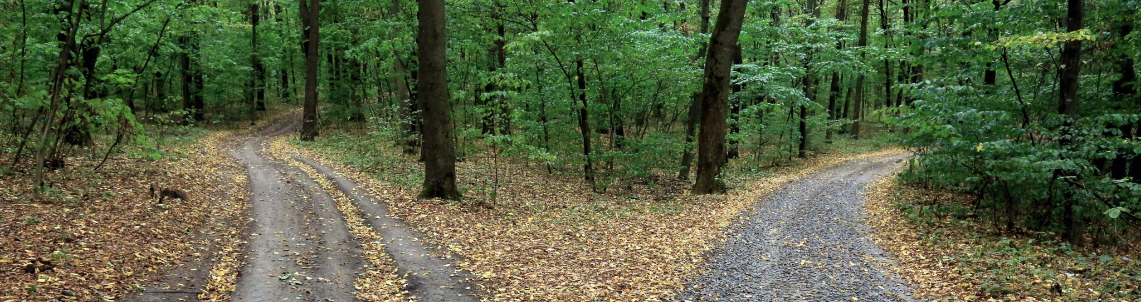
Solving the right problems:
Requirements capture for large-scale, evolving research projects
Gabrielle M. Schroeder
Newcastle University RSE Team
RSECon24

Slide 2

Embarking on a new RSE project
Goal: Map the course of the project
Image: Tabea Schimpf (Unsplash)
Notes:
Usually the exact requirements of an RSE project aren’t clear, and our first task is mapping out the course the project will take.

Slide 3
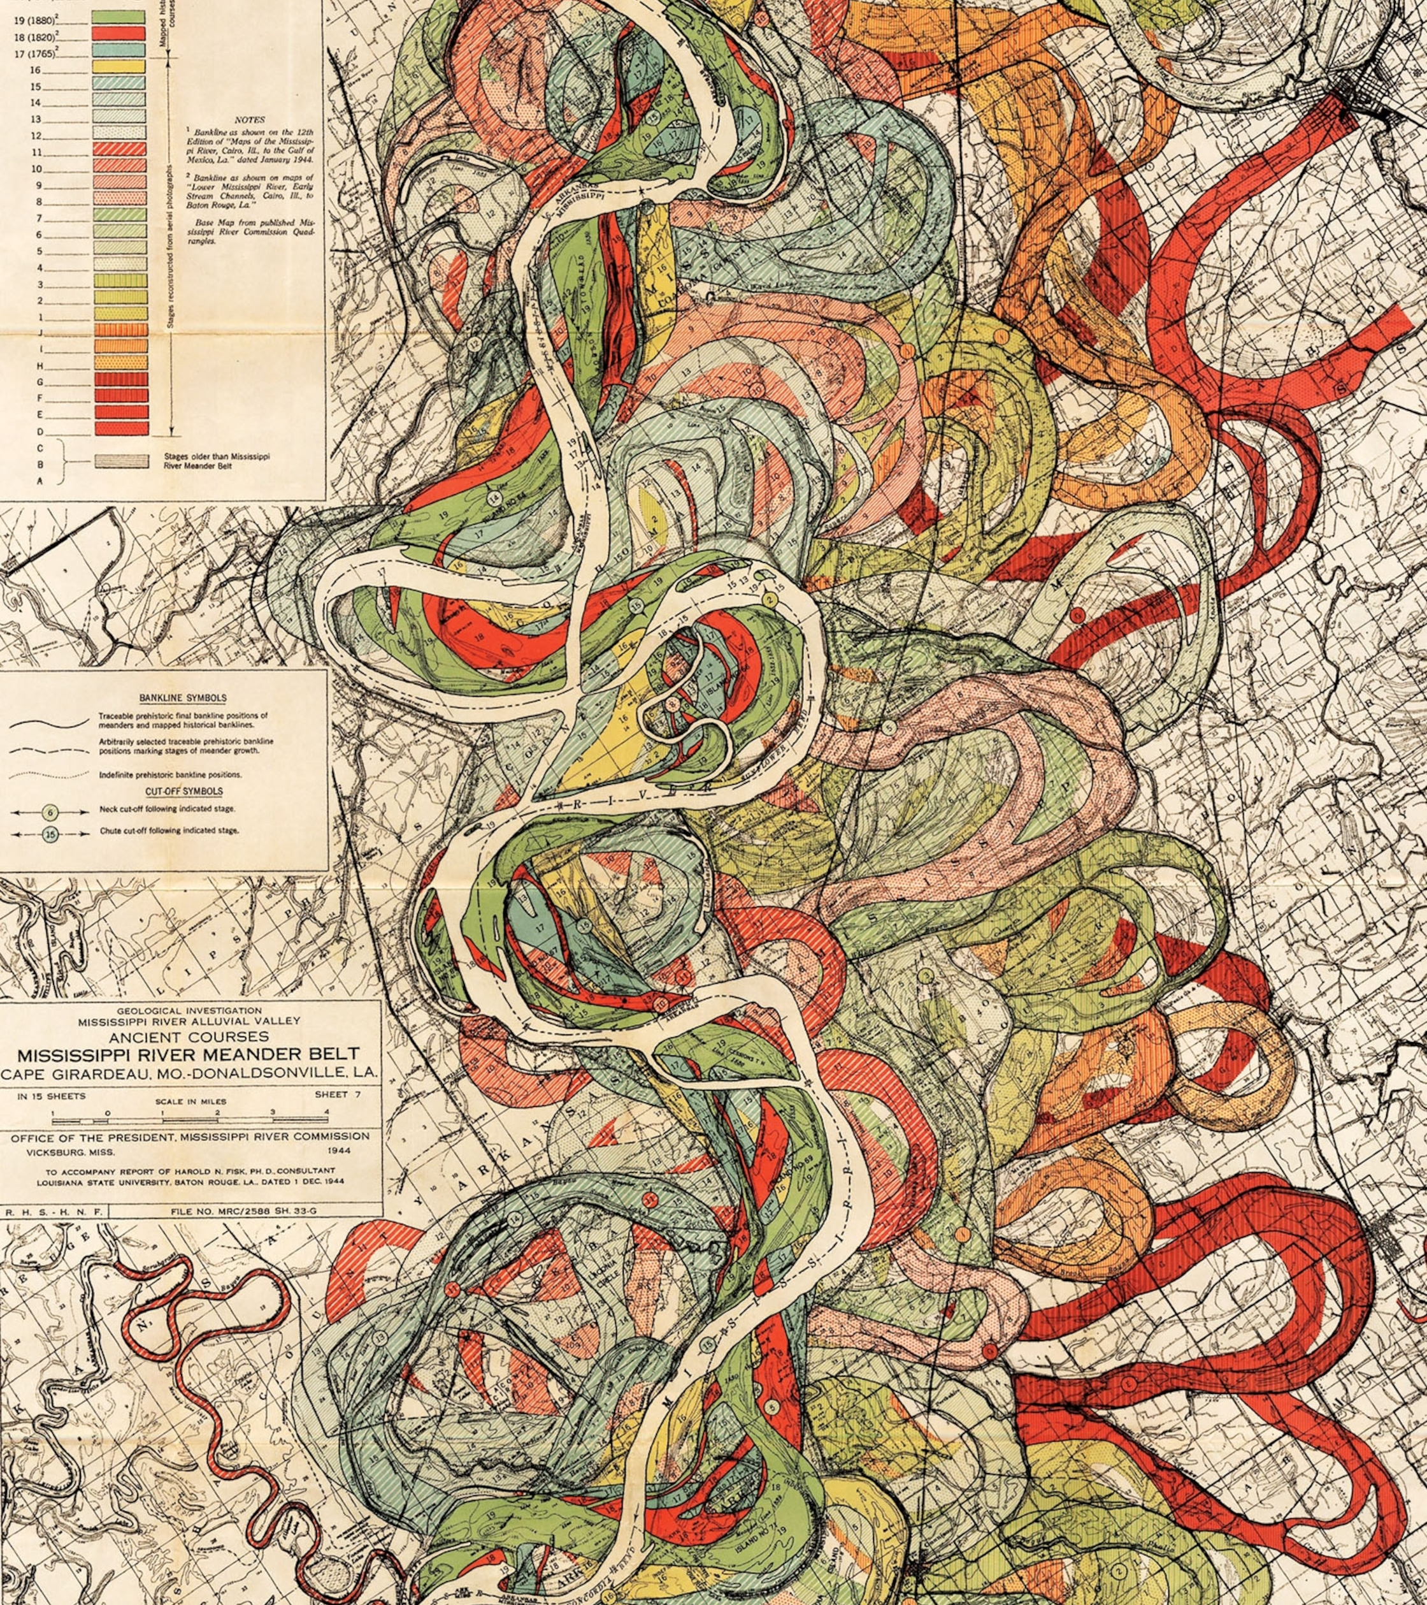
Embarking on a new RSE project
Goal: Map the course of the project
Challenge: Large, evolving research projects
“The nature and origin of the Alluvial Valley of the Lower Mississippi River” by Harold Fisk (1944)
Notes:
The challenge is that the research landscape isn’t static. This is a visualization of the evolution of the Mississippi River, and many research projects have a similarly overwhelming and tangled history with changing goals, requirements and designs. This complexity is an expected and even exciting part of working on research, but it does make navigating these projects more challenge – which is why careful requirements capture is particularly essential.

Slide 4

OpenScan
Driving horizon scanning research at the National Institute for Health and Care Research Innovation Observatory (NIHRIO)
Image: Clemens van Lay (Unsplash)
Notes:
OpenScan is an example of such a complex project. It is an NIHR Innovation Observatory project, and their core mission is horizon scanning research – they identify medical advances to ensure those innovations reach NHS patients. The challenge is that there is no central repository of global clinical trials (the main way to identify medical advances). Different countries and regulatory bodies have their own registries with unique formats, which makes collecting and analysing this data very challenging.
OpenScan addresses this challenge by using web scrapers to collect, standardise, and consolidate clinical trial records from around the world. However, OpenScan no longer met needs of the IO – largely because its software and infrastructure had become complex and poorly documented, and its tech stack no longer aligned with the team’s skillset. These issues made the OpenScan difficult and time-consuming to maintain – taking away time that the team wanted to spend on research.

Slide 5




Capturing OpenScan’s requirements
Assessment stage
Regular meetings
Document current state
Document planned work
Notes:
The Innovation Observatory reached out to the RSE team for help redesigning OpenScan to address these issues. We paid careful attention to requirements capture to ensure we addressed (and didn’t exacerbate!) these challenges.
We started off with an assessment stage – instead of diving right in and making changes, we spent the first few months clarifying requirements and evaluating potential solutions.
During this time, we held regular meetings with OpenScan’s key developers and users.
We used the information we gathered to document OpenScan’s current state – and in particular, the pain points the team was experiencing – and our planned work – using approaches such as user stories, requirements specifications, and work packages. These documentation steps were particularly crucial because writing things down forced us to be precise and helped reveal any gaps in our knowledge. It also helped us define the scope and deliverables for the RSE team’s work.

Slide 6
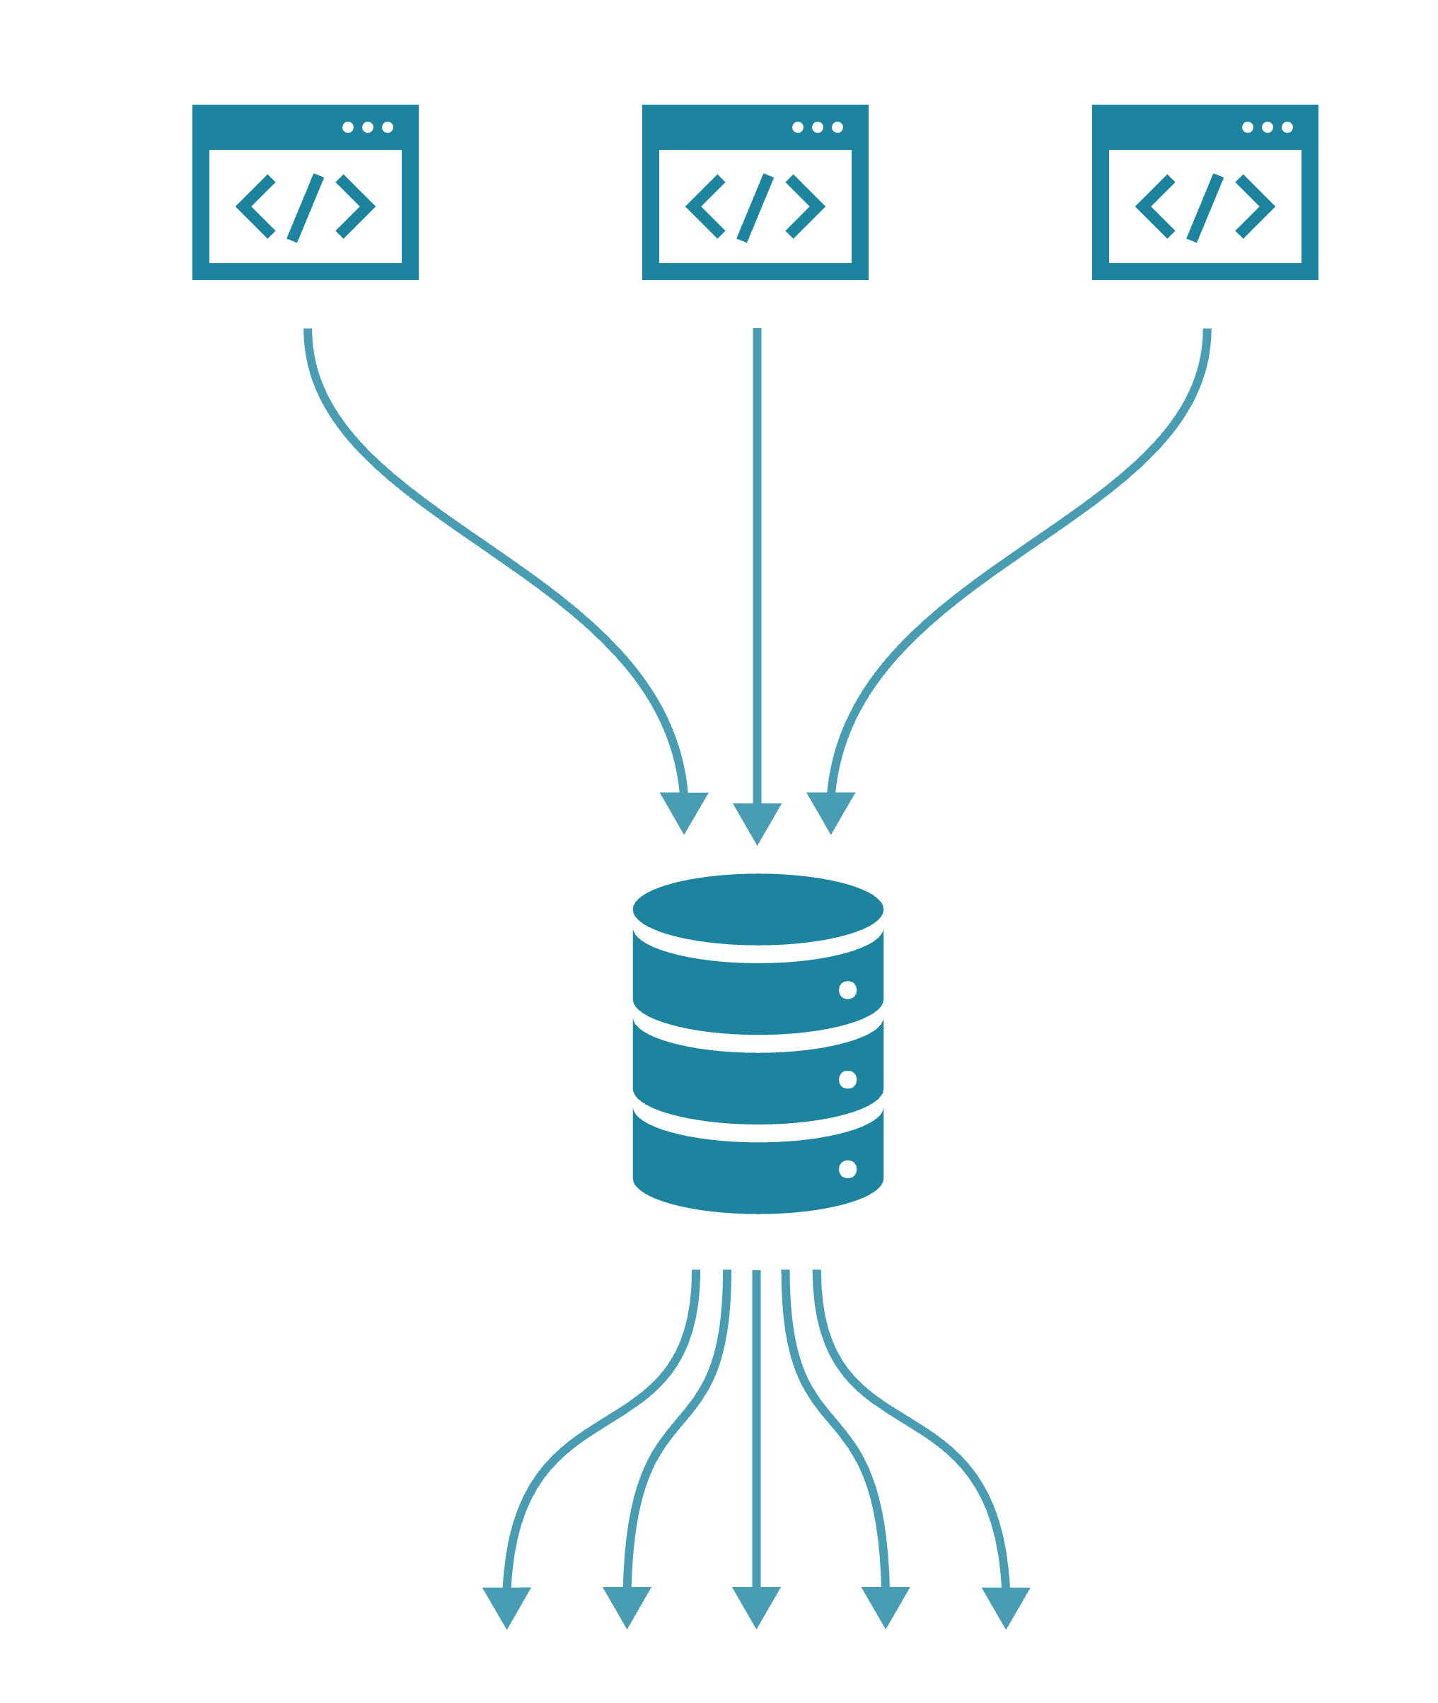
Example work package
Re-designing the web scraper system
Scrape clinical trial records
Process
records
Store in
database
Analyse and
disseminate
Notes:
I’ll highlight this process using an example work package.

Slide 7
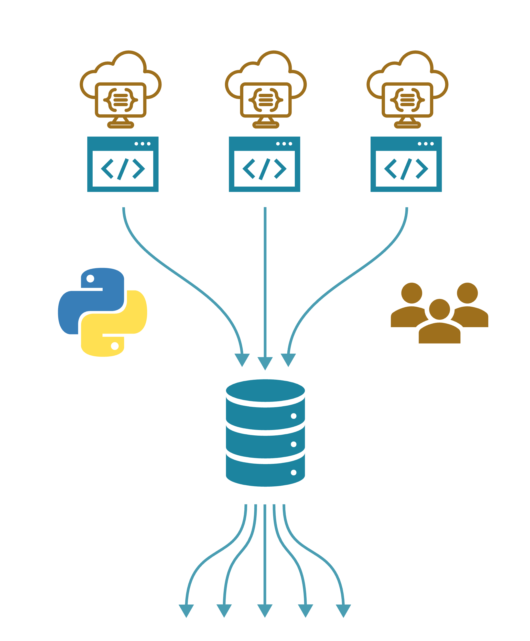
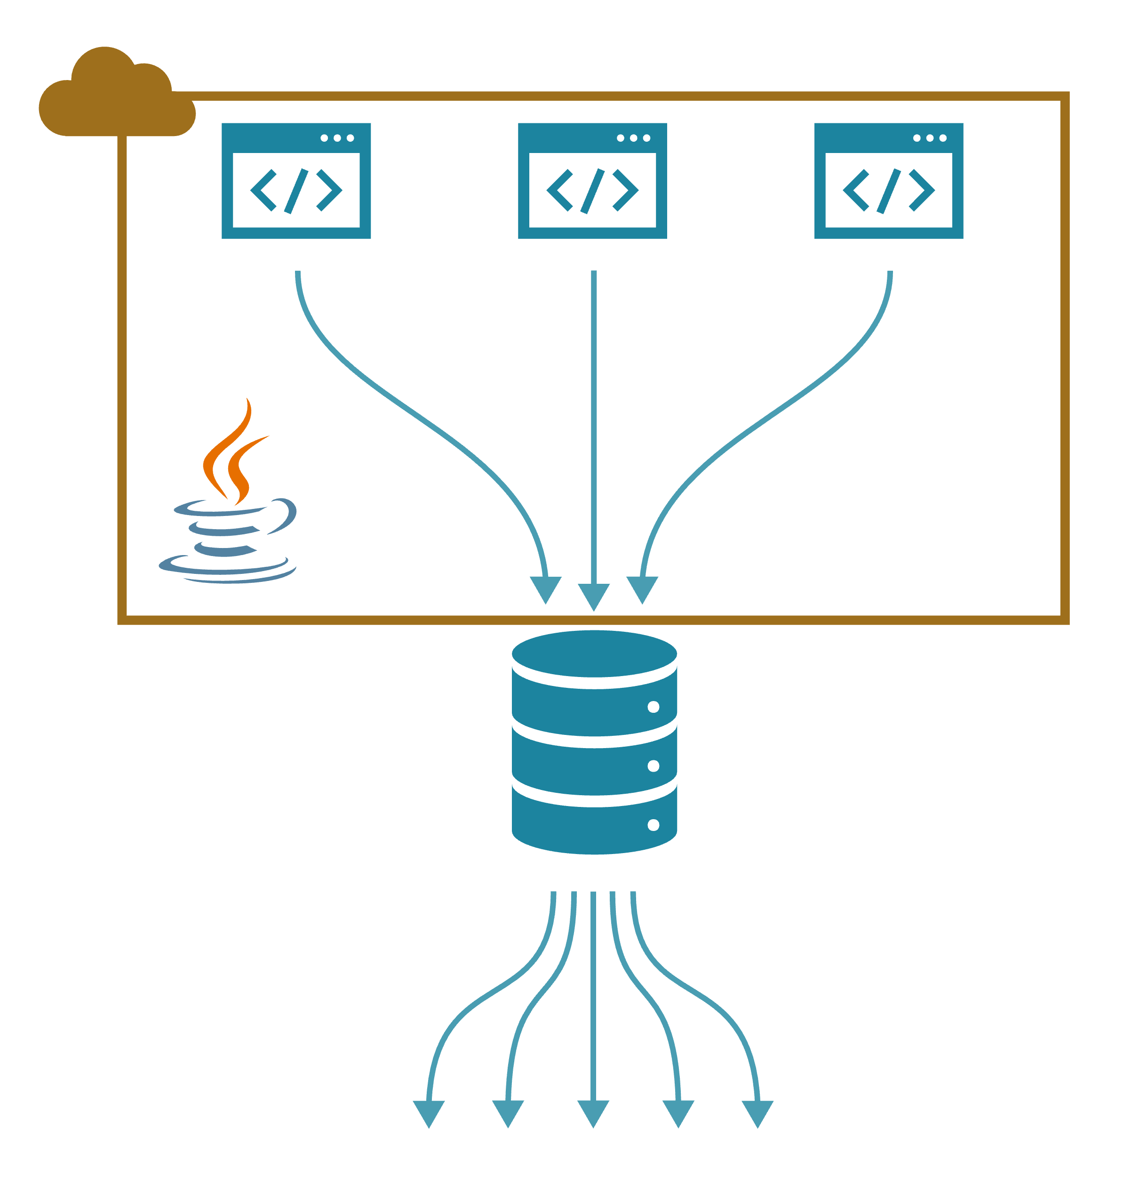
Requested changes
Serverless icon: Vecteezy.com
Notes:
The Innovation Observatory came to use with ideas on how to improve this system:
Current system
Software written in Java framework (complex and difficult for the team to use).
Deployed on an AWS server.
Proposed changes
Convert software to Python (more accessible language for the team).
Switch to a serverless deployment – would no longer need to manage a server or determine amount of computing resources needed as the size of the project changed.
Implement collaboration tools for working on this system.

Slide 8
Strategy: User stories
As a <user> I want to <goal> so that <benefit>.
Notes:
To clarify the goals for this redesign, we started by writing user stories.

Slide 9
Strategy: User stories
As a <user> I want to <goal> so that <benefit>.
Goals should not include the technical solution:
I want to easily train researchers to write web scrapers
rather than
I want to write web scrapers using Python
Notes:
User stories help us abstract away from technical solutions. We can evaluate multiple technical solutions instead of being pigeon-holed into one from the start.

Slide 10
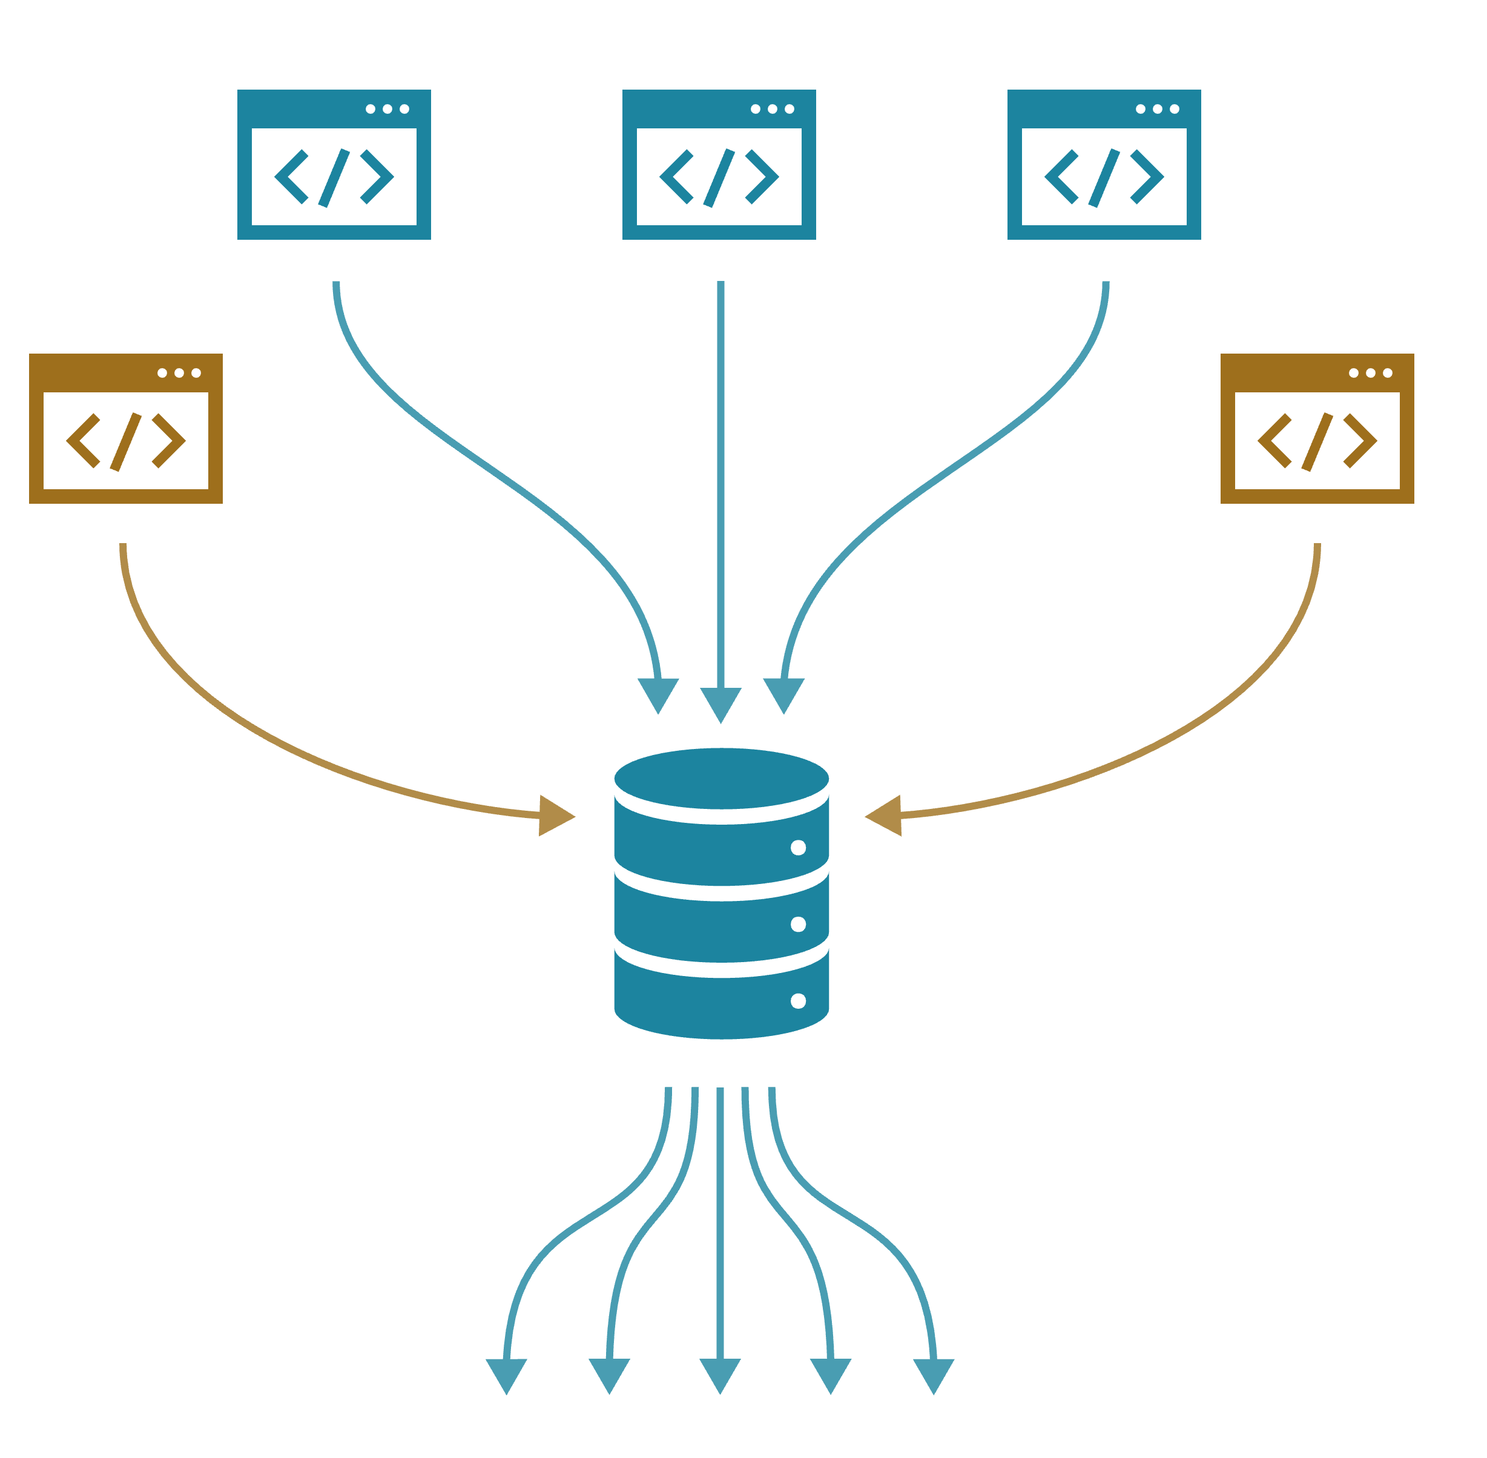
User stories
As an NIHRIO developer,
I want to easily add new web scrapers
so that we can expand OpenScan and develop similar projects.

Slide 11
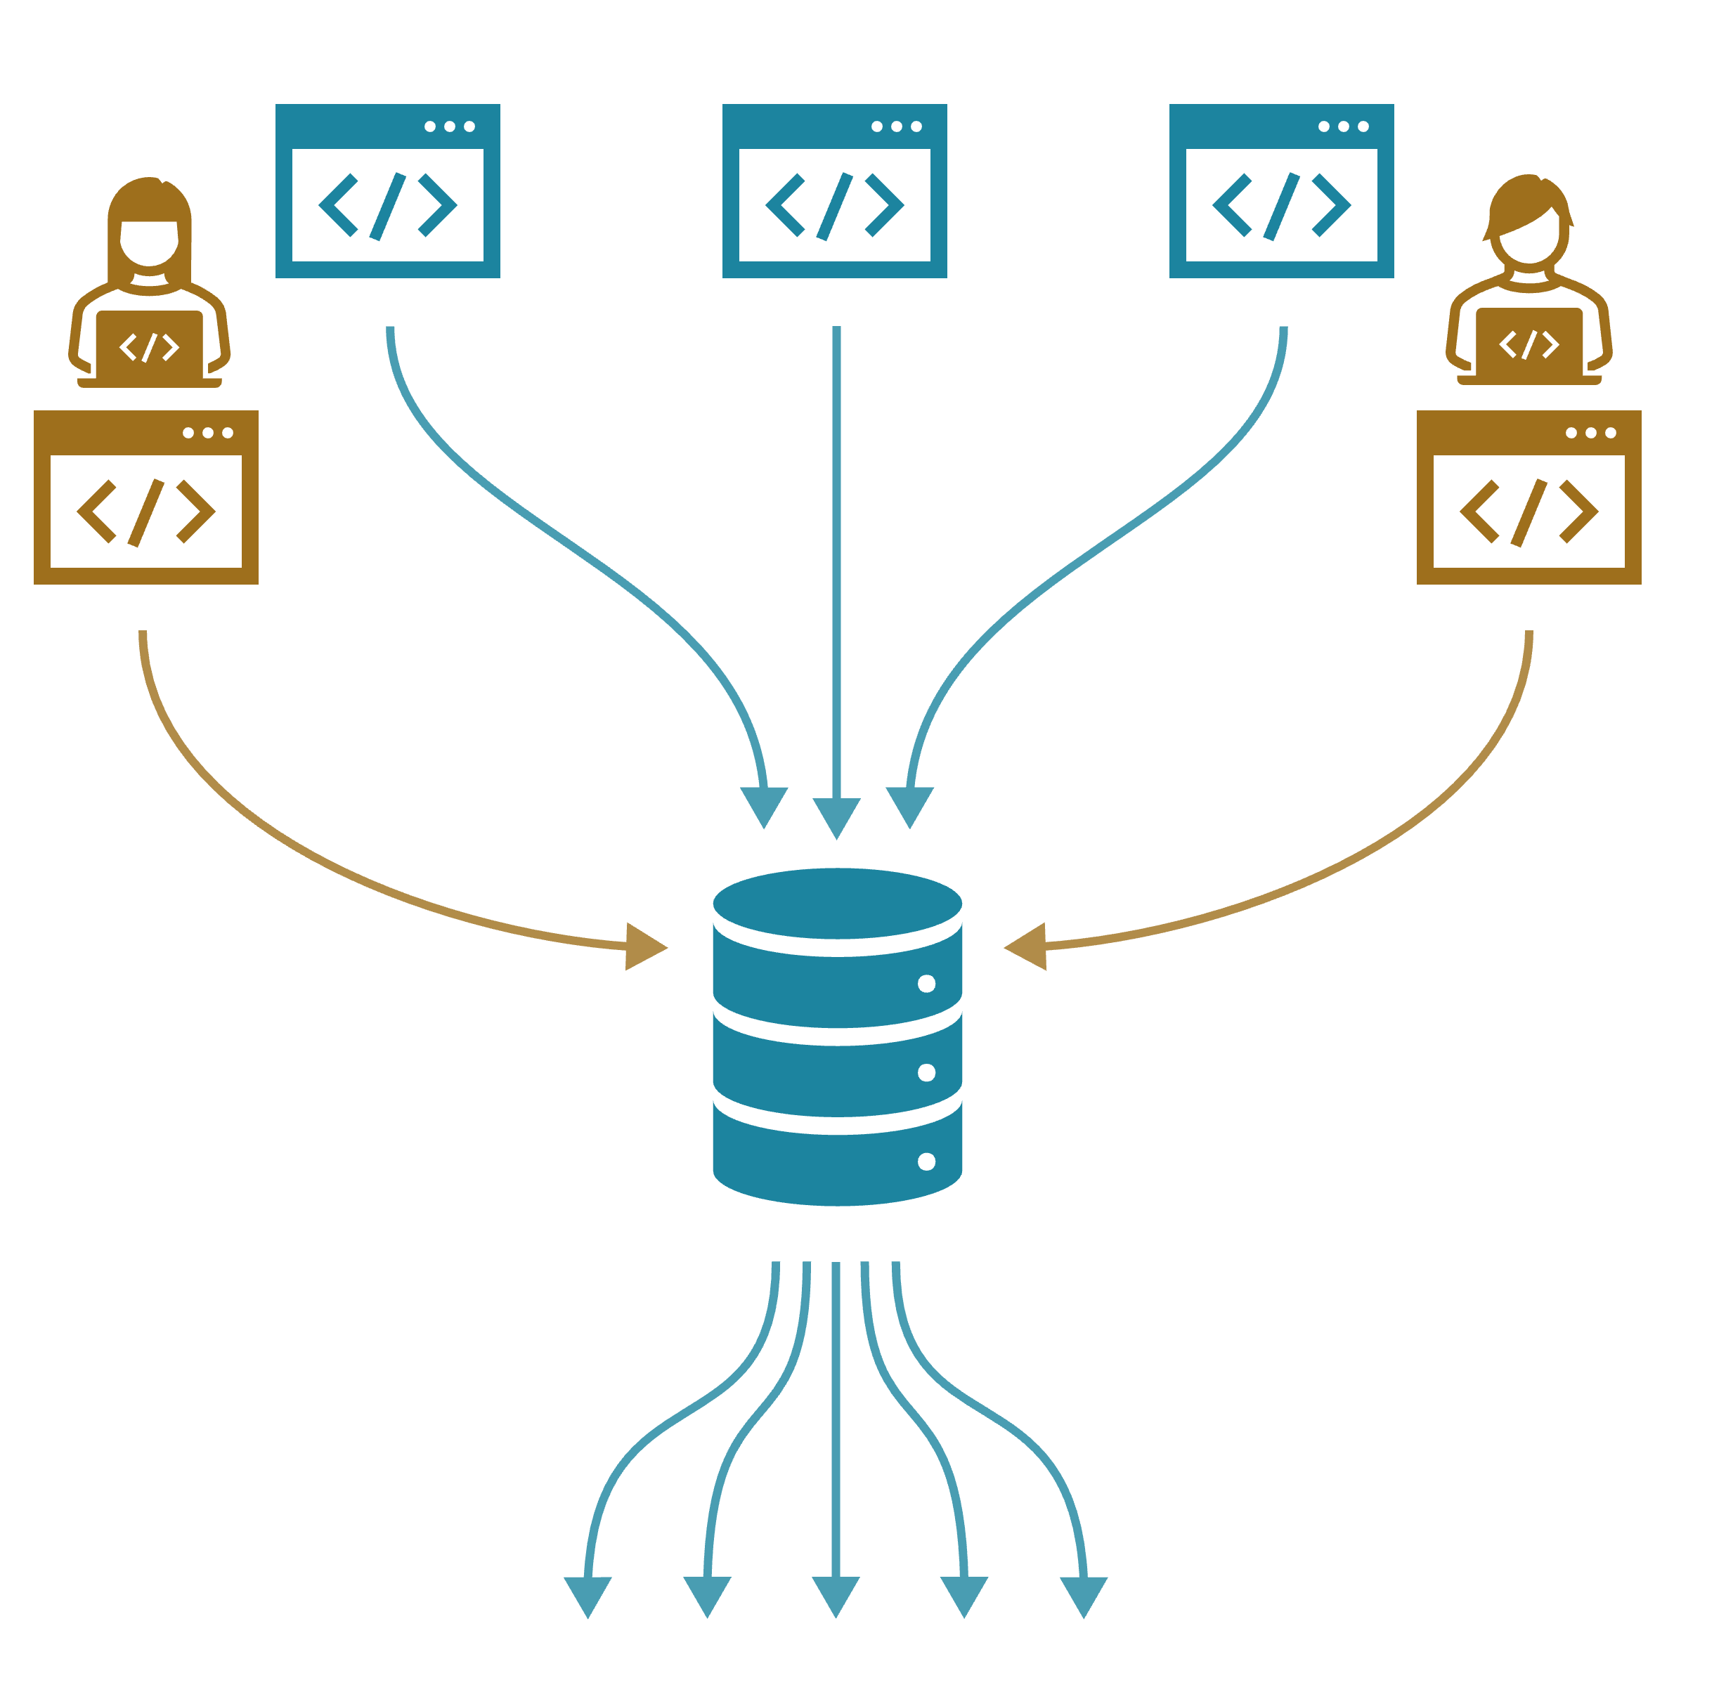
User stories
As an NIHRIO developer,
I want to collaborate on web scrapers
so that multiple people can maintain and develop OpenScan.

Slide 12
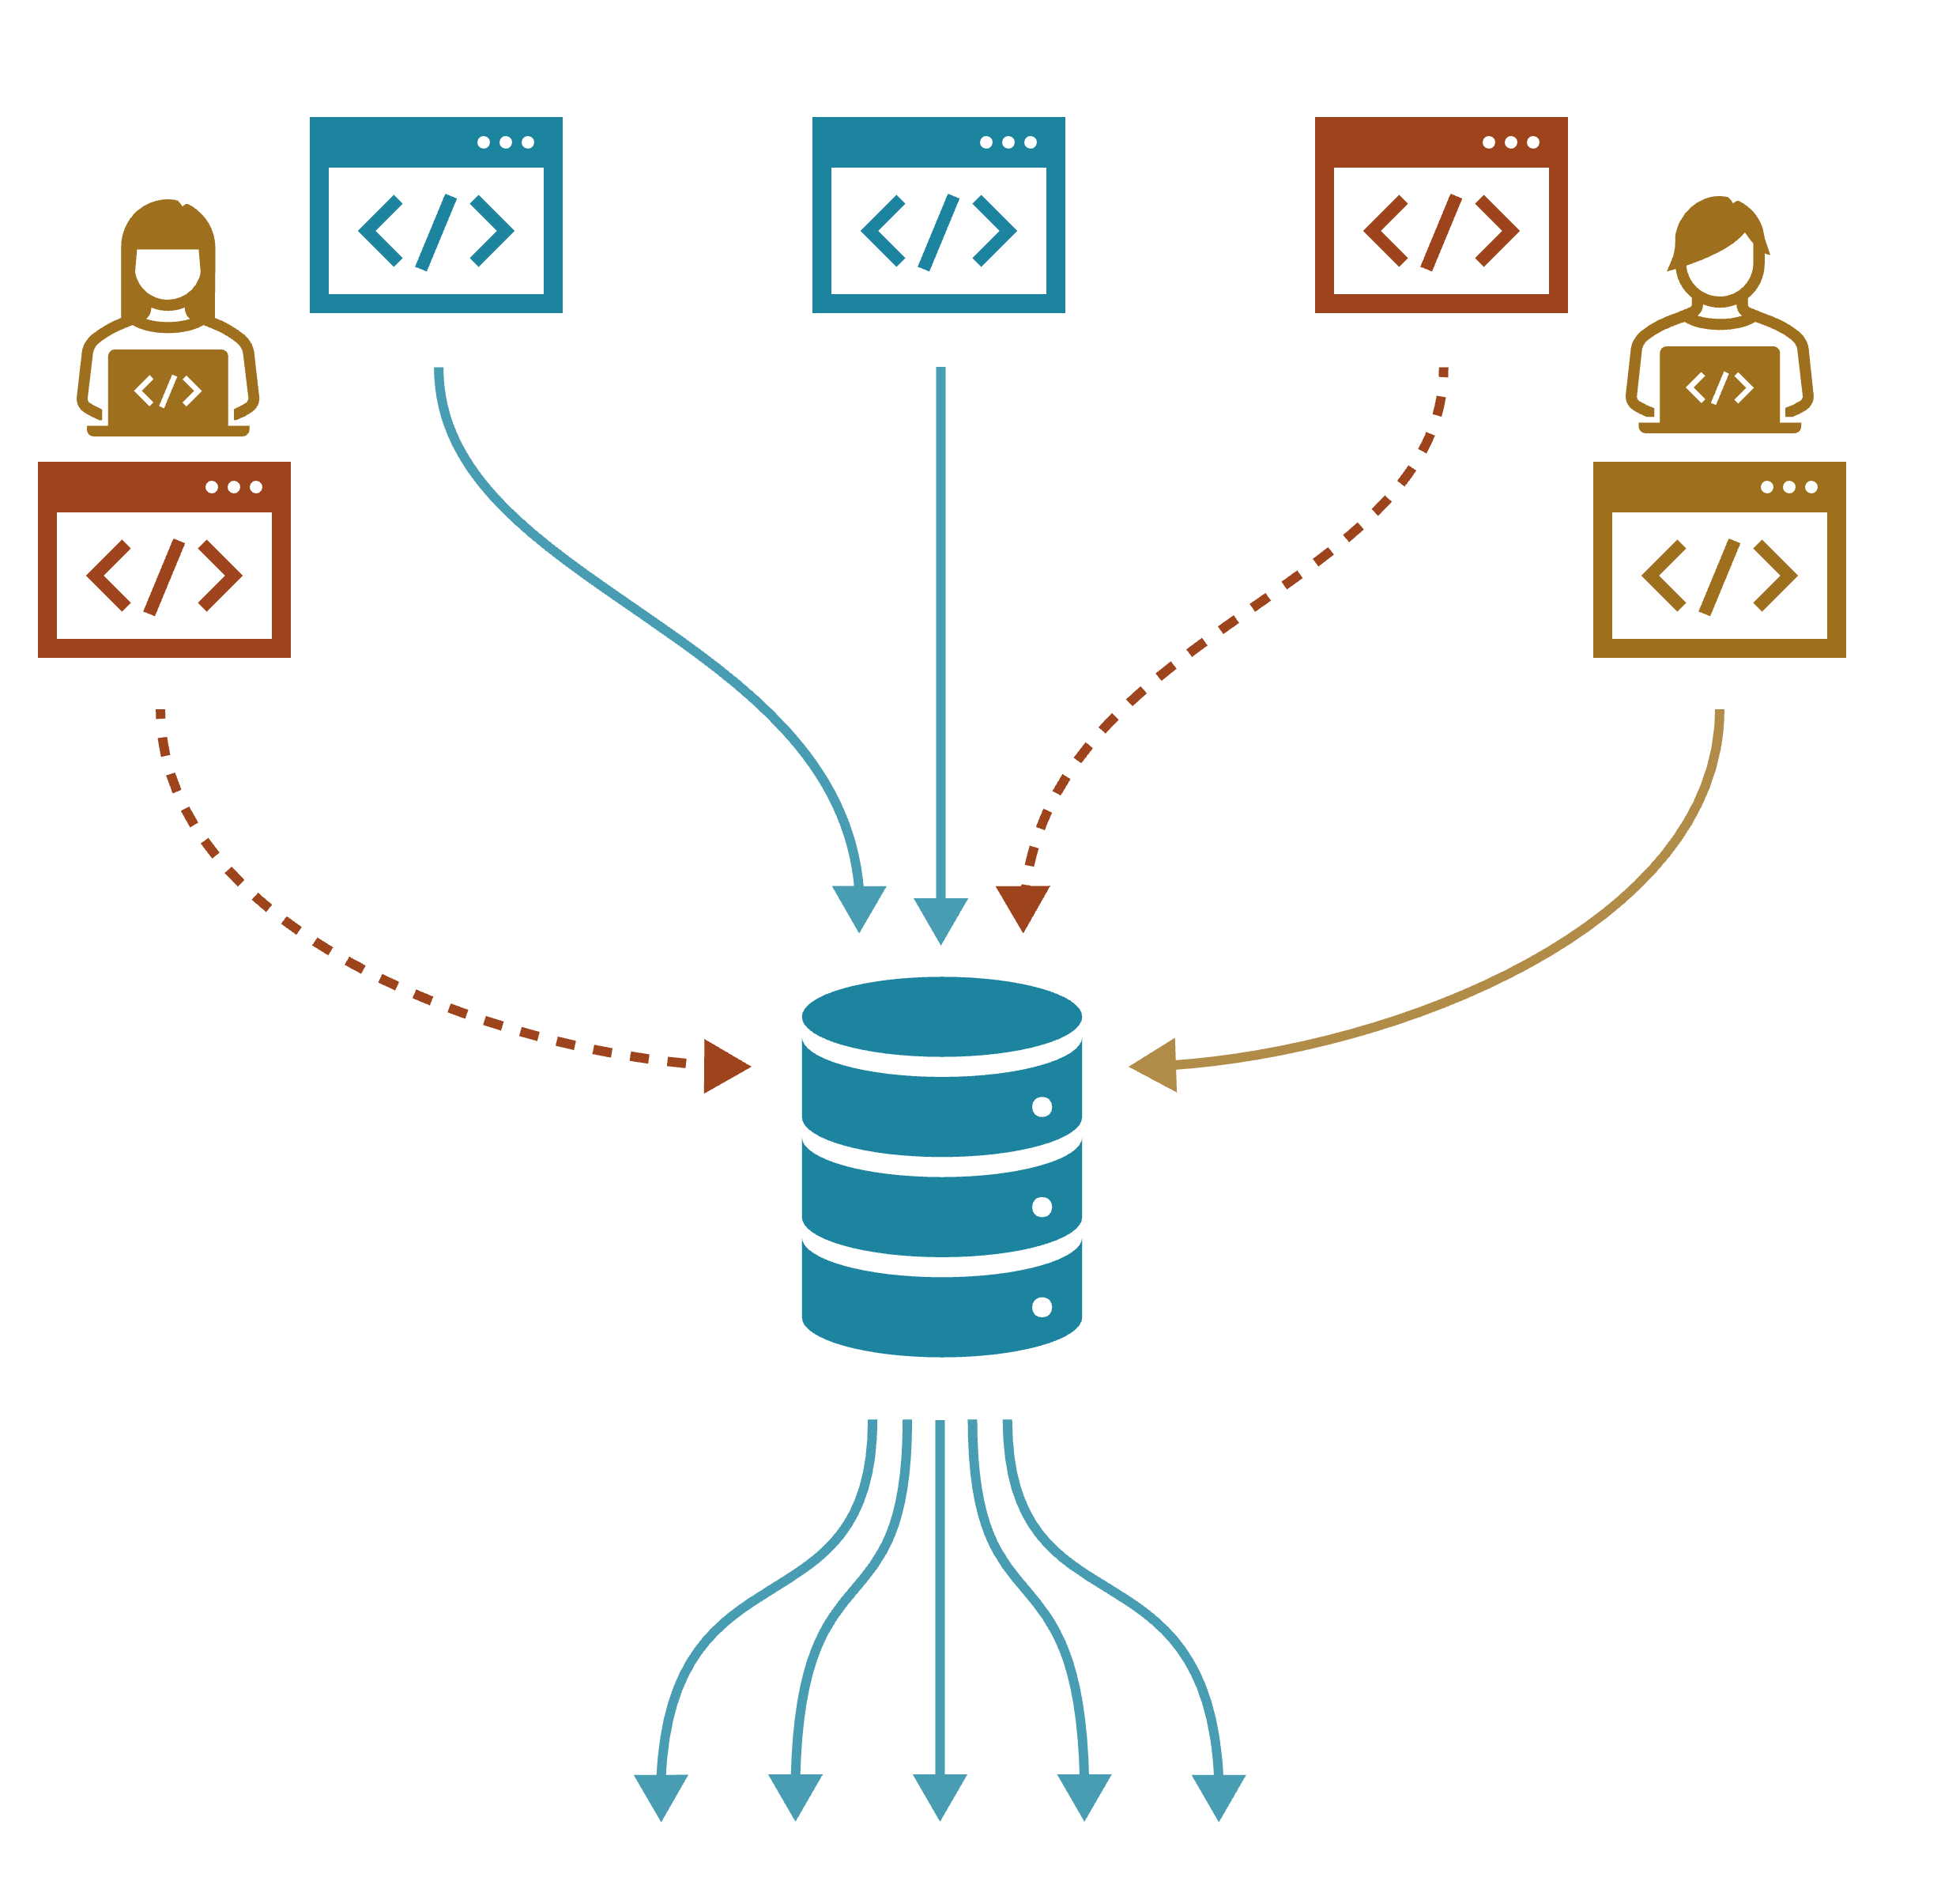
User stories
As an NIHRIO developer,
I want to ensure that different developers do not break other’s web scrapers
so that our pipelines are reliable and robust.

Slide 13
Strategy: Investigate current workflows
Notes:
Because these stories focused on development and collaboration, we took a closer look at the team’s current development workflow, which soon revealed why this workflow was a pain point.

Slide 14
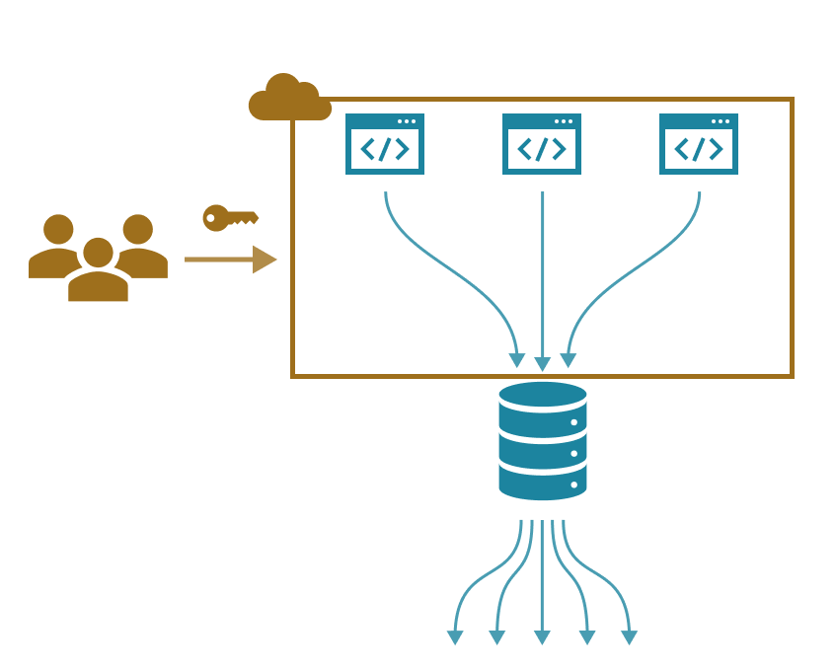
Strategy: Investigate current workflows
One login for server!
Difficult to deploy
Poor version control
Fragile
Notes:
The AWS server for the web scraper system only has one log-in, which meant only one person could work on the system at a time.

Slide 15
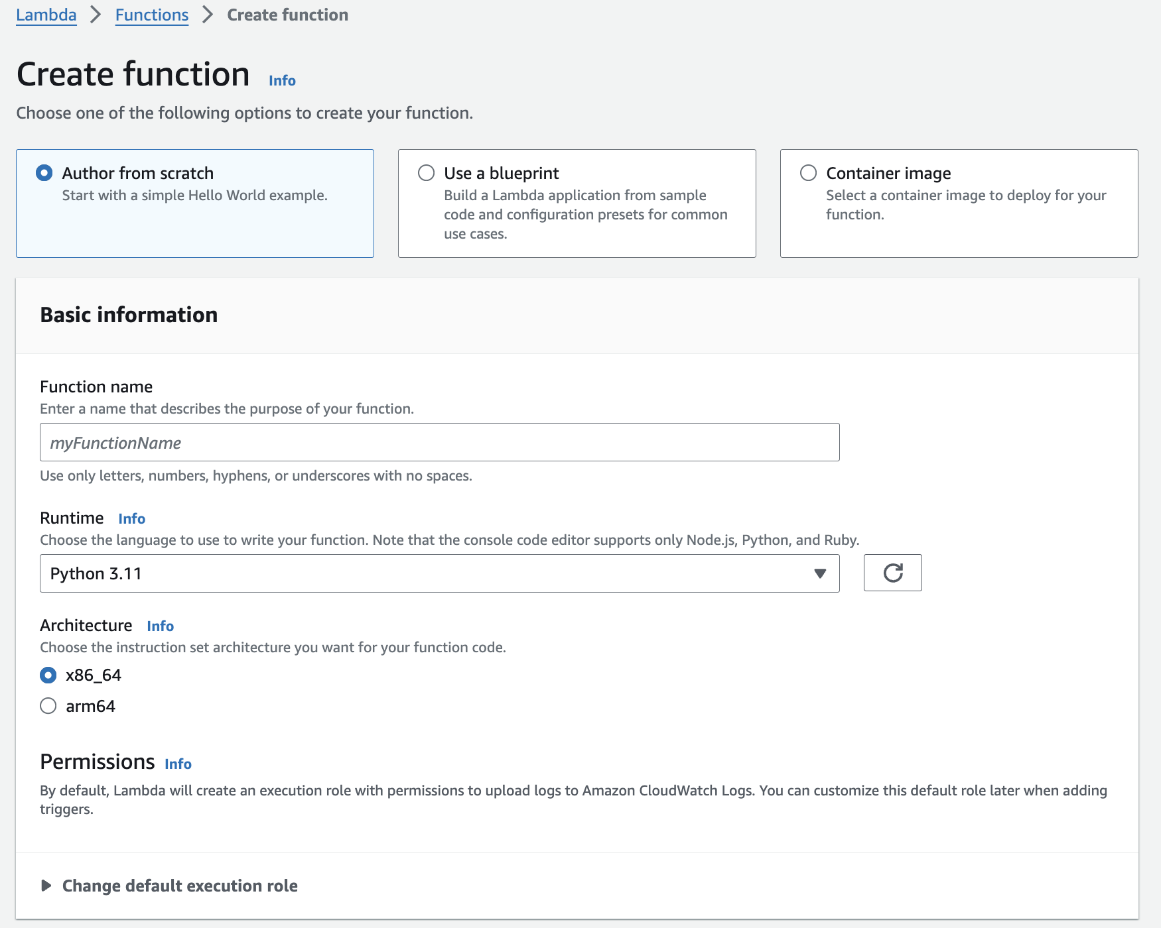
New requirement
Need easy-to-use, reproducible, and traceable workflows for developing web scrapers.
Notes:
Moving to serverless in part helps meet this requirement by removing the bottleneck of the single AWS server. However, in other ways it exacerbates this issue because we now have to specify the serverless configuration for each piece of code (e.g., Python version and memory requirements).
The default way of doing so is with forms like this – not easy to use, reproducible, or traceable!

Slide 16
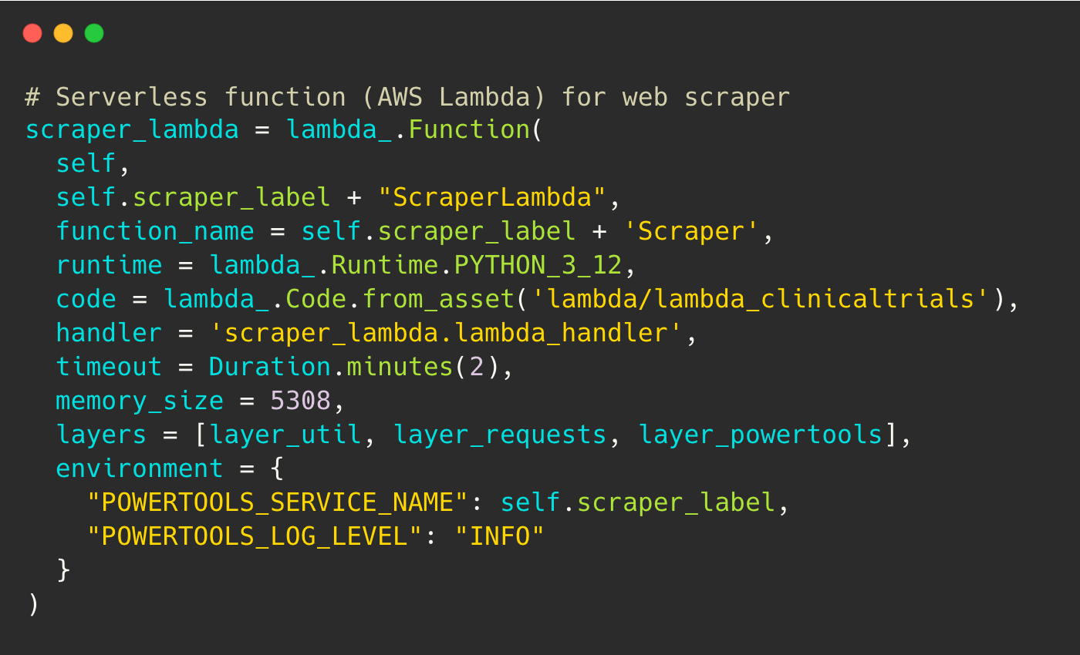
New requirement
Need easy-to-use, reproducible, and traceable workflows for adding web scrapers.
Solution:
Infrastructure-as-Code (in Python)
Notes:
Infrastructure as code will allow the Innovation Observatory to collaborate together using GitHub to develop the entire system. Web scraper code and serverless configurations will be version controlled, and any changes are traceable and easy to deploy.

Slide 17
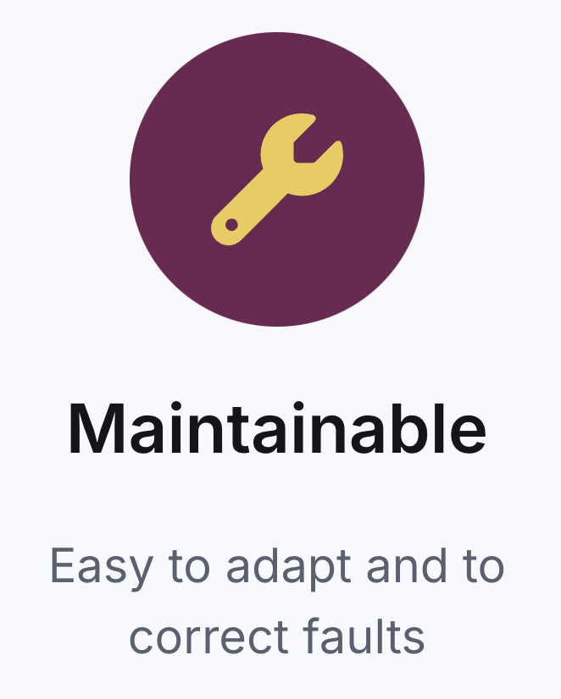
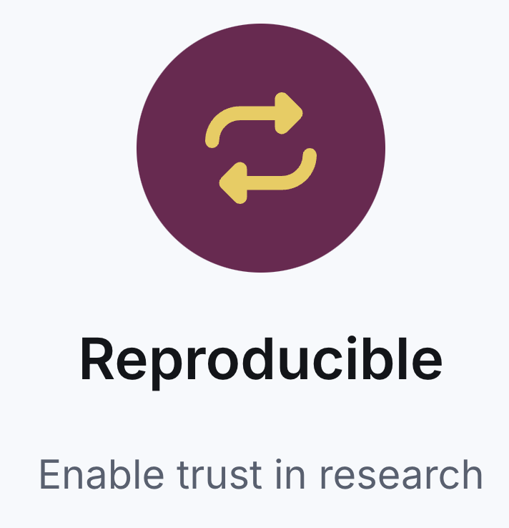
Summary
We identified additional requirements for OpenScan’s redesign.
Careful requirements capture will help make OpenScan maintainable and reproducible.
RSECon2024 Conference Themes

Slide 18

Lessons for RSE projects
Dedicate time for requirements capture.
Investigate the current state and pain points.
Document requirements to formalise your thoughts.
Plan for long-term needs.

Slide 19
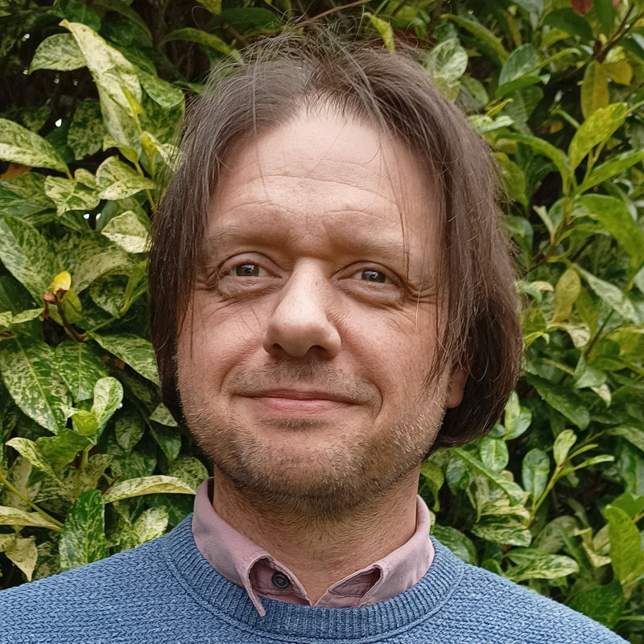
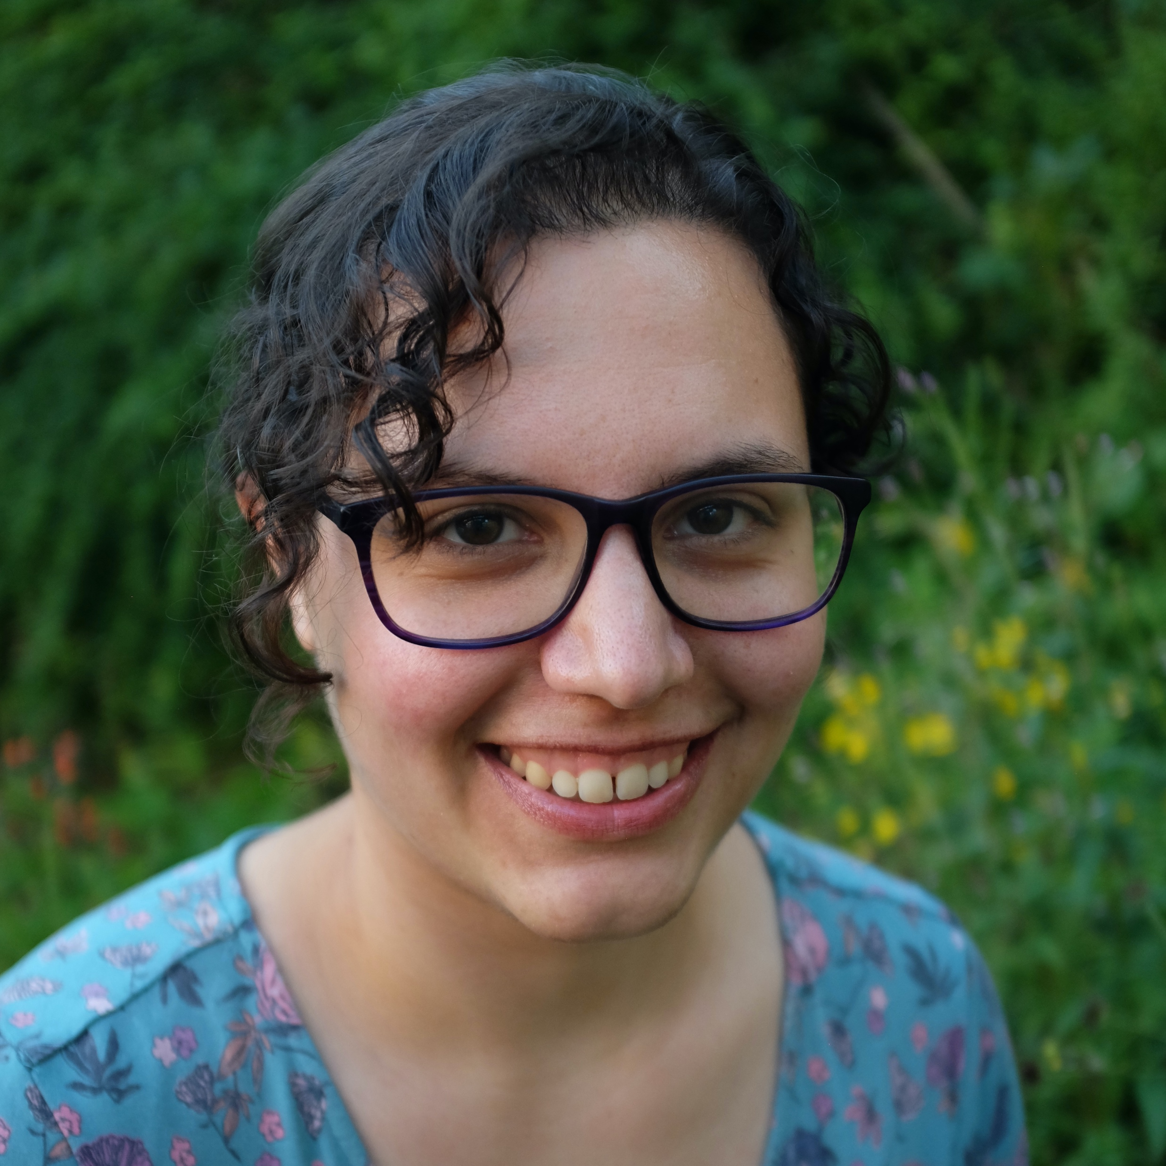
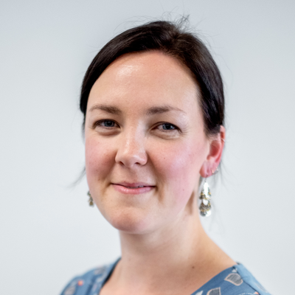
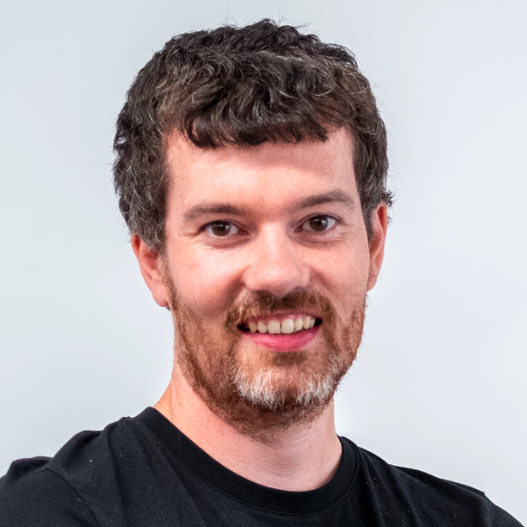
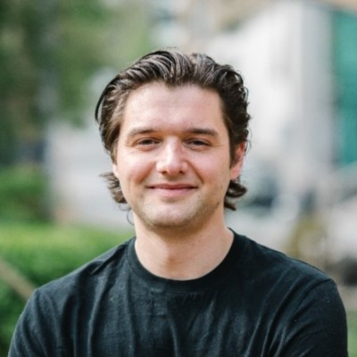
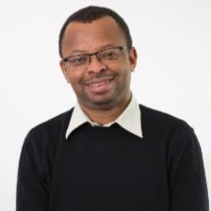
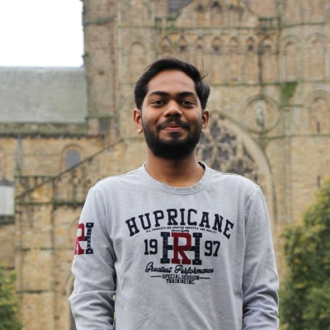
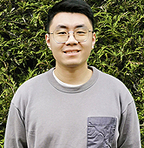
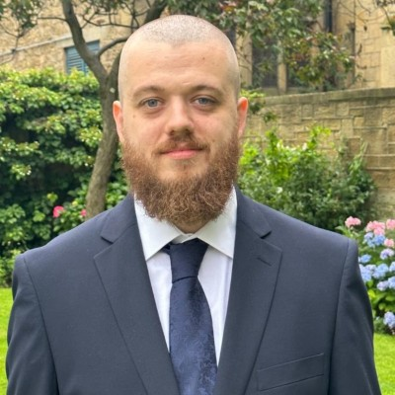
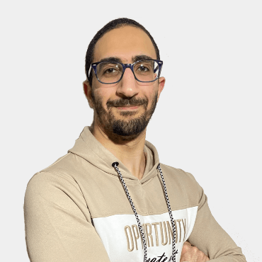
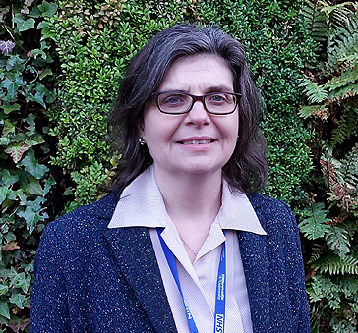
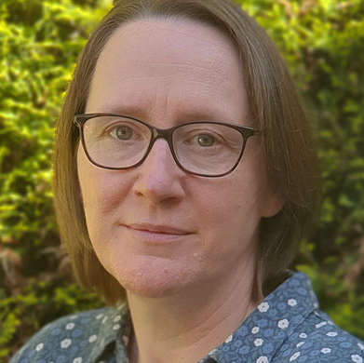
Thank you
Robin Wardle
Gabrielle Schroeder
Kate
Court
Mark Turner
Contact
gabrielle.schroeder@ncl.ac.uk
www.linkedin.com/in/
gabrielleschroeder
Chris Marshall
Saleh Mohamed
Amey
Vedpathak
Hongbo
Bo
Kieran
McDonough
Karim
Elkobrossy
Teresa Fortune
Dawn
Craig

