Slide 1

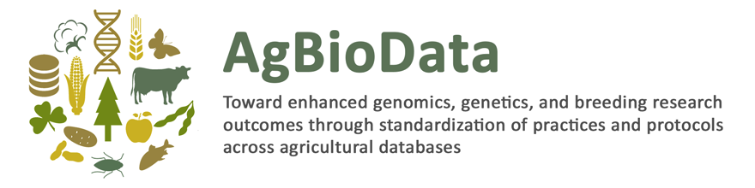
What is a biological digital repository?

Slide 2
What you will learn today
Overview of scientific databases, including the variety of terms used to refer to databases and the differences among them
Brief history of databases; when and why first databases were established
Types of biological databases

Slide 3
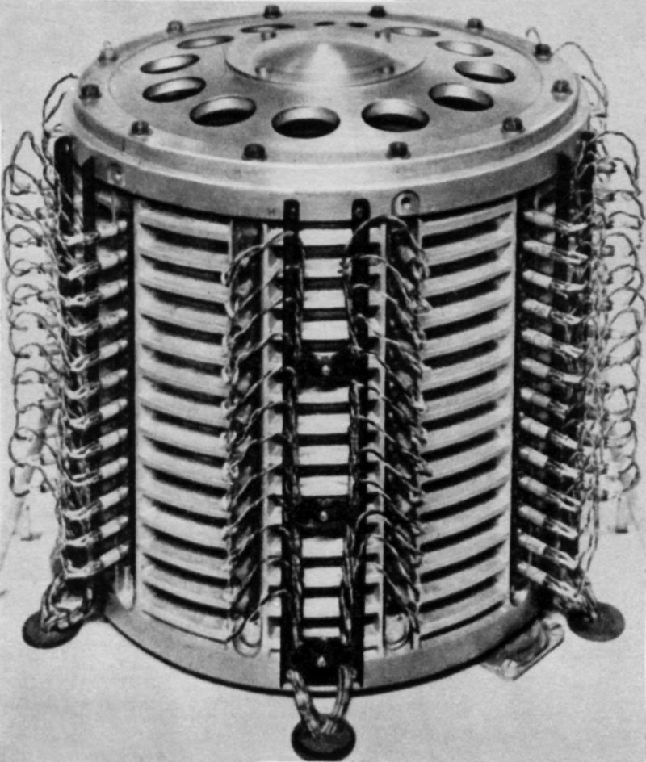
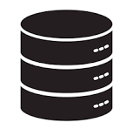
Database Technology
Database technology is associated with the disciplines of Data Science and Computer Science
Organized collection of data
Stored and accessed electronically by software
Querying language
Database technology is an area of active research
How to model complex data and data relationships?
How to represent and store data efficiently?
Query languages
Security and privacy
Distributed access (concurrent access, fault tolerance)
Early digital data storage in the 1950s and 1960s was on large magnetic storage devices called
“drum memory”.
(https://en.wikipedia.org/wiki/Drum_memory)

Slide 4



Databases in Biological Science
Any structured data, such as an Excel file, could be broadly considered a database. For the purposes of this training, we will be focused on large, online data resources.
“Database” is used more broadly in biology than in computer science
Includes not just the data storage but the technology and access methods
Used to represent an entire resource or website
“NCBI is a database”, “TAIR is a database”
Generally, end users apply terms more loosely and with a more all encompassing meaning than information and computer domain scientists.

Slide 5
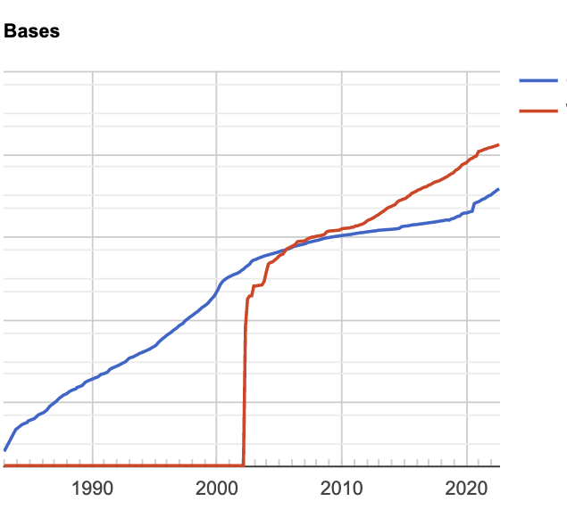
Biological databases are growing in scope and size
This growth has been spurred in large part by cheap short read DNA and RNA sequencing.
New high throughput assays are growing in many other areas of biology, increasing the need for large data storage, high performance computational resources, and performant databases.
10¹⁵
GenBank
Whole
Genome
Sequencing
10¹³
10¹¹
10⁹
Sustained Log -Scale Growth
10⁷

Slide 6
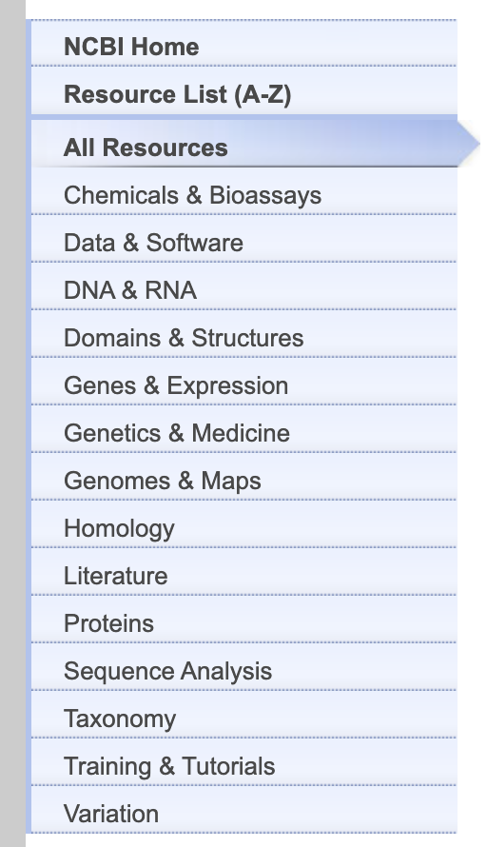
How do databases support research?
Databases enable access to a wide variety of biologically relevant data
Data can be searched and downloaded in a meaningful format
Data becomes much more valuable when integrated with other data and information
Databases are not merely passive information stores but rather they play a range of critical roles in knowledge formation.
Stevens, 2018

Slide 7
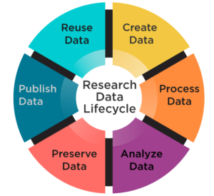
How do databases support the scientific community?
Accelerate scientific discovery
Improve research data impact
Share knowledge across the world
Provide transparency and reproducibility of research findings
Whatley et al 2018, https://wp.nyu.edu/library-drsr/category/background/
Proper data management and deposition in appropriate databases is increasingly required by science funders, publishers and governmental agencies.

Slide 8
Databases can have different goals or multiple goals.
Archive
Priority is persistence of data long term
Datasets intact and entire
Uniform structure may be optional
Aggregator
Priority is access and integration of data
Datasets maybe entire or partial
Data structure and standards are enforced
vs.

Slide 9
“Database” is one of many frequently used and related terms
The data is in the…?
Database
Information Resource
Data bank
Data repository
Web site
Library
Digital repository
Web portal
Archive

Slide 10
These terms can imply different purposes and technologies, but also overlap and are frequently used interchangeable
Purpose: Access and Aggregation
Purpose: Preservation
Library
Web site
Information Resource
Technology Focus: Data Storage
Database
Web portal
Technology Focus: Data Access
Digital/Data repository
Data bank
Archive
Notes:
The idea of this diagram is not to define these terms but to think about the ultimate goals of the database or online resource. Is it looking to preserve data long time or facilitate access to data and integration fo datasets now? Is the technology backing the database focused on data storage (a raw data bank for example) or on data access (a web site and accompanying analysis tool that perhaps actually aggregate data from elsewhere)? These are not binary either/or distinctions - many databases do a combination of these things - but understanding the intent of the database and its developers is helpful for understanding how to interact with it.

Slide 11
Data Handling
In addition to understanding the purpose and technologies being used in a database, it is important to evaluate the underlying data and how it has been handled
Data sources and handling concepts
  Primary vs secondary data
  Metadata
  Data provenance
  Data curation

Slide 12
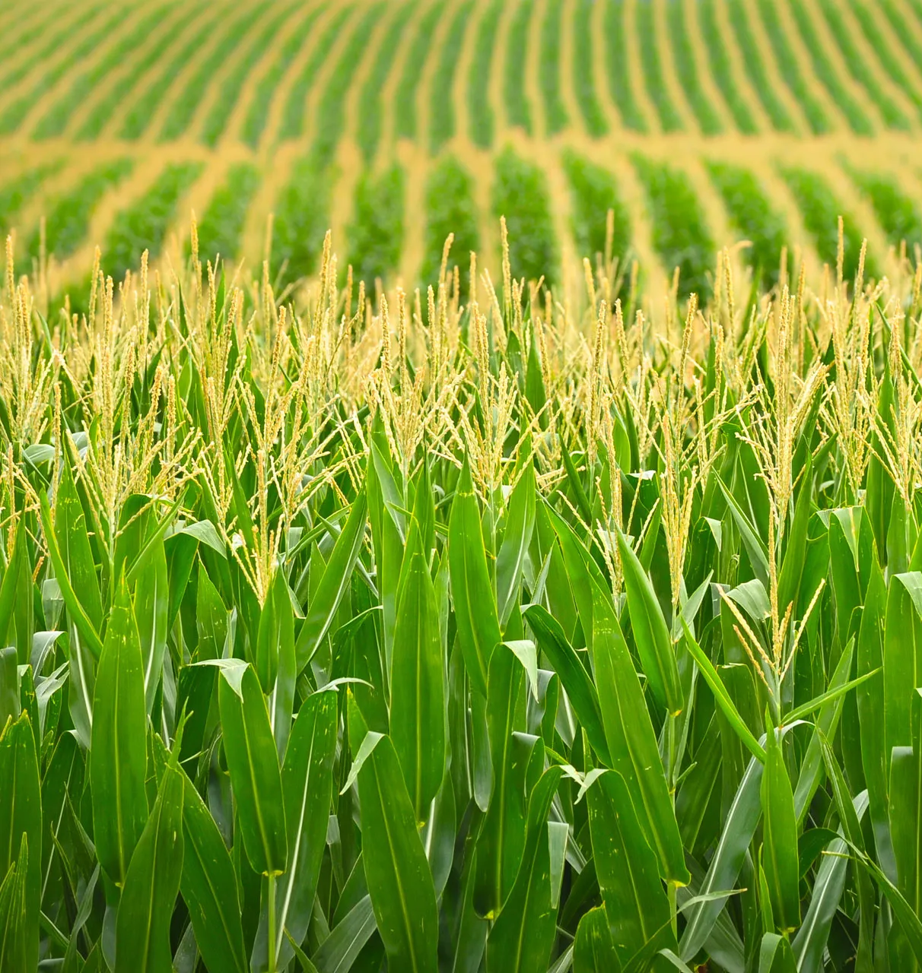
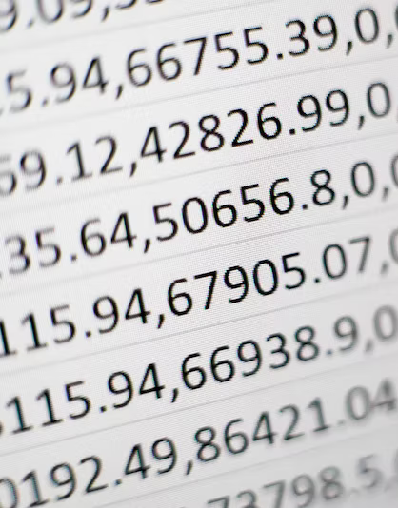
Primary vs. secondary data
Primary data - data that is directly collected; original data
Experiments, observations, surveys/interviews
In terms of the researcher, this is the data they produce
Secondary data – existing, previously gathered data. Can be raw or processed.
Data from databases/repositories, publications, government
May be less reliable and may require validation of authenticity
Example:
A researcher grows 3 varieties of plants and measures their yield at the end of the season. The measurements are primary data.
Example:
A database holds the records of variety yields from 3 different research groups. The database offers average yield data aggregated from the studies. These datasets are secondary data.

Slide 13
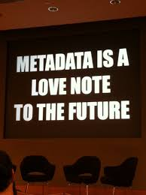
Metadata
Metadata is data about data
Where did the data come from?
  Organism or substrate, experimental conditions, location, time and date, tissue
How was the data collected?
  Field methods, lab methods, instruments
How has the data been processed?
  Normalization, removal of “bad” data, any processing at all
User rights and management for the data
  Is this open for additional publication or is it embargoed?
  Does it carry a license?
http://twitpic.com/6ry6ar

Slide 14
Data Provenance
A record of the origin of a piece of data and a full history of how and why it got to the present place.
“Chain of custody” of data - how it was generated and by who, as well as any changes, manipulations, or transfers to new storage locations
Important for scientists to have confidence in the validity in data
Example for a list of genes downloaded from a database that respond to heat treatment:
  Transcriptome data was produced and fully described in the paper Doe et al, 2020
  Genes with significant differential expression in the experiment were uploaded to a community database in 2021

Slide 15

Data Curation
“reading published papers (or other forms of experimental results) and distilling them down into structured knowledge that can be stored in databases”
Examples
  Cleaning
  Indexing
  Adding metadata
  Normalizing data
  Ensuring compliance with standards or policies
  Ingesting data into a repository
  Validating file integrity
Time and effort required
Professional curators are often employed by databases, often PhD level
Curation can also be automated.
  A frequent example is gene function. New gene sequences are annotated with predicted domains and functions based on automated searches to existing databases
Annotation: additional information associated with or added to existing data

Slide 16
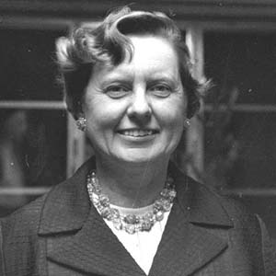
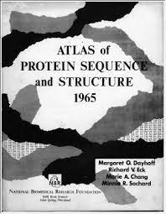
History of Genetic Databases
Margaret Dayhoff, 1925-1983
‘the mother and father of bioinformatics’
Dayhoff pioneered the application of computational methods to the field of biochemistry
Dayhoff and R.S. Ledley developed the first protein database - Atlas of Protein Sequence and Structure, a 1965 printed book containing the 65 then-known protein sequences
“direct ancestor of the databases which now form the backbone of contemporary bioinformatics” - Strasser, 2009
Enabled comparisons of sequences to understand the evolutionary history of species

Slide 17
History of Genetic Databases, continued
1970s - at least 4 protein databases - structural information, peptide sequences, RNA sequences
1979-1980 - An international group of scientists hold a series of meetings to call for a comprehensive nucleotide sequence database, available over a computer network and by magnetic tape
1981 - EMBL (European Molecular Biology Laboratory) DataBank established
1982 - GenBank established by NIH
1980s - Emergence of databases with new data types including genetic markers
Late 1980s - Journals are requiring submission of data to GenBank/EMBL

Slide 18
Types of Databases in Biology
Generalist Databases
Specialist Biological Databases
International Nucleotide Sequence Database Collection
Community Databases

Slide 19



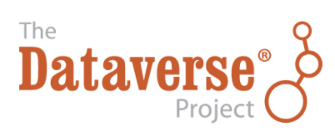


General Repositories
Store heterogeneous datasets, often from a single publication
Store data or other digital artefacts that are not accepted elsewhere
No or low formatting requirements
Supports acquisition, preservation, sharing and re-use
“Open repositories”
Main drawbacks are lack of integration and standardization

Slide 20




Generalist Biological Repositories
By the early 1980s GenBank and EMBL-Bank were dividing up data entry by journal and exchanging data by mailing tapes.
1987 - Launch of DNA Data Bank of Japan (DDBJ)
GenBank, EMBL-Bank and DDBJ joined to form the International Nucleotide Sequence Database Collaboration

Slide 21
Foundational policy still in effect today: data is available for free and unrestricted access, for any purpose, with no restrictions on analysis, redistribution, or re-publication.
Data is synchronized on a daily basis
Led to the need for unique accessions and to agree on common data formats.
Spurred the establishment of open data and open science.
[A feat of] negotiation, translation, and standardization occurred successfully across national boundaries.
Stevens 2018

Slide 22
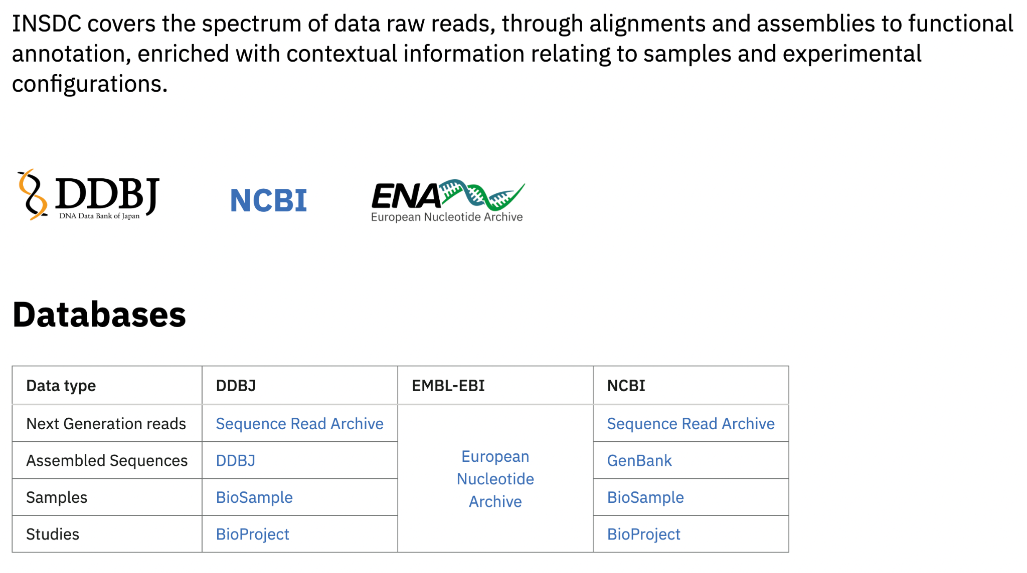

Slide 23
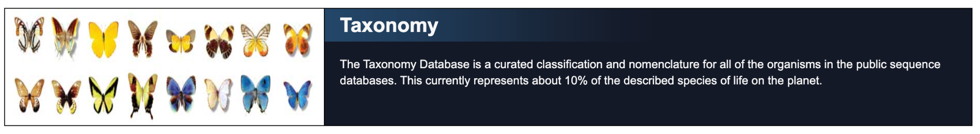


Topical Databases
Provide specific types of data sets, often aggregated from and relied on by many other databases
Example:
NCBI’s Taxonomy DB relies on information from 21 other sites:
AlgaeBase
Amphibian Species of the World
American Society of Mammalogists (ASM) Mammal Diversity Database
Etc (see Schoch et al 2020 for full list)

Slide 24
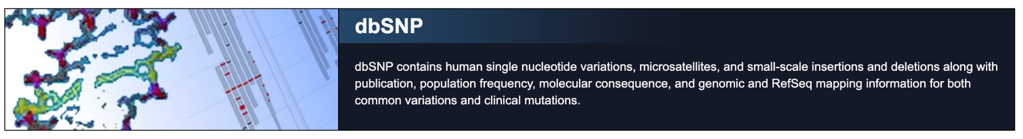

Topical Databases
Provide specific types of data sets, often aggregated from and relied on by many other databases
Example:
NCBI’s dbSNP - genomic variation for humans
EMBL-EBI’s Array Express - functional genomics data for all taxa. Data types:
  transcription profiling (mRNA and miRNA)
  SNP genotyping
  chromatin immunoprecipitation (ChIP)
  comparative genomic hybridisation

Slide 25


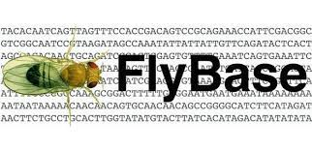



Community Databases
Emerged in the 1990s as
some scientific communities saw value in setting up specialized databases
Usually set up to serve one organism or group of organisms, often “model organisms”
May be referred to as a “secondary database”
  Utilizes sequences from primary databases (INSDC) and/or topical databases
  Often adds additional data not supported elsewhere
Model organism - a non-human species that is extensively studied to understand particular biological phenomena (Wikipedia)

Slide 26
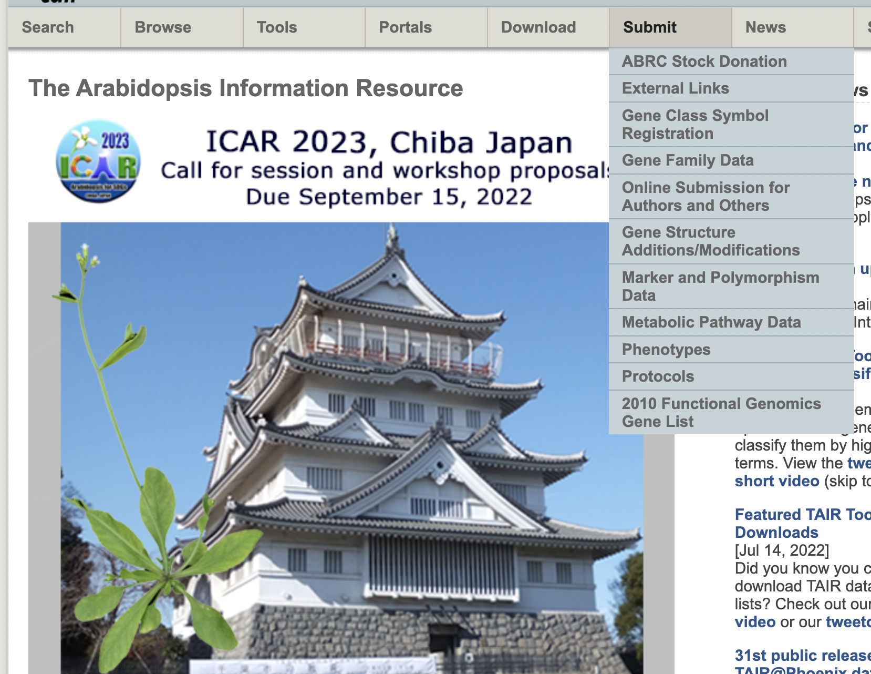
Value Added by Community Databases
In-house team of biological data curators who gather and integrate data
Extracting annotations from published articles
Normalize and reanalyze datasets to add value
Support data types not housed elsewhere
  Mutants, protocols, stocks, genetic maps
Standardize and organize naming of genes, mutants, etc.
Engage with their research community as active participants to steer, prioritize, and submit
Custom training and tool development
https://www.arabidopsis.org/, Sept 1, 2022

Slide 27
Summary
Biological data is often stored in databases or repositories, which have a long history of supporting the scientific community.
These resources support scientists by enabling access to a wide variety of data that can be searched and downloaded in a meaningful format.
These resources support science by accelerating scientific discovery, improving research data impact, sharing knowledge across the world, and providing transparency and reproducibility of research findings.
When working with data, evaluate if it is primary or secondary data, it’s available metadata and provenance, and if there are associated annotations from a curator.
There are many types of databases/repositories, including general purpose repositories, generalist biological repositories (like the INSDC), and community databases.

Slide 28
References
Arita M et al. The international nucleotide sequence database collaboration. Nucleic Acids Research. 2021 Jan 8;49(D1):D121-4.
Baxevanis AD, Bateman A. The importance of biological databases in biological discovery. Current protocols in bioinformatics. 2015 Jun;50(1):1-.
Caswell J et al. Defending our public biological databases as a global critical infrastructure. Frontiers in bioengineering and biotechnology. 2019 Apr 5;7:58.
Cooray MP. Molecular biological databases: evolutionary history, data modeling, implementation and ethical background. Sri Lanka Journal of Bio-Medical Informatics. 2012 Oct 31;3(1).
Gauthier J et al. A brief history of bioinformatics. Briefings in bioinformatics. 2019 Nov;20(6):1981-96.
Harper L et al. AgBioData consortium recommendations for sustainable genomics and genetics databases for agriculture. Database. 2018 Jan 1;2018.
Leonelli S, Ankeny RA. Re-thinking organisms: The impact of databases on model organism biology. Studies in History and Philosophy of Science Part C: Studies in History and Philosophy of Biological and Biomedical Sciences. 2012 Mar 1;43(1):29-36.
Liu L, Özsu MT, editors. Encyclopedia of database systems. New York, NY, USA:: Springer; 2009 Sep 29.
Mayernik MS, DiLauro T, Duerr R, Metsger E, Thessen AE, Choudhury GS. Data Conservancy Provenance, Context, and Lineage Services: Key Components for Data Preservation and Curation. Data Science Journal. 2013 Nov 17;12.
Rhee SY. Carpe diem. Retooling the “publish or perish” model into the “share and survive” model. Plant Physiology. 2004 Feb;134(2):543-7.
Sharma PK, Yadav IS. Biological databases and their application. Bioinformatics 2022 Jan 1 (pp. 17-31). Academic Press.
Smith TF. The history of the genetic sequence databases. Genomics. 1990 Apr 1;6(4):701-7.
Stevens H. Globalizing genomics: the origins of the international nucleotide sequence database collaboration. Journal of the History of Biology. 2018 Dec;51(4):657-91.
Strasser BJ. Collecting, comparing, and computing sequences: the making of Margaret O. Dayhoff’s Atlas of Protein Sequence and Structure, 1954–1965. Journal of the History of Biology. 2010 Dec;43(4):623-60.

Slide 29

Education Working Group, version 0.1, Sept 3, 2022.
Lead: Margaret Staton
Contributors:
Leyla Cabugos
Alenka Hefner
Beant Kapoor
Annarita Marrano
John McNamara
Megan O’Donnell
Leonore Reiser
Timothee Cezard
Fortune Awala
Huiting Zhang
Award #2126334

