Slide 1
Open Seeds by OLS
Open Science Garden(s)

Slide 2
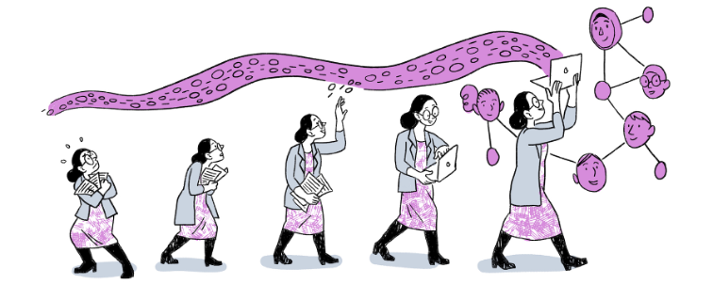
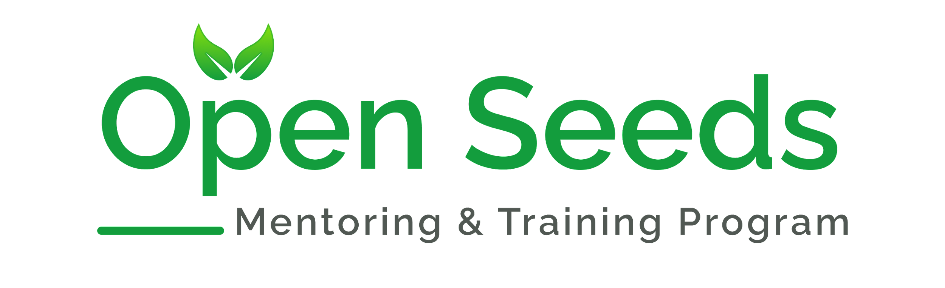
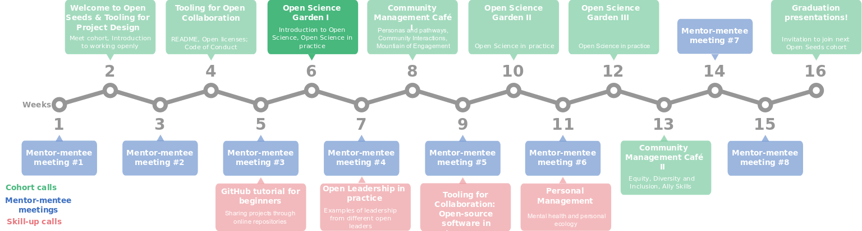

Slide 3
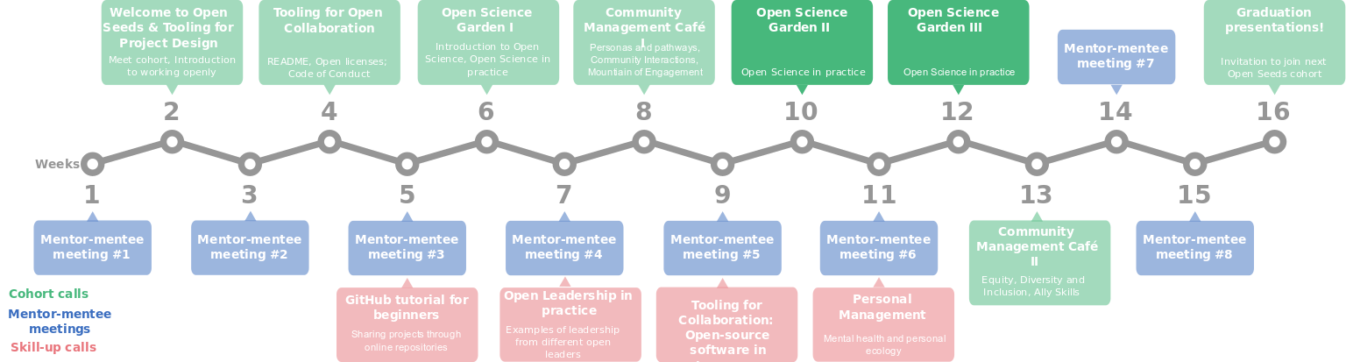

Slide 4
Open Science Gardens in Open Seeds
Learning objectives
At the end of the 3 sessions, we will be able to
Define Open Science and Responsible Research
List the different principles of Open Science
Give examples of use cases of the different Open Science principles

Slide 5
Open Science Garden I
Learning objectives
At the end of today’s session, you will be able to
Discuss the importance of open science for responsible research
Know that open data practices allow sharing data responsibly in projects, safeguard it when needed, and be transparent about the methods used
Identify and leverage Open Educational Resources (OER) to use, adapt, and build upon for teaching/upskilling others in your network

