Slide 1
Open Seeds by OLS
Tooling for Project Design

Slide 2


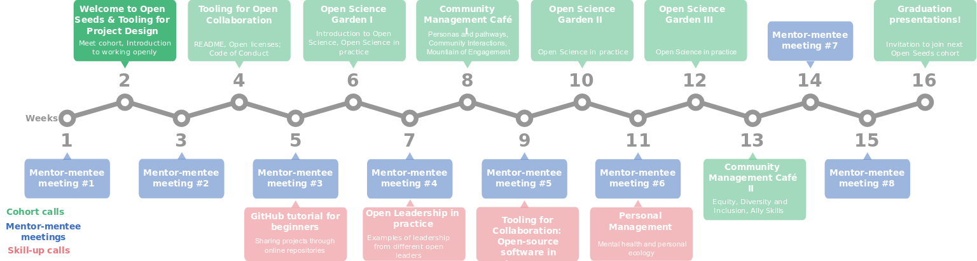
The Turing Way Community, & Scriberia. (2023). Illustrations from The Turing Way: Shared under CC-BY 4.0 for reuse. Zenodo. https://doi.org/10.5281/zenodo.8169292, https://zenodo.org/record/3332807

Slide 3
Tooling for Project Design
Aim: Help you clarify and communicate your project idea, purpose and goals in a way that will invite and encourage participation from your community

Slide 4
Tooling for Project Design
Learning objectives
At the end of this session, we will be able to
Identify tools to help you design your project in a clear way for newcomers to quickly understand what the project is about, who can be involved, and where the work is headed
Fill the open canvas for your project to think through an open project strategy to develop a MVP
Make and post a Roadmap for your project with milestones, tasks, and description

Slide 5
Tooling for Project Design
Content
2 Talks for the current cohort
  Open Canvas
  Project Roadmapping
Talks in previous cohorts, available on the Open Seeds Video Library
Hands-on development of these resources for your project

Slide 6
🏗️ Tracking your project in Open Seeds
Activity: 10 mins
📑 Open an issue on OLS-9 repo where you will be able to track your progress in this cohort
Click this to create an issue: https://github.com/open-life-science/ols-9/issues/new?assignees=&labels=&template=project.md
Add title - edit the main text with information that it asks about your project and team)

Slide 7
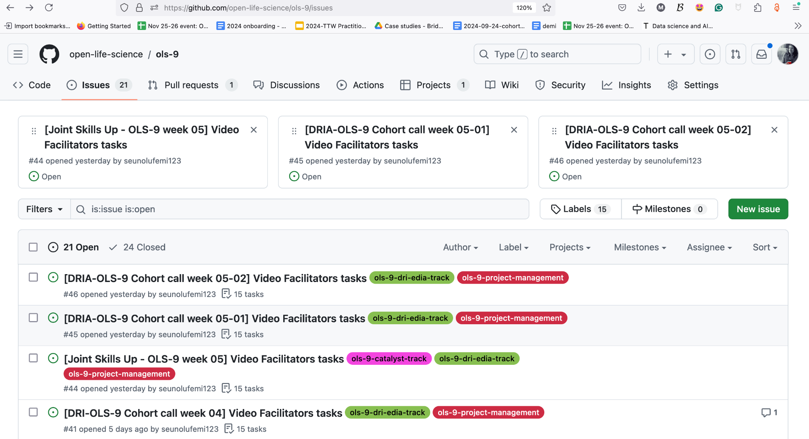
🏗️ Step 1: Visit the GitHub repo -> Issue https://github.com/open-life-science/ols-9/issues

Slide 8
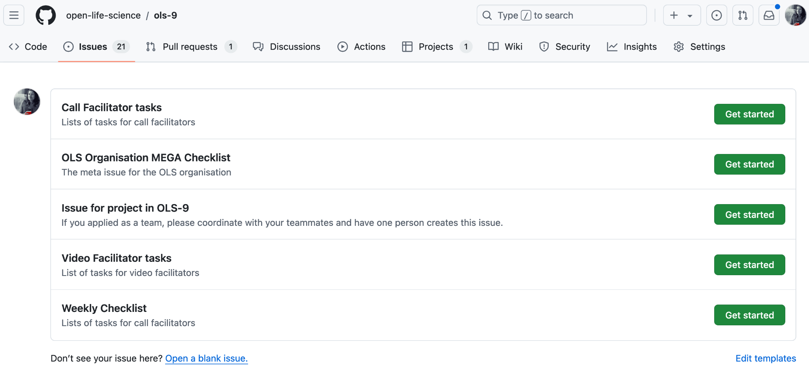
🏗️ Step 2: Click on new issue → Issue for Project in OLS-9

Slide 9
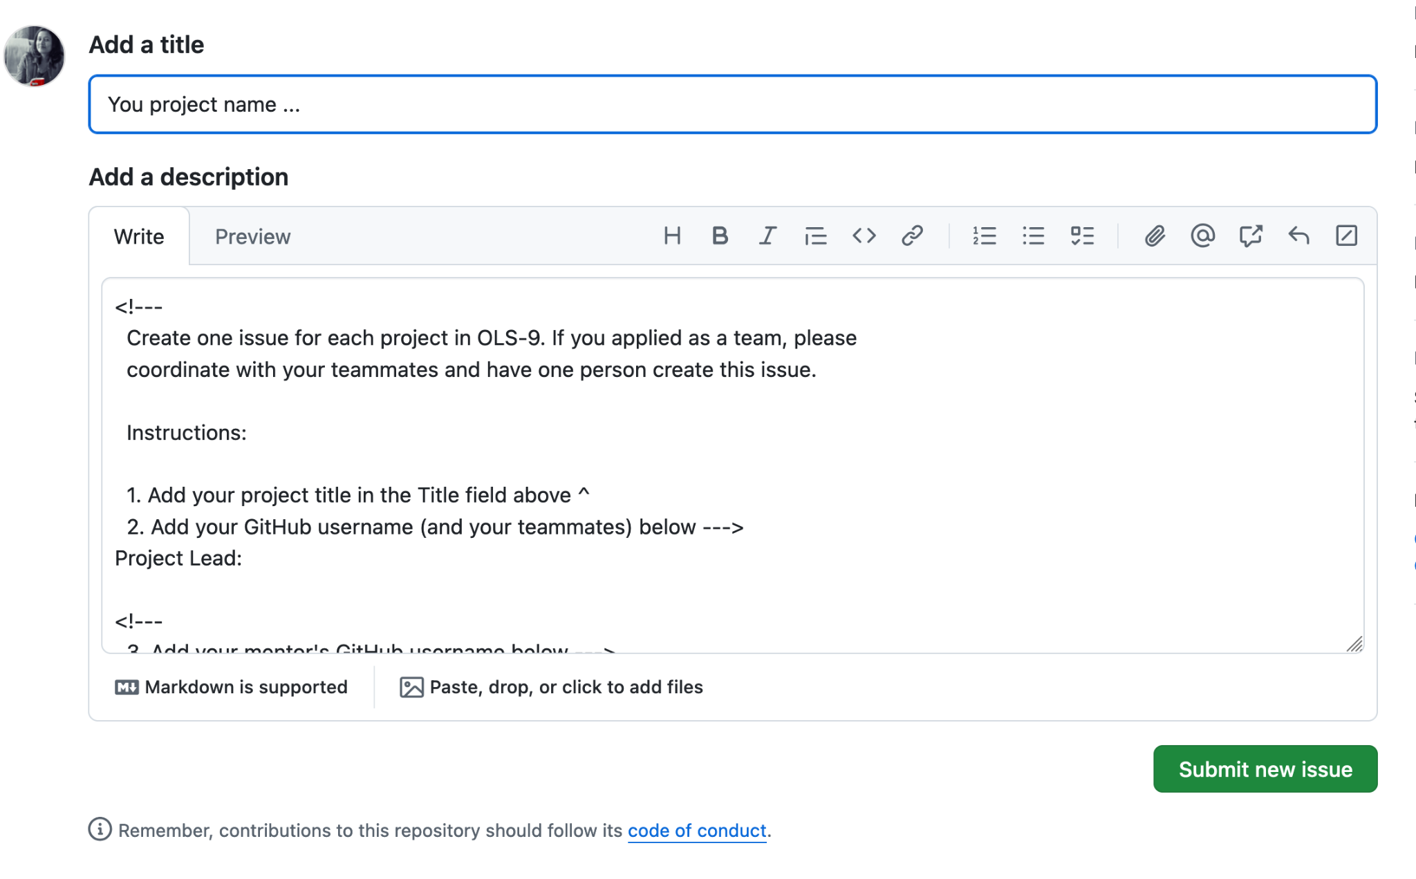
🏗️ Step 3: Edit information -> Submit new issue

