Slide 1
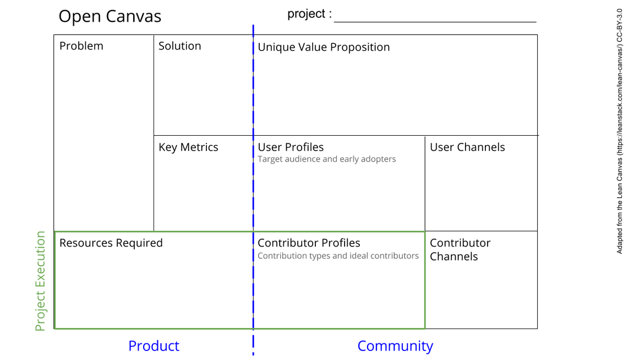
This is a template. Please make a copy for yourself (file -> Make a copy).
See next slide for instructions!
Notes:
Go to File > Make a Copy… to make your own canvas
See next slide for instructions

Slide 2
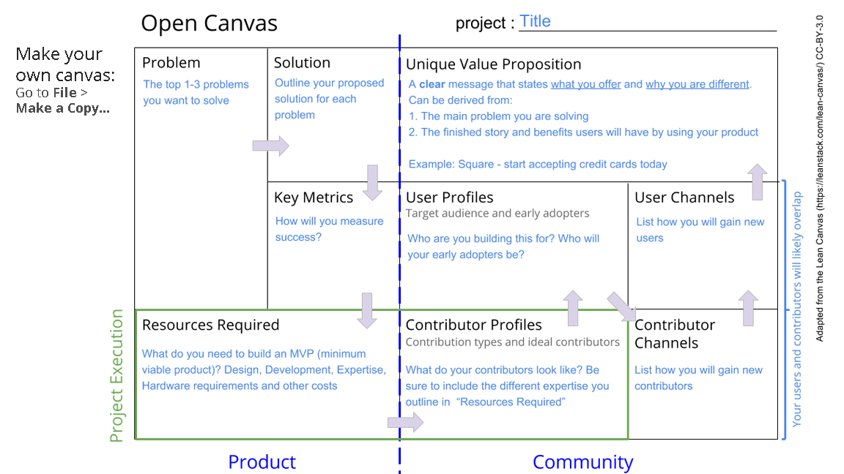

Slide 3
The BioLab Open Project
Despite all effort make against infectious diseases, they remain the first cause of death in developing countries.
The genomic evolution of pathogens which lead to the drugs resistance in many cases.
Make widely understandable genomics data to propose solution through collaboration.
A unique place where data is stored by scientists from local place, and they can collaborate with others from different region and backgrounds.
Where just a idea can born to a project with low cost through collaboration and learning from others.
Doing research project with people from different backgrounds and expertise is the most exciting things in science
Everyone who wishes to undertake a open project in infectious diseases is welcome.
This is an example to help you understand how you can create an open canvas for your project
First requirement is a database,
Bioinformatics tools, Galaxy is a great resources. Data collection resources, and contributors
Biologists, Students, Informaticists, Bioinformaticists, Health workers, Laboratories, Universities and Research Institutions
Role of open science in diseases fighting such as infectious diseases in developing countries through collaborations.
Notes:
Go to File > Make a Copy… to make your own canvas
See next slide for instructions

