Slide 1
www.openaire.eu
Webinar|
22 Nov 2024
Horizon Europe Open Science requirements in practice
Jonathan England

Slide 2

Horizon Europe reference documentsProgram Guide of Horizon Europe
Annotated Model Grant Agreement (AGA)
ERC Managing your project > Open Science
Information package for MSCA and Financial Guide (6.4)
EC Participant Portal – 'Continuous reporting' guide
OpenAIRE guides
Next webinar
Friday 14 March 2025 at 12:00 CET
Q&A from previous webinars
‘A Quick Guide to Horizon Europe Open Access Requirements'

Slide 3
Open Science
“Open science is an approach based on open cooperative work and systematic sharing of knowledge and tools as early and widely as possible in the process”
European Commission
Open Access to publications
Responsible management of data (FAIR principles)
Open access to data ‘as open as possible, as closed as necessary’
Information about outputs / tools / instruments to validate/re-use results and data
Digital /physical access of results to validate the conclusions

Slide 4
Requirements for publications

Slide 5
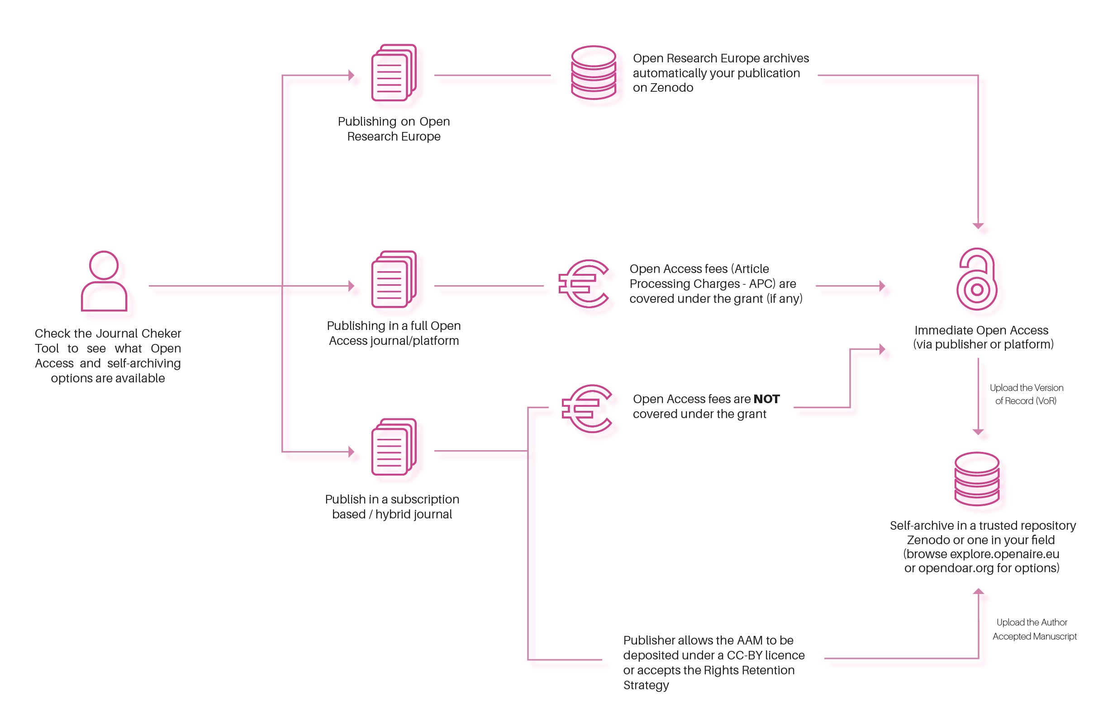
Requirements
Peer-reviewed manuscript (AAM or VoR) in a metadata-ready trusted repository
No embargo period (i.e. immediate OA)
Authors retain their rights by having the AAM and/or the VoR under a CC-BY 4.0 licence
Information about research outputs or tools/instruments needed to validate the conclusions of the publication
Add the acronym/code of the project within
Specificities
Publication fees (Article Processing Charges) are reimbursable if the venue is full OA
No restrictions on where to publish (journal doesn't have to be full OA), but APCs for hybrid journals are not covered
CC BY-NC/BY-ND/BY-NC-ND allowed for long-text formats (e.g. monographs; a chapter in an edited book is not eligible)

Slide 6
Mandate
Applies only to peer-reviewed publications (but recommended for all your work)
No restrictions on where you can publish
Deposit the peer-reviewed version of your manuscript (AAM or VoR) in a ‘trusted repository’
Provide immediate Open Access upon publication (i.e. no embargo period)
Ensure you retain your rights on at least one of the peer-reviewed version of your manuscript (AAM, VoR) under a CC-BY 4.0 licence
Provide information about research outputs or tools/instruments needed to validate the conclusions of the publication
Acknowledge the EU (Art. 17); add the acronym/code/DOI of the project

Slide 7




Author Accepted Manuscript (AAM) vs Version of Record (VoR)
Author Accepted Manuscript (AAM)
or postprint
Version of Record (VoR)
Pre-print
Draft
Submission
Peer-reviewing
Revisions
Accepted for publication
Copy-editing and type-setting
Publication
Adapted from Library of Curtin University
Icons from manshagraphics on Flaticon

Slide 8

Self-archiving
Open repository = digital platform that provides free, immediate and permanent access to research results for anyone to use, download and distribute
Social networking sites (e.g. ResearchGate, Academia), the publisher’s website, your profile page on the institution’s website, etc. are NOT repositories
Self-archiving = you deposit a version of your work in an open repository
Regardless of where you publish (even fully Open Access or hybrid journal), always deposit the AAM or VoR in a repository.
It is about where you make it available in Open Access, NOT where you publish
Definition from Wikipedia,"Open-access repository", CC BY-SA 4.0

Slide 9


Trusted repositories
Three categories of trusted repositories:
  Certified repositories
  Discipline and domain-specific repositories commonly used and endorsed by the international research communities
  General-purpose/institutional repositories that meet a set of essential criteria (metadata)
Compliance challenge:
  Another mandatory requirement: metadata should be in line with the FAIR principles and under a CC0 licence
  Not all ‘trusted repositories’ are fully ready for Horizon Europe compliance
Search for a repository on:
https://explore.openaire.eu/​
For your publications:
OpenDOAR
https://sherpa.ac.uk/opendoar/
For everything:
https://zenodo.org/

Slide 10
Trusted repositories
Currently only 5 trusted repositories are ‘ready’ for compliance (HAL, AUSSDA, <intR>²Dok, DANS Data Station Archaeology, Zenodo)
Check if the repository is ‘trusted’ and has the essential metadata criteria (Annex 1). But many are “close to essential” and currently making changes, so check even if it is not in the list yet:
Search for a repository on:
https://explore.openaire.eu/​
For your publications:
OpenDOAR
https://sherpa.ac.uk/opendoar/
https://doi.org/10.5281/zenodo.13919642
In doubt deposit on Zenodo:
Fully compliant with repository requirements
Free and easy to use (also used by the EC to deposit Open Research Europe publications)
For everything:
https://zenodo.org/

Slide 11
Licence
AAM and/or VoR has to be under a Creative Commons Attribution licence (CC BY 4.0)
Different ways to achieve this:
  Publish in a full OA journal: VoR under CC BY 4.0
  Pay to publish in a hybrid venue: pay an OA fee to publish in a subscription-based journal (when publishers offer different licences, make sure to select CC BY 4.0)
  Publish in a subscription-based journal (you don’t pay an OA fee) and add the ‘Rights Retention Statement’
With a CC BY licence you own the rights to that version of your work, so you can deposit it freely on any repository, website, etc.
The AAM and VoR might be available under different licences, e.g. signing a Copyright Transfer Agreement on the VoR but retaining your rights (under a CC-BY licence) on the AAM, allowing you to share it openly
CC BY-NC/BY-ND/BY-NC-ND licence allowed for long-text formats (e.g. monographs); a chapter in an edited book is not eligible

Slide 12
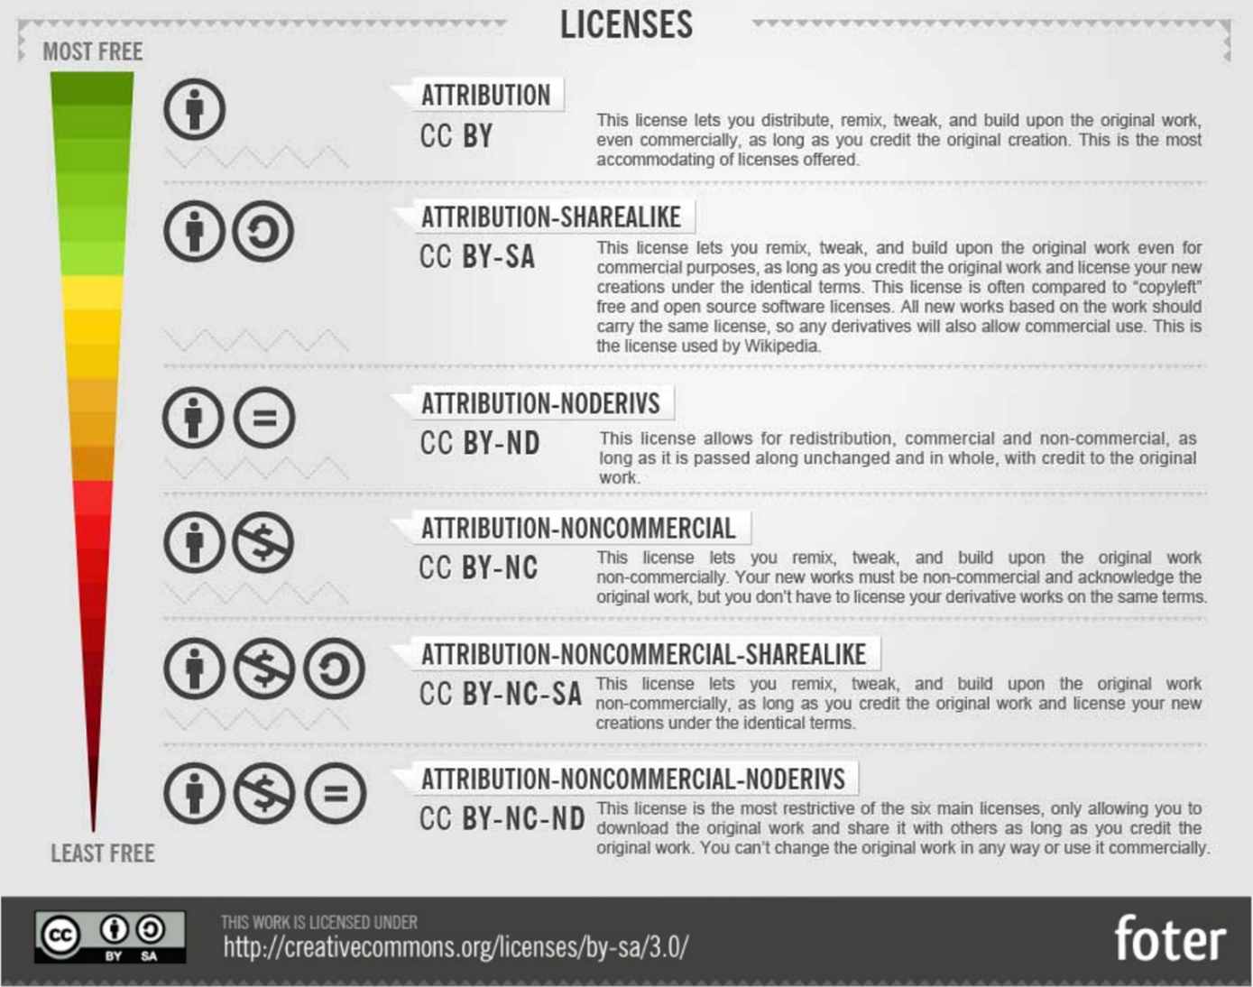


Creative Commons
Removes ambiguity over what others can and cannot do with your work
You keep (certain) rights, but you grant certain reuses without them needing to contact you
Universally recognisable and juridically sound (you can still claim copyright infringements)
You can share, adapt for any purpose, no attribution is required (it is similar to ‘Public Domain’ but is an actual licence
You can share, adapt for any purpose as long as you credit the author

Slide 13
Rights Retention Statement
This work was funded by the Εuropean Union under the Horizon Europe grant [grant number]. As set out in the Grant Agreement, beneficiaries must ensure that at the latest at the time of publication, open access is provided via a trusted repository to the published version or the final peer-reviewed manuscript accepted for publication under the latest available version of the Creative Commons Attribution International Public Licence (CC BY) or a licence with equivalent rights. CC BY-NC, CC BY-ND, CC BY-NC-ND or equivalent licenses could be applied to long-text formats.

Slide 14
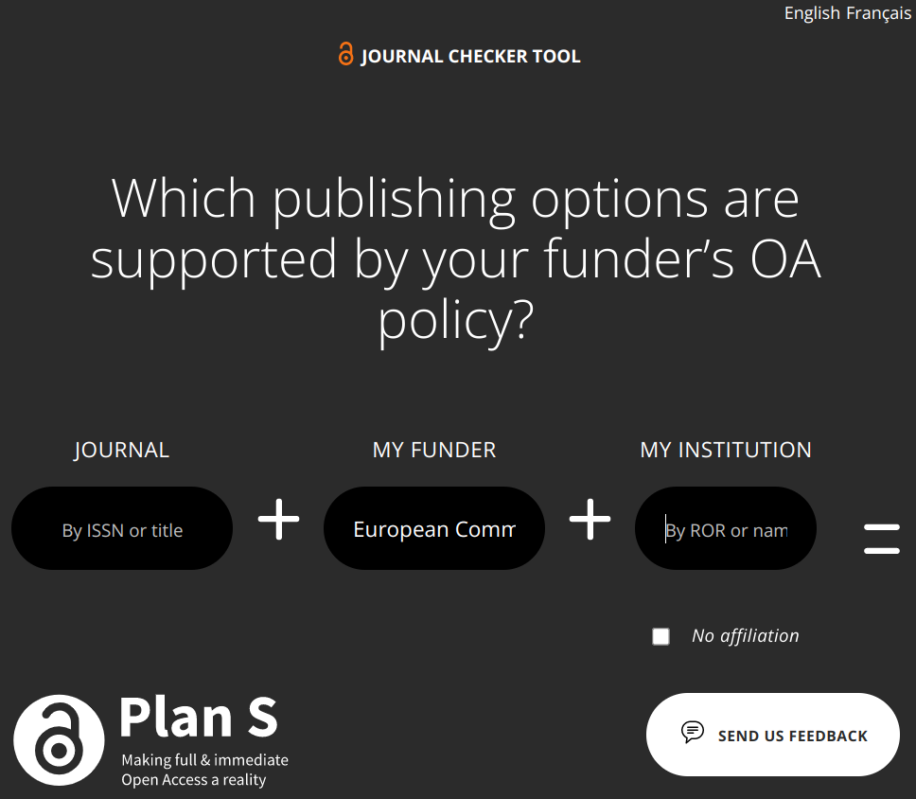
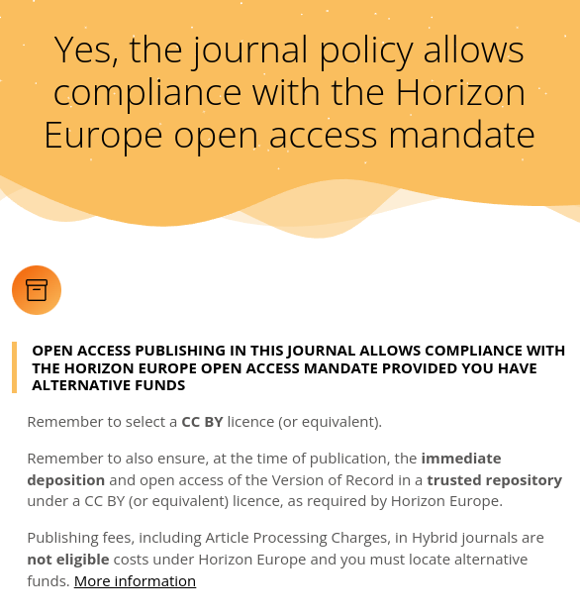
Check the journal's eligibility
https://journalcheckertool.org/

Slide 16

Budget
Publication fees (Article Processing Charges) can be covered by the grant if the venue is full Open Access (also known as 'Gold' OA)
Hybrid venues aren’t eligible: you will have to find another way to cover those costs (except for MSCA)
  no matter whether they are considered "transformative journals" committed to transition to a fully open access journal, or covered by "transformative agreements" between institutions and publishers
Any printing fees (for monographs, books­ or articles) can’t be covered by the grant either

Slide 17

Extra information
Research outputs, tools and instruments;
  e.g. data, software, algorithms, protocols, models, workflows, electronic notebooks and others.
Information should include a detailed description of the research output/tool/instrument, how to access it, any dependencies on commercial products, potential version/type, potential parameters, etc.
Best practice: open access is provided to these research outputs, tools and instruments — unless legitimate interests or constraints apply.

Slide 18
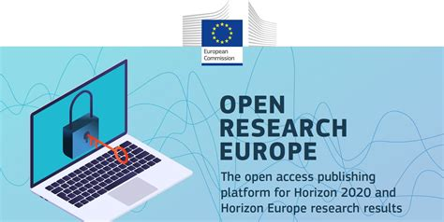
Another option

Slide 19
Open Research Europe
Victoria Tsoukala, PhD
Policy Officer, Unit for Open Science and Research Infrastructures
DG Research & Innovation
European Commission
Open AIRE training
November 22, 2024
Online

Slide 20
Open Research Europe (ORE)
Peer-reviewed open access publishing platform for original research (NOT a repository)
Platform for grantees of EU programmes (including Horizon Europe)
  Optional service, at no cost to them, during and after end of their projects
  Automatic compliance with Horizon Europe open access requirements (deposit of peer-reviewed publications in zenodo)
Innovative publishing model initiated by a funder
  Post-publication open peer review: first you publish; then review takes place
  All articles and reviews in open access under CC BY licenses
  High scientific standards and policies: Scientific Advisory Board; publisher policies and guidelines, including underlying data availability, analysis of method etc.
  Transparent service: in editorial process, in research process
Publishes in all disciplines
  Gradually developing researcher-led community gateways and collections in specific fields
  ca 700 articles, 1500 reviews
Indexed in important indexers & national lists (including Scopus and PubMed)
Operated by F1000 Research Ltd through public procurement

Slide 21
2021- 2024 (November) in important numbers
Just over 1000 submissions
Ca 769 articles published
500 articles indexed (completed successful peer-reviews)
Ca 1500 published authors; ca 1700 submitted authors
Nearly 2000 reviewers
Ca 850 unique institutions published, ca 950 unique submitting institutions

Slide 22
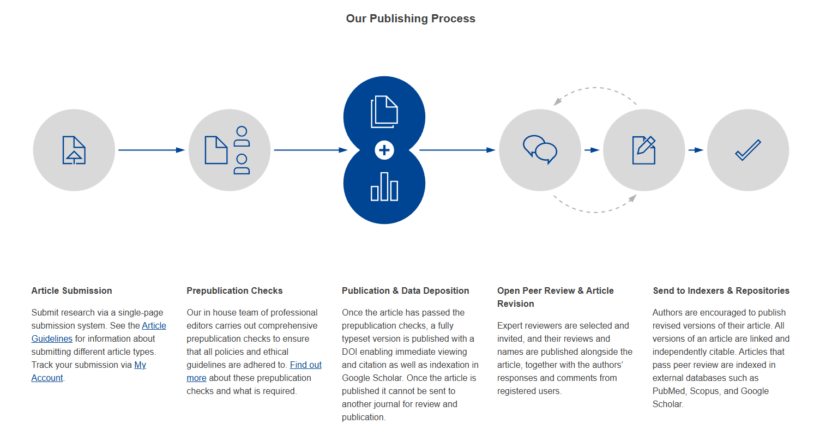
An innovative publication model

Slide 23
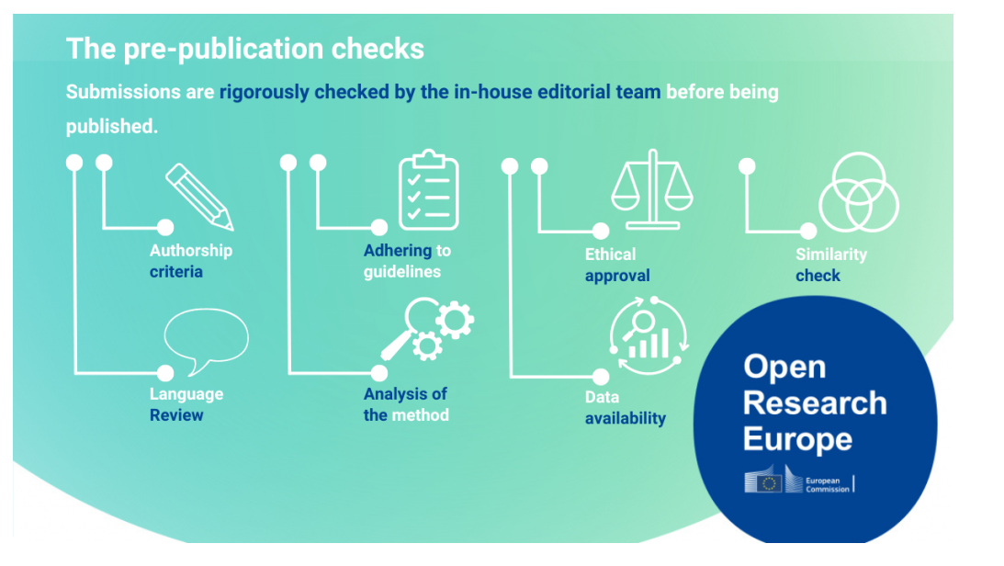
Prepublication checks
Prepublication Checks | Open Research Europe

Slide 24
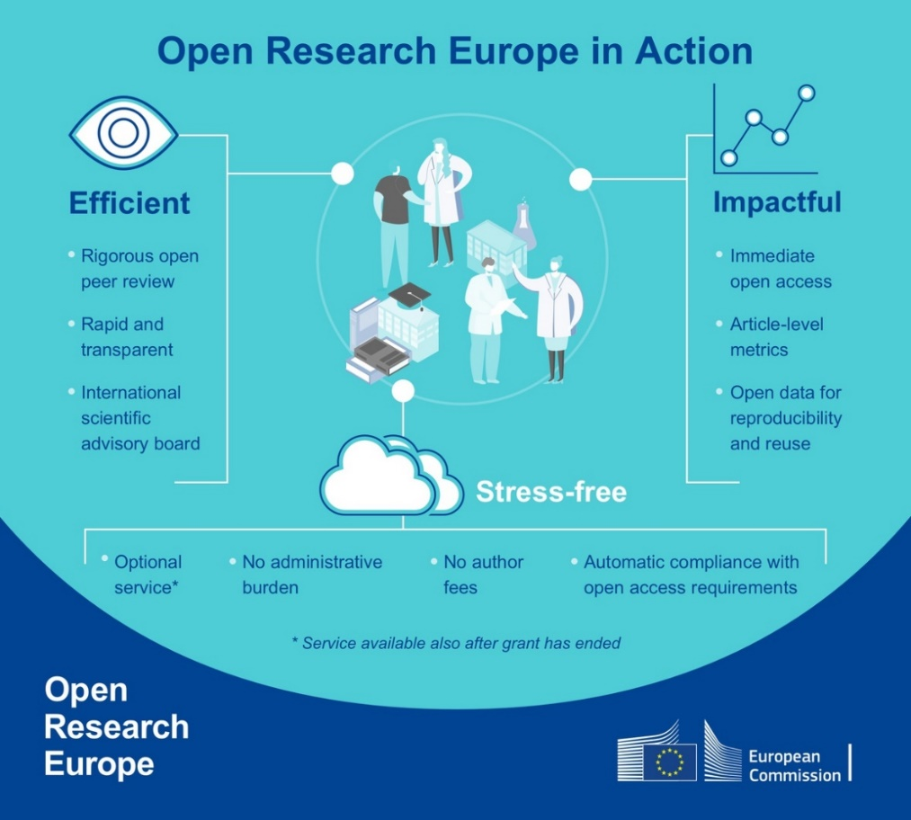

Slide 25
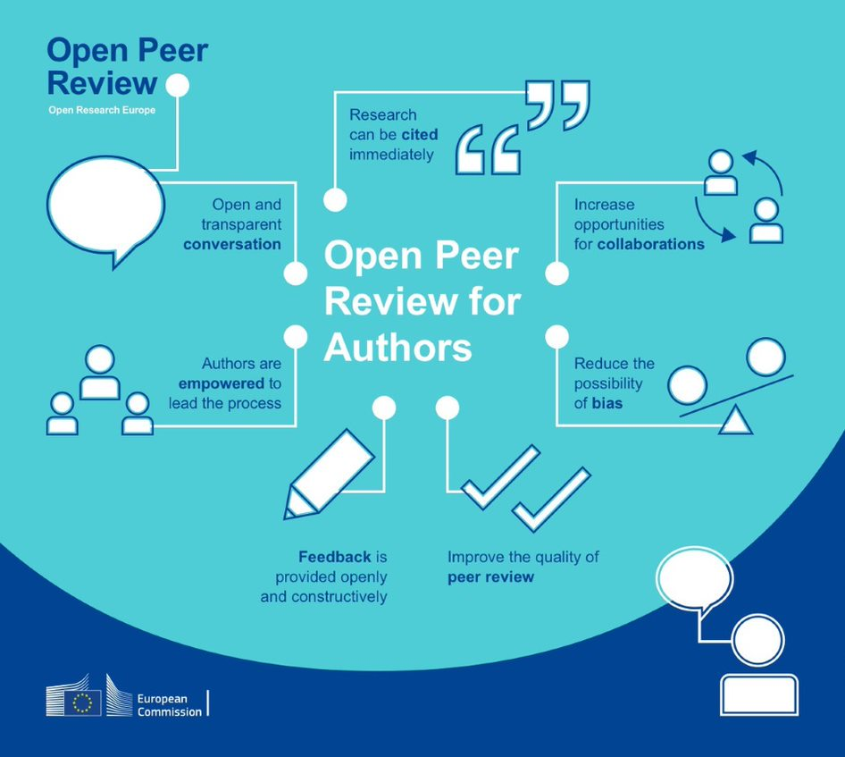
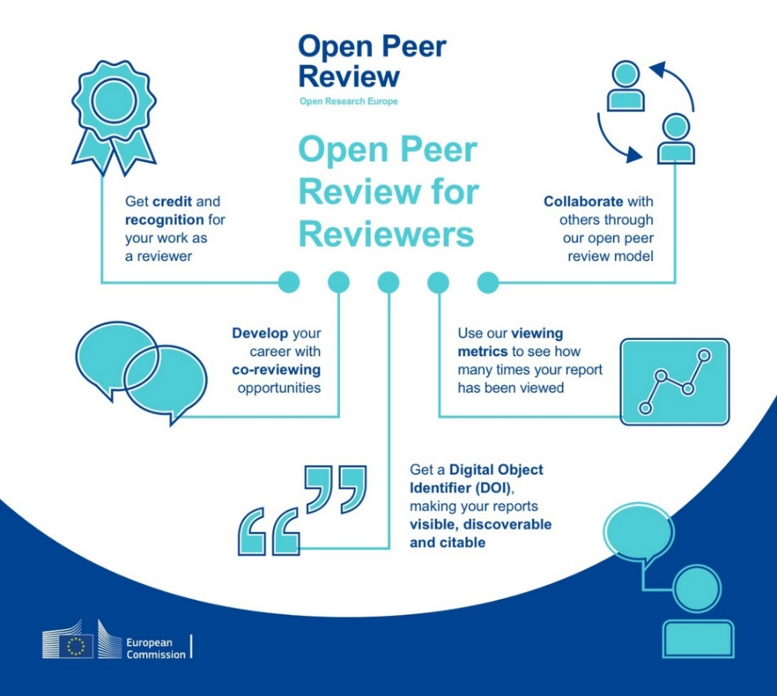
Open peer review: a win-win situation

Slide 26
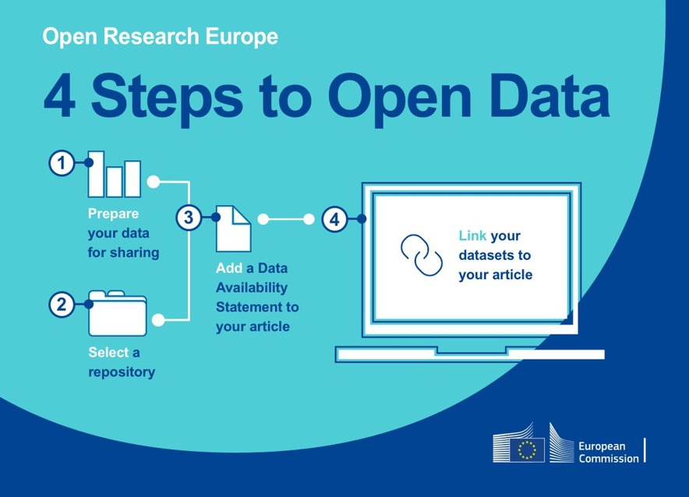
Supporting reproducibility & transparency in research

Slide 27
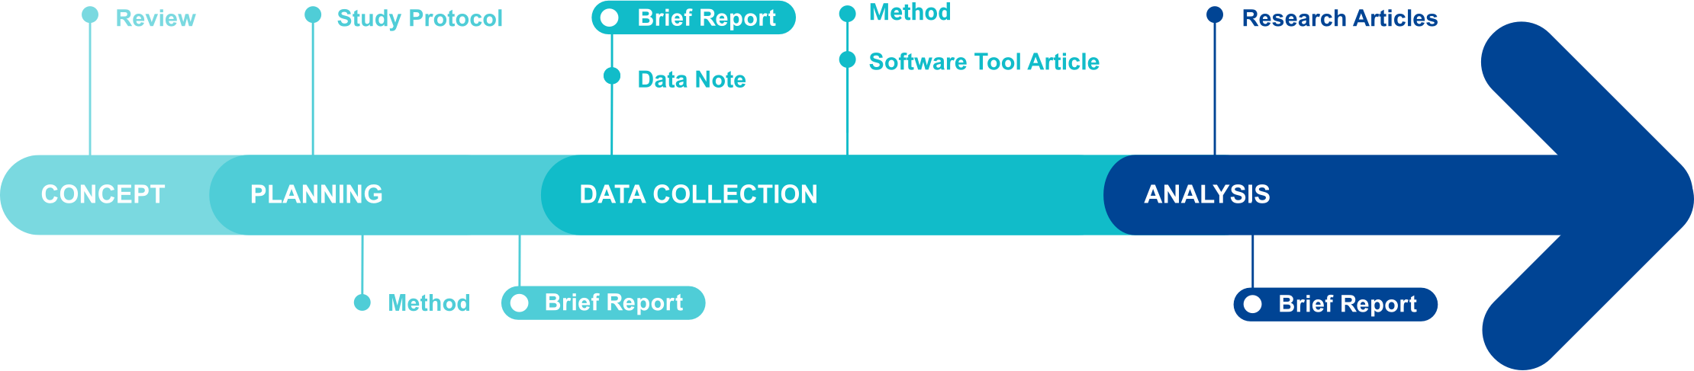
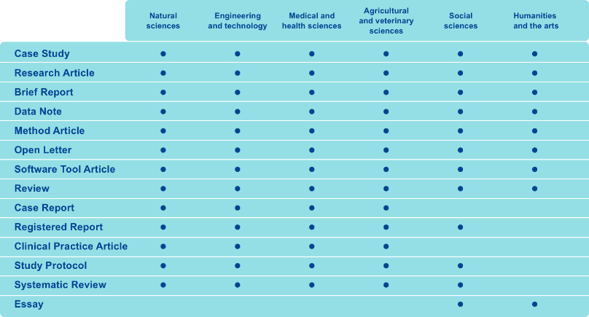
Publishing throughout the research process

Slide 28

Follow ORE online!
Follow @OpenResearch_EU on Twitter
Scan to register to ORE Newsletter (4/year)

Slide 29

Thank you
© European Union 2023
Unless otherwise noted the reuse of this presentation is authorised under the CC BY 4.0 license. For any use or reproduction of elements that are not owned by the EU, permission may need to be sought directly from the respective right holders.

Slide 30
Requirements for research data

Slide 31
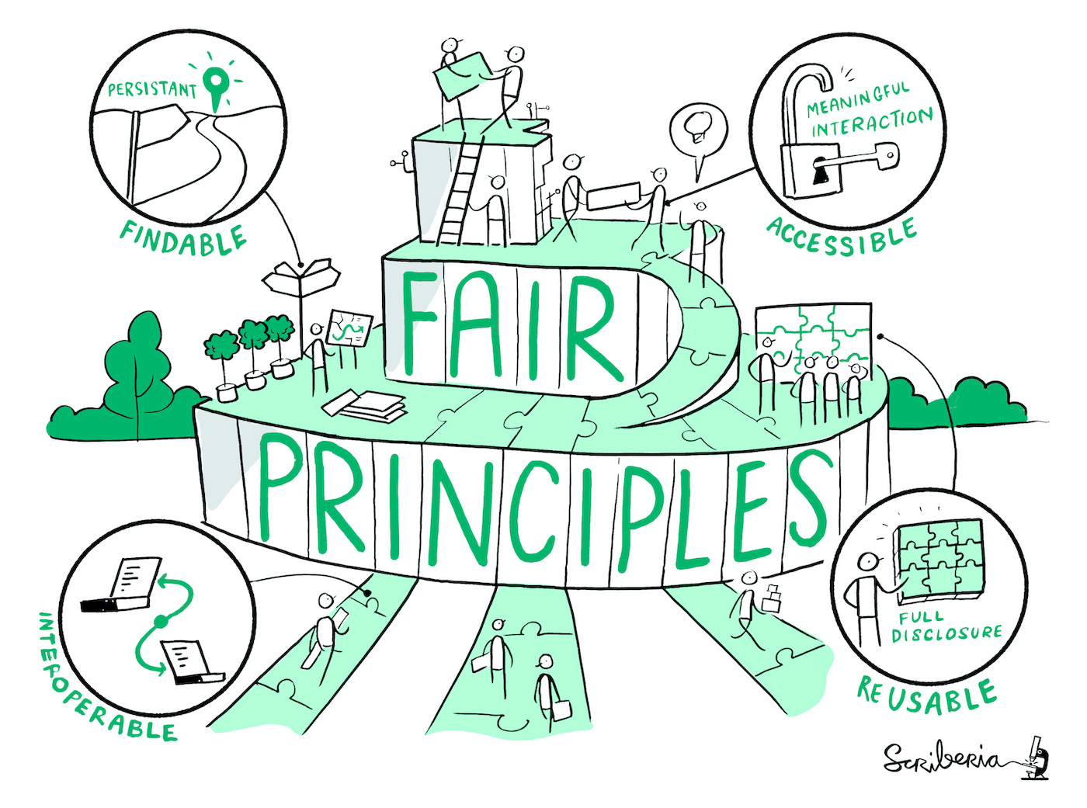
Mandate
Must manage the digital research data in line with the FAIR principles (Findable, Accessible, Interoperable, Reusable)
Data Management Plan (DMP) is required by M6; updated mid-project and at end of project
Deposit (meta)data as soon as possible after production/generation or after processing and quality controls
Deposit data in a trusted repository and make them open as soon as possible (deadlines set in DMP), following the “as open as possible, as closed as necessary” (open by default) principles
Image by Scriberia for The Turing Way Community under CC-BY 4.0

Slide 32

FAIR principles
Findable
Accessible
Persistent identifier (e.g. DOI)​
Rich metadata​
Searchable and discoverable online
Deposited on a trusted repository (e.g. Zenodo)​
Data can be restricted and still FAIR – “as open as possible, as closed as necessary”​
FAIR
Interoperable
Reusable
Lossless, open and/or standardised file formats (e.g. using a CSV file format instead of the proprietary XLSX format).
Use shared definitions and standardised terms within your specific domain.
Well documented (e.g. README files), including provenance and tools / instruments needed to reproduce the results​
Clear licence (e.g. CC BY 4.0, CC0)​
https://www.openaire.eu/how-to-make-your-data-fair

Slide 33

Data Management Plan
Formal ‘living’ document that specifies how research data will be handled both during and after a research project.
It identifies key actions and strategies to ensure that research data are of a high quality, safe, sustainable and – where possible – accessible and reusable.
There are no absolute right answers
But be clear, specific and detailed… and justify decisions
The DMP is to prove to the funder that you’ve reflected on what to do and the approach seems reasonable
And that your data is “As open as possible, as closed as necessary” (FAIR principles)
Slide adapted from Venkataraman, S. (2018) under CC-BY 4.0 http://doi.org/10.5281/zenodo.1489929

Slide 34

Specificities
Data closed if necessary, but metadata must be FAIR and under CCO (metadata-ready trusted repositories will automatically share metadata in CCO)
Open licence, preferentially CC-BY or CC0 licence
Detailed information about research outputs or tools/instruments needed to re-use or validate the data (e.g. data, software, algorithms, protocols, models, workflows, electronic notebooks)
Examples of metadata
author(s) name, author(s) ORCID, DOI, licence, language, journal, title, etc.

Slide 35

Valid justification for not opening the data
Commercially valuable data if it would undermine its exploitation or other results (e.g. endanger trade secrets (‘soft’ IP)), or make IP protection of results more difficult
Data protection/privacy rules of sensitive and/or personal data
Security rules for projects dealing with strategic assets, interests, autonomy or security of the EU

Slide 36

Exceptions
Doesn’t apply to ERC projects
Validation of findings
Restricted or closed data might need to be made available through agreements with relevant confidentiality provisions
Public emergencies
Can be triggered by the request of the granting authority
Immediate OA is extended beyond publications to any research outputs – as soon as feasible and in CC BY or CC0
DMP provided with the proposal or before grant signature
In case of conflict of legitimate interests for openness, beneficiaries must grant non-exclusive licences to legal entities that need the research to address the emergency (this provision applies up to 4 years after the end of the action)

Slide 37
Some useful tools

Slide 38
EOSC EU Node
https://open-science-cloud.ec.europa.eu/
A new platform to support users at every stage of the research lifecycle, aiming towards more extensive collaboration across Europe and fostering innovation throughout the entire research community.
Various services available on your User Space:
  File Sync and Share facility to maintain consistent data sharing across your multiple work environments.
  Notebook environment to create and share documents with real-time code execution.
  Large File Transfer function to reliably send files to colleagues.
  Virtual Machines to design and conduct experiments with flexibility while ensuring reproducibility.
  Cloud Container Platform to streamline the execution of cloud-native research workflows.
  Bulk Data Transfer system to efficiently move large datasets without incurring in any loss.
Services accessed using credits - provided free by the EC upon first login and renewed every three months. The credit amount is based on the affiliation of your organisation.
A Resource Hub that gives access to:
  Research data, publications and software
  Services offered by the broader research community
  Support and learning material to help you practice FAIR and Open Science
  Deployment tools and recipes that enable execution of data science workflows

Slide 39

OpenAIRE EXPLORE
Makes the links
A comprehensive and open dataset of research information covering 166m publications, 59m research data, 203k research software items, from 131k data sources, linked to 3m grants and 193k organisations
Connect and view all of your research – publications, datasets, ORCID, software, DMP, etc. All linked together through citations and semantics.
Search for publications, research data, research software...
Download reports for research products of projects, organisations and data sources
Find statistics, metrics and graphs for projects, data sources, research products...
Browse by Sustainable Development Goals or fields of research
Add to ORCID your research products with the ORCID search and link wizard
Find a repository to deposit or publish your research (publications, data or software) in Open Access.
https://explore.openaire.eu/

Slide 40







AMNESIA – anonymisation tool
Why anonymise?
Anonymised data are outside the scope of GDPR
Anonymisation provides a statistical guaranty about the risk of information leakage
It is the most suitable way to give information to third parties, without revealing personal data
User friendly
Works locally, no data transfer risk
Allows users to customize the solution
The only tool to offer anonymization for set-valued data
The only tool to support k^{m}-anonymity
Easy to incorporate to third party information systems
Slide adapted from Terrovitis, M. (2023) under CC-BY 4.0

Slide 41


ARGOS – write your DMP
Free and open source
Free for researchers, open source, configurable and extensible tool for planning Research Data Management activities according to OA & FAIR data policies.
Discoverable through OpenAIRE EXPLORE
Accessible: Persistent Identifiers (ORCIDs & DOIs)
Interoperable: Research Data Alliance DMP Common Standard
Reusable: Licences
Versioned (history/provenance)
Published and preserved in Zenodo
Enables research communities to create templates (dataset profiles) tailored to domain standards and practices.
https://argos.openaire.eu/
Slide adapted from Papadopoulou, E. (2022) under CC-BY 4.0

Slide 42
Reporting and monitoring

Slide 43

Reporting - Monitoring
Extensive reporting of Open Science practices:
  Structured reporting of requirements regarding OA
  Free-text reporting of encouraged Open Science practices
Monitoring by project officers and reviewers in periodic reviews
Monitoring of the FP through Key Impact Pathways (KIPs)
Slide adapted from Alea López de San Román (2021) under CC-BY 4.0 https://doi.org/10.5281/zenodo.4681073

Slide 44
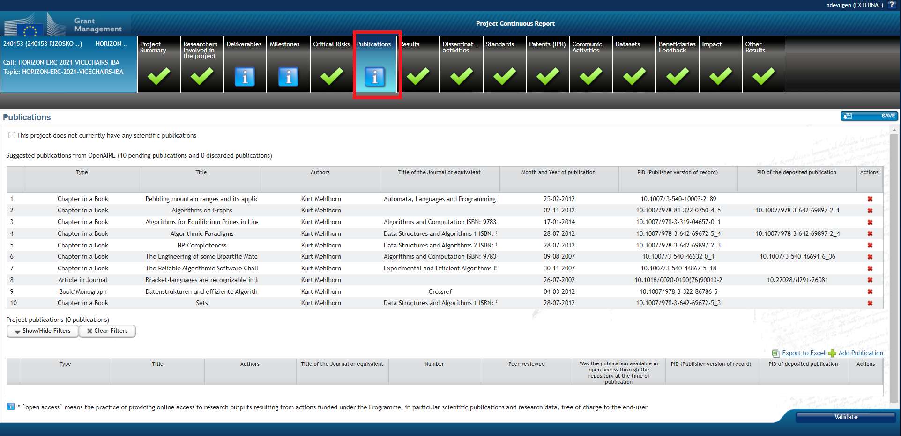
EC Participant Portal – Continuous reporting

Slide 45
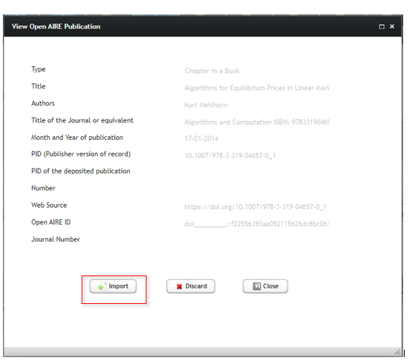
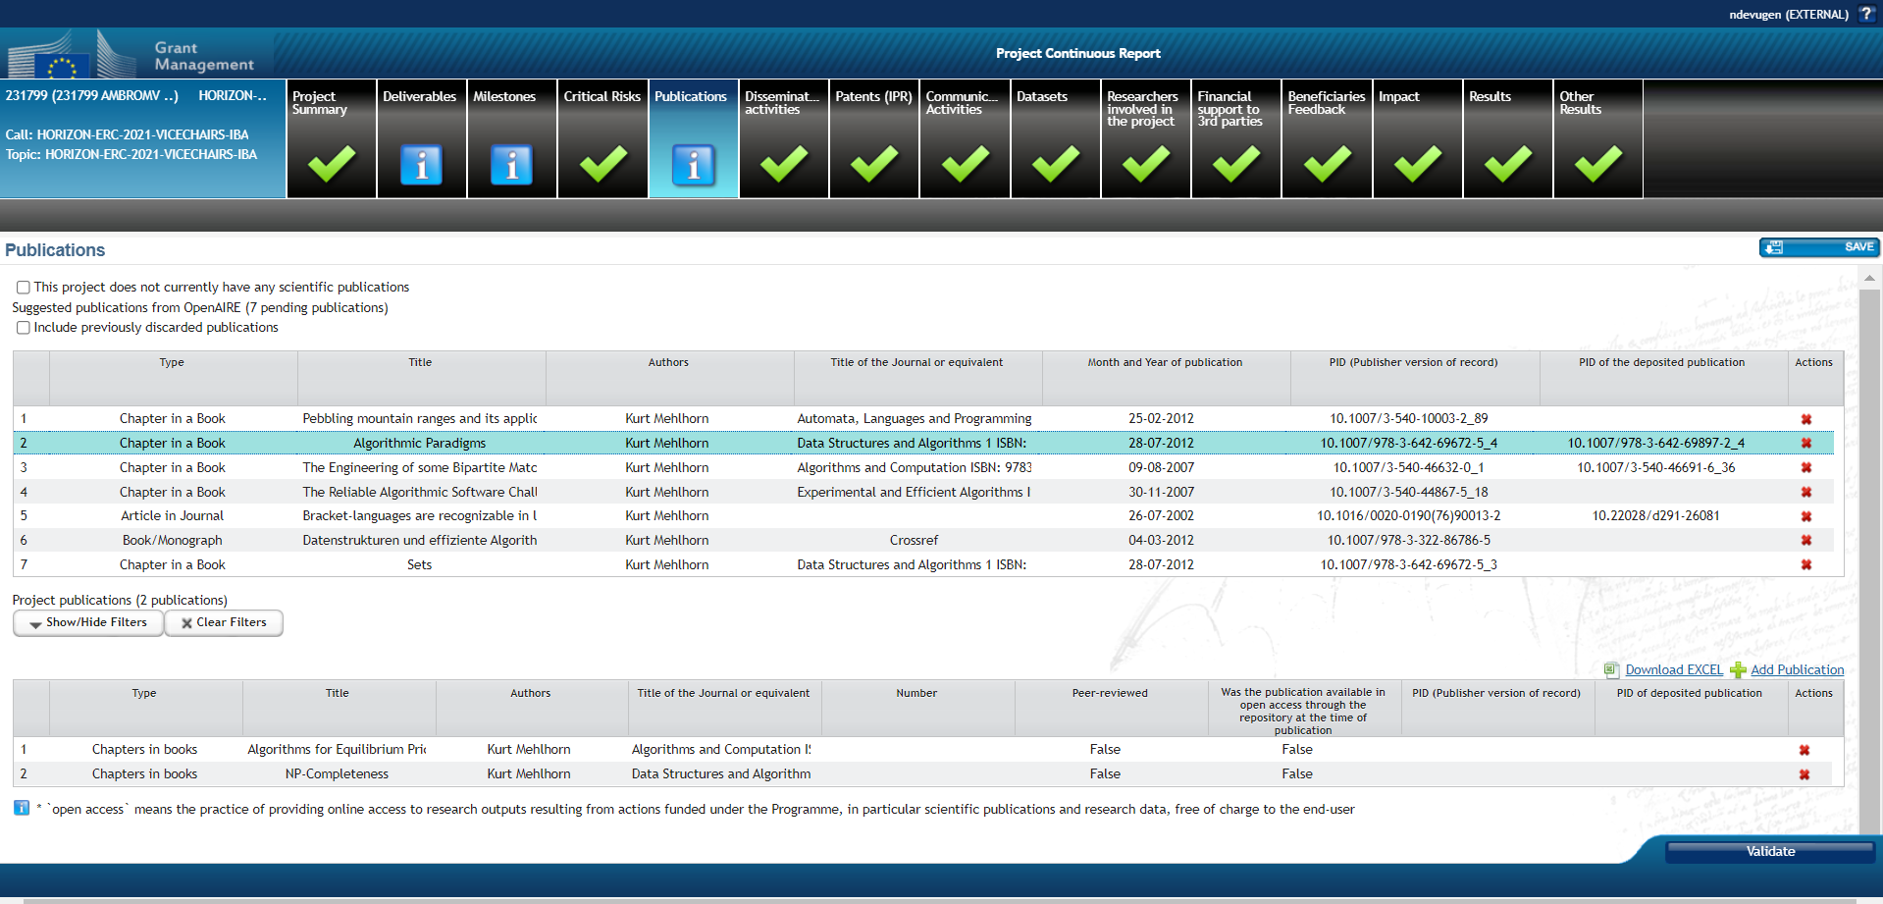
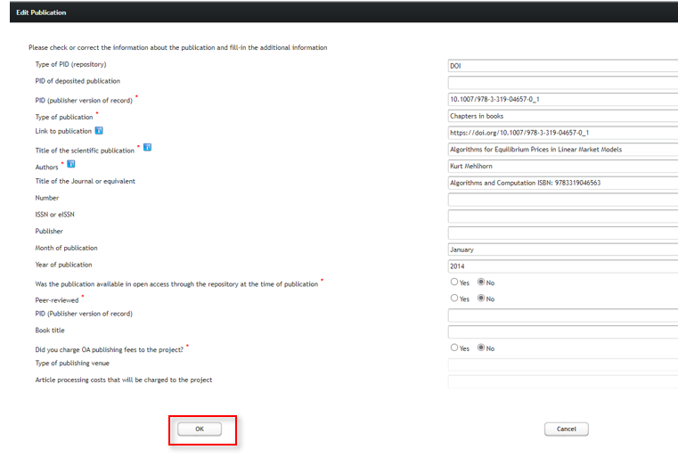
Publications
https://webgate.ec.europa.eu/funding-tenders-opportunities/pages/viewpage.action?pageId=34472316

Slide 46
Publications
"Type of PID" = unique URL given by the repository or the publisher
"PID of deposited publication" = URL to the repository where AAM/VoR is archived
"PID (Publisher version of record)" = URL to the place where it was published (e.g. given by the journal)
"Article processing costs that will be charged to the project" – remember that OA fees to publish in a non-full-OA journal/platform cannot be charged to the project

Slide 47
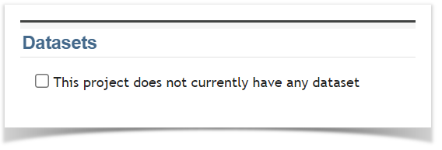
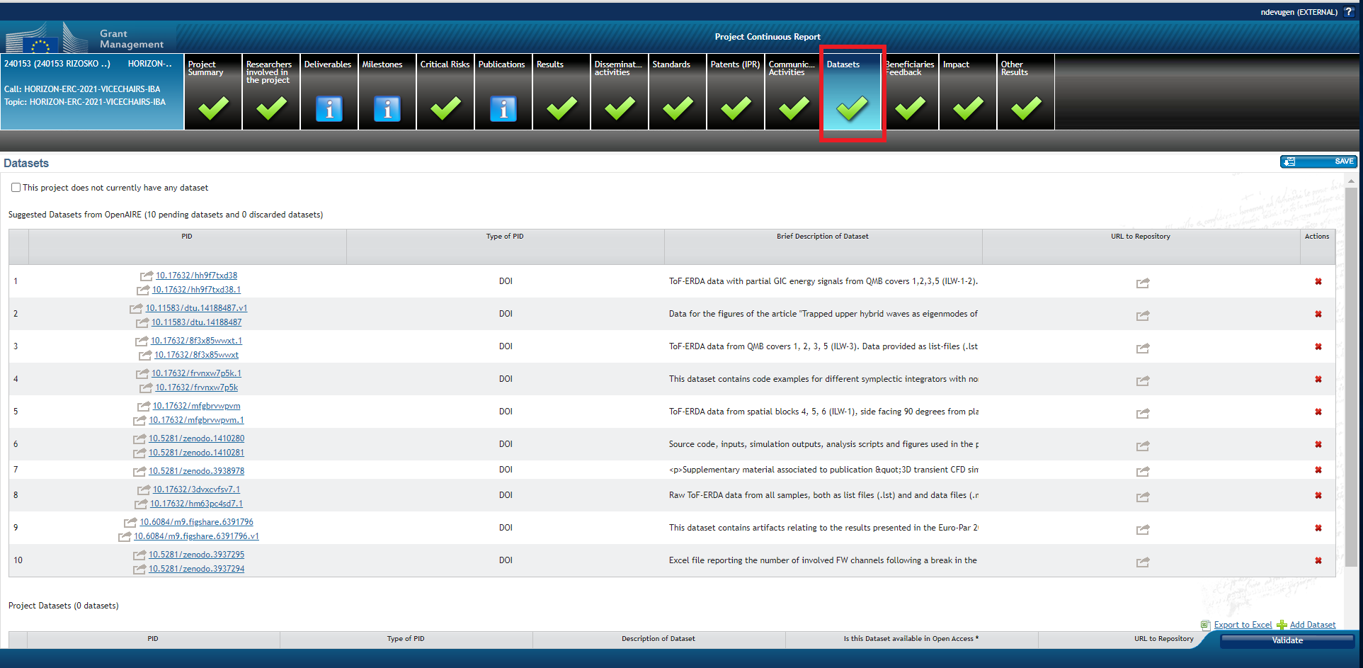
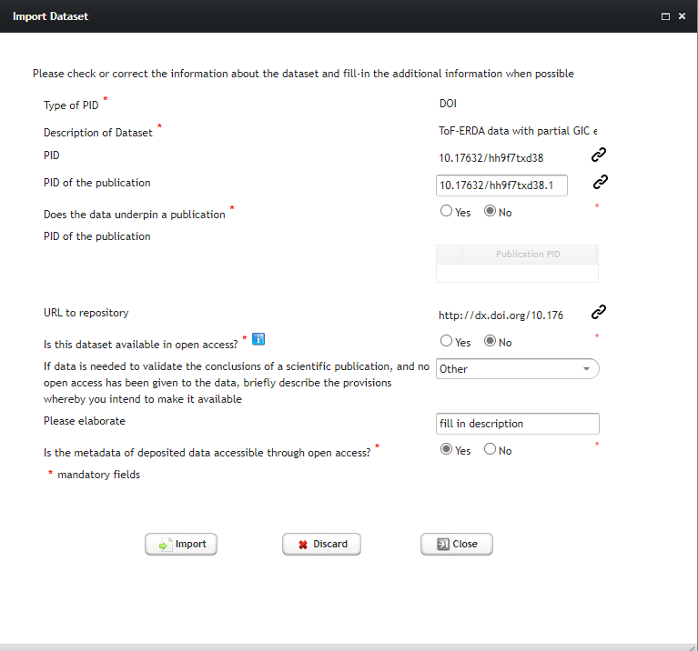
Datasets
https://webgate.ec.europa.eu/funding-tenders-opportunities/pages/viewpage.action?pageId=25559674

Slide 48
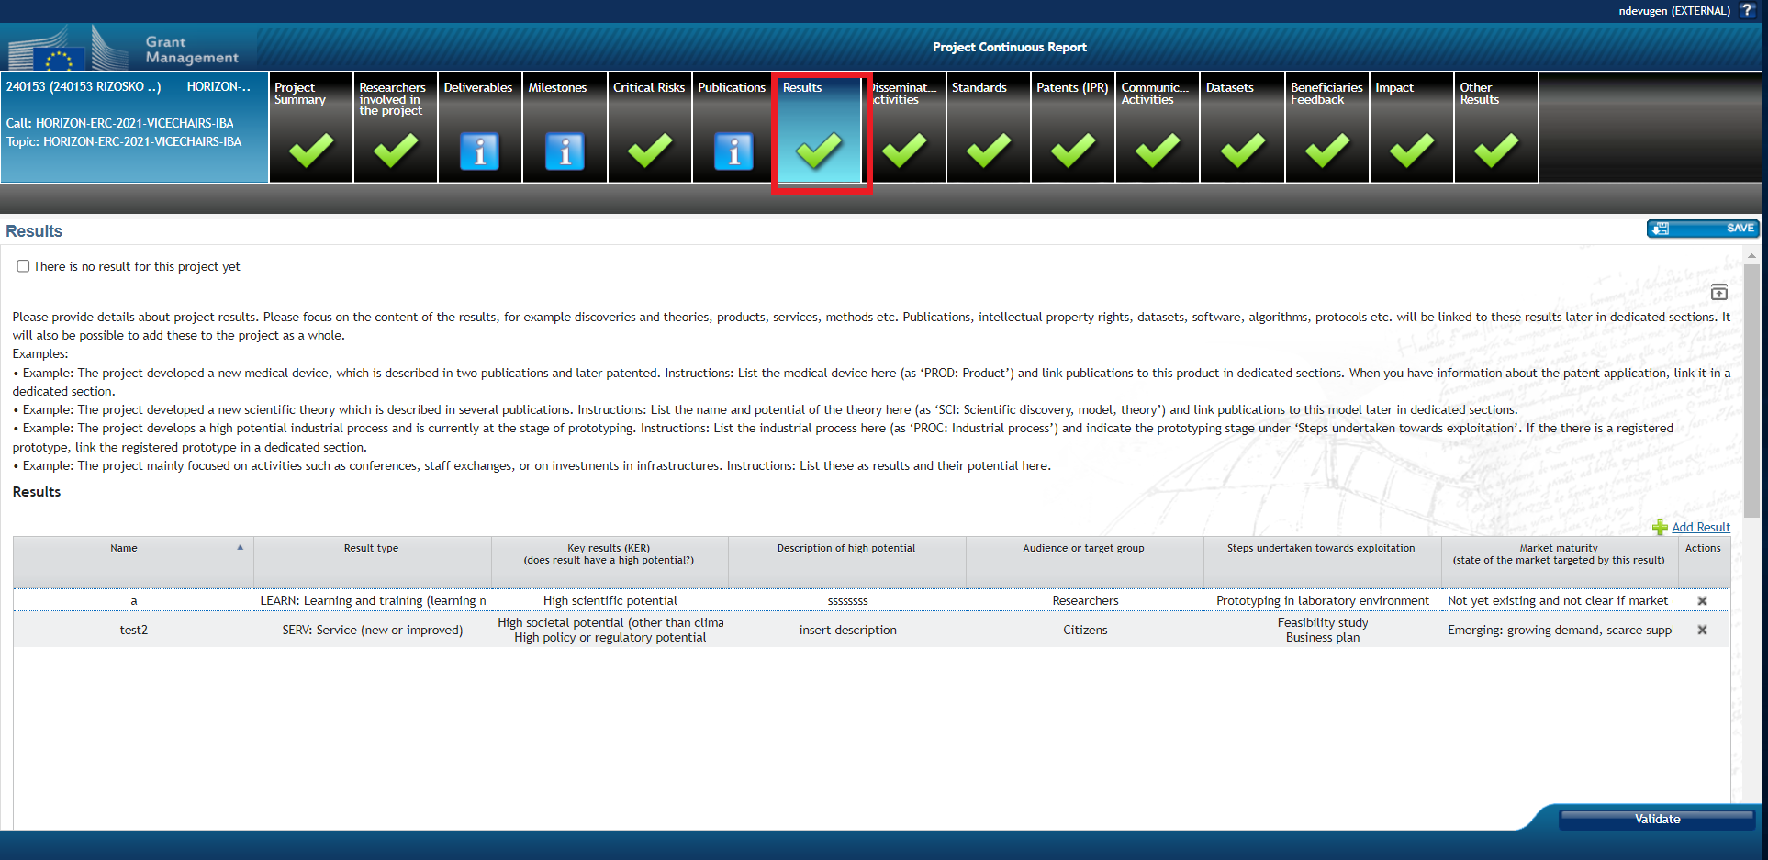
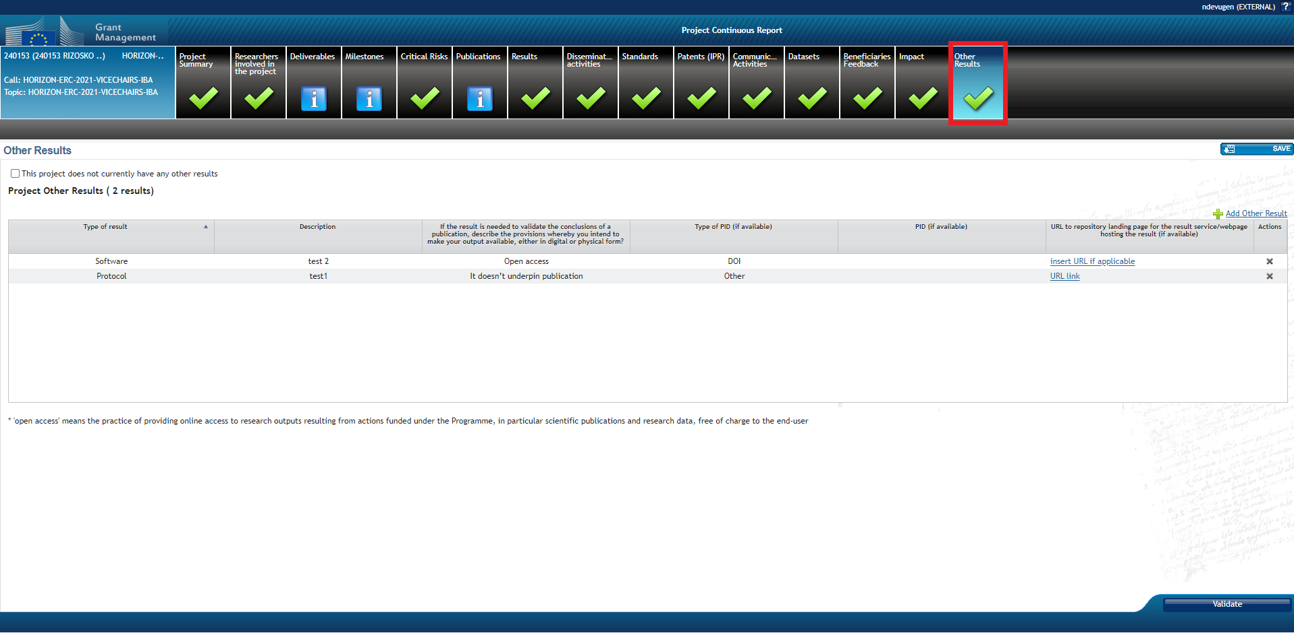
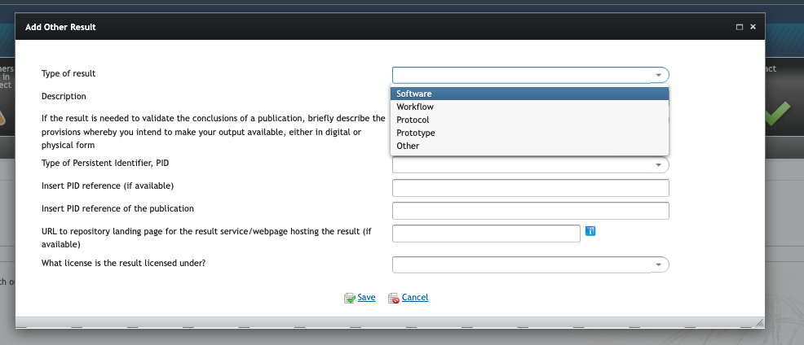
Results vs Other Results
'Results' tab focused on the content of the results: discoveries and theories, products, services, methods, etc.
'Other Results' tab is for reporting about software, workflows, protocols, prototypes, etc.

Slide 49
www.openaire.eu
Webinar|
22 Nov 2024
Horizon Europe grant proposals
Jonathan England

Slide 50
Open Science parts
PART A – Application form
  List 5 publications, widely-used datasets, softwares, goods, services or any other achievements relevant to the call
PART B – Project proposal – technical description
  Under ‘Excellence’ – ‘1.2 Methodology’ (Open Science, RDM and management of other research outputs)
  Under ‘Impact’ – ‘2.2 Measures to maximise impact’ (dissemination, exploitation and communication)
  Under ‘Quality and efficiency of the implementation’ – ‘3.1 Work plan and resources’ and ‘3.2 Capacity of participants and consortium as a whole’

Slide 51

Publications
Your publications cited should be available in OA (i.e. openly available on a trusted repository)
Your publications cited will only be evaluated qualitatively (i.e. the Impact Factor of the journal is irrelevant)
Give insights in where you are hoping to publish (e.g. Open Research Europe, full OA journals)

Slide 52

Research Data
Your data listed should be FAIR, available on a trusted repository and a Persistent Identifier (e.g. DOI) provided
An official DMP is not needed but the grant proposal does include aspects very similar to a DMP (e.g type and size of data, Persistent Identifiers, Intellectual Property Rights, interoperability, licences, curation, responsabilities
Distinct Work Package on ‘project management’ that must include the DMP as a deliverable

Slide 53
Other aspects eligible in the budget
“engagement of citizens, civil society and end-users” – citizen science and participation in crowdsourcing activities
Data curation costs
Article Processing Charges (hybrid journals are not eligible)

Slide 54

Writing tips
Be as specific as possible
Make it easy for the project officer to find all the information
You do not need to explain what Open Access, FAIR data, Open Science, etc. mean. Focus on what concretely you will do

Slide 55
Special cases

Slide 56

ERC
No explicit evaluation or requirement to describe Open Science practices; but if included, will (implicitly) positively affect assessment of ‘scientific excellence’
ERC projects do not have scientific work packages or deliverables.
But now requires a “Research Data Management” WP, with “Data Management Plan” as the one deliverable (type “R – Document, report” with due data M6)
ERC DMP template

Slide 57

MSCA
Underlying principles: Open Science, Responsible Research & Innovation
Award criteria will consider the “soundness of the proposed methodology” (‘Excellence’ criteria weighing 50% of the evaluation) which must consider “the quality of Open Science practices”
Training activities and Career Development Plan must address key transferable skills “fostering the culture of Open Science, innovation and entrepreneurship” and prepare to the increase in “research collaboration and information-sharing” (e.g. collaborative tools, OA, open data, FAIR data, public engagement, citizen science)
There is no specific cost eligibility rule for APCs: OA fees for hybrid venues can be covered

Slide 58
Open Science recommended practices

Slide 59

Evaluation
Mandatory Open Science practices – score will be lowered for not sufficiently addressing them unless duly justified
Recommended Open Science practices – no impact on score if not addressed but score will be increased if sufficiently addressed
Open Science practices listed in the template for proposals (section Excellence > Methodology) but is a non-exhaustive list
de San Román (2021). Open Science in Horizon Europe. Train-the-trainer workshop. Zenodo. CC-BY 4.0 https://doi.org/10.5281/zenodo.5549524

Slide 60
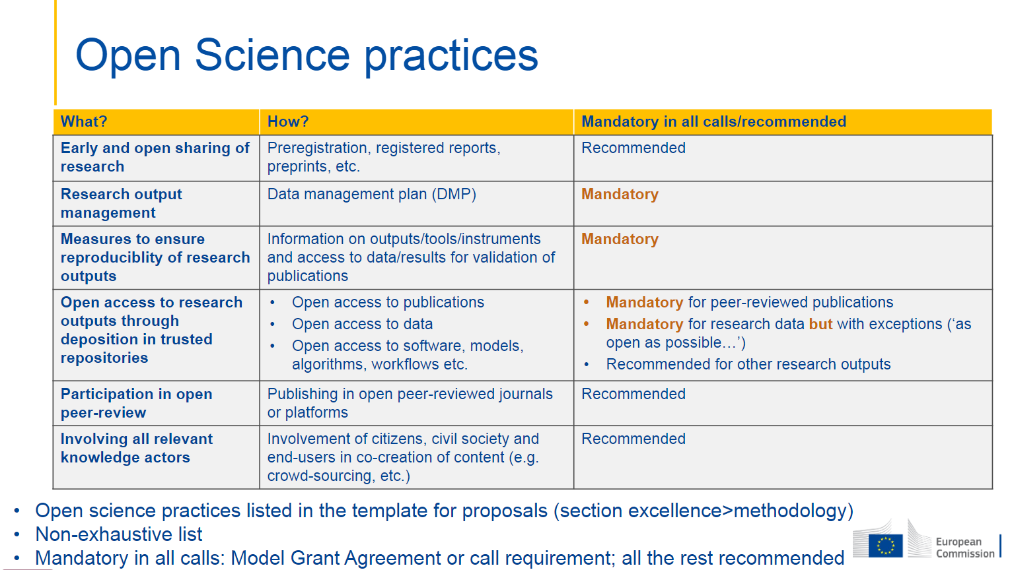
de San Román (2021). Open Science in Horizon Europe. Train-the-trainer workshop. Zenodo. CC-BY 4.0 https://doi.org/10.5281/zenodo.5549524

Slide 61
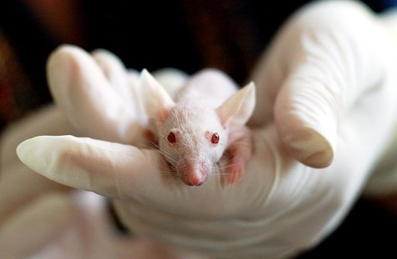
Pre-registration
Quantitative evaluation of research outputs has pushed towards less responsible research practices and the replication crisis (e.g. data dredging/p-hacking, cherry picking, HARKing [Hypothesising after the results are known])
Pre-registration = “practice of publishing the plan for a study, including research questions/hypotheses, research design, data analysis before the data has been collected or examined” (FORRT)
Some research domains have standard procedures in place; e.g. pre-registration of clinical trials, check ECRIN: https://ecrin.org/
https://www.cos.io/initiatives/prereg
Nosek et al. (2018). The preregistration revolution.
https://doi.org/10.1073/pnas.1708274114

Slide 62
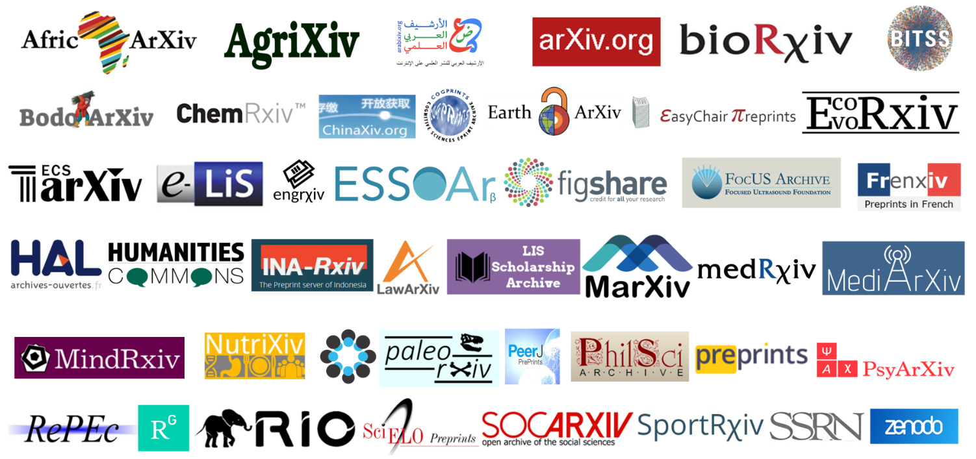
Pre-prints
Traditional scholarly publishing is usually time-consuming and slow
Preprints allow authors to share their results ahead of peer-reviewing on preprint servers
Faster dissemination and broader access to research outputs, opportunities for early feedback
Visible outputs for early-career researchers, can increase employability

Slide 63
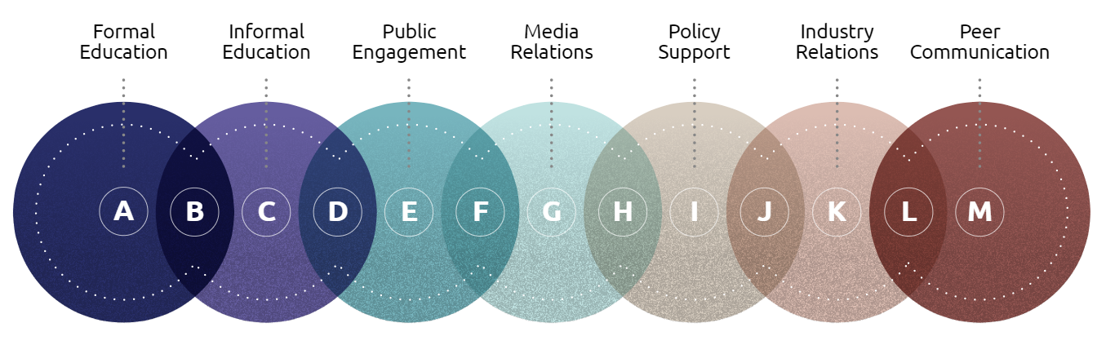


Public engagement
Open and inclusive research and innovation includes society that can be listened to, awarded relevant input and influence during all stages of the research process (RRI Tools) – public engagement contributes to the democratisation of science
Increases scientific literacy of the public, improves societal relevance of science, increases the support and uptake of research
E.g. European Researchers’ Night, Science is Wonderful, public talks, talks in schools or cultural centres, popular science books, social media, documentaries, TV shows, school activities, art/science projects
Pompea & Russo (2020). The role of astronomers in the astronomy education ecosystem. https://doi.org/10.48550/arXiv.2011.11350

Slide 64
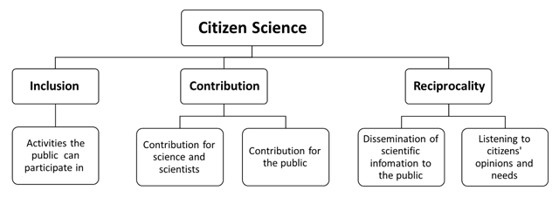
Citizen Science
Projects that actively involve the general public, in any of the stages of research, acting as collaborators, contributors or project leaders (FORRT)
Increases scientific literacy of the public, empowers citizens with scientific approaches, improves societal relevance of science, increases the support and uptake of research, explores new pathways for participatory governance
European Citizen Science Association, EU Citizen Science platform
E.g. Zooniverse, School Network Alerts Citizens analysing seismograms, in video games (e.g. Borderlands 3)… and many more
Golumbic et al. (2017). CC-BY 4.0.

Slide 65
Final tips

Slide 66

Overall tips
Design an Open Science strategy for your project.
Include specific provisions in the Consortium Agreement about where publications and data will be deposited and who is responsible for doing this. Who will make sure that all outputs have been deposited in the appropriate repositories?
Implement your Open Science strategy, report at reviews and provide updates.
Keep track of issues, discuss the solutions.

Slide 67
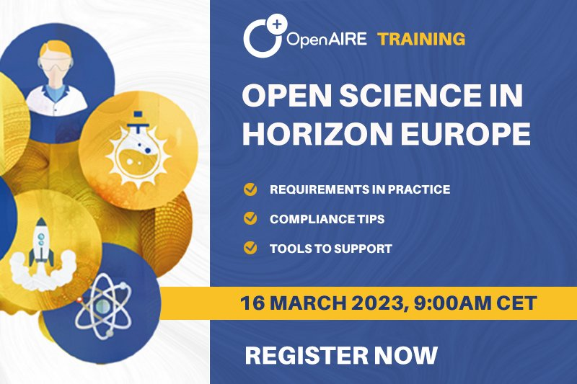

NEXT WEBINAR
Friday 14 March 2025 at 12:00 CET
14 March 2025, 12:00 CET

Slide 68

All pictures available in CC0 from Pixabay.com unless otherwise stated
THANKS
Contact us for more information
Web
www.openaire.eu
Email
helpdesk@openaire.eu
Social media
@openaire_eu @jonatortue

