Slide 1
FAIR and Heritage Collections
Generic metadata for scientific databases
Maastricht University Library
Jetze Touber

Slide 2
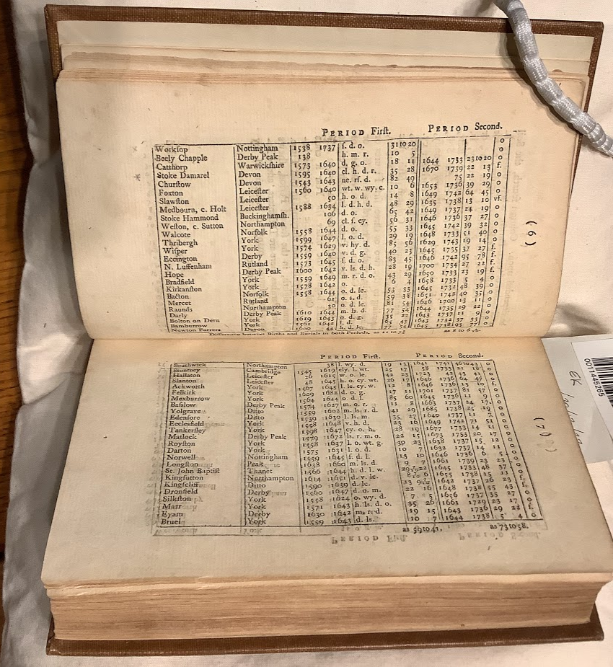
Generic metadata for scientific databases
Functions and types
Metadata standards
Some elements
Metadata and systems
Exercise

Slide 3
Functions and types

Slide 4
Functions and types
Metadata or "data about data" are descriptors that facilitate cataloguing data and data discovery.
Systematically documented research data is the key to making the data publishable, discoverable, citable and reusable.
Metadata constitute machine readable data documentation
Data can be archived with open, closed, or restricted access. Metadata should always be open access.
Source:
CESSDA Data Management Expert Guide, https://dmeg.cessda.eu/Data-Management-Expert-Guide/2.-Organise-Document/Documentation-and-metadata

Slide 5
Functions and types
Metadata create the context necessary to interact with research data in a meaningful way.
Research data in the humanities:
Tabular data
Textual data
Images
Audio
Video
…

Slide 6
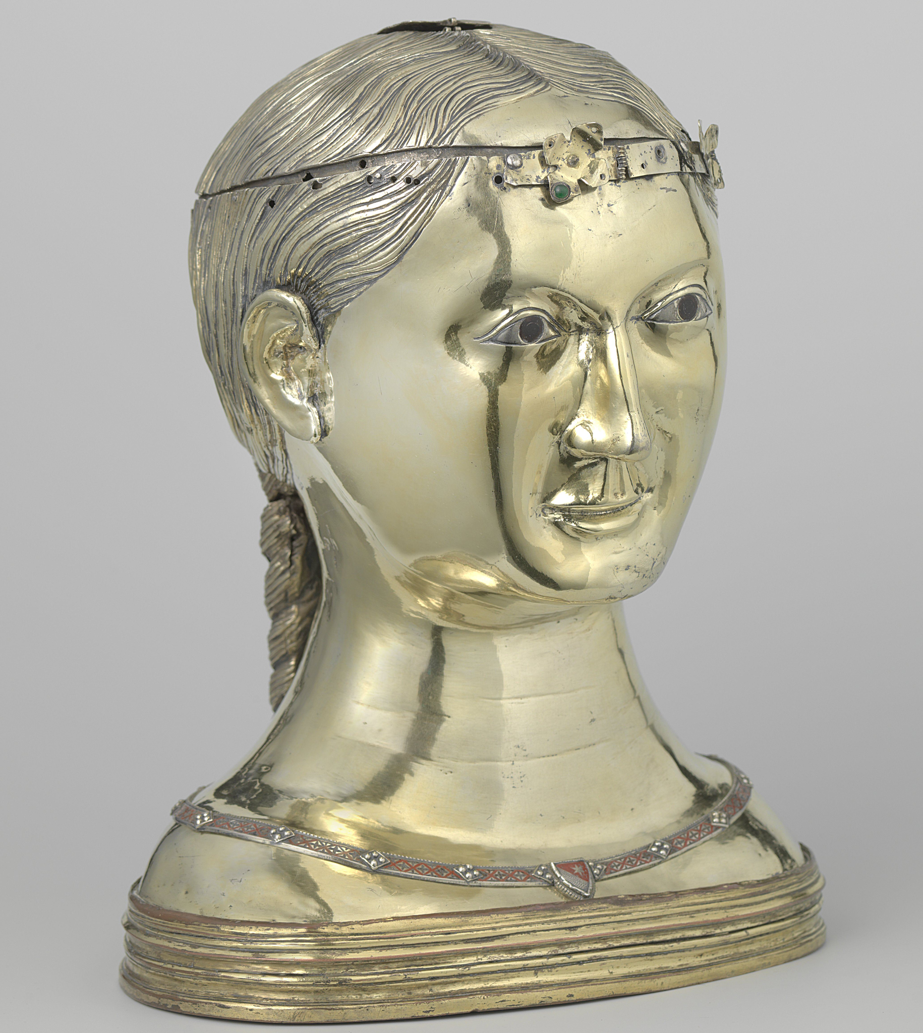
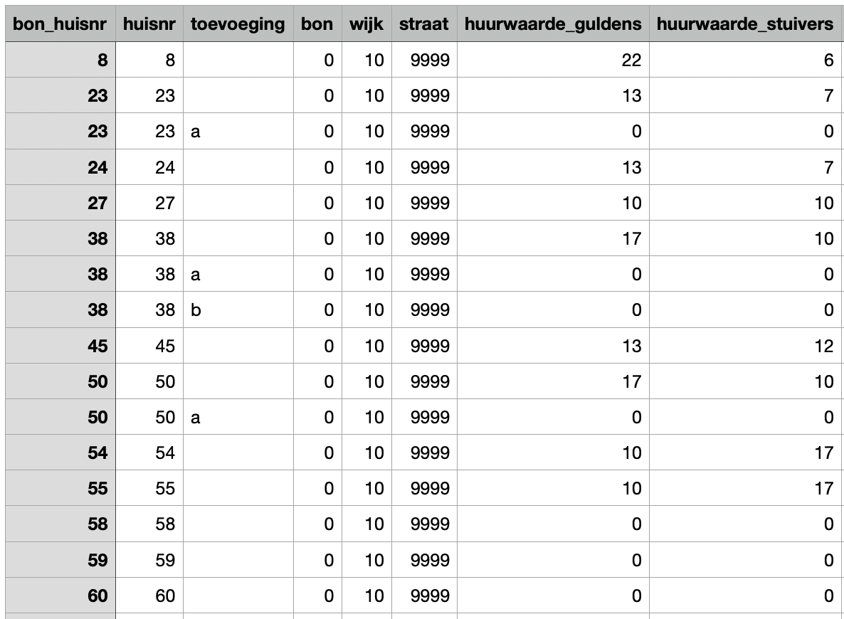
Functions and types
Generic metadata, e.g.:
title
date of creation
Specific metadata, e.g.:
measurements
material composition
Specific metadata, e.g.:
sources used
explanation of variables
http://hdl.handle.net/10934/RM0001.COLLECT.17758
https://doi.org/10.17026/dans-23u-3exj

Slide 7
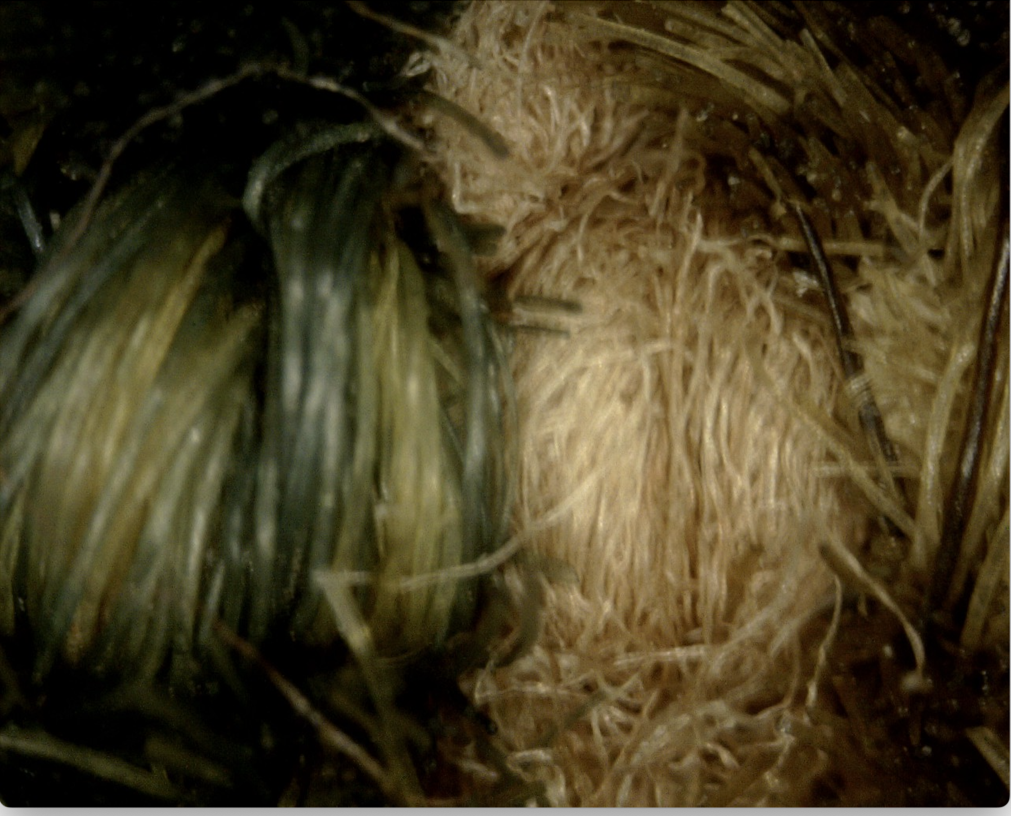
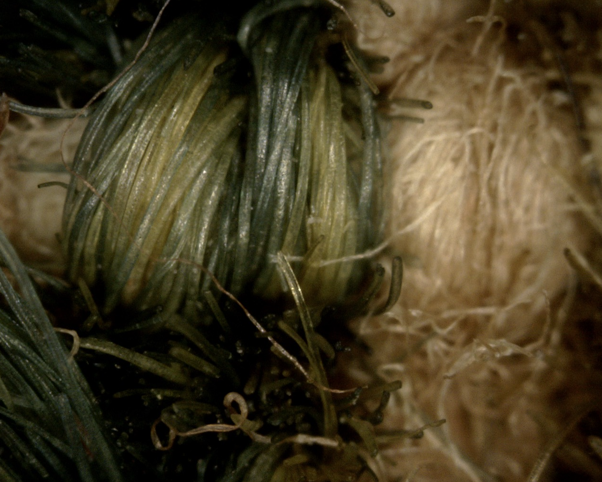
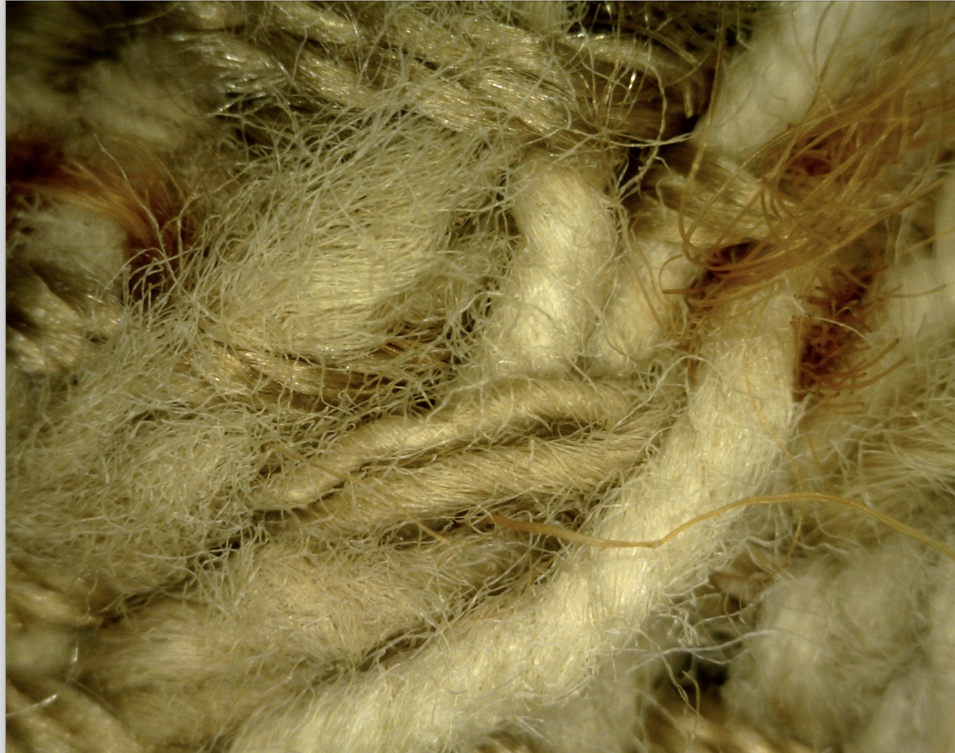
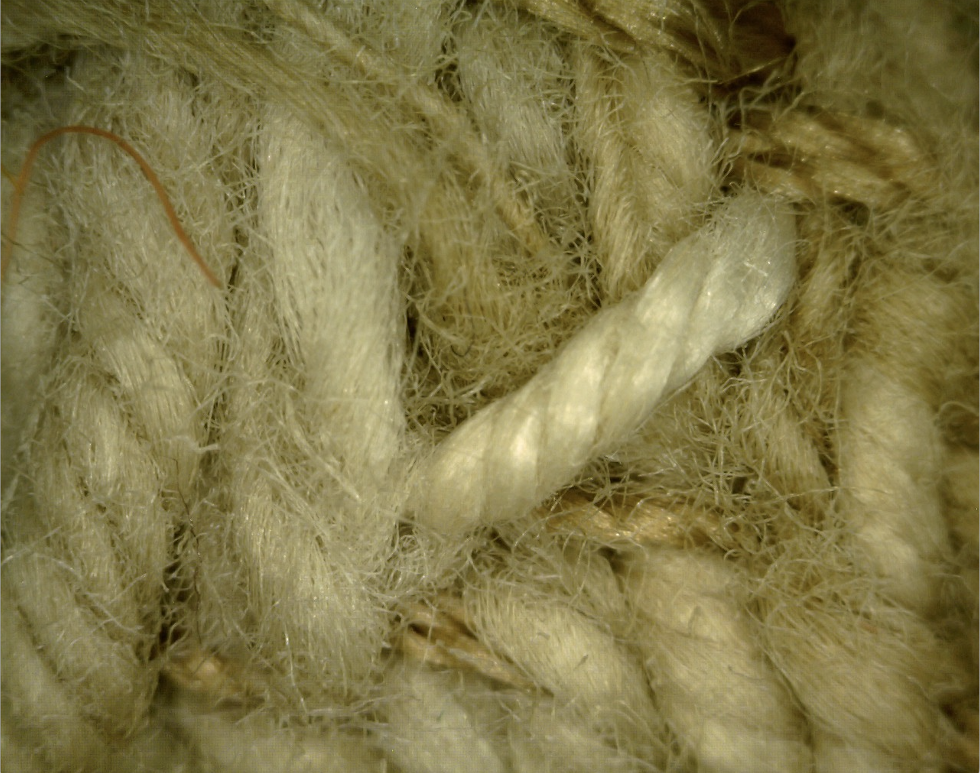
Functions and types

Slide 8
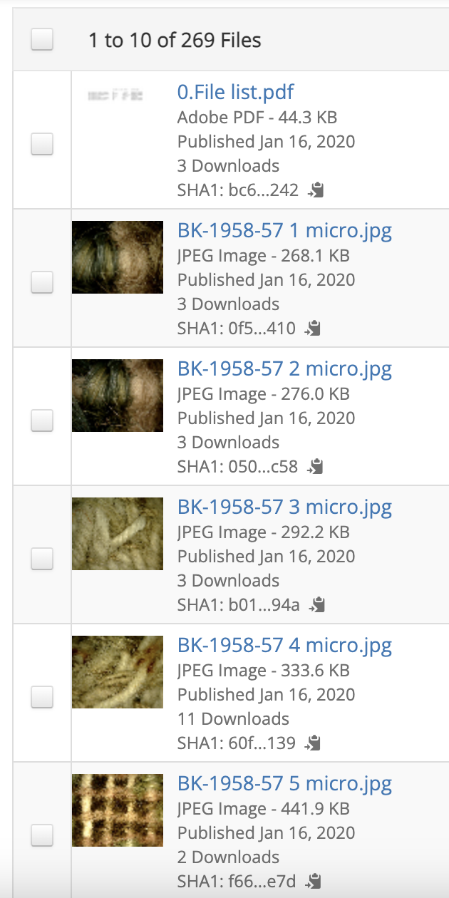
Functions and types

Slide 9
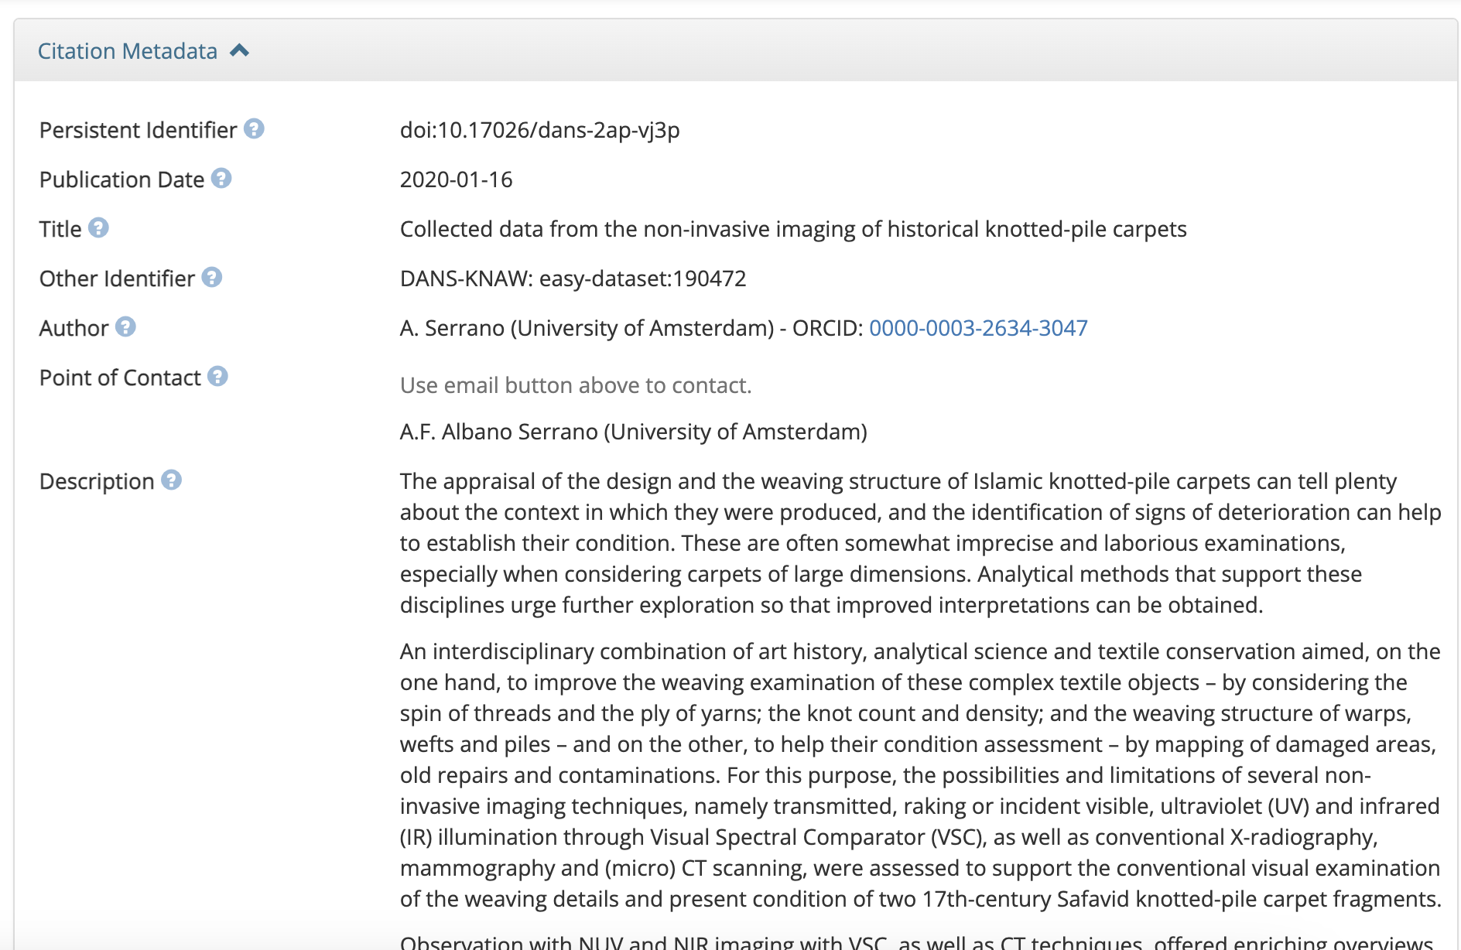
Functions and types

Slide 10
Functions and types

Slide 11
Functions and types
Source:
CESSDA Data Management Expert Guide, https://dmeg.cessda.eu/Data-Management-Expert-Guide/2.-Organise-Document/Documentation-and-metadata
Project level
creator
title
subject
collection method and source
funding information
rights (access and reuse)
relation to other information objects (e.g. journal articles)
Data level
relation to other digital objects (e.g. research software)
data type (e.g. tabular, audiovisual, etc.)
file format (e.g. CSV, MP4)
file size
technical metadata (e.g. EXIF for images)
descriptive
Project level
administrative
structural
Data level
technical

Slide 12
Metadata standards

Slide 13
Metadata standards
Used for human and machine actionability
Harvesting metadata: catalogues, registries, portals
Machine actionability puts more stringent demands on standardization

Slide 14
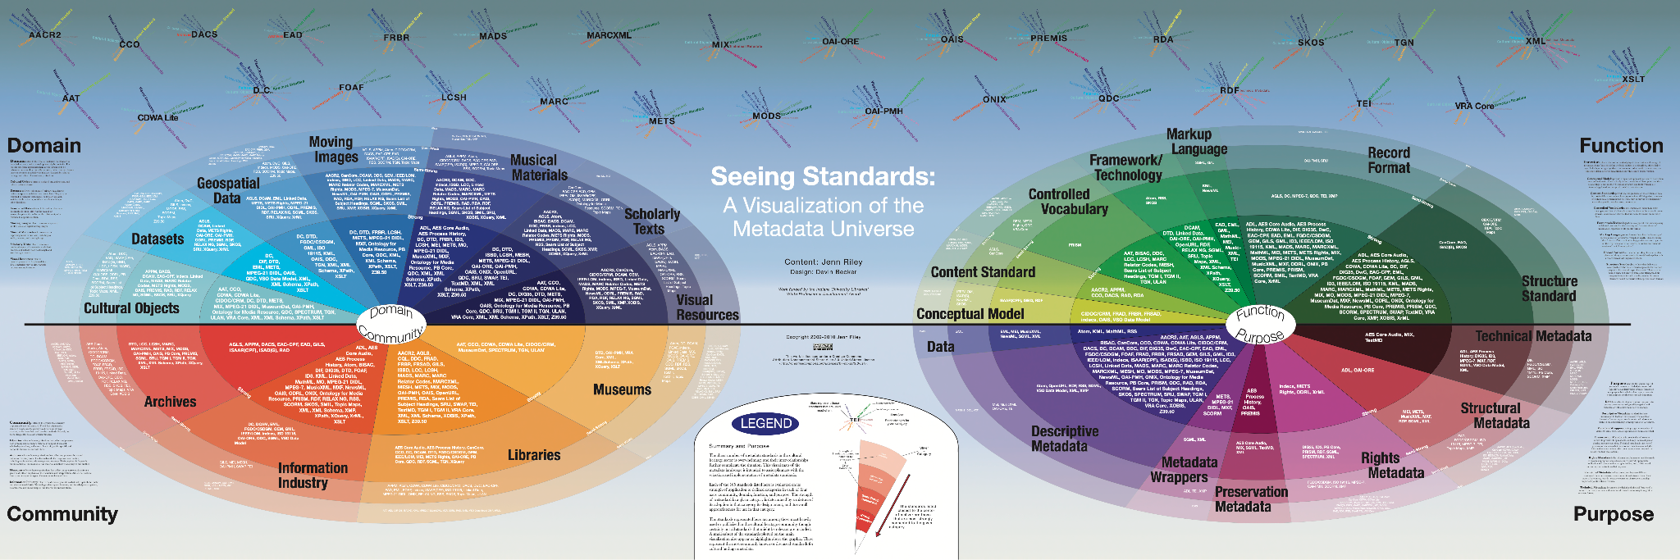
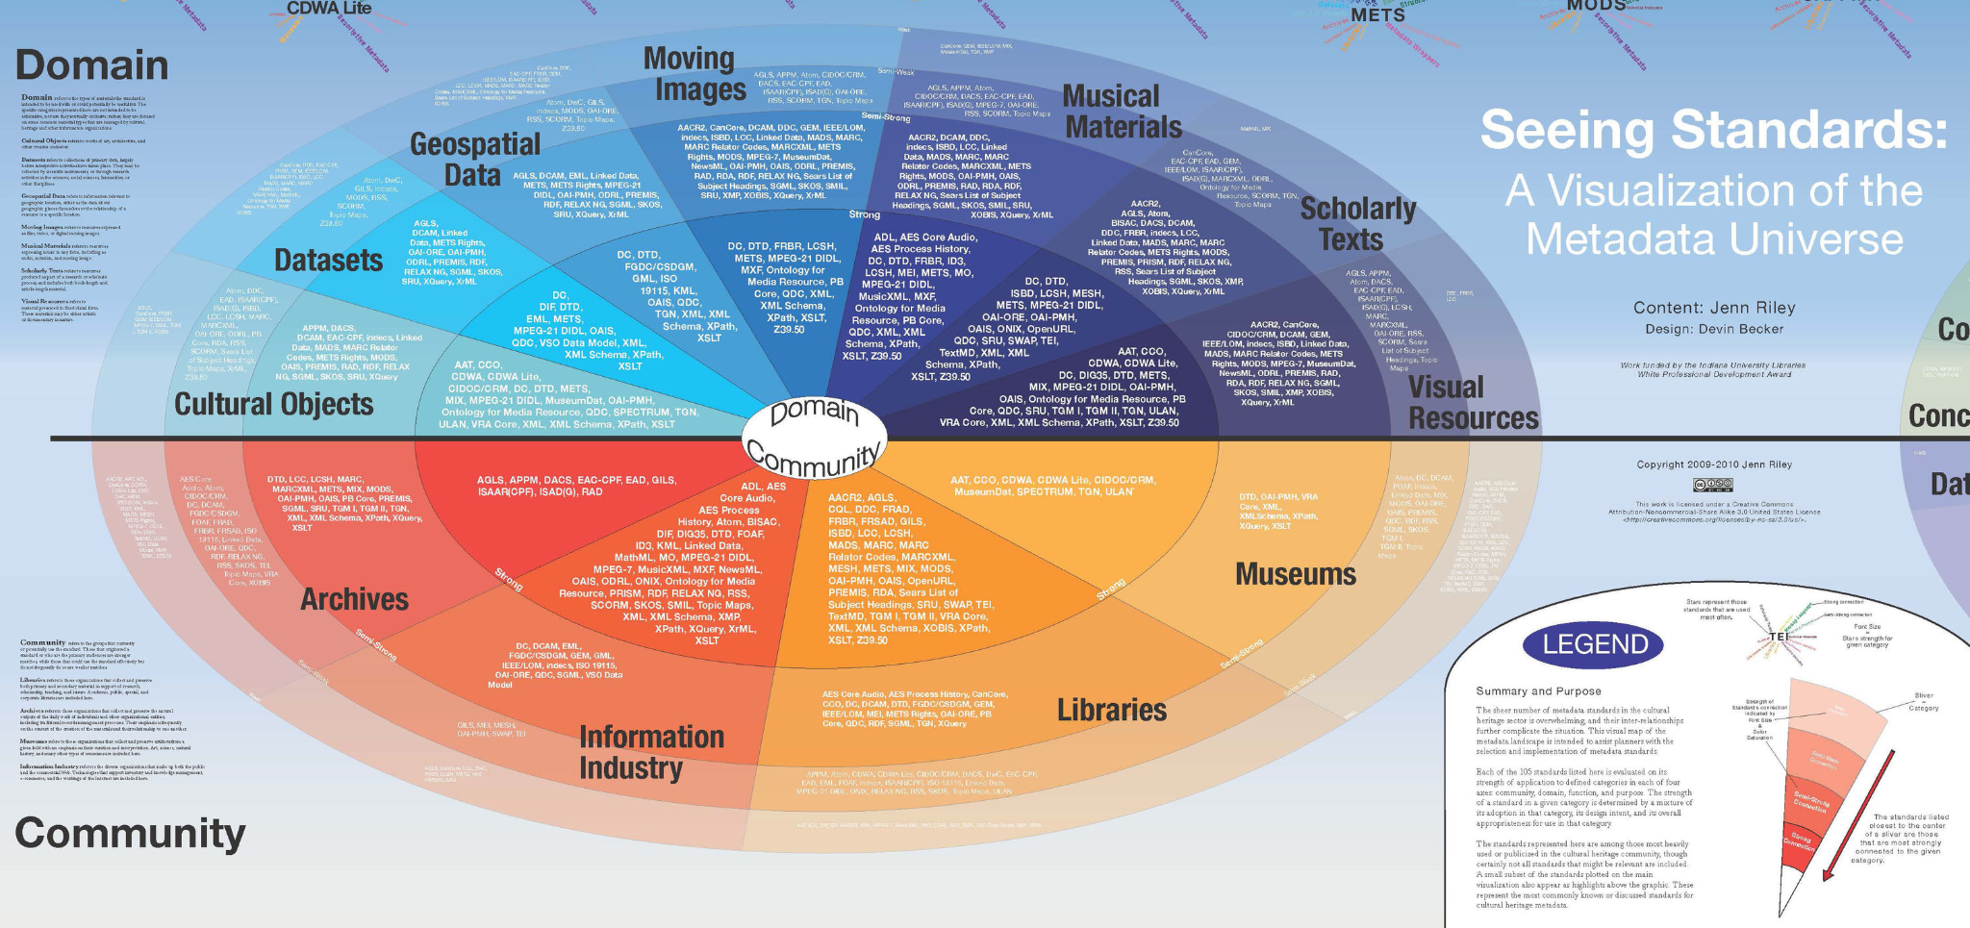
Metadata standards
Source:
Jenn Riley, ‘Seeing Standards: A Visualization of the Metadata Universe’,
https://jennriley.com/metadatamap/seeingstandards.pdf

Slide 15


Metadata standards
Dublin Core
  very generic
  15 ‘core’ elements
  a proper standard! (ISO 15836)
DataCite
  generic, but …
  for datasets
  research data
https://www.dublincore.org/
https://datacite.org/

Slide 16
Metadata standards
Dublin Core 15 elements
Identifier | Coverage
Title | Language
Creator | Type
Contributor | Format
Publisher | Relation
Date | Rights
Description | Source
Subject

Slide 17
Metadata standards
Dublin Core vs. DataCite
Identifier | Coverage
Title | Language
Creator | Type
Contributor | Format
Publisher | Relation
Date | Rights
Description | Source
Subject
Identifier | Geo Location | Alternate Identifier
Title | Language | Related Identifier
Creator | Resource Type | Size
Contributor | Format | Version
Publisher | Related Item | Publication Year
Date | Rights
Description
Subject | Funding Reference

Slide 18
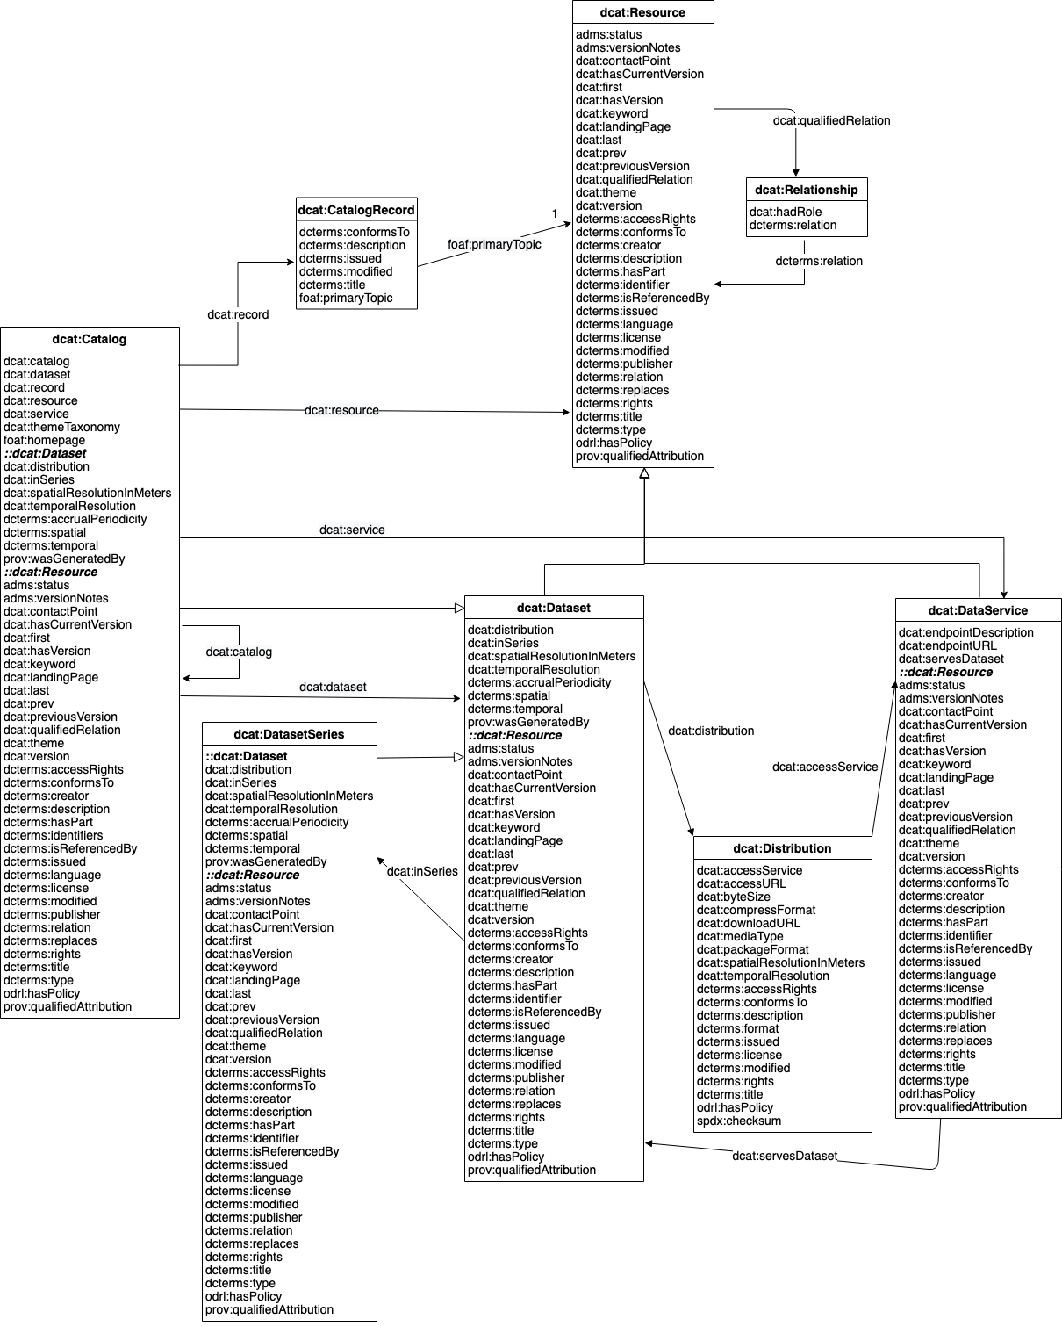
Metadata standards
DCAT (Data Catalog Vocabulary)
From a government context, rather than research.
Increasingly also for research outputs!
  less emphasis on:
    descriptive aspects
    research context
  more emphasis on:
    data exchange
    structure (data, dataset, series, catalog)
    technical access (distributions, data services)
    https://www.w3.org/TR/vocab-dcat-3

Slide 19
Metadata:
some elements

Slide 20
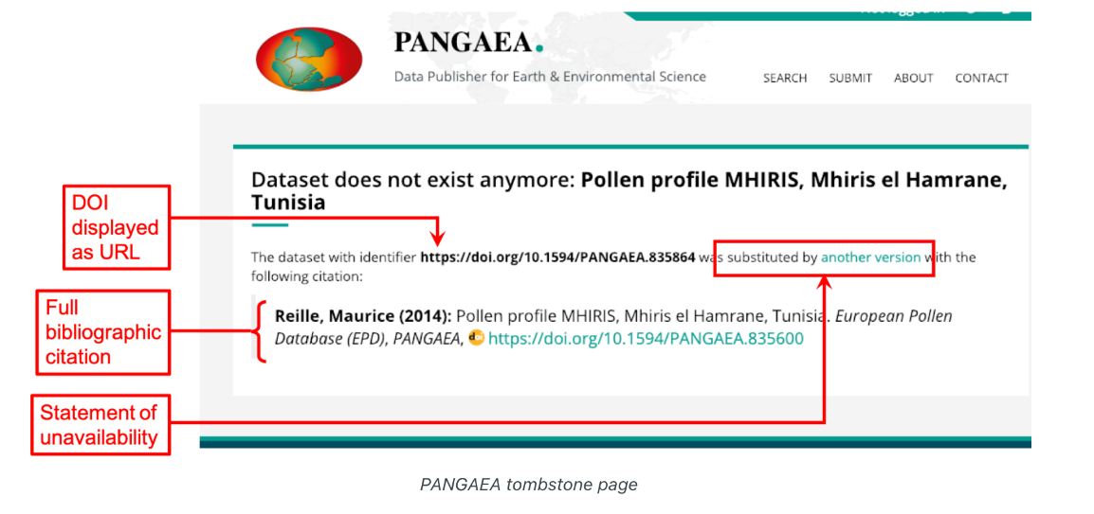
Identifier(s)
PID = persistent identifier
unique ID of a digital object
location-independent (URL may change)
Guarantees findability
Leads to landing page with metadata
(even if data have been removed)
Source: ‘Best Practices for Tombstone Pages’, DataCite support pages

Slide 21
Creators / Contributors
Potentially a variety of roles
Project leader / PI
Researcher
Registrar
Data manager / steward
(Research) software engineer
Subproperties:
ID (ORCID)
Affiliation (ROR)

Slide 22
Date(s)
Date of collection
Production date
Date of deposit
Publication date
Date available
ISO 8601:
“YYYY-MM-DD”

Slide 23
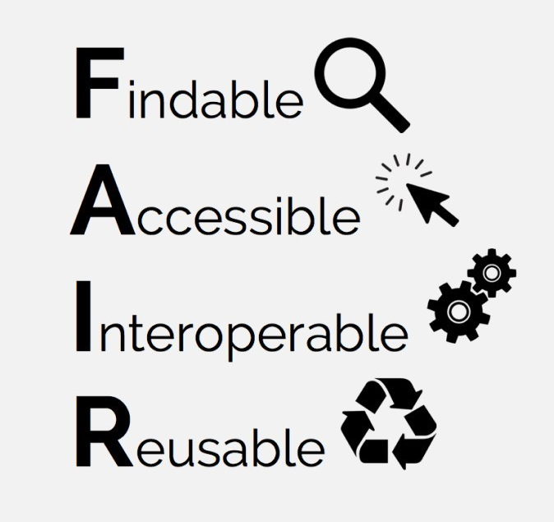
Rights
Access rights
Open Access
Restricted Access
Closed Access
Licence for re-use
Creative Commons
Software licences
More restricted: e.g. DANS licence
Rightsholder
Often institutional

Slide 24
Coverage
Temporal coverage
Time interval
Period
e.g.
Periodo
https://perio.do/
Spatial coverage:
Box
Point
Free text
e.g.
GeoNames
https://www.geonames.org/
Getty Thesaurus of Geographic Names
https://www.getty.edu/research/tools/vocabularies/tgn/

Slide 25
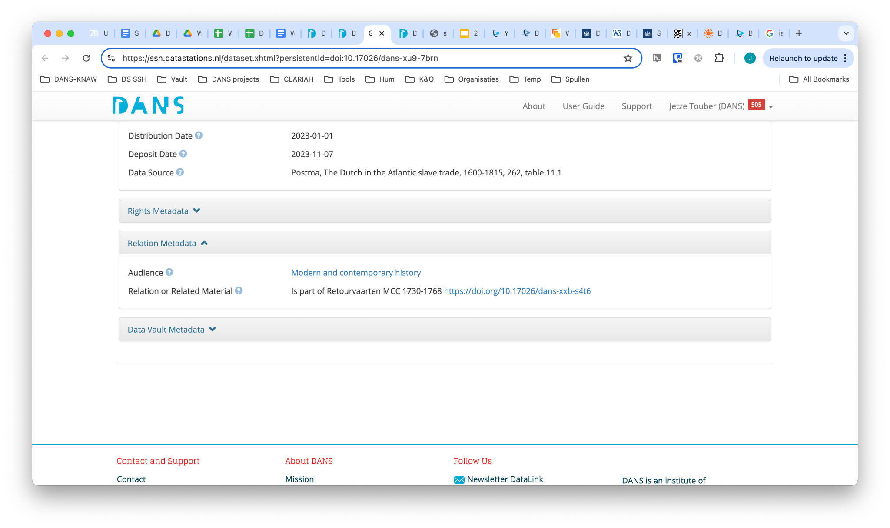
Relation
Preferably: expressed as a statement
Examples:
Dataset X isPartOf / hasPart Resource Y
Dataset X isVersionOf / hasVersion Resource Y
Dataset X References / isReferencedBy Resource Y
Preferably: Resource Y is provided with a PID!
Example:

Slide 26
Metadata and systems

Slide 27
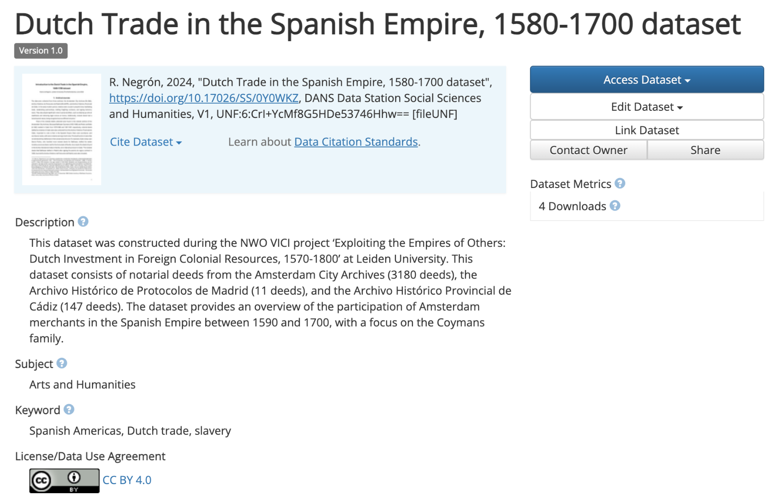
Metadata and systems
Metadata captured
in repository
DANS Data Station Social Sciences and Humanities
https://ssh.datastations.nl/

Slide 28
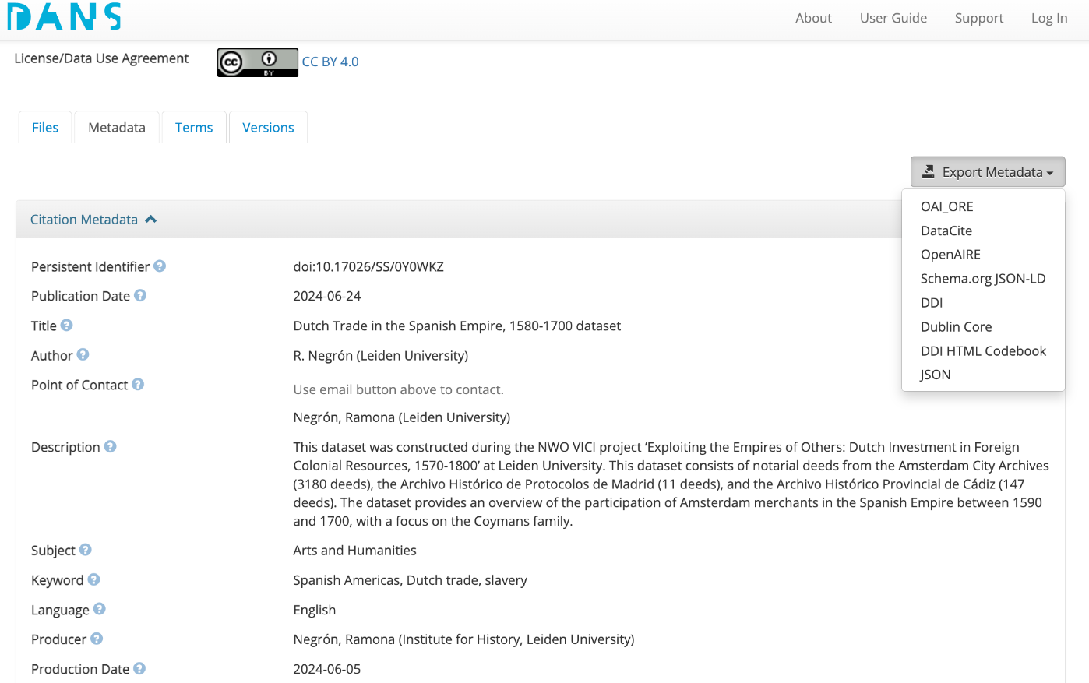
Metadata and systems
Metadata export
in various formats
DANS Data Station Social Sciences and Humanities
https://ssh.datastations.nl/

Slide 29
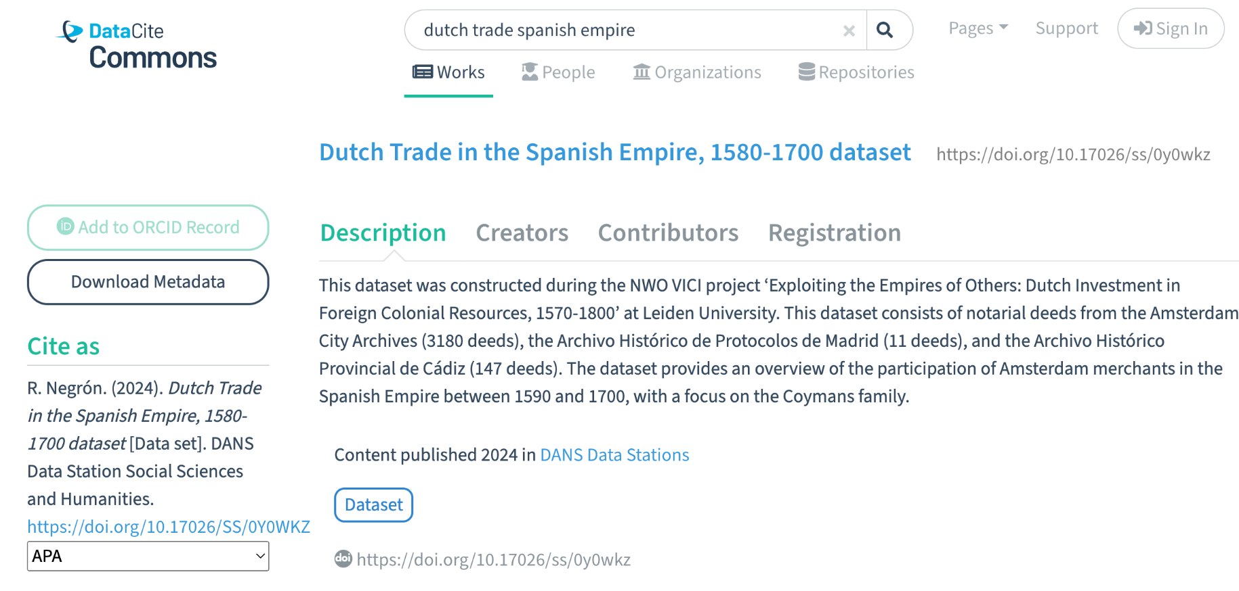
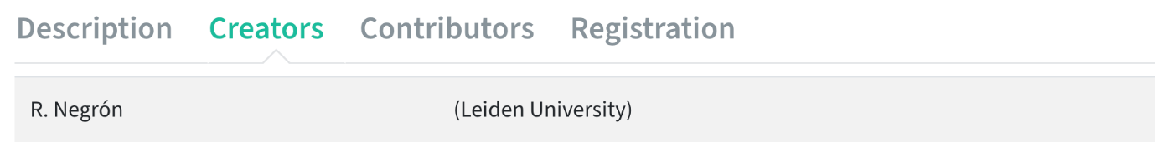
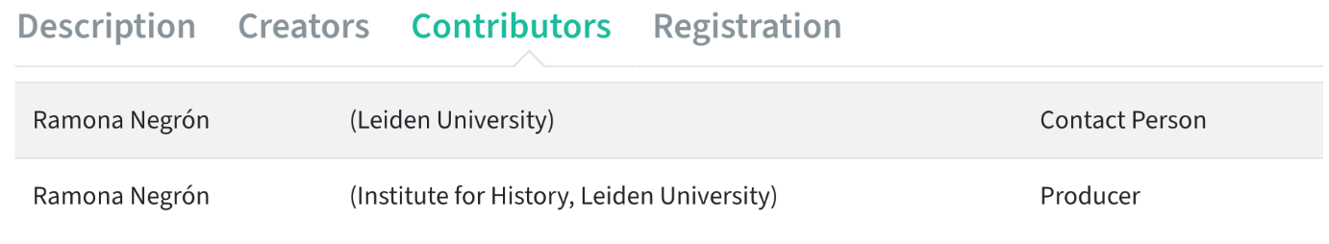
Metadata and systems
Metadata of dataset
harvested by
external catalogues
DataCite Commons
https://commons.datacite.org/

Slide 30
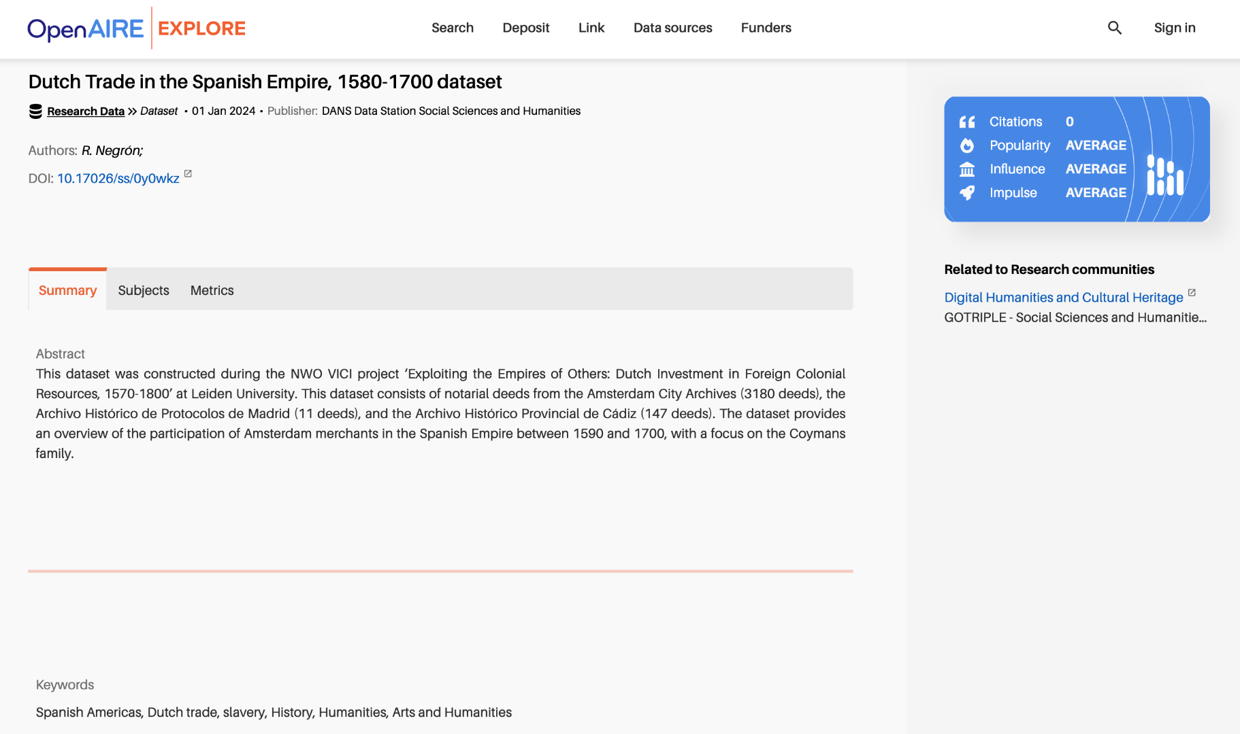
Metadata and systems
Metadata of dataset
harvested by
external catalogues
OpenAIRE Explore
https://explore.openaire.eu/search/find/research-outcomes

Slide 31
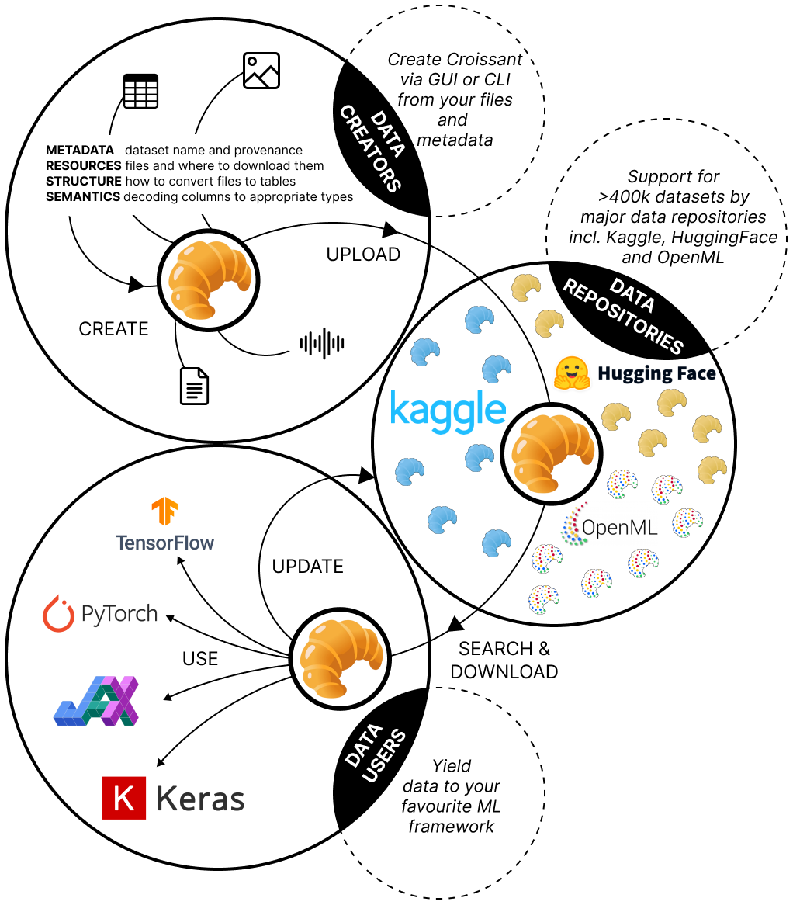
Metadata and systems
Metadata of dataset
harvested by
machine learning
systems
Croissant
https://mlcommons.org/working-groups/data/croissant/

Slide 32
Exercise

Slide 33
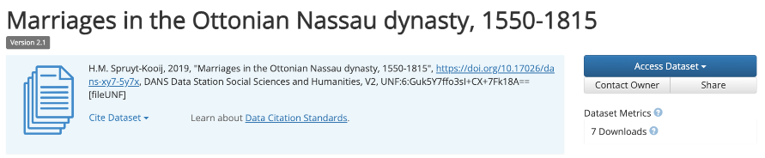
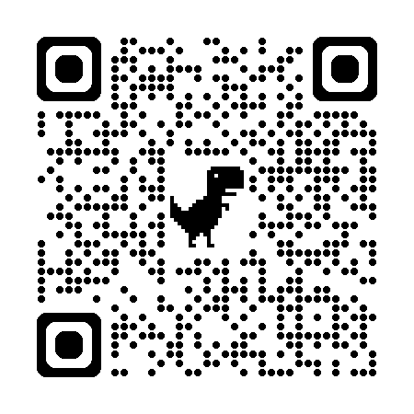
Exercise
Go to https://ssh.datastations.nl/ and find the following dataset:
Study the metadata
Do you find all information you would expect, where you would expect it?
What do you appreciate in the metadata?
What could be improved in the metadata?
1.

Slide 34
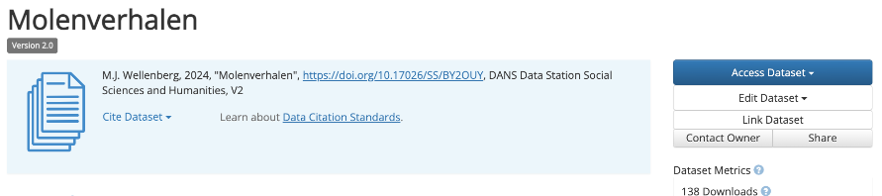
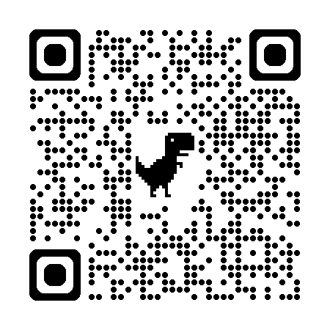
Exercise
Go to https://ssh.datastations.nl/ and find the following dataset:
Study the metadata
Do you find all information you would expect, where you would expect it?
What do you appreciate in the metadata?
What could be improved in the metadata?
2.

Slide 35
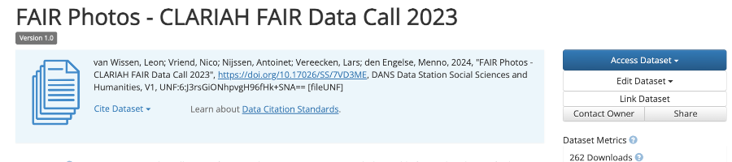
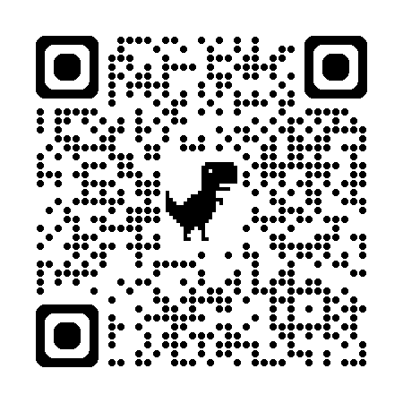
Exercise
Go to https://ssh.datastations.nl/ and find the following dataset:
Study the metadata
Do you find all information you would expect, where you would expect it?
What do you appreciate in the metadata?
What could be improved in the metadata?
3.

Slide 36



More information
Visit our website www.dans.knaw.nl
And follow us online
Mastodon @DANS_knaw_nwo
LinkedIn @DANS
X @DANS_knaw_nwo

