Slide 1
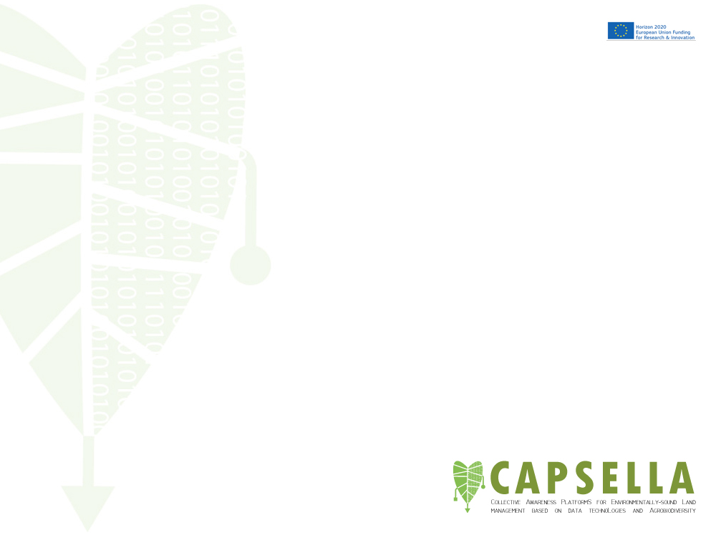
Collective Awareness PlatformS for Environmentally-sound Land management based on data technoLogies and Agrobiodiversity
CAPSELLA Platform
Panagiota Koltsida, ATHENA RC

Slide 2
What is it
A data infrastructure that offers a set of data services including
  Data management supporting various formats
  Metadata Publishing
  Data analytics and processing
  A set of interoperable services for interacting with it
It is developed on the basis of being extensible and pluggable to seamlessly allow the integration of new services and data types

Slide 3
CAPSELLA Platform
Data Aggregation
Data Analysis
Knowledge extraction
Sentiment analysis
Support decision making for farmers and consumers

Slide 4
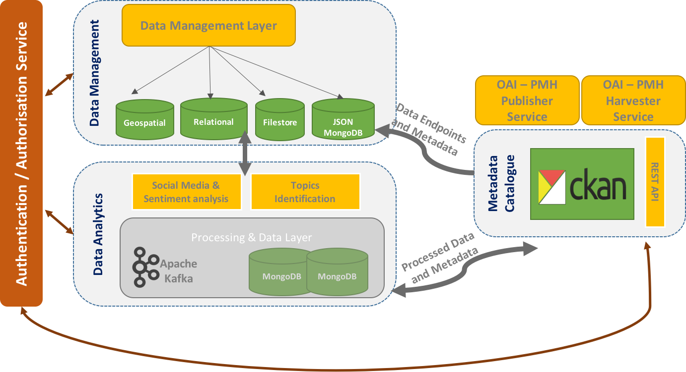
CAPSELLA Platform Architecture

Slide 5
Platform Services
The CAPSELLA Authentication service: It acts as a central point of authentication and authorisation and is based on the LDAP protocol
The Data Management System: Offers data storage, retrieval and query facilities on top of the available datasets.
The Metadata Catalogue: The main CAPSELLA catalogue offering browse and search facilities over the available datasets
The CAPSELLA Data analytics and Management System: Offers analytics services, like sentiment analysis and opinion mining on various datasets.
The CAPSELLA interoperability services: Based on the OAI-PMH protocol

Slide 6
Platform Services – Swagger UI
Authentication Service: https://capsella-services.madgik.di.uoa.gr:8443/capsella_authentication_service/swagger-ui.html#!/
Data Manager Service: https://capsella-services.madgik.di.uoa.gr:8443/data-manager-service/swagger-ui.html#!/

Slide 7
How to login to the CAPSELLA Platform
A test account has been created for the purposes of this hackathon:
username: agrohacker
pass: @gr0h@ck3r
group: hackathon
* Available for a limited time

Slide 8
CAPSELLA Platform wiki: https://ticketing.madgik.di.uoa.gr/redmine/projects/capsella-public/wiki/Platform_Services
CAPSELLA Github: https://github.com/CAPSELLA

