Slide 1
Agile Methods for RSEs
A formula for scrum-driven software development in research?
Ann Gledson, Adrian Harwood & Scott Archer-Nicholls
Research IT, IT Services, The University of Manchester

Slide 2
Contents
Project Management in your Group
Agile and Scrum Overview
Scrum in your Group
Adaptation for UoM RSE
  Requirements Capture
  Tools
  Modifications
Metrics and Measures
Would you adopt Scrum?

Slide 3
Contents
Project Management in your Group
Agile and Scrum Overview
Scrum in your Group
Adaptation for UoM RSE
  Requirements Capture
  Tools
  Modifications
Metrics and Measures
Would you adopt Scrum?

Slide 4
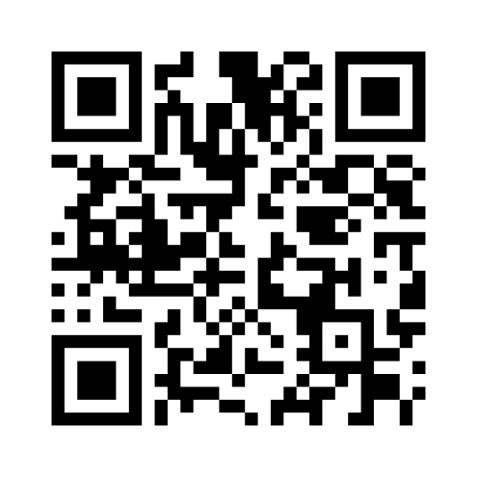
Project Management in your Group
Join in with Part 1!
https://www.menti.com/alvmgnkkhzsf
Access Code: 4588 1433
Notes:
DON’T FORGET TO OPEN THE SURVEY
https://www.mentimeter.com/app/presentation/n/alnzgzdvg5js5vv8ktjq6uey53qmqmwo/edit?question=dfuzqipp54pj
… and share the window, advancing to the end of Part-1
IF ANY PROBLEMS:
Just share the RSE-Con results instead: https://www.mentimeter.com/app/presentation/n/aljaaj7kyg28kos7yanhh9z96oiq1fr1/edit?question=y8dtduwo5a25

Slide 5
Contents
Project Management in your Group
Agile and Scrum Overview
Scrum in your Group
Adaptation for UoM RSE
  Requirements Capture
  Tools
  Modifications
Metrics and Measures
Would you adopt Scrum?

Slide 6
Agile Methodologies
A methodology for project / product management built on a set of values.
The “Agile Manifesto” defines the values.
  Customer collaboration over contract negotiation.
  Responding to change over following a plan.
  Individuals and interactions over processes and tools.
  Working software over comprehensive documentation.
There are many implementations of the manifesto and its values
  Scrum (most popular)
  Extreme Programming (XP)
OVER
NOT
INSTEAD OF

Slide 7




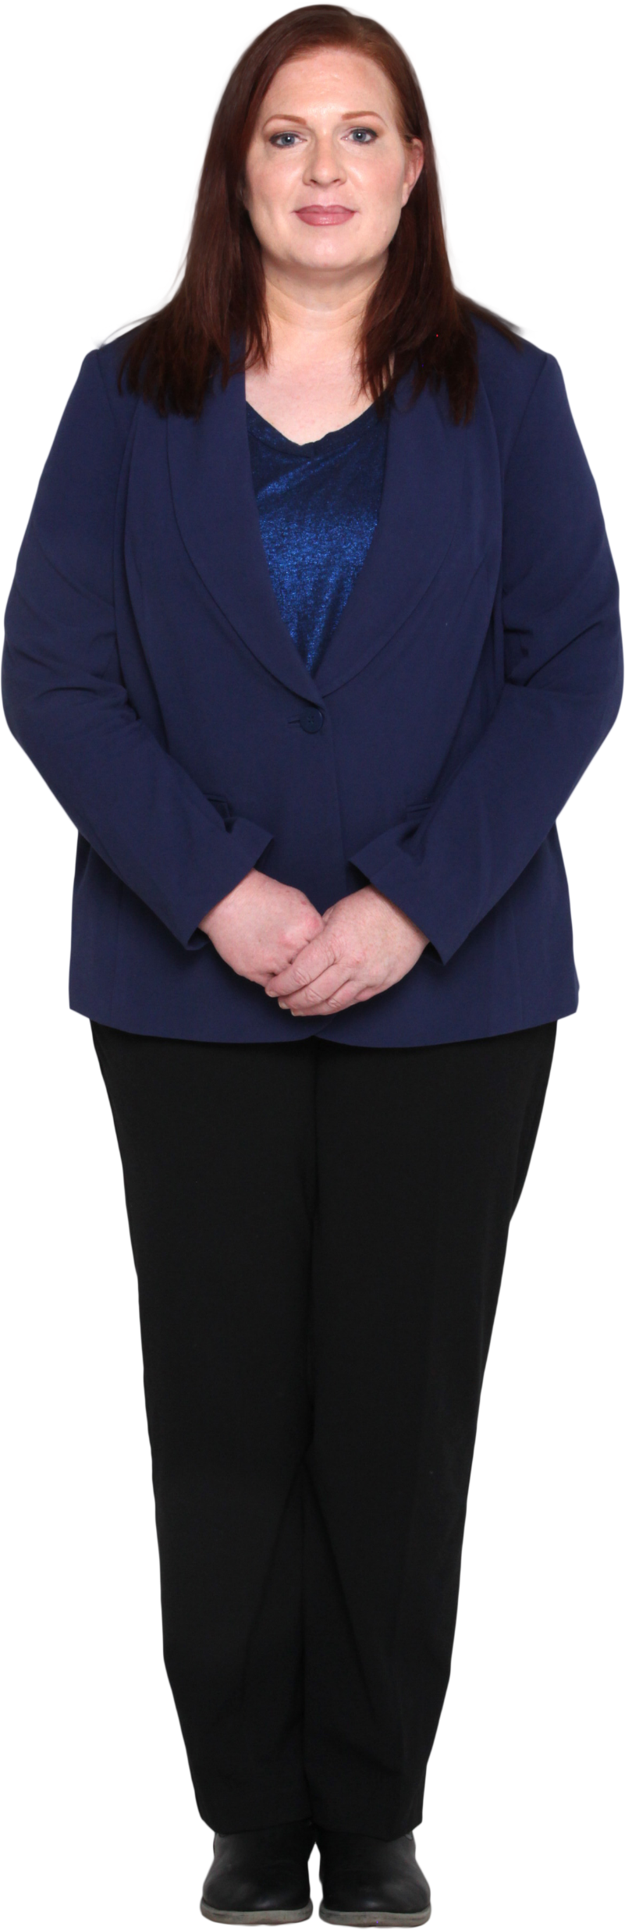





Waterfall Processes
The process is executed once for the entire project
Stakeholders
Requirements Engineer
Developers
Require-ments
Planning / Design
Implemen-tation
Testing
Feedback
Project Manager
Notes:
Let’s revisit the Waterfall development diagram.
So that the Scrum development framework can fulfil the criteria for Agile, it is cyclical rather than linear…

Slide 8


Scrum
Product Owner
(was Requirements Engineer)
Require-ments
Planning / Design
Implemen-tation
Testing
Feedback
Stakeholders
A project is carried out over many sprints executed back-to-back
Scrum Master
(was Project Manager)
Iterations
(“Sprints”)
Developers
Notes:
So how does that work?
The software development phases that we saw earlier are now repeated, in multiple cycles, known as ‘Sprints’
… In essence, this gives the Stakeholders and the Scrum Team multiple opportunities to re-visit and edit the list of requirements, throughout the project lifespan.
The Agile / Scrum answer is:
To Encourage the mindset where change is normal.
And to Make the software development process embrace that change.
The Scrum methodology fulfils this philosophy by using Sprint Cycles.
And how do we get these Sprint cycles to work?
In the next few slides, we will go through Scrum’s definitions of roles, events and artefacts, that make it all function.
It involves:
Collecting and editing requirements regularly (using Epics and Stories).
Clear roles, each with clear definitions.
The use of 2 main Scrum artefacts: The Product Backlog and the Sprint Backlog.
Regular well-defined Events: Scrum methods involve ‘Purpose-driven daily interactions across the Scrum Team and Stakeholders.

Slide 9







Scrum Roles
Have a vested interest in product.
Not part of the Scrum Team.
A variety of (non-Scrum) roles
(researchers, end-users…).
Perform User Acceptance Testing (UAT).
Defines / prioritises work to be done.
Ensures work aligns with Stakeholder needs.
Represents Stakeholders and the team.
Product Owner
Stakeholders
Typically 2-9 people in size.
Cross-functional domain expertise.
Self-organising: determine, together, the best way to complete the work.
Ensures team follows Scrum process.
Removes blockers.
Promotes exchange of information.
Facilitates the process.
Development Team
Scrum
Master
Notes:
The Scrum Roles are Stakeholder, Product Owner, Developer and Scrum Master.
[Read from slides]
NOTE: Development Team:
By Cross-functional, we mean a team of workers from different parts of the org. Or with different domain expertise.
We typically loosen these definitions for our RSE version of scrum. For example:
The Scrum Master will often assume a level of responsibility for delivery that would normally be held by the Product Owner
Our accountability mapping is also a little different from Scrum’s
We will go on to explain more later.

Slide 10
Scrum Team
Defines / prioritises work to be done.
Ensures work aligns with Stakeholder needs.
Represents Stakeholders and the team.
Product Owner
“Stakeholders” are not part of the Scrum team
Typically 2-9 people in size.
Cross-functional domain expertise.
Self-organising: determine, together, the best way to complete the work.
Ensures team follows Scrum process.
Removes blockers.
Promotes exchange of information.
Facilitates process.
Development Team
Scrum
Master
Notes:
So to recap, when we refer to the Scrum Team, we mean the Product Owner, the Developer(s) and the Scrum Master.

Slide 11

Product Backlog
Description | Priority
Prioritised list of all work to be done to deliver the complete product.
Managed by the Product Owner but visible to all.
What are work items?
  E.g. New features, enhancements, bug fixes
  Can be written as “User Stories”
  A good issue has a clear definition of “Done”
A living thing: Items can (at any time) be:
  Added
  Removed
  Re-ordered
  Evolved
Work Item #1
1
Work Item #3
1
Work Item #6
1
Work Item #2
2
Work Item #5
2
Work Item #4
3
Work Item #7
3
Product Owner
Work Item #8
3
Notes:
The Product Backlog (also known as just ‘Backlog’):
Is A Prioritised list of all work that could be done for the product.
… based on the requirements
It is Managed by the Product Owner. … so any changes must be agreed by them.
(but it is viewable by all members of the Scrum team, at any time.)
It consists of Work Items:
Which can be: New features | Enhancements | Bug fixes
These are added to the backlog as the appropriate issue type: Stories or Tasks
A good issue has a clear definition of ‘Done’
… and this ‘definition of done’ must be agreed and described explicitly. (You will have a go at doing this on the 2-day course).
The Product Backlog is Live: So items can (at any time) be:
Added
Removed
Re-ordered
Or Evolved
… So as we can see, this follows the notion of ‘agile’.

Slide 12
Sprint Backlog
Description | Priority | Points
Items to be worked on in the next sprint, as agreed by the Development Team.
Managed by the Development Team.
  Nobody else can add items to sprints including the Product Owner.
Product Backlog work items can be broken down into smaller items then moved to the Sprint Backlog.
Each work item has a size estimate (“story points”) representing the relative amount of effort to achieve the definition of done.
Work Item #1.1
1
0.5
Work Item #1.2
1
1
Work Item #3.1
1
2
Work Item #3.2
1
8
Work Item #6
1
13
Work Item #5.1
2
2
Developers
Work Item #5.2
2
3
Notes:
The Sprint Backlog…
…Is a Subset of the Product Backlog.
(We’ll see more about how we populate the Sprint Backlog, when we talk about Sprint Planning Meetings later on.)
It is a list of Items to be worked on in the next sprint, as agreed by the Development Team.
It is also managed by the Development Team.
And nobody else can add issues to sprints.
That includes the Product Owner and the Stakeholders.
So the Sprint Backlog is like a sealed list of issues that will be worked on
and Only very urgent changes in requirements can cause it to be changed.
Original (Product Backlog) tasks can be broken into subtasks, as we transfer them into the next sprint.
Each issue has a size, estimated using “story points”.
The points represent the Effort required to get it done.
The points score is agreed by Development Team…
… using a game called “Planning Poker” (which you will have a go at playing on the 2-day course)
The Scrum methodology is flexible about how points are used to reflect the required effort,
but a typical set of points to choose from is a list resembling fibronacci numbers: 0.5, 1, 2, 3, 5, 8, 13, 20, 40, 100
Again, I will explain this process in more detail soon, when we talk about Sprint Planning.

Slide 13
Sprints: Kanban Board
To Do | In Progress | Blocked | Ready for Review | Done
Work Item #1.1
Work Item #1.2
Work Item #3.1
Work Item #3.2
Work Item #6
Work Item #5.1
Work Item #5.2
Developers
Notes:
As many of you will already know, the Sprint Backlog is typically represented as a Kanban Board, where items are moved across the board, as they are being worked on.
The columns here are common ones used by software development teams and roughly match those that we recommend for use in the RSE department.

Slide 14
Sprints: Kanban Board
To Do | In Progress | Blocked | Ready for Review | Done
Work Item #1.1
Work Item #1.2
Work Item #3.1
Work Item #3.2
Work Item #6
Work Item #5.1
Work Item #5.2
Developers
Notes:
Here we see how the Kanban board works and items move along from left to right, as the Sprint progresses.
For code-based items, the ‘Ready for Review’ column is equivalent to ‘PR Raised’.
We use the more general term ‘Ready for Review’ here, as not all tasks result in code changes and PRs.

Slide 15

Sprint Planning
Scrum Master
Chairs
Ensures process is followed
Gets agreed start & end dates
Description | Priority
Description | Priority | Points
Work Item #1
1
Work Item #1.1
1
0.5
Work Item #3
1
Product Owner
Shares highest-priority items
Defines “Sprint Goal”
Work Item #1.2
1
1
Work Item #6
1
Work Item #2
2
Work Item #6
1
13
SPRINT PLANNING
Work Item #5
2
Work Item #5.1
2
2
Work Item #4
3
Developers
Break down work items into smaller items
Assign “Story Points”
Populate the next Sprint Backlog
Collectively commit to doing the work
Work Item #5.2
2
3
Work Item #7
3
Sprint Backlog
Product Backlog
Notes:
Following on from the descriptions of the Product and Sprint Backlogs, you may remember that the sprint backlog is a sub-set of the product backlog.
So how do we decide which items are moved across from one to the other?
This is done during the Sprint Planning Meeting…
In the Sprint Planning Meeting, we fill the sprint backlog with the highest priority tasks from the Product Backlog and we do this as follows:
The Scrum Master chairs the meeting, ensuring that the correct procedures are followed:
The Product Owner presents and gets agreement on the ‘Sprint Goal’ and highlights the priority issues that are related to that goal.
An example sprint goal might be: “Create a dashboard with basic widgets for the most common two platforms”
The Product Owner and Development team review the prioritised user stories and, if required, identify any new tasks or sub-tasks.
The Development team do story point estimation for each priority issue, one at a time (using the planning poker cards).
The Planning poker game (pictured in the slide) is a way of getting agreed estimates for task sizes,
whilst avoiding ‘Group-Think’ or a subset of the team dominating any decisions.
For each task, each developer selects a card with a number representing the amount of effort and puts it face down on the meeting table.
Once everyone has selected a card, all of the cards are turned over at the same time, for all to see.
Any disagreements are explained, and if the discrepancy is large, further rounds are completed until agreement is reached.
You will be doing this game (along with all other Sprint Planning tasks) in the 2-day training course, so if it’s not yet clear, it will become so later.
The Development team then populate the sprint backlog, keeping in mind how many story points they are capable of during the next sprint.
and they collectively commit to that work
Then, the Sprint start and end dates are agreed
The RSE department policy is that sprints should last 4 weeks for a 40% commitment i.e. 8 days of effort for a single RSE.
The Scrum Master begins the sprint and the next tranche of development work begins.

Slide 16







Daily Stand-Up
Chaired by Scrum Master.
Attended by ALL Scrum Team members.
Strict timing:
  15-20 minutes total
  2-3 minutes each
Each Scrum Team member:
  What you did the day before
  What you plan to do today
  Any issues blocking progress
Scrum Master:
  Records blockers
  Removes blockers…after the meeting
Notes:
The Daily Stand-up meeting is:
Chaired by Scrum Master.
Attended by ALL Scrum Team members.
Has a strict time limit of:
15-20 Minutes
So each team member speaks only for 2-3 minutes each
Each Scrum Team member presents:
What they did the day before
Their plans for today
And any issues blocking progress
Scrum Master:
Records any blockers
And Removes those blockers
…after the meeting if necessary
When fully implementing Scrum, these are short meetings attended by ALL Scrum team members and any updates for absentees are read out
The Product Owner can also add any further updates and comments, for example, about progress towards the sprint goal.
In the RSE Dept, daily stand-ups are not compulsory, unless a project really needs that level of scrutiny.
Our policy is usually more lightweight, with a 30-minute fortnightly check-in or a weekly 15-minute check-in by the G7 Project Manager (who is acting as Scrum Master).

Slide 17





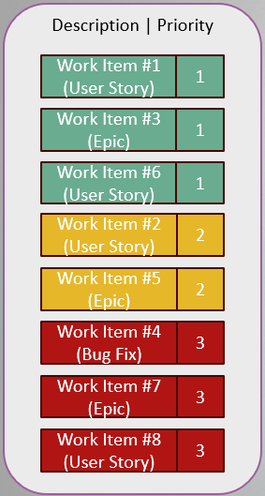
Sprint Review
Chaired by Product Owner
Attended by Scrum Team and Stakeholders
Developer(s) present demo showcasing the achievements of the sprint.
Opportunity for questions to be raised
from demo
Does the product meet the requirements?
Product Owner captures all feedback
Notes:
The Sprint Review meeting gives the Stakeholders a chance to review the work done (the increment) and provide feedback.
This meeting is:
Chaired by Product Owner
Attended by Scrum Team and Stakeholders
Developer(s) present demo
showcasing the achievements of the sprint.
Opportunity for questions to be raised
from demo
Does the Product meet the requirements?
P.O. captures all feedback to …
Enhance the Product Backlog. AKA:
Backlog Grooming
Backlog Refinement
Backlog Pruning

Slide 18







Sprint Retrospective
Chaired by the Scrum Master
Time to reflect on the latest sprint
  What went well?
  What needs improving?
  Assessment of the process
    NOT of individuals
Attended by the Scrum Team
Adapt ways of working
https://www.atlassian.com/agile/scrum/retrospectives
Notes:
If you remember, when we learned about the 3 Scrum Pillars, they proposed the use of ‘Inspection’ and ‘Adaption’.
Inspection: Check your work as you are doing it. The ‘Sprint Retrospective’ meeting gives the Scrum team a regular chance to reflect and evaluate their performance
Adaption: Is not just about adapting requirements throughout the project, but also the processes followed, to decide if they are working or can be improved.
These meetings are:
Chaired by the Scrum Master
A time to reflect on the latest sprint
What went well?
What needs improving?
They are an assessment of the process
NOT of individuals
Attended by the Scrum Team
Adapt ways of working
In addition, these meetings should incorporate the following two the Scrum values:
Courage to do the right thing, to work on tough problems
Respect: Scrum Team members respect each-other to be capable and independent people.

Slide 19
Contents
Project Management in your Group
Agile and Scrum Overview
Scrum in your Group
Adaptation for UoM RSE
  Requirements Capture
  Tools
  Modifications
Metrics and Measures
Would you adopt Scrum?

Slide 20
Scrum in your Group
Join in with Part 2!
https://www.menti.com/alvmgnkkhzsf
Access Code: 4588 1433
Notes:
DON’T FORGET TO OPEN THE SURVEY
https://www.mentimeter.com/app/presentation/n/alnzgzdvg5js5vv8ktjq6uey53qmqmwo/edit?question=dfuzqipp54pj
… and share the window, advancing to the end of Part-2

Slide 21
Contents
Project Management in your Group
Agile and Scrum Overview
Scrum in your Group
Adaptation for UoM RSE
  Requirements Capture
  Tools
  Modifications
Metrics and Measures
Would you adopt Scrum?

Slide 22
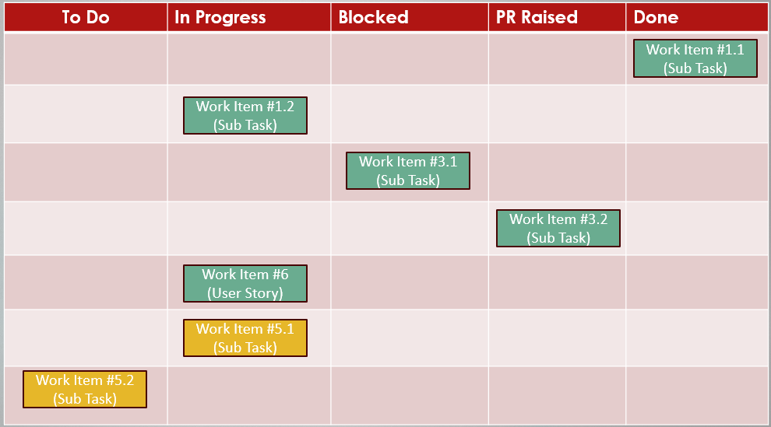




Why adopt?
Constant evolution of requirements and priorities characterises research
Fail fast and regular feedback minimise risk.
Small teams, often cross-functional.
Focus on a subset of tasks for makes complex solutions tractable.
Help?

Slide 23
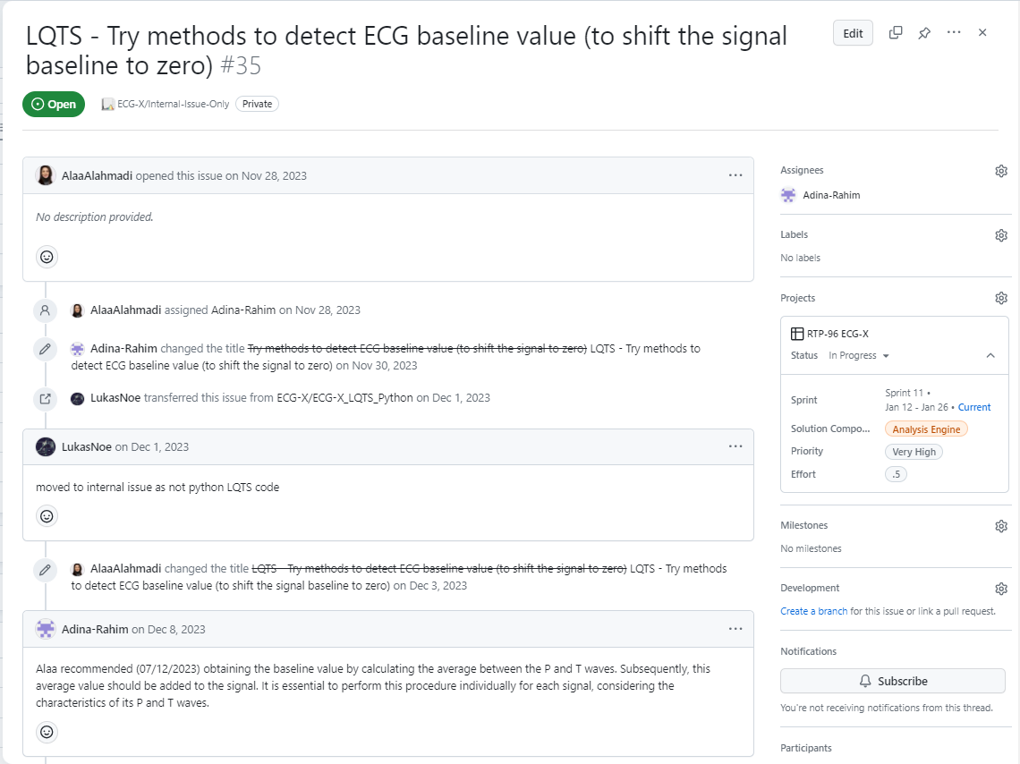
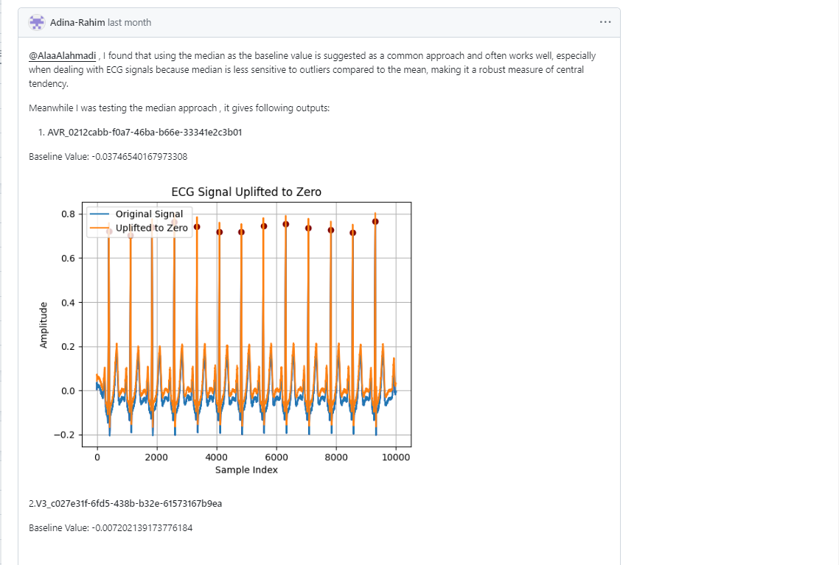
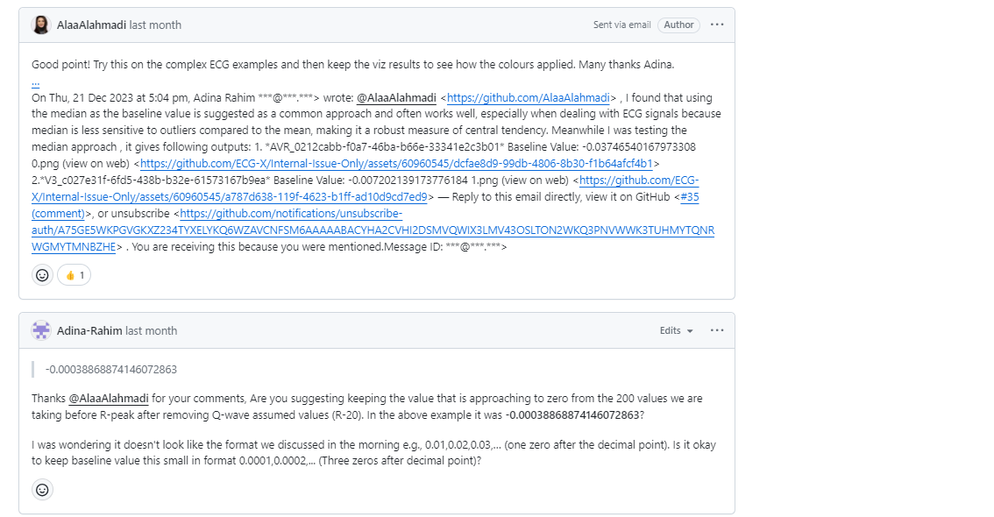
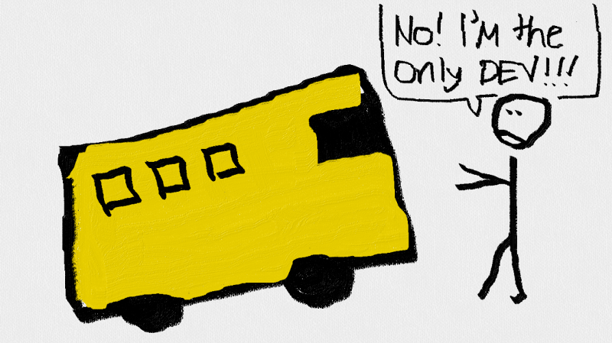
Why adopt?
Clear roles and expectations.
History, progress and plans always visible to all those involved in the project.
Eliminates the bus
factor.

Slide 24
Why adapt?
Scrum Teams | RSE / Academic Teams
Developers work on 1 project at a time. | RSEs usually work on multiple projects concurrently.
Consistently 2-8 developers + Product Owner + Scrum Master. | Unpredictable team including 1-2 RSEs, maybe a PDRA, maybe one or more academics.
Have dedicated Product Owner. | Academics split between projects, often not available or engaged to do this role.
Have dedicated Scrum Master. | Senior RSE usually assumes this role but is split between projects.
Product is almost always a “thing” e.g. a software solution or application. | Product might sometimes be lab support including training and not necessarily always a concrete asset.

Slide 25
What we kept in
PI (or a nominee) as Product Owner
Senior RSE as Scrum Master
RSE(s) + PDRAs + PhDs as Development Team
Product Backlog
Sprint Backlog
Kanban
Sprint Planning (every sprint)
Stand-Ups (not daily though)
Sprint Review (every sprint)
Sprint Retrospective (via 1-2-1s between RSEs and Senior RSE)
Core elements are all there but “how” we implement them is flexible

Slide 26
Flexible Scrum: Examples
Project Size
1-2 RSEs
5+ RSEs
Nominated PDRA as Product Owner. Follow some Scrum processes: No daily standup. Sprint Retro happens via 1-2-1s with Senior RSE. Adapted sprint planning: Product Owner populates product backlog. Development Team populate sprint backlog without Product Owner input. Supplementary weekly technical meetings to refine backlog instead. | PDRAs as dedicated Product Owners Several RSEs in cross-functional Development Team. Dedicate senior RSE as Scrum Master. Follow all Scrum processes. Dedicated Program Manager in addition to the Product Owner.
Only RSE and academic attend sprint review. Senior RSE as Scrum Master but shared with other projects. RSE acts as Product Owner with academic as Stakeholder. Fortnightly combined sprint planning & sprint review with academic. RSE as both developer and Product Owner: Manages the product and sprint backlogs. Agrees priorities with academic. Agrees sprint plan with academic. | Development Team largely made up of RSEs. No engaged academic with PDRAs and PhDs as Stakeholders. Senior RSE as Scrum Master but shared with other projects. Sprint Planning with rotating chair, attended by Development Team and Scrum Master only. Development Team members double up as Product Owners for each component of the solution. Sprint review with PDRA and PhDs, rarely with academic.
Stakeholder Engagement
Notes:
Here we have 4 example RSE projects. I know this slide shows a lot of information,
…but the main point of this matrix is to show the variation in RSE Dept projects and give examples of how we have adapted Scrum.
The 2 key areas of variation are the size, ie the number of people working on the project and the level of engagement by the academic team.
I won’t read out all of these in detail, but note that:
The Scrum Master’s involvement can be dedicated or just a light touch from our G7 RSEs.
Retrospective can always happen even if it is one RSE being reflective with the G7 Scrum Master.
Sprint planning and review can be combined if there is low engagement from the stakeholders.
All roles are always filled by someone even if a different person than intended e.g. RSEs acting as PO if the PI doesn’t have enough time to fully engage.
If you want to read these in more detail, press pause and read through each one. Perhaps have a think about where your current projects would fit in with this.
Don’t forget there will be time for questions at the start of the 2-day hands-on course.

Slide 27
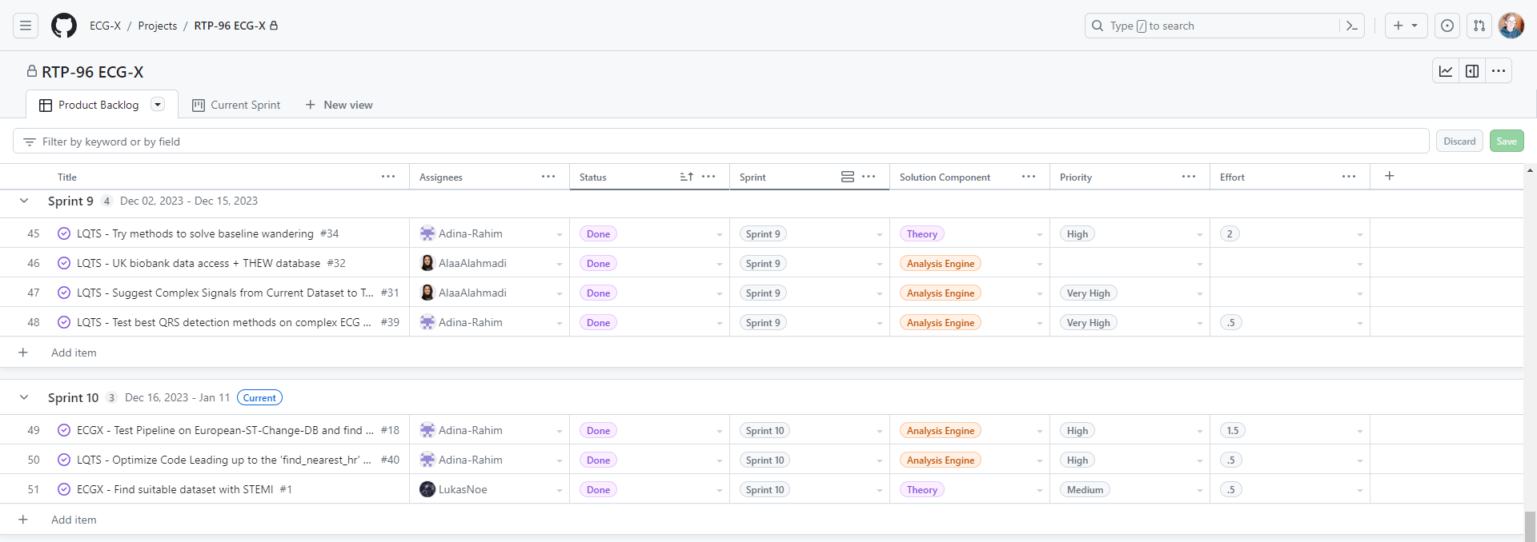
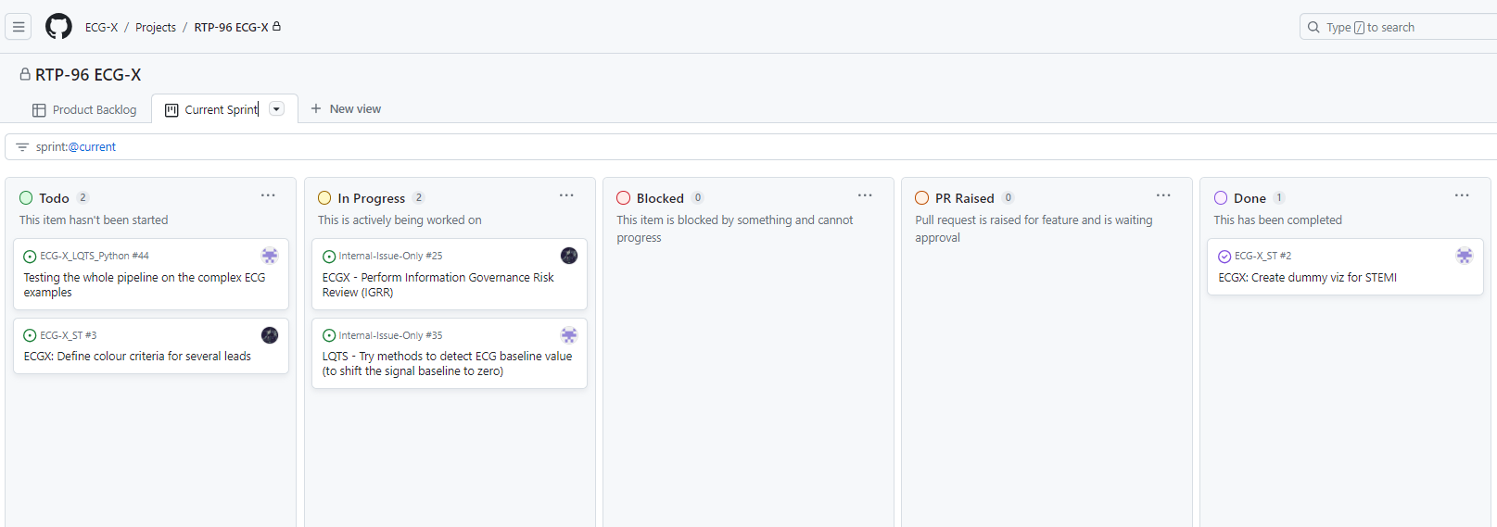
Tools: GitHub Projects
Project templates allow ready to run configuration.
Most Scrum functionality available (or at least configurable via custom fields).
Lives alongside the code; project management and development exist side-by-side.
Easy to link to GitHub repos, issues, PRs, and our customers can engage with the issues directly.
Notes:
The second is GitHub Project, which is the default tool that we’ll be using in the RSE Department.
Administrated by Research IT.
There’s a project template available in our RIT GitHub organisation, to get people started
(and you will be using this on the 2-day course.)
GitHub Project is fairly new, but it does have a Growing user-base.
Most Agile/Scrum functionality IS available (or at least configurable via custom fields).
User Documentation is still work-in-progress and there are plenty of useful features still in beta stage.
But it is easy to link to GitHub repos, issues, PRs and users to where our code lives and our customers can easily access the issues

Slide 28
Contents
Project Management in your Group
Agile and Scrum Overview
Scrum in your Group
Adaptation for UoM RSE
  Requirements Capture
  Tools
  Modifications
Metrics and Measures
Would you adopt Scrum?

Slide 29
Feedback from RSEs: Senior Level
“…It was very interesting to see how this can help to manage the process and get people involved in the projects; in particular, allowing the person you are developing the software for to add and change their requirements directly in the project [Kanban] boards, allowing them to see the whole process as it unfolds, but also giving the power to the development team to work on those requirements in a way that they can use their expertise to get the tasks done…”
“…[the flexible approach] facilitates knowledge transfer from different RSEs on how their projects have worked and how scrum and agile techniques could make things easier and more efficient using direct, lived examples.”

Slide 30
Feedback from RSEs: Senior Level
“…I’ve found Scrum to be an invaluable tool for the kind of complex, evolving software engineering projects we work on in the RSE department. The transparency, focus, and communication it fosters are really helpful...I'd encourage anyone to find out more about Scrum.”
“It was really interesting to see how the wider RSE team reacted to the programme we have been developing. We weren't sure what to expect, as most were new to agile, but everyone approached this new way of working with a high degree of professionalism, and wanted to try it out. There were some robust opinions expressed, which gave us a chance to justify the reasons for what we were introducing…”

Slide 31
Feedback from RSEs: Developers
“I work on a relatively large project, and our team has been using Scrum since June last year. [It is interesting] to see how [agile methods] can be applied flexibly to projects of different scales….”
“…grappling with unclear user requirements presented some challenges that [agile methods] effectively address. This training equipped me with invaluable techniques to clarify requirements, break them down into actionable tasks and subtasks, and prioritise them using MoSCoW labels. I believe it will provide developers with essential skills to navigate ambiguity, set realistic expectations, and deliver high-quality products that exceed stakeholders' expectations, ultimately enhancing our ability to achieve success.“

Slide 32
Feedback from RSEs:
Developers
“…the Scrum framework served as a ‘common language’ promoting more effective communication between different stakeholders, and it helped us to stay focused and complete the assigned tasks more efficiently. It also meant that we weren’t completely derailed by a ‘surprise’ change in requirements! I found the concept of ‘time-boxing’ especially useful in helping me to organise and prioritise.”
“…the integration with GitHub for managing projects alongside the code [is a really good approach]. Having the whole team involved…was particularly helpful…to learn a common structure and language to help us work more effectively together on future Agile projects.”

Slide 33
Feedback from Customers
"Research projects involving…several stakeholders can get messy quite quickly if there is no sound project management and structured development environment in place. Using Scrum…has helped tremendously to keep a clear overview of responsibilities and tasks. Our fortnightly sprint planning meetings further ensure that everyone's workload is balanced and feasible in the set out timeframe. This has improved productivity through setting reasonable goals, making every concluded sprint feel like a great achievement."
"Regular meetings…are really helpful. We have benefitted from guidance from a senior RSE in these, helping us to navigate unexpected issues. It is great to have the transparency of the issue tracking too. We now use this across the project, not just for the tasks that the RSE is working on directly."
“…the introduction of clear progress monitoring and the ability for me to dynamically adjust the priorities helped for me to feel closer to the project development.”

Slide 34
Feedback: Summary
Senior RSE (Scrum Masters) similar value from the process as the RSEs developing – making complex things easier to handle, easier to manage requirement changes, efficiency?
Customers generally value the visibility and control?
Difficult to get a balanced assessment – the silent (indifferent) majority?
But how has this affected behaviour in the last 5 months?

Slide 35
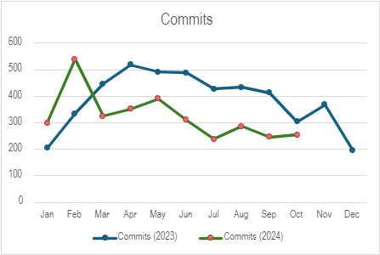
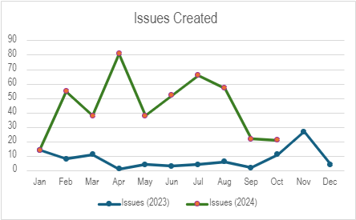
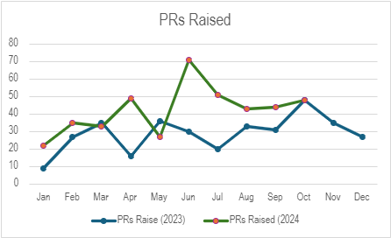
GitHub Usage Statistics:
All RSEs

Slide 36
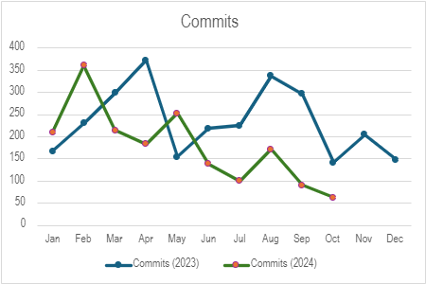
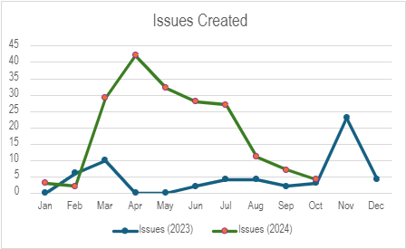
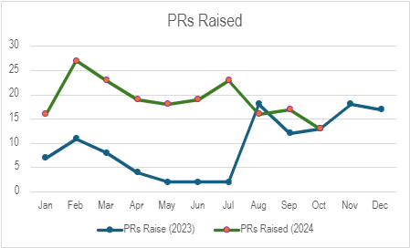
GitHub Usage Statistics:
Senior RSEs

Slide 37
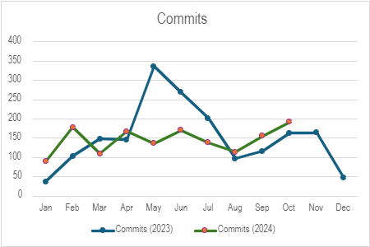
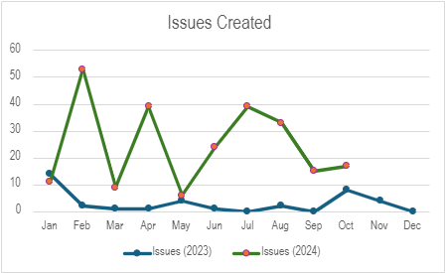
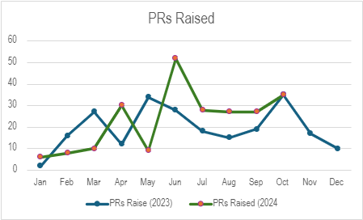
GitHub Usage Statistics:
Full and Junior RSEs

Slide 38
GitHub Usage Statistics:
Summary
Little to no impact on commits
  Perhaps expected as Scrum does not necessarily impact Git use?
Increase in issues created and PRs created
  Use of GitHub projects, process of breaking down issues are likely responsible for the former.
  A repo template with a branch protection ruleset to enforce GitFlow was introduced as part of the approach which explains the latter.
Senior RSEs have changed their behaviour more
  They are responsible for the projects and leading by example?
Too early to assess long-term trend so will repeat next year!

Slide 39
Contents
Project Management in your Group
Agile and Scrum Overview
Scrum in your Group
Adaptation for UoM RSE
  Requirements Capture
  Tools
  Modifications
Metrics and Measures
Would you adopt Scrum?

Slide 40
Would you adopt Scrum?
Join in with Part 3!
https://www.menti.com/alvmgnkkhzsf
Access Code: 4588 1433
Notes:
DON’T FORGET TO OPEN THE SURVEY
https://www.mentimeter.com/app/presentation/n/alnzgzdvg5js5vv8ktjq6uey53qmqmwo/edit?question=dfuzqipp54pj
… and share the window, advancing to the end of Part-3

Slide 41
Key Points
Delivering value for researchers as an RSE service (as we are in Manchester) requires a “consistent yet flexible” management approach – zero management is not an option and that includes “management by exception”!
Research is necessarily dynamic and management shouldn’t obstruct this – agile methodologies embrace continuous change.
Providing practical tooling and workflows to make doing it easy are essential for adoption.
Don’t be afraid to offend the purists – adapt to suit your needs!

Slide 42
Further Reading
Agile Methodologies
  https://www.atlassian.com/agile
  https://www.agilealliance.org/agile101/
  https://www.agilealliance.org/agile101/the-agile-manifesto/
Scrum
  https://www.scrumalliance.org/about-scrum
  https://scrumguides.org/scrum-guide.html
  https://www.atlassian.com/agile/scrum
  https://www.linkedin.com/learning/what-is-scrum/

