Slide 1



Unraveling Particle Distribution Functions: A Novel VDF Reconstruction Method
Laura Garavito
Mentors: Dr. Michael Terres, Dr. Srijan Bharati Das, Dr. Kristoff Paulson

Slide 2
Unraveling Particle Distribution Functions: A Novel VDF Reconstruction Method
Laura Garavito
Mentors: Dr. Michael Terres, Dr. Srijan Bharati Das, Dr. Kristoff Paulson

Slide 3
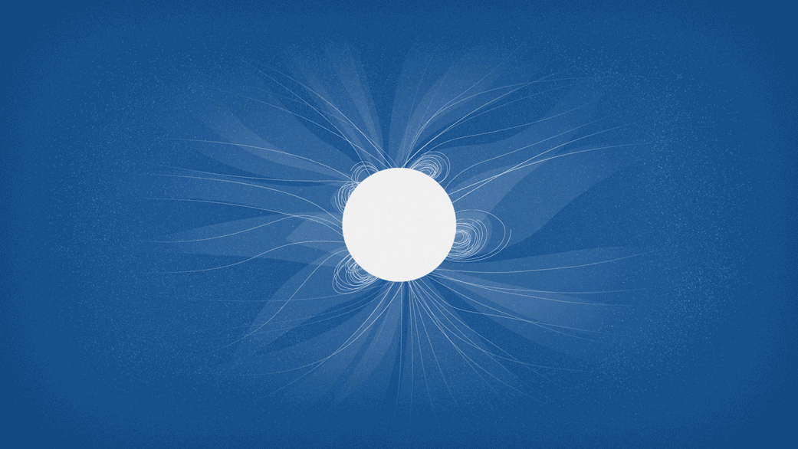
Solar Wind
Source(s): NASA’s Goddard Space Flight Center/Lisa Poje/Genna Duberstein
Notes:
The solar wind is created by the outward expansion of plasma, made of ions, protons, and electrons. The plasma is heated to the point that the suns gravity cant hold it down. These particles then follow the suns magnetic field lines that extend outward.
There are two different regions of magnetic field lines on the sun’s corona: open and closed.
Closed corona is the region where magnetic field lines are connected to the solar surface on both ends. They are called helmet streamers and look like large loops that form over magnetically active regions. The plasma traveling along these lines are confined to being near the sun.
The open corona refers to regions where magnetic field lines seem to start on the sun and stretch out into space. All magnetic field lines have to start and end so they do eventually come back to the sun’s surface but they stretch so far out they can be considered “open”. These create a “highway” for the plasma to travel into space. These lines start out on coronal holes, these are cooler regions and the sources of fast solar wind.

Slide 4
Solar Wind
Source(s): NASA’s Goddard Space Flight Center/Lisa Poje/Genna Duberstein
Notes:
The solar wind is created by the outward expansion of plasma, made of ions, protons, and electrons. The plasma is heated to the point that the suns gravity cant hold it down. These particles then follow the suns magnetic field lines that extend outward.
There are two different regions of magnetic field lines on the sun’s corona: open and closed.
Closed corona is the region where magnetic field lines are connected to the solar surface on both ends. They are called helmet streamers and look like large loops that form over magnetically active regions. The plasma traveling along these lines are confined to being near the sun.
The open corona refers to regions where magnetic field lines seem to start on the sun and stretch out into space. All magnetic field lines have to start and end so they do eventually come back to the sun’s surface but they stretch so far out they can be considered “open”. These create a “highway” for the plasma to travel into space. These lines start out on coronal holes, these are cooler regions and the sources of fast solar wind.

Slide 5
Solar Wind
Source(s): NASA’s Goddard Space Flight Center/Lisa Poje/Genna Duberstein
Notes:
The solar wind is created by the outward expansion of plasma, made of ions, protons, and electrons. The plasma is heated to the point that the suns gravity cant hold it down. These particles then follow the suns magnetic field lines that extend outward.
There are two different regions of magnetic field lines on the sun’s corona: open and closed.
Closed corona is the region where magnetic field lines are connected to the solar surface on both ends. They are called helmet streamers and look like large loops that form over magnetically active regions. The plasma traveling along these lines are confined to being near the sun.
The open corona refers to regions where magnetic field lines seem to start on the sun and stretch out into space. All magnetic field lines have to start and end so they do eventually come back to the sun’s surface but they stretch so far out they can be considered “open”. These create a “highway” for the plasma to travel into space. These lines start out on coronal holes, these are cooler regions and the sources of fast solar wind.

Slide 6
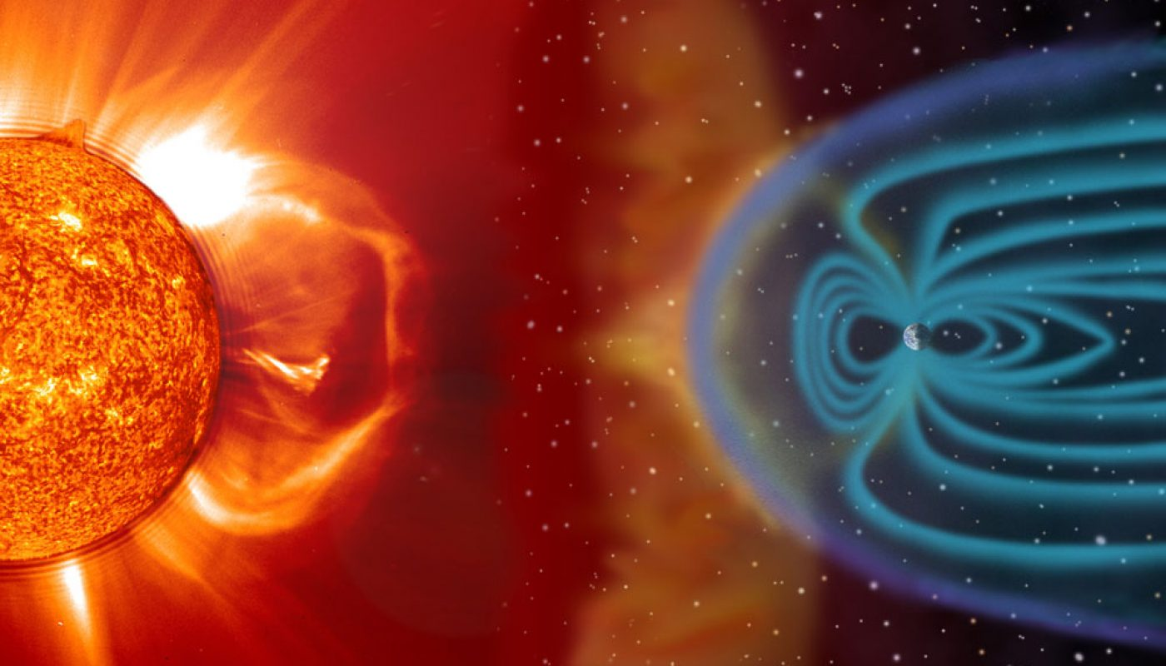

Solar Wind: Plasma
Source(s): NASA
Corona
Solar Wind
Magnetosheath
Notes:
Plasma beta parametsrs Thermal pressure vs. magnetic pressure
Solar wind ions are cold, very narrow, hot in magnetosheath.
Thermal pressure

Slide 7
Solar Wind: Plasma
Source(s): NASA
Corona
Solar Wind
Magnetosheath
Notes:
THE CORONA:
The beta parameter is close to 1. Thermal and magnetic component one does not govern the other.

Slide 8
Solar Wind: Plasma
Source(s): NASA
Corona
Solar Wind
Magnetosheath
Notes:
THE CORONA:
The beta parameter is close to 1. Thermal and magnetic component one does not govern the other.

Slide 9
Solar Wind: Plasma
Source(s): NASA
Corona
Solar Wind
Magnetosheath
Notes:
THE CORONA:
The beta parameter is close to 1. Thermal and magnetic component one does not govern the other.

Slide 10
Velocity Distribution Functions
The distribution of velocities certain particles have at a given time and place.
Importance
1D Velocity Distribution
Velocity Distribution Function
Density
Bulk Speed
Thermal Velocity
Kinetic Properties
Electrons vs Protons
f(v)
Velocity
Notes:
I will explain the 1d vdf because it is much simpler to Understand. But think of the 3d VDF as if you were looking from the top of the 1d vdf and could see densities that way.

Slide 11
Velocity Distribution Functions
The distribution of velocities certain particles have at a given time and place.
Maxwellian distribution
Importance
1D Velocity Distribution
Velocity Distribution Function
Density
Bulk Speed
Thermal Velocity
Kinetic Properties
Electrons vs Protons
f(v)
Velocity

Slide 12

Velocity Distribution Functions
The distribution of velocities certain particles have at a given time and place.
Zeroth moment of the distribution is the density of the particles
Given by equation:
Importance
1D Velocity Distribution
Velocity Distribution Function
Density
Bulk Speed
Thermal Velocity
Kinetic Properties
Electrons vs Protons
f(v)
Velocity
Notes:
The area underneath the curve is the density of the particels

Slide 13

Velocity Distribution Functions
The distribution of velocities certain particles have at a given time and place.
First moment of the distribution is the Bulk Speed
The most probable velocity
Given by equation:
Importance
1D Velocity Distribution
Velocity Distribution Function
Density
Bulk Speed
Thermal Velocity
Kinetic Properties
Electrons vs Protons
f(v)
Velocity
Notes:
The peak value is the bulk density, you can use this to analyze values you hypothesize

Slide 14


Velocity Distribution Functions
The distribution of velocities certain particles have at a given time and place.
Full Width Half Max
Importance
1D Velocity Distribution
Velocity Distribution Function
Density
Bulk Speed
Thermal Velocity
Kinetic Properties
Electrons vs Protons
f(v)
Velocity
Notes:
The full width half max of the function tells you the thermal velocity

Slide 15
Velocity Distribution Functions
The distribution of velocities certain particles have at a given time and place.
Non Maxwellian distribution
Different particles
Magnetic field
Importance
1D Velocity Distribution
Velocity Distribution Function
Density
Bulk Speed
Thermal Velocity
Kinetic Properties
Electrons vs Protons
f(v)
Velocity
Notes:
When your function does not look like a maxwellian distribution this can tell you kinetic properties of the population, the magnetic field affects the VDF and that might be why

Slide 16
Velocity Distribution Functions
The distribution of velocities certain particles have at a given time and place.
Non Maxwellian distribution
Different particles
Magnetic field
Importance
1D Velocity Distribution
Velocity Distribution Function
Density
Bulk Speed
Thermal Velocity
Kinetic Properties
Electrons vs Protons
f(v)
Velocity
Notes:
This could show different populations

Slide 17
Velocity Distribution Functions
Electron vs. Protons
The distribution of velocities certain particles have at a given time and place.
Electron mass much less than proton mass
Velocities are more evenly distributed
Importance
1D Velocity Distribution
Velocity Distribution Function
Density
Bulk Speed
Thermal Velocity
Kinetic Properties
Electrons vs Protons
f(v)
Velocity
Notes:
Root mean square thermal velocity.
There is an important difference in electron and proton VDFs. Electron mass is much smaller than proton mass, that makes the value of the Thermal velocity much larger. That looks like a more distributed set of velocities. Protons, on the other hand, are more localized. This means that the VDFs do not have a complete coverage in phase space, and an instrument is more likely to not fully observe the bulk of the distribution.

Slide 18
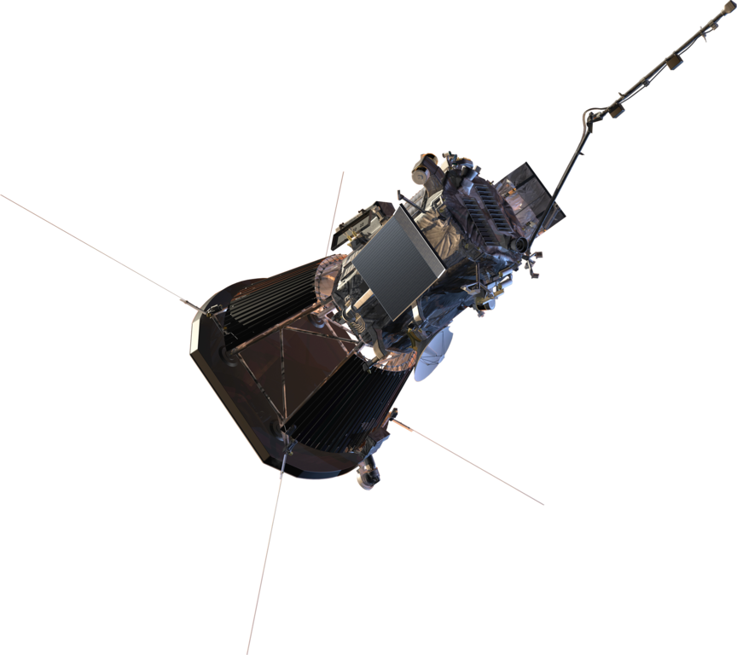
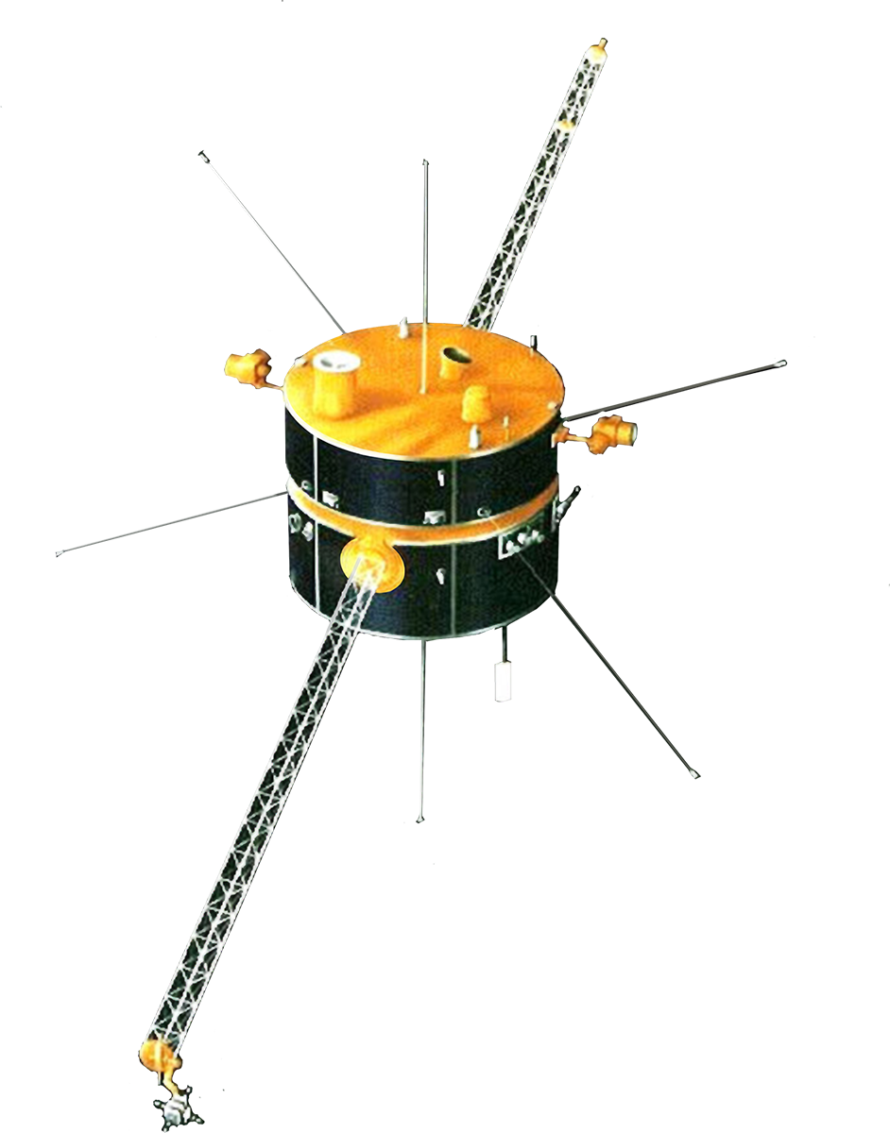
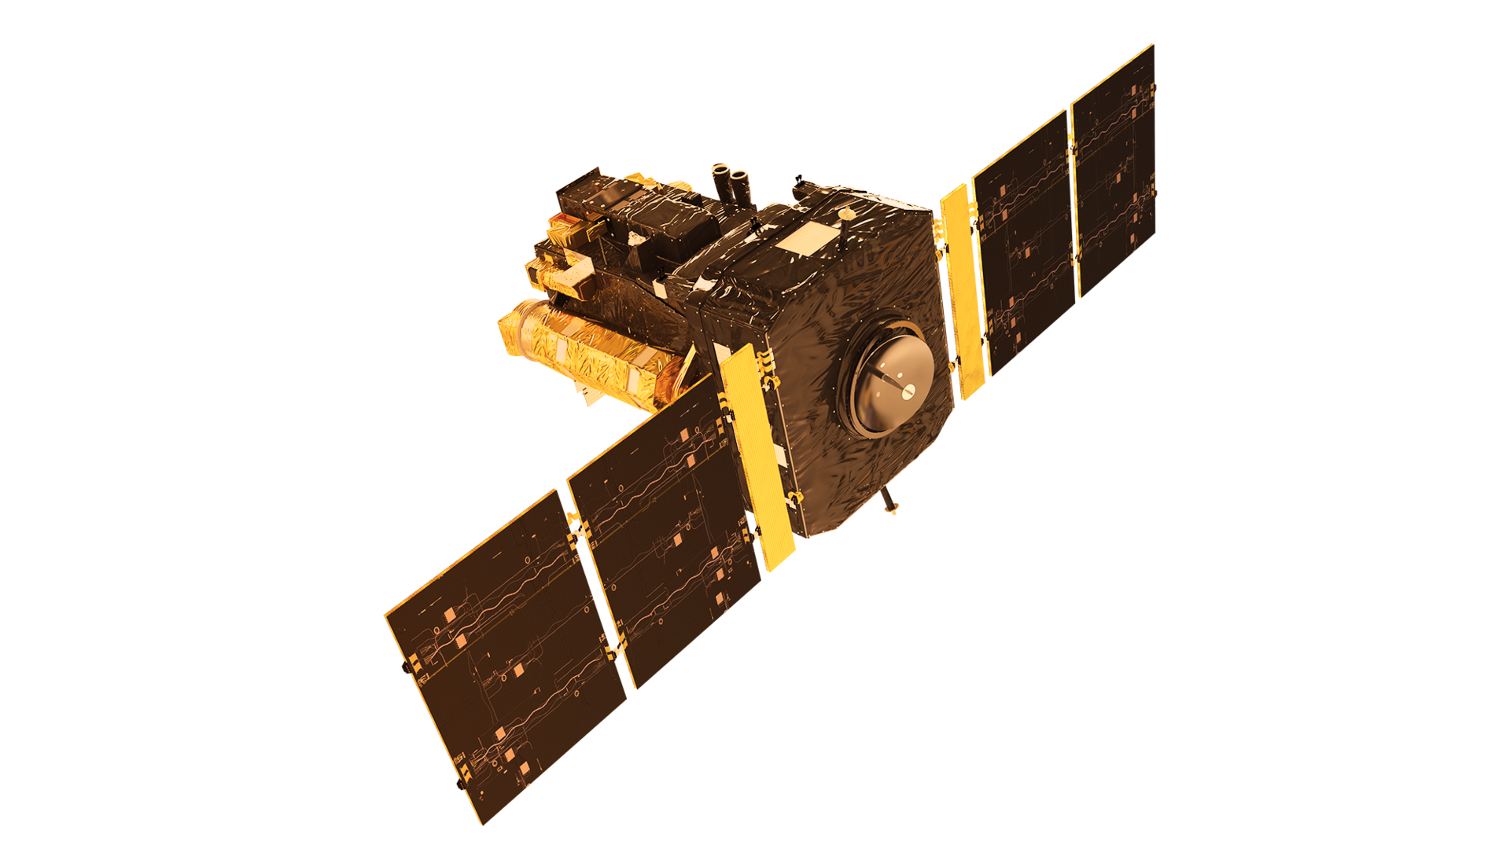
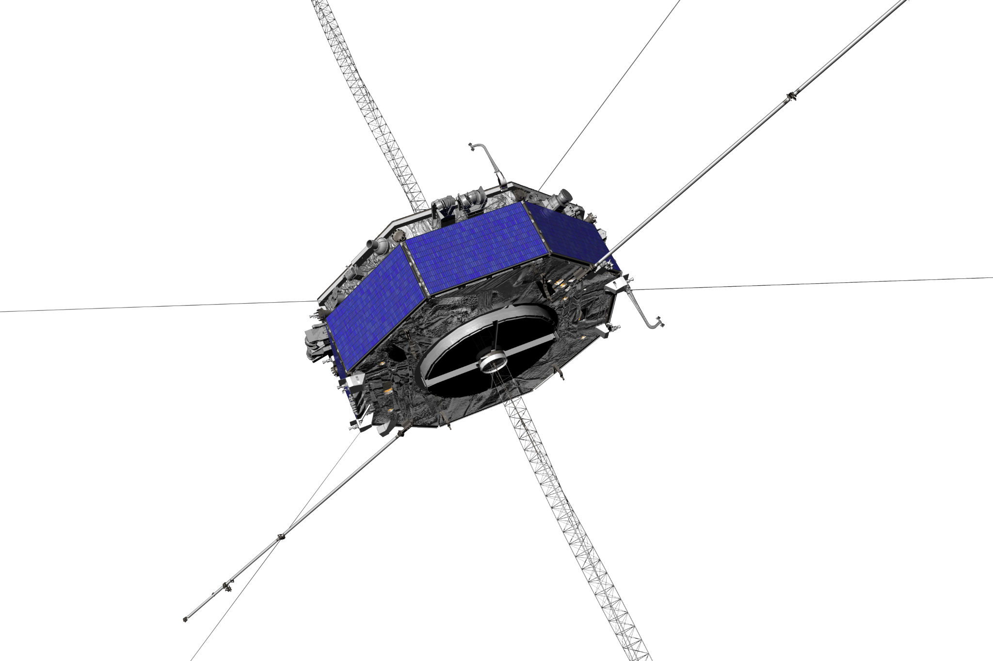
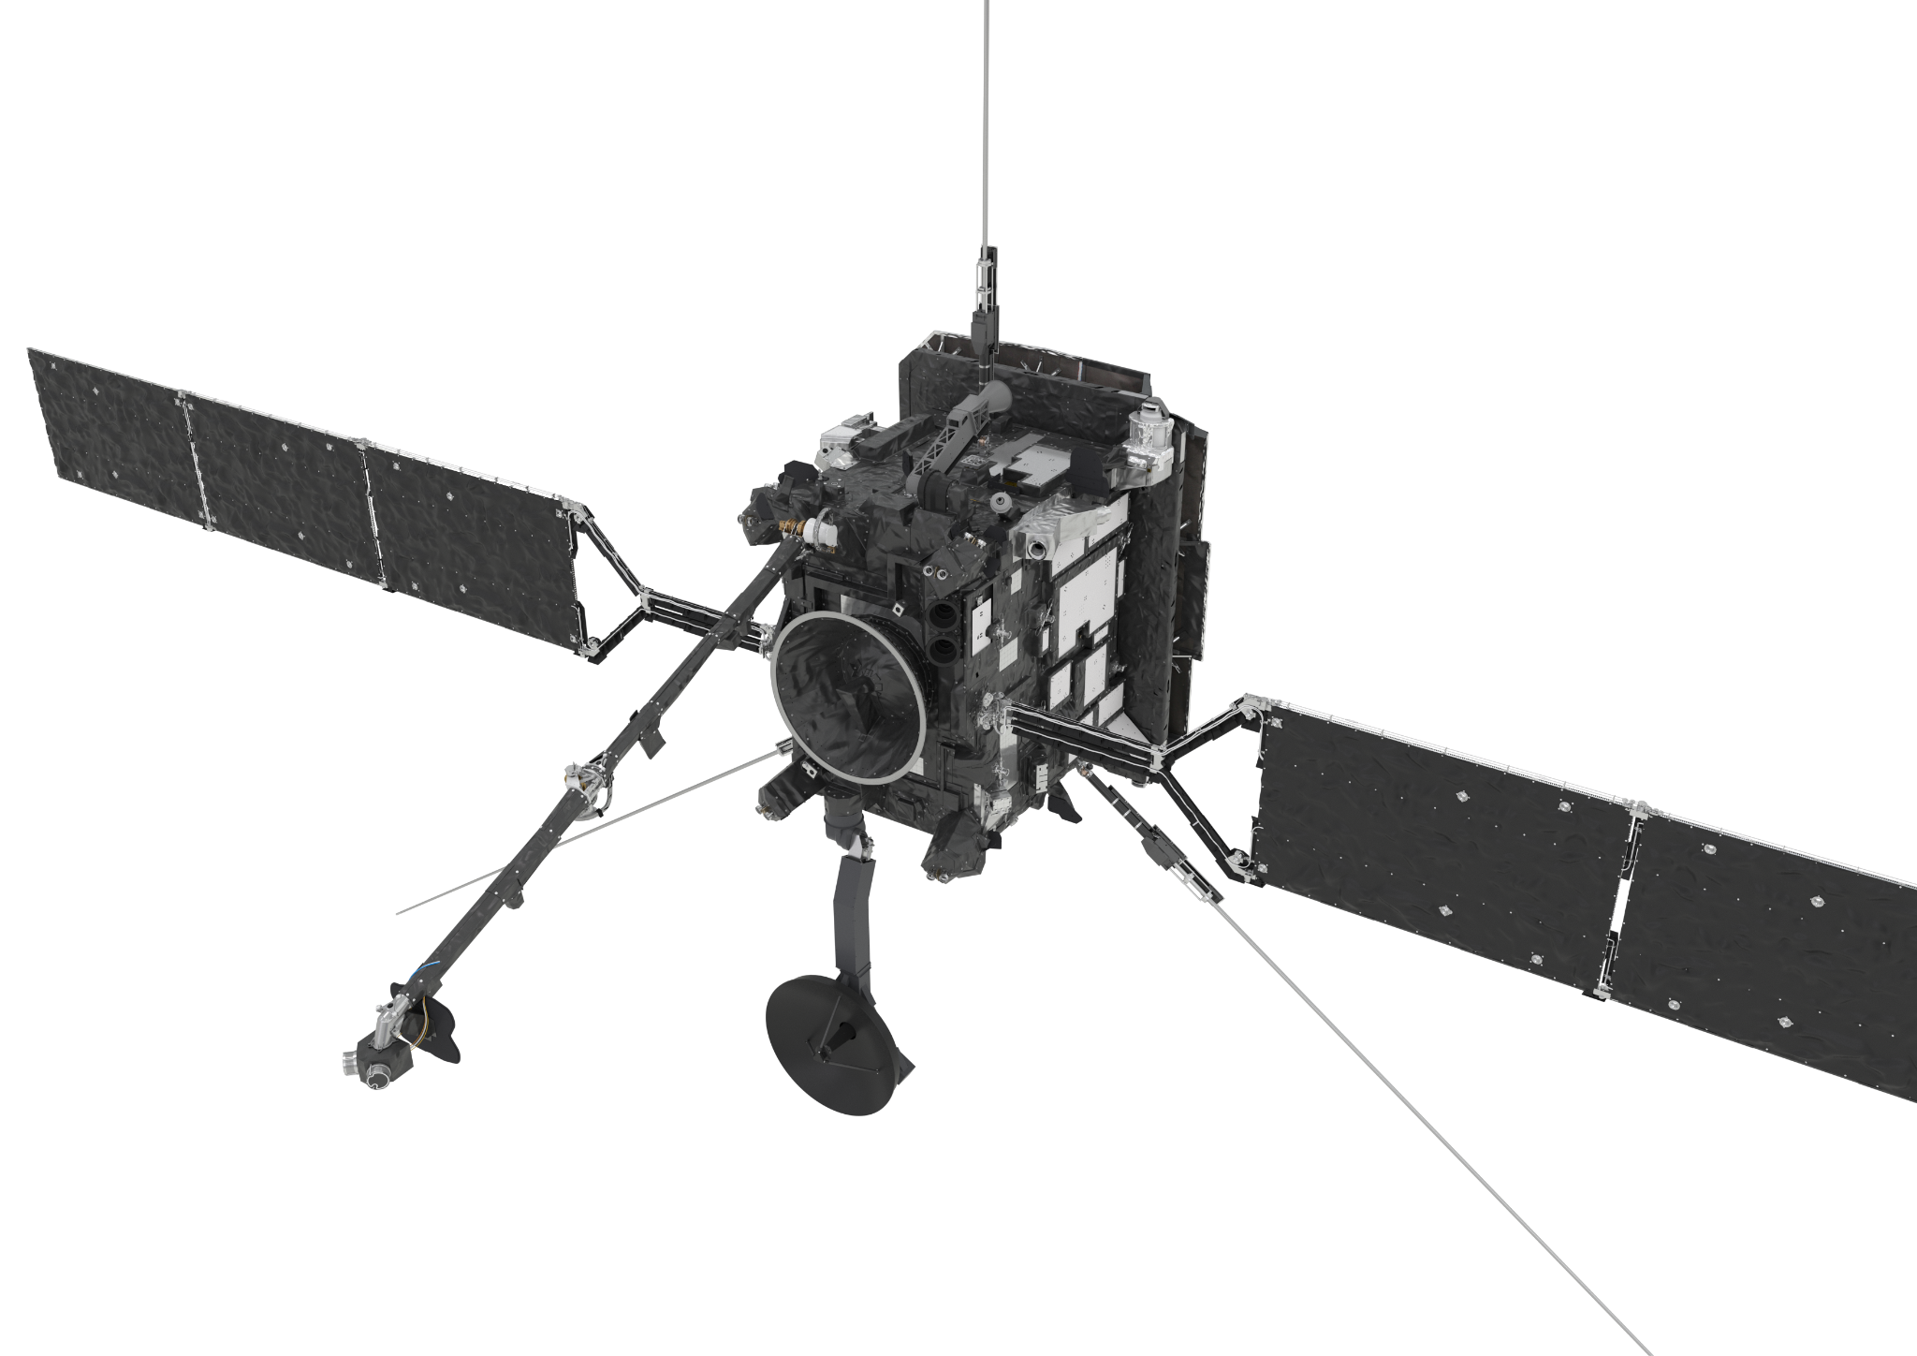
Solar Wind: Observations
Source(s): NASA, ESA
Corona
Parker Solar Probe
Solar Wind
Solar Orbiter
Magnetosheath
MMS
Cluster
L1 Point
Solar and Heliospheric Observatory
Wind
Future Missions
Helioswarm
Notes:
Plasma beta parametsrs Thermal pressure vs. magnetic pressure
Solar wind ions are cold, very narrow, hot in magnetosheath.
Thermal pressure

Slide 19
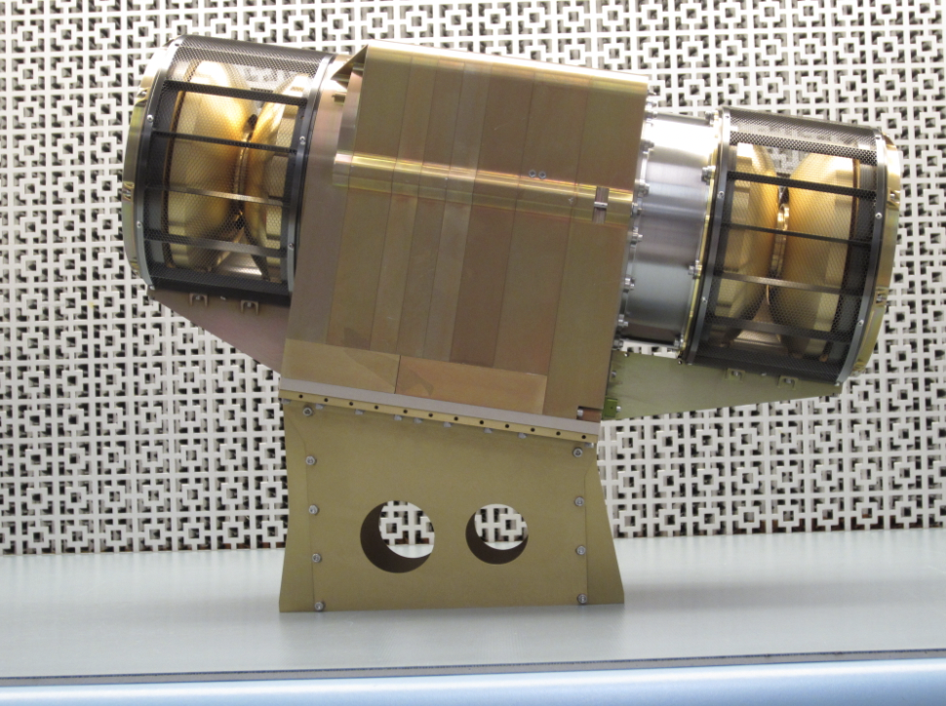
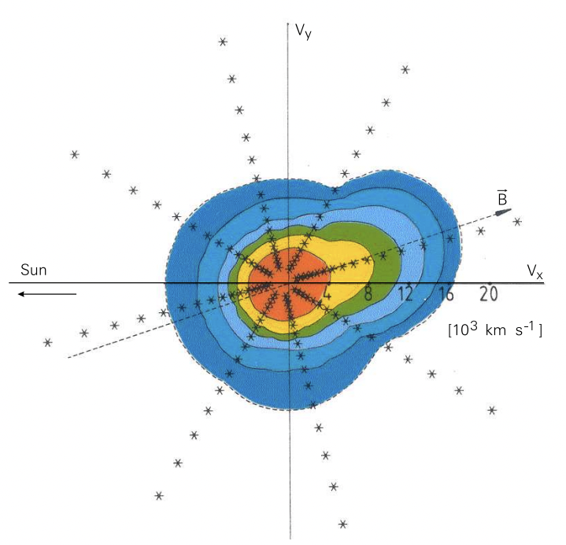
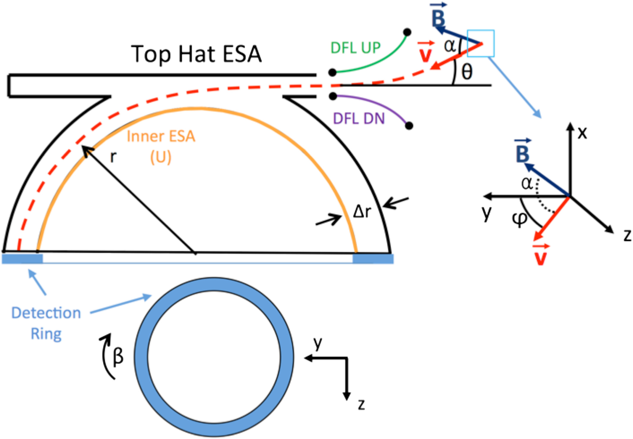
Top Hat Electrostatic Analyzer
Source(s): Clark et al. 2016, Marsch et al. 2006
Notes:
A specific current is emitted to only measure particles of a certain energy level. Those particles come in and travel on the red line (apply voltage deters their path) and near the detection ring they hit a ??? (microchannel ) that sends a shower of electrons to the ??(microchannel plate? anode?) where they are detected. This is happening on the whole circle in set angular intervals. That is how we get a 3D VDF
Discrete gridpoints.
You might ask why we don’t just have an ESA on every instrument, why Faraday Cups are more common. This is for two main reasons the fist is that because electrons keep bombarding ESA’s they degrade much faster over time. They also receive a much higher quantity of data is not as easy and cheap to handle.
Keeps bombarding electrons - degrading over time

Slide 20
Solar Wind: Instruments
Source(s): NASA, ESA
ESA?
Corona
Parker Solar Probe
Solar Wind
Solar Orbiter
Magnetosheath
MMS
Cluster
L1 Point
Solar and Heliospheric Observatory
Wind
Future Missions
Helioswarm
Notes:
All these instruments have an ESA, they dont all work EXACTLY step by step like parker’s SPAN instrument but the all use a very similar technique.

Slide 21
Solar Wind: Instruments
Source(s): NASA, ESA
ESA!
Corona
Parker Solar Probe
Solar Wind
Solar Orbiter
Magnetosheath
MMS
Cluster
L1 Point
Solar and Heliospheric Observatory
Wind
Future Missions
Helioswarm
Notes:
All these instruments have an ESA, they dont all work EXACTLY step by step like parker’s SPAN instrument but the all use a very similar technique.

Slide 22
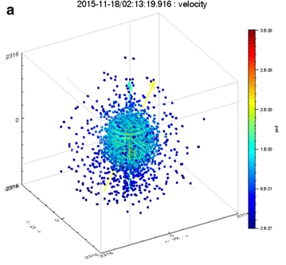
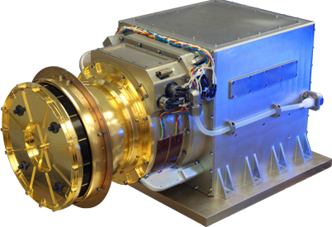
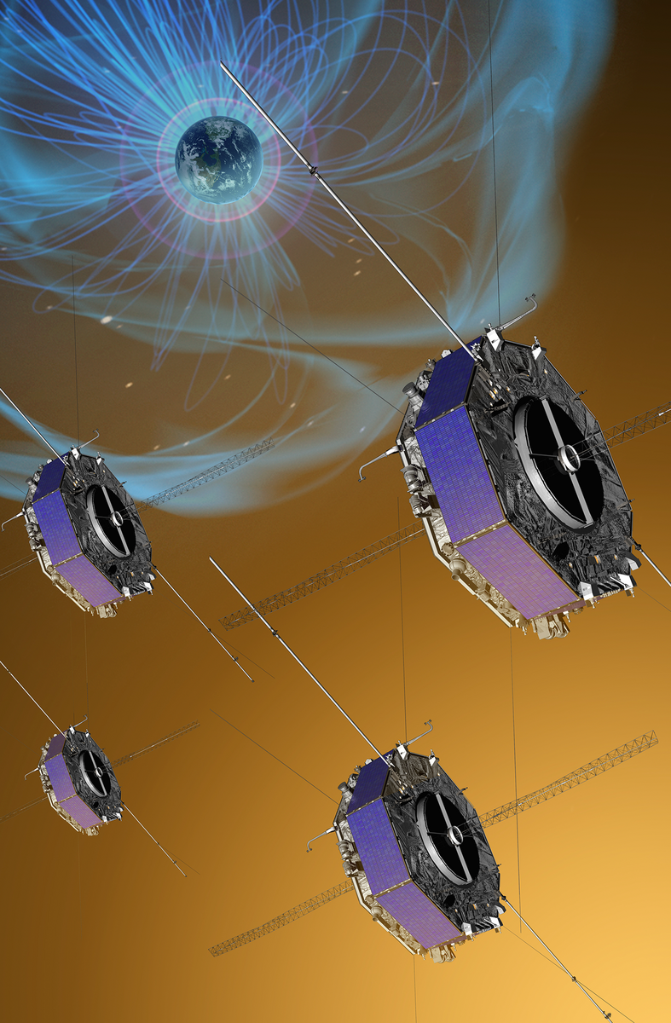
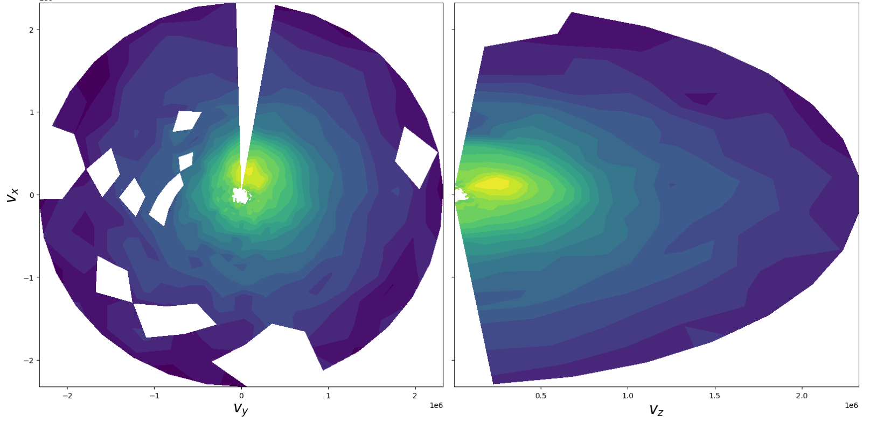
Solar Wind
Observations
Source(s): NASA/GSFC, Keika et al. 2017
Hot Plasma Composition Analyzer
2D Slices of MMS Ion VDFs
Notes:
The Magnetospheric Multiscale (MMS) Mission is a NASA robotic space mission to study the Earth's magnetosphere, using four identical spacecraft flying in a tetrahedral formation.
MMS investigates how the Sun’s and Earth’s magnetic fields connect and disconnect, explosively transferring energy from one to the other in a process that is important at the Sun, other planets, and everywhere in the universe, known as magnetic reconnection.
Four identically instrumented spacecraft measure plasmas, fields, and particles in a near-equatorial orbit that will frequently encounter reconnection in action.
The mission builds upon the successes of the ESA Cluster mission,
this mission is able to collect three-dimensional information on how the solar wind interacts with the magnetosphere and affects near-Earth space and its atmosphere, including aurorae.
Examples of a the scatter mode and b the 2D slice plot for ion velocity distributions (phase space density vs. velocity) in magnetic field coordinates observed by MMS1/FPI. Cyan and yellow arrows represent the directions of the magnetic field and the velocity vector, respectively. The spacecraft was crossing the dayside magnetopause at this time period, as shown in Fig. 7

Slide 23
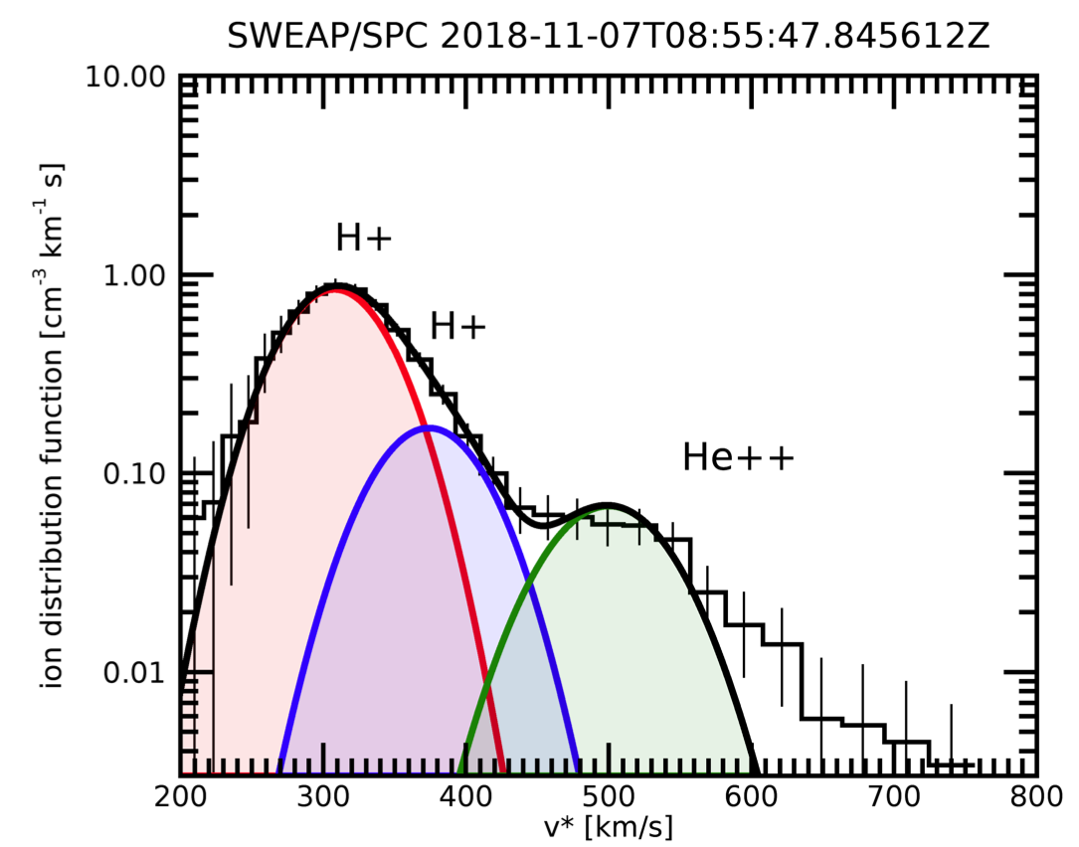
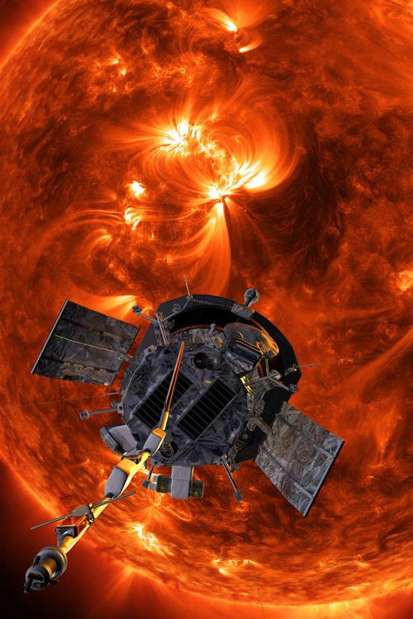
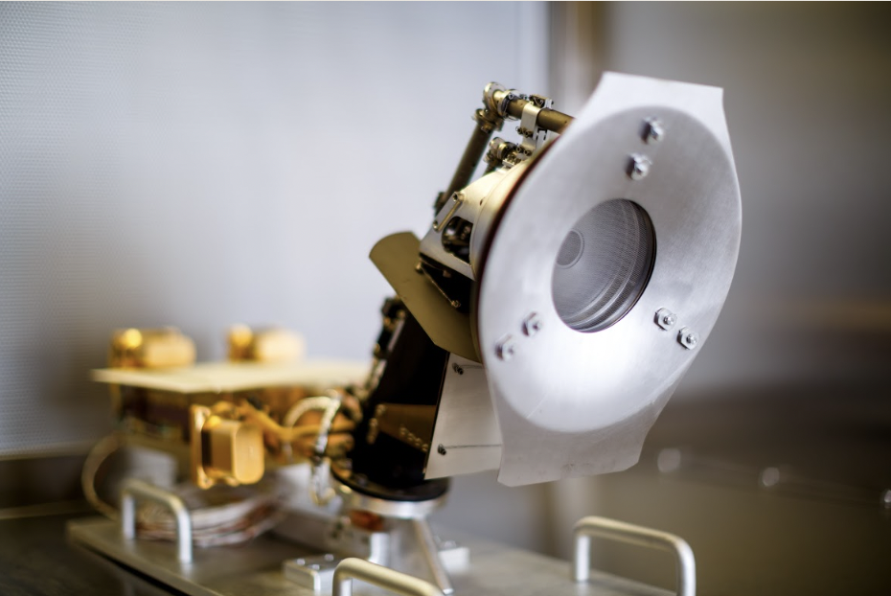
Solar Wind
Observations
Source(s): NASA, Wang, CfA, Marsch et al. 2006, Case et al. 2019
SPC
Faraday Cup (FC)
SPAN-i
Electrostatic Analyzer (ESA)
Notes:
These two instruments take measurements in the form of velocity distribution functions of particles in the solar wind. (the next slides explain what a VDF is and why its important in understanding particles in the solar wind.) SPC takes 1d VDFS and SPAN gets 3D VDFs.
SPAN is Located on the RAM side (meaning the side that is RAMMING) through the wind in the direction PSP moves.
At parahelion you can have the VDF flowing fully into the detector
Outside parahelion everything flowing thru the spacecraf is not being measured by span bc of the heat shield
But it is being measured by SPC
Ions always on the ram side because localized
Need span B for full coverage of phase space electrons
SPC = direct current. If negative, restrict ions can get electrons
Actual observation : primarily protons and ions
For my sake SPC only measures ions

Slide 24
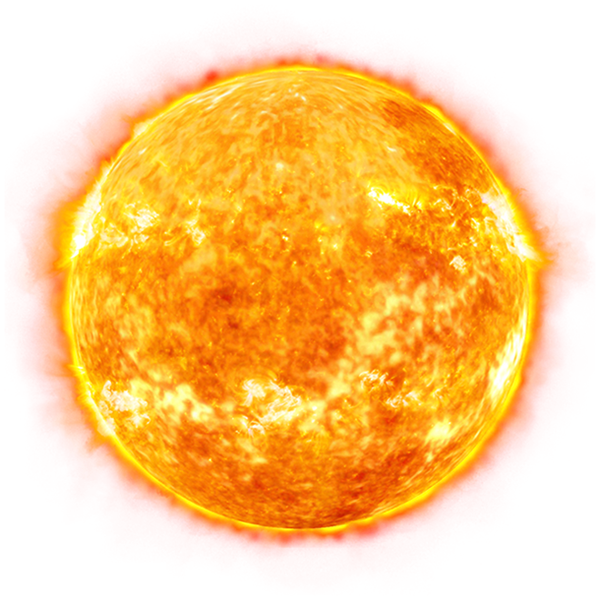
Field of View Restrictions

Slide 25
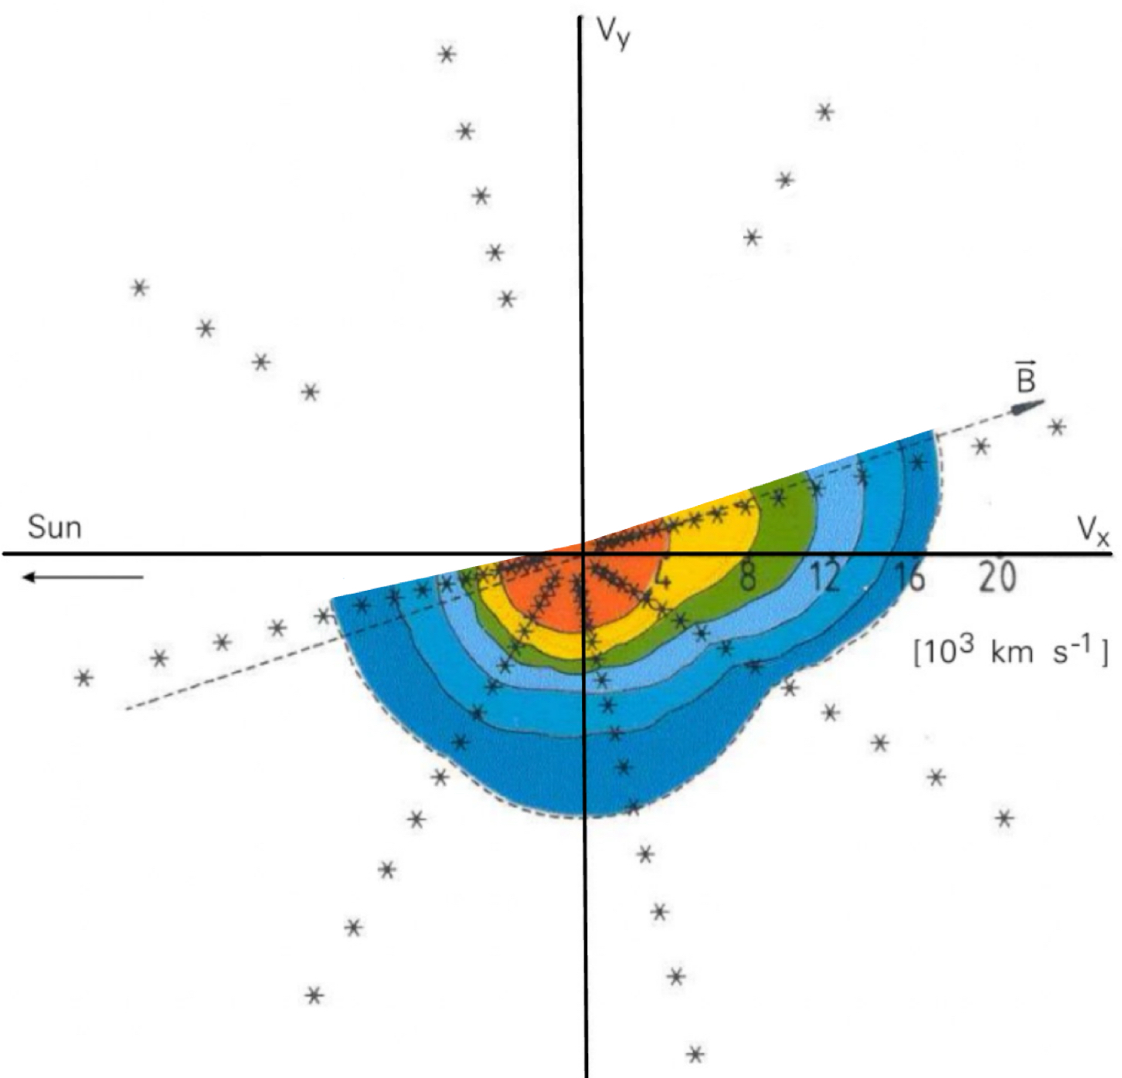
Solar Wind
Observations
Source(s): NASA, Wang, CfA, Marsch et al. 2006, Case et al. 2019
SPC
Faraday Cup (FC)
SPAN-i
Electrostatic Analyzer (ESA)
Notes:
These two instruments take measurements in the form of velocity distribution functions of particles in the solar wind. (the next slides explain what a VDF is and why its important in understanding particles in the solar wind.) SPC takes 1d VDFS and SPAN gets 3D VDFs.
SPAN is Located on the RAM side (meaning the side that is RAMMING) through the wind in the direction PSP moves.
At parahelion you can have the VDF flowing fully into the detector
Outside parahelion everything flowing thru the spacecraf is not being measured by span bc of the heat shield
But it is being measured by SPC
Ions always on the ram side because localized
Need span B for full coverage of phase space electrons
SPC = direct current. If negative, restrict ions can get electrons
Actual observation : primarily protons and ions
For my sake SPC only measures ions

Slide 26
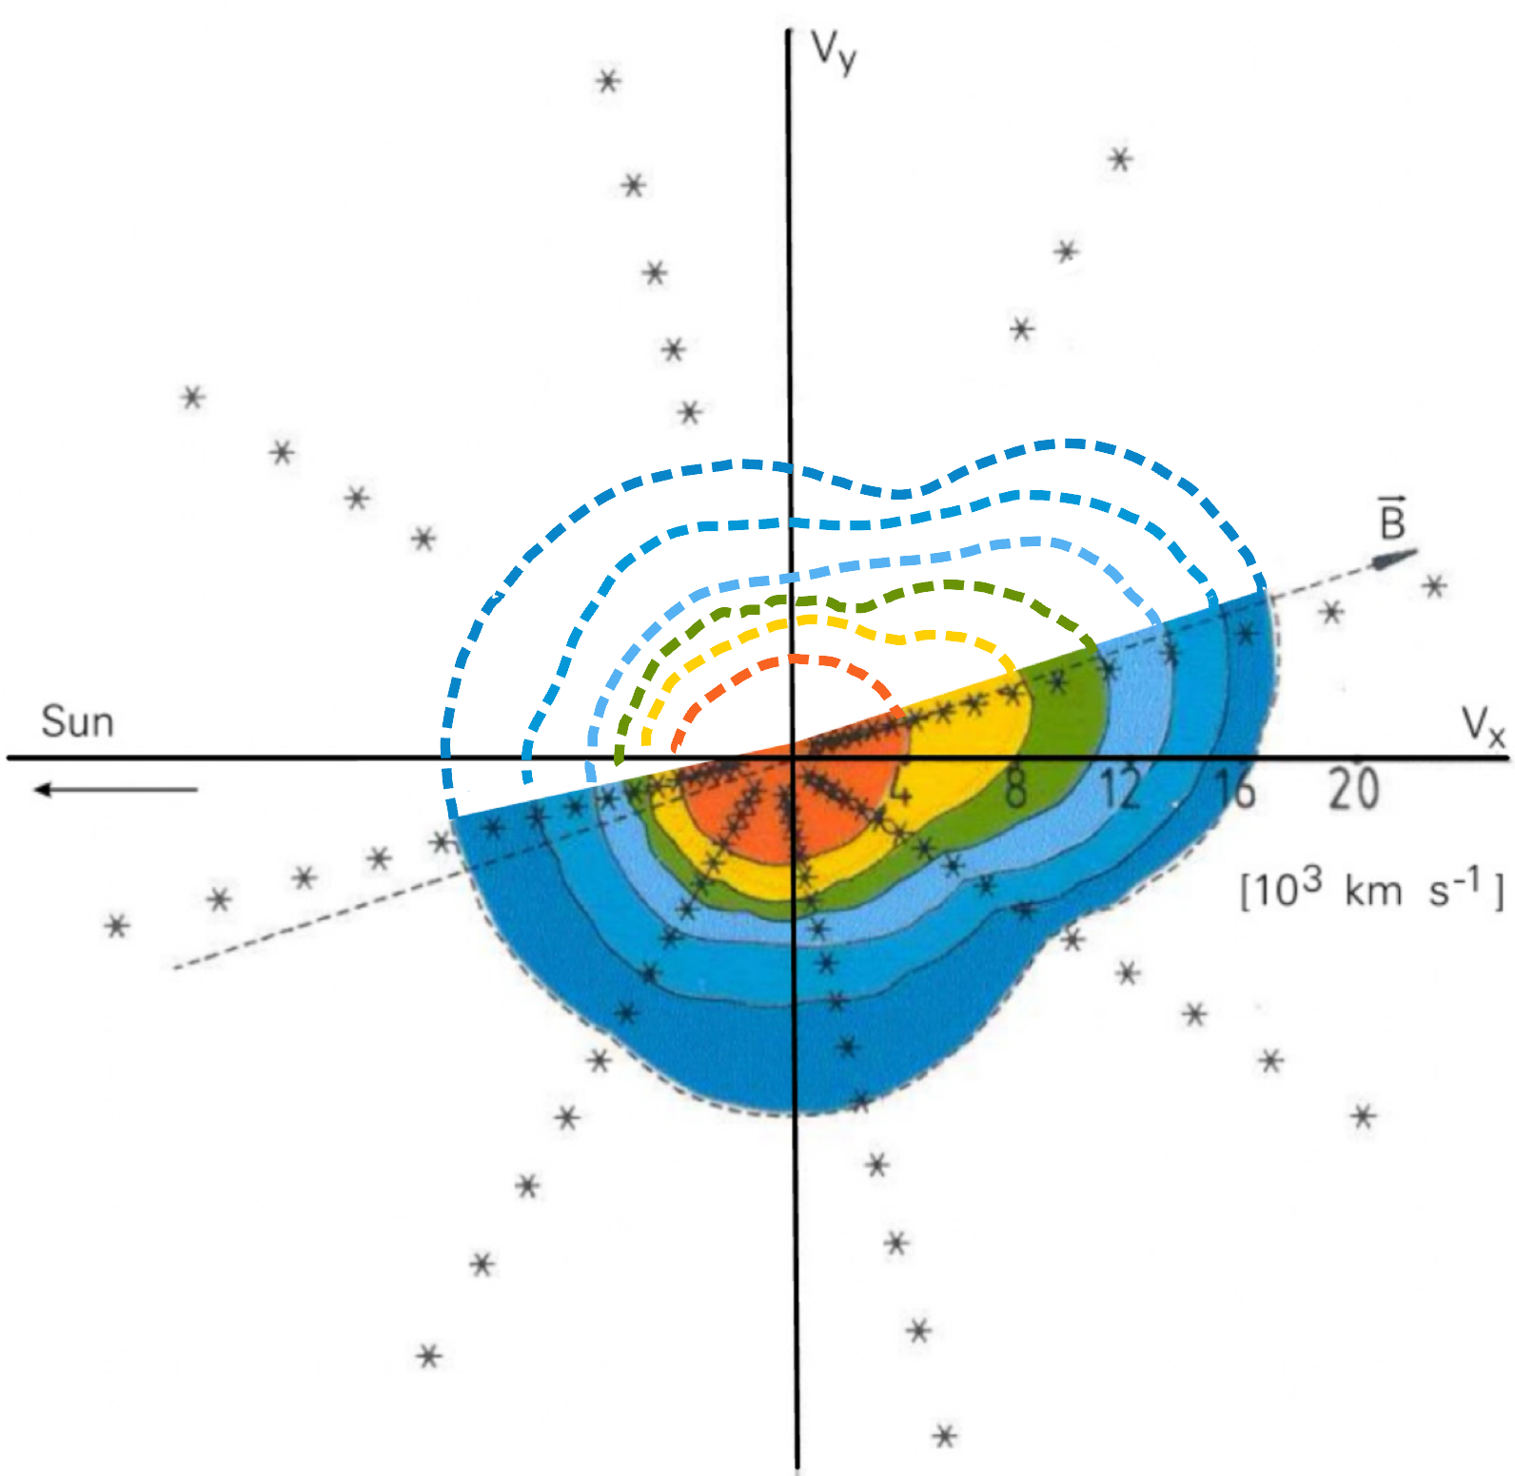
Solar Wind
Observations
Source(s): NASA, Wang, CfA, Marsch et al. 2006, Case et al. 2019
SPC
Faraday Cup (FC)
SPAN-i
Electrostatic Analyzer (ESA)
Notes:
These two instruments take measurements in the form of velocity distribution functions of particles in the solar wind. (the next slides explain what a VDF is and why its important in understanding particles in the solar wind.) SPC takes 1d VDFS and SPAN gets 3D VDFs.
SPAN is Located on the RAM side (meaning the side that is RAMMING) through the wind in the direction PSP moves.
At parahelion you can have the VDF flowing fully into the detector
Outside parahelion everything flowing thru the spacecraf is not being measured by span bc of the heat shield
But it is being measured by SPC
Ions always on the ram side because localized
Need span B for full coverage of phase space electrons
SPC = direct current. If negative, restrict ions can get electrons
Actual observation : primarily protons and ions
For my sake SPC only measures ions

Slide 27
Unraveling Particle Distribution Functions: A Novel VDF Reconstruction Method
Laura Garavito
Mentors: Dr. Michael Terres, Dr. Srijan Bharati Das, Dr. Kristoff Paulson

Slide 28

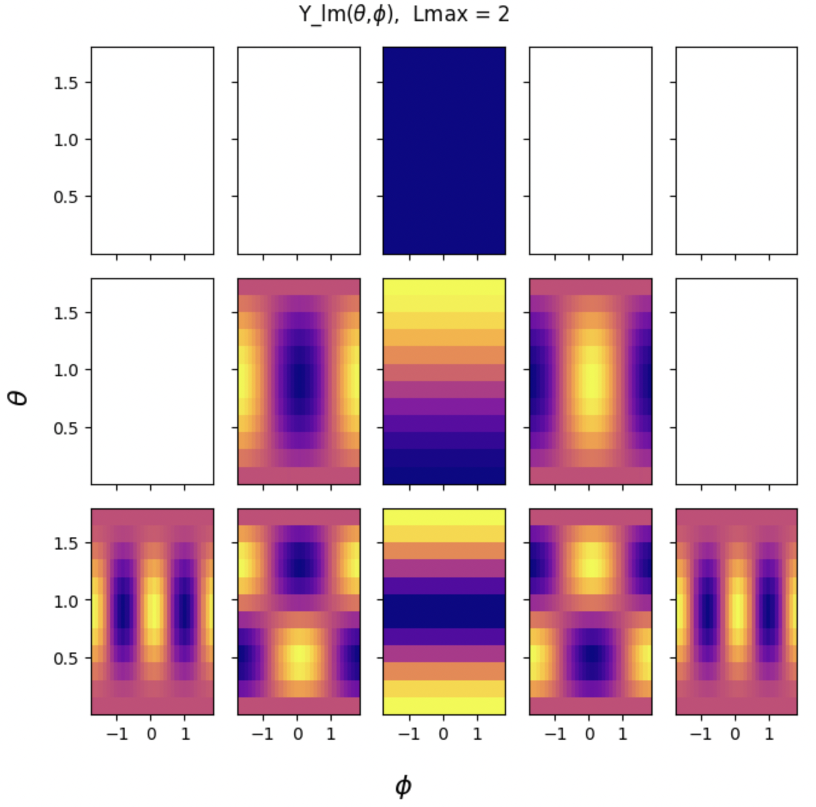
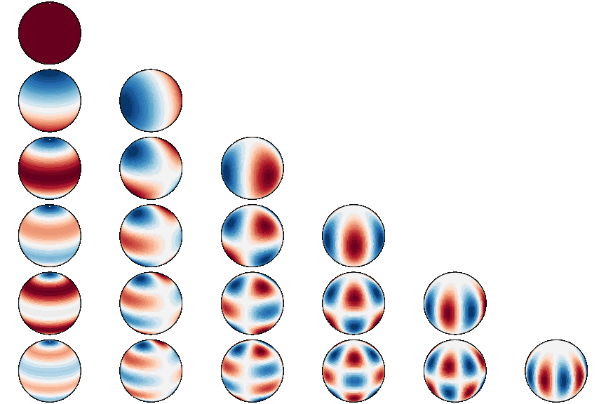
Spherical Harmonics
Source(s): Kurth https://github.com/NVIDIA/torch-harmonics
Y_{lm}(θ,ɸ), Lmax = 5
Notes:
Spherical Harmonic Basis functions! Python look, sphere look

Slide 29

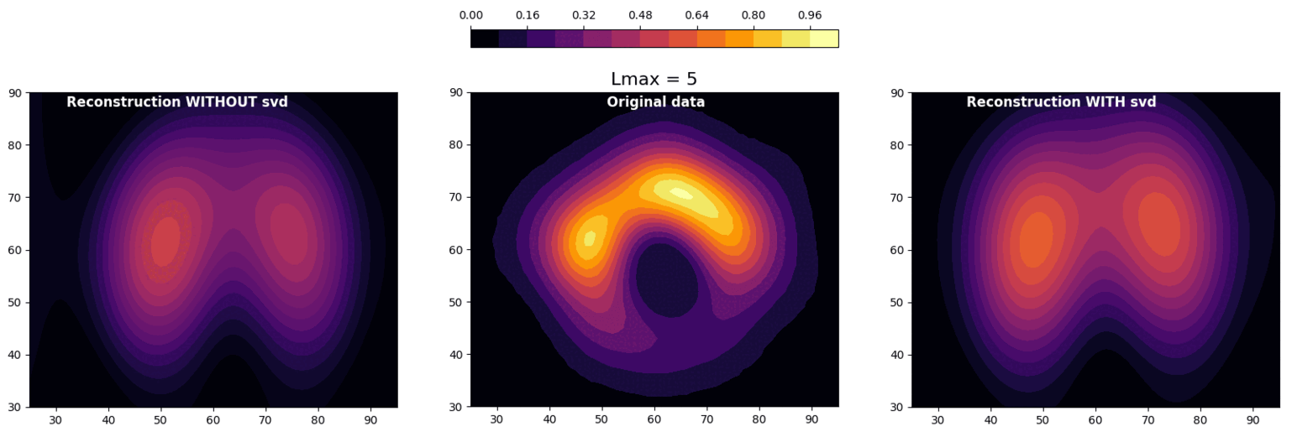


Reconstructing Images Using Spherical Harmonics
Source(s): Event Horizon Telescope Collaboration
Notes:
It is known that spherical harmonics can reconstruct data pretty well. Here is a fun example of how spherical harmonics can reconstruct an incomplete data set. The reconstruction on the left does not ignore the missing data but places garbage values of 0 for them to do the reconstruction. I had to edit this method so it would reconstruct ignoring the missing data and fill in what should be there. This can be done with any image!
What we can notice is how well Spherical harmonics work. And how important it is to use SVD instead of the python package.

Slide 30
Velocity Distribution Functions
Electron vs. Protons
The distribution of velocities certain particles have at a given time and place.
Electron mass much less than proton mass
Velocities are more evenly distributed
Importance
1D Velocity Distribution
Velocity Distribution Function
Density
Bulk Speed
Thermal Velocity
Kinetic Properties
Electrons vs Protons
f(v)
Velocity
Notes:
Because of this information, we decided to start the reconstruction method using electron data.

Slide 31
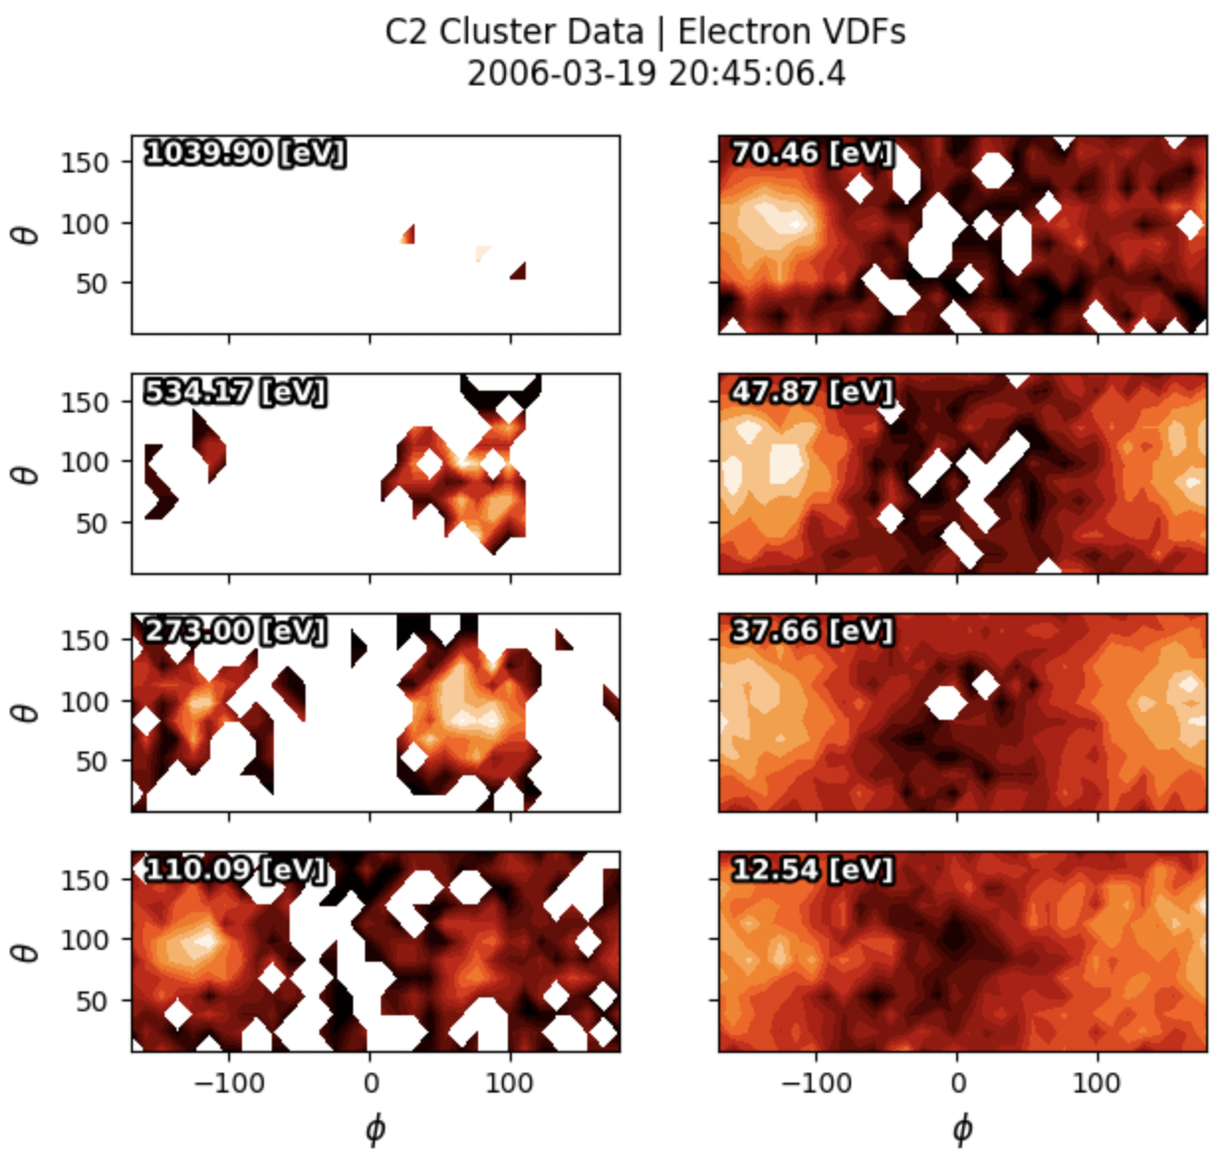
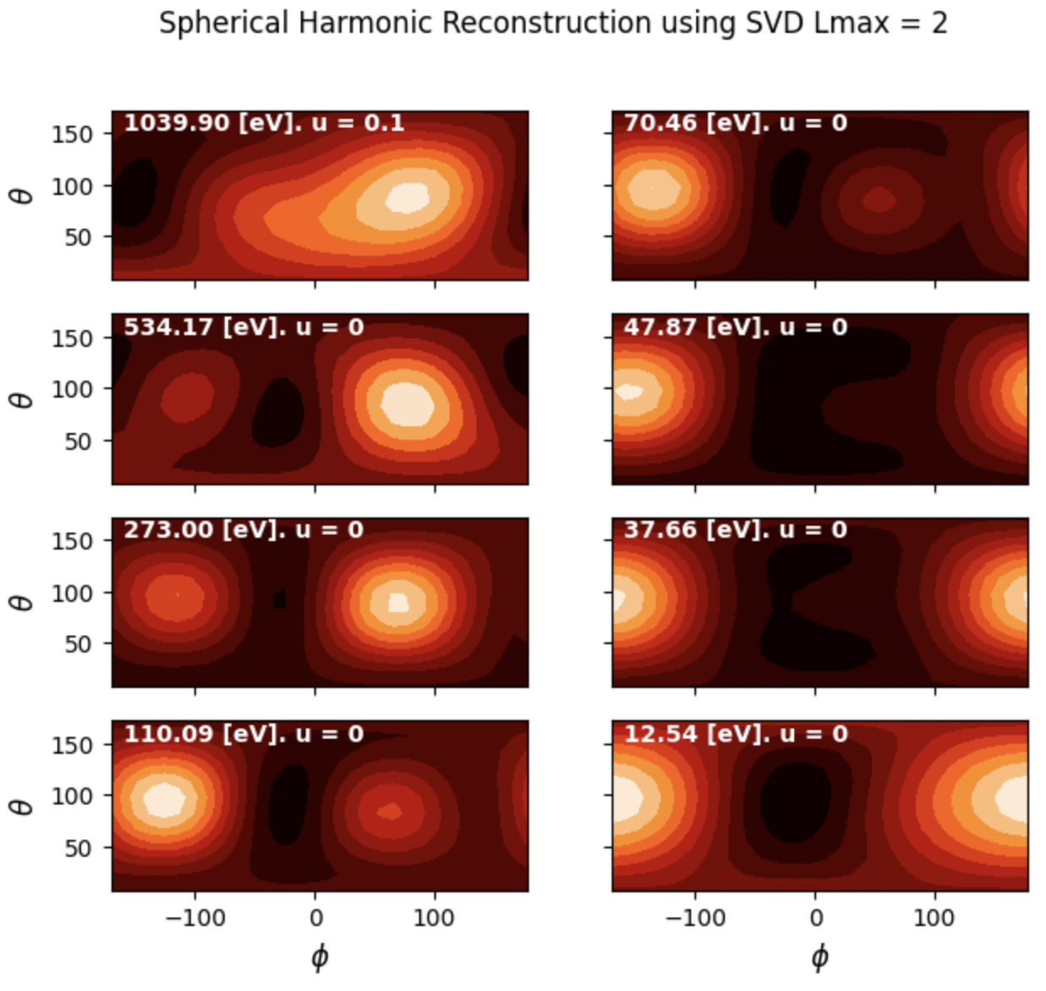
Electron VDFs Reconstruction With Spherical Harmonics
Notes:
Here it is with SVD! MUCH better

Slide 32
Solar Wind: Plasma
Source(s): NASA
f(v)
Velocity
Notes:
THE CORONA:
The beta parameter is close to 1. Thermal and magnetic component one does not govern the other.
https://www.researchgate.net/figure/Plasma-b-in-the-solar-atmosphere-Modified-version-from-Gary-2001-Fig-3-Reprinted_fig8_282478237

Slide 33
Applying Spherical Harmonics to Ions

Slide 34
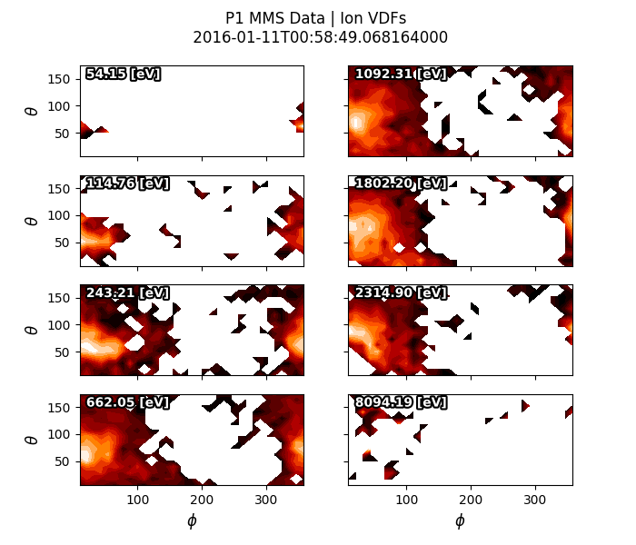
Electron VDFs vs. Ion VDFs
Notes:
Basically same results as example paper! The technique works! (this part of theproject was onboarding, geting me to understand the technique and making sure I was re-creating it correctly)

Slide 35
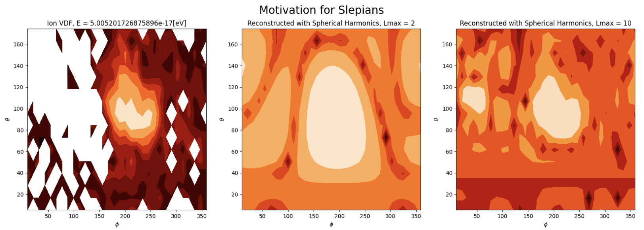
Reconstructing Ion VDFs with Spherical Harmonics
Notes:
I just showed a range of Electron and ion VDFs, based on what we have seen it seems like it could be reasonable to try applying spherical harmonic reconstruction to Ion VDFs. So i tried it out. Here I show
Makes the inverse problem ill posed

Slide 36
Problems with Spherical Harmonics when Decomposing Ion VDFs
10
5
+
5
=
10
unknown
7
3
10
+
=
-3
4
Notes:
It is important to note that spherical harmonics are functions that are defined on a sphere. This works really well for electrons since they are spread out on all phase space.

Slide 37
What can we do?

Slide 38
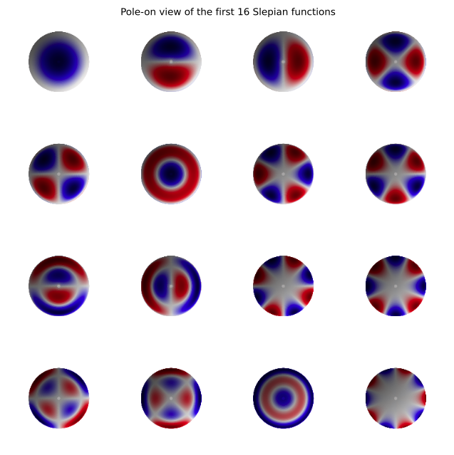
Localized set of functions: Slepians
Source(s): Das
Notes:
Slepians are defined on a pole and knowing the center is very important. How do we do that? Gaussian fits next slide

Slide 39
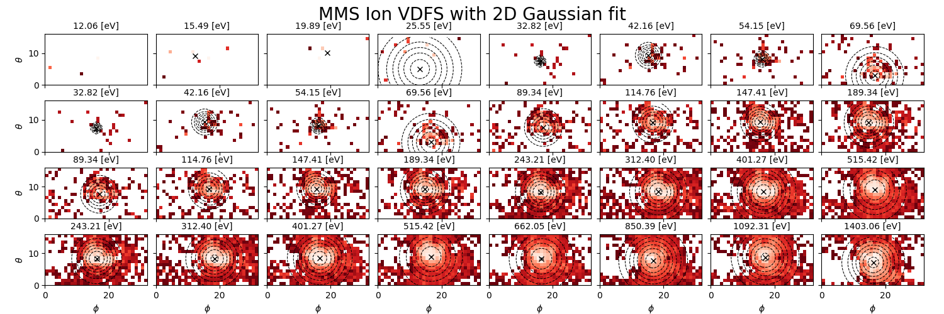
Gaussian Fitting: Finding Axis of Gyrotropy
Notes:
Choose slepians
Steps for fitting MMS,
Axis of gyrotropy
Theta phi point where magnetic field is threading through
Not exactly the peak

Slide 40
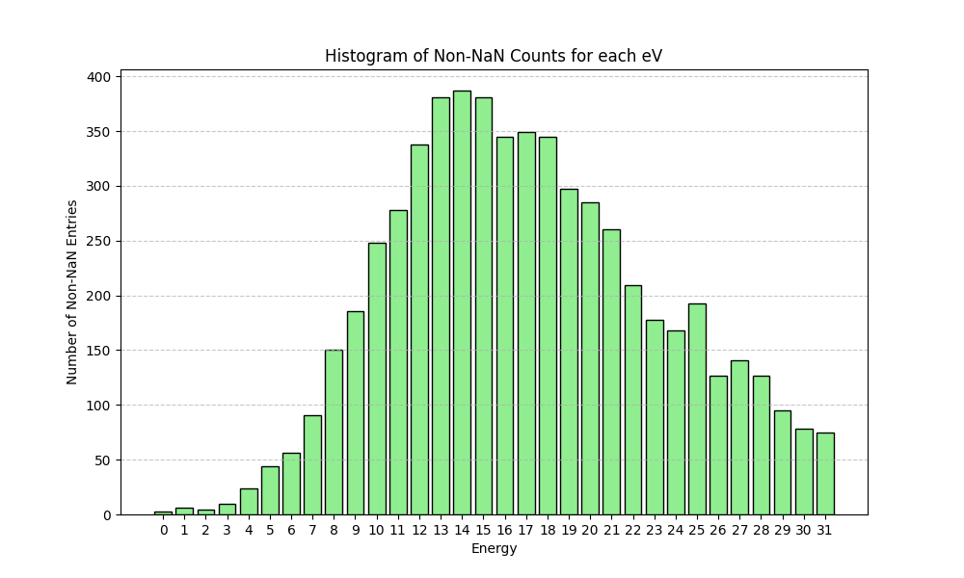
Gaussian Fitting: Finding Axis of Gyrotropy
Notes:
Choose slepians
Steps for fitting MMS,
Axis of gyrotropy
Theta phi point where magnetic field is threading through
Not exactly the peak

Slide 41
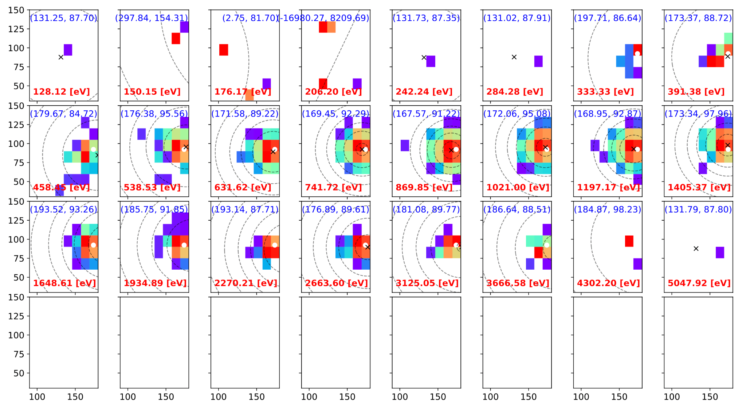
2D Gaussian Fit on Ion VDFs from Parker Solar Probe
Source(s): Das
Notes:
Choose slepians
Steps for fitting MMS,

Slide 42
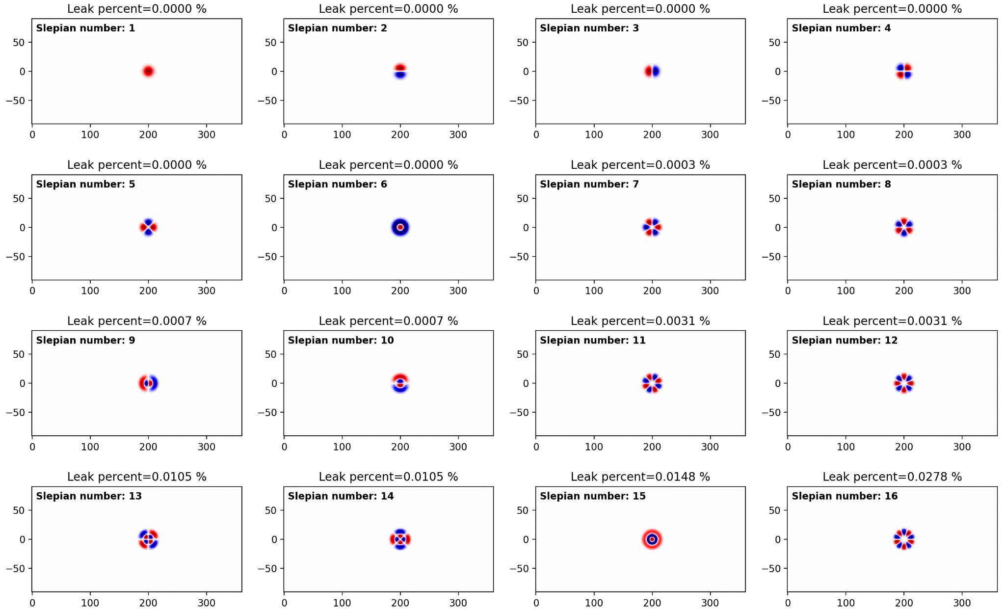
Rotated Slepian Functions
Source(s): Das
Notes:
Choose slepians
Steps for fitting MMS,

Slide 43
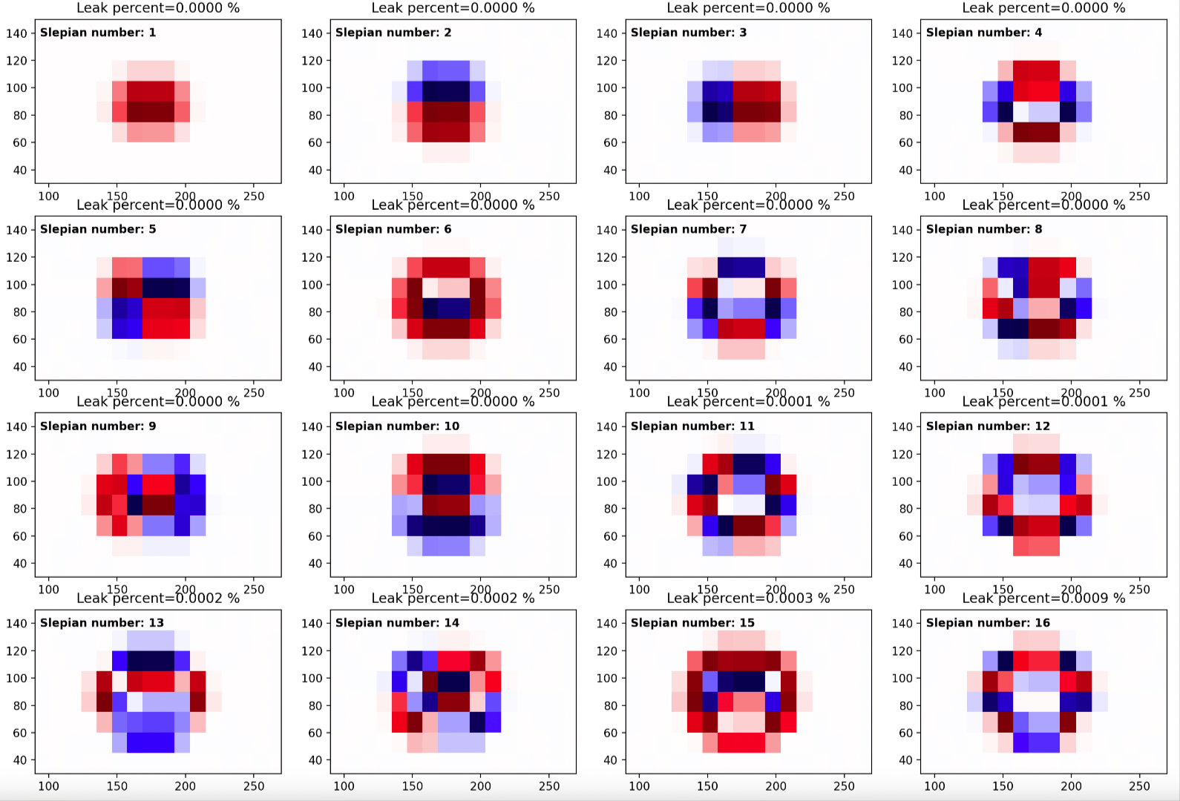
Rotated Slepian Functions
Source(s): Das
Notes:
we will be using the same grid resolution of the data, so our Slepians would instead look like this.

Slide 44

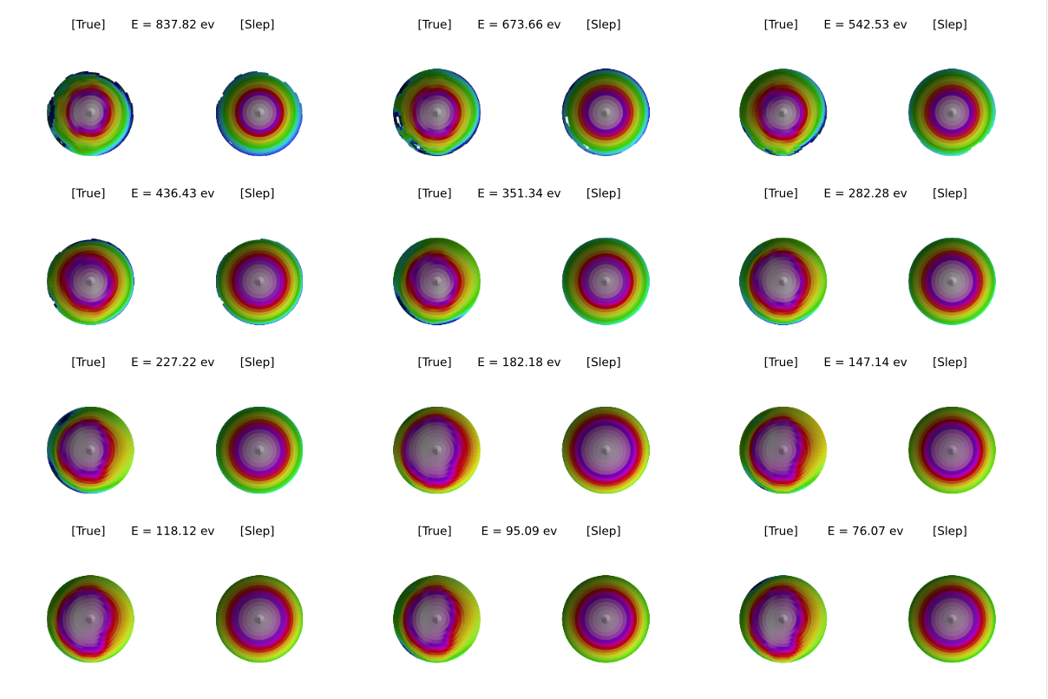
Next Steps
Source(s): Das
Axis of gyrotropy
Slepians for MMS ion VDFs
MMS ion VDF Slepian reconstructions
Calculate the moments of MMS ion VDFs
Asses their validity
Notes:
Ultimate goal combining SPC and SPAN and reconstructing data using slepian basis functions!

Slide 45
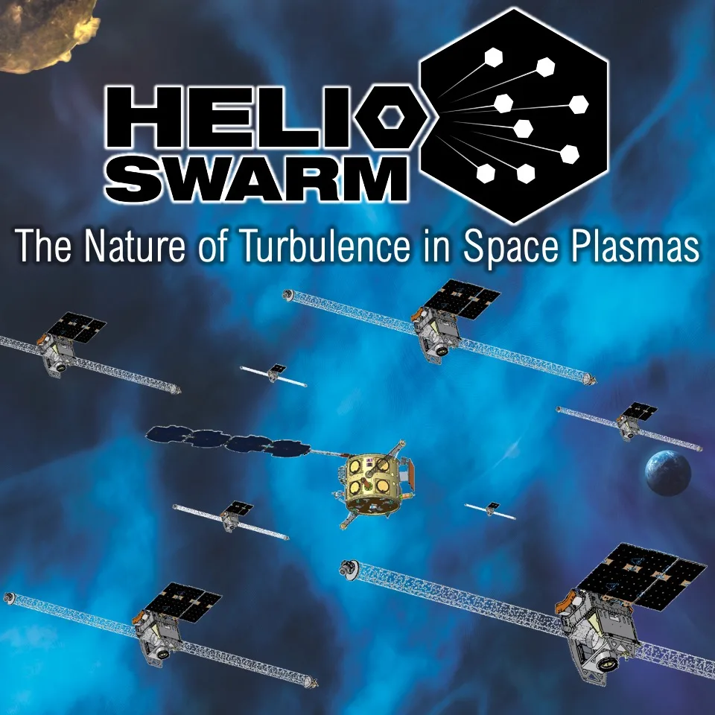
Future Applications
Source(s): NASA, ESA
Any ESA
Multiple Instruments
Future Missions!
Notes:
Ultimate goal combining SPC and SPAN and reconstructing data using slepian basis functions!

Slide 46
Acknowledgments
This work is supported by the NSF-REU solar physics program at SAO. It would not be possible without the program leaders Dr. Chad Allen Madsen and Dr. Kathy Reeves, my Mentors Dr. Michael Terres, Dr. Srijan Bharati Das, and Dr. Kristoff Paulson.
Notes:
THANKS, best program EVERRRRR

Slide 47
Electrostatic Analyzer
Spherical Harmonics
Singular Value Decomposition
VDF Slides
PSP Instruments
Black Hole
E VDFs
Challenges & Future
Notes:
Ion &ElectronVDFs, Spherical Harmonics, SVD,
Drawing explanations of M c = d, old challenges
What is thermal velocity

Slide 48
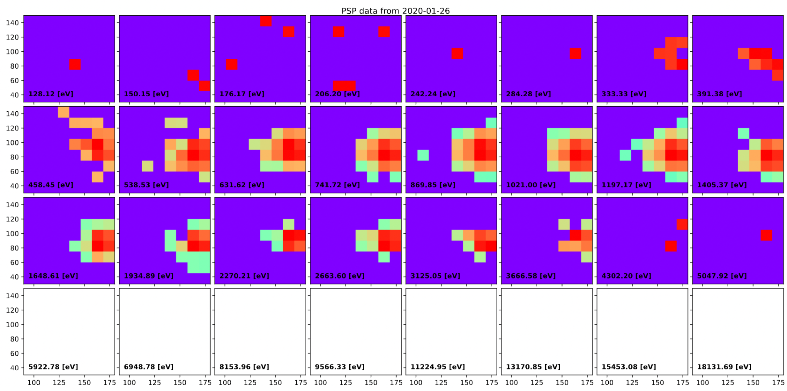
Parker Solar Probe SPAN data
Source(s): Das
Notes:
we will be using the same grid resolution of the data, so our Slepians would instead look like this.

Slide 49
Rotated Slepian Functions
Source(s): Das
Notes:
we will be using the same grid resolution of the data, so our Slepians would instead look like this.

Slide 50
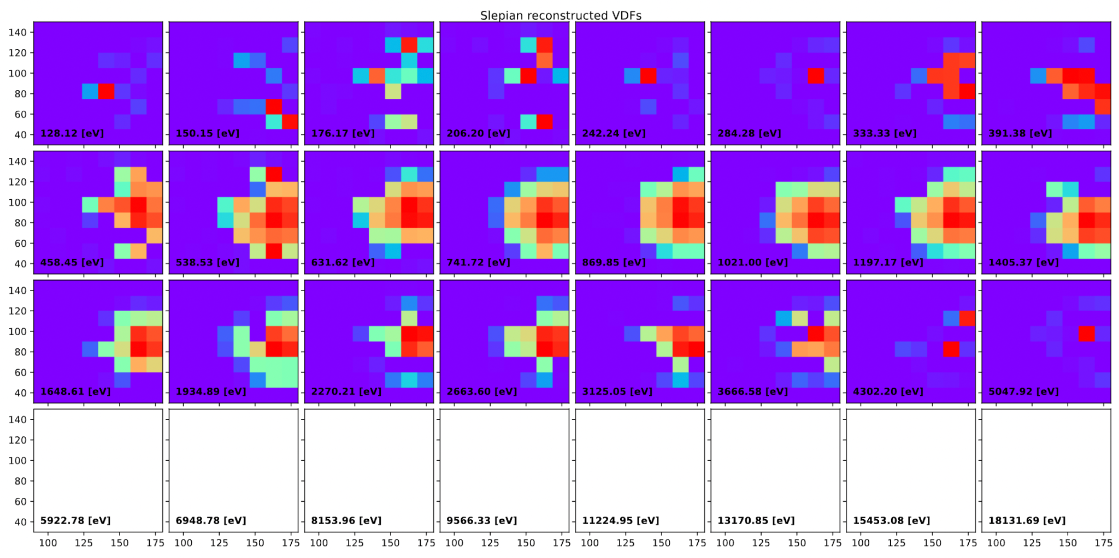
Reconstructed with Slepians
Source(s): Das
Notes:
we will be using the same grid resolution of the data, so our Slepians would instead look like this.

Slide 51
Spherical Harmonics
Source(s): Kurth https://github.com/NVIDIA/torch-harmonics
Y_{lm}(θ,ɸ), Lmax = 5
Notes:
Spherical Harmonic Basis functions! Python look, sphere look

Slide 52
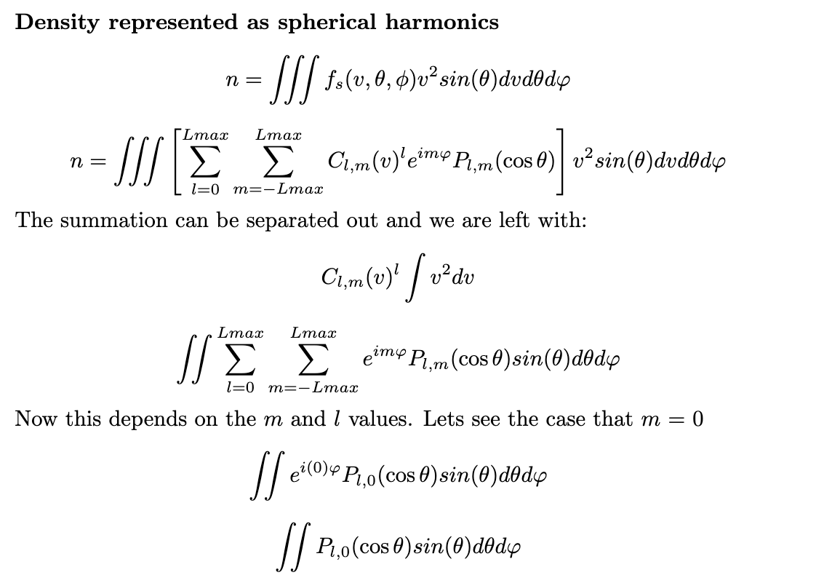
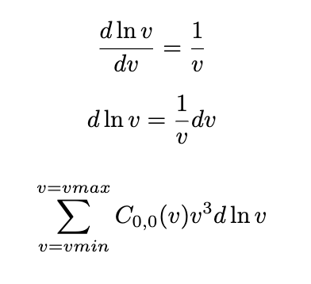
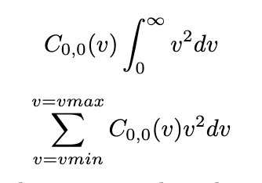
Problems with Spherical Harmonics on Ion VDFs
5
+
5
=
10
10
unknown
7
3
10
+
=
9
-3
6
Notes:
Maybe this could be a backup slide

Slide 53
Singular Value Decomposition
Spherepy does this:
Y_{lm}(θ,ɸ)
Coefficients
Image

Slide 54

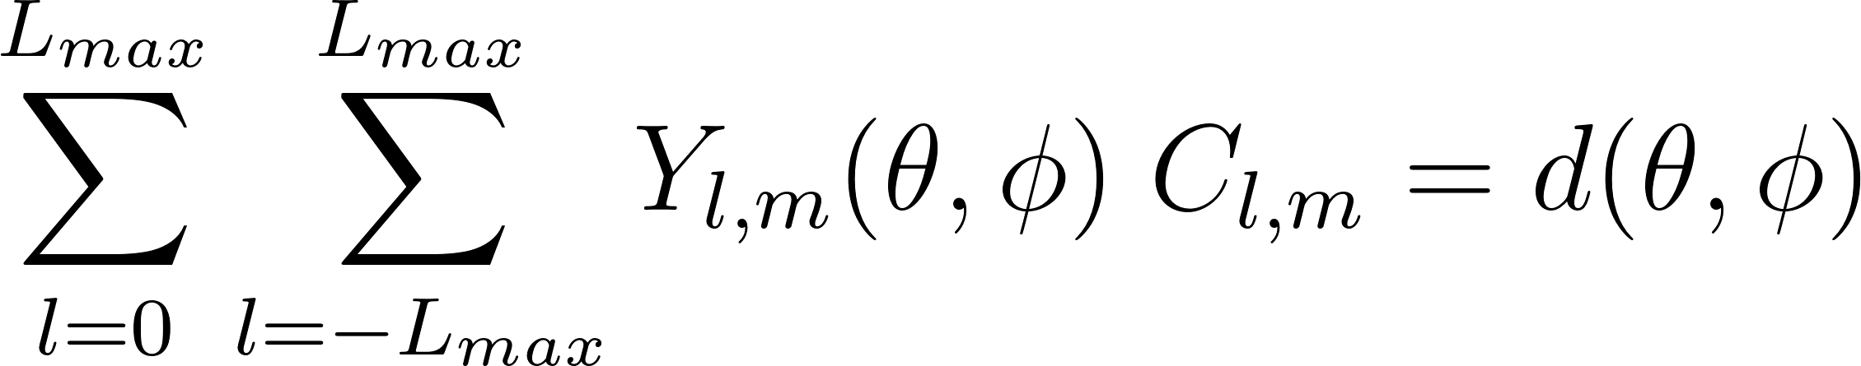

Singular Value Decomposition

Slide 55
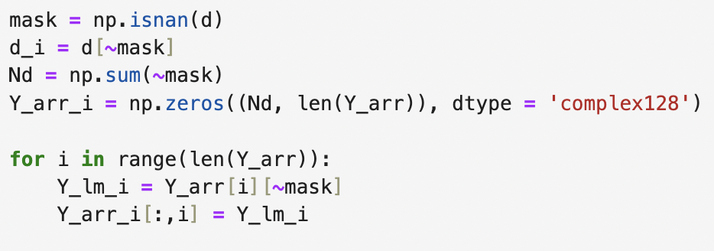

Singular Value Decomposition

Slide 56
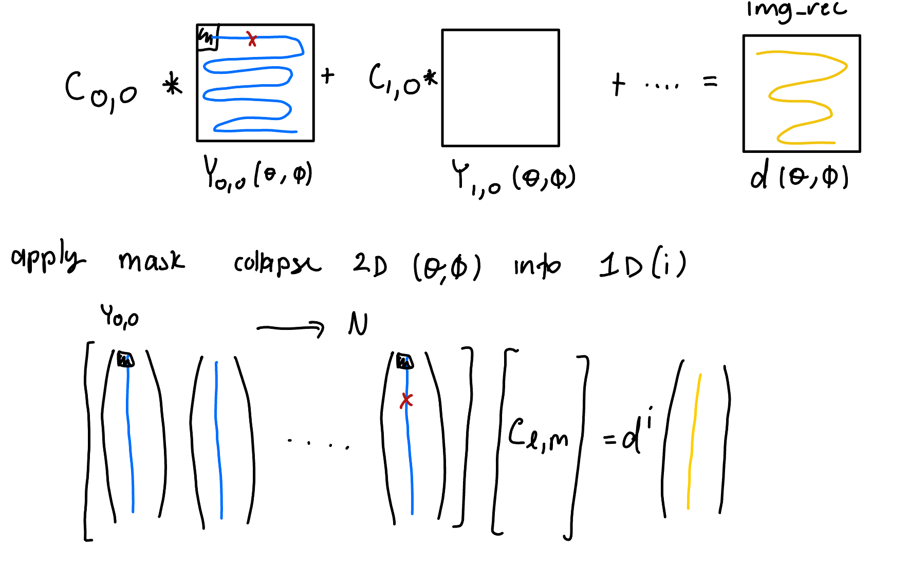
Singular Value Decomposition

Slide 57
Singular Value Decomposition

Slide 58
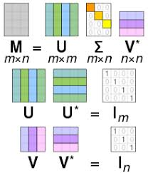
Singular Value Decomposition
Source(s): Wikipedia SVD

Slide 59
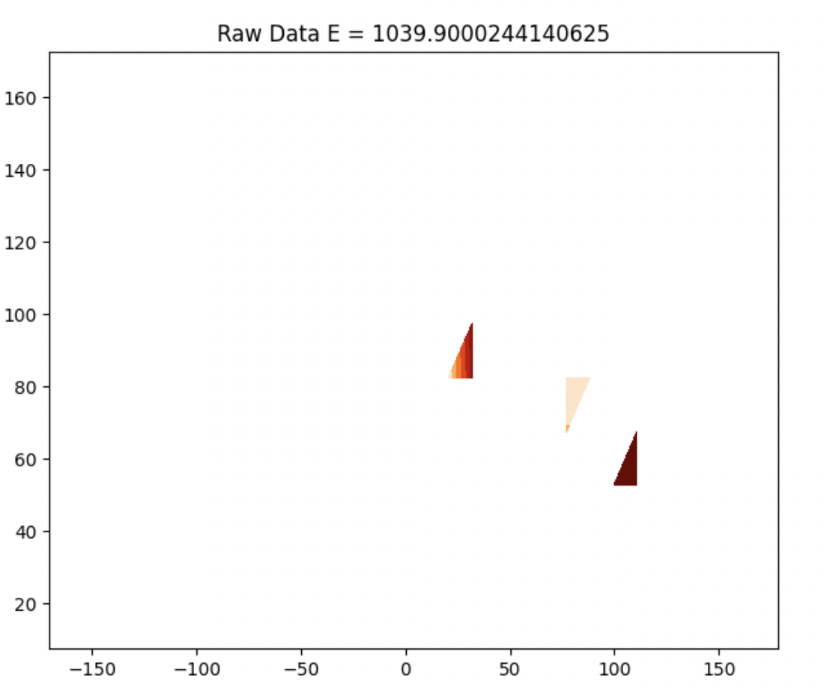
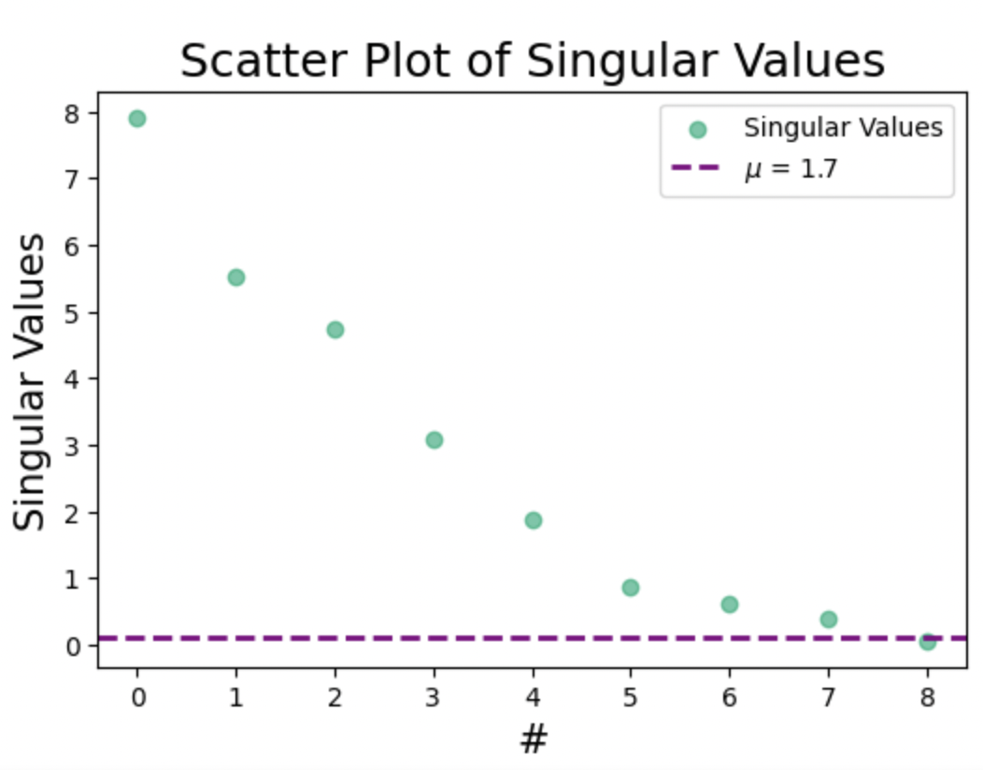
Singular values on E = 6, u= 0.1
Source(s): Wikipedia SVD

Slide 60
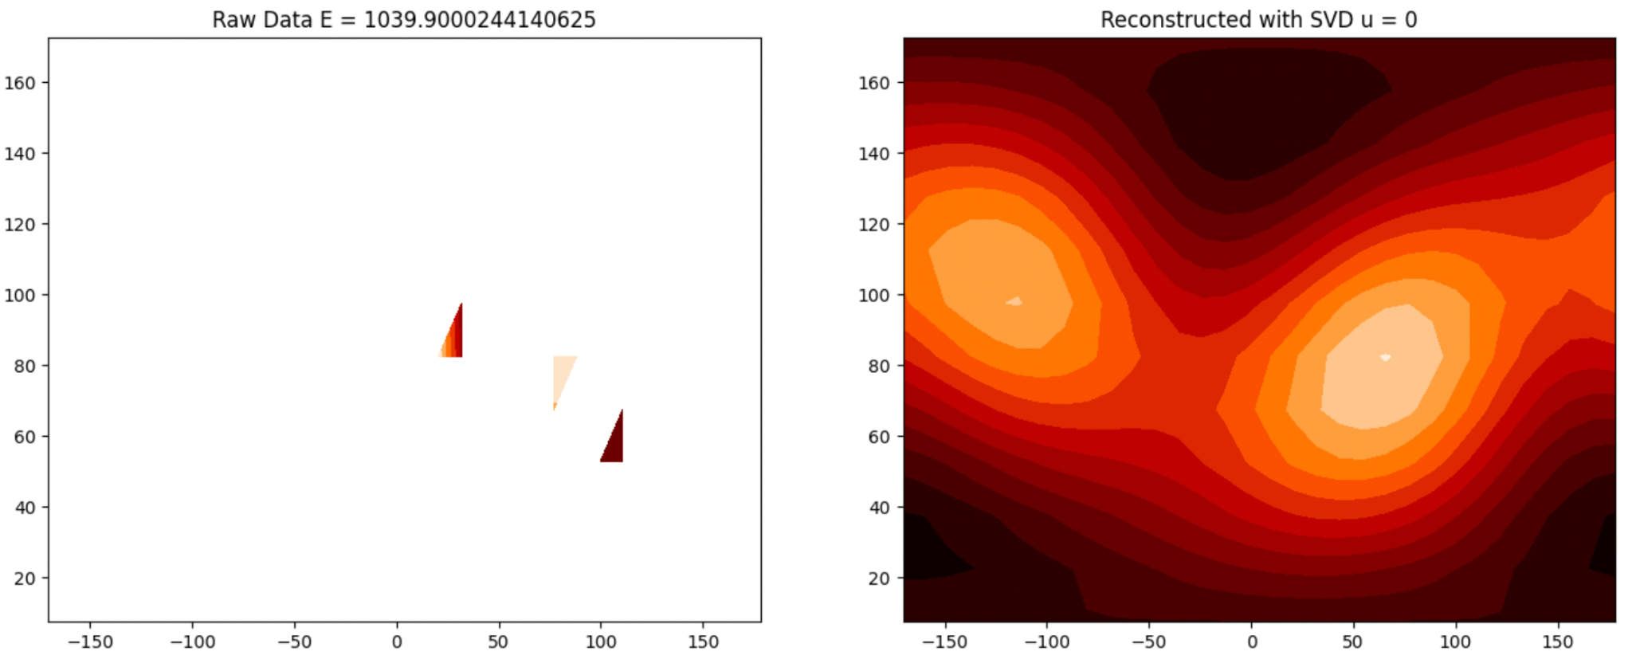
SPH Reconstruction Using SVD u = 0

Slide 61
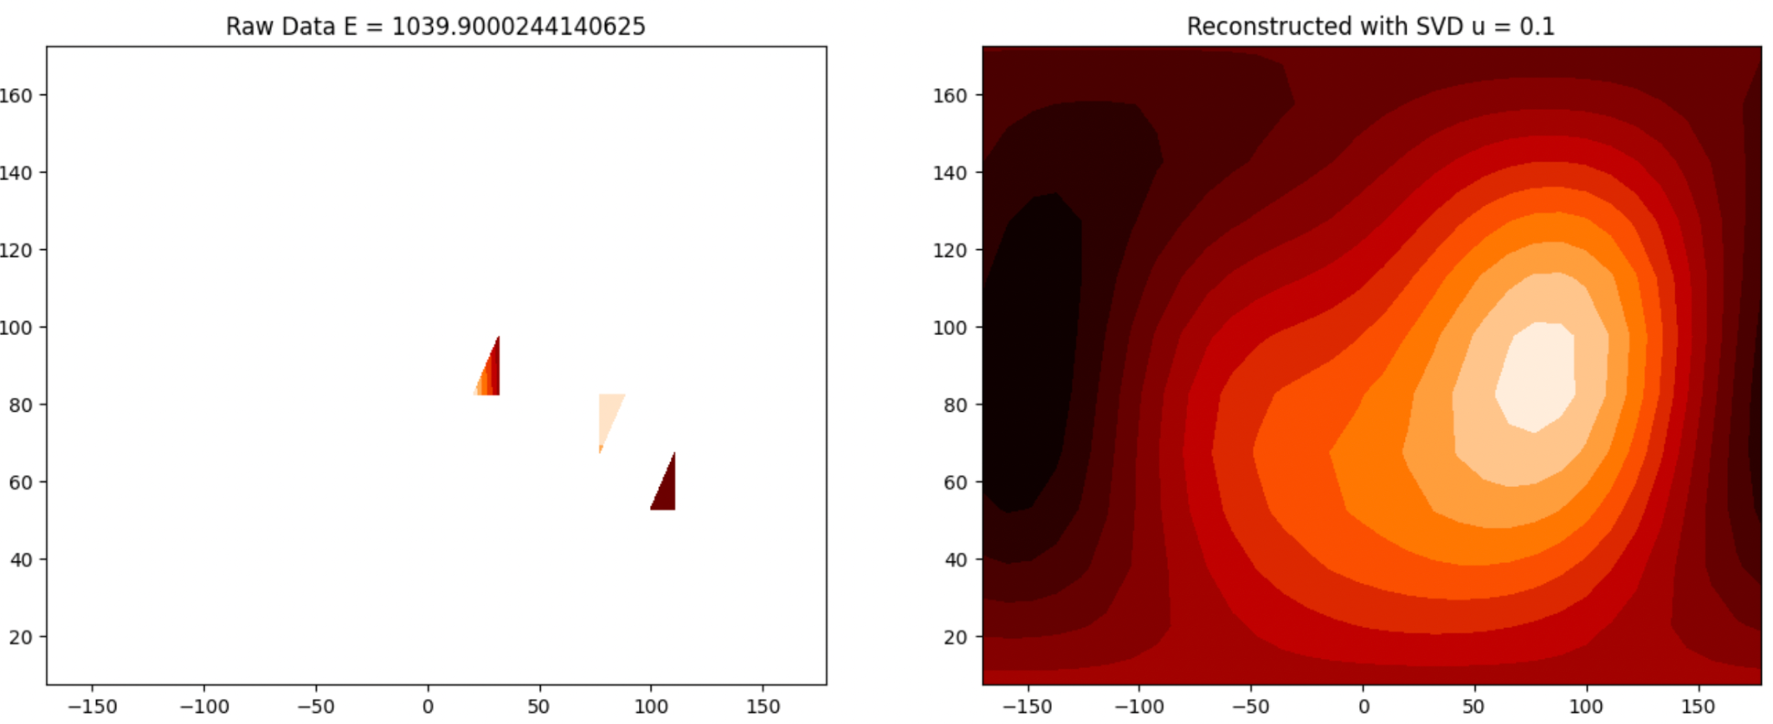
SPH Reconstruction Using SVD u = 0.1

Slide 62
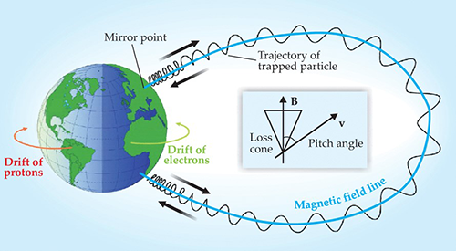
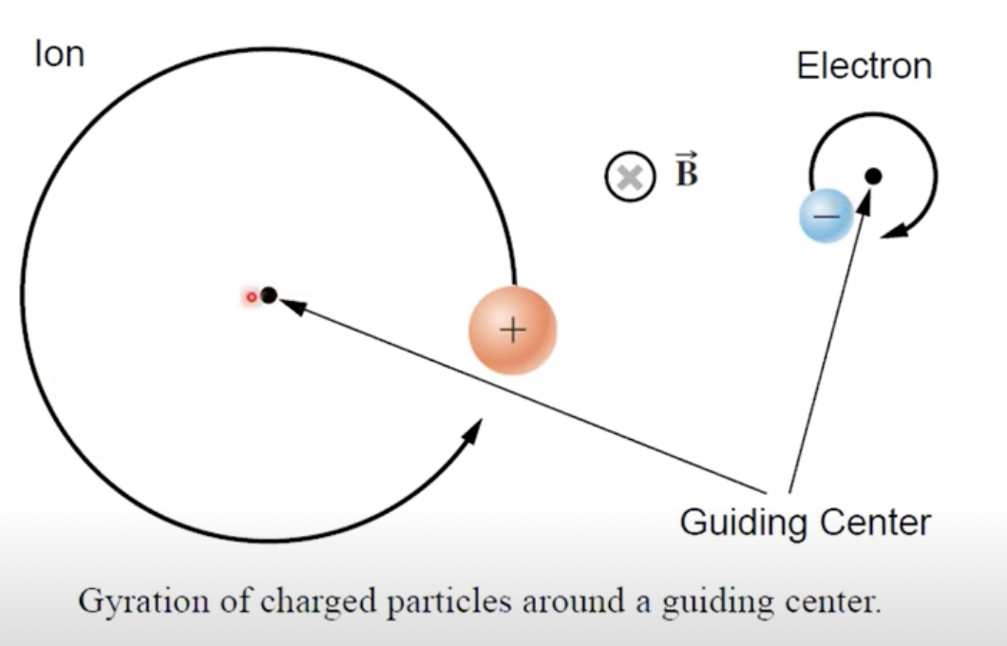



Solar Wind Particles
Source(s):
Notes:
Is this the same for the sun?
A schematic view of the charged-particle motion in Earth's inner magnetosphere. Particle gyro motion around field lines, “bounce” back-and-forth motion and drift motion due to the gradient and curvature of the magnetic field. Ions drift towards west and electrons drift east and thus generate the ring current, an electric current circulating around Earth.
Mass of electron is much smaller so gyroradius of an ion is much bigger than gyroradius of an electron. More efford to change the direction(acceleration) of a heavier particle.
Non uniform Magnetic field:
Magnetic mirror effect, momentarily stop and bounce back to that point.
https://www.youtube.com/watch?v=BGDyYgq8X58 Macalald 2020

