Slide 1


Building Bridges in Open Science:
Collaborative Ventures at Khalifa University Library
Rani Anand, Information Literacy Instructor
Khalifa University, UAE

Slide 2


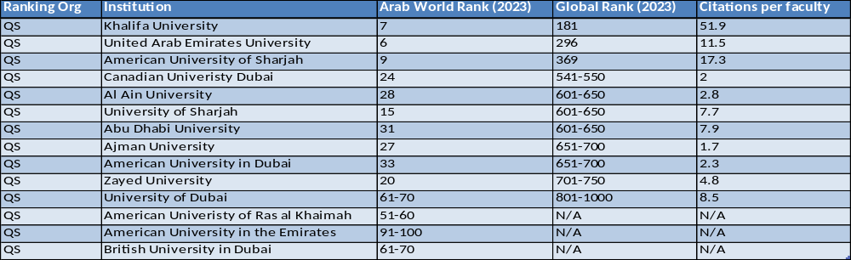
Khalifa University is a top ranked international university is home to the UAE’s leading research centers as interdisciplinary research units focused on long-term strategic priorities addressing regional and global challenges in a systematic and targeted manner via engagement of world-class researchers and facilities.

Slide 3

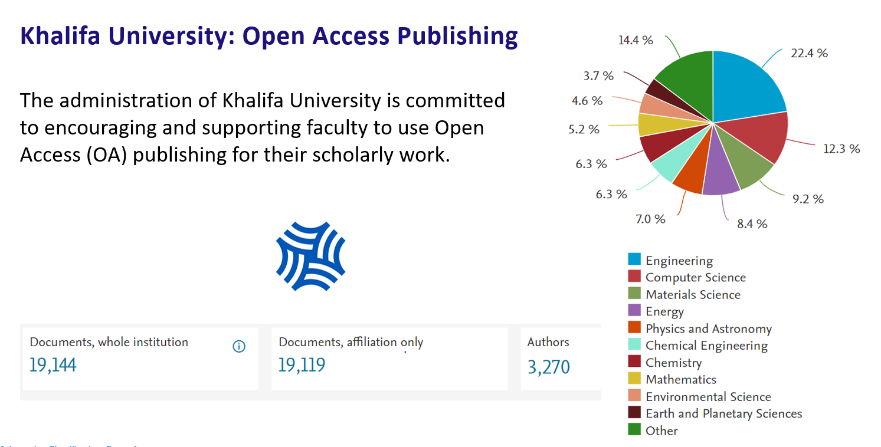

Khalifa University: Open Access Publishing
The administration of Khalifa University is committed to encouraging and supporting faculty to use Open Access (OA) publishing for their scholarly work.
Khalifa University and Open Science
Documents,
whole institution
Documents,
Affiliation only
Authors

Slide 4

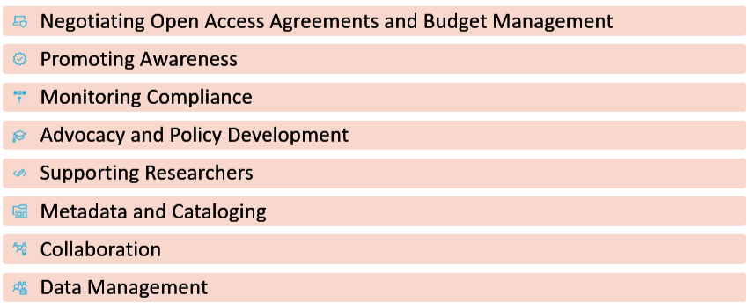
Open Science
Open science has emerged as a pivotal approach for enhancing transparency, reproducibility, and accessibility in research.
Role of Libraries

Slide 5
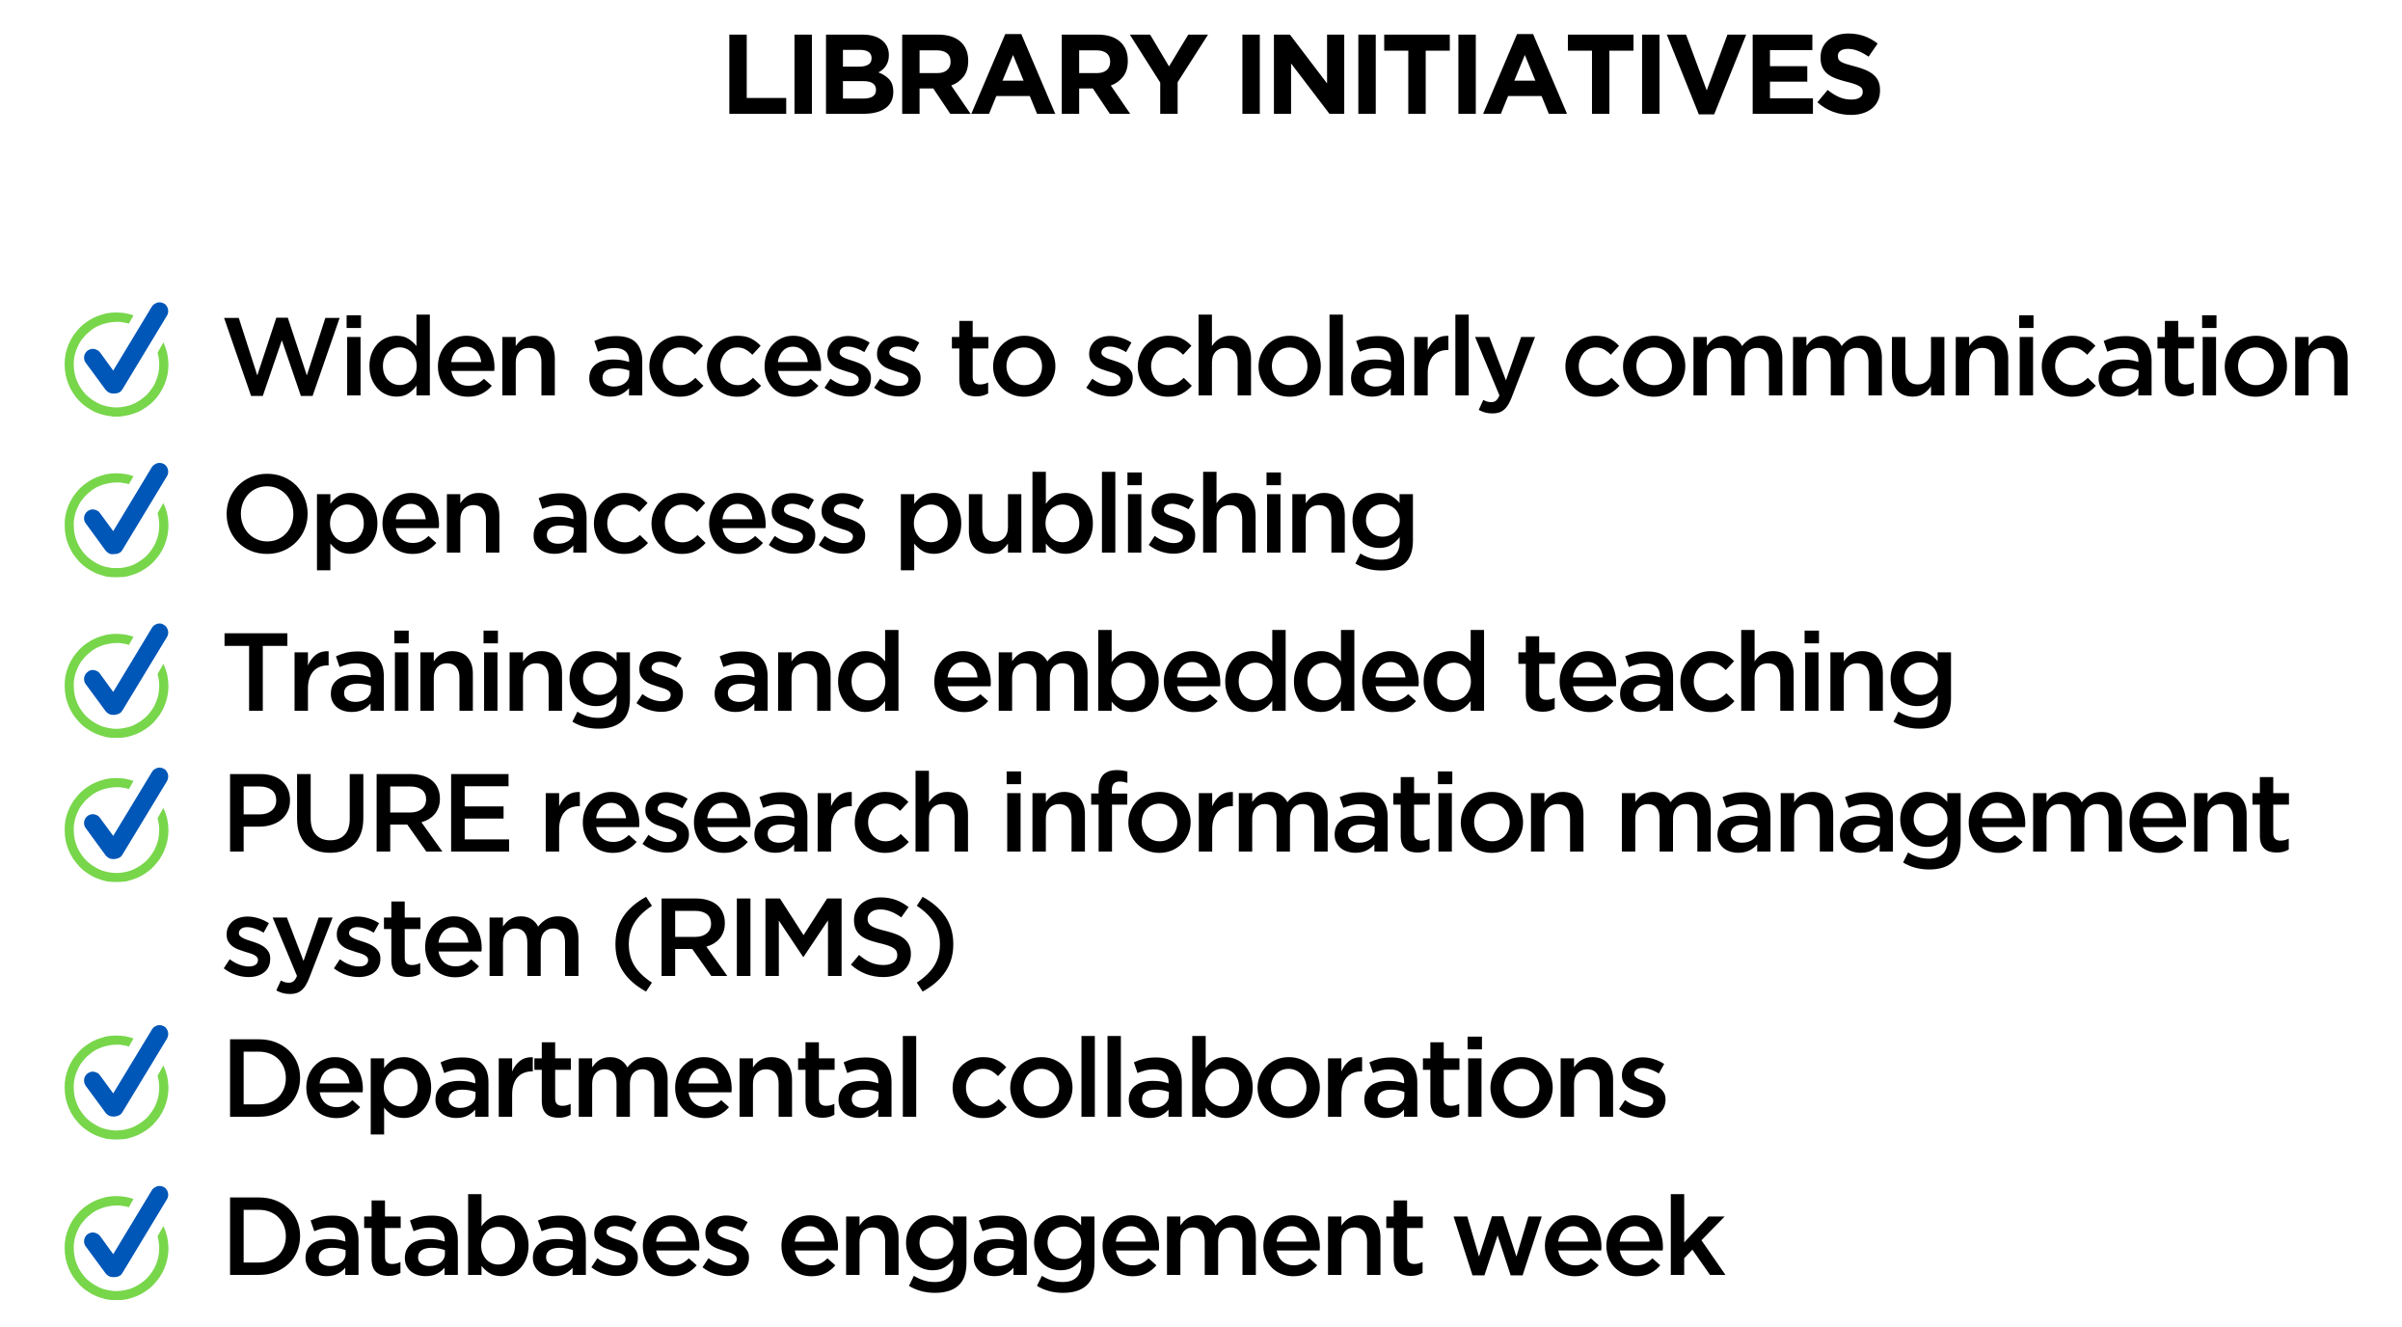

KU Library’s Journey with Open Science

Slide 6
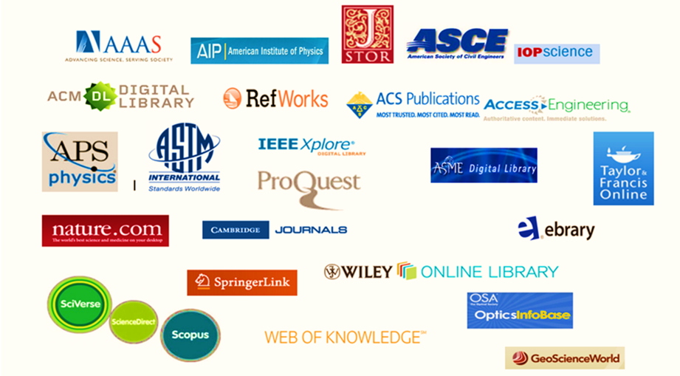
Scholarly Communications
E-Collections: E-books, databases, e-journals

Slide 7
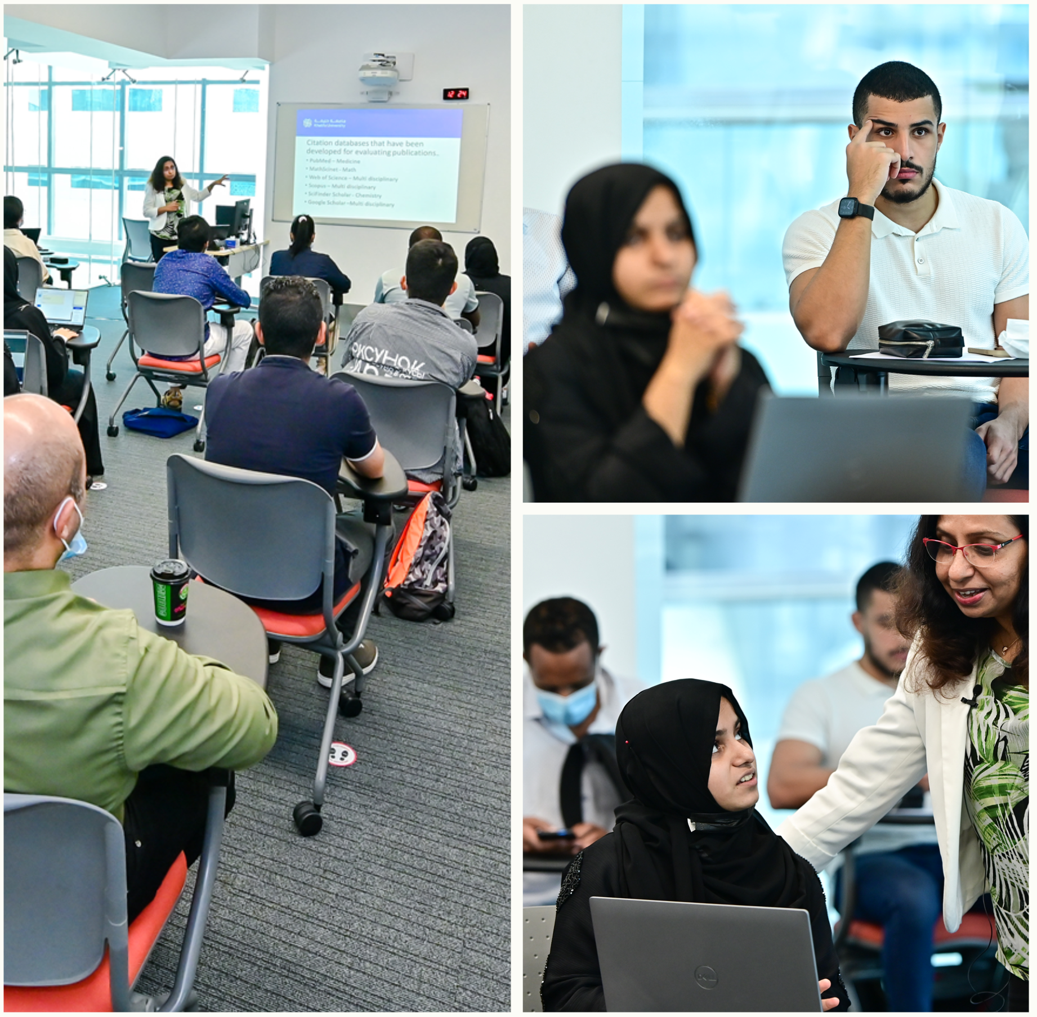
Embedded sessions
Senior design seminars
  Literature and Patent Review
  E-resources and search strategies
PhD Scientific Research Methods
  Patents and Standards
  Research data management
  Citation managers

Slide 8
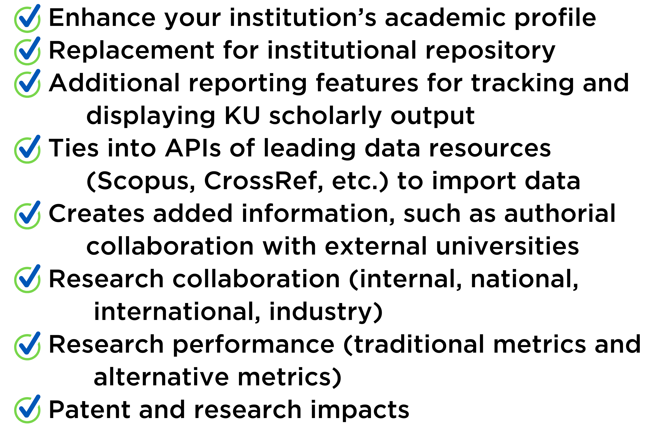
PURE (RIMS)
Research
Information
Management
System

Slide 9
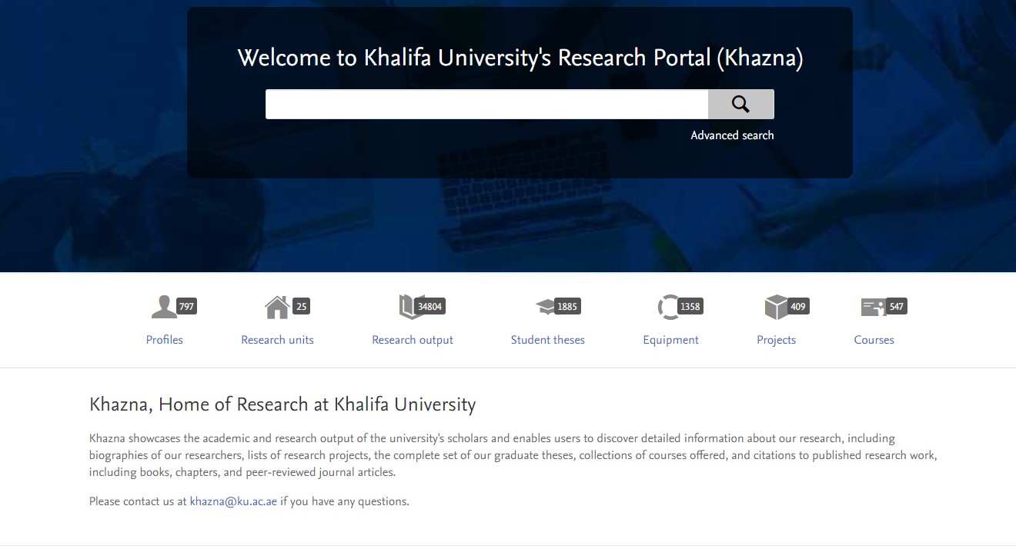
790 Profiles of current Faculty and Researchers
566 Graduate Students
34,800+ Research Outputs (updated weekly)
1,885 Student Theses
409 Academic Projects
547 Courses
1,358 Pieces of Equipment
PURE (RIMS)
Research
Information
Management
System

Slide 10
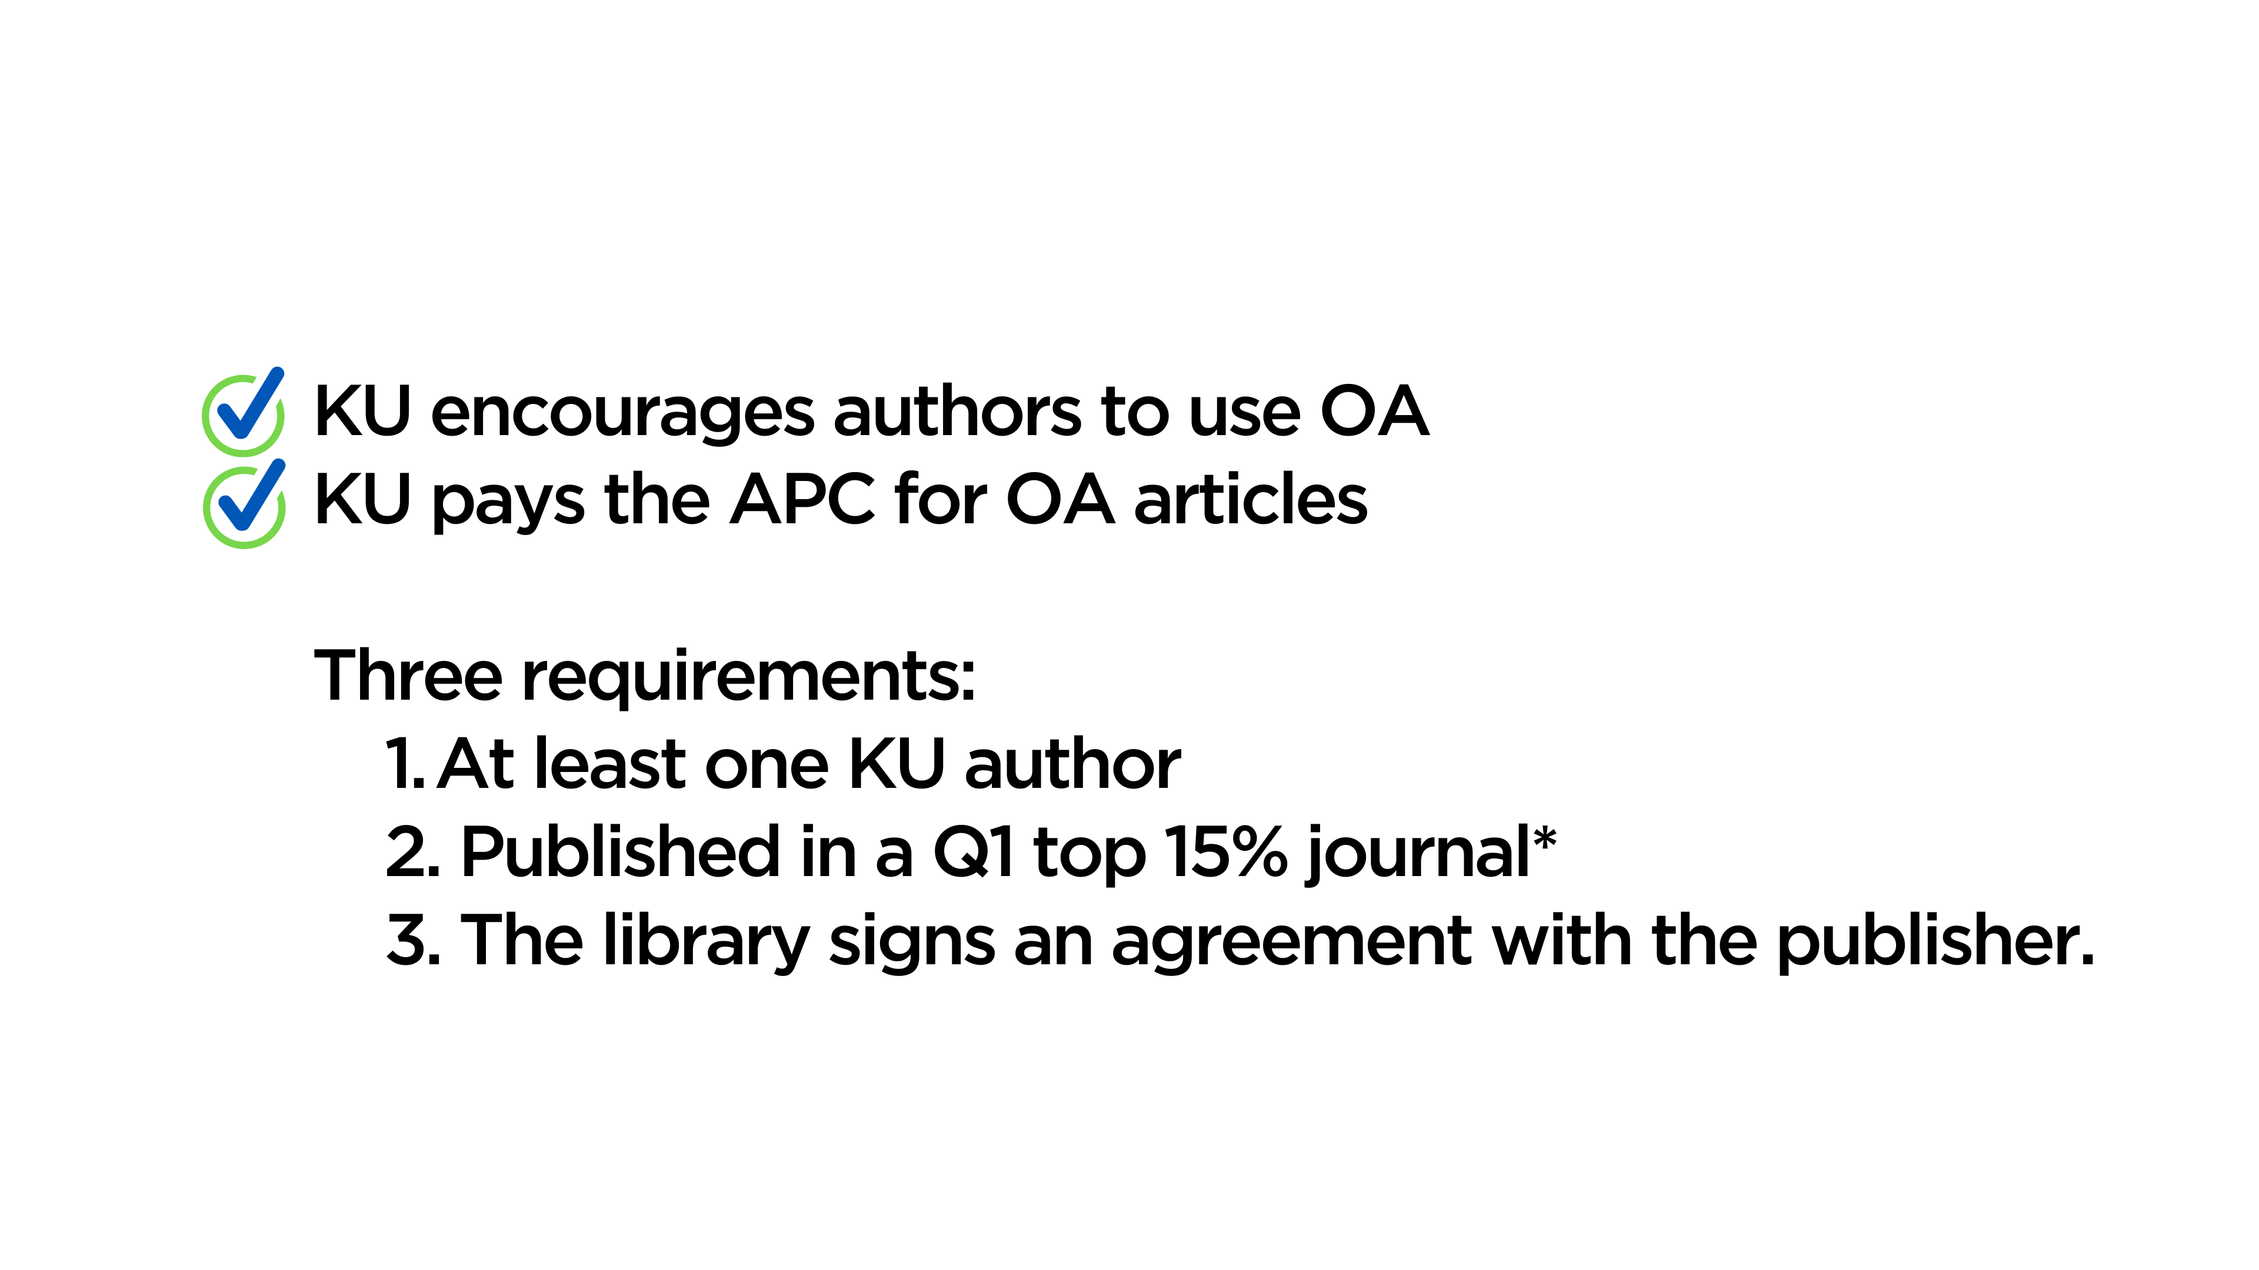
What is KU’s Open Access Project?

Slide 11
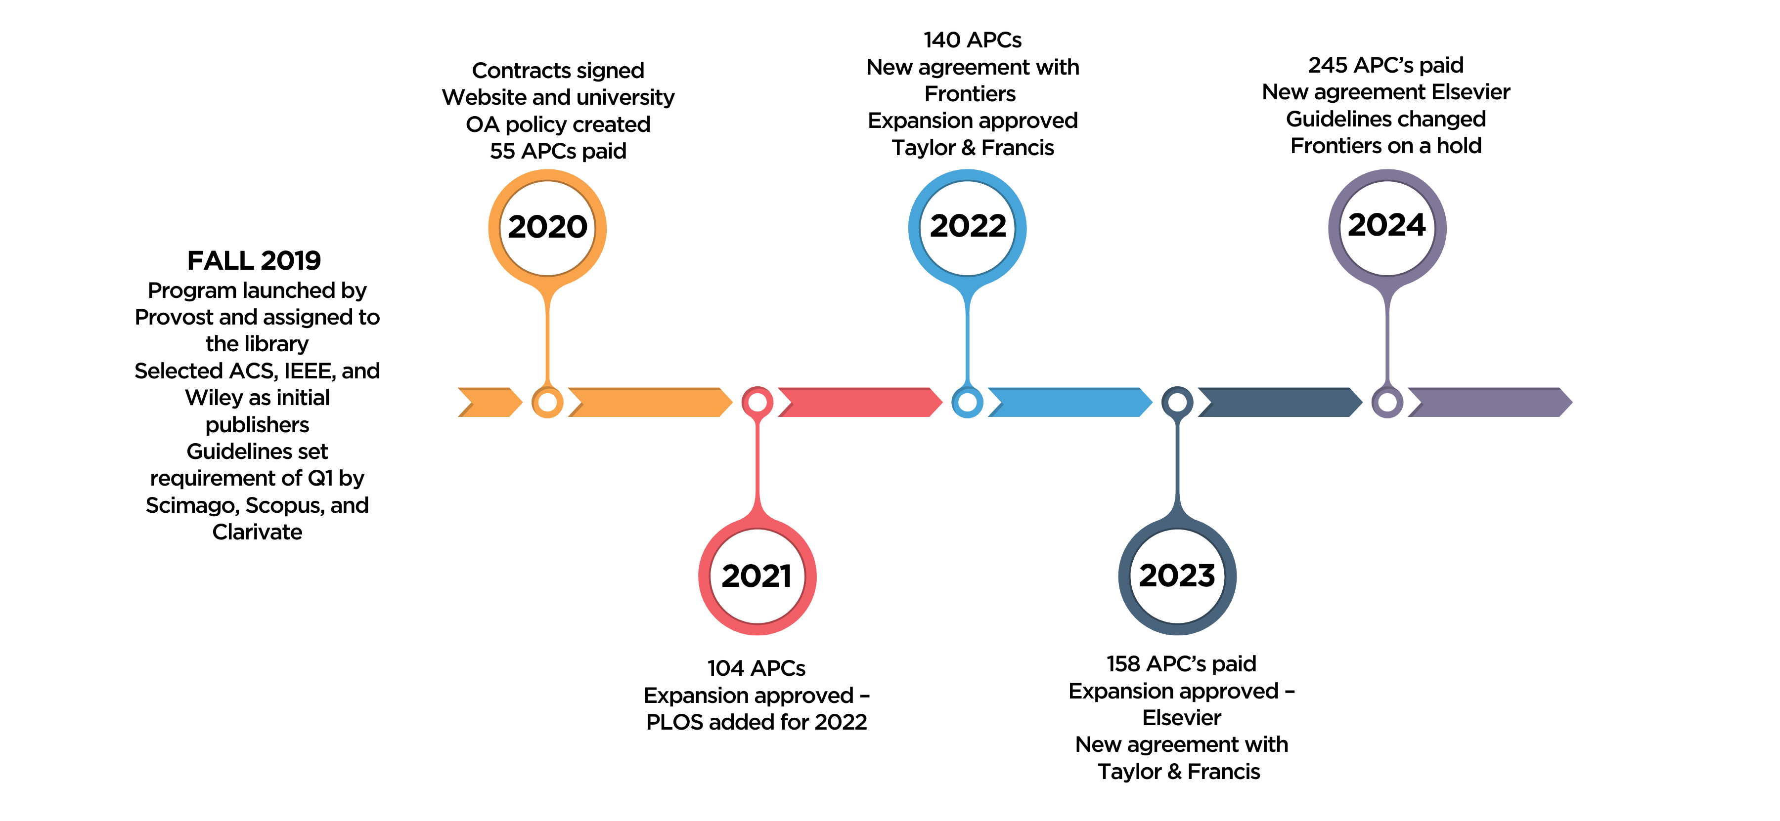
History of Open Access Publishing at KU

Slide 12
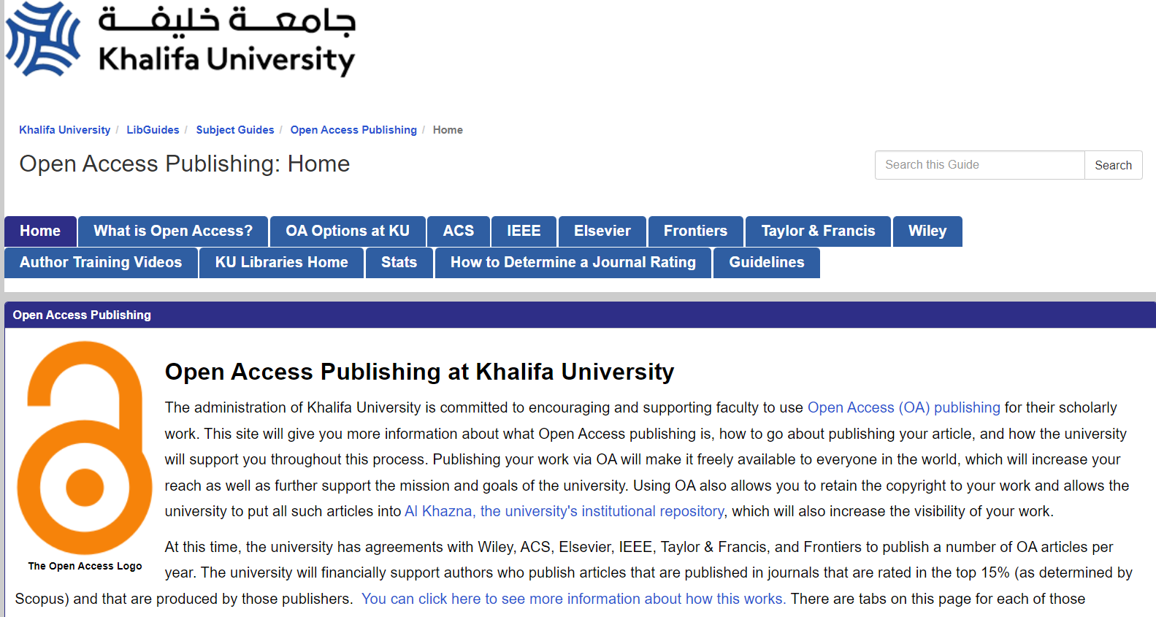
KU Library guide on Open Access

Slide 13
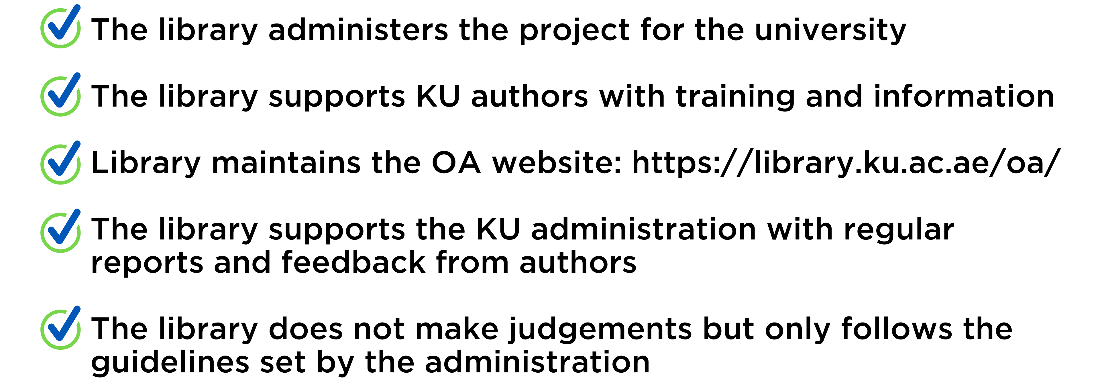
What is the Library’s Role?

Slide 14
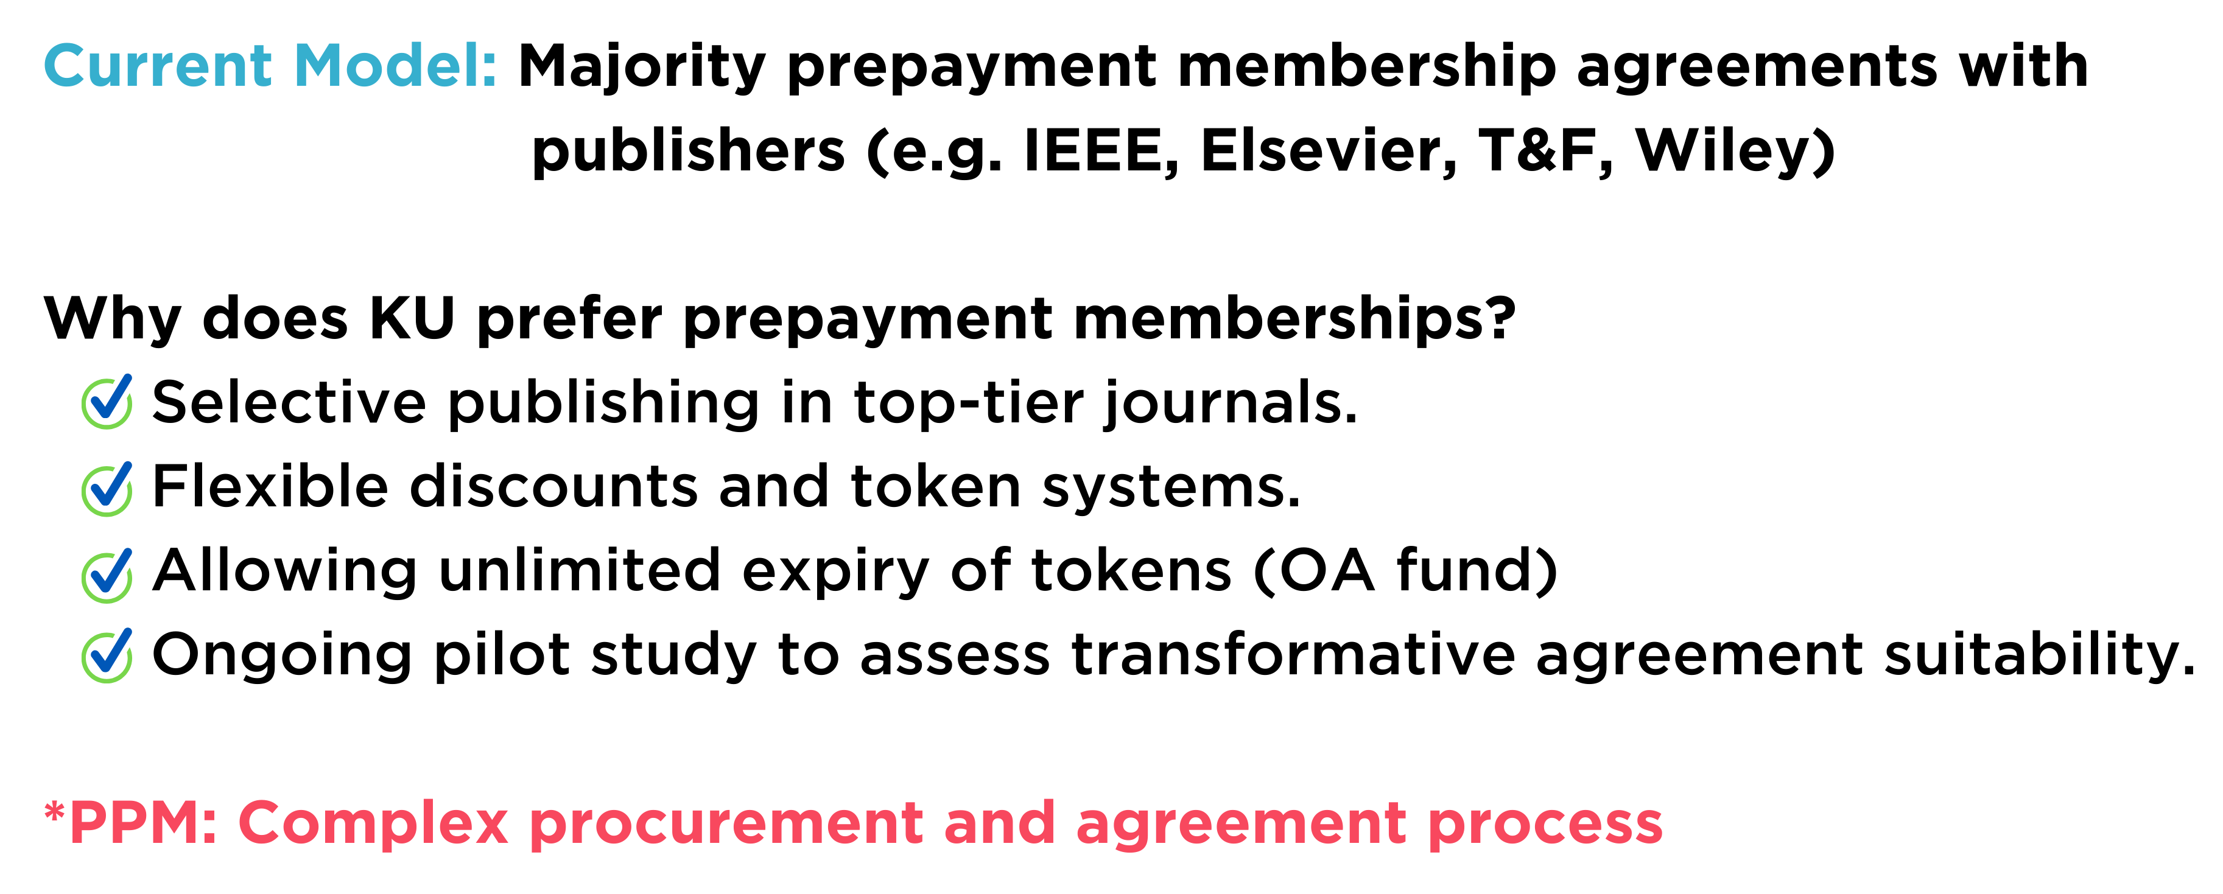
OA Agreements: KU Model

Slide 15
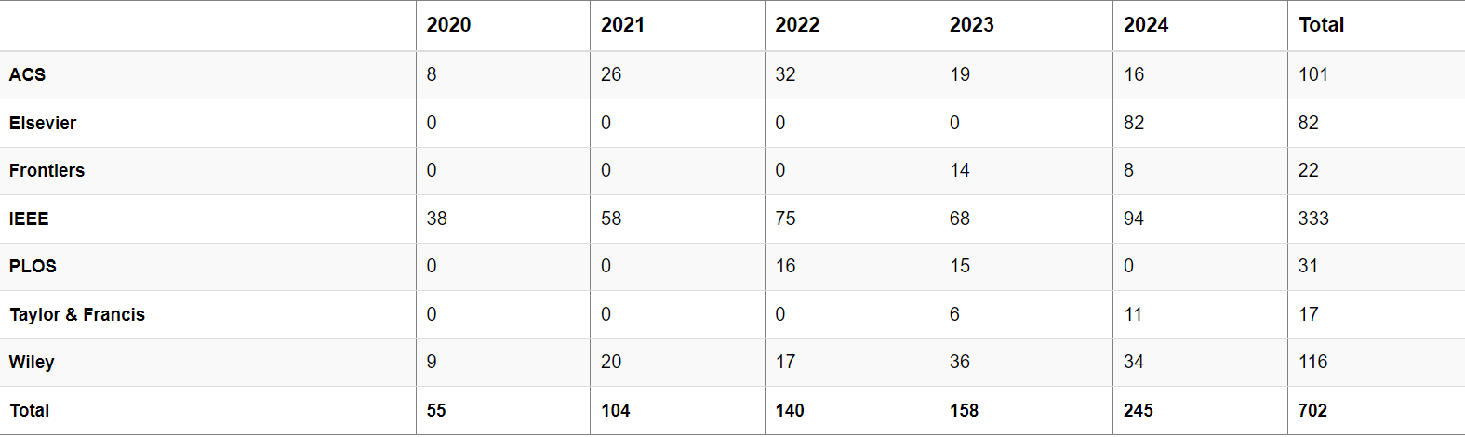
APCs Paid by Open Access Services

Slide 16
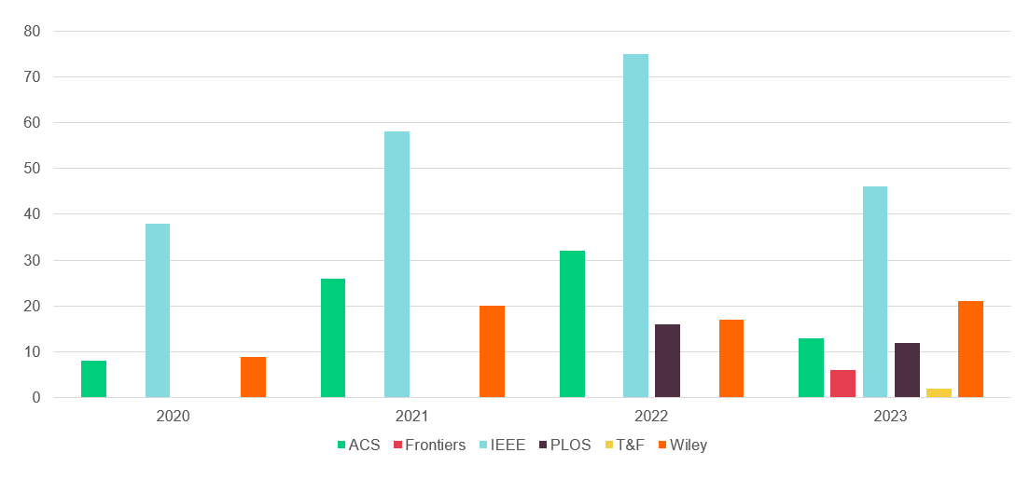
APCs Paid

Slide 17
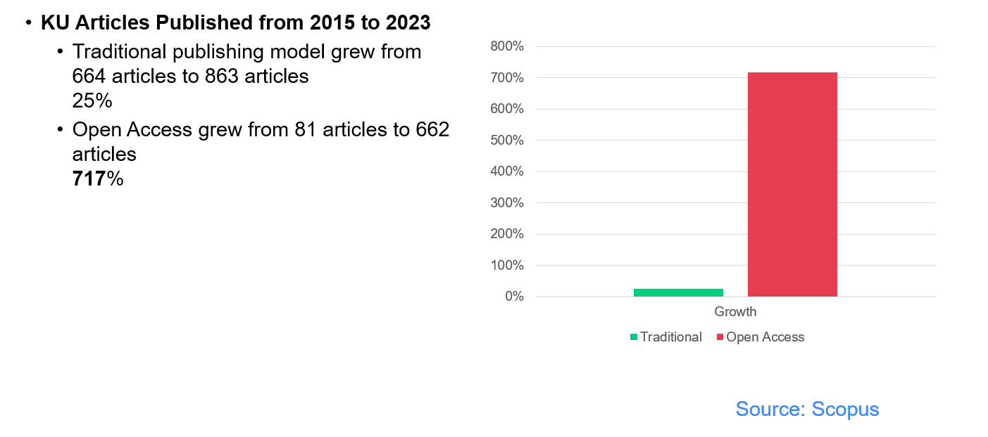
Growth of OA Articles at KU

Slide 18
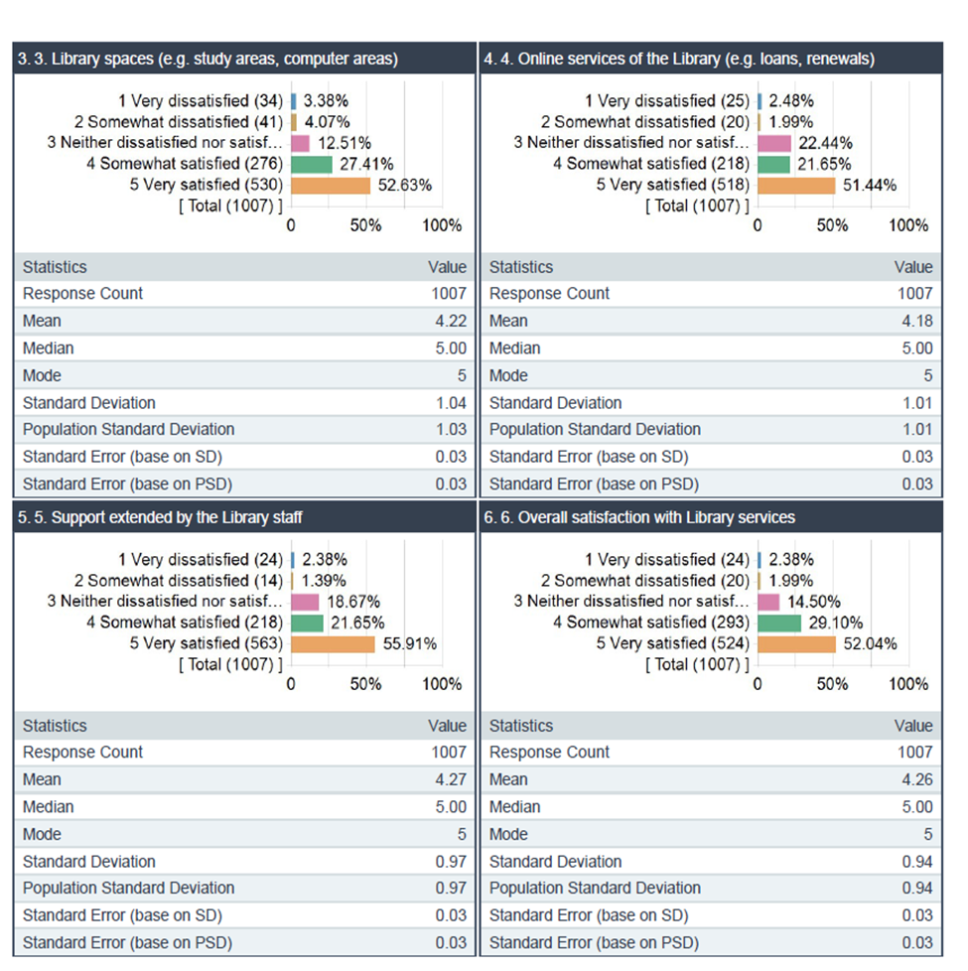
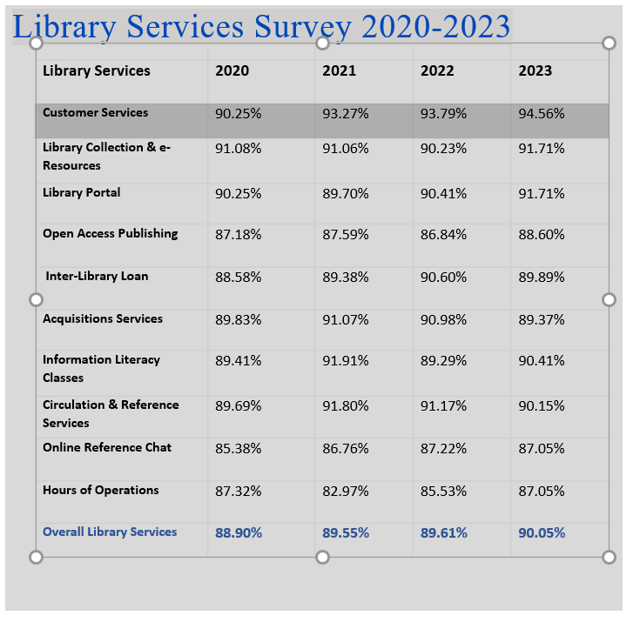
Library Service survey

Slide 19

Thank You !

