Slide 1
MVEE:
A Framework for Evolutionary Studies.
?
?
Daniel Ari
Friedman
2018
Notes:
Goals…….

Slide 2
Research Question:
How can we formalize the evolution of heredity, environment, and phenotype through time and across biological levels?

Slide 3
Research Question:
How can we formalize the evolution of heredity, environment, and phenotype through time and across biological levels
……..accounting for……..
plasticity & meta-plasticity,
interactions within and among scales,
scientific knowledge/measurement/modeling constraints,
ecological variability over behavioral/developmental/evolutionary time,
diversity & open-endedness of evolving systems (bio/social/computational)
?

Slide 4
Research Question:
How can we formalize the evolution of heredity, environment, and phenotype through time and across biological levels?
Goal:
Extend Variational Neuroethology (Ramstead et al. 2017) to specify a tractable general framework for all Evolutionary studies, Biological and Otherwise.
This would allow us to integrate current data across systems and suggest new measurements/experiments/systems.

Slide 5
This Talk:
Background theory...Part 1
  Claim 1: EcoEvoDevo is trapped in a locally-optimizing regime because it is trapped in an incoherent G-P-E & F phrasing.

Slide 6
This Talk:
Background theory...Part 1
  Claim 1: EcoEvoDevo is trapped in a locally-optimizing regime because it is trapped in an incoherent G-P-E & F phrasing.
Background theory...Part 2
  Claim 2: The data, theory, math, and philosophy already exist to synthesize a tractable generalized model of evolution.

Slide 7

This Talk:
Background theory...Part 1
  Claim 1: EcoEvoDevo is trapped in a locally-optimizing regime because it is trapped in an incoherent G-P-E & F phrasing.
Background theory...Part 2
  Claim 2: The data, theory, math, and philosophy already exist to synthesize a tractable generalized model of evolution.
MVEE - A Way Forward….
  MVEE sits between VNE and EcoEvoDevo.
  MVEE is a Synergetic framework for Evolutionary studies.
  MVEE == Variational Neuroethology + EcoEvoDevo + Collective Behavior + ML

Slide 9
Theoretical Background
Part 1

Slide 10
“Fitness”?

Slide 12
Theoretical Background
Part 2

Slide 13
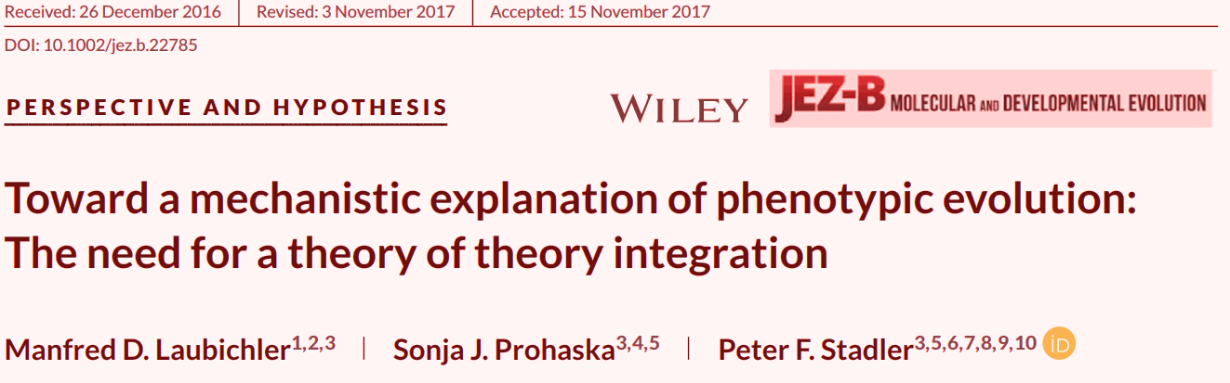
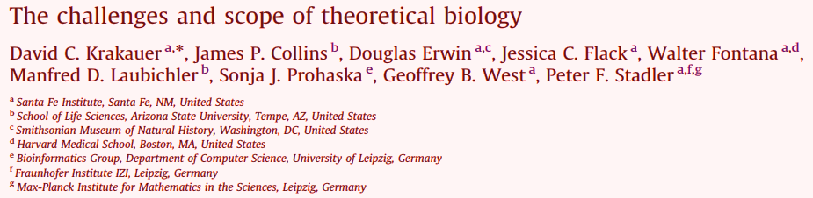
2018
2011
We need a way to integrate sub-theories.

Slide 14
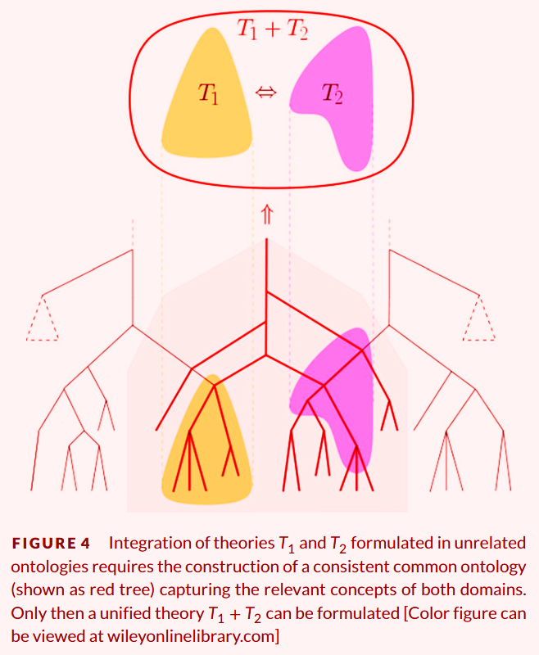
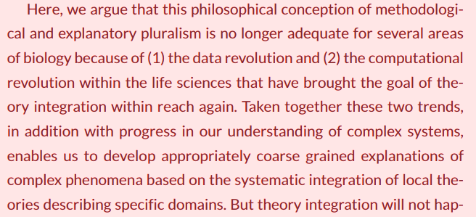
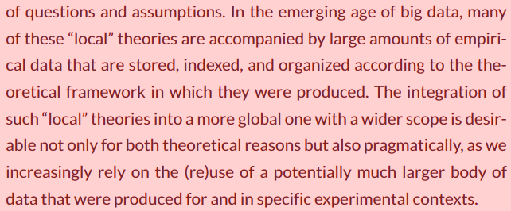
2018

Slide 15
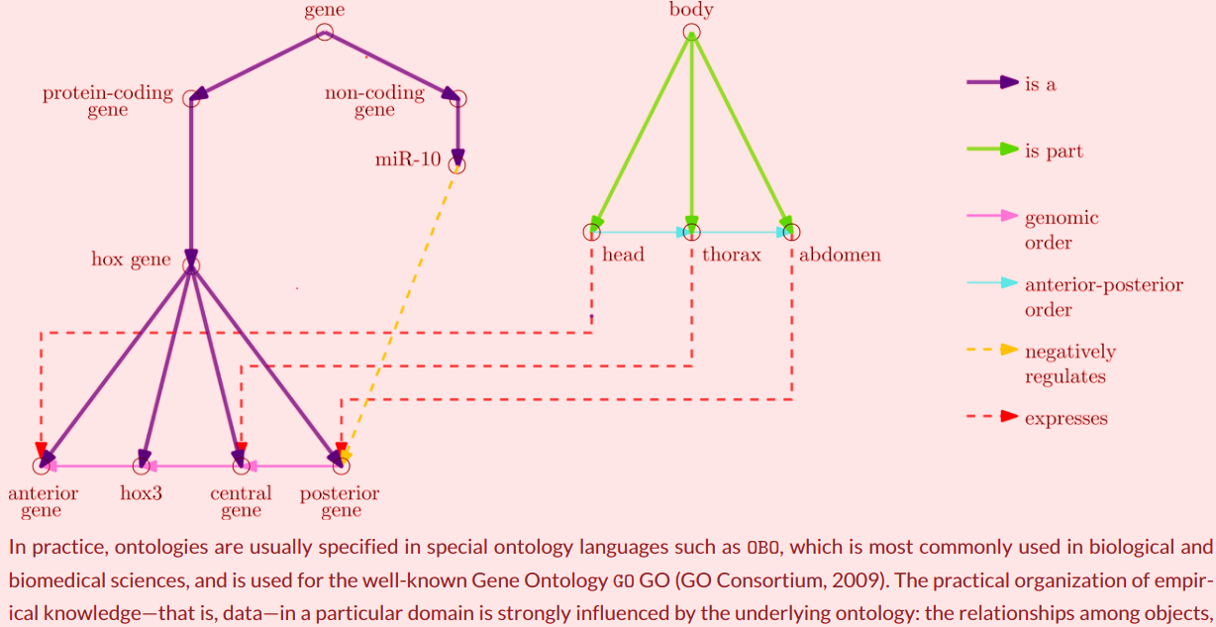

Slide 16
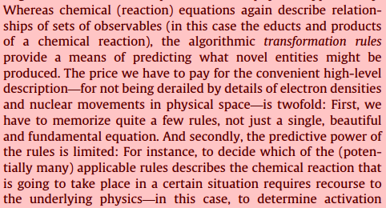
k_{ab}
A + B
A-B
2011
???
???
???
First issue: Complex biological patterns, no “rules”….
(e.g. not just “entropy” or ψ)
Second issue:Which rules apply for a specific situation? How do we compute or apply these rules/patterns?

Slide 17
s
s
x₁
x₁
x₂
h²
R = h²s
R
Simple state models in Biology….
Theoretical assumptions are violated in nature (H-W, additivity)
No insights/inferences into mechanisms or counterfactuals
Hard to apply to real data (or limited plausible sample size)

Slide 18
R = h²s
Is like a “F=MA” of Biology.
Like Fundamental Theorem of NS, or Price Eq., or Indirect/Kin...
State models don’t make assumptions about underlying processes.
We don’t think that F=MA is (or, “needs to be”) hard-coded into our universe. F=MA is a pattern that applies to varying degrees of accuracy for certain spatial temporal scales.
What is “hard-coded” below F=MA?

Slide 19
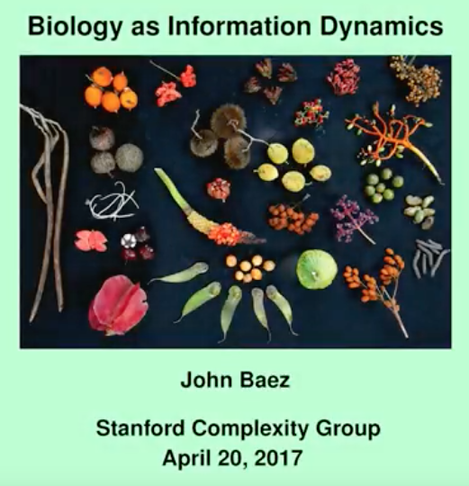
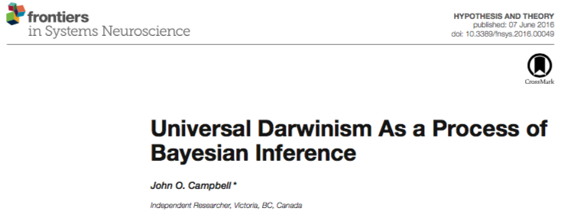

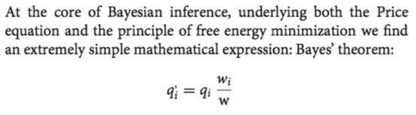
2016
2017
2016
Recent work on Gauge theories and Information Entropy in Biology….
2017

Slide 20

2016
2017
2017
2016
Recent work on Gauge theories and Information Entropy in Biology….
2017
2017

Slide 21
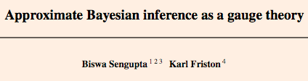
2016
2017
2017
Recent work on Gauge theories and Information Entropy in Biology….
2017

Slide 22
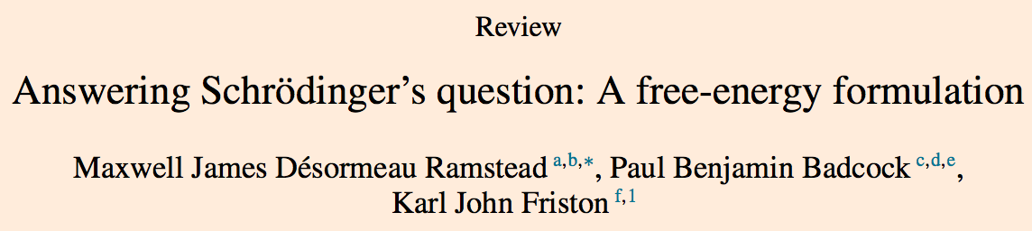
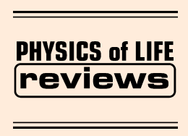
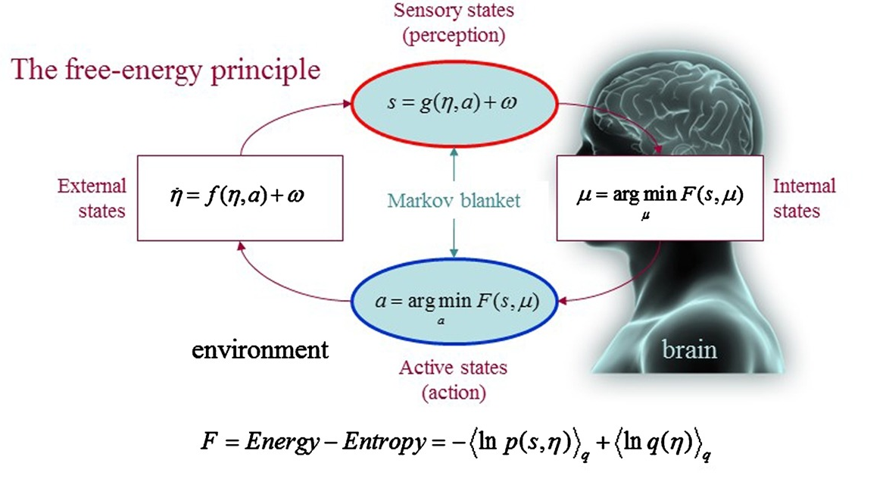
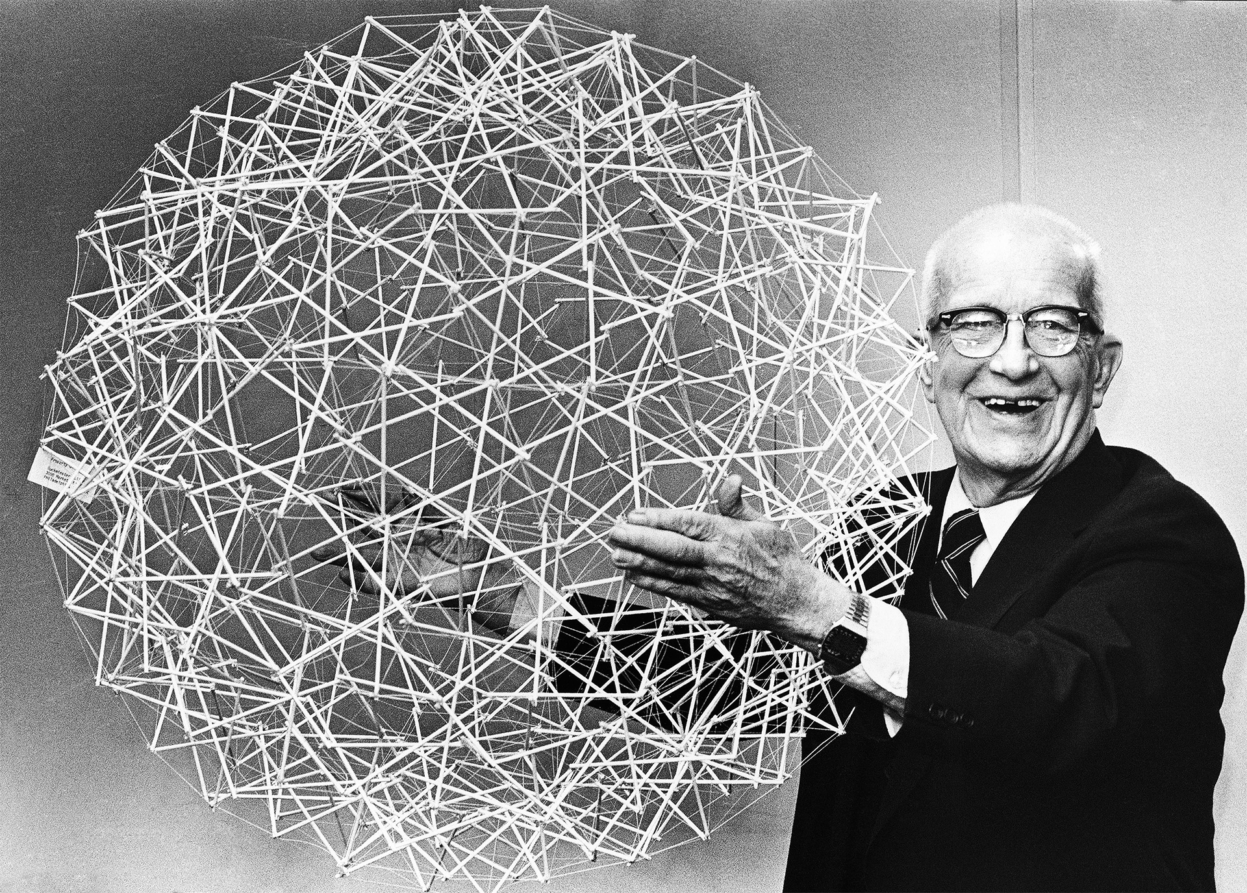
VNE
Variational
Neuro-
Ethology
Ramstead, Badcock & Friston
2017
RBF
“just a coincidence”??

Slide 23
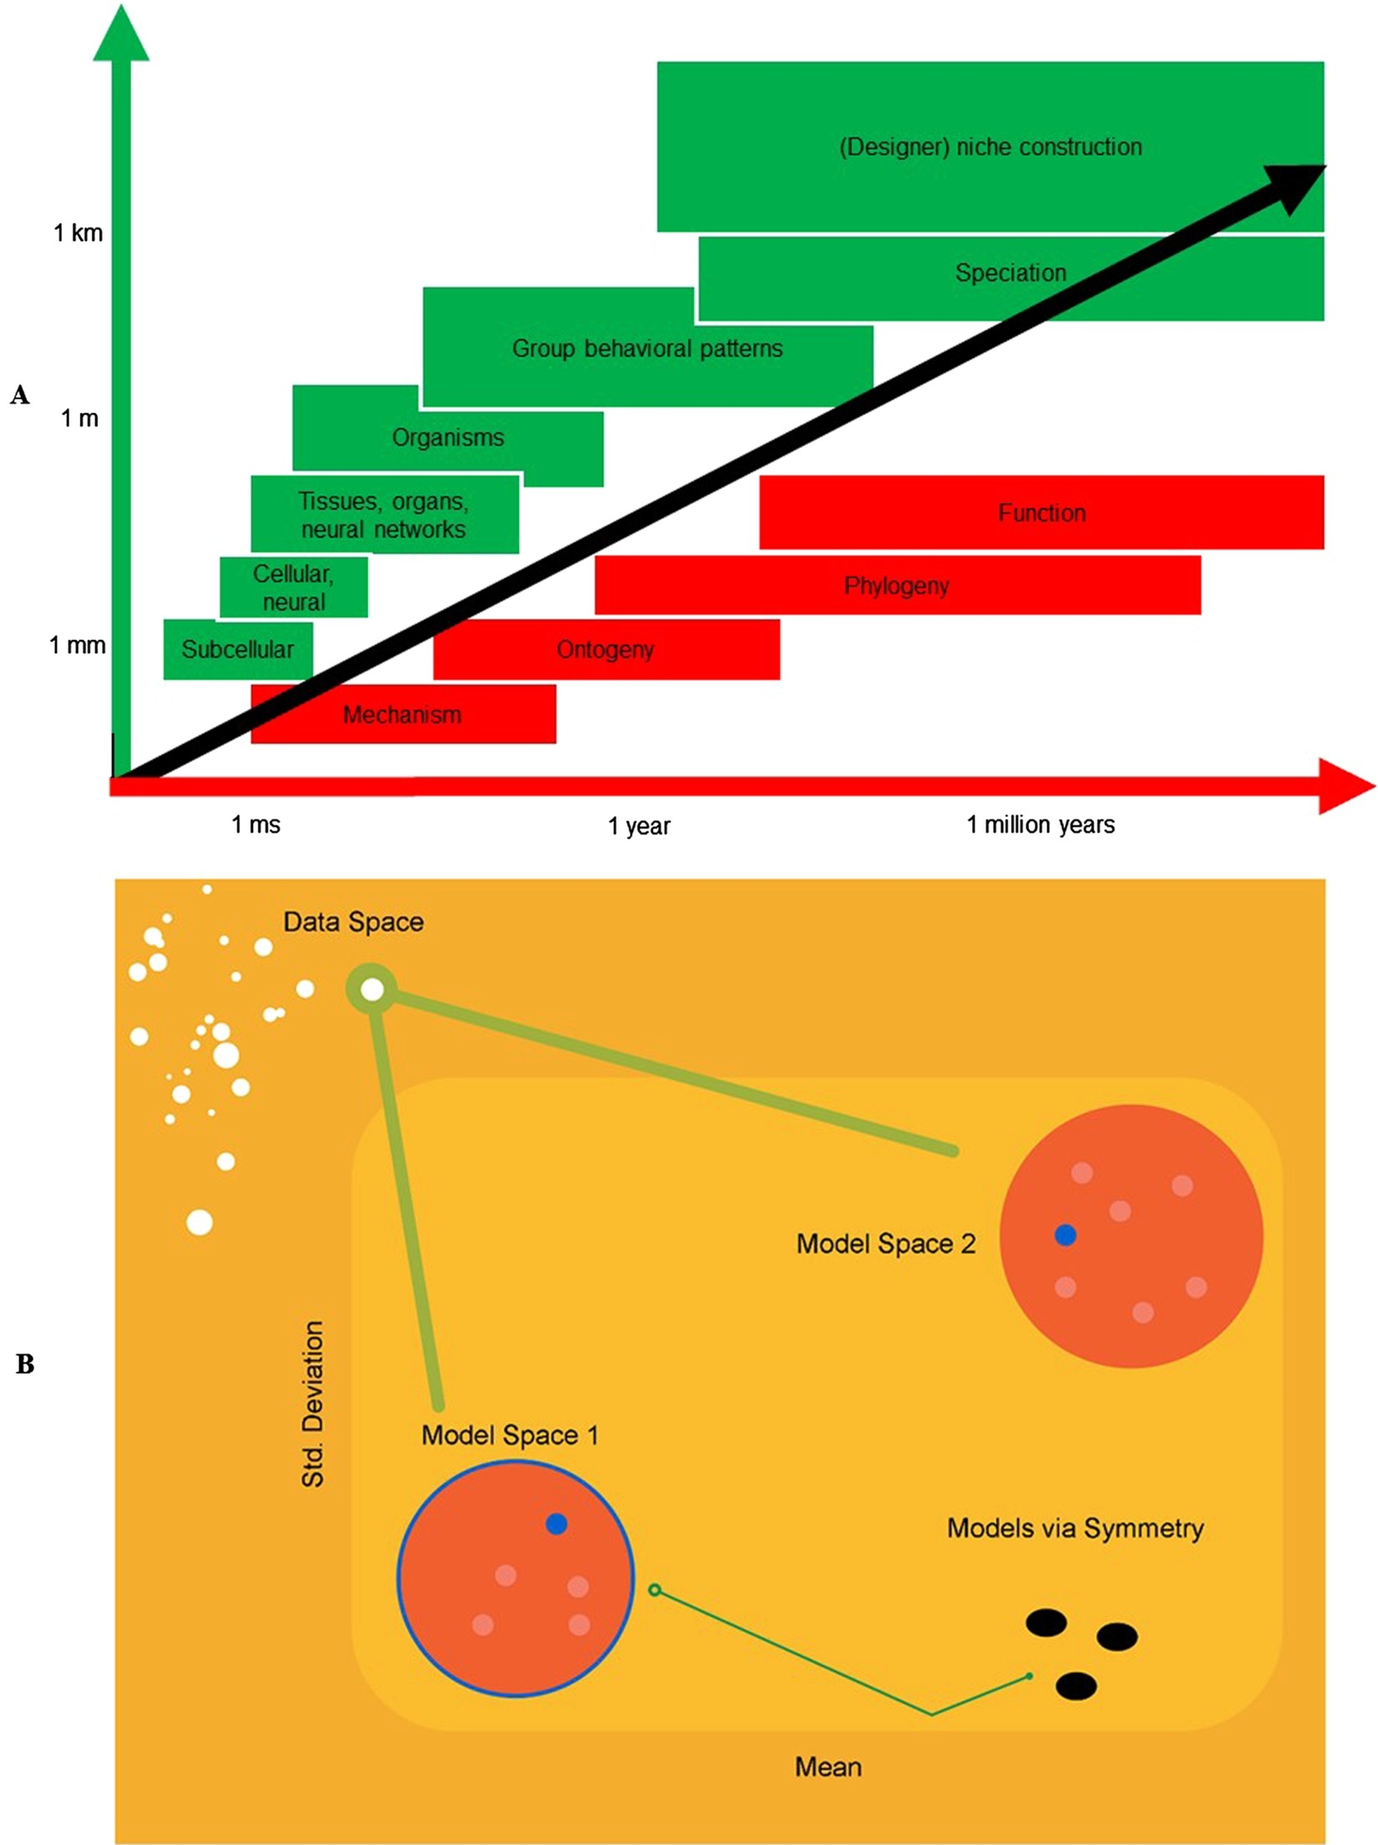
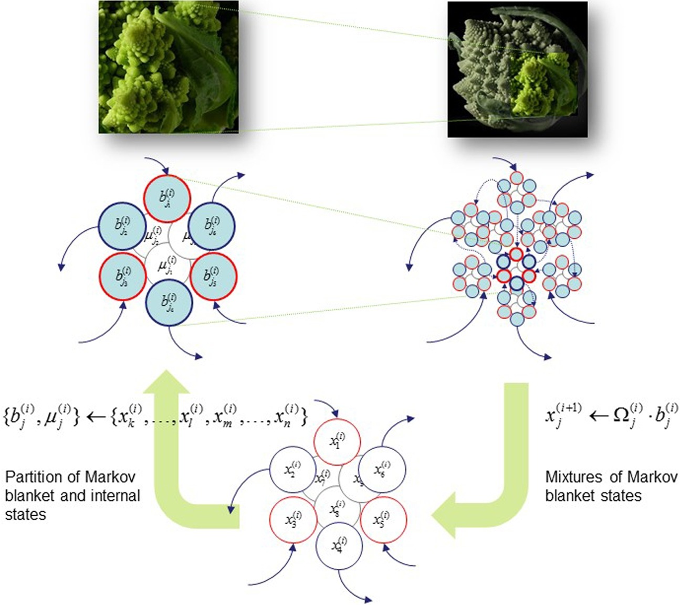
VNE applies to biological systems across many orders of magnitude of spatio-temporal variation.
VNE is an Evolutionary Systems Theory about how hierarchically-nested Markov blankets performing active inference inextricably (statistically and mechanistically) link internal and external states through action and perception among, and across, biological spatio-temporal scales.

Slide 24
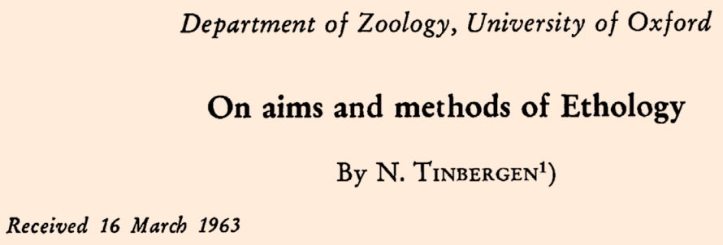
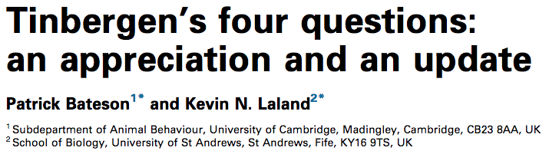
RBF 2017: “Given the success of this explanatory framework in biology, we suggest that Tinbergen’s levels of inquiry might be apt to elucidate structural laws that supplement the general principles provided by the FEP….the FEP describes a [general biological modeling imperative], while Tinbergen has offered a distinctive but complementary framework that allows us to develop substantive explanations for the phenotypic traits and behaviors of any given species or organism…”
Contemporary
Historical
How?
(Proximate)
Mechanism
Causal Explanation
Development
Ontogeny, Plasticity
Why?
(Ultimate)
Function
Use or Survival Value
Evolution
Selection and Drift

Slide 25
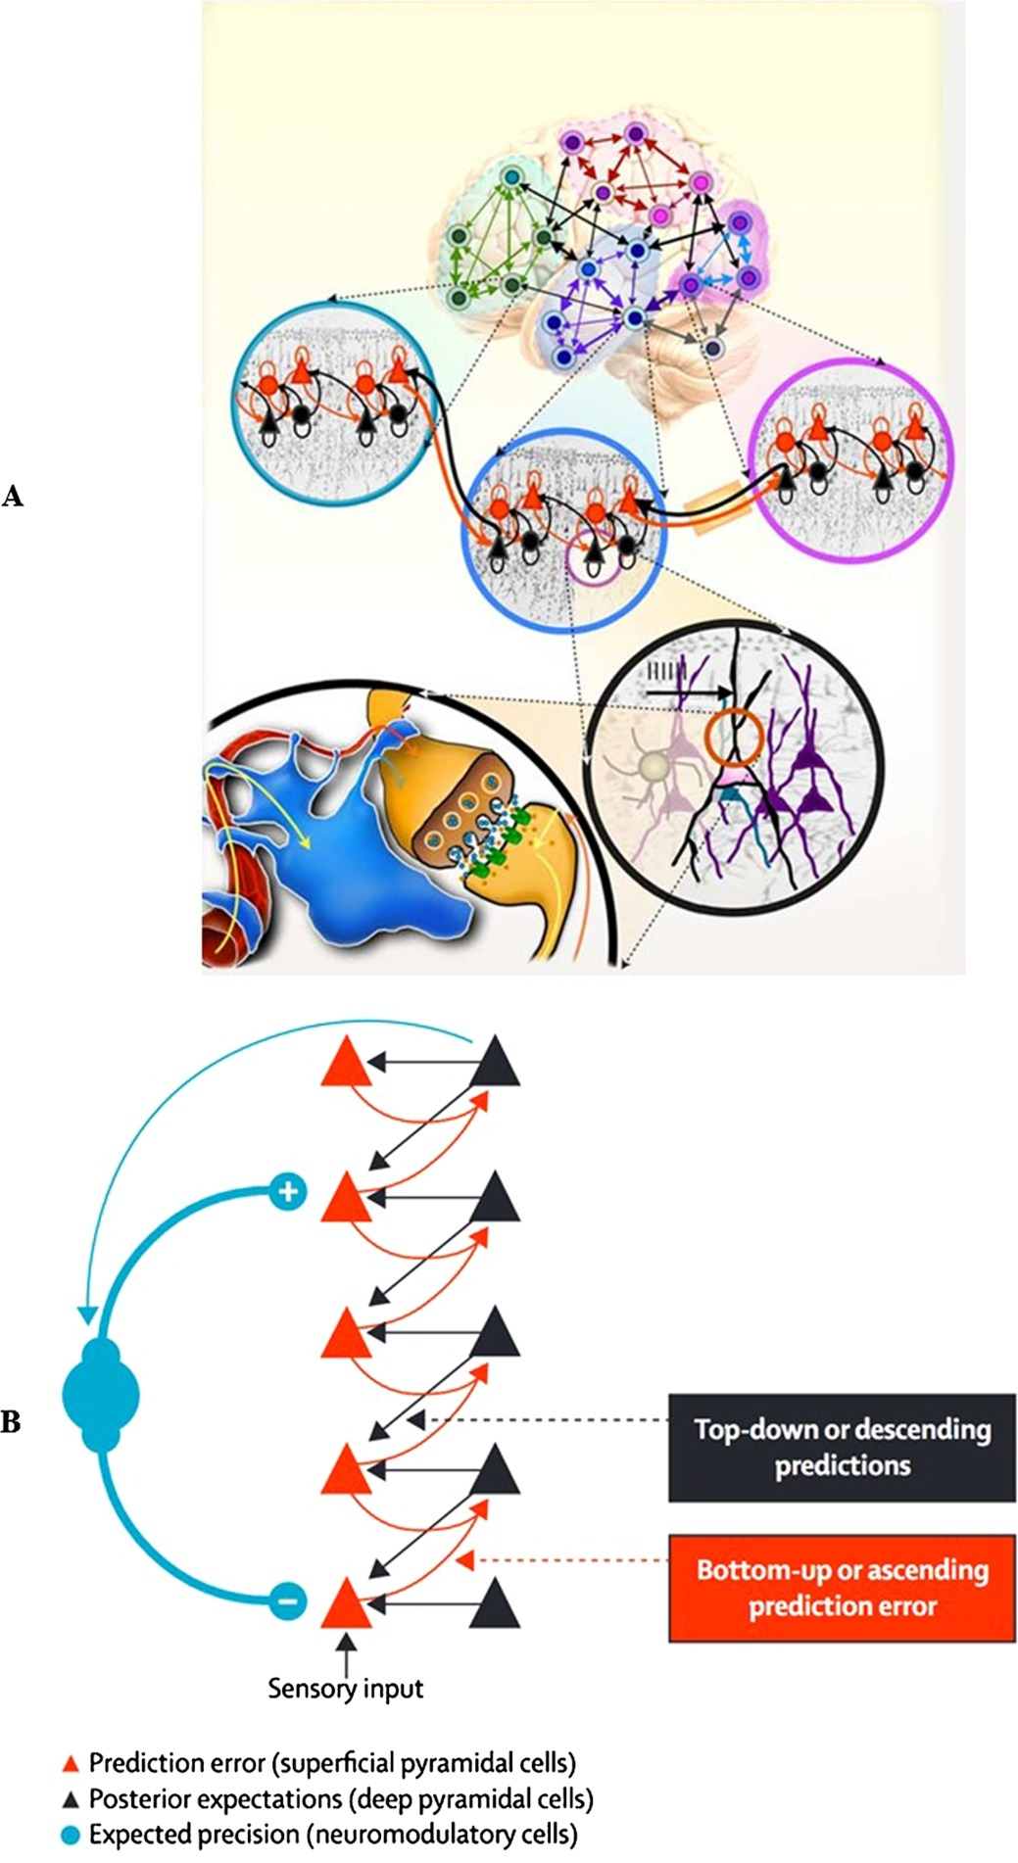
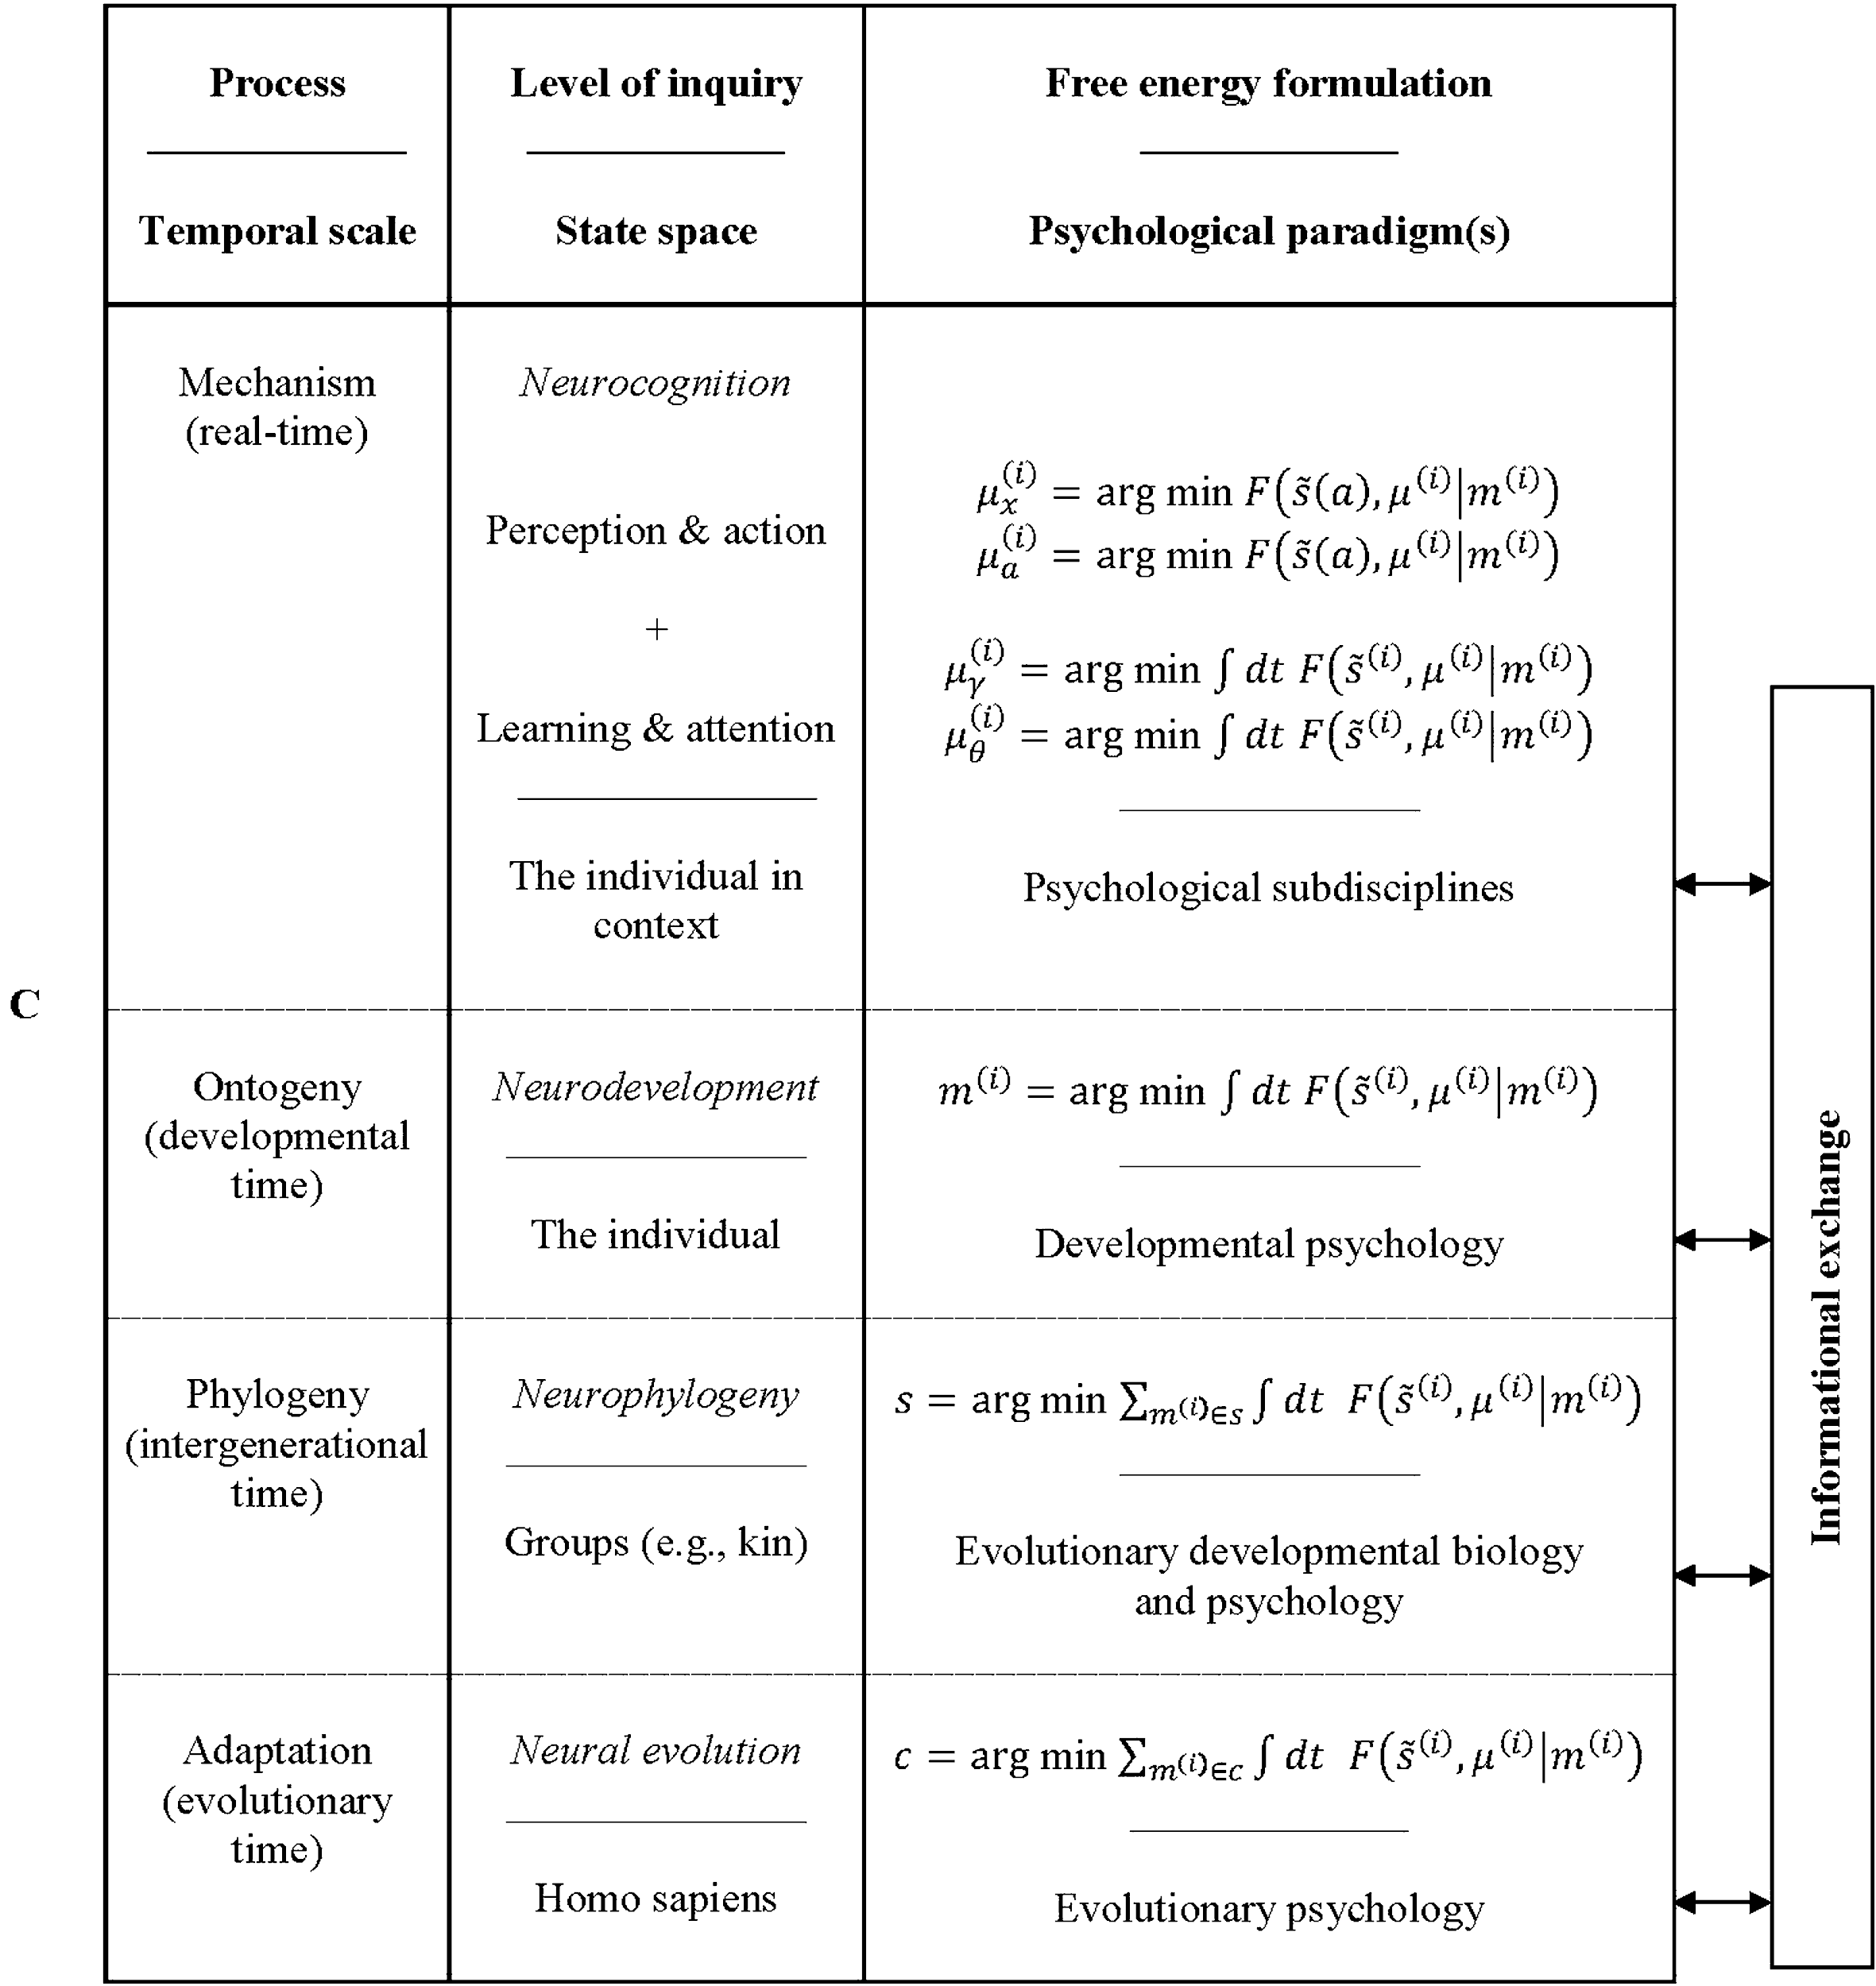
RBF 2017 work through only one example in their paper:
How the “Hierarchically Mechanistic Minds” EST can be used within the Variational Neuroethology framework to study all scales of human socio-biocultural evolution in Humans.

Slide 26
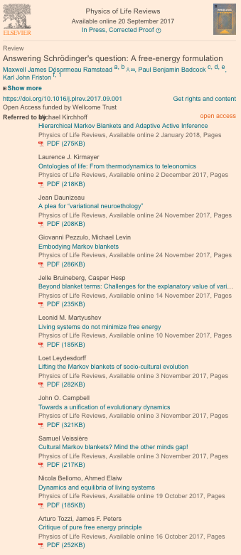
Other people are already critiquing and building on VNE.
As of 1/3/2018
12 comments

Slide 27
The case study in VNE on human cognition is still not operationalized in a way that allows usage of actual data:
And it is even more unclear how the VNE approach could be deployed in other, arbitrary evolutionary systems…….. Especially using real data!

Slide 28
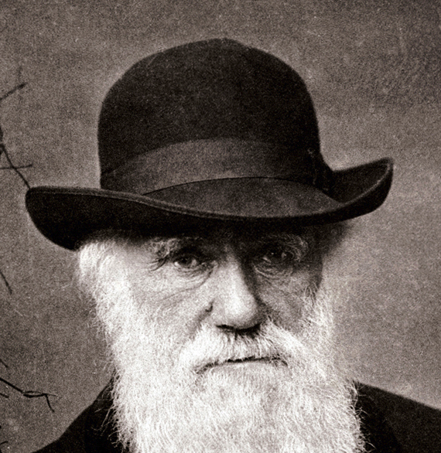
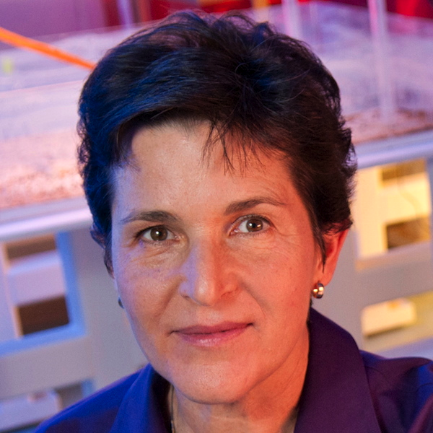
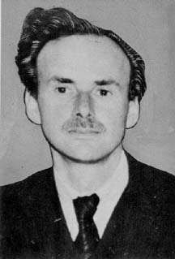
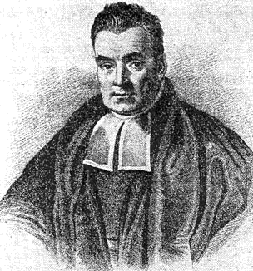
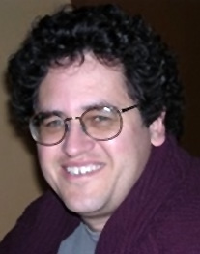
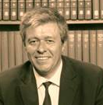
“Read Dennett (1995) and Noble (2016) and J&L (2005)
& Akçay & Van Cleve (2016) and EFK (2000) and .....”
2013
Processes, Interactions, Context (1992,2011,2014,2016)
“Keep it rational and measurable”
Ⓕⓡⓔⓔ Ⓔⓝⓔⓡⓖⓨ
Pragmatic…Empirical…Quantitative…Pluralistic...
Make predictions.…..Accommodate Complexity…

Slide 29
Claim 2:
The data, theory, and philosophy already exist to synthesize a tractable generalized model of evolution!
The challenge lies in finding how to integrate the VNE with classical evolutionary theory and apply it to real systems using limited empirical data.

Slide 31

MVEE- A Way Forward...
EcoEvo
Devo
Lamarck…
Darwin…
W1959?
W-E2003?
Modern
Synthesis
Natural
Selection
1920’s
1806
1859

Slide 32
EcoEvoDevo
T4?’s
EST
EcoDevo

Slide 33
VNE
EcoEvoDevo
FEP
T4?’s
EST
EcoDevo

Slide 34
MVEE
VNE
EcoEvoDevo
FEP
T4?’s
EST
EcoDevo

Slide 35
ML
MVEE
TFlow
Bucky
Hakan
Collective Behavior
Synergetics
Hakan
VNE
EcoEvoDevo
FEP
T4?’s
EST
EcoDevo

Slide 36
Multilevel Variational Evolutionary Ecology
(MVEE)
“Variational” in the Darwinian sense refers to “Natural Variation”, for example in Lewontin 1983. However “Variational” also is technically used to refer to variational (ensemble) Bayesian models, for example in the Variational Free Energy Principle. MVEE draws on both these definitions.
MVEE also has another embedded meaning:
Minimum Viable Evolutionary Explanation.
As it turns out, MVEE is the framework for formulating MVEE’s!

Slide 37
Is MVEE consistent with prior Biological theory?
  Yes, I believe MVEE is at worst equivalent to EcoEvoDevo at best.
Is MVEE a Gauge Theory?
  Yes, it only deals with observables and follows RBF 2017.
Can MVEE deal with theoretical (analytical) evolution?
  Yes, and may provide atemporal formal solutions to these systems.
Can MVEE deal with empirical (open) evolution?
  Yes, and at least can provide statistically-optimal estimates and maximally-informed hypotheses about real biological systems.
What is the computational architecture of MVEE?
  By using a single integrated machine learning framework on pre-existing biological data (TensorFlow/compute-graph), MVEE jointly and optimally considers coarse-grained state and process models across scales.

Slide 38
No “Fitness”....
Only measurable things:
G, E, P, and Time
Time
P₁
P₂
E₁
E₂
G₁
G₂

Slide 39
PROCESS MODELS
STATE MODELS
P₁
P₂
time
E₁
E₂
G₁
G₂
Collective Behavior
Decent. Algorithms

Slide 40
STATE MODELS
Use what
works!
P₁
P₂
E₁
E₂
G₁
G₂

Slide 41
Developmental &
Quant. Genetics
Env. Change
Evo. Genetics
P₁
P₂
E₁
E₂
G₁
G₂

Slide 42
(plasticity or transgenerational)
Epigenetics
Niche Construction
Phenomenological models of DNA evolution (GTR)
P₁
P₂
E₁
E₂
G₁
G₂

Slide 43
Development
P
E
G

Slide 44
Development
Evolution of Development…..
time
Within generation = “Meta-Plasticity”
Between generations =
“EcoEvoDevo”
P₁
P₂
E₁
E₂
G₁
G₂

Slide 45
PROCESS MODELS
Collective Behavior
Local computation
Predictive/Adaptive
Multilevel Feedback loops
Robustness & Evolvability
Emergence/Self-Organization
What is the Algorithm?
What does each agent perceive?
What can each agent do?
How do group outcomes arise?

Slide 46

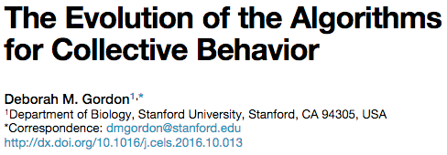
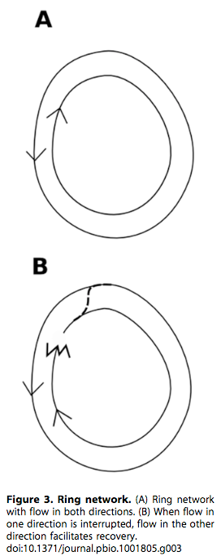
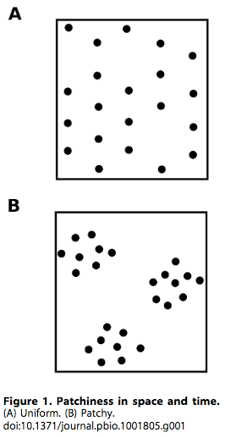
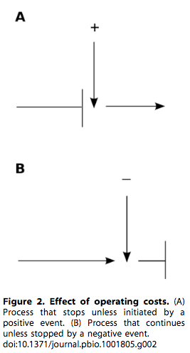
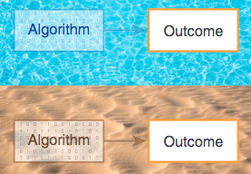
Formalizing a decentralized process implies formalizing the environmental dynamics:
2014
2016
Also see Collective Behavior Appendix

Slide 47
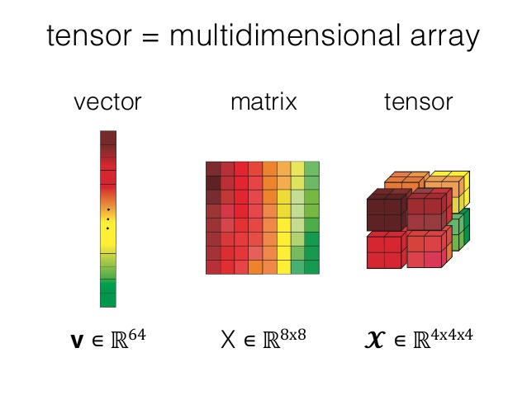


GEP₁
GEP₂
Biology ∈ ℝ^{GEP}
^{t}
GEP₃
GEP_{n}
Generalized, Dynamic, multiscale
Tensor representation of Any Evolving System.
Free from “Fitness”!

Slide 48
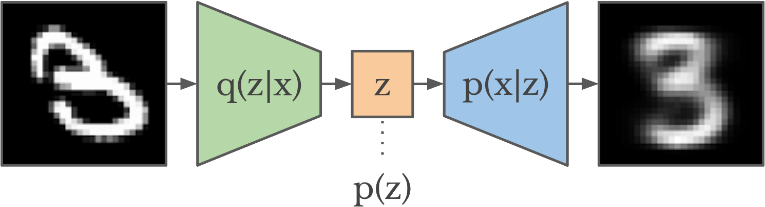
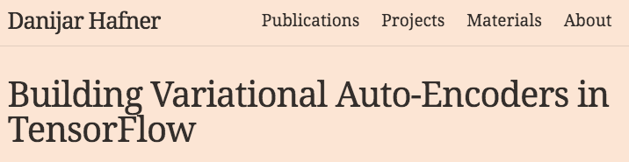
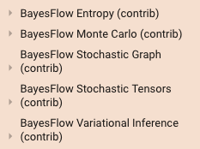
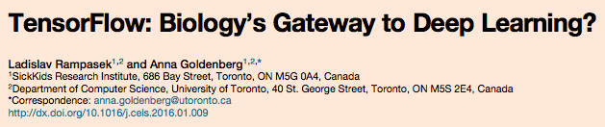
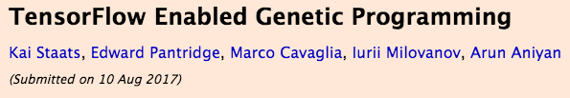
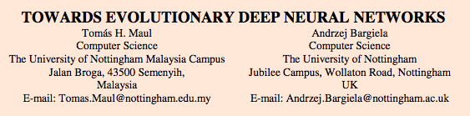
And more...

Slide 49
E = MVEE⊗t
Evolution is (described by)
Multilevel Variational Evolutionary Ecology
tens⊗rized through time

Slide 50
Summary
In Two Breaths

Slide 51
1.
D
P
EED
is a mess...
G
E
F
E
?

Slide 52
E = MVEE⊗t
2.
Biology ∈ ℝ^{GEP}
^{t}
MVEE draws on many sources, especially VNE,
to potentially overcome some of the fundamental weaknesses in current evolutionary studies.

Slide 53

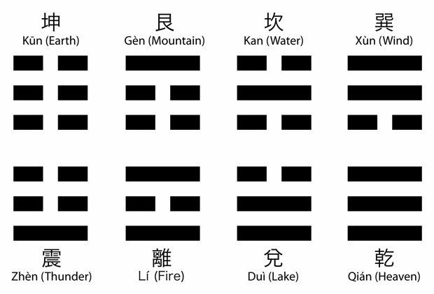
&
E = MVEE⊗t
Biology ∈ ℝ^{GEP}
^{t}

Slide 55
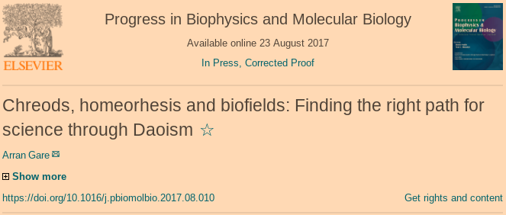
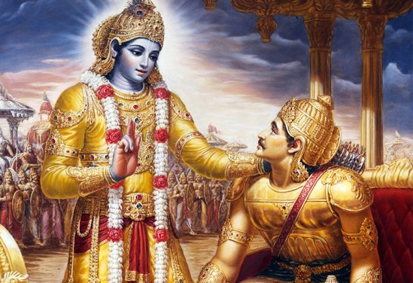
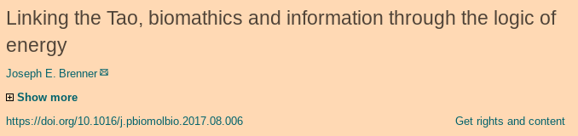
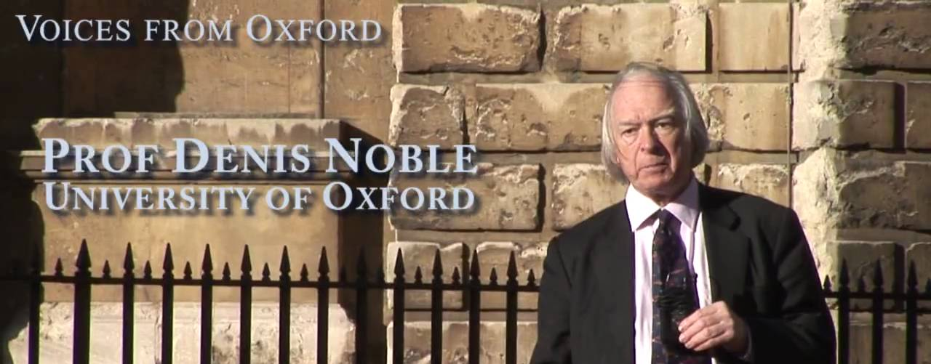
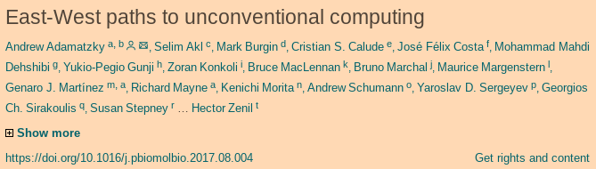
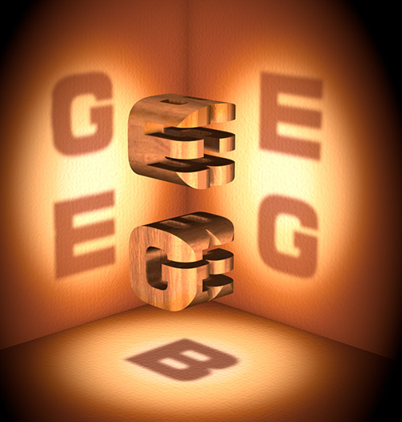
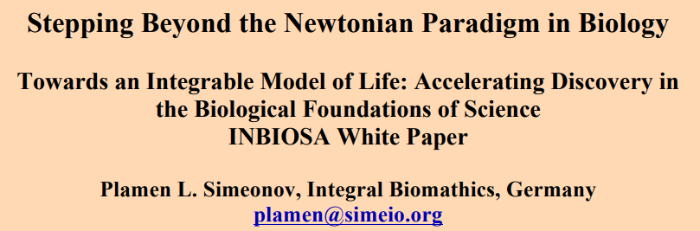
Hankey, Igamberdiev, Hu/Petoukhov², Islami, Rosen, Longo…...

Slide 56
Appendix 1
Collective
Behavior

Slide 57
Appendix 2
Synergetics

Slide 58
Appendix 3
Gauge and
Coarse-Graining.

Slide 60
Appendix 1
Collective
Behavior

Slide 61
Define “Behavior”:
Pragmatically, Pluralistically,
Algorithmically, Empirically,
Parsimoniously, etc
A multilevel, Coarse-Grained, Mechanism-Flexible taxonomy is our manifold map to effectively navigate the multilevel (G-E-P)_{t} Tensor construct.

Slide 62
“Hallmarks of Life”
Heredity
Development
Reproduction
Response to Stimuli
Metabolism
Homeostasis
Adaptation/Evolution
Negentropy Generation (S. 1944)
Aperiodic Crystal Structure (S. 1944)

Slide 63
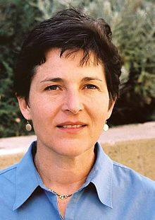
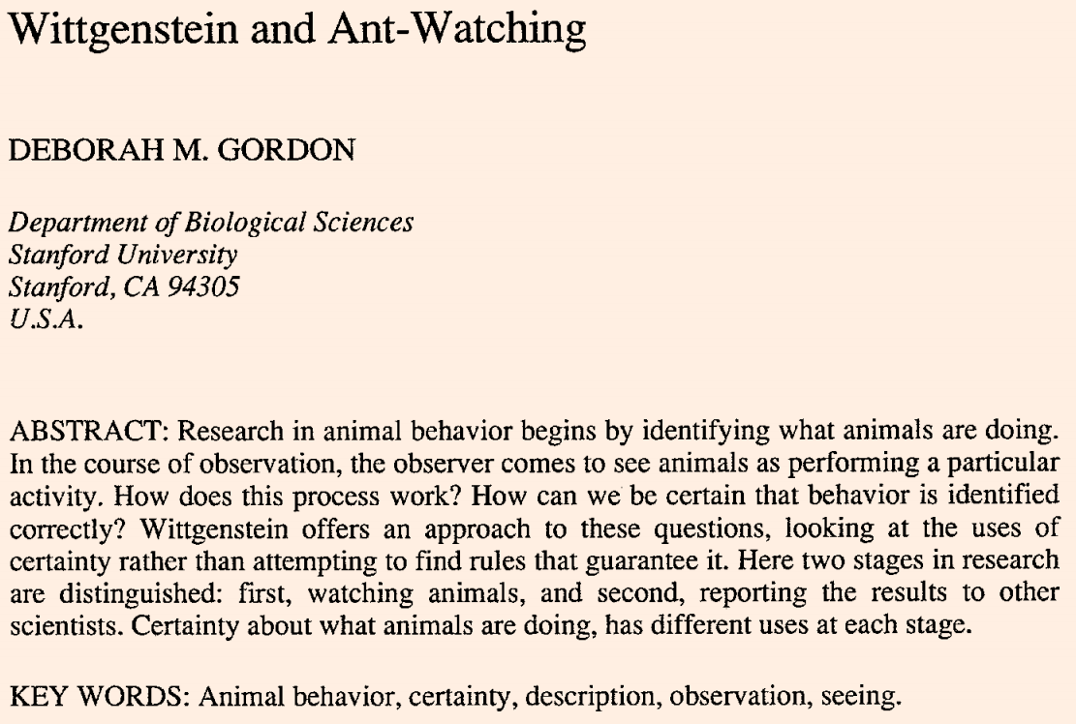


1992

Slide 64
“Hallmarks of Life”
Heredity
Development
Reproduction
Response to Stimuli
Metabolism
Homeostasis
Adaptation/Evolution
Negentropy Generation (S. 1944)
Aperiodic Crystal Structure (S. 1944)

Slide 65
“Hallmarks of Life”
“Algorithms of Life!!”
Heredity
Maintain Information/Material
Development
Intra-Generational Change
Eco
Evo
Devo
Reproduction
Inter-Generational Change
Response to Stimuli
Process Information
Metabolism
Process Resources
Homeostasis
Resilience, Robustness, Persistence
Adaptation/Evolution
Learning & Inference (Implied from above)
Negentropy Generation (S. 1944)
Local organization (e.g. Stigmergy)
Aperiodic Crystal Structure (S. 1944)
Physical-Informational Nexus

Slide 66
The “Algorithms of Life” are coarse-grained or simulated algorithmic models, providing biologically-plausible manifolds to explore the GEP tensor over any time scale….
The compute graph (TensorFlow) model allows arbitrary, modular, and tractable use of current data/models.

Slide 67
The “Algorithms of Life” are coarse-grained or simulated algorithmic models, providing biologically-plausible manifolds to explore the GEP tensor over any time scale….
In other words, we use information about the species/time-specific processes to preferentially explore functional manifolds that are reachable under informed models but implausible under incorrect models (e.g. Parsimony vs. GTR+I+G)......
We know that bone morphogenetic processes and allometric scaling allow us to understand biases of morphological evo. (Gould’s Antlers, Wagner, Turing) ...................We need something like this for collective behavior!

Slide 68
TREE, 2013
Contemporary
Historical
How?
(Proximate)
Mechanism
Causal Explanation
Development
Ontogeny, Plasticity
Why?
(Ultimate)
Function
Use or Survival Value
Evolution
Selection and Drift

Slide 70
Appendix 2
Synergetics

Slide 71



+ Hakan (1983) :
"Nonequilibrium Nonlinear Statistical Physics"
Complexity:
"Self-Organization"
"Chaos and Order"
(Phase transitions, etc…)
1975
1979

Slide 72


P
RBF’s K-Shell Class of Tensegrity Structures exhaustively and hierarchically describes structural dynamics among K items.
E
G

Slide 73
An MVEE object is a formalized dynamic multiscale Synergetic equilibrium:
Class 3 + 1
Tensegrity system
(open ended Szathmary et al. 2016/2017, Infinite Semiosis/Novelty)
States
Processes
P
P
E
Time
E
G
G

Slide 74
An MVEE object is a formalized dynamic multiscale Synergetic equilibrium:
Class 3 + 1
Tensegrity system
(open ended Szathmary et al. 2016/2017, Infinite Semiosis/Novelty)
Class 4
Tensegrity system
(closed-form Nowak / Game Theory, limited syntactic Novelty)
(Mechanism under strong closure)
F
States
P
Processes
P
P
E
E
Time
G
E
G
G
Formal, timeless relationships
as in Newtonian physics

Slide 76
Appendix 3
Gauge and
Coarse-Graining.

Slide 77
If you printed and crystallized the single-stranded DNA of all possible sequences of a 100-basepair genome, the required volume would be:
?

Slide 78

If you printed and crystallized the single-stranded DNA of all possible sequences of a 100-basepair genome, the required volume would be
10 billion times the volume of Jupiter.
(1.76e+25 km^3 == (1.1e-26 m^3 displaced per 100-bp DNA helix) * (1.6e60 oligomers, representing the 4^100 combinations in sequence space)).
Every specific genomic configuration is novel.
The same could probably be said for Phenotype or Environment, which are both endlessly dynamic and infinitely describable (cue Borges story…..). So…..
We use abstract lower-dimensional state spaces (manifolds).

Slide 79
Broadly we can consider two types of theory -- State and Process theories:
State = What?
PV = nRT……..E = mc²……...R = h²S….
These are State theories because they describe how aspects of the system (measured or calculated) are instantaneously related to one another. They are predictive and mechanistically agnostic.
Process = How?
Natural Selection….Thermodynamics…..Semiotics….
Theses are Process theories because they describe algorithmic, procedural, or mechanistic relationships and becomings. They are not predictive unless coupled to a state theory as well.
For example, R = h²S is a simple state model following the process model of Darwin 1859.

Slide 80





G
E
P
D i m e n s i o n a l r e d u c t i o n ….
(Coarse-Graining of Data)
F

Slide 81

2013
“Gauge”= “Measurement”
“Dirac defines gauge as under-determination of the variables’ evolution, and observes that….only gauge-invariant quantities can be physical, by definition...”
Rovelli 2013

Slide 82

2013
“Dirac defines gauge as under-determination of the variables’ evolution, and observes that….only gauge-invariant quantities can be physical, by definition...”
Rovelli 2013

Slide 83





Coarse-graining
Mainstream:

Slide 84



Coarse-graining
Fringe:
2013
2016

Slide 85
Coarse-graining
I personally don’t care about philosophical issues of top-down causation but I am bolstered by knowing that some people heartily endorse this principle as transcendent.
I am interested in how we can formalize optimal State and Process model/data coarse-graining, given our available information about the states and processes of the world.

Slide 86
Example state/process + coarse-graining for “Pogo Foraging”
For the scale of one ant colony over one day:
State: Dynamic model (any type) with colony-, time- and environment-effects, e.g. Prab.2012
Process: an agent-based model like e.g. G.G.2013 + Davidson.2016
For the scale of a population of colonies over a summer:
State: An ensemble characterization of foraging dynamics using the State model above. Calculated on a realized ecological trajectory, or over a distribution of trajectories.
Process: A parametric or non-parametric descriptor of ensembles of the Process model above, allowing for natural variation in colony-specific “sensitivity”, iterated over a summer.
For the scale of populations over intergenerational time:
State: Something like Fisher’s Fundamental Theorem or R = h²S (but see Ewens/Lessard 2015 and Plutynski 2006), applied to the simulated/actual Phenotype-Fitness mappings from the above State model.
Process: A life history table showing how colony behavior, colony developmental stage, and ecological context influence the likelihood that a colony leaves offspring….AND….. a mechanistic neurophysiological model explaining how statistical heritability arises via vertical transmission of molecular variation........Make Darwin Proud Again!!!

Slide 87




2017
2016

Slide 88



