Slide 1


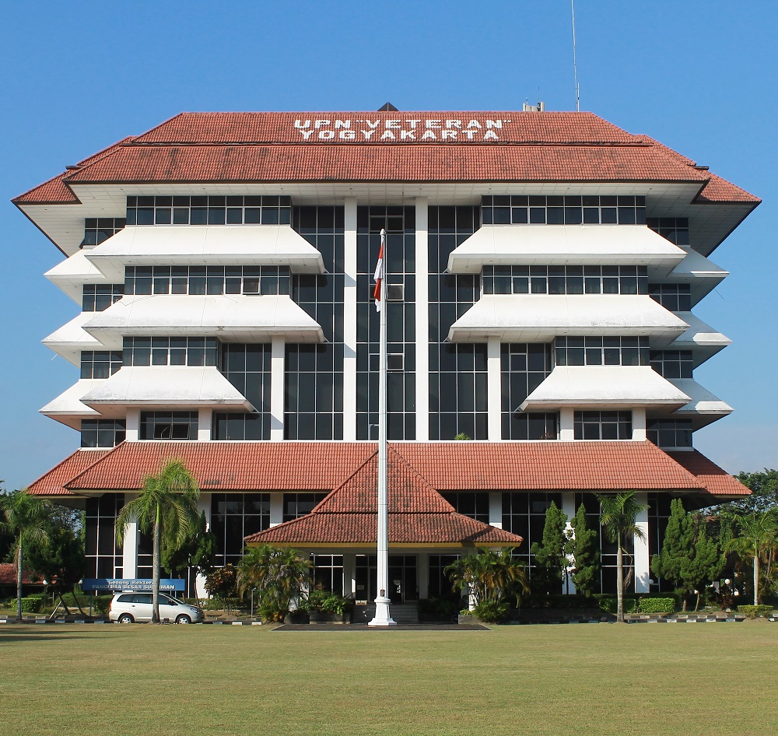
International Conference on Advanced Research in Engineering and Technology (ICARET-24)
October 23rd-24th, 2024 | LPPM UPN “Veteran” Yogyakarta
Multi Objective Optimization
of Physical Work Environment Parameters to Minimize Driver Fatigue
in the Logistics Industry
Intan Berlianty, Irwan Soejanto, Indun Titisariwati, Wahyu Tri utami, Mohammad Kamil Insani,
Favian Ersanta Andhika Putra
01

Slide 2
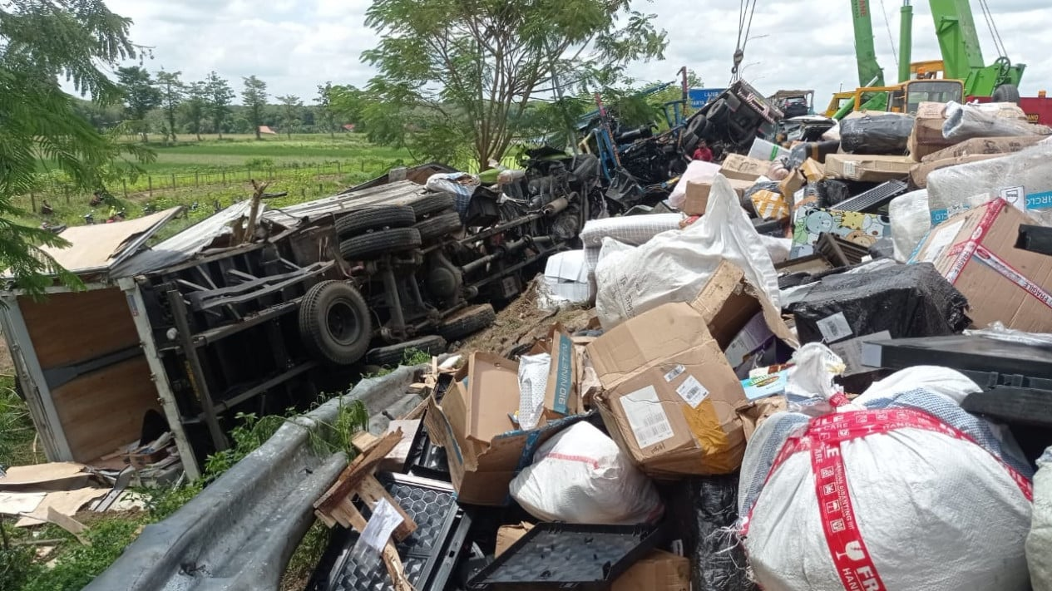

International Conference on Advanced Research in Engineering and Technology (ICARET-24)
October 23rd-24th, 2024 | LPPM UPN “Veteran” Yogyakarta
RESEARCH PURPOSES
The logistics industry has experienced significant growth, driven by increasing consumer demand for fast and efficient delivery. However, behind this operational success, there are major challenges related to the health and safety of drivers, who are the backbone of the supply chain [1]. One of the main problems faced by drivers is work fatigue [2], [3], which not only negatively impacts their health but also on road safety and operational efficiency [4]. Driver fatigue has been identified as a contributing factor to traffic accidents, operational errors, and deterioration in service quality, making it a critical issue to address [5] .
Driver fatigue is often affected by unfavorable physical work environment conditions, such as high noise levels and extreme temperatures (6). Therefore, creating a better physical working environment for drivers is an important priority in the logistics industry.
Creating a better physical working environment to minimize work fatigue on the drivers as the backbone of the supply chain, especially on the logistic industry
02

Slide 3

International Conference on Advanced Research in Engineering and Technology (ICARET-24)
October 23rd-24th, 2024 | LPPM UPN “Veteran” Yogyakarta
THEORY APPROACH
Excessive noise can lead to impaired concentration, stress, and mental fatigue, while uncomfortable temperatures, especially in enclosed vehicles, can interfere with the driver's physiological functions, leading to dehydration, physical fatigue, and even more serious health risks [7].
a Multi-Objective Optimization (MOO) approach to overcome the problem of driver fatigue by optimizing the parameters of the physical work environment at the same time[8]. This approach differs from previous studies because MOO allows for the optimization of multiple objectives simultaneously. In this case the reduction of noise levels and temperatures that can minimize driver fatigue [9].
the study adopts an exponential regression model to describe the non-linear relationship between physical work environment conditions and driver fatigue levels [10]. With an exponential model, the study was able to capture more substantial and significant changes, such as how small increases in noise or temperature at certain levels can cause disproportionate fatigue spikes [10].
This approach is expected to provide guidance that can be implemented directly by logistics companies to create safer and more productive working conditions [12]. This context not only make a theoretical contribution but also have high practical relevance [11].
03

Slide 4
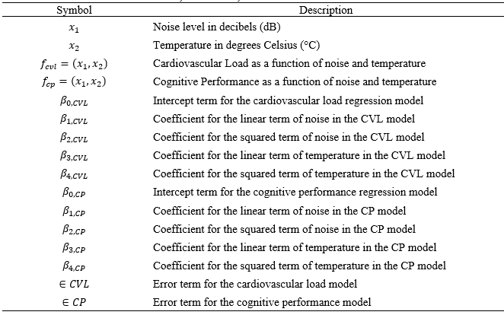
International Conference on Advanced Research in Engineering and Technology (ICARET-24)
October 23rd-24th, 2024 | LPPM UPN “Veteran” Yogyakarta
METHODOLOGY
Problem Formulation
Table 1. Set, Parameter, and Constant Definitions
f_{CVL}(x₁,x₂) > 0 represent a function that models the cardiovascular load as a function of noise levels (x₁​) and temperature (x₂​), where x₁ ∈ Noise Level (dB) and x₂ ∈ temperature (°C).
f_{CP}(x₁,x₂) > 0 represent a function that models cognitive performance under the same conditions.
These functions are formulated as quadratic regression models, incorporating both the linear and squared terms of the independent variables.
The complete model formulations for cardiovascular load and cognitive performance are as follows:
04

Slide 5
International Conference on Advanced Research in Engineering and Technology (ICARET-24)
October 23rd-24th, 2024 | LPPM UPN “Veteran” Yogyakarta
METHODOLOGY
Data Collection
Data collection was conducted during the period form May, 2024 to July 2024.
The dataset generated for this study provides a comprehensive representation of the environmental conditions typically encountered in logistics and industrial settings.
The dataset includes 150 data points, each of which records the environmental noise and temperature levels that drivers experience during their work shift.
Data points were generated to reflect a range of conditions, with noise levels ranging from 70 to 85 decibels (dB) and temperatures ranging from 25 to 35 °C.
Specifically, we calculated the predicted CVL and CP for each observation by substituting the observed values of noise levels (x₁​) and temperature (x₂​) into the respective models.
05

Slide 6
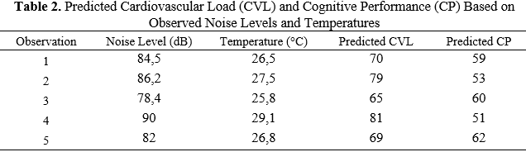
International Conference on Advanced Research in Engineering and Technology (ICARET-24)
October 23rd-24th, 2024 | LPPM UPN “Veteran” Yogyakarta
RESULT AND DISCUSSION
The first observation as an example, where the noise level was recorded at 84,5 dB and the ambient temperature at 26,5°C.
Computed the predicted cardiovascular load using the following regression model formulations (1).
The cognitive performance was predicted using the following regression model formulations (2).
In 1St Observation resulted in a predicted CVL of 7.0 and a CP of 5.9. This indicates a moderate level of cardiovascular strain and a noticeable decrease in cognitive function.
In contrast, Observation 2, which recorded a higher noise level of 86.2 dB and a temperature of 27.5°C, showed an increased CVL of 7.9 and a further reduced CP of 5.3. This suggests that higher noise levels and temperatures exacerbate physiological stress and cognitive decline.
06

Slide 7
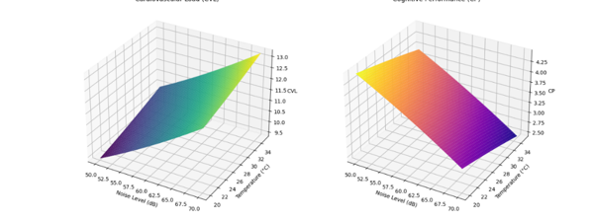
International Conference on Advanced Research in Engineering and Technology (ICARET-24)
October 23rd-24th, 2024 | LPPM UPN “Veteran” Yogyakarta
VALIDATION AND SENSITIVITY ANALYSIS
Sensitivity analysis highlighted that the model is particularly sensitive to temperature changes, where small increases above the optimized level significantly raised CVL.
The 3D surface plots in Figure A and B illustrate the relationship between environmental factors noise levels and temperature with their impact on cardiovascular load (CVL) and cognitive performance (CP).
The CVL plot on the Figure A shows that cardiovascular load increases as noise and temperature rise, indicating that these stressors cumulatively strain drivers, potentially leading to fatigue.
Conversely, the CP plot on the Figure B reveals a downward trend, where cognitive performance decreases with higher noise and temperature. This decline highlights the detrimental effect of harsh environmental conditions on cognitive function, which is critical for tasks requiring sustained attention and quick decision-making, like driving.
Figure A
Figure B
Surface Plots Showing the Impact of Noise Levels and Temperature on Cardiovascular Load (CVL) and Cognitive Performance (CP)
07

Slide 8
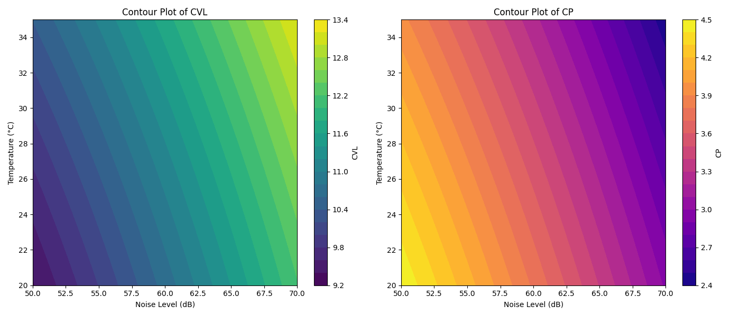
International Conference on Advanced Research in Engineering and Technology (ICARET-24)
October 23rd-24th, 2024 | LPPM UPN “Veteran” Yogyakarta
VALIDATION AND SENSITIVITY ANALYSIS
The contour plots in Figure C examine the relationship between noise levels, temperature, and their effects on cardiovascular load (CVL) and cognitive performance (CP).
The contour plots in Figure C examine the relationship between noise levels, temperature, and their effects on cardiovascular load (CVL) and cognitive performance (CP).
The left plot shows CVL variations, with darker shades representing lower strain in quieter, cooler environments and lighter shades indicating higher strain as noise and temperature increase.
The highest CVL values are found in the upper right corner, where both factors peak, highlighting a strong physiological response.
This analysis emphasizes the need to control environmental factors to effectively manage cardiovascular strain
Figure C. Contour Plots of Cardiovascular Load (CVL) and Cognitive Performance (CP) as Functions of Noise Level and Temperature
08

Slide 9
International Conference on Advanced Research in Engineering and Technology (ICARET-24)
October 23rd-24th, 2024 | LPPM UPN “Veteran” Yogyakarta
DISCUSSION
Implications for the Logistic Industry
This research has significant implications for the logistics industry, especially in the management of driver health and performance.
The clear relationship between environmental factors such as noise levels and temperature with cardiovascular load (CVL) and cognitive performance (CP) indicates the need for logistics companies to monitor and control these conditions in the work environment to improve efficiency, safety and productivity.
Theoretical Contributions to MOO
By integrating quadratic regression models into the MOO framework, the research demonstrates that the relationships between environmental factors and their impacts on health and performance are complex and often nonlinear.
this research underlines the importance of considering both physical and cognitive outcomes in optimization models, thereby providing a more comprehensive approach to enhancing worker performance and safety.
09

Slide 10

International Conference on Advanced Research in Engineering and Technology (ICARET-24)
October 23rd-24th, 2024 | LPPM UPN “Veteran” Yogyakarta
DISCUSSION
Limitations and Future Research Directions
Although this study provides valuable insights, it is not without limitations.
One limitation is that it considers two environmental factors (noise level and temperature) while other variables such as humidity, air quality and vibration are not included, but can have a significant impact on the driver's health and performance.
Expanding the scope of environmental factors in future research could provide a more comprehensive understanding of the conditions that influence drivers.
Additionally, this study assumes a static environment, whereas real-world logistics operations are dynamic, with conditions changing rapidly over time.
10

Slide 11
International Conference on Advanced Research in Engineering and Technology (ICARET-24)
October 23rd-24th, 2024 | LPPM UPN “Veteran” Yogyakarta
CONCLUSION
This study highlights the significant impact of environmental factors, specifically noise levels and temperature, on cardiovascular load (CVL) and cognitive performance (CP) in logistics operations.
Using quadratic regression models and multi-objective optimization, we found that as noise and temperature increase, cardiovascular strain rises while cognitive performance declines.
These results emphasize the need for managing environmental conditions within optimal ranges to protect driver health and enhance operational efficiency.
Logistics companies should invest in advanced monitoring and control systems to optimize cabin conditions, reducing the risks of fatigue and cognitive impairment.
Future research should validate these findings with real-world data and explore additional factors like humidity and air quality, along with dynamic models to better reflect the changing environments drivers face.
11

Slide 12

International Conference on Advanced Research in Engineering and Technology (ICARET-24)
October 23rd-24th, 2024 | LPPM UPN “Veteran” Yogyakarta
ACKNOWLEDGEMENTS
The authors sincerely thank the Research and Community Service Institution (LPPM) of Universitas Pembangunan Nasional "Veteran" Yogyakarta for their generous financial support, which was crucial for this study on driver health and performance in the logistics industry.
11

Slide 13

International Conference on Advanced Research in Engineering and Technology (ICARET-24)
October 23rd-24th, 2024 | LPPM UPN “Veteran” Yogyakarta
REFERENCES
[1] R. L. - and D. R. K. S. -, “Transportation Challenges: Ensuring Safe Movement of Dangerous Goods in the Supply Chain,” Int. J. Multidiscip. Res., vol. 6, no. 2, Apr. 2024, doi: 10.36948/ijfmr.2024.v06i02.16739.
[2] I. Berlianty and D. Rachmawati, “Noise Level Measurement to Reduce the Risk of Injury with the Internet of Things and Ergonomic Approach,” RSF Conf. Ser. Eng. Technol., vol. 1, no. 1, pp. 126–135, 2021, [Online]. Available: https://proceeding.researchsynergypress.com/index.php/cset/article/view/385.
[3] Y. Sun, Z. Sun, M. Yin, and J. Zhou, “Reliability model of sequence motions and its solving idea,” Ekspolatacja i Niezawodn. - Maint. Reliab., 2019, doi: 10.17531/EIN.2019.3.1.
[4] S. Phatrabuddha, T. Wonginta, and N. Phatrabuddha, “Development of Work-Rest Model for Reducing Fatigue in a Long Distance among Chemical Truck Drivers: Case Study in an Industrial Gas,” Appl. Environ. Res., 2018, doi: 10.35762/aer.2018.40.3.7.
[5] N. Gyimah, “Contributing Factors to Road Accidents in Ghana,” Mathews J. Emerg. Med., vol. 8, no. 1, 2023, doi: 10.30654/mjem.10048.
[6] H. Li, L. Liu, Y. Li, Z. Yuan, and K. Zhang, “Measurement and characterization of electromagnetic noise in edge computing networks for the industrial internet of things,” Sensors (Switzerland), vol. 19, no. 14, Jul. 2019, doi: 10.3390/s19143104.
[7] L. M. Munoz, “Ergonomics in the Industry 4.0: Collaborative Robots,” J. Ergon., vol. 07, no. 06, 2017, doi: 10.4172/2165-7556.1000e173.
[8] Y. Yun, A. Chuluunsukh, and M. Gen, “Sustainable closed-loop supply chain design problem: A hybrid genetic algorithm approach,” Mathematics, vol. 8, no. 1, 2020, doi: 10.3390/math8010084.
[9] E. G. Radhika, S. Bharath, S. Ezhilarasan, and M. Shankar, “Container based Driver Fatigue System using IoT,” 2022, doi: 10.1109/ICCES54183.2022.9835937.
[10] J. Zhao, L. Huang, D.-H. Lee, and Q. Peng, “Improved approaches to the network design problem in regional hazardous waste management systems,” Transp. Res. Part E-logistics Transp. Rev., vol. 88, pp. 52–75, 2016, doi: 10.1016/J.TRE.2016.02.002.
[11] X. Ren, “Factors Associated with Fatigue Among Truck Drivers,” in Proceedings of the 2021 5th International Seminar on Education, Management and Social Sciences (ISEMSS 2021), 2021, vol. 571, doi: 10.2991/assehr.k.210806.006.
[12] A. McStay and L. Urquhart, “In cars (are we really safest of all?): interior sensing and emotional opacity,” Int. Rev. Law, Comput. Technol., vol. 36, no. 3, 2022, doi: 10.1080/13600869.2021.2009181.
[13] Y. Tominaga, T. Goto, J. Shelby, A. Oshio, D. Nishi, and S. Takahashi, “Secondary trauma and posttraumatic growth among mental health clinicians involved in disaster relief activities following the 2011 Tohoku earthquake and tsunami in Japan,” Couns. Psychol. Q., vol. 33, no. 4, 2020, doi: 10.1080/09515070.2019.1639493.
12

Slide 14
International Conference on Advanced Research in Engineering and Technology (ICARET-24)
October 23rd-24th, 2024 | LPPM UPN “Veteran” Yogyakarta
Thank You For Your Attention
Presentation Completed
13

