Slide 1


Researchers’ experiences of publishing academic books open access
February 2025

Slide 2

About these materials
These materials were produced by Insights Media for UK Research and Innovation (UKRI) as part of a project to develop case studies on the experiences of researchers who published their books open access.
The case studies are the outcome of interviews with the researchers who participated in the project. The interviews were conducted in 2024. The views in these case studies are those of the researchers and do not necessarily reflect the views, priorities, and policies of UKRI.
All materials related to this project can be accessed on Zenodo at https://10.5281/zenodo.13944972
This work is licenced under a Creative Commons Attribution Share Alike 4.0 International Licence.
Images are not covered under this licence.
© UK Research and Innovation
Notes:
I might also say something that later we will be covering the funding and in terms of some the considerations on that aspect I just want to set out a bit of context - and I will maybe refer to the key principles we need to consider - can just do verbally no need for a slide

Slide 3


Contents
“Being an early adopter of publishing openly has been very beneficial to my career”– Janneke Adema (Slide 6)
“So much is available electronically now – it’s transformational.” – Gwyn Bevan (Slide 7)
“Open access allows for multimedia work in a different way. I couldn’t imagine publishing this work in a more traditional format.” – Francesca Coppa (Slide 8)
“Knowledge doesn’t benefit anyone if it’s inaccessible.” – Martin Eve (Slide 9)
“Knowledge should be freely available.” – Jean-Paul Faguet (Slide 10)
“Change has to come from more established academics” – Aileen Fyfe (Slide 11)
“Whose knowledge counts? Whose knowledge is available? Whose knowledge circulates widely?” – Elie Gore (Slide 12)
“I’m a strong believer that open access is the way to go for works that have been publicly funded, but there is still a pejorative sense that open access means self-publishing.” – Roger Kain (Slide 13)
Notes:
There will be a 10-minute break after the Q&A.

Slide 4
Contents
“It rapidly became clear that an incredible number of downloads were taking place, all over the world. The free on demand PDF was the big feature.” Geoffrey Khan (Slide 14)
Publishing my book open access makes it easier for me to disseminate knowledge, meaning my work is more widely known across the world.” – Marie Lall (Slide 15)
“Being able to share research across boundaries is a great thing. It’s how knowledge can make a difference.” – David Luke (Slide 16)
“A lot of the presses I like are scholar-led, embedded within their academic disciplines. You have this quality to it, because it’s being not just submitted by an expert, it’s being shaped by an expert in the field, edited by one and sometimes even copy edited by one.” – Samuel Moore (Slide 17)
“To create more fully democratic access to knowledge across the world, we would also need to ensure that authors in other countries can not only read but also publish without having to pay.” – Joanna Page (Slide 18)
Notes:
There will be a 10-minute break after the Q&A.

Slide 5
Contents
“My book is different from the traditional reading experience. I didn’t want it to be the sort of book that symbolises knowledge and configures readers as receivers of knowledge.” – Matthew Reynolds (Slide 19)
“I wanted to make a difference. I want to have an impact on the world and I want the world to be a better place.” – William Sutherland (Slide 20)
“I think open access is terrific for people early on in their career.” – Jane Winters (Slide 21)
Notes:
There will be a 10-minute break after the Q&A.

Slide 6

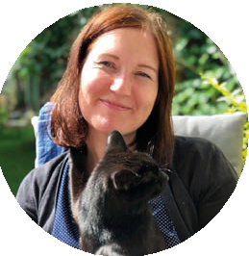

“Being an early adopter of publishing openly has been very beneficial to my career”
21:09
Researchers’ experiences of publishing academic books open access
How publishing open access benefits Adema
Highly visible and transparent approach creates a buzz
Collaborative approach engages other researchers
Raises profile early in your career
Bigger and broader reach for your work
Breaks down barriers to your work
Adema says there shouldn’t be any barriers to accessing research. Nor does she believe in waiting to put a finished product out there.
When it’s suitable and appropriate, she believes in open practice throughout the research lifecycle, from the initial conception of a research idea and the planning stages, data collection and sourcing information, through to analysis and publication.
An early blogger, she has regularly invited others to collaborate with her and engage with her work as it progresses.
She explained: “Communicating my research is something I’ve always done, right from the start of my academic career. I’ve always put as much as possible on my blog and shared it – my work in progress, my research presentations, my conference presentations and my papers.
Janneke Adema, Associate Professor in Digital Media
at The Centre for Postdigital Cultures, Coventry University
Publish your book open access www.oabooks-toolkit.org

Slide 7


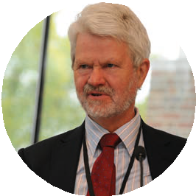


“So much is available electronically now
– it’s transformational.”
Researchers’ experiences of publishing academic books open access
How open access and digital have been
transformational for Bevan
Knowledge is easily and freely available. It’s at your fingertips, not shut away in a library, including important documents and primary research
“How Did Britain Come to This?”, is Bevan’s latest book. Published open access, it had over 3,000 downloads in the first nine months.
Based on his experience, Bevan thinks technology and open access publishing have changed
academia for the better. People can access and publish research more easily and freely, and research is more easily found and read. This leads to higher reader numbers,
a more diverse readership and more citations. Academics gain a much higher profile, as does their research.
Bevan thinks that in the future, people who chose to publish through more traditional routes will be at a disadvantage. “Stuff you can access electronically will get read and cited, and stuff which you have to buy as a book or go to a library or access behind a paywall, will not do as well, will not have the same reach or citations.”
Gwyn Bevan, Emeritus Professor of Policy Analysis in the Department of Management at the London School of
Economics and Political Science
The research process is faster and enriched by the depth and breadth of material that is available
People, academics and the general public, have much greater access to his research, amplifying its reach
Publish your book open access www.oabooks-toolkit.org

Slide 8


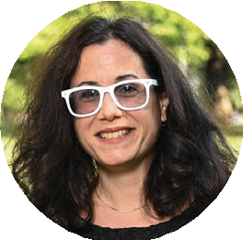


“Open access allows for multimedia work in a different way. I couldn’t imagine publishing this work in a more traditional format.”
Researchers’ experiences of publishing academic books open access
How open access publishing benefitted Coppa’s research
It supported experimentation around form, content and style
Open access publishing is rooted in the digital age.
As a result, Coppa says it encourages innovation, such as new ways of creating and producing research. It enables academics to play around with form and content and to make the most of digital publishing.
This suits Coppa, who is a strong advocate of remix cultures and transmedia storytelling.
Her research explores how stories overlap across text, video, theatre and image, so it was essential when she published her latest book that the output included and reflected the actual research.
Coppa said: “It’s a book about video artists, so it was really important to me to include clips and examples of the art.”
Francesca Coppa, Professor of English, Theatre and Film Studies at Muhlenberg College
It is multimedia, enabling Coppa to include videos, clips, images and links connected to the research
The research output was designed to suit the research material and message
Publish your book open access www.oabooks-toolkit.org

Slide 9

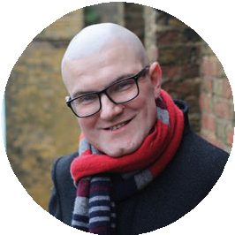






“Knowledge doesn’t benefit anyone if it’s inaccessible.”
Researchers’ experiences of publishing academic books open access
Eve says open access book publishing drives impact
It breaks down access barriers
Access drives engagement and that creates impact
It disseminates research to a bigger, wider audience
Knowledge is used and built on more widely
Improved access encourages diversity of thinking and debate
Research has impact when people can access it, engage with it and build on it. Eve firmly believes that open access book publishing enables that greater impact, facilitating the dissemination of knowledge by removing geographical and financial barriers.
He says this creates a more equitable world, one where scholars and people everywhere can easily find and use knowledge. Eve has mobility issues so open access publishing enables him to access knowledge easily, while at the same time amplifying his voice through enabling him to reach a wider audience.
He says: “It’s had a very positive impact on my career. And I have much greater satisfaction and purpose in what I do, knowing there’s a much broader audience for my work. People who don’t engage with open access are missing out on a huge opportunity to do good in the world.”
Martin Paul Eve, Professor of Literature, Technology and Publishing at Birkbeck, University of London
Publish your book open access www.oabooks-toolkit.org

Slide 10

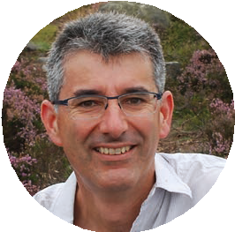



“Knowledge should be freely available.”
Researchers’ experiences of publishing academic books open access
Why Faguet believes in open access publishing
Research reaches people who need it
Knowledge is shared equitably around the world
Data and evidence can be used for the greater good
It stops research from being extractive
Academics working for wealthy institutions in the Global North don’t always realise the access issues facing academics working for less wealthy institutions, particularly those in the Global South.
Faguet says open access publishing helps address issues of inequality, which he feels
is particularly important in his
area of research. He wouldn’t like to be conducting fieldwork and gathering data and then putting it all behind a paywall
where only those at elite institutions in the Global North can access it.
“The people we study live in developing countries, and the results, conclusions and recommendations - the main
point of this research - is really
aimed at developing countries, first and foremost.”
Jean-Paul Faguet, Professor of the Political Economy of Development at London School of Economics and Political Science
Publish your book open access www.oabooks-toolkit.org

Slide 11


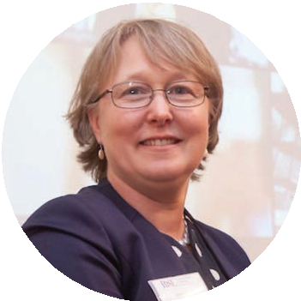

“Change has to come
Researchers’ experiences of publishing academic books open access
Fyfe’s advice on how senior scholars can break down barriers
from more established
scholars.”
Open access book publishing is on the rise but Fyfe says many academics still shy away from it. She fears many senior academics also advise early career scholars to take the well- trodden, prestige publishing route, thinking it is safer and will open more doors.
Fyfe thinks this is a shame and that senior academics need to agitate for change. She published her first open access book in 2022 in collaboration with three post-doctoral researchers and says it has been a hugely positive experience.
It wasn’t a decision she took lightly. She too was concerned that it would affect the career prospects of her
Share how open access increased their profile and visibility: Fyfe saw 1,800 downloads in one month
Show it can (and should) be done with rigorous and quality publishing standards
Share the benefits of born-digital publications, like flexibility of format and style
Challenge perceptions in their communities and organisations
early career researchers, but the reality has been very different. The book has generated a lot of interest, with 1,800 downloads in the first month. One of Fyfe’s researchers has since published their own book open access, and is working on another.
Fyfe says senior scholars need to get behind open access book publishing.
“We need to see senior members of the profession speaking out in favour, demonstrating that it can be done and that the publishing process is very similar in terms of editorial boards, peer review and copy editing.”
Aileen Fyfe, Professor of Modern History at the University of St Andrews
Publish your book open access www.oabooks-toolkit.org

Slide 12

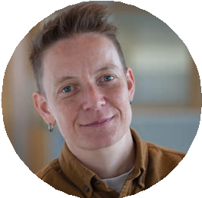




“Whose knowledge counts? Whose knowledge is available? Whose knowledge circulates widely?”
Researchers’ experiences of publishing academic books open access
Why Gore believes equity of access is important
Knowledge should be available to everyone who wants and needs it
Who does and who doesn’t have access to knowledge is something Gore cares deeply about. They think research should be easily and freely available.
When publishing their book, “Between HIV Prevention and LGBTI Rights: The Political Economy of Queer Activism in Ghana”, they chose open access to ensure there weren’t any geographical or financial barriers and that everyone
who participated in the research could access it.
Academics, activists and institutions in the Global South often have limited access to research due to the cost of academic books and paywalls.
By publishing open access, Gore says anyone and everyone will have access, regardless of where they live.
Research that circulates widely also tends to have more impact. It is more likely to stimulate debate, challenge established narratives and influence policy, for example.
That is important to Gore: “I’m hoping it’s not just academics and researchers that read it. I’d like to think it is of interest to policymakers, activists, civil society organisations in Africa and around the world who are concerned about LGBTI rights and the struggle for queer liberation.”
Dr Ellie Gore, Lecturer in Global Political Economy in the Department of Politics, University of Manchester
People shouldn’t be disadvantaged because of their location or economic position
Research can be circulated far and wide
Different voices and perspectives can surface
Some of the ongoing Global North - Global South power imbalances can be addressed
Publish your book open access www.oabooks-toolkit.org

Slide 13

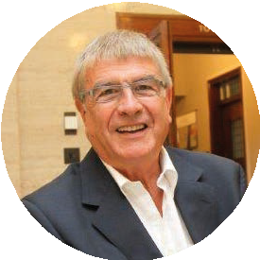



“I’m a strong believer that open access is the way to go for works that have been publicly funded, but there is still a pejorative sense that open access means self-publishing.”
Researchers’ experiences of publishing academic books open access
Why Kain thinks attitudes to open access publishing are changing
Higher reader numbers
The ability to influence thinking is greater
Higher citation numbers
People believe in equitable access to knowledge
Attitudes to digital publishing are evolving
Kain feels that attitudes to open access publishing
are slowly changing. This is partly due to the ability for academics to reach a bigger, more diverse audience, the influence that research has when it’s disseminated more widely and the higher citations numbers. However, Kain says many scholars in management positions are still of the view that it is an inferior publishing choice and advise early career researchers against it.
But, Kain thinks the momentum for change is building and that the younger generation of academics will move the debate forward.
“The generation of researchers who were early career five
or so years ago and are now coming through to the mid- career stage – they are going to carry a very different view of open access to people of my generation.”
Roger Kain, Professor of Humanities at the School of Advanced Study, University of London
Publish your book open access www.oabooks-toolkit.org

Slide 14


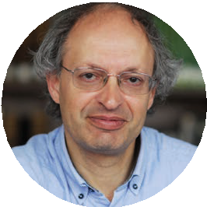


Why Khan believes in publishing open access
Researchers’ experiences of publishing academic books open access
“It rapidly became clear that an incredible number of downloads were taking place, all over the world. The free on demand PDF was the big feature.”
Research outputs reach a wider audience within academia
Research goes global
Research extends beyond academia
Research is more influential when people can access it, engage with it and use it
Digital, a cornerstone of open access publishing, drives accessibility
Khan made the switch to open access publishing because
he wanted to reach a wider audience. He wanted his books to be read. His previous books had very low circulation figures, less than 100 sales, which is the norm with traditional scholarly publishing.
That changed almost overnight when he published his next book open access. It has been downloaded nearly 16,000 times so far. Citations have also increased.
Khan says it has been the same for the other authors publishing through his open access series. He says it is important that research is disseminated widely and freely, so that it goes beyond academia and the confines of traditional publishing.
“There is a genuine thirst for access to scholarship, a hunger for knowledge which goes beyond academic institutions.”
Geoffrey Khan, Regius Professor of Hebrew at the University
of Cambridge and general editor of the open access series Cambridge Semitic Languages and Cultures.
Publish your book open access www.oabooks-toolkit.org

Slide 15

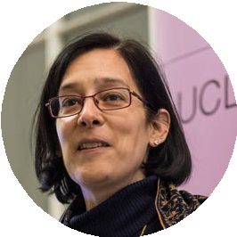



“Publishing my book open access makes it easier for me to disseminate knowledge, meaning my work is more widely known across the world.”
Researchers’ experiences of publishing academic books open access
Why Lall supports publishing books open access
It ensures equitable access to research and knowledge
By publishing her latest book – “Myanmar’s Education Reforms. A pathway to social justice?” – open access, Lall ensured that people in the Global South can read it, not just a handful of academics in the Global North. That means academics, policy makers, activists, the general public and the people who participated in the research, all have access to it.
This was hugely important to Lall. She thinks academia should make it as easy as possible for people to access important research so that
no-one is shut out and research can have maximum impact.
Lall said: “Myanmar has had a coup. Nobody can go to a bookshop, nor do they think to spend money on a book, but they will click on a link and read it.”
And they are clicking on the link, so far, the book has been downloaded 37,724 times in 173 countries, including 2,793 of those downloads happening in Myanmar.
It would have been a very different story had Lall chosen to publish with a traditional press. Access would have been very limited, particularly in the Global South.
Professor Marie Lall, Chair of Education and South Asian Studies at the UCL Institute of Education
Dissemination is greater
It stops research from being extractive
Change is more likely if policy makers and activists can access research
Publish your book open access www.oabooks-toolkit.org

Slide 16

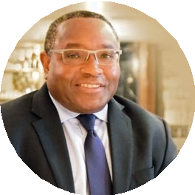


“Being able to share research across boundaries is a great thing. It’s how knowledge can make a difference.”
Researchers’ experiences of publishing academic books open access
How Luke thinks publishing open access benefits research and researchers
Research reaches a bigger audience,
including the Global South
Winner of the BCA African Business Book of the Year Award 2024, publishing open access has been good for Luke’s research and his profile.
The judges liked the open access approach, praising the book for breaking down barriers and being globally accessible. It was assessed on its merits, quality and global reach, not from a proxy measure.
When research is good, open access amplifies it, as has been the case for Luke. He has been invited to speak about his research, including a visit to the Carnegie Endowment for International Peace in the US.
Greater access to thinking drives change. “Research should be shared among scholars, among people who can use the research,” says Luke.
David Luke, Professor in Practice and Strategic Director at the Firoz Lalji Institute for Africa at the London School of Economics and Political Science
Drives impact as insights, ideas and information are shared and acted on
Open access enhances the integrity and rigour of
research by increasing the opportunity
for findings to be scrutinised
Publish your book open access www.oabooks-toolkit.org

Slide 17

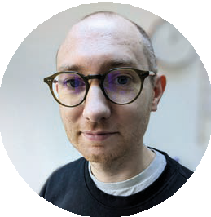

“A lot of the presses I like are scholar-led, embedded within their academic disciplines. You have this quality to it, because it’s being not just submitted by an expert, it’s being shaped by an expert in the field, edited by one and sometimes even copy edited by one.”
Researchers’ experiences of publishing academic books open access
Moore’s advice for finding a credible open access book publisher
Tap into the rise of community, scholar- led presses
Pick a professional press with high publishing standards
Check the quality of the process, that peer review, copy editing and the editorial board all adhere to high standards
Look around because there are options
Open access facilitates community-led publishing, which Moore thinks is a very positive development. It encourages experimentation with form, content and audience participation, while adhering to the same high standards as traditional publishing.
Moore explains: “Publishing open access felt to me
like a traditional publishing
experience in terms of copy editing, peer reviews and such like.”
Dr Samuel Moore, a scholarly communications specialist at Cambridge University Library, is an early career researcher publishing his first monograph open access through a community press.
Publish your book open access www.oabooks-toolkit.org

Slide 18
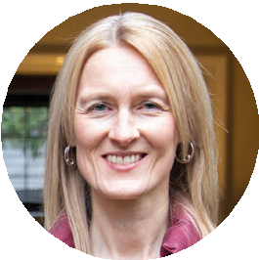
“To create more fully democratic access to knowledge across the world, we would also need to ensure that authors in other countries can not only read but also publish without having to pay.”
Researchers’ experiences of publishing academic books open access
Page’s tips on open access publishing
?
Ask publishers if they publish open access (this is not always advertised)
Find out if a publisher has a waiver scheme
Some publishers run pilot initiatives
If a publisher requires a fee, check if there is a waiver scheme or
another source of funds.
Funding is often available from a number of sources, e.g., institutional funds.
Page says academia needs to radically rethink how knowledge is shared and paid for to ensure equitable dissemination around the globe.
Determined that her research should be freely accessible to anyone and everyone, she
always publishes open access.
She says it is both easier to achieve and less costly than people expect.
“I’ve never had to pay to publish an open access book and don’t believe I should. You aren’t limited to publishers that advertise open access routes.”
Joanna Page, Professor of Latin American Studies at the University of
Cambridge, Director of CRASSH
$
Publish your book open access www.oabooks-toolkit.org

Slide 19

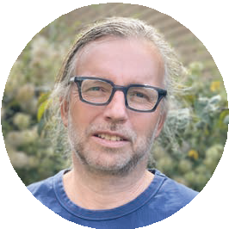

“My book is different from the traditional reading experience. I didn’t want it to be the sort of book that symbolises knowledge and configures readers as receivers of knowledge.”
Researchers’ experiences of publishing academic books open access
Reynolds thinks publishing open access benefits research
It enables authors to explore the potential of digital
It breaks down barriers, encouraging interdisciplinary working
New ways of publishing encourage innovation and new research outputs
It encourages diversity of thinking
According to Reynolds, Prismatic Jane Eyre: Close-Reading a World Novel Across Languages was never going to be an ordinary book. Just as Jane Eyre is not just an English book – it has been
translated into many different languages, with each translation creating shifts in interpretation, understanding, language, voice and style. There are now many Janes, says Reynolds, who led the Prismatic Jane Eyre research project, which culminated in an open access volume.
Reynolds collaborated with many academics from around the world and he wanted the book to reflect the international input and the nature of the work - that literature is not restricted to one language, one interpretation or one voice.
He said: “Reviewing all this work by translators and publishers in
different locations is creative work. It’s collaborative and creative, remaking and discovering new significances in new locations.”
Being open access and born digital, there was much more flexibility over the book’s form, language and content. The different authors had more freedom to write in their own voice and style, and the text includes digital interactive maps and verbal animations.
Reynolds says this approach helps break down disciplinary and traditional
academic silos, leading to greater creative expression.
Matthew Reynolds, Professor of English and Comparative Criticism at Oxford University
Publish your book open access www.oabooks-toolkit.org

Slide 20

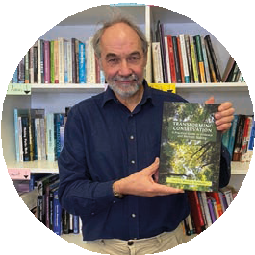




“I wanted to make a difference. I want to have an impact on the world and I want the world to be a better place.”
Researchers’ experiences of publishing academic books open access
Sutherland thinks open access publishing helps academics make a difference
Research has greater reach
According to Sutherland, when he started his career in conservation, he realised that
many libraries around the world weren’t well stocked. As a result, many academics and community groups in the Global South in particular didn’t have access to the latest research and thinking.
So instead of receiving royalties from his early books, the money was spent on sending out free copies to people who would benefit from his work.
Digitisation opened up new possibilities. Research could be made available to people around the globe at the click of a button, paving the way for open access publishing.
But, access is still restricted – many academics have to pay for books or to get past paywalls.
Sutherland said: “Books are only accessible to a limited number of people and where there’s the greatest need for conservation, these books are hardest to acquire and hardest to afford.”
William Sutherland, Professor of Conservation Biology and Director of Research at the University of Cambridge
Readers can access the latest research, insights and evidence
Geographical barriers are removed
Financial barriers are removed
There is greater equity of access
Publish your book open access www.oabooks-toolkit.org

Slide 21

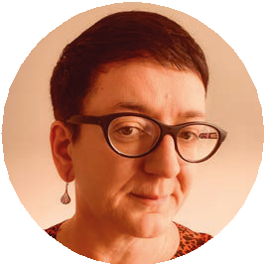



Researchers’ experiences of publishing academic books open access
“I think open access is terrific for people early on in their career.”
Why Winters thinks publishing a book open access is good for early career researchers
It boosts research dissemination
Senior academics often advise early career researchers to publish with a traditional press. They say publishing a book open access could harm their career prospects. But, when Winters was the editor of an early career researcher book series, she found that open access book publishing was hugely beneficial to the fledgling scholars she worked with. Their work rapidly gained a high profile, getting their names noticed in academic circles. From that, they gained lots of networking opportunities.
“The early career researchers benefitted enormously from the attention their open access books got.
And they were able to cross-promote each other’s work, building a real community around that. It was really effective in career development terms.”
More established scholars also benefit from open access book publishing – they too reach a wider audience, and more quickly, increasing the likelihood of their research having an impact. And the research process and quality of output is richer and potentially stronger because academics can easily access a more diverse range of source material.
Jane Winters, Professor of Digital Humanities and Director of the Digital Humanities Research Hub at the University of London
It is good for profile building and networking
It can create a buzz around research
There are presses specifically aimed at new scholars
Publish your book open access www.oabooks-toolkit.org

