Slide 1
National Competence Centre SLING newsletter migration
Ariela Herček, Arnes
SIG-Marcomms Meeting

Slide 2
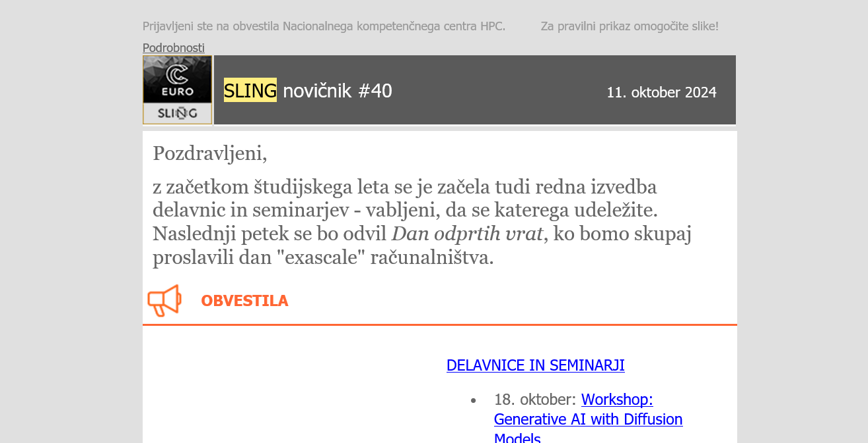

Slide 3
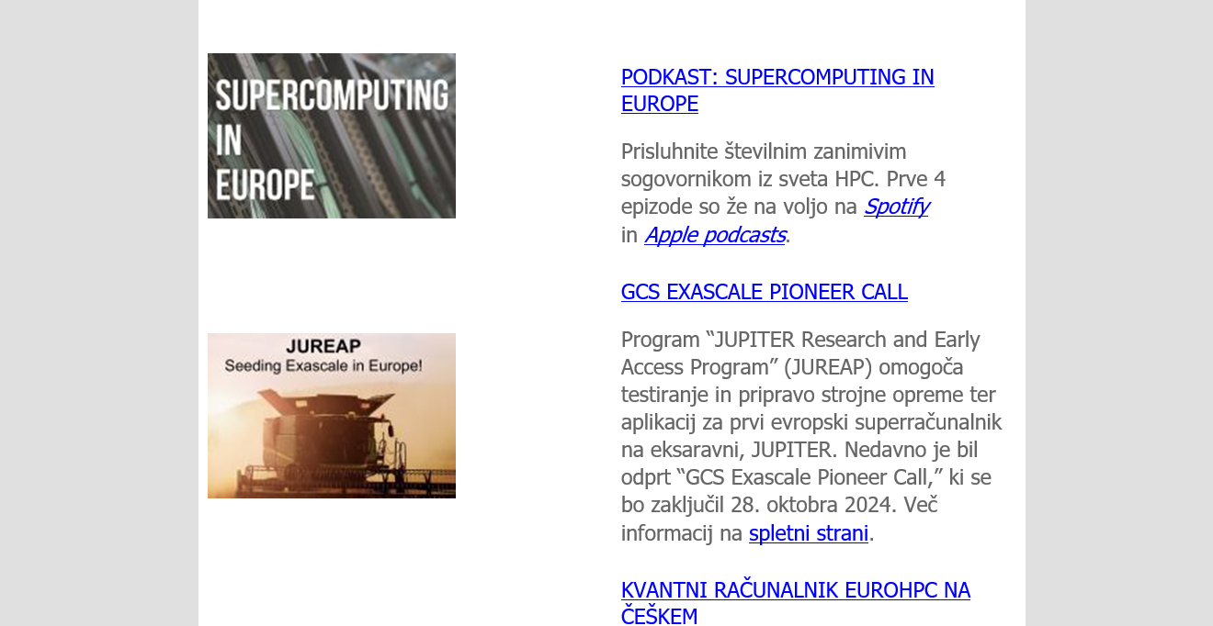

Slide 4
CHALLENGES
modernizing the look of our newsletter to fit our branding and UX,
dissecting the content: what fits into our idea of newsletter and what do our users want to read?

Slide 5
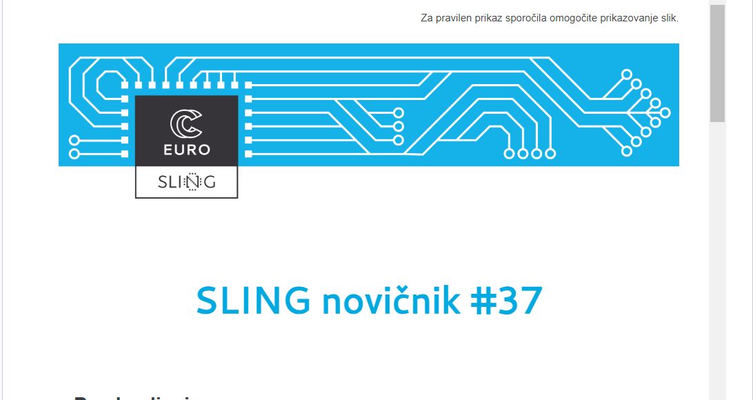

Slide 6
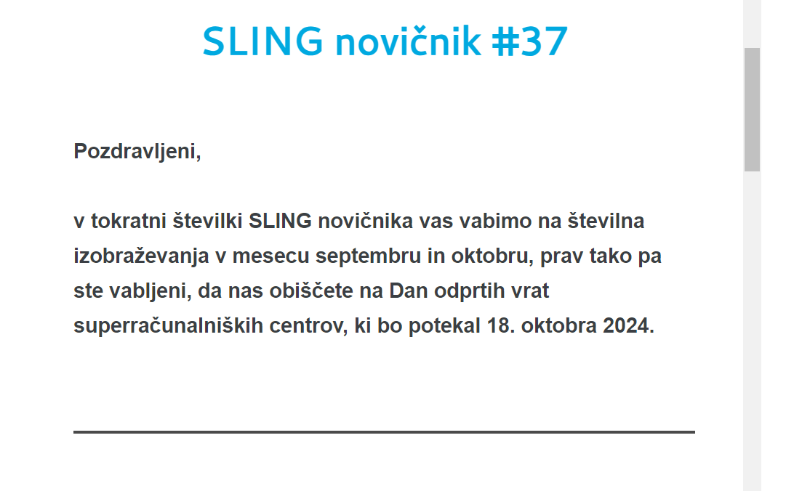

Slide 7
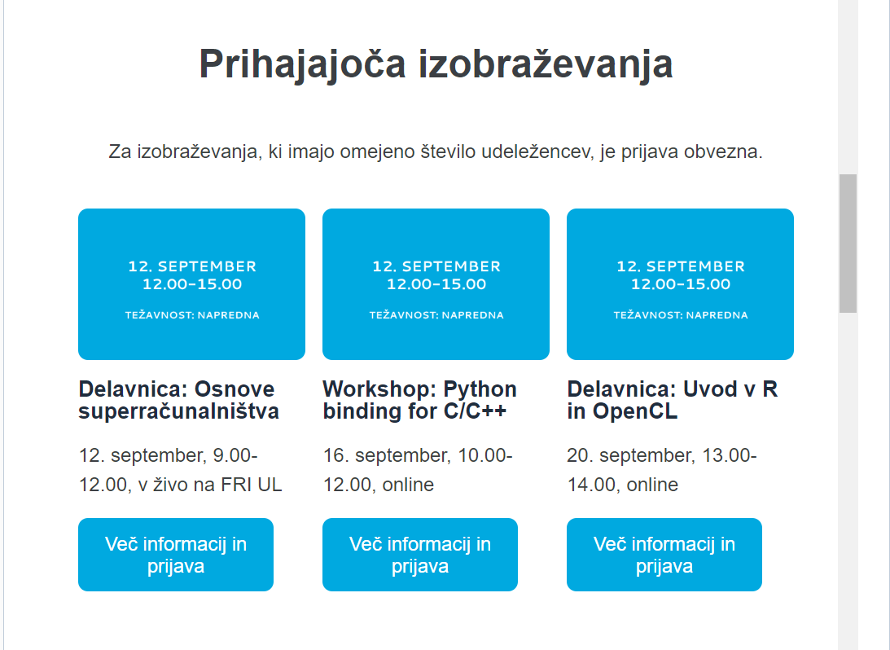
wireframing,
usability,
visibility of important topics

Slide 8
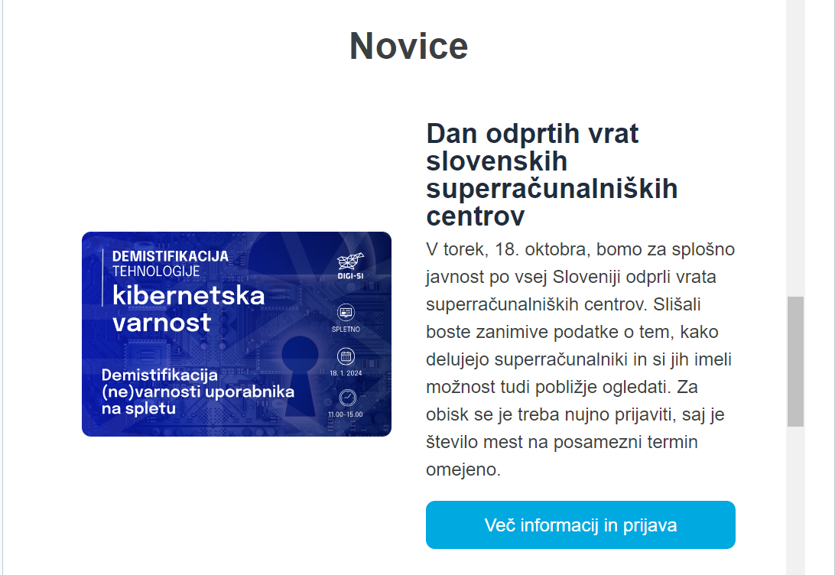
less news items,
focus on bolding the important information

Slide 9


TECHNICAL AND LEGAL CHALLENGES
finding the right service provider,
GDPR and personal data storage,
onboarding: templates, training
production and user feedback.

Slide 10
ariela.hercek@arnes.si

