Slide 1




Accelerating secure digital science through community collaboration
Sponsored by:
2nd September 2024
Newcastle, UK
Sponsored by:

Slide 2
Agenda
10:15 - 10:30 - Welcome and introductions
10:30 - 11:00 - CMWG updated/announcements: Bid for funding
11:00 - 12:15 - Federation: Accelerating digital science
  Keynote 1 - 20mins
  Keynote 2 - 20mins
  Panel discussion + Q&A - 30mins
12:15 - 12:55 - Accelerating digital science = Focused discussion breakout (with Coffee)
13:00 - 14:00 - Lunch & networking
14:00 - 15:00 - Breakout session 2 : Community breakouts: Working groups + suggested topics
15:00 - 15:15 - Quick coffee break and room changeover
15:15 - 16:15 - Lightning talks (@4mins each + QA at end if time allows)
16:15 - 16:45 - DARE UK Phase 2 presentation
16:45 - 17:00 - Wrap up
2nd Sept 2024
UK TRE Community Conference

Slide 3
Agenda
10:15 - 10:30 - Welcome and introductions
10:30 - 11:00 - CMWG updated/announcements: Bid for funding
11:00 - 12:15 - Federation: Accelerating digital science
  Keynote 1 - 20mins
  Keynote 2 - 20mins
  Panel discussion + Q&A - 30mins
12:15 - 12:55 - Accelerating digital science = Focused discussion breakout (with Coffee)
13:00 - 14:00 - Lunch & networking
14:00 - 15:00 - Breakout session 2 : Community breakouts: Working groups + suggested topics
15:00 - 15:15 - Quick coffee break and room changeover
15:15 - 16:15 - Lightning talks (@4mins each + QA at end if time allows)
16:15 - 16:45 - DARE UK Phase 2 presentation
16:45 - 17:00 - Wrap up
2nd Sept 2024
UK TRE Community Conference

Slide 4
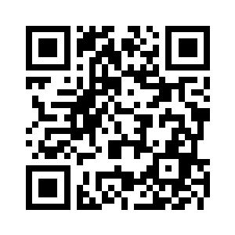
Housekeeping
Guide for today including all links
https://bit.ly/uktre2024
Codes of conduct (RSECon, UK TRE)
Agenda
Collaborative notes
Co-chairs are here to help!
Online: Madalyn
In rooms: David, Simon, Balint, Pete
Questions: Slido:
Recordings: keynote and community updates will be recorded, for breakout rooms we are relying on you to take notes
Fire alarms: we aren’t expecting any today, if it goes off please leave the building
2nd Sept 2024
UK TRE Community Conference

Slide 5


Thank you to….
The Society of Research Software Engineering and the RSECon24 committee for organising the venue, catering, and other support
DARE UK for sponsoring this event

Slide 6
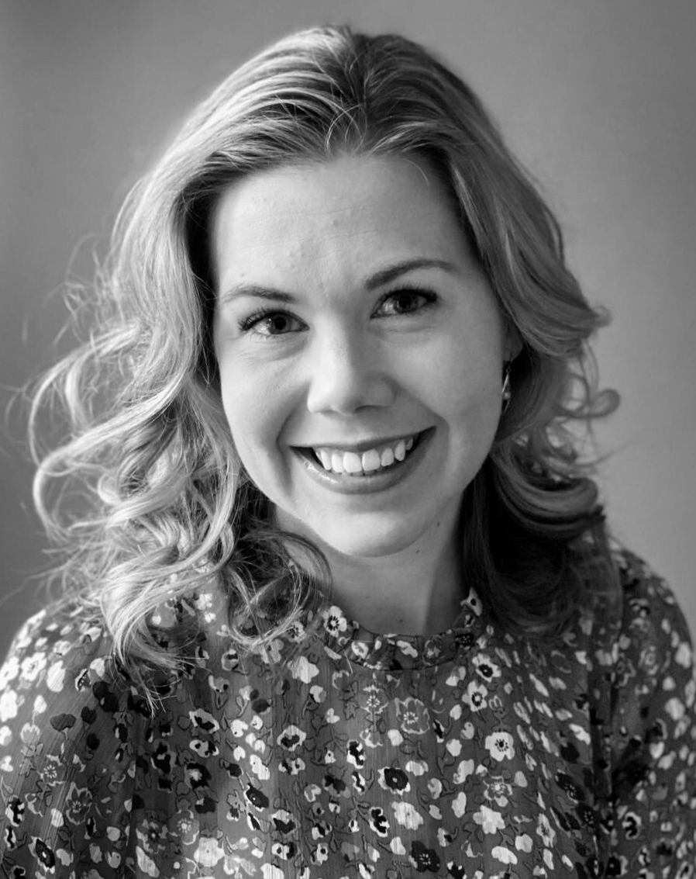
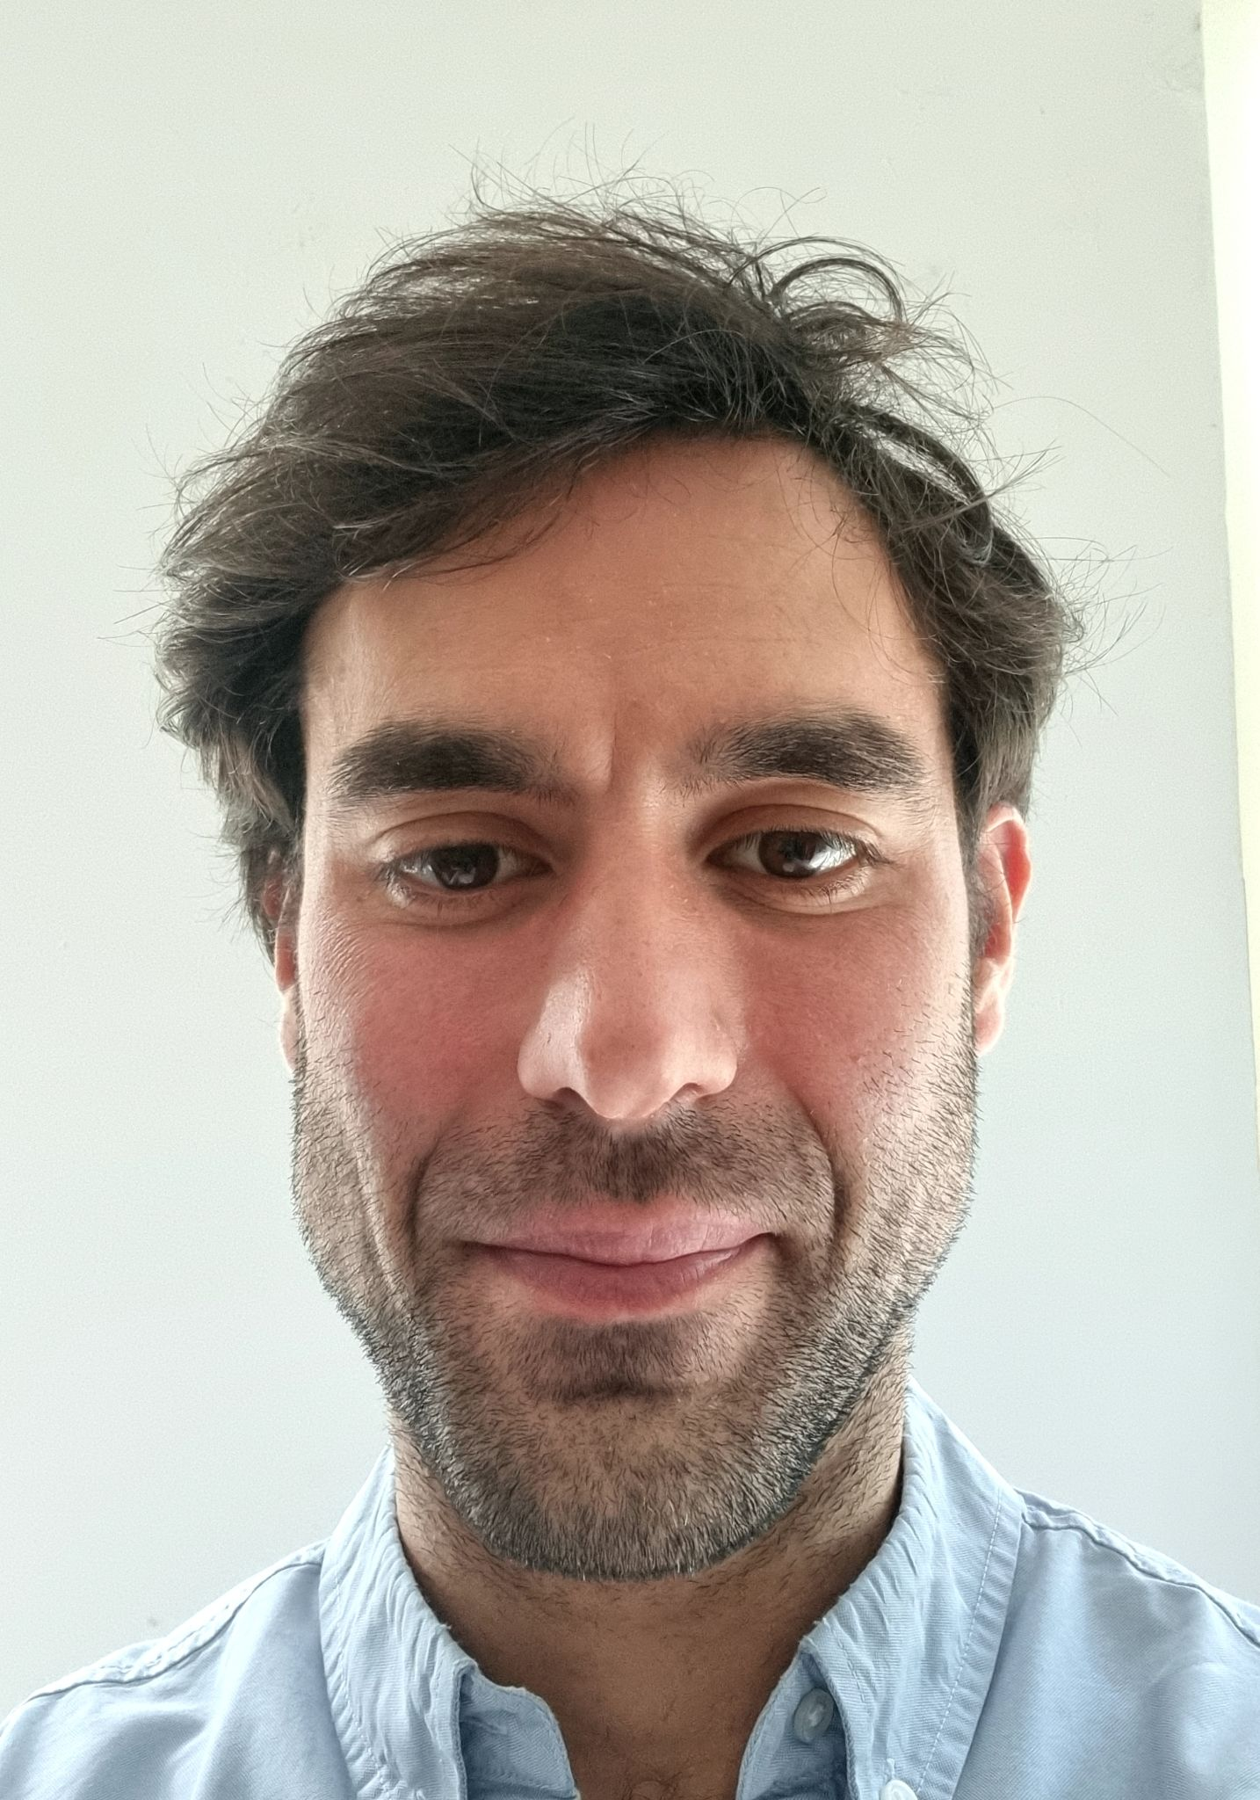
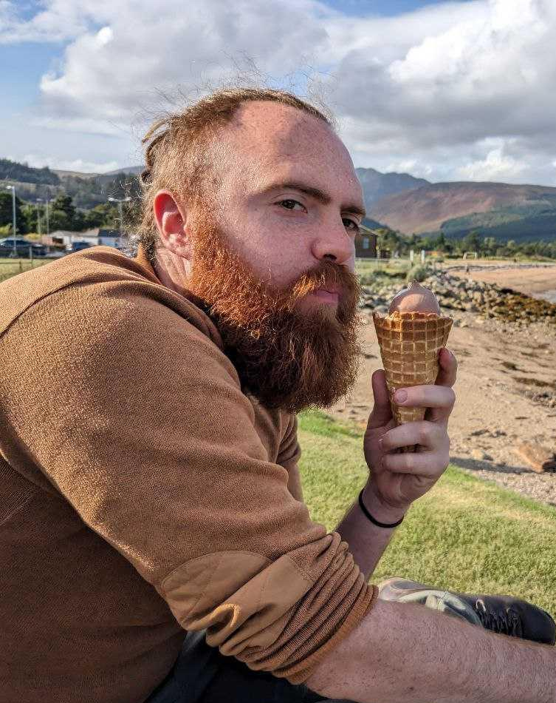
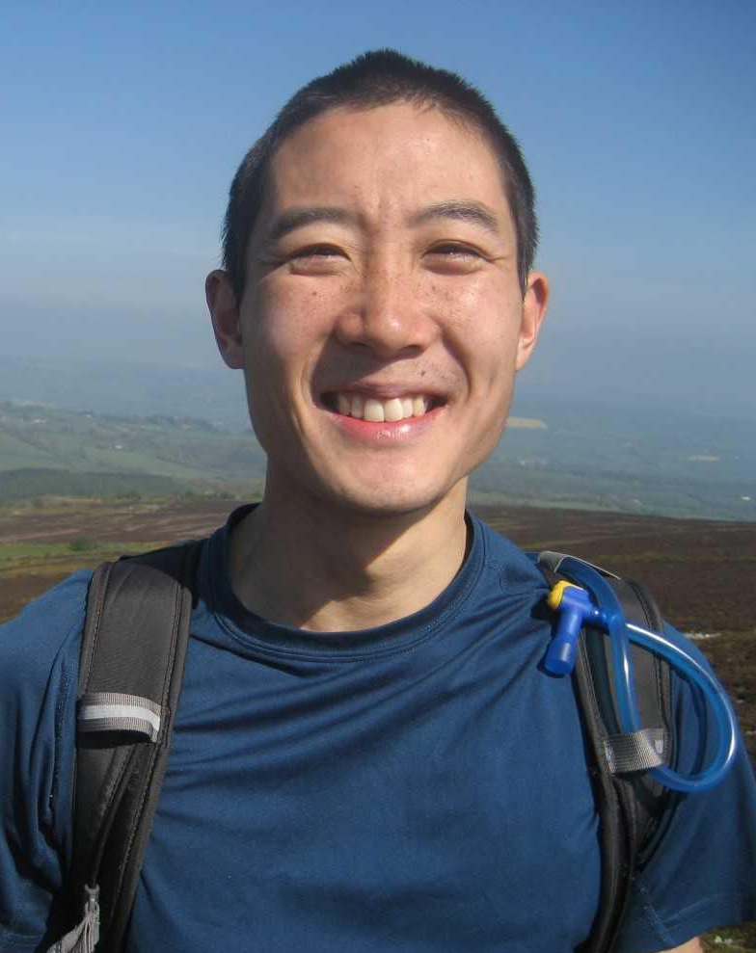
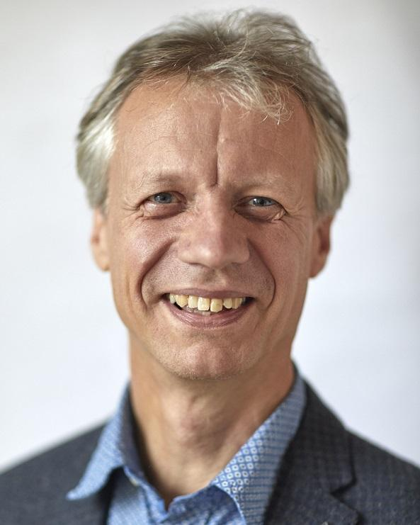
UK TRE Co-chairs
Madalyn Hardaker
Kings College London
Balint Stewart
DARE UK
David Sarmiento
Turing
Simon Li
Dundee University
Pete Barnsley
Francis Crick Inst.
Any questions please ask – we might know.

Slide 7
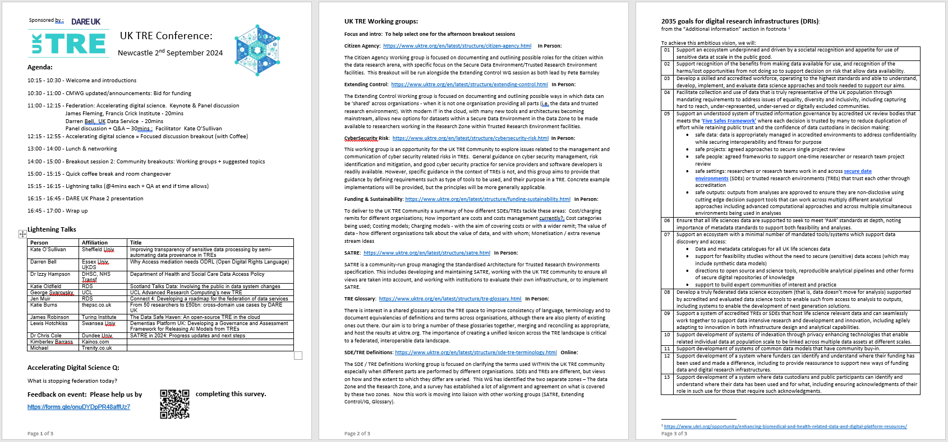
Supporting today: Handout
Page 1: Agenda & Talks & Feedback
Page 2: Breakout 2: Working Groups
Page 3: Breakout 1 : 2035 Vision
Agenda
Lightning Talks
Feedback

Slide 8
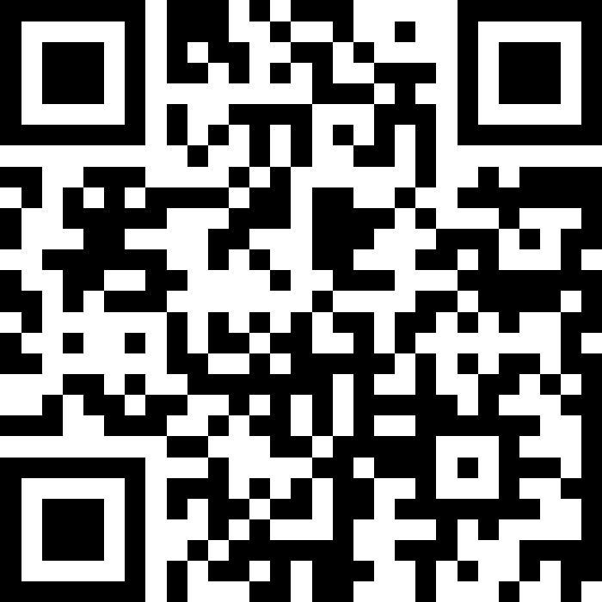
To get us started…
https://app.sli.do/event/7iLYtyTJinrXRMcXfum9Rq
2nd Sept 2024
UK TRE Community Conference

Slide 9

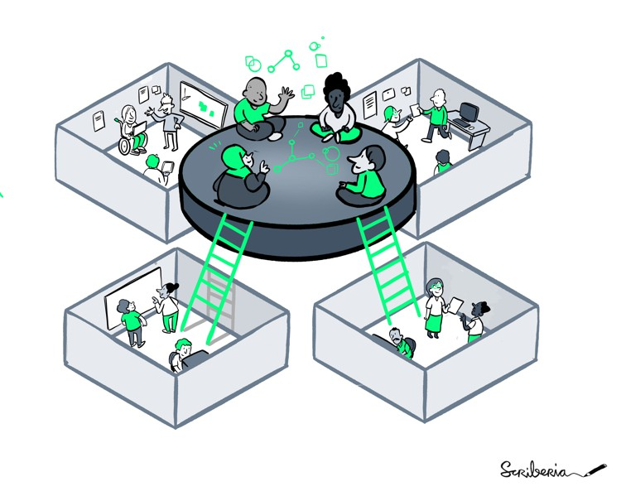
The UK TRE community
Foster collaboration
Vision
Knowledge exchange
To have a four nations, coordinated, collaborative approach to research infrastructure for working with sensitive data
Avoid duplication
Driven by community needs!
Mission
To provide the space to signpost, share knowledge and facilitate conversations across the UK TRE landscape
Move towards standardisation
Share best practice
2nd Sept 2024
UK TRE Community Conference
Notes:
The key here is our perceived role as facilitators, rather than drivers - a lot of great work is already happening and we want to make sure it is joined up effectively. We have no set agenda ourselves apart from doing this, and being driven by what the community needs

Slide 10
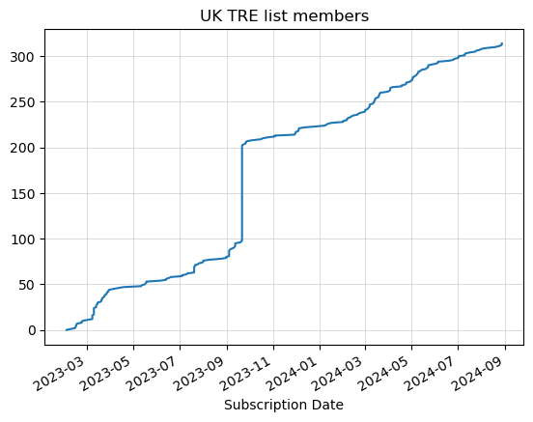

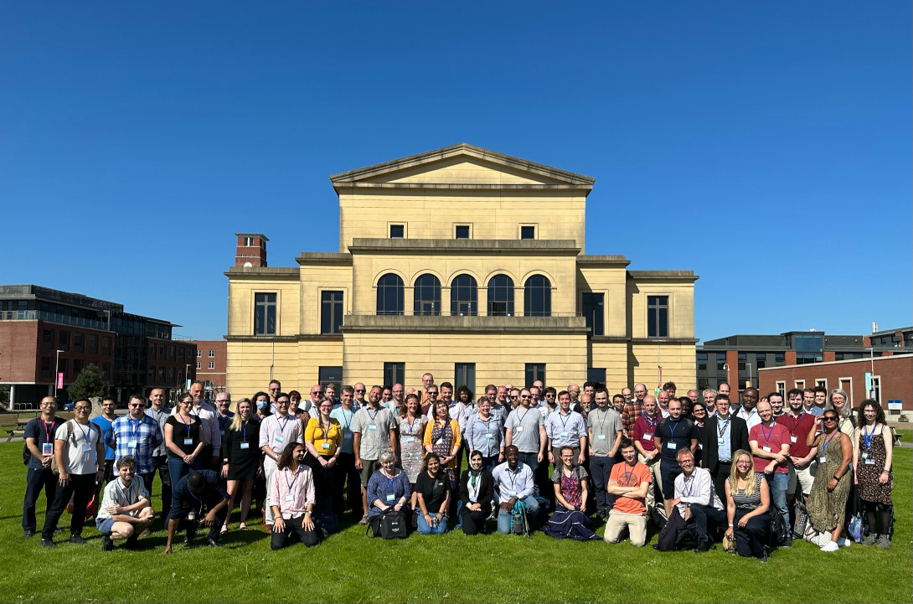

The UK TRE Community
Sep 2022, ~40 people
Sep 2023, ~100 members
Sep 2024, 300+ members
~100 organisations
7 working groups
Notes:
Simon’s notes:
Welcome to this years UK TRE Community Annual meeting!
Code of Conduct (UK TRE, and RSE. Summary: be nice to each other)
Sponsored by DARE UK (visit their stand if you haven’t met them before)
Today’s about talking to each other
Goals for today:
- …
We started two years: ~30 people came together at a RSE TRE community event in September 2022, Newcastle.
Informal get together, informal community
Since then we've grown significantly:
- Official website
- Regular events
- Becoming more professional as we seek to drive the future of TREs in the UK
Our current aims:
- Accelerating secure digital science through community collaboration
- Placing the community on a secure financial footing so we can focus on supporting people to achieve results
Who’s running the community:
- Hari Sood was instrumental in setting up this community has left
- Pete Barnsley has joined
- Looking for others to help run this community!

Slide 11
Agenda
10:15 - 10:30 - Welcome and introductions
10:30 - 11:00 - CMWG updated/announcements: Bid for funding
11:00 - 12:15 - Federation: Accelerating digital science
  Keynote 1 - 20mins
  Keynote 2 - 20mins
  Panel discussion + Q&A - 30mins
12:15 - 12:55 - Accelerating digital science = Focused discussion breakout (with Coffee)
13:00 - 14:00 - Lunch & networking
14:00 - 15:00 - Breakout session 2 : Community breakouts: Working groups + suggested topics
15:00 - 15:15 - Quick coffee break and room changeover
15:15 - 16:15 - Lightning talks (@4mins each + QA at end if time allows)
16:15 - 16:45 - DARE UK Phase 2 presentation
16:45 - 17:00 - Wrap up
2nd Sept 2024
UK TRE Community Conference

Slide 12

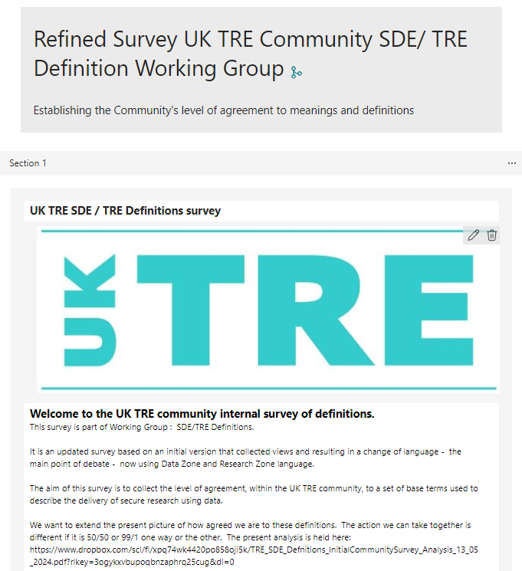
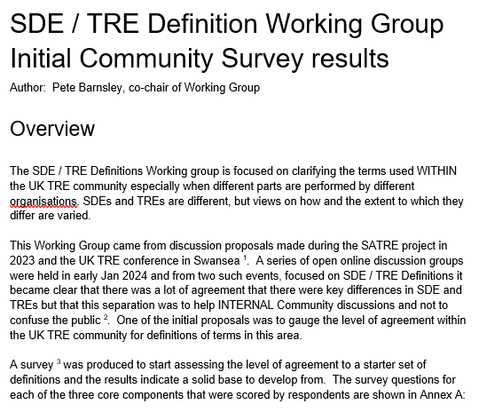



What progress – the difference a year can make!
Oct
2023
Sept
2024
Website
CMWG governance
Slack channels
Working group charter & Release processes
Finalise Principles???
WG Charter
Community Mgmt WG
Citizens Agency
Extending Control
SDE / TRE Definition
Community Working groups
Glossary
Funding & Sustainability
SATRE
Cybersecurity Risk
Information Governance
In development
Information Governance
Funding
To be envisaged
?????
Notes:
Simon as he did the welcome and intro section starts. He does the Website and the Slack Channels. Click on these to go to the next slide then bring us back to this one.
David does the Working group charter and the WG Charter session and talks about the Community Mgmt WG.
Click through showing these continue (green) and click out to the Finalise Principles slide and then back after discussion.
Pete picks up on the Working Groups. Brings up the seven and explains each a little. Explains they started at different times but now all have full charteres.
Pete brings out IG started before and has started to be resurrected but not really supported. Clicks to Specific slide to get discussion and then back.
Pete then uses the SDE/ TRE Definitions one to exemplify these WG and that starting early has allowed a lot of progress. _ Zoom engagement -> Survey -> General agreement and new refined survey -> Continued agreement.
Flag that this will be the subject of the Breakout session Madalyn will be running after lunch
Pete then brings up these will carry on, and again exemplify that SDE/TRE Defn is moving towards engaging with others and may complete soon (225) as its work goes elsewhere.
Bring up the fact we are open to other WGs to be initiated.
Then stress that this is all voluntary. Past DARE support showed what this can do for progress, so need funding.
Press funding arrow hyperlink

Slide 13

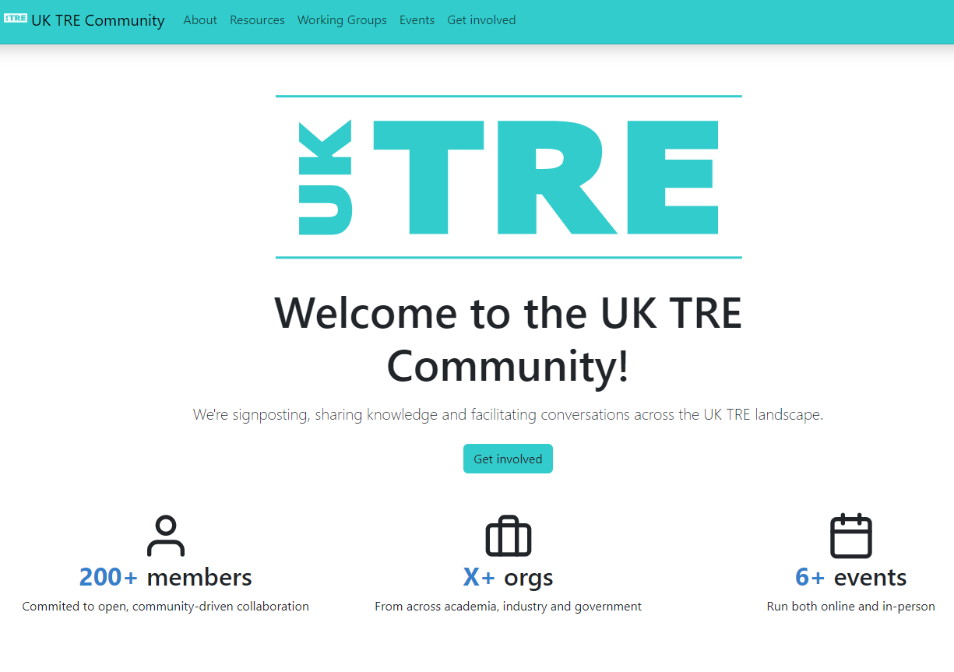
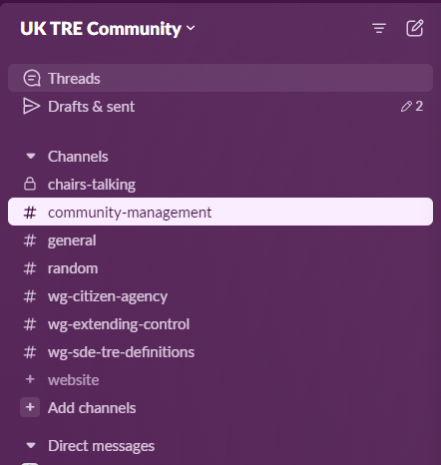
The new Website and Slack channels
Back
Join

Slide 14
What progress – the difference a year can make!
Oct
2023
Sept
2024
Website
CMWG governance
Slack channels
Working group charter & Release processes
Finalise Principles???
WG Charter
Community Mgmt WG
Citizens Agency
Extending Control
SDE / TRE Definition
Community Working groups
Glossary
Funding & Sustainability
SATRE
Cybersecurity Risk
Information Governance
In development
Information Governance
Funding
To be envisaged
?????
Notes:
Simon as he did the welcome and intro section starts. He does the Website and the Slack Channels. Click on these to go to the next slide then bring us back to this one.
David does the Working group charter and the WG Charter session and talks about the Community Mgmt WG.
Click through showing these continue (green) and click out to the Finalise Principles slide and then back after discussion.
Pete picks up on the Working Groups. Brings up the seven and explains each a little. Explains they started at different times but now all have full charteres.
Pete brings out IG started before and has started to be resurrected but not really supported. Clicks to Specific slide to get discussion and then back.
Pete then uses the SDE/ TRE Definitions one to exemplify these WG and that starting early has allowed a lot of progress. _ Zoom engagement -> Survey -> General agreement and new refined survey -> Continued agreement.
Flag that this will be the subject of the Breakout session Madalyn will be running after lunch
Pete then brings up these will carry on, and again exemplify that SDE/TRE Defn is moving towards engaging with others and may complete soon (225) as its work goes elsewhere.
Bring up the fact we are open to other WGs to be initiated.
Then stress that this is all voluntary. Past DARE support showed what this can do for progress, so need funding.
Press funding arrow hyperlink

Slide 15

What should we do on Principles?
Back
Community Principles:
We have a draft document building on the Newcastle Commitment (2022)
https://docs.google.com/document/d/1hI1rfjA6XSI7fy_UF8GP4YKYM6ITW2_BkAIXujj8fxs/edit#heading=h.l1bdidkyfmt7
Questions to the Community:
Do we need this formalised?
How do you want to do that?
  Review window then Steering Co-chairs decide

Slide 16
What future for the Information Governance WG?
Back
Information Governance Working Group:
Is there anyone willing and able to take on the chair?
Is there anyone willing to be a core member of the group or participate in it?
Questions to the Community:
What do we do?
Should it be adopted into other WGs?
  E.g. Extending Control?

Slide 17

How do we continue the progress!
We plan to apply to become a Skills Network Plus:
Funding: UKRI Digital Research Technical Professional Skills NetworkPlus
Current bid = £1.9m over four years
Areas of investment:
Support for leads to run working groups, and organise the skills network for the UK TRE community.
Run a skills project developing an agreed pathway for the core skills groups needed for the UK DRI TRE/SDE community.
Sponsoring specific projects to press forward the UK TRE community challenges. – collect proposals, decide and fund small projects specific to the community.
Developing an open transparent collaboration and community technology platform to provide website, collaboration spaces, resource hubs and opensource repositories for engagements around TREs. This builds from the seed-corn funding by DARE UK.
Annual Conference
Event Organiser
Sponsored Projects
Project leads
Working groups
WG Co-chair leads
Events, travel, accommodation,
Flexible fund
Events, travel, accommodation,
Flexible Fund
Events, travel, accommodation,
UK TRE expert requests
Skills framework
project
Network Leadership
Meetings
Workspaces
Co-chair leads
Grant Manager
Flexible fund
travel, accommodation,
WG & project
Repositories
Project lead
Flexible Fund
Accreditation advisors
Resource Hub
Collaboration Platform
Websites
Technology Platform
Steering Board
External expert
travel & subsitence
2nd Sept 2024
UK TRE Community Conference

Slide 18
How do we continue the progress! We need you
We are talking to PEDRI / SPRITE+ and DTNet+
Open to all: please join us in preparing the bid.
Our internal deadline: Friday Sept 20th 2024.
Actions:
We need a volunteer organisation to take on the PI role. (Digital Research Technical Professional Champions).
Letters of support?
  Your institution
  Any other bodies / networks
…
Help with forming the bid.
Annual Conference
Event Organiser
Sponsored Projects
Project leads
Working groups
WG Co-chair leads
Events, travel, accommodation,
Flexible fund
Events, travel, accommodation,
Flexible Fund
Events, travel, accommodation,
UK TRE expert requests
Skills framework
project
Network Leadership
Meetings
Workspaces
Co-chair leads
Grant Manager
Flexible fund
travel, accommodation,
WG & project
Repositories
Project lead
Flexible Fund
Accreditation advisors
Resource Hub
Collaboration Platform
Websites
Technology Platform
Steering Board
External expert
travel & subsitence
2nd Sept 2024
UK TRE Community Conference

Slide 19
Agenda
10:15 - 10:30 - Welcome and introductions
10:30 - 11:00 - CMWG updated/announcements: Bid for funding
11:00 - 12:15 - Federation: Accelerating digital science
  Keynote 1 - 20mins
  Keynote 2 - 20mins
  Panel discussion + Q&A - 30mins
12:15 - 12:55 - Accelerating digital science = Focused discussion breakout (with Coffee)
13:00 - 14:00 - Lunch & networking
14:00 - 15:00 - Breakout session 2 : Community breakouts: Working groups + suggested topics
15:00 - 15:15 - Quick coffee break and room changeover
15:15 - 16:15 - Lightning talks (@4mins each + QA at end if time allows)
16:15 - 16:45 - DARE UK Phase 2 presentation
16:45 - 17:00 - Wrap up
2nd Sept 2024
UK TRE Community Conference

Slide 20
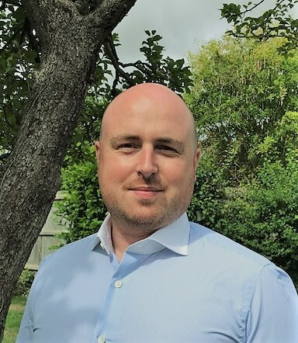
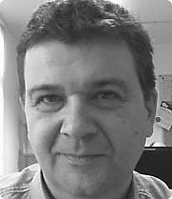
‘Keynote’ Federation: Accelerating digital science
James Fleming:
CIO, The Francis Crick Institute, London
Talk: “Reconstructing the human in health research: A vision for data federation”
Picture
Darren Bell:
Director – Technical Services, UK Data Service, Essex University
Q&A Panel
Peter Maccallum, ELIXIR CTO
Emily Jefferson, CTO HDR UK & Interim Director DARE UK
Facilitator: Kate O’Sullivan, Sheffield University
2nd Sept 2024
UK TRE Community Conference
Notes:
Today’s presentation is about the latest updates from the UK TRE Community - we’ve recently gone through a number of changes, and momentum is really building!

Slide 21
Federation: Q&A Slido (open now)
https://app.sli.do/event/7iLYtyTJinrXRMcXfum9Rq
2nd Sept 2024
UK TRE Community Conference

Slide 22
Agenda
10:15 - 10:30 - Welcome and introductions
10:30 - 11:00 - CMWG updated/announcements: Bid for funding
11:00 - 12:15 - Federation: Accelerating digital science
  Keynote 1 - 20mins
  Keynote 2 - 20mins
  Panel discussion + Q&A - 30mins
12:15 - 12:55 - Accelerating digital science = Focused discussion breakout (with Coffee)
13:00 - 14:00 - Lunch & networking
14:00 - 15:00 - Breakout session 2 : Community breakouts: Working groups + suggested topics
15:00 - 15:15 - Quick coffee break and room changeover
15:15 - 16:15 - Lightning talks (@4mins each + QA at end if time allows)
16:15 - 16:45 - DARE UK Phase 2 presentation
16:45 - 17:00 - Wrap up
2nd Sept 2024
UK TRE Community Conference

Slide 23


Accelerating digital science focused discussion breakout
How this will work:
We are including a second room for the breakouts: Follow the co-chairs
Grab a coffee / tea
Join a discussion table / and online breakout Zoom room.
  Room 1.17
Focus:
Where the community is going (e.g. MRC proposal for digital research infrastructure in 2035) and how to get there. What is stopping federation today?
Please volunteer or nominate someone from each table to capture key points and conclusions of discussion. HackMD’s are set up, and paper/pens available.
Will do a quick report back summary during wrap up at end of day.
This session ends at 13:00
so after that enjoy lunch and networking after selecting your WG to join…
and be back in the appropriate breakout / plenary room ready for the second breakout meeting around our working groups and how they are helping accelerate digital science.
2nd Sept 2024
UK TRE Community Conference
Notes:
Today’s presentation is about the latest updates from the UK TRE Community - we’ve recently gone through a number of changes, and momentum is really building!

Slide 24
In your groups, please discuss the following:
What is stopping federation today?

Slide 25
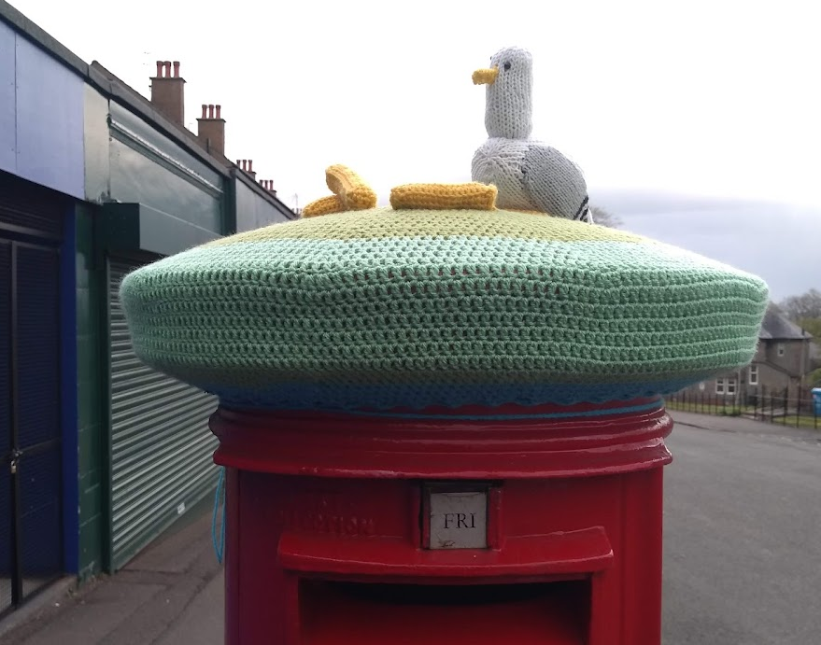
Time for Lunch!
10:15 - 10:30 - Welcome and introductions
10:30 - 11:00 - CMWG updated/announcements: Bid for funding
11:00 - 12:15 - Federation: Accelerating digital science
  Keynote 1 - 20mins
  Keynote 2 - 20mins
  Panel discussion + Q&A - 30mins
12:15 - 12:55 - Accelerating digital science = Focused discussion breakout (with Coffee)
13:00 - 14:00 - Lunch & networking
14:00 - 15:00 - Breakout session 2 : Community breakouts: Working groups + suggested topics
15:00 - 15:15 - Quick coffee break and room changeover
15:15 - 16:15 - Lightning talks (@4mins each + QA at end if time allows)
16:15 - 16:45 - DARE UK Phase 2 presentation
16:45 - 17:00 - Wrap up
2nd Sept 2024
UK TRE Community Conference

Slide 26
Over lunch please pick which working group or discussion breakout you’d like to attend
Working groups (open to everyone, you don’t need to be a member)
  Glossary
  Cybersecurity Risks
  SATRE
  Funding and Sustainability
  SDE/TRE Definitions
  Extending Control / federated Information Governance
  Citizen Agency
Other suggested topics:
  Encouraging more EDI researchers to use TREs
  NLP free-text de-identification
https://bit.ly/uktre2024 https://app.sli.do/event/7iLYtyTJinrXRMcXfum9Rq

Slide 27
Agenda
10:15 - 10:30 - Welcome and introductions
10:30 - 11:00 - CMWG updated/announcements: Bid for funding
11:00 - 12:15 - Federation: Accelerating digital science
  Keynote 1 - 20mins
  Keynote 2 - 20mins
  Panel discussion + Q&A - 30mins
12:15 - 12:55 - Accelerating digital science = Focused discussion breakout (with Coffee)
13:00 - 14:00 - Lunch & networking
14:00 - 15:00 - Breakout session 2 : Community breakouts: Working groups + suggested topics
15:00 - 15:15 - Quick coffee break and room changeover
15:15 - 16:15 - Lightning talks (@4mins each + QA at end if time allows)
16:15 - 16:45 - DARE UK Phase 2 presentation
16:45 - 17:00 - Wrap up
2nd Sept 2024
UK TRE Community Conference

Slide 28
Accelerating digital science
Breakout 2 (Working groups and suggested topics)
Glossary | Rob Baxter / Kate O’Sullivan / Balint Stewart | Table 1 (Upstairs)
Cybersecurity Risks | Donald Scobbie / Martin O’Reilly | Table 2 (Upstairs)
SATRE | Simon Li / Chris Cole / Martin O’Reilly / James Robinson / Andrew Payne / Michelle Amugi | Table 3 (Upstairs)
Funding and Sustainability | Rebecca Fox / Lisa Scerri | Table 4 (Upstairs)
Extending Control (for Information Governance) | James Fleming / Pete Barnsley | Table 5 (Upstairs)
SDE/TRE Definitions | Madalyn Hardaker / Pete Barnsley | Table 6 (Downstairs)
NLP free-text deidentification |  | Table 7 (Downstairs)
Anything else |  | Table 8 (Downstairs)
2nd Sept 2024
UK TRE Community Conference

Slide 29
Agenda
10:15 - 10:30 - Welcome and introductions
10:30 - 11:00 - CMWG updated/announcements: Bid for funding
11:00 - 12:15 - Federation: Accelerating digital science
  Keynote 1 - 20mins
  Keynote 2 - 20mins
  Panel discussion + Q&A - 30mins
12:15 - 12:55 - Accelerating digital science = Focused discussion breakout (with Coffee)
13:00 - 14:00 - Lunch & networking
14:00 - 15:00 - Breakout session 2 : Community breakouts: Working groups + suggested topics
15:00 - 15:15 - Quick coffee break and room changeover
15:15 - 16:15 - Lightning talks (@4mins each + QA at end if time allows)
16:15 - 16:45 - DARE UK Phase 2 presentation
16:45 - 17:00 - Wrap up
2nd Sept 2024
UK TRE Community Conference

Slide 30
Break time: Back at 15:15
Check the agenda for next sessions!
2nd Sept 2024
UK TRE Community Conference

Slide 31
Agenda
10:15 - 10:30 - Welcome and introductions
10:30 - 11:00 - CMWG updated/announcements: Bid for funding
11:00 - 12:15 - Federation: Accelerating digital science
  Keynote 1 - 20mins
  Keynote 2 - 20mins
  Panel discussion + Q&A - 30mins
12:15 - 12:55 - Accelerating digital science = Focused discussion breakout (with Coffee)
13:00 - 14:00 - Lunch & networking
14:00 - 15:00 - Breakout session 2 : Community breakouts: Working groups + suggested topics
15:00 - 15:15 - Quick coffee break and room changeover
15:15 - 16:15 - Lightning talks (@4mins each + QA at end if time allows)
16:15 - 16:45 - DARE UK Phase 2 presentation
16:45 - 17:00 - Wrap up
2nd Sept 2024
UK TRE Community Conference

Slide 32
Lightning Talks
4mins max, Display goes red with 1 min left, timer will sound at end.
Next speaker (in below order - see handout) please get ready to come up to front asap.
Q&A at end if time allows.
Person | Affiliation | Title
Kate O’Sullivan | Sheffield Univ | Improving transparency of sensitive data processing by semi-automating data provenance in TREs
Darren Bell | Essex Univ, UKDS | Why Access mediation needs ODRL (Open Digital Rights Language)
Dr Izzy Hampson | DHSC, NHS Transf | Department of Health and Social Care Data Access Policy
Katie Oldfield | RDS | Scotland Talks Data: Involving the public in data system changes
George Svarovsky | UCL | UCL Advanced Research Computing's new TRE
Jen Muir | RDS | Connect 4: Developing a roadmap for the federation of data services
Katie Burns | thepsc.co.uk | From 50 researchers to £50bn: cross-domain use cases by DARE UK
James Robinson | Turing Institute | The Data Safe Haven: An open-source TRE in the cloud
Lewis Hotchkiss | Swansea Univ | Dementias Platform UK: Developing a Governance and Assessment Framework for Releasing AI Models from TREs
Dr Chris Cole | Dundee Univ | SATRE in 2024: Progress updates and next steps
2nd Sept 2024
UK TRE Community Conference

Slide 33
Lightning talks questions: Slido
Person | Affiliation | Title
Kate O’Sullivan | Sheffield Univ | Improving transparency of sensitive data processing by semi-automating data provenance in TREs
Darren Bell | Essex Univ, UKDS | Why Access mediation needs ODRL (Open Digital Rights Language)
Dr Izzy Hampson | DHSC, NHS Transf | Department of Health and Social Care Data Access Policy
Katie Oldfield | RDS | Scotland Talks Data: Involving the public in data system changes
George Svarovsky | UCL | UCL Advanced Research Computing's new TRE
Jen Muir | RDS | Connect 4: Developing a roadmap for the federation of data services
Katie Burns | thepsc.co.uk | From 50 researchers to £50bn: cross-domain use cases by DARE UK
James Robinson | Turing Institute | The Data Safe Haven: An open-source TRE in the cloud
Lewis Hotchkiss | Swansea Univ | Dementias Platform UK: Developing a Governance and Assessment Framework for Releasing AI Models from TREs
Dr Chris Cole | Dundee Univ | SATRE in 2024: Progress updates and next steps
https://app.sli.do/event/7iLYtyTJinrXRMcXfum9Rq

Slide 34
Kate O’Sullivan
Sheffield Univ.
Improving transparency of sensitive data processing by semi-automating data provenance in TREs

Slide 35
Darren Bell
UK Data Service, Essex Univ.
Why Access mediation needs ODRL (Open Digital Rights Language)

Slide 36
Dr Izzy Hampson
UK Data Service, Essex University
Department of Health and Social Care Data Access Policy

Slide 37
Katie Oldfield
Research Data Scotland
Scotland Talks Data: Involving the public in data system changes

Slide 38
George Svarovsky
UCL
UCL Advanced Research Computing's new TRE

Slide 39
Jen Muir
Research Data Scotland
Connect 4: Developing a roadmap for the federation of data services

Slide 40
Katie Burns thepsc.co.uk
From 50 researchers to £50bn: cross-domain use cases by DARE UK

Slide 41
James Robinson
Turing Inst.
The Data Safe Haven: An open-source TRE in the cloud

Slide 42
Lewis Hotchkiss
Swansea Univ.
Dementias Platform UK: Developing a Governance and Assessment Framework for Releasing AI Models from TREs

Slide 43
Dr Chris Cole
Dundee Univ.
SATRE in 2024: Progress updates and next steps

Slide 44
Q & A for Lightning talks

Slide 45
Agenda
10:15 - 10:30 - Welcome and introductions
10:30 - 11:00 - CMWG updated/announcements: Bid for funding
11:00 - 12:15 - Federation: Accelerating digital science
  Keynote 1 - 20mins
  Keynote 2 - 20mins
  Panel discussion + Q&A - 30mins
12:15 - 12:55 - Accelerating digital science = Focused discussion breakout (with Coffee)
13:00 - 14:00 - Lunch & networking
14:00 - 15:00 - Breakout session 2 : Community breakouts: Working groups + suggested topics
15:00 - 15:15 - Quick coffee break and room changeover
15:15 - 16:15 - Lightning talks (@4mins each + QA at end if time allows)
16:15 - 16:45 - DARE UK Phase 2 presentation
16:45 - 17:00 - Wrap up
2nd Sept 2024
UK TRE Community Conference

Slide 46
DARE UK presentation: Phase 2
2nd Sept 2024
UK TRE Community Conference

Slide 47
Agenda
10:15 - 10:30 - Welcome and introductions
10:30 - 11:00 - CMWG updated/announcements: Bid for funding
11:00 - 12:15 - Federation: Accelerating digital science
  Keynote 1 - 20mins
  Keynote 2 - 20mins
  Panel discussion + Q&A - 30mins
12:15 - 12:55 - Accelerating digital science = Focused discussion breakout (with Coffee)
13:00 - 14:00 - Lunch & networking
14:00 - 15:00 - Breakout session 2 : Community breakouts: Working groups + suggested topics
15:00 - 15:15 - Quick coffee break and room changeover
15:15 - 16:15 - Lightning talks (@4mins each + QA at end if time allows)
16:15 - 16:45 - DARE UK Phase 2 presentation
16:45 - 17:00 - Wrap up
2nd Sept 2024
UK TRE Community Conference

Slide 48
Wrap up
Summaries from break-outs
  Extending Control (for Information Governance)
  Cybersecurity Risks
  Funding and Sustainability
  SATRE
  Accelerating digital science
2nd Sept 2024
UK TRE Community Conference

Slide 49
Wrap up
Our Working Groups are focussed on key enablers to accelerate digital science – Please join and have your say.
The Skills Network bid will great help this community. Letters of Support and Collaborators are very welcome - please get in touch.
Actions:
  Engage with our Working Groups
  Start a new working group (e.g. Information Governance?)
  Support the Skills Network bid
2nd Sept 2024
UK TRE Community Conference

Slide 50
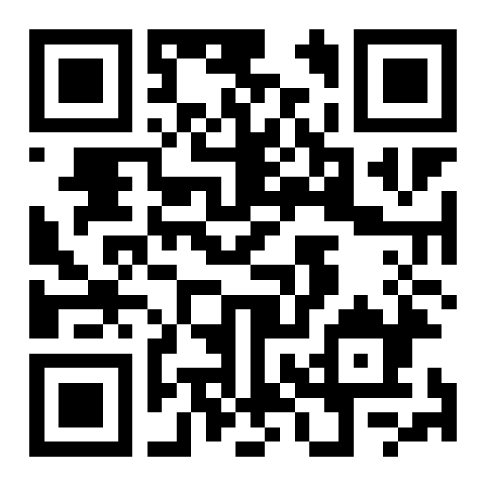




Next steps
Feedback
Please help us know what to do better- complete the feedback form.
Quarterly meetings
Next one: online in December
Details will be circulated with the UK TRE
mailing list or use the link or QR code to register
Get involved
https://forms.gle/onuDYDpPR48affUz7
Website
uktre.org
Repository
github.com/uk-tre
Mailing list
Slack channel
2nd Sept 2024
UK TRE Community Conference

Slide 51
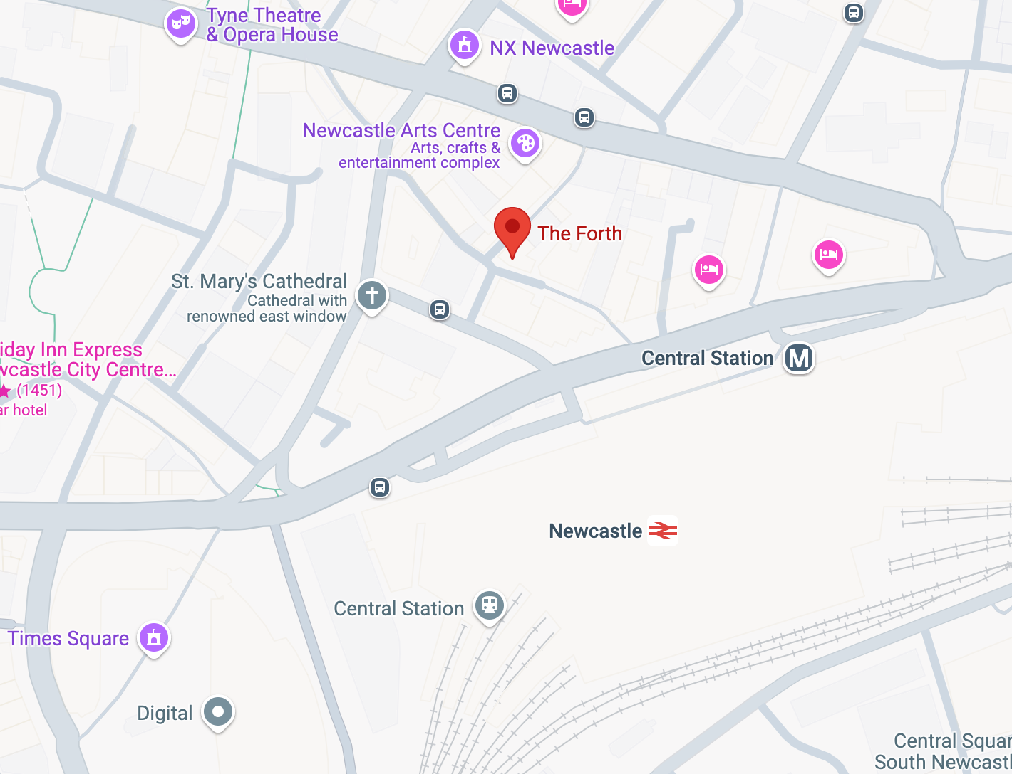
Thank You!
Those staying around:
Meeting in The Forth pub near station.
Get involved
Website
uktre.org
Repository
github.com/uk-tre
Mailing list
Slack channel
2nd Sept 2024
UK TRE Community Conference

