Slide 1
Reconstructing the human in health research:
A vision for data federation
James Fleming
Chief Information Officer – The Francis Crick Institute
Chair, OneLondon SDE Technical Design Authority
Strategic Advisory Partner, Digital Science & AI – LifeArc & Crick

Slide 2
A ‘Digital Revolution’ in discovery science, translation and healthcare relies on data flowing seamlessly from clinic, to lab, to industry, and yet we persist in design point solutions and perpetuating silos…
Discovery
Translation
Healthcare

Slide 3
‘Personal’ and ‘Precision’ Medicine and IT
The prospect of being able to offer AI-assisted multi-mode diagnostics, and deliver personalised drugs and therapies is in the very near future. Actually delivering this to patients however needs a complete rethink of how we look at both data, and connections between R&D, Pharma, Healthcare providers and Technology. We need to normalise and implement several key concepts – a patient-owned ‘data account’ centralising their data across the entire health ecosystem, solve how we embed AI at scale into care pathways, and then change the operating mode of drug delivery from generic, to directly coupled to the patient. Each of these is a fundamental technology challenge:
Today
Possible Future
Enabled By
Reactive, illness-driven
Proactive, health-driven
Patient Data accounts
Care management
Single mode, single hypothesis
Multi-mode, holistic
AI-assistance
Diagnosis
Generic by illness
Individual by patient
Drug-as-a-Service
Treatment

Slide 4
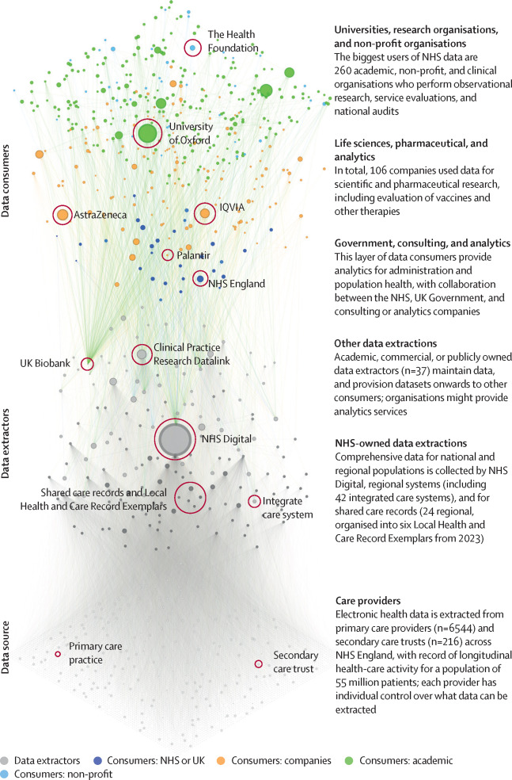
National Fragmentation of Data
NHS in England
The picture on the right visualises the problem:
Thousands of pockets of data
No coherent strategy at any level on investment
Hugely wasteful duplication
Huge barriers to entry for research
(6544+216) = 6760 Sources
(42+24+6+37) = 109 Extractors
(106+260) = 366 Private/Academic TREs
~30 Public TREs
So we have created 291 million possible ways of interrogating data about only 55 million people
This is a catastrophic failure of strategy, policy and funding
Figure of Data flows from Zhang, Morley et al., 2023
https://d3london.github.io/nhs_data_architecture/
Notes:
There are 55 million patients in England….
…there are ONLY 55 million patients in England
So why are we spreading their information across ~10,000 different data sources?
Why does every new research project need another TRE?
Why do we keep building new silos and pockets of data and congratulating ourselves?
Why are we spreading available funding so thinly by constantly duplicating effort?

Slide 5
What could it look like?
LATTICE
RPOs can use the Lattice fabric to both ‘market’ their own data, either openly or charged for, and connect secure, project centres workspaces to multiple different data sources
Private research organisations can use the fabric in exactly the same way – marketing their own data as well as consuming data from others, all within one IG framework
Care providers could move to a single national instance of from each major vendor (for supplier redundancy)
      Moves from 6760 instances to 5 across primary and secondary care
2. Create a single national data service to extract
Moves from 109 different extraction infrastructures to 1
3. Create a single R&D data fabric platform
Data providers can land a curated copy of their data set
Project-centred TREs can be spun up to combine data across sources once IG is satisfied
RPOs can bring their own data, and pay their own compute bills
Move from 396 TREs to a single federation platform
Total data ecosystem cost is reduced by orders of magnitude – from 7,265 different infrastructures to 7
Data governance is centrally controlled
Access time is dramatically reduced, accelerating research
Government and management analytics use cases can all be handled via the same infrastructure as discovery research taking subsets of the main data libraries and reporting on them
National Data Service
……
A single, secure infrastructure, providing consistent data normalisation and enrichment for all consumers AND sync between care systems
……
Moving from 6700 individual instances to one instance per supplier, to a common data standard, and synchronised via the National Data Service. Care is no longer geographic
Notes:
There are 55 million patients in England….
…there are ONLY 55 million patients in England
So why are we spreading their information across ~10,000 different data sources?
Why does every new research project need another TRE?
Why do we keep building new silos and pockets of data and congratulating ourselves?
Why are we spreading available funding so thinly by constantly duplicating effort?

Slide 6
Federation – Working with data across the R&D ecosystem
No single initiative can afford to deliver the complete picture of patient data – we must collaborate on a common strategy and architecture
Better Data
Multi-modal, multi-scale, population level, used in combination with lab-generated results
Better Research
Defining research programmes around the best possible datasets, not local availability
Better Health Outcomes
More time on science, less time on paperwork. Broader, more equitable participation, and acceleration of innovation
Life Science is undergoing a computational revolution.
The last generation of ‘Secure Data Environments’ catered for population science – large, anonymised data sets of a particular type.
We need to cater for fundamental discovery and translational science – new drugs and therapies require mechanistic understanding of biology at scale.
This means working with consented cohorts and multiple data modalities – images, EHR records, genomes and more – in combination with vast data generated in laboratories.
Months or even years are currently lost to paperwork with researchers trying to assemble such datasets from dozens of different sources.
We need to create an infrastructure that enables working securely with data at scale and in combination: we need federation across the Data Ecosystem

Slide 7

Federation – why do we need this?
Human Biology means understanding the human in their entirety – not bits of them.
We need to construct the most complete picture we can of the individuals we are studying, and this needs to be built from many different sources – healthcare, laboratory and 3rd party data from wearables, apps and private healthcare
EHR
Serology
NHS Sources
Longitudinal, standardised, periodic
RPO Generated
Custom assays, unique protocols
Genome
WGS
Pathology
Multi-omics
No single initiative or body can ever hold the complete picture of patient data – we must collaborate on a common strategy and architecture across the ecosystem
Wearable Devices
Private Health
3rd Parties

Slide 8
We need to reconstruct the full patient’s record – a longitudinal Unified Patient Model created from all available data sources
The Healthcare ecosystem of the future has to be anchored around a complete view of the patient, not our current model of fragmentary transactional data, siloed by administrative boundaries.
Amount
Quasi continuous
Wearables
TIME
Primary Health (GP)
Amount
Non/semi cyclic, event snapshots
TIME
Secondary Health (Hospitals)
Amount
Non/semi cyclic, event snapshots
TIME
Amount
Private Health
Semi cyclic, event snapshots
TIME
e.g. Our Future Health, GEL (Unchanging facts)
Amount
Fixed value metadata or data facts
TIME
Amount
Research Participation
Multi-modal, high volume, cyclic
Survey
Survey
Survey
Survey
Survey
Survey
Survey
Survey
Survey
Survey
Survey
Survey
Survey
Survey
TIME

Slide 9


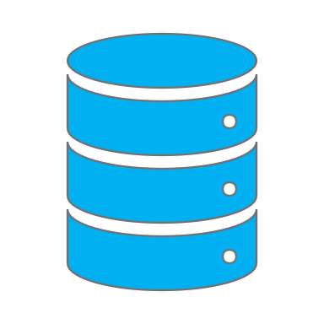
Enabling this feedback loop -
There are three major elements to creating a working feedback loop – powerful, curated and authoritative data sets, technical environments which are built around research projects, and an information governance control boundary that links the two
Authoritative data sets joining modes of data around patients
Tech-enabled Information governance
Project research environments – combining lab AND healthcare data
NHS
R&D
Common infrastructure
RPO
EPR(s) x7300
SN-SDE (x11)
TREPO
EPR
…
Approvals:
Ethical
Legal
Financial
EPR
Project
EPR
Data Out
EPR
EPR
Project
Project
…
SN-SDE (x11)
Project
Project
Project Collaboration
Researcher
Genomics England
Extended
UK Gov
UKBiobank
Share
Share
EPR
EPR
OFH
domain
EPR
…
share
…
EPR
Data
SDE
RPO 1
Health professional
of IG
…
Safe havens
control
Lab data
SAIL
UK RPO
Innovation In
…
Data
UK Data Service
x1000s
Open logs
SDEs
TREs
x1000s

Slide 10
Patterns of data exchange
There are three basic patterns of how data can be utilised between the a host and any 3rd party research performing organisation (RPO) – ‘hosted’, ‘exported’ and ‘shared’. Not all are equivalent, and in many ways, the default ‘hosted’ model is the least desirable for all parties.
Security | Cost | Function
Data remains in Host control | Host bears FULL COST of R&D compute (Crick alone, £2.5m PA) | Research limited to only internal Host records
Data leaves Host control | RPO covers cost of own compute | Can combine across any relevant data source
Data remains in Host control | RPO covers cost of own compute | Can combine across any relevant data source
Hosted (default)
Approved Researcher given access to local data in a controlled environment
Host Environment
Data
Exported
Approved Researcher is given a local copy of relevant data to work with in their own environment
Host Environment
RPO Environment
Data
Data physically
copied
Data
Data
Shared
Host org and RPO use their own environments on a common tech platform, which allows the Host to share an ‘image’ of the data, without direct copying
Common Data Fabric
Host Environment
RPO Environment
Data
Data ‘image’
shared
Data
Data

Slide 11
LATTICE – a Data Fabric to underpin UK healthcare and R&D
A data fabric architecture allows any data controller to maintain direct control over their data, whilst sharing ‘images’ of it in controlled fashion with trusted partners. It is absolutely ideal for the problem space we are trying to tackle.
This architecture is technically achievable today, and is based on exploiting the technology already chosen for the OneLondon SDE and many other data environments. What is needed is organisation and strategy, both locally and nationally, to achieve this.
LATTICE – UK Research Data Fabric
Data Controller Zone
Research Performing Organisation Zone - TRELLIS
Research Performing Orgs
NHS SDEs
Data Library
Collab 1
Universities
Collab 3
Project Collab 1
Genomics
Data Library
Collab 1
Institutes & BRCs
Population scale ~millions
Collab 3
Project Collab 2
Biotech startups
Pathology
Data Library
Collab 2
Pharma
Biobanks
Data Library
Collab 2
Project Collab 3
NHS bodies
Collab 3
Public agencies
Cohort scale ~thousands
Targeted scientific data-sets
Data Library
Collab 2
3rd party data sources
Research Registries
Patient Consent Registry
Funding Bodies
Organisations
Projects
Researchers
Citizen-facing consent data account
General Public
Information Governance Workflow

Slide 12
Thankyou

