Slide 1


DHSC Data Access Policy
2nd September 2024 UK TRE Annual conference lightning talk
Dr Izzy Hampson, Senior Policy lead – Data access ecosystem

Slide 2








Data Access Policy - Direction Already Indicated
The NHS Research Secure Data Environment (SDE) Network will become the primary route to access NHS data for research purposes.
Data access will become default for the secondary uses of NHS data.
The transition to data access will be phased. Data sharing will not be switched off overnight.
Data Sharing will only continue in the limited scenarios where there is a justification under technical, ethical, legal or regulatory reasons to do so.
We are putting in place a robust accreditation model to oversee and assure SDEs and ensure the highest standards of security and transparency are met.
We do not expect solely commercial and/or academic controlled SDEs to host NHS data or make it available for research.
We will consolidate multiple data access routes down into Data Access Committees associated with specific SDEs
Large scale public engagement programme to ensure the public support the shift to data access and to inform design choices

Slide 3
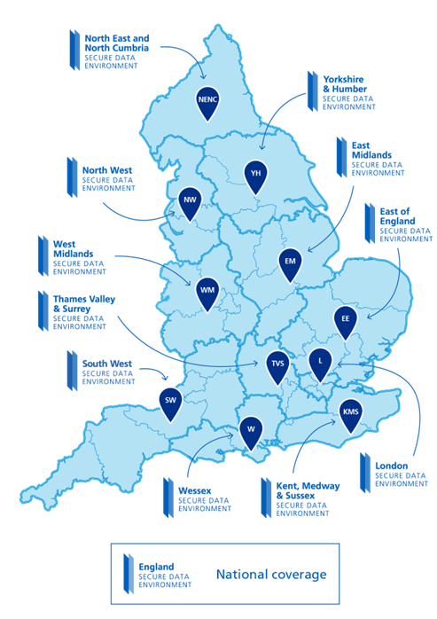

The NHS Research SDE Network
Interoperable England-wide system of SDEs at a national and a regional level.
Designed to help provide safer, more secure and faster access to different types of NHS data as well as ensure consistent standards and interoperability.
Underpinned by patient and public involvement and engagement.

Slide 4

Data Access Policy Indicative Timeline
Initiate
Completed Jun 22
Phase one
Completed Sept 22
Phase two
Completed Sep 23
Phase three
(current phase)
Oct 23 – April 24
Phase four*
expected May 24 – December 24
Phase five*
expected Jan 25 – Spring 25
Phase six*
Spring 25 - onwards
Direction setting
Data strategy published - commitment ‘data access as default’
Goldacre Review published – recommendation to implement network of SDEs
Policy framing
Policy guidelines – overarching principles for SDEs. Published September 2022.
Published public explainer and wider public content.
Scope setting
Data access policy update 1 –consultation in June, final version published 12/10/2023
Data strategy ‘one year on’ – announced accreditation plans. Published here.
Transition timeline (NHS investments)
Wider SDE ecosystem (England)
Transition timeline to data access
Accreditation phase 2 – scoping, legal basis and funding
DHSC delegated access to national SDE
Accreditation Framework and pilot design alongside policy development
DAC Reform & User Journey
Research Ecosystem mapping
UK & internat'l considerations
Further implementation policy TBC
Preparation for Accreditation roll-out
Data access policy update – further detail & clarity
* proposed future steps
Large scale public engagement programme

Slide 5
Thank you
Any queries please email: dataaccesspolicy@dhsc.gov.uk

