Slide 1


UK TRE Annual Community Meeting 02 Sep 2024
Why access mediation needs ODRL
Darren Bell
Director Technical Services
Copyright © 2022 UK Data Service. Created by DaRT team, UK Data Service.

Slide 2
Mediation of access at UKDS
Top Level Classifications
OPEN
  Zero disclosure risk, limited utility, available for download immediately as an anonymous user
SAFEGUARDED
  (1) EUL (End User Licence) – limited risk of disclosure
  available for download immediately subject to authentication and agreeing not to be naughty e.g. attempting to link to other datasets
  (2) Special Licence – limited risk of disclosure. Must complete application form to be approved by data owner before download is permitted
CLOSED
  Significant risk of disclosure. Must complete application form to be approved by multiple parties before analysis is permitted in a secure environment
  (TRE: Trusted Research Environment)

Slide 3
It’s all bad
Mediating access to digital objects is excessively human-mediated
Access policies are often locally defined, unstructured and bespoke
Lack of upstream Access metadata inhibits machine-actionability
Heterogeneous terminology makes federation difficult e.g.
  openAccess/restrictedAccess (CESSDA)
  Open/Safeguarded/Controlled (UK Data Service)
  ClosedAccess / EmbargoedAccess / RestrictedAccess / OpenAccess (openAire)

Slide 4
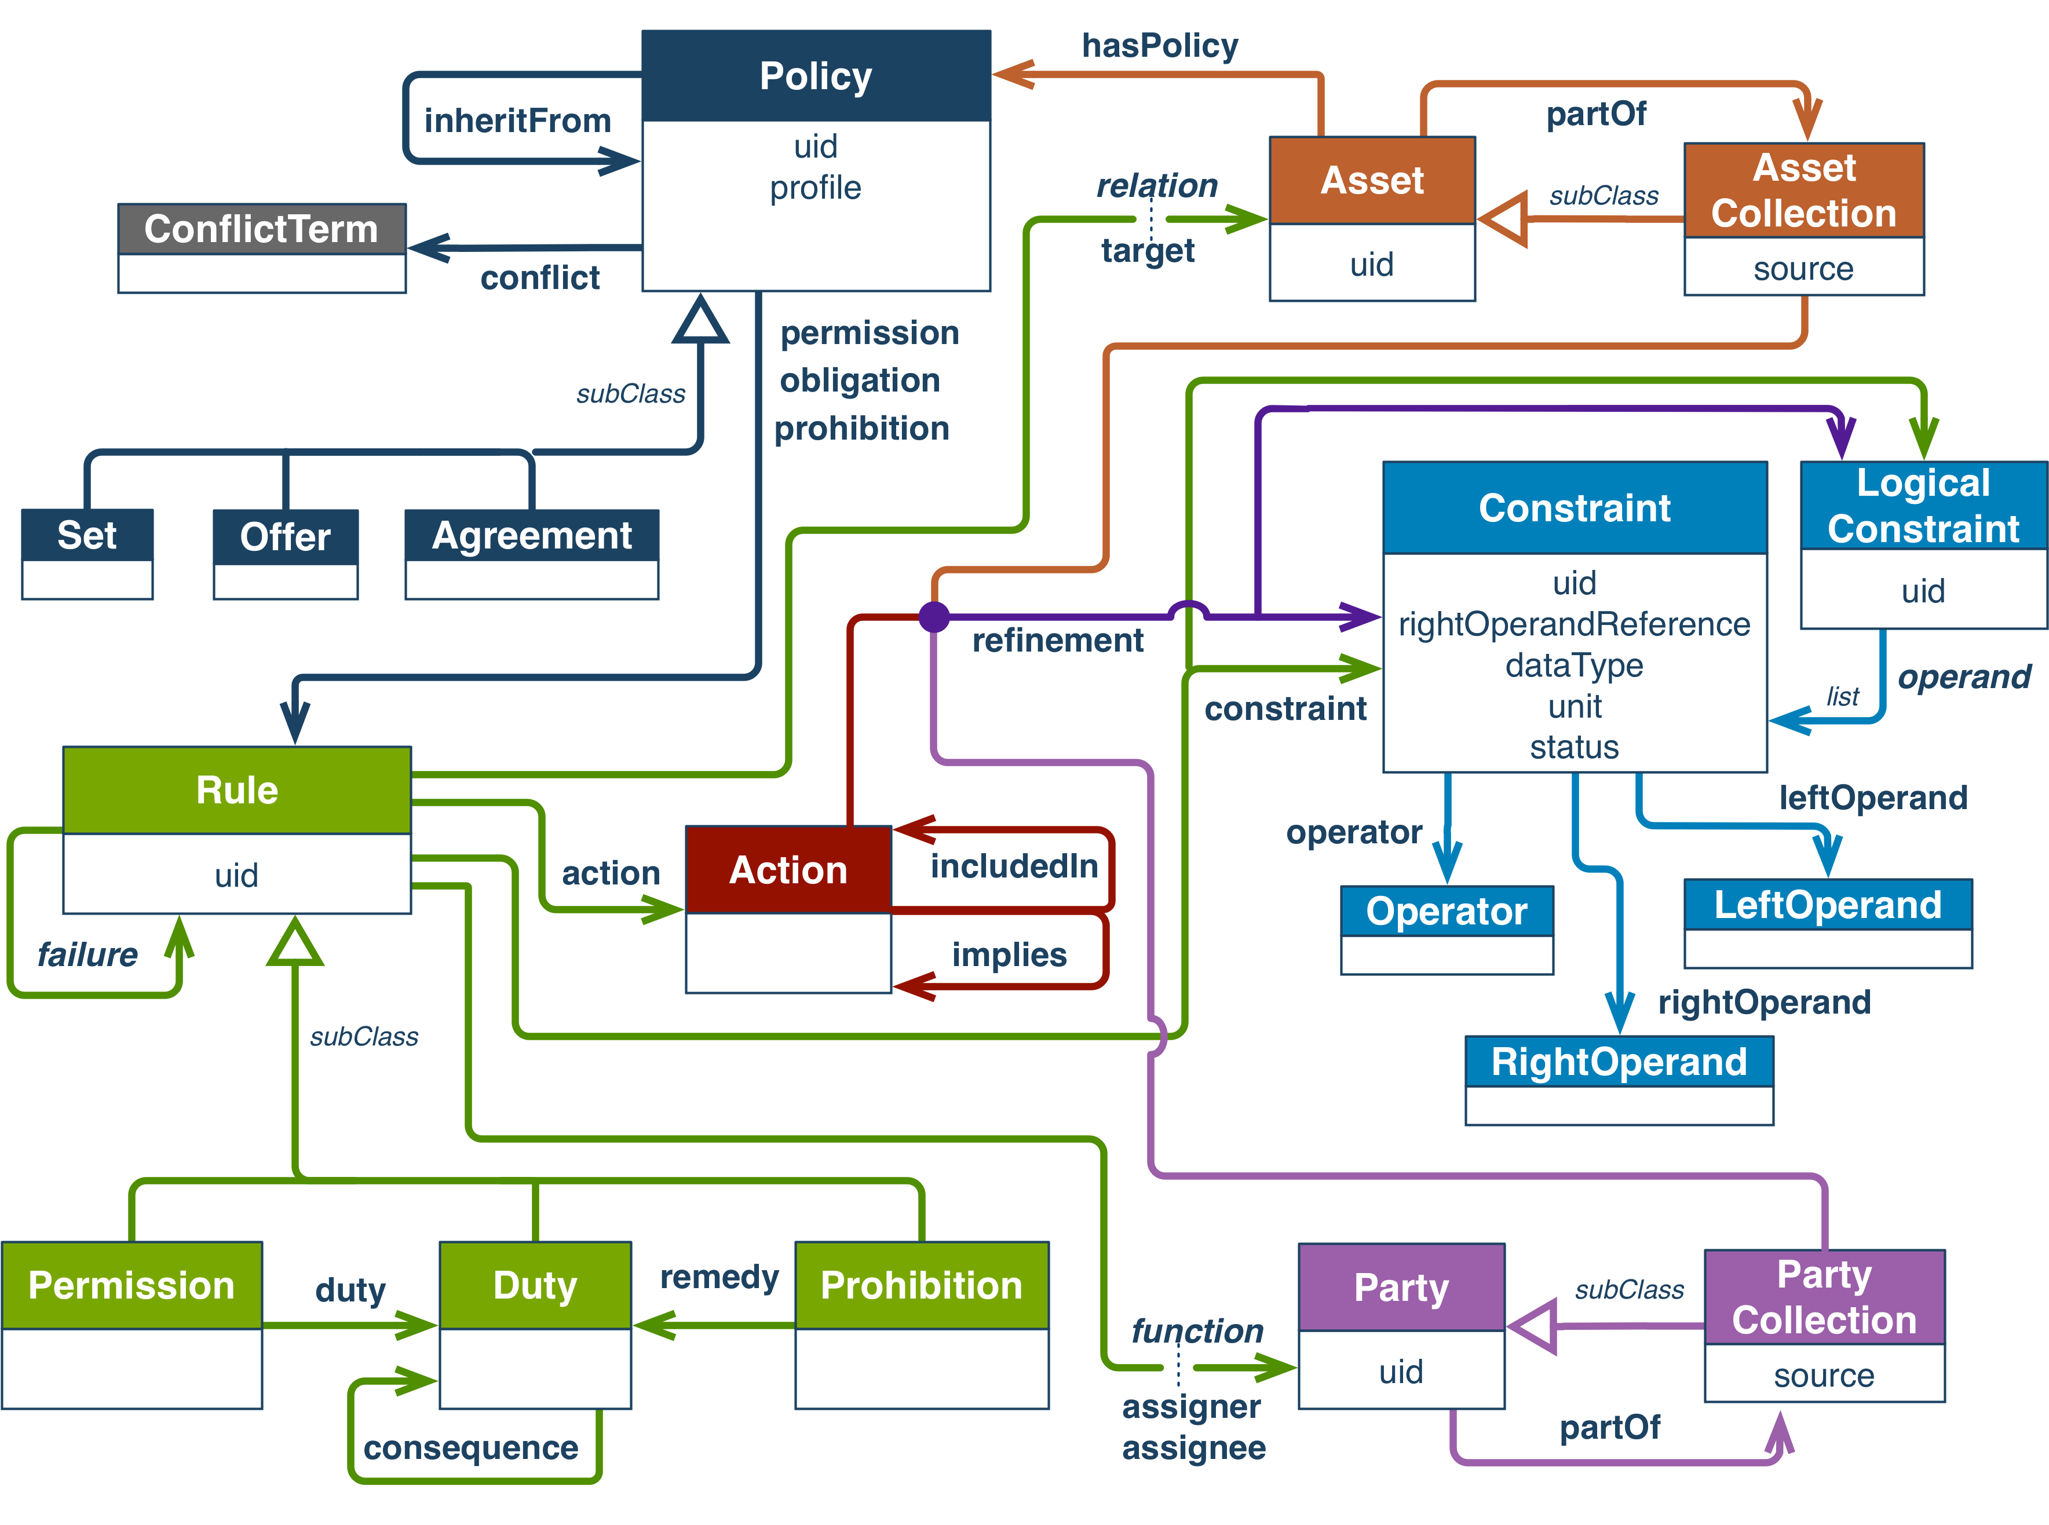
ODRL – Open Digital Rights Language https://www.w3.org/TR/odrl-model/

Slide 5
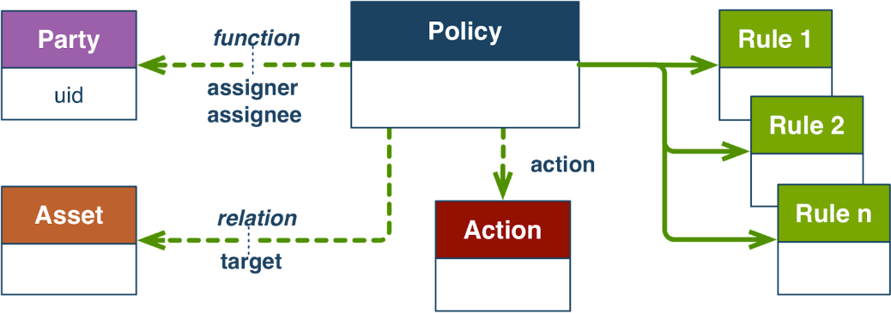
ODRL - Main classes
ODRL “Parties” - actors or agents who exercise:
ODRL “Rules” - ODRL Permissions (can do), ODRL Duties (must do), ODRL Prohibitions (must not do) encompassing:
ODRL “Actions” - operations performed on:
ODRL “Assets” - digital objects.
ODRL “Policies” are structured artefacts which encapsulate the above information.

Slide 6
Simple use case
{
"@context": "http://www.w3.org/ns/odrl.jsonld",
"@type": "Set",
"uid": "http://example.com/policy:1",
"permission": [
{
"target": "http://example.com/dataset_6123",
"action": "Analyse_In_TRE",
"assignee": {
"@type": "PartyCollection",
"source": "ANU_Registered_Users",
"refinement": [
{
"leftOperand": "Accredited_Researcher_Property",
"operator": "eq",
"rightOperand": "true"
}
]
}
},
{
"target": "http://example.com/dataset_6123",
"action": "SecondaryUse",
"assignee": {
"@type": "PartyCollection",
"source": "ANU_Registered_Users",
"refinement": [
{
"leftOperand": Researcher_Location_Property",
"operator": "eq",
"rightOperand": "Australia"
}
]
}
}
]
}
NB
In the example above, Actions, PartyCollections and Refinements, while now framed in an ODRL structure, only have local meaning and can only be executed locally. That is to say, “Analyse_In_TRE” and “SecondaryUse” are labels that currently have no wider potential for machine-actionability beyond the local repository environment.

Slide 7
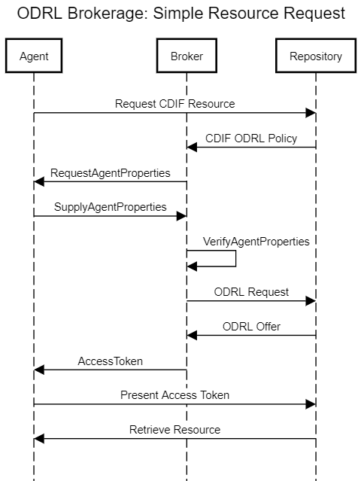
More complex use case
Access Metadata Aggregation – harmonising Access classifications. Will require extending ODRL Core Vocabulary
Access workflow choreography
  Requires extended typologies to connect
  Actions to repeatable executable workflows

Slide 8
Thank you

