Slide 1



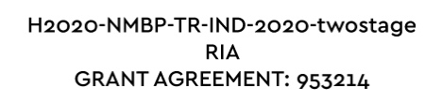
Upcycling Packaging: EU Research Driving Sustainability
upPE-T project
Fuensanta Monzó
Tuesday 1st October 2024

Slide 2
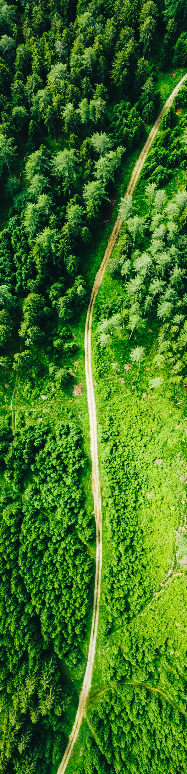
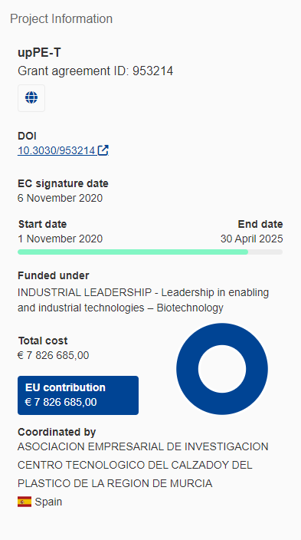
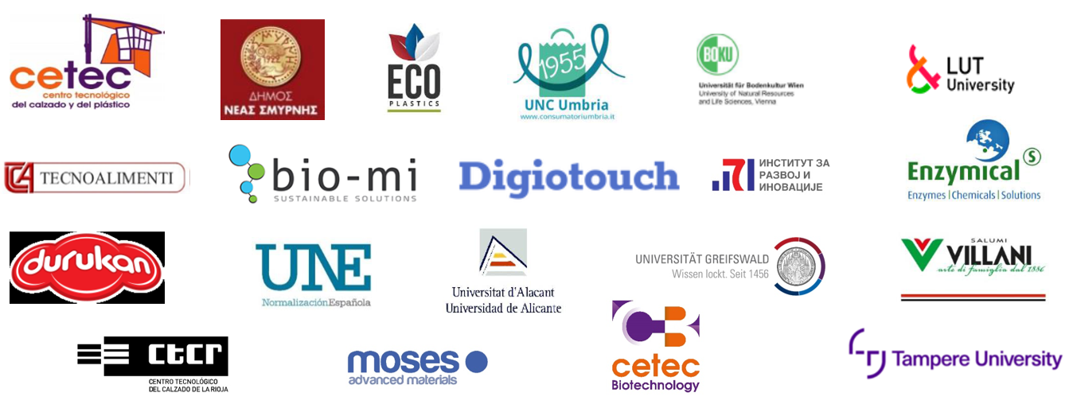
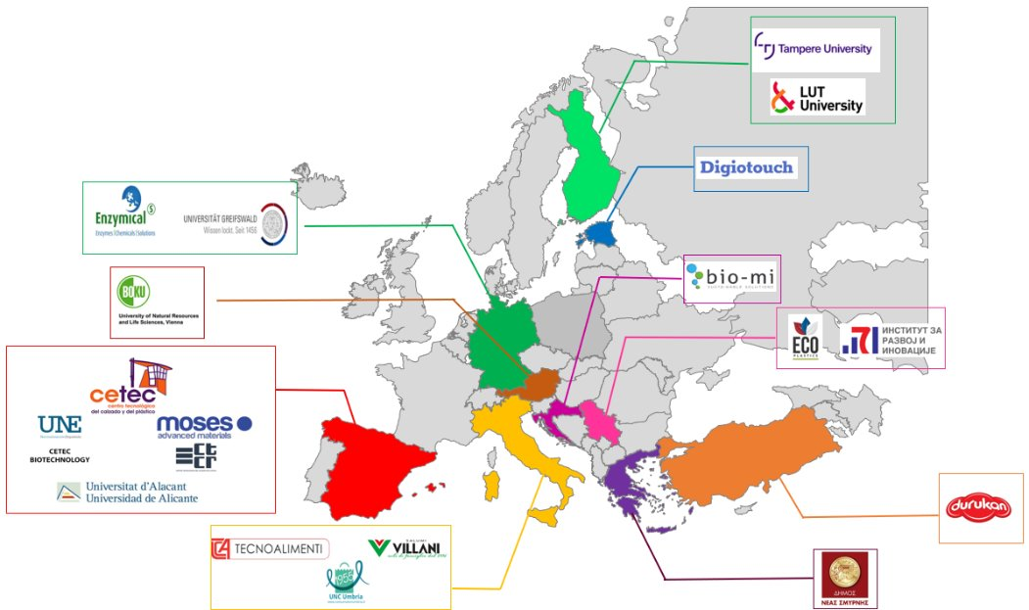
INTRODUCTION
20 partners- 10 countries

Slide 3
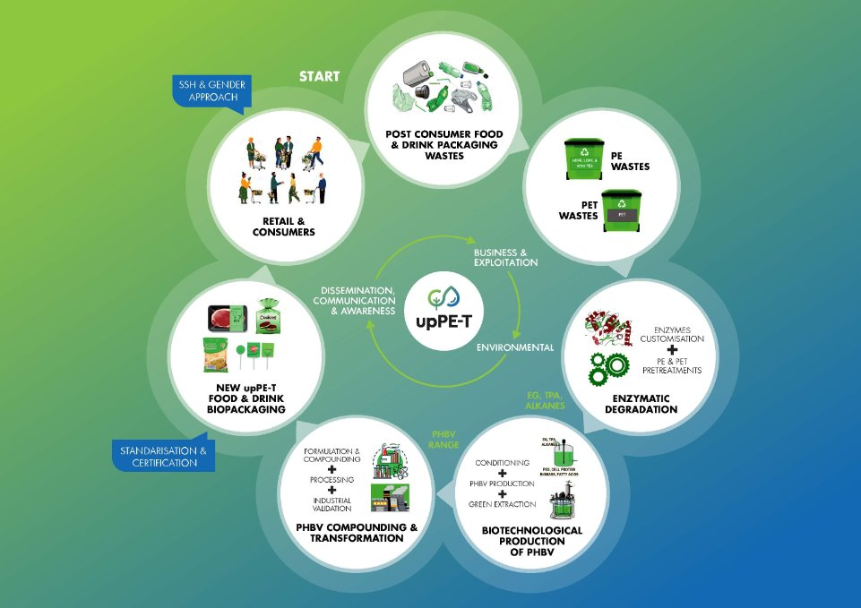
upPE-T Ecosystem

Slide 4



Technical WPs
The holistic upPE-T concept- WP2-WP3-WP4​
PHBV 10% HV
25% HV
WP5-WP6​
Enzymatic degradation of pretreated PET packaging waste
Enzymatic degradation of pretreated PE packaging waste
EG
PHBV riched biomass
LCA, s-LCA & LCC of upPE-T products
TPA
Valorization of
by-products
Nutrients
Organic acids
Precursors
Novel standards & Certification schemes
Comamonas
Cell factory
H.mediterranei
Cell factory

Slide 5
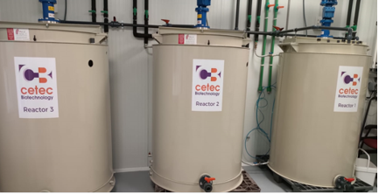
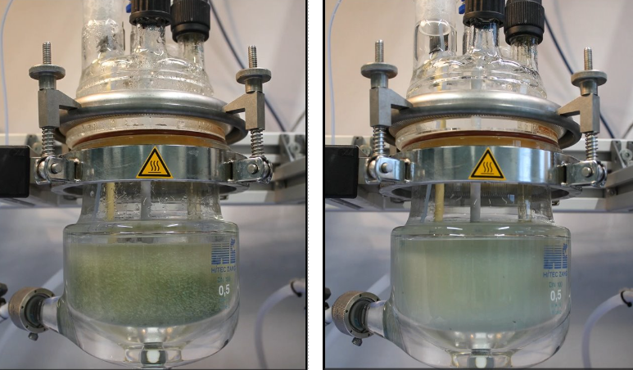

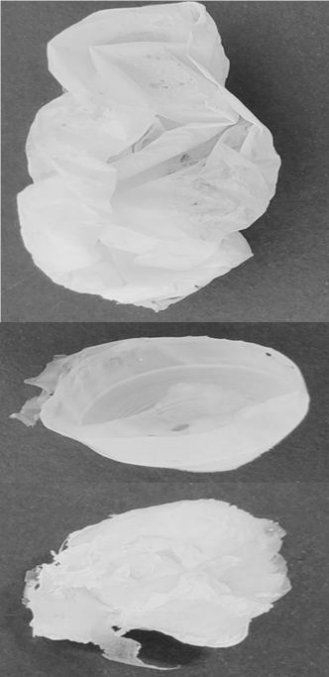
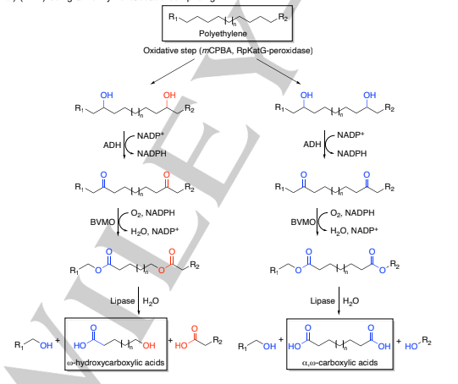



KEY ACHIEVEMENTS
Novel PET degrading enzymes
300 L PHBV bioreactor
Novel chemoenzymatic cascade reaction for depolymerization of PE
https://www.mdpi.com/2306-5354/11/9/870
Novel Aqueous two-phase system (ATPS) green PHBV extraction
https://onlinelibrary.wiley.com/doi/10.1002/anie.202415012

Slide 6
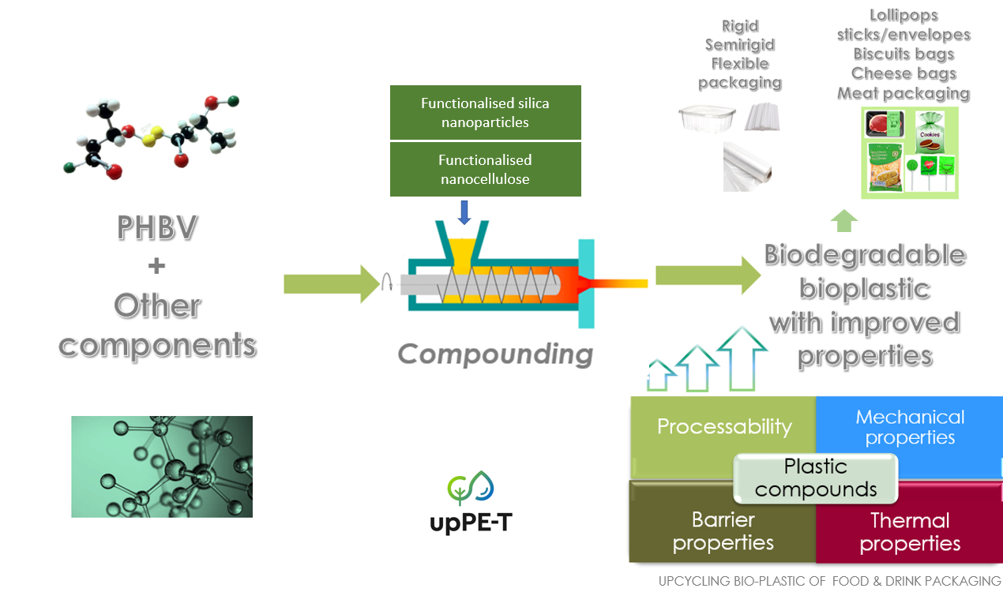
Technical WPs
WP5-WP6​
Assessment of biodegradability & recyclability
Evaluation of
Shelf-life

Slide 7
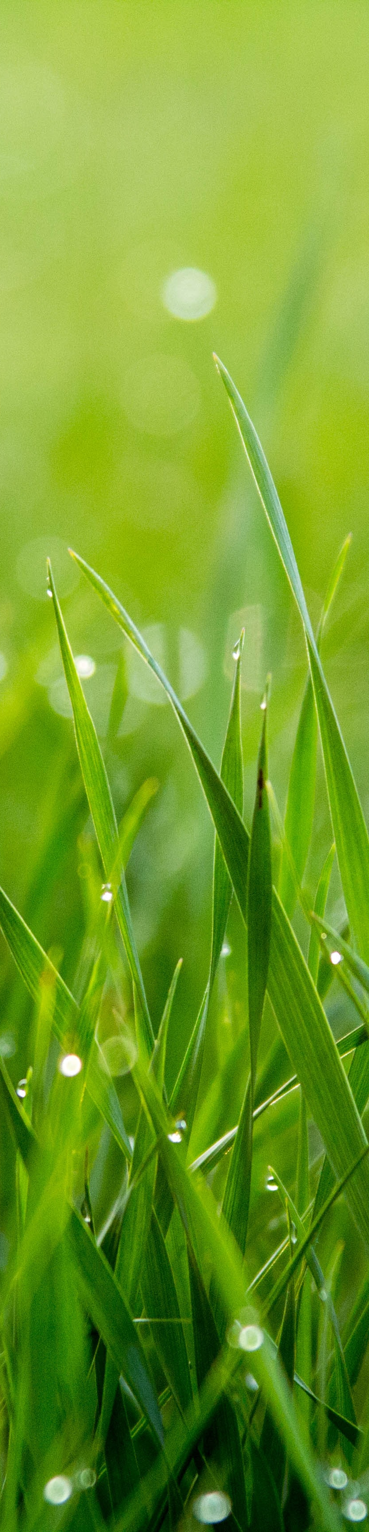
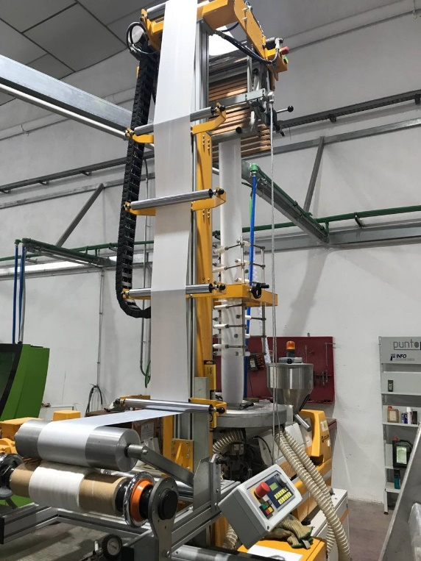
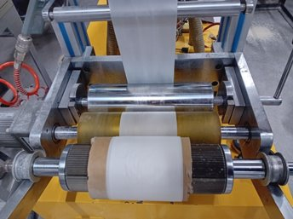
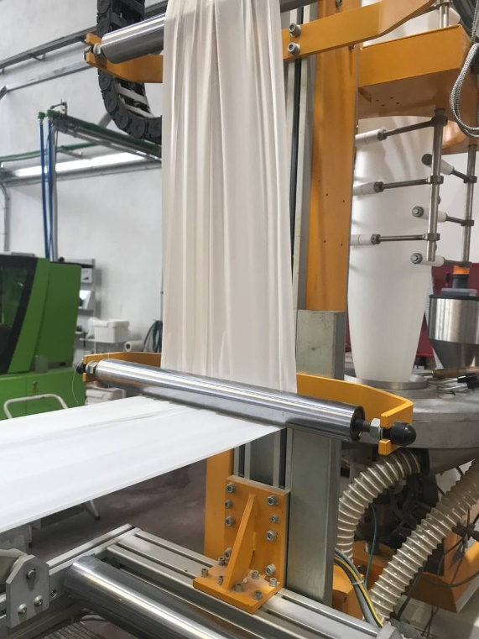


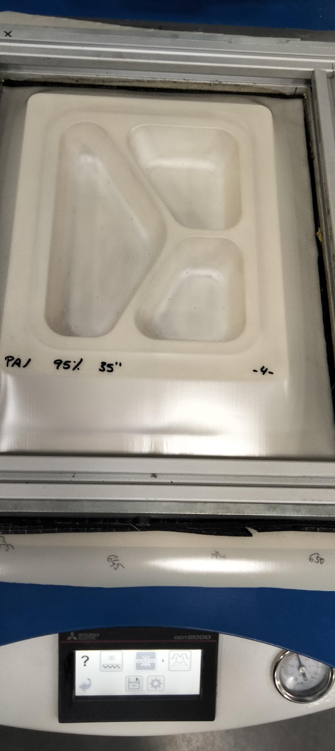


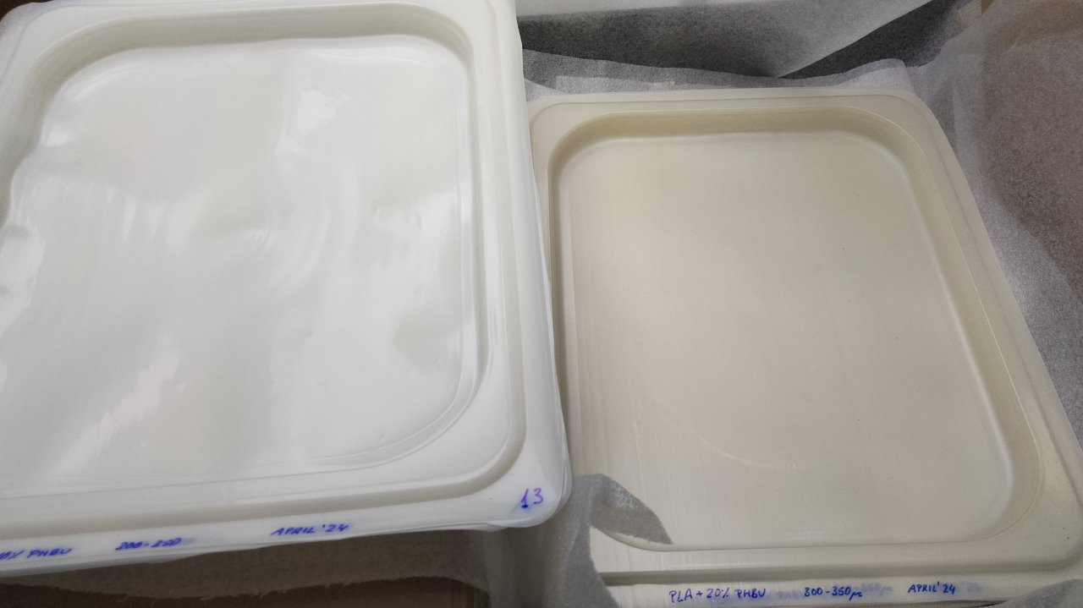
KEY ACHIEVEMENTS
Flexible blends for flexible packaging
Rigid blends for trays

Slide 8
https://uppet.eu/
THANK YOU
f.monzo@ctcalzado.org

