Slide 1
PRESERVE
High performance sustainable bio-based packaging with tailored end of life and upcycled secondary use
Upcycling Packaging: a White Paper on EU Research driving Sustainability
1st October 2024, online

Slide 2

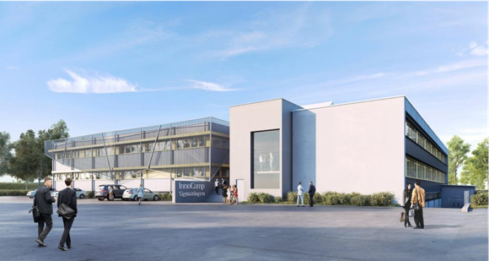
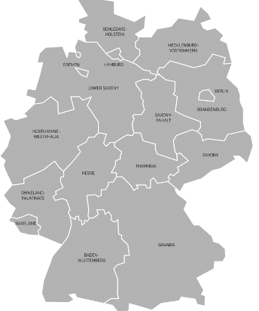

The SPI in Sigmaringen
Forschungsfabrik
Startup-Zentrum
Akademie
The Sustainable Packaging Institute, SPI for short, is involved in research & teaching in six thematic areas
The Institute has a research focus on „sustainable packaging concepts"
Sigmaringen

Slide 3
Mission Statement
"To competently & holistically support all players in the packaging industry along the entire value chain in the life science industry on their way, towards a more sustainable circular bioeconomy."

Slide 4






Thematic Area of the SPI
1. Biogenic raw materials
6 Bioeconomy & Sustainability
(Concepts, Assessment &
Perception)
2. Process technology &
Process design
5. Preservation &
Packaging
3. Functional materials
4. Smart packaging
(Active & Intelligent Packaging)
Project presentations and project updates can be found at: www.hs-albsig.de/spi
Notes:
Our work is rounded off by the 6th thematic area, "Bioeconomy & Sustainability", which [...]

Slide 5









Projects of the SPI
BUSINESS
PLA2Scale
EDELNASS
PackMit
ZIM - HOT Screen
ZIM - Heyne & Penke
ZIM - Hugo Beck
SmartMaterial
Project presentations and project updates can be found at: www.hs-albsig.de/spi
Notes:
Our work is rounded off by the 6th thematic area, "Bioeconomy & Sustainability", which [...]

Slide 6
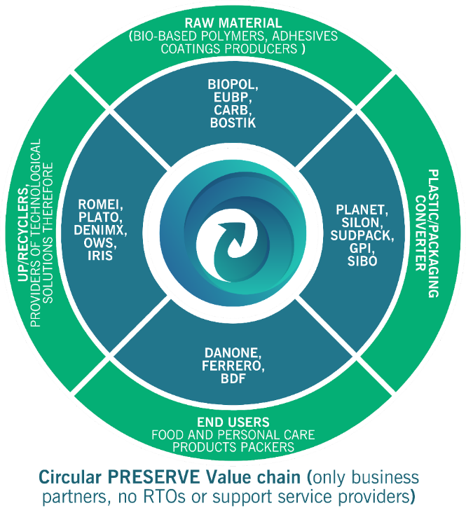
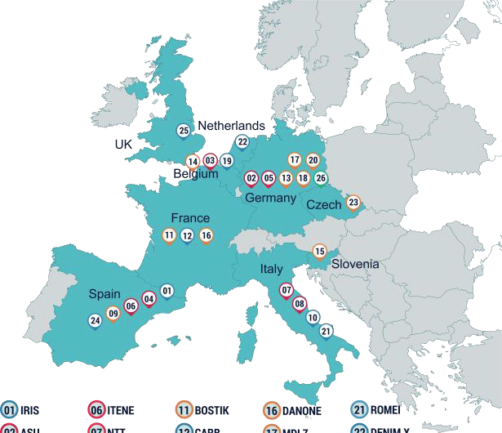

PRESERVE – Main Figures
4 years (January 2021- Dec 2024)
Funding from EC Horizon 2020 programme under the topic:
CE-BIOTEC-09-2020 Upcycling Bio Plastics of food and drinks packaging
23 partners including 7 research organisations, partners along the circular supply & value chain with large end users and the largest bioplastics producer/users’ association.

Slide 7
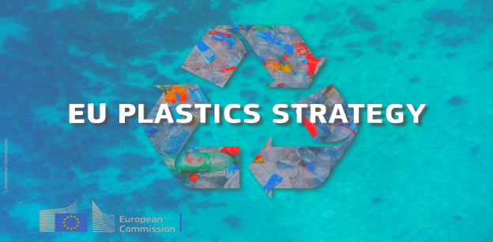
In 2021, 19 M tons of packaging produced
→ Europe is far from its sustainability goals
→ Required recycling rate by 2030: 70%
In 2021, recycling rates vary between 38-80% (average: 64%)¹
Why is PRESERVE needed?
    High performance bio-based materials need to be developed and produced.
    Their recycling approaches need to be better established and in motion.
    Biodegradability of biopolymers applications to be expanded to more environments.

Slide 8
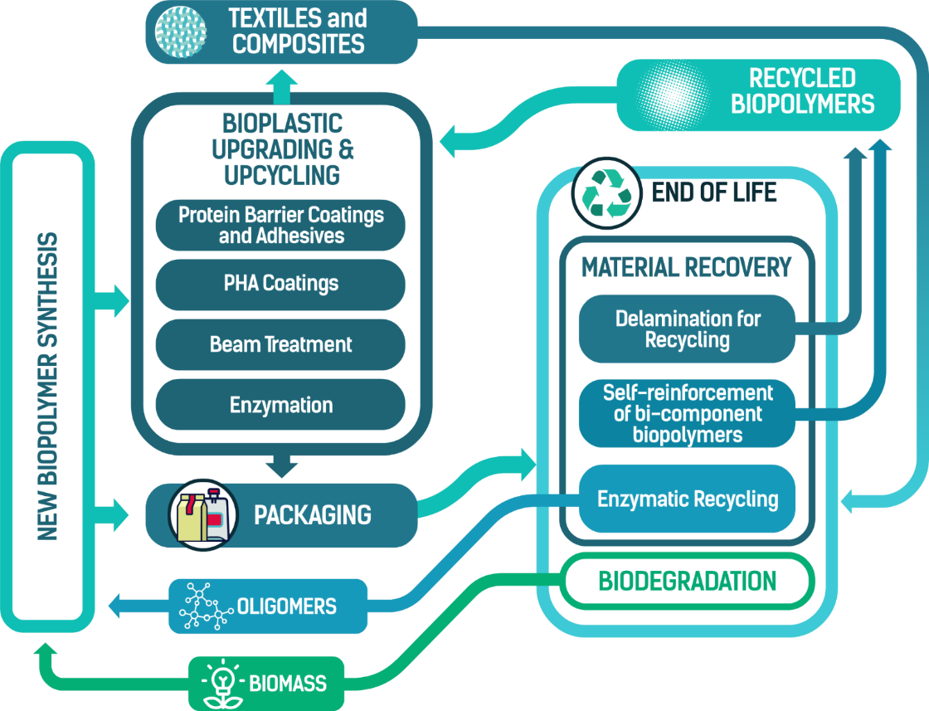
PRESERVE objectives

Slide 9
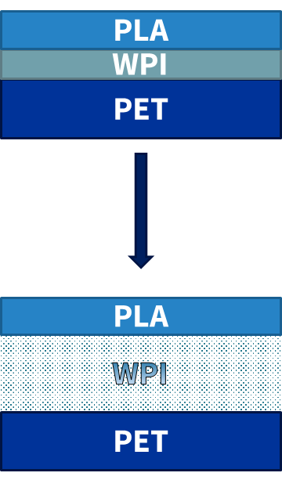
PRESERVE – Protein Coating
Whey by-product of cheese manufacturing
Yearly production in Europe: 50 mio. t, 50 % of which discarded²
→ non-food competitive source
Potential bio-based alternative to EVOH due to high oxygen barrier properties³
Use of protein layer to allow separation of multilayer structures in recycling⁴

Slide 10
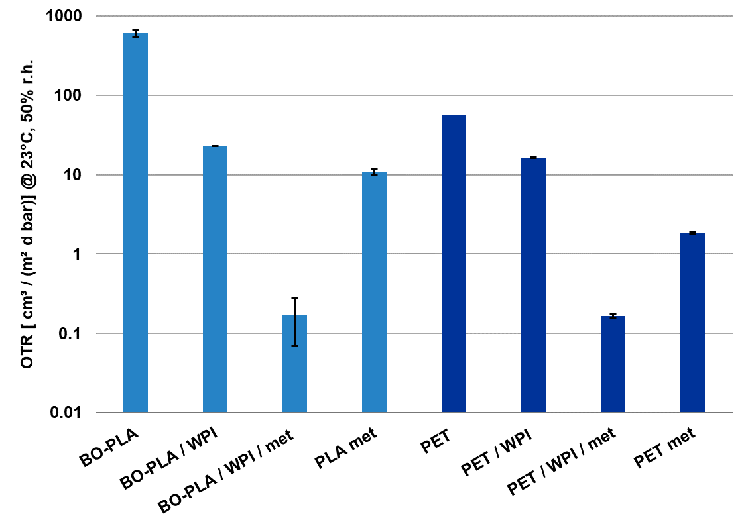
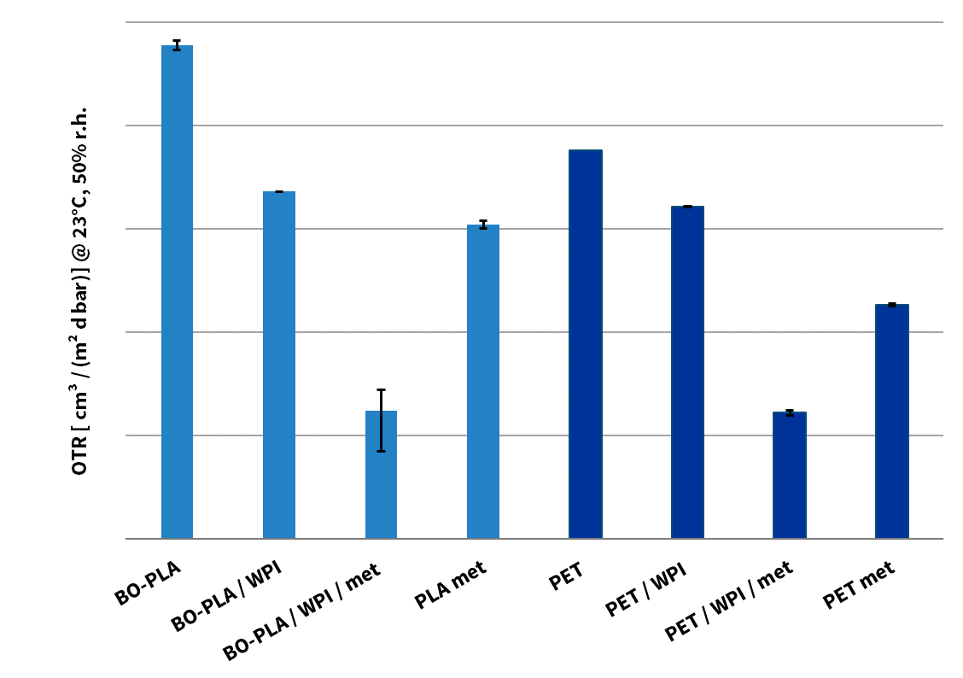
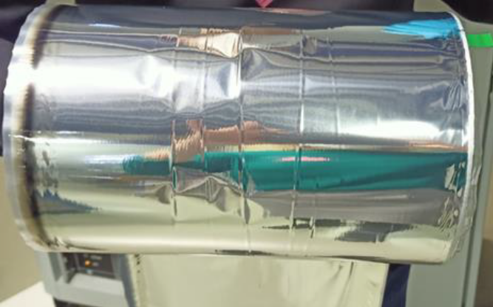
PRESERVE – Protein Coating
Upscaling to pilot plant
Reduction of OTR by factor 26.2 (PLA) and 3.5 (PET)
Further reduction by factor 167.6 (PLA) and 135.9 (PET) upon metalization of protein layer
Metallized and whey protein coated PET

Slide 11

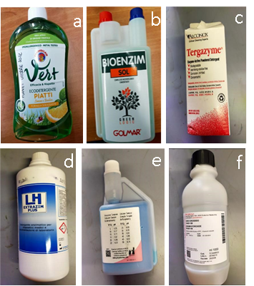


PRESERVE – Delamination
Trade name | Product | Result
Sodium chloride (NaCl) | Salt
Vert | Biodegradable liquid dish soap
Bioenzim SOL | Concentrated microbiological complex
Tergazyme | Combination of ALCONOX® and protease enzyme
Extrazim Plus LH | Concentrated enzymatic detergent
Sodium hydroxide solution | Sodium hydroxide solution
Buffer solution Ph 9 | Buffer solution Ph 9

Slide 12
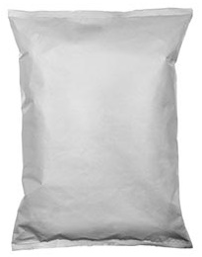
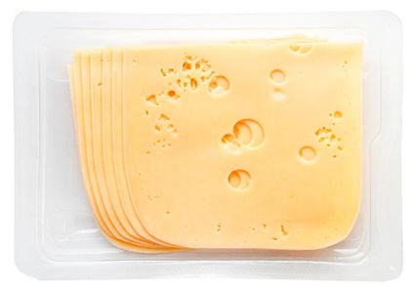
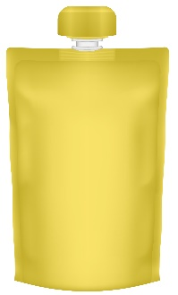


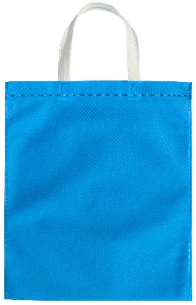
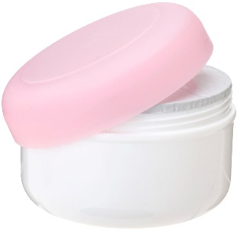
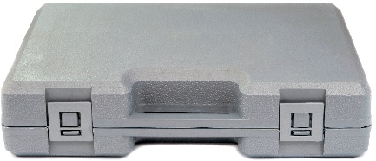
Take Home Message
Potential for biobased multilayers to rethink food packaging
Flow packs
Trays
Pouches
Beverage bricks
Options for bio-based design to separate & recycle for 2nd high performance applications in personal care and transport packaging
Injected jars
Bottles
Carrier boxes
Bags

Slide 13


THANK YOU FOR YOUR ATTENTION
Contacts
Dr. Aldo R. Reyes
IRIS – Project Coordinator
Email: aramirez@iris-eng.com
Dr. Kristina Eissenberger
ASU – Scientific Coord.
Email: eissenberger@hs-albsig.de
Max Sturm
ASU – Scientific Coord.
Email: sturm@hs-albsig.de
Prof. Dr. Markus Schmid ASU
Email: schmid@hs-albsig.de

Slide 14























Slide 15
References
Eurostat, Recycling rates for packaging waste, 2021. Available at: https://ec.europa.eu/eurostat/databrowser/view/ten00063/default/table?lang=en (Accessed on: 15.04.2024).
Eurostat. (2020). Agriculture, forestry and fishery statistics - milk and milk products statistics, December 2020. Luxembourg: Publications Office of the European Union
Bugnicourt, E.; Schmid, M.; Nerney, O. Mc.; Wildner, J.; Smykala, L.; Lazzeri, A.; Cinelli, P. (2013): Processing and Validation of Whey-Protein-Coated Films and Laminates at Semi-Industrial Scale as Novel Recyclable Food Packaging Materials with Excellent Barrier Properties. In Advances in Materials Science and Engineering 2013, pp. 1–10. DOI: 10.1155/2013/496207.
Cinelli, P., Schmid, M., Bugnicourt, E., Coltelli, M.B., Lazzeri, A., 2016. Recyclability of PET/WPI/PE Multilayer Films by Removal of Whey Protein Isolate-Based Coatings with Enzymatic Detergents. Materials (Basel, Switzerland) 9 (6). 10.3390/ma9060473.

