Slide 1

MoeBIOS project and the BIOplastics upcycling in the packaging, textile and agricultural sectors.

Slide 2







MoeBIOS- Project
Slide summary
IMprOving wastE management of BIObased plastics and the upcycling in packaging, textile and agriculture sectors.
Demonstrating the integration of the bioplastics BIOs End of Life value chain from collection, recycling, upcycling in Packaging (Spain), Textiles (Italy) and Agriculture (Germany).
Consortium of 21 partners + 2 Affiliated Entities led by ITENE Research Centre.
Waste streams containing BIOs as a feedstock.
3 upcycled demonstrators from developed value chains (packaging, Agriculture and Textile).
Reduce waste, lower environmental impact, providing a sustainable alternative to fossil resources.
Creation of a novel model for the BIOs End of Life in Europe focused in 3 sectors: packaging, textile and agriculture.
2

Slide 3
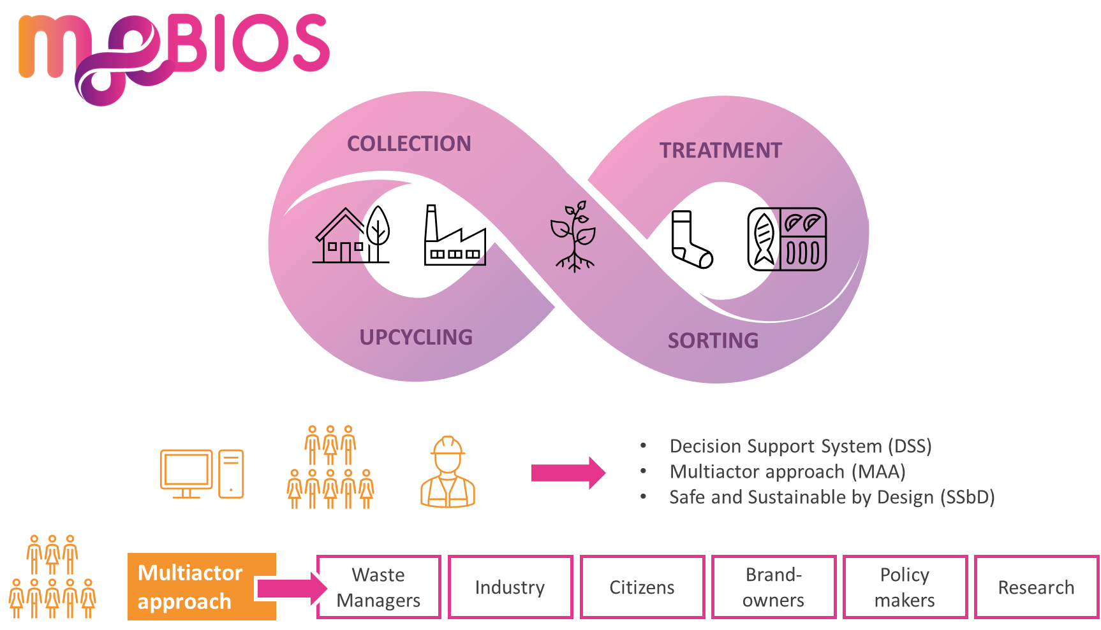
MoeBIOS project
MoeBIOS CONCEPT
The MoeBIOs concept :Closing the loop of the BIOs End of Life
8

Slide 4

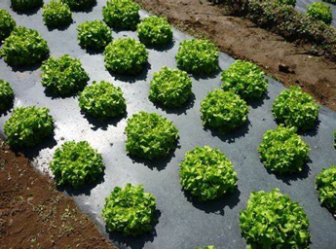
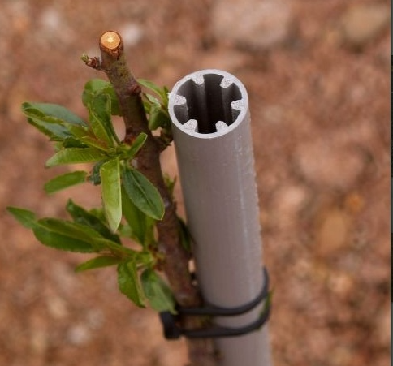



MoeBIOS project
Upcycling routes.
MoeBIOs demonstrators: Routes to develop high value products from bioplastics waste.
Formulation & compounding
Transformation in rigid packaging → Tray.
Characterization vs requirements
Industrial validation
Transformation in flexible films, pots and nets/tutors.
r-biobased plastics
Formulation & compounding
Characterization vs requirements
Industrial validation
Melt spinning
Texturation (air-jet)
Knitting and weaving
Final characterization
8

Slide 5
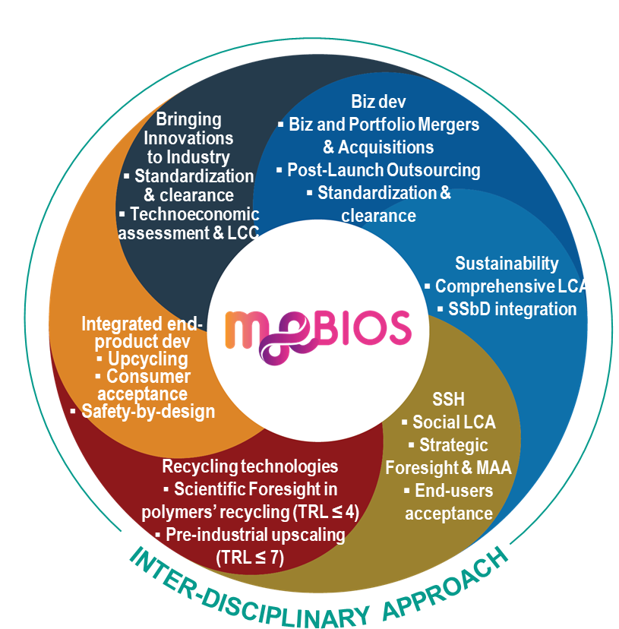





MoeBIOS Project
BENEFITS
Benefits to society and the environment:
Preventing landfilling and incineration and promoting valorization vs degradation as EoL options for BIOs.
Decreasing the demand of virgin/fossil resources.
New business models to be implemented within textile, packaging and agriculture sectors (economic and corporate benefits).
BIOs standardization, good practices & Support Decision Tool creation.
New added value biobased and recycled products.
9

Slide 6
THANKS FOR YOUR ATTENTION
María José Jiménez Pardo Miriam Lorenzo Navarro
maria.jimenez@itene.com miriam.lorenzo@itene.com

