Slide 1



SEQUENCE-TO-SEQUENCE TRANSLATION FROM MASS SPECTRA TO PEPTIDES
WITH A TRANSFORMER MODEL
Wout Bittremieux — EuBIC-MS 2024/09/26
@wout@sigmoid.social
bittremieux.be
wout.bittremieux@uantwerpen.be

Slide 2
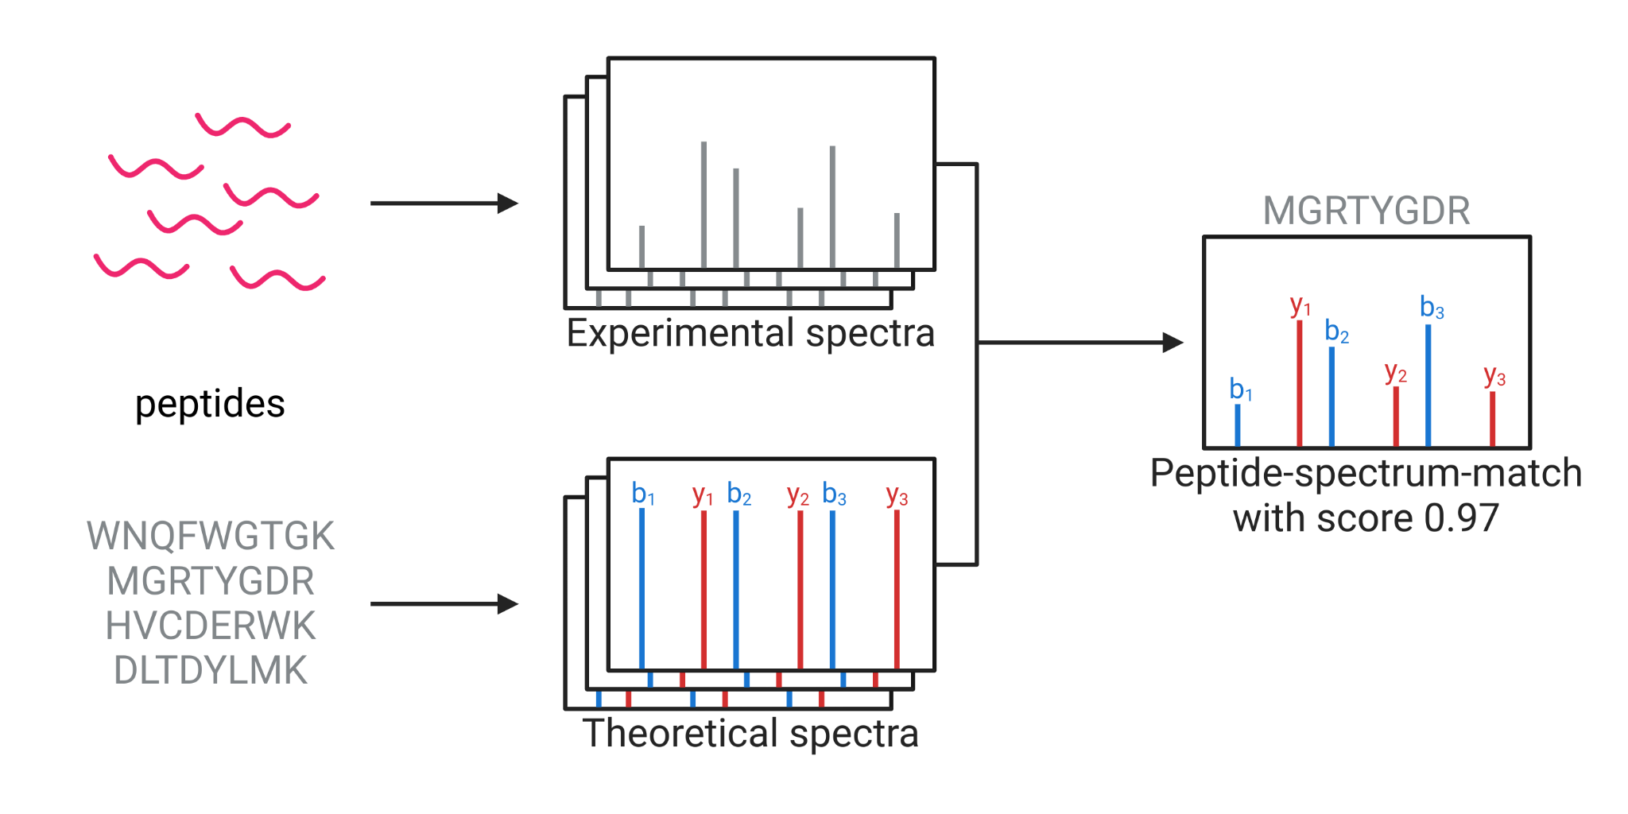
HOW CAN WE GO FROM SPECTRUM TO PEPTIDE?
sequence database searching
Notes:
A similar strategy is used during sequence database searching, which is the most common strategy for spectrum annotation. In this case, besides our experimentally measured spectra, we have a sequence database from which candidate peptides are derived. For each candidate peptide we can simulate theoretical spectra based on the position of their expected fragments. And by finding the match between each experimental spectrum and its best theoretical spectrum, we can assign peptide labels to the spectra.

Slide 3
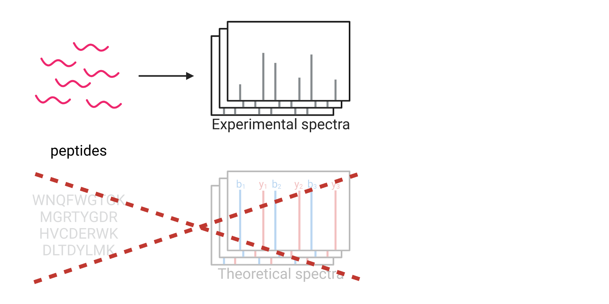
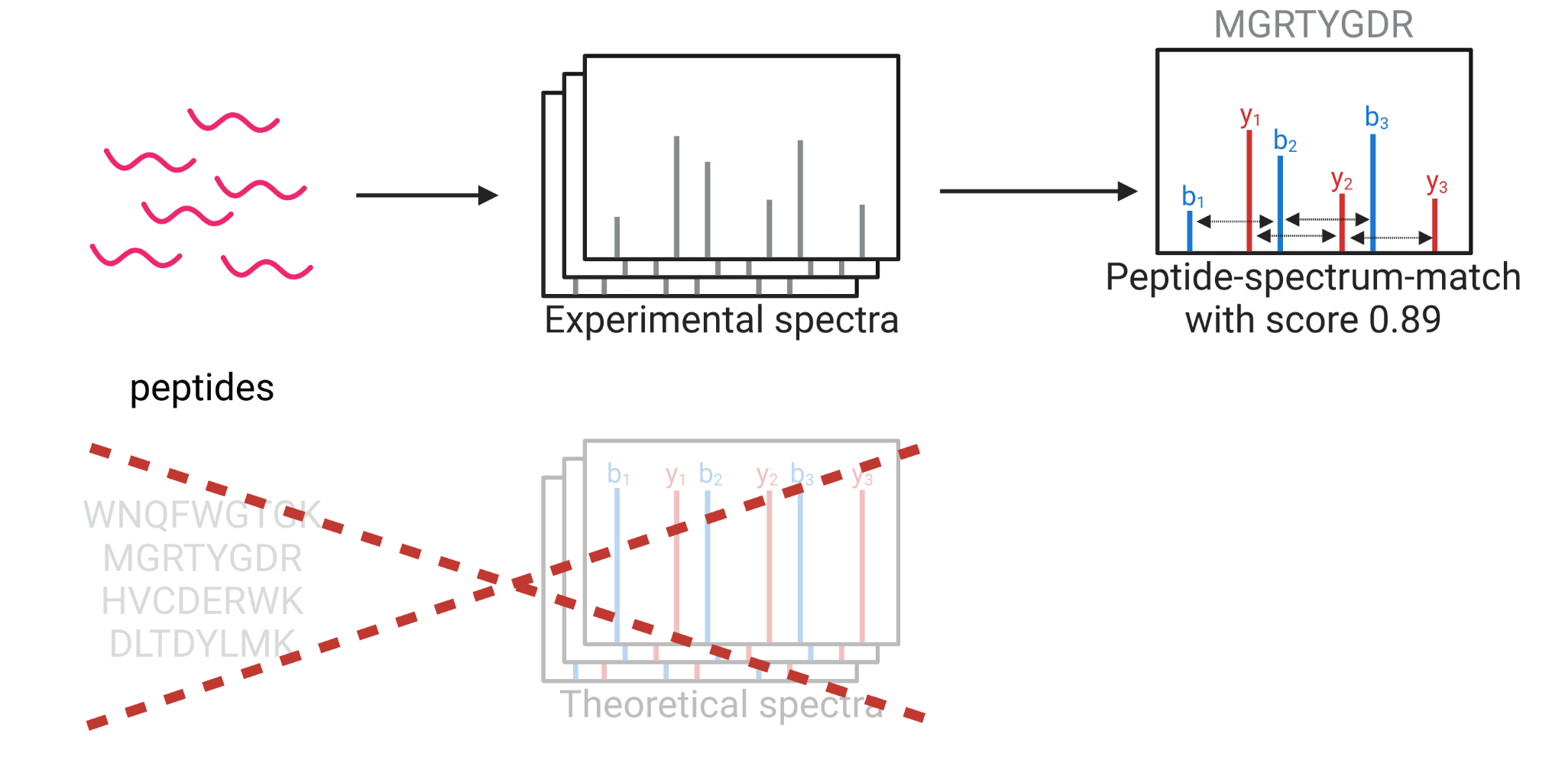
HOW CAN WE GO FROM SPECTRUM TO PEPTIDE?
de novo peptide sequencing
Notes:
An alternative is de novo peptide sequencing. Here the peptide-spectrum-match is determined by deriving the peptide from the spectrum directly, for example by checking whether the distance between peaks corresponds to specific amino acids. This works for high-quality spectra, but because we don’t know exactly which peptides we’re looking for, this is a significantly more challenging task. Compare it to building our Lego city with having the instruction booklet: you might be able to build some of it, but it’s going to be much more challenging and you might make mistakes here and there as well.

Slide 4


PEPTIDE SEQUENCING AS A TRANSLATION PROBLEM
“el”
“espec”
“de”
“masas”
“es”
“increíble”
[stop]
LLM
[start]
“mass”
“spec”
“is”
“awesome”
Notes:
Our idea was that we can use the latest advances in deep learning, and then especially large language models, to do de novo peptide sequencing. In essence, we’re using very similar models to what is used in ChatGPT to formulate de novo peptide sequencing as a translation task. Where you would normally go from a sentence in one language to its translation in another language, now we’re translating from the language of mass spectra to the language of amino acids.

Slide 5
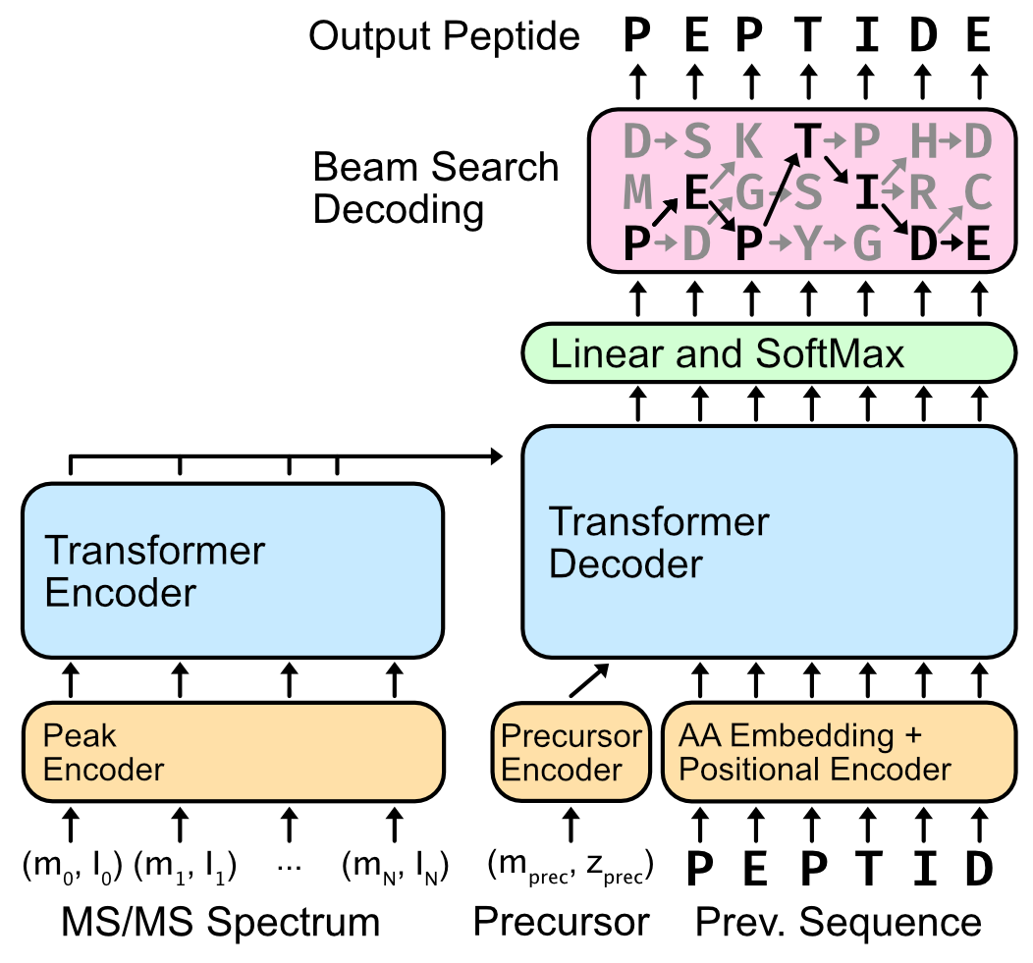
CASANOVO IS A DE NOVO SEQUENCING TRANSFORMER
Encoder: Learns contextualized representations for peaks
Decoder: Predicts the de novo sequence one amino acid at a time
Beam search decoding finds the highest-scoring peptide
Yilmaz, M. et al. ICML (2022).
Notes:
Our tool is called Casanovo and it uses a so-called transformer neural network architecture. Transformers are the dominant deep learning approach currently used. In our case, we use a transformer encoder which gets the peaks, determined by the m/z and intensity values, as input and learns a contextualized latent representation of the spectrum. This is then provided to a transformer decoder, alongside some extra information such as the precursor m/z and charge, and then the precursor iteratively predicts the next amino acid in the peptide. Finally, we combine that with a beam search decoding strategy to find the find with the highest score.

Slide 6
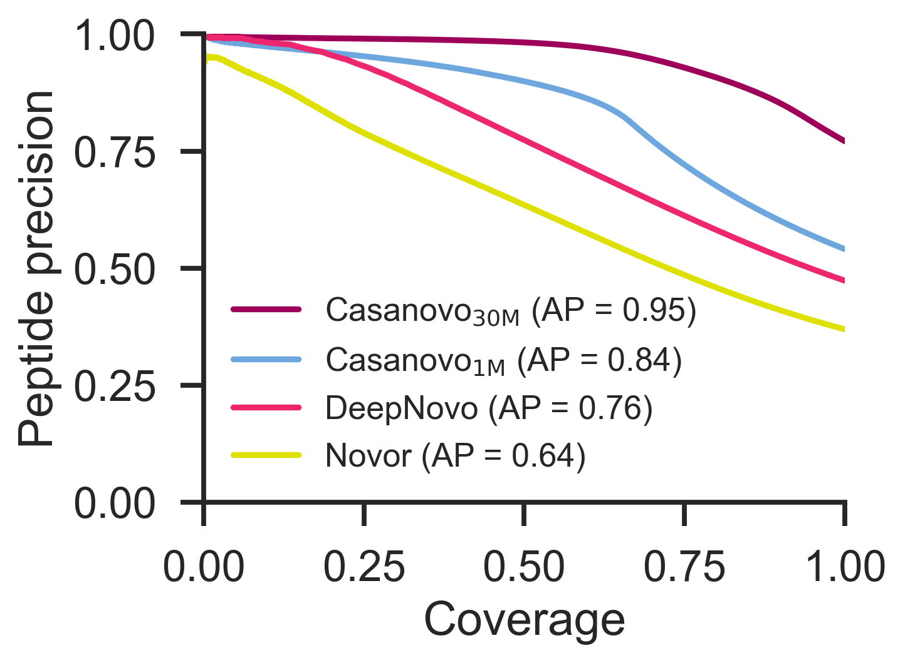
CASANOVO OUTPERFORMS OTHER DE NOVO TOOLS
With same training data, Casanovo outperforms traditional and deep learning-based de novo sequencing tools
Large training data significantly improves performance
Yilmaz, M. et al. Nature Communications 15, 6427 (2024).
Notes:
We compared Casanovo to a few other popular de novo peptide sequencing tools: Novor and DeepNovo. Remember that Novor is a widely used tool that uses a machine learning scoring function, and DeepNovo is also based on neural networks. Let me briefly explain how to interpret this precision-coverage plot. Coverage indicates for how many spectra we make a prediction, and precision indicates how many of those are correct. So the ideal method is in the upper right corner, in which case you make predictions for all spectra and all of those are correct. Whereas if you’re about here, you make predictions for half of the dataset, and about ¾ of those predictions are correct.
So when training Casanovo on a similar dataset that DeepNovo was trained on, consisting of approximately 1 million peptides, we already see that Casanovo, here in light blue, outperforms both DeepNovo and Novor. However, the biggest advantage arises when we train Casanovo on a much larger dataset of 30 million spectra. Now we see that Casanovo significantly outperforms both other tools, and gets excellent precision-coverage results. This really highlights the advantages of these powerful deep learning approaches in that they can really learn from massive amounts of data.

Slide 7
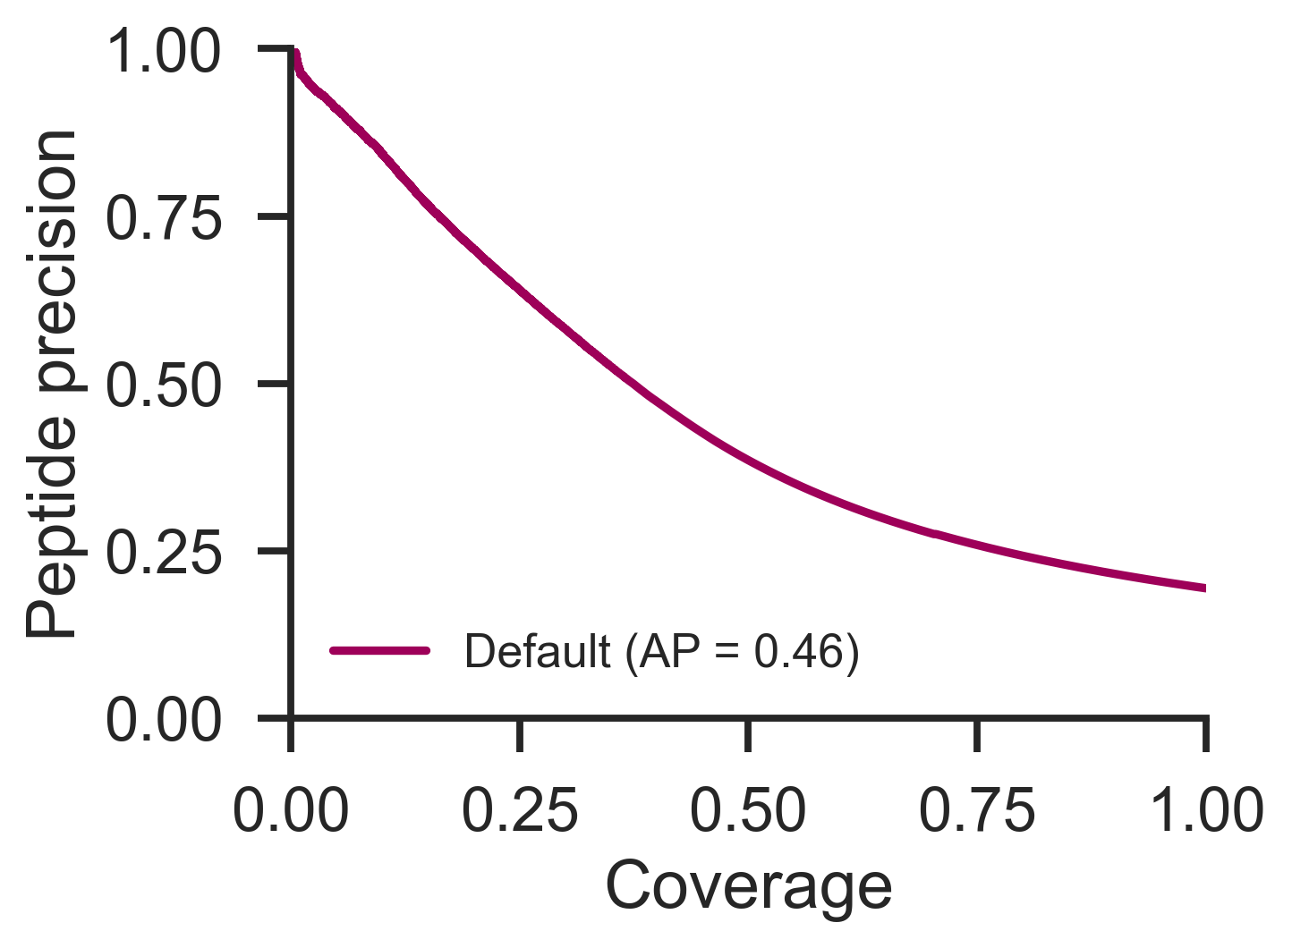
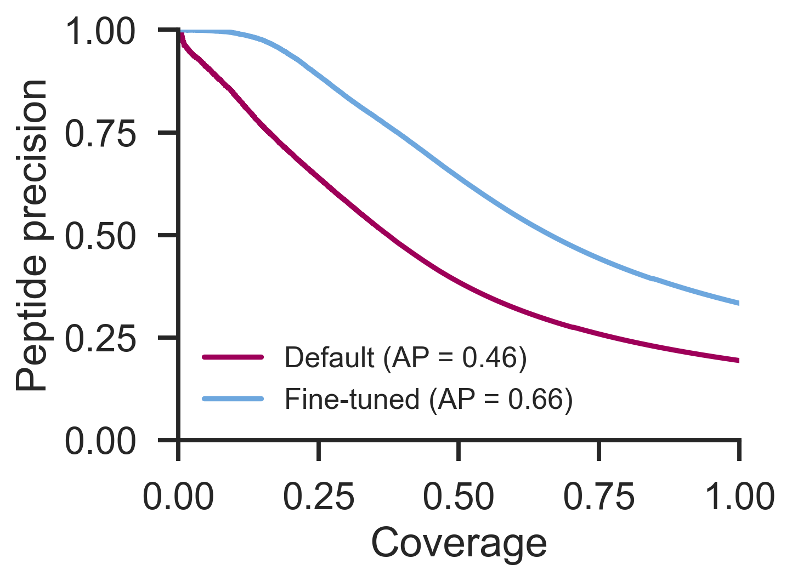
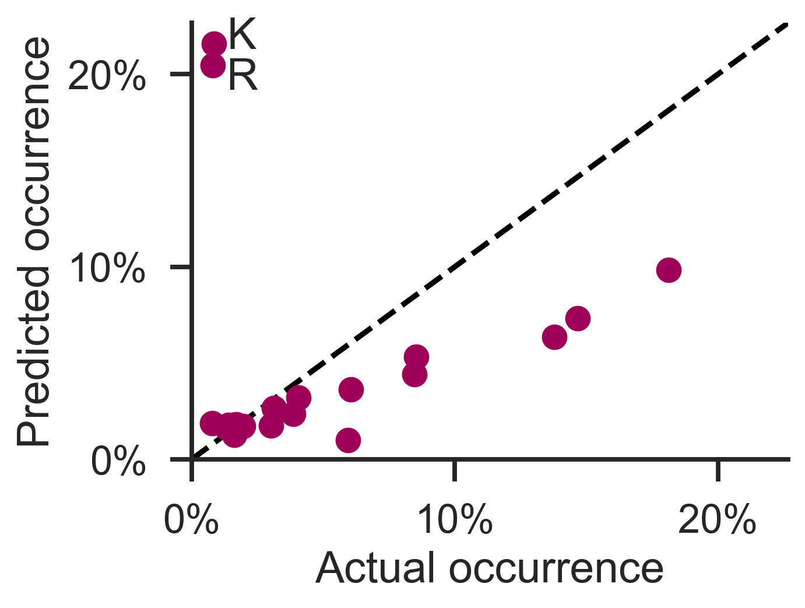
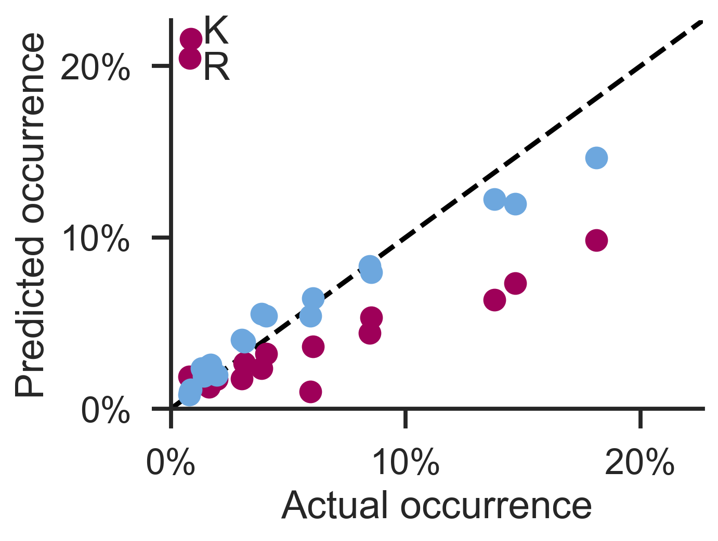
MULTI-ENZYME TRAINING AVOIDS TRYPTIC BIAS
Casanovo is trained on bottom-up proteomics data, exhibiting a tryptic bias
Fine-tuning gives strong performance across various enzymes
Yilmaz, M. et al. Nature Communications 15, 6427 (2024). Melendez, C. et al. Journal of Proteome Research (2024).
Notes:
To mitigate this tryptic bias, we compiled a non-enzymatic dataset of 1 million peptides to finetune Casanovo. If we then check the performance of this finetuned model, it’s a lot better, and also crucial, the tryptic bias in the predicted peptides is gone.

Slide 8
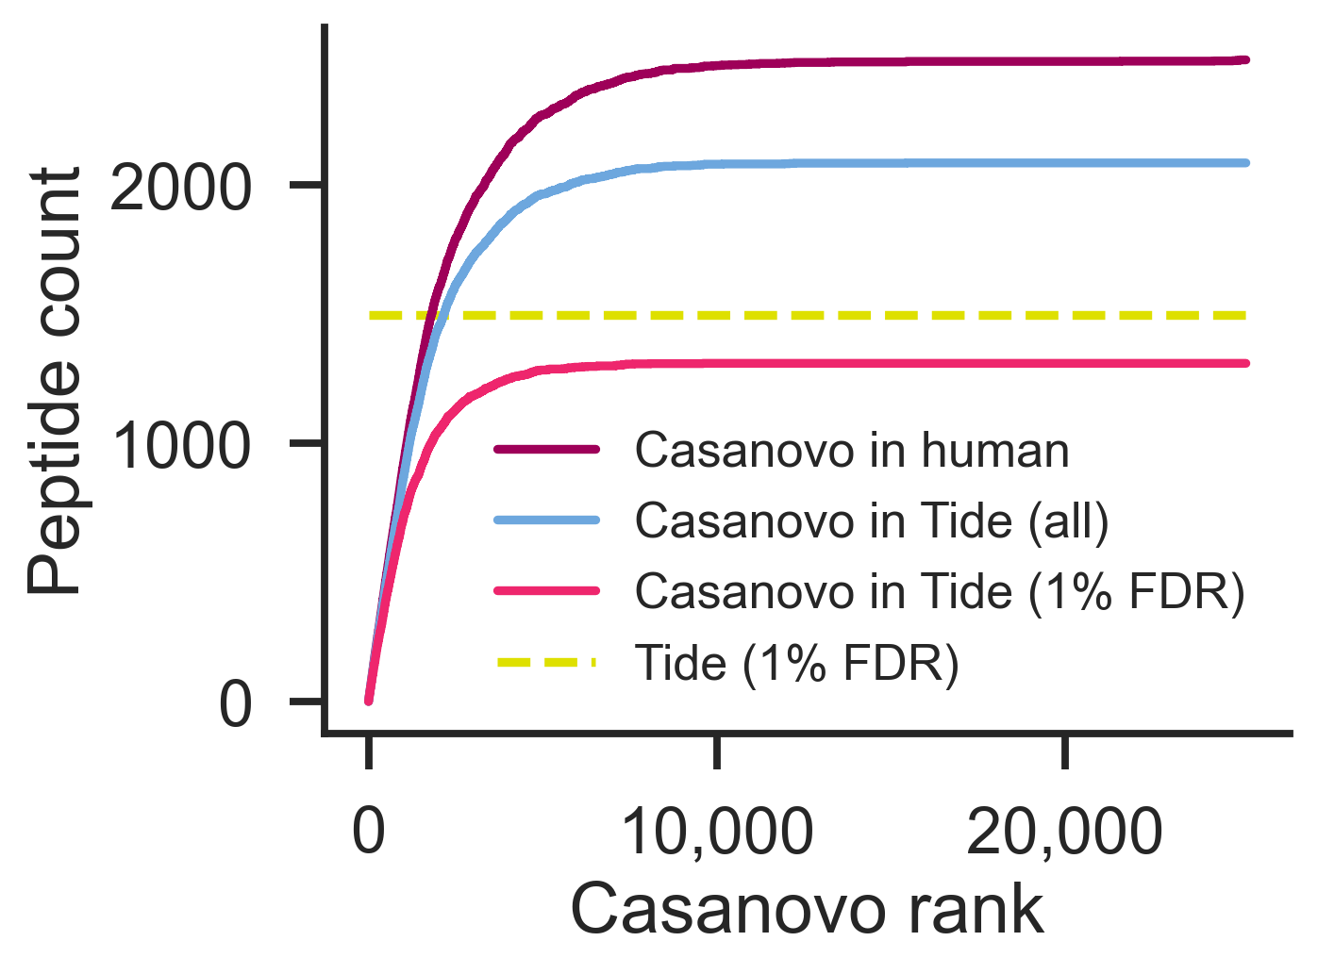
CASANOVO OUTPERFORMS DATABASE SEARCHING
Immunopeptidomics
Check if Casanovo predictions:
Are in the human proteome
Match database search on human proteome
→ Casanovo identifies 65% more unique peptides matching to the human proteome
Yilmaz, M. et al. Nature Communications 15, 6427 (2024).
Notes:
Then we took this model and we applied it to an immunopeptidomics dataset of breast cancer cells and we compared Casanovo to standard sequence database searching. Mutations in these immunopeptides are of interest to find tumor-related antigens, but they are challenging to identify using sequence database searching, so this is an excellent task for de novo peptide sequencing.
To evaluate the Casanovo predictions, we checked whether they were shared with the sequence database searching results on the one hand, and whether the predicted peptides occured in the human proteome on the other hand. Remember that de novo peptide sequencing is basically an entirely unrestricted search strategy, so if a predicted peptide out of that vast search space matches the human proteome, that’s a strong indication that it’s a correct peptide identification.
Here we see the baseline performance from database searching indicated by the dashed yellow line. Casanovo is able to reproduce a lot of those peptides, in bright pink. But when we check for peptides in the unfiltered results from database searching or in the human proteome, we see that Casanovo identifies up to 65% more unique peptides than sequence database searching was able to get. So this was super exciting!

Slide 9
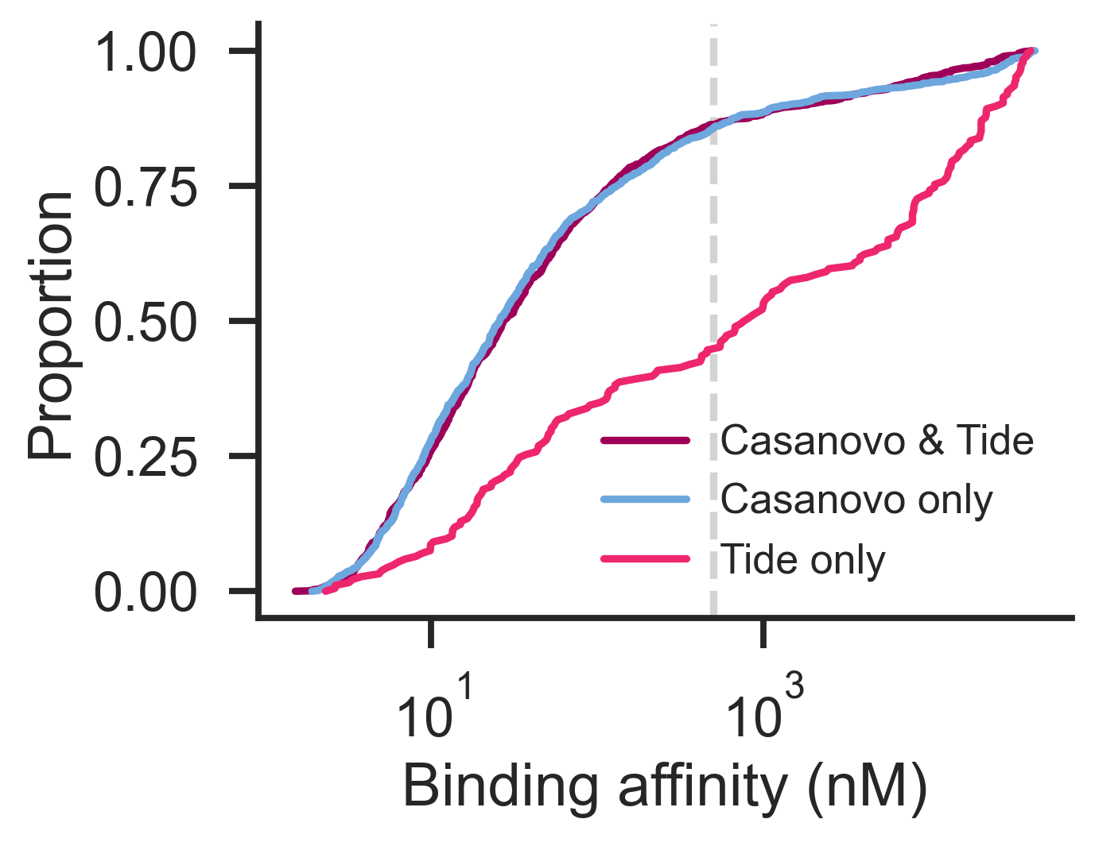
CASANOVO OUTPERFORMS DATABASE SEARCHING
NetMHCpan to predict the HLA binding affinity
Casanovo predicted peptides in human are:
  As plausible as Casanovo & Tide shared peptides
  More plausible than peptides uniquely identified by Tide
Yilmaz, M. et al. Nature Communications 15, 6427 (2024).
Notes:
As an orthogonal validation of those predicted peptides, we used NetMHCpan, which is a tool that predicts the binding affinity between immunopeptides and known HLA proteins. Here we see again excellent results from Casanovo, with the unique Casanovo peptides getting a similar binding affinity as the peptides that were identified by both Casanovo and Tide, whereas the peptides that were uniquely identified by Tide are much less likely to bind to the known HLA proteins. So this again indicates that the Casanovo predictions are very likely correct identifications.

Slide 10
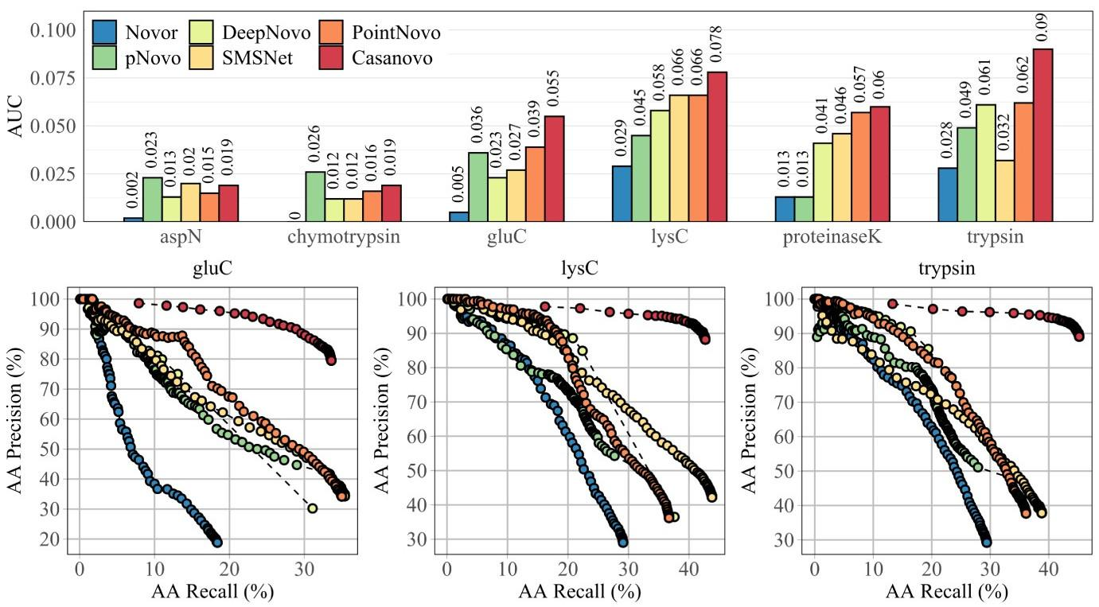
EXTERNAL EVALUATION OF ANTIBODY ASSEMBLY
Beslic, D. et al. Briefings in Bioinformatics 24, bbac542 (2023).
Notes:
Finally, there was also an independent evaluation of several de novo peptide sequencing tools applied to the assembly of antibodies by another group. We were very encouraged to see that other people also were able to get very impressive performance with Casanovo, significantly outperforming several other deep learning-based tools.

Slide 11
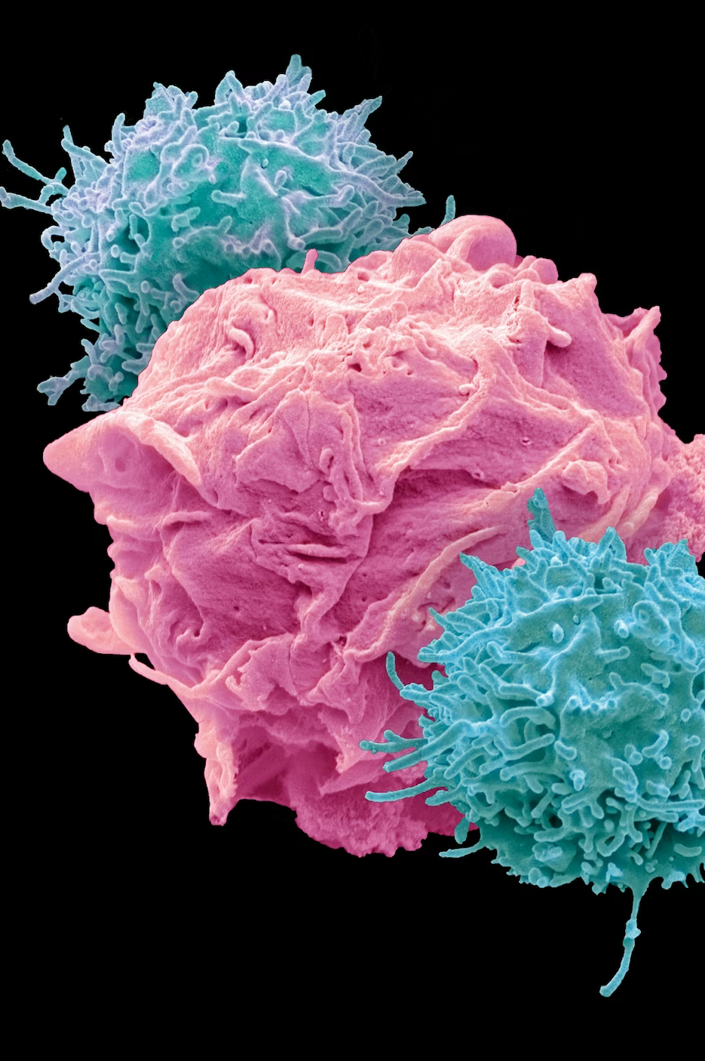
CONCLUSION
De novo peptide sequencing is challenging
Casanovo harnesses the latest advances in deep learning to predict peptides from spectra
Large-scale training achieves optimal performance across heterogeneous data
Notes:
So in conclusion, identifying immunopeptides is challenging, but also super relevant for clinical applications. Our Casanovo tool uses a transformer neural network and was trained on millions of spectra to achieve state-of-the-art performance in de novo peptide sequencing. Casanova is fully open source and available on GitHub, so I encourage everyone to check it out and give it a go.

Slide 12











ACKNOWLEDGEMENTS
University of Washington
Bill Noble
Melih Yilmaz
Will Fondrie
Carlo Melendez
Rowan Nelson
Varun Ananth
Sewoong Oh
Wout Bittremieux
Sebastian Piedrahita
Ceder Dens
Charlotte Adams
Issar Arab
Madina Bekbergenova
Janne Heirman
Alejandro Mendoza Cantu
Marina Pominova

