Slide 1
Helping to Ensure Quality in Scholarly Communication:
Understanding the Self-Assessment Tool for DOAS
https://diamas.fecyt.es/

Slide 2
DOAS
Deployment
Based on the Diamond Open Access Standard (DOAS)
Online service that allows publishers to evaluate their compliance with the standard
Help publishers identify strengths and areas for improvement in their editorial processes
What is the Self-assessment tool for Diamond OA?

Slide 3
Usability of the Self-assessment tool
1. User-friendly Interface
Designed with an intuitive, easy-to-use interface that guides users step-by-step through the assessment. No technical expertise is required.
2. Four-step Process
Involves answering questions related to the seven components. Users can easily navigate through the sections and complete the questionnaire at their own pace.
3. Responsive and Accessible
Accessible on different devices (desktop, tablet, mobile), ensuring that editors can access the platform from anywhere.
4. Progress Tracking
Users can track their progress and save their responses, allowing them to pause and return to the assessment at any time.
5. Comprehensive Results
After completing the self-assessment, users receive a detailed report with insights into areas of strength and opportunities for improvement.

Slide 4
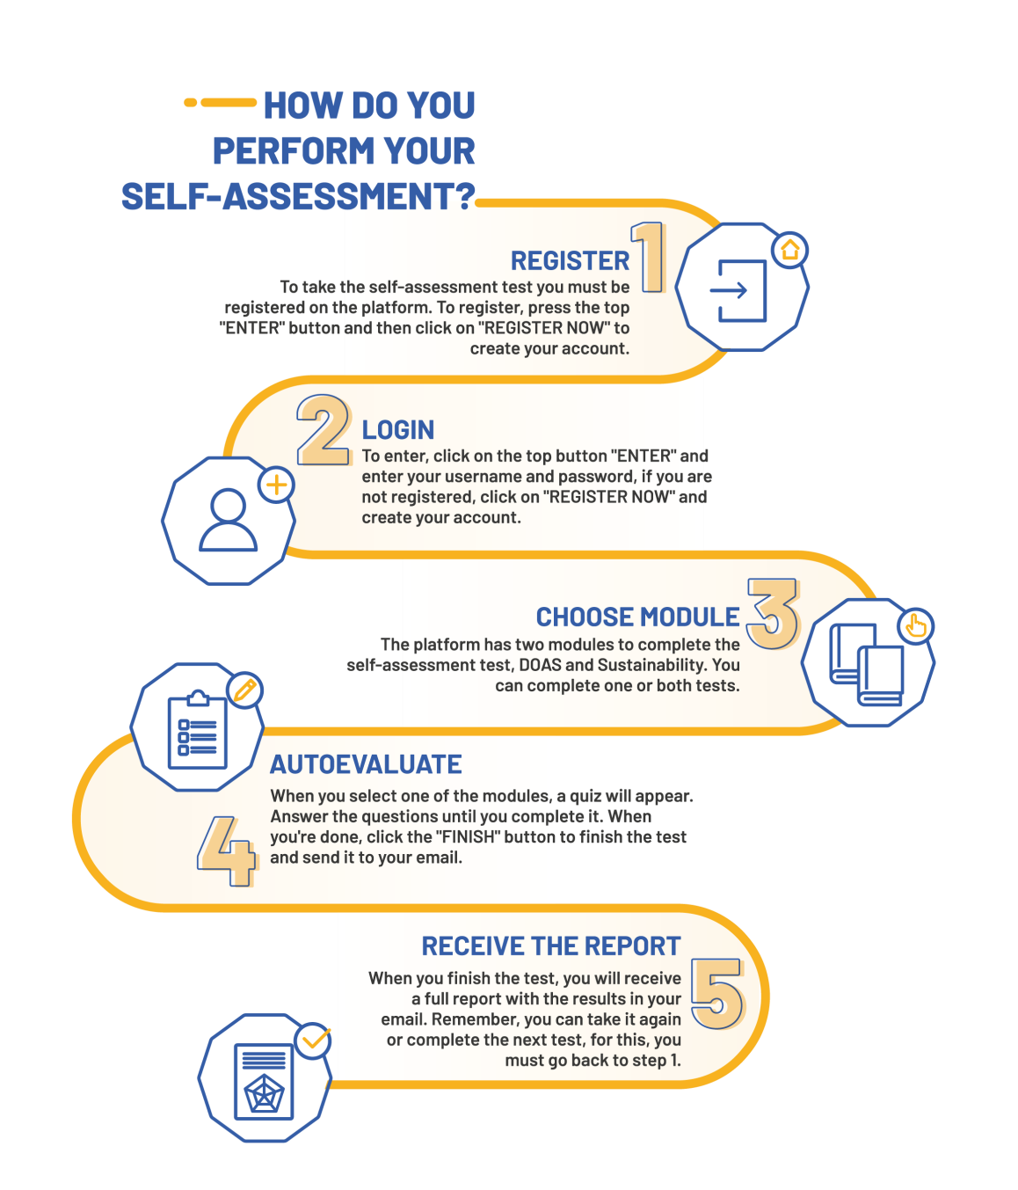
How does
the Self-assessment tool work?
A simple 4-step process:
1. Register on the online platform
2. Complete a structured questionnaire based on the 7 DOAS components
3. Receive a detailed report with scores and recommendations
4. Use additional resources to improve compliance with the DOAS

Slide 5
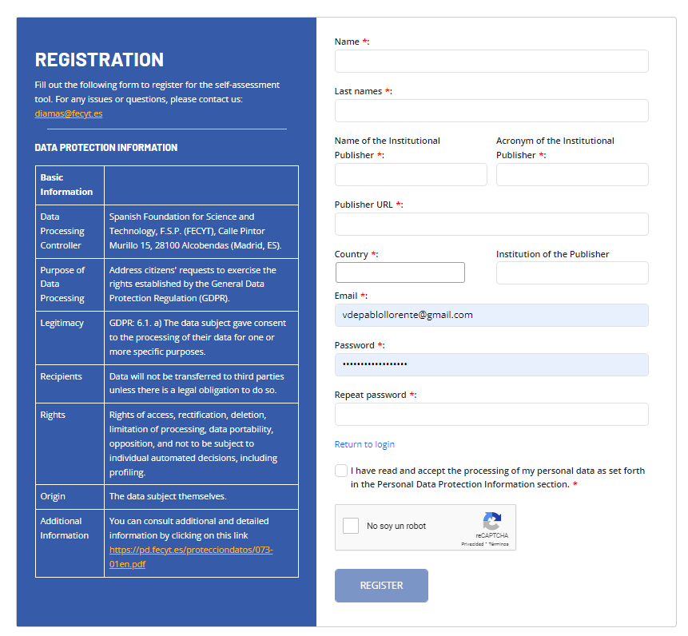
Register the Self-assessment tool
It is necessary to fill in the fields to create a user account
Once the account is created, you can log in to answer the questions in the questionnaire and find out the level of compliance with the DOAS
https://www.youtube.com/wat ch?v=_RUwV_bcFAI

Slide 6
Self-assessment tool questionnaire
1. Funding: Diamond OA model, long-term sustainability, funding transparency, and editorial independence.
2. Governance: Clear ownership, transparency in changes, mission alignment with academia, and transparent governance.
3. Open Science: Open Science policy, author rights retention, transparency on intellectual property, and sharing of research.
4. Edition: Transparent editorial processes, clear peer-review policies, research integrity, and incentives for reviewers.
5. Technical: Secure platforms, interoperability standards, persistent identifiers, and long-term article preservation.
6. Visibility: Strategies for visibility, effective communication with academia, and metrics for assessing impact.
7. EDIB: EDIB policies, accessibility for all, and diversity in editorial and publication decisions.

Slide 7
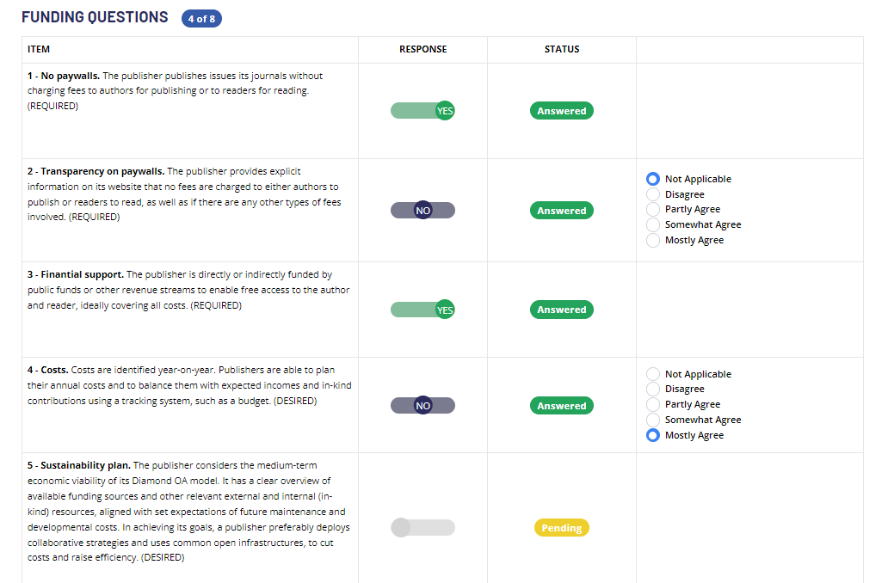
The Core Components in the Self-Assessment Tool
The self-assessment tool is designed to help scholarly publishers evaluate their compliance with the DOAS
It covers seven the seven core components, essential for maintaining high-quality in fully open-access publishing

Slide 8
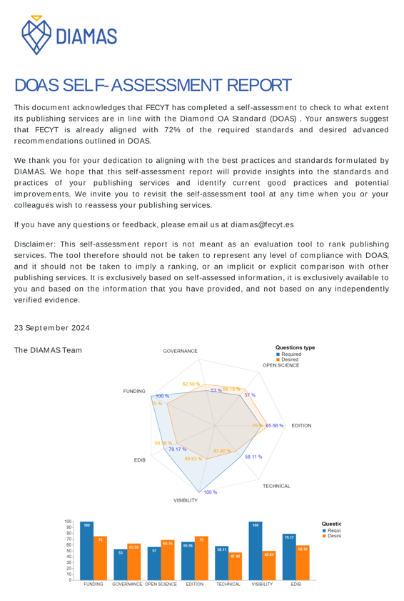
Self-assessment tool Results
Publishers will receive a report with:
Scores per component (compliance with DOAS)
Recommendations for improving compliance
Access to a suite of tools and best practices to improve the quality of their publication
The report is private and accessible only by the publisher

Slide 9
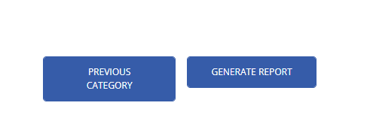
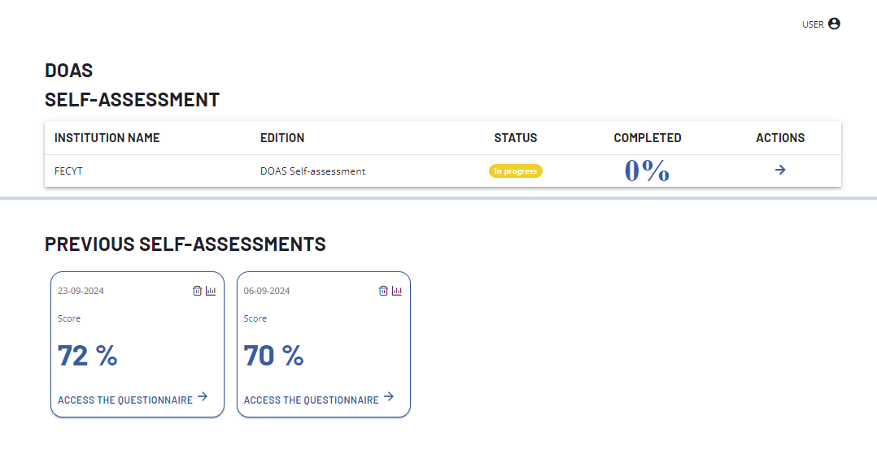
Detailed Results
The Self-assessment tool downloads a full report to the computer upon request and allows access to it in more detail

Slide 10
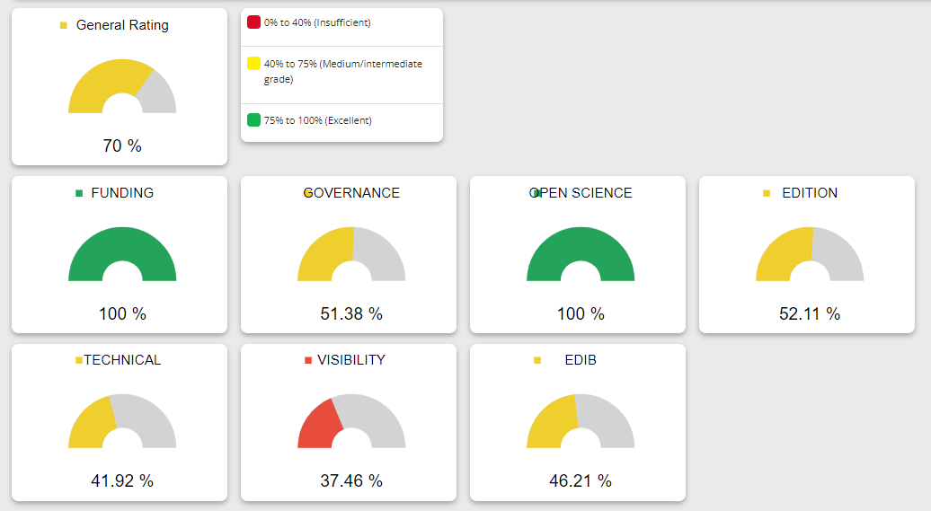
Detailed Results
The detailed results are visualised in the tool, represented by diagrams of colors
Green indicates full compliance
Yellow shows partial compliance, meaning there’s room for improvement
Red highlights areas where the journal needs significant changes
These visuals helps quickly identify which strong areas and which require more attention

Slide 11
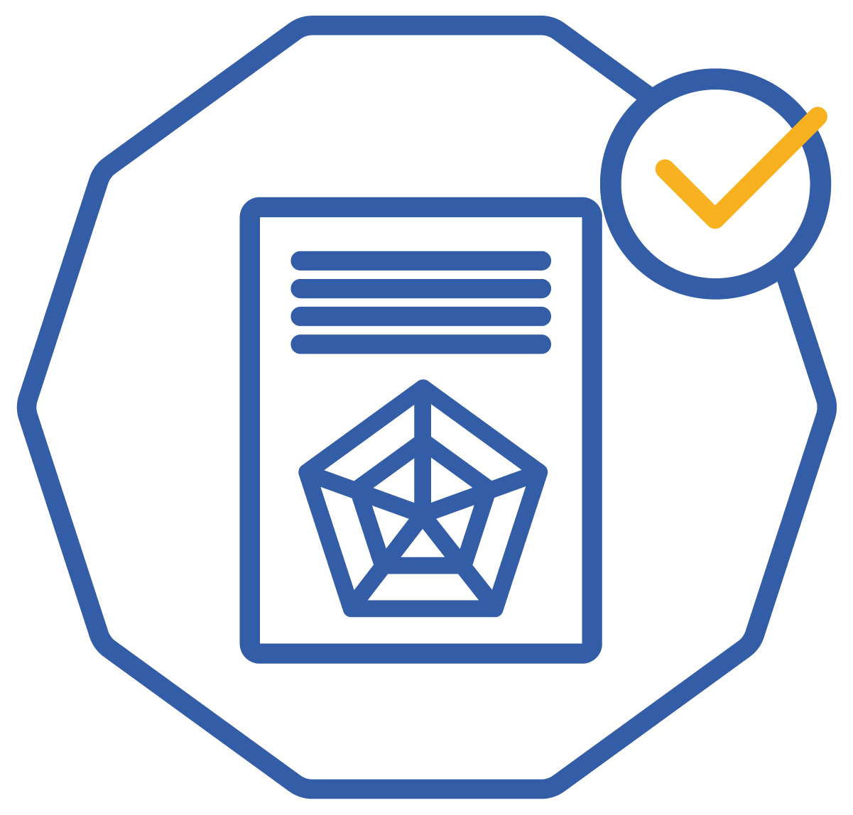
Conclusion and Next Steps
The self-assessment tool is the first step toward improving the quality and compliance with DOAS
Review the assessment results and apply the recommendations
Questions and further technical support in the following sessions

Slide 12
THANK YOU
X: @DiamasProject
LinkedIn: https://www.linkedin.com/company/diamas-project/
Web: @diamasproject
HTTPS://DIAMASPROJECT.EU
https://www.youtube.com/wat ch?v=_RUwV_bcFAI
Notes:
Ensuring Quality in Scholarly Communication: Understanding the Self-Assessment Tool for DOAS
The purpose of this presentation is to explain how a self-assessment tool works, which will help users determine whether their publications meet the quality standard set by the Diamond Open Access Standard, or DOAS, developed in the DIAMAS project.
By the end of this presentation, you will have a good understanding of the tool’s content, that is based on the seven core (or key) components developed in the Diamond Open Access Standard (DOAS), and how to use it to evaluate journal’s performance.

