Slide 1

The Turing Way
Practitioners Hub
Kick Off Event 2024
Programme Overview: September 2024
Malvika Sharan, Arielle Bennett
Slide deck developed for The Turing Way Practitioners Hub Cohort -2, 2024
Notes:
Intro:
Share notes link - ask people to add their name & contact details if they want them shared
Reminder of CoC

Slide 2
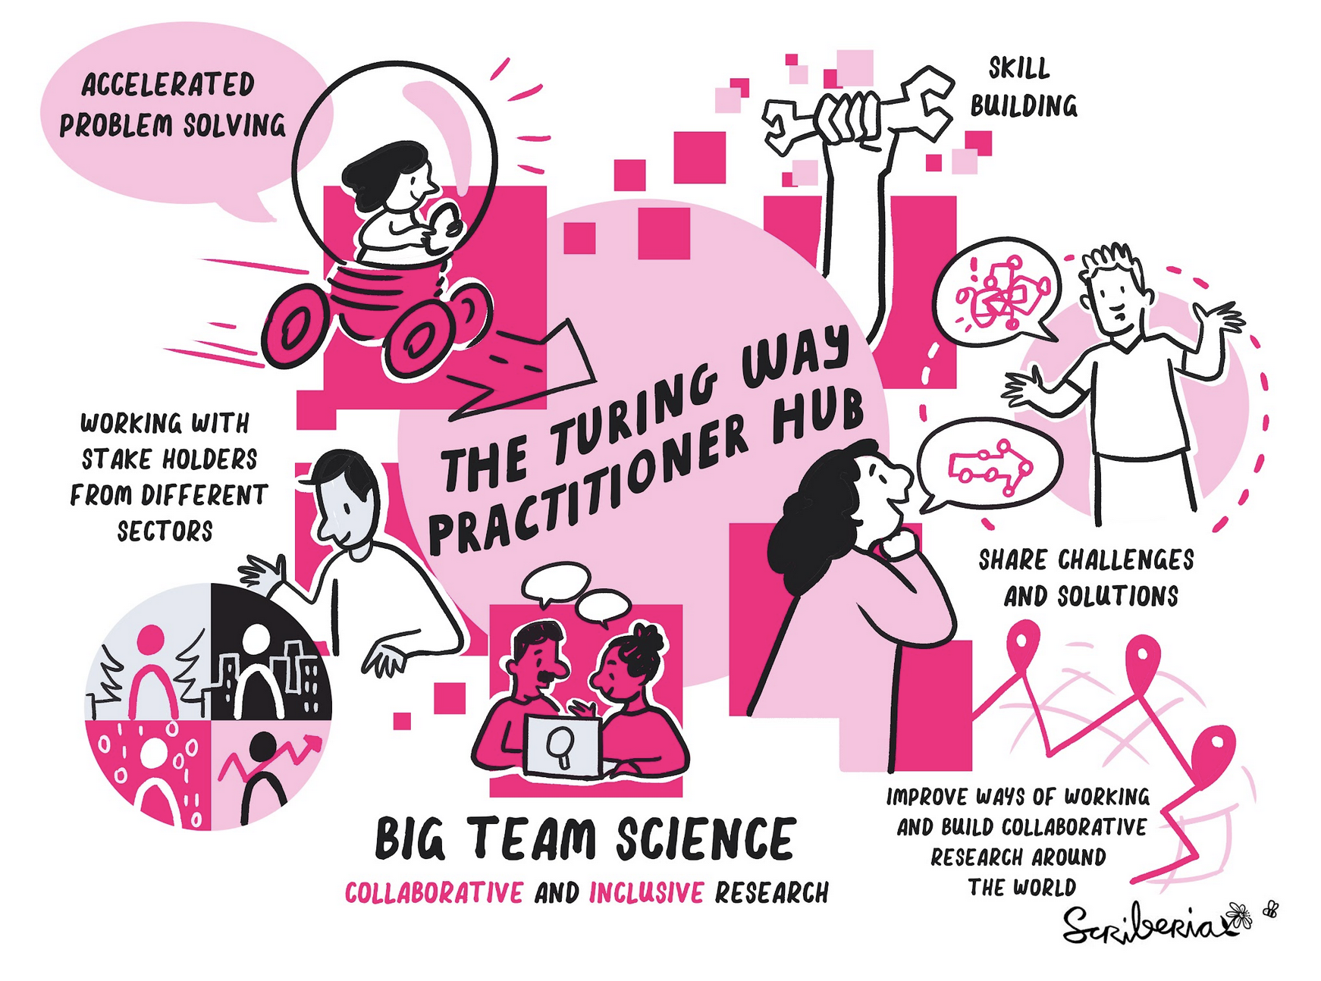
Extending the impact through ‘Practitioners Hub’
A forum for cross-sector engagement, knowledge exchange and strategic collaboration with organisations across academia, research, engineering systems, government, and healthcare leading data science initiatives.
Slide deck developed for The Turing Way Practitioners Hub Partners, CC-BY 4.0 image by The Turing Way community and Scriberia. Zenodo: https://zenodo.org/record/10.5281/zenodo.10358146, DOI: 10.5281/zenodo.10358146

Slide 3
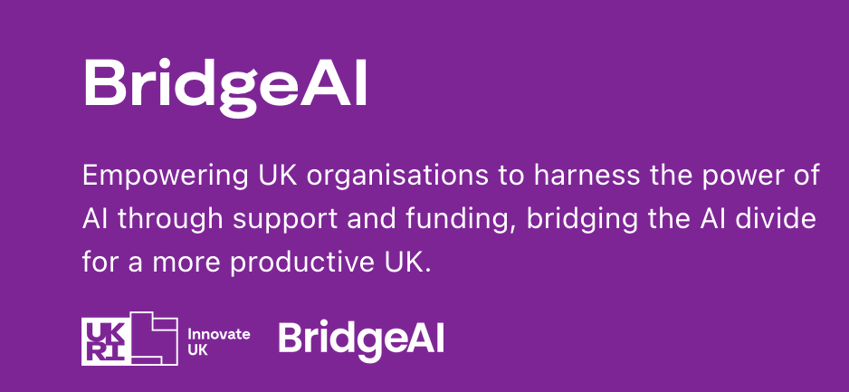


With the potential to increase UK GDP by up to 22%, AI technologies are key. Innovate UK BridgeAI, a £100 million investment, stimulates the adoption of AI in priority sectors, creating new opportunities for businesses, jobs and economic growth while driving increased productivity

Slide 4
The Turing Way Practitioners Hub
Systematic approach for enhancing expertise, building strategic insight, and improving readiness for SMEs* to co-adopt AI and industry best practices, with a focus on open source, open data, and reproducibility.
Our goal is to enable organisations to lead innovative, community/user-centric, and ethical data science/AI business.
Slide deck developed for The Turing Way Practitioners Hub Partners, CC-BY 4.0 image by The Turing Way community and Scriberia.
* SMEs: Small and Medium-sized Enterprises

Slide 5








Organisations and Experts in Residence (EiRs)
Our first cohort of EiRs represented five organisations who will:
engage in the Hub around open, reproducible and collaborative practices
co-create case studies capturing the state of these practices in their organisations
exchange and adopt approaches from across different sectors to improve their business
Utilise The Turing Way to engage in bidirectional flow of their knowledge & visibility
First Cohort Partners
Slide deck developed for The Turing Way Practitioners Hub Partners, Logos taken from the respective organisations

Slide 6
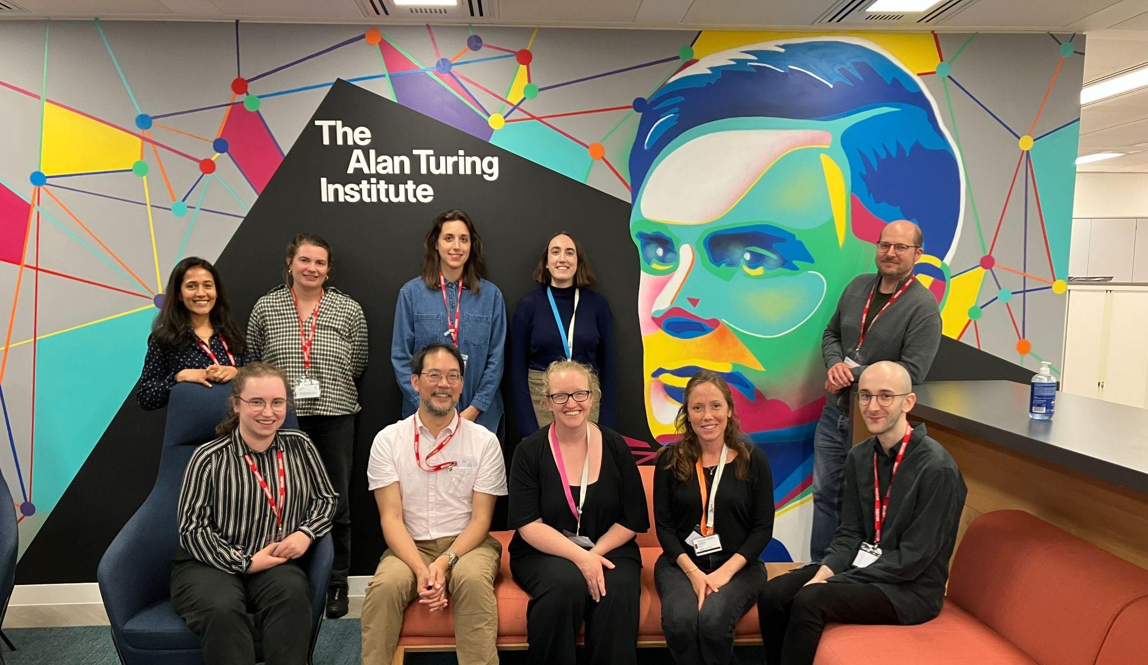
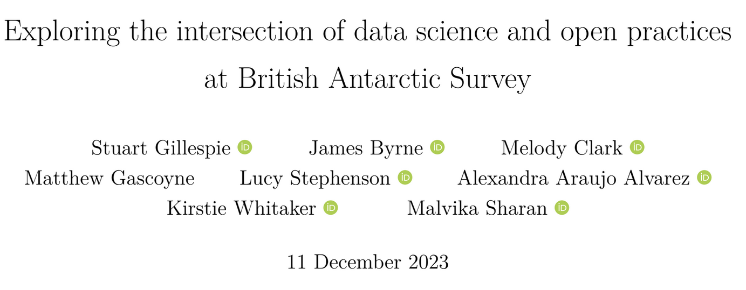
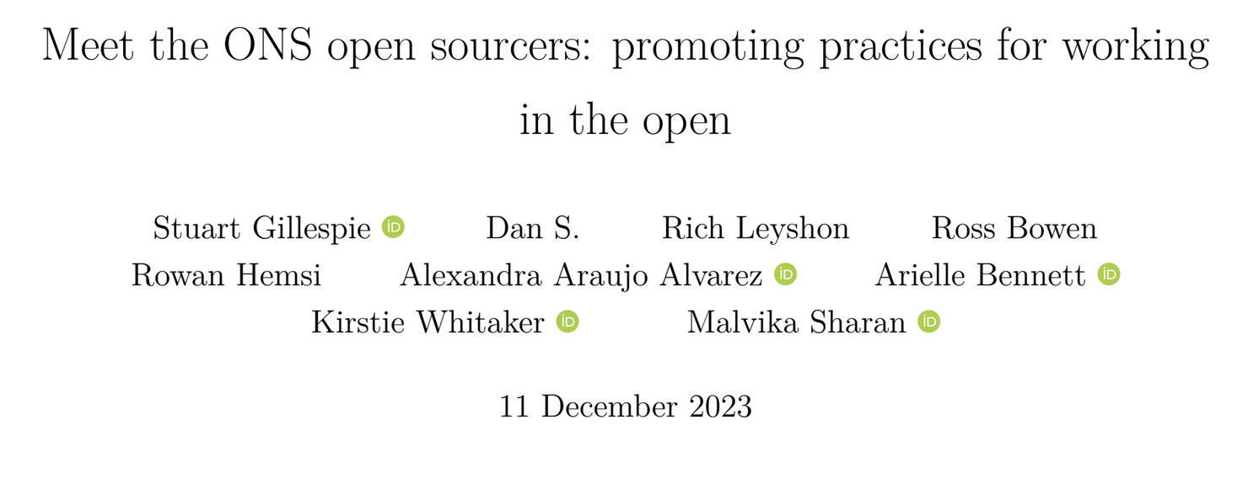
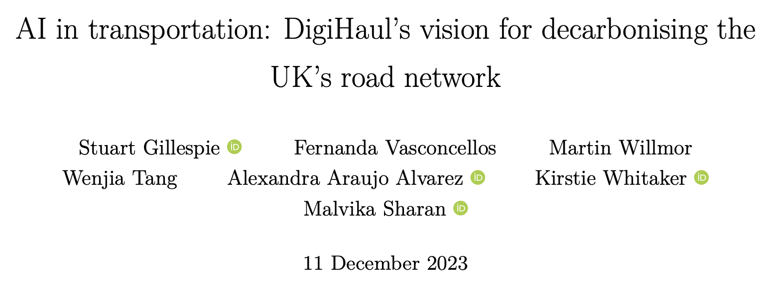
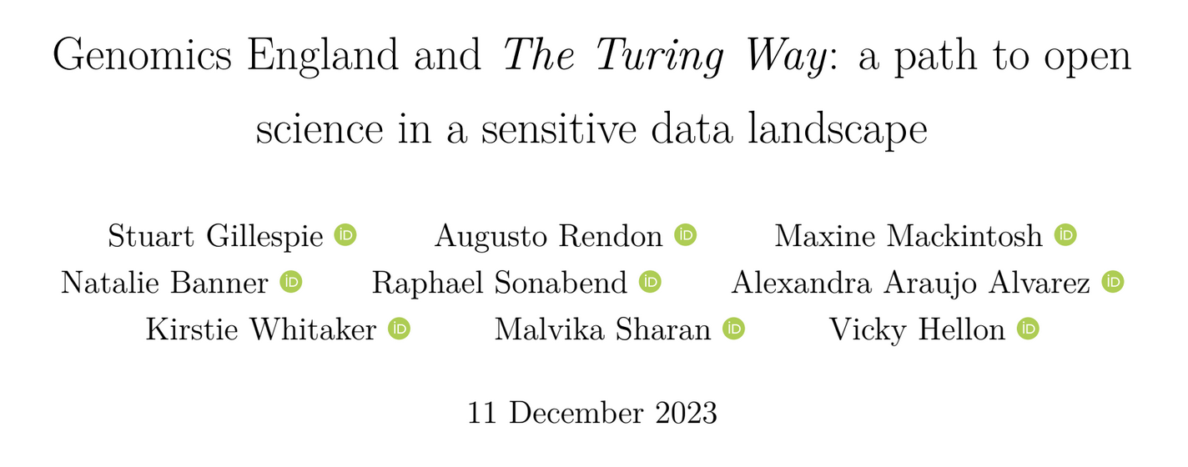
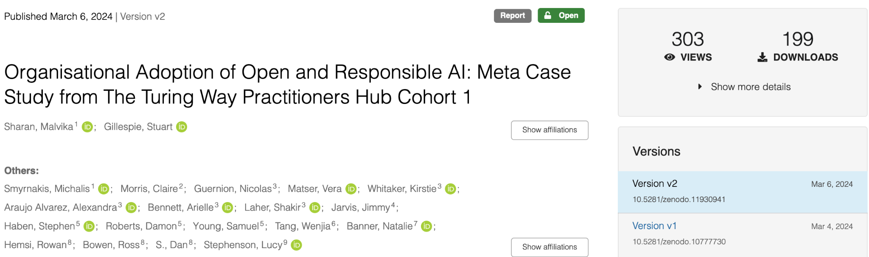
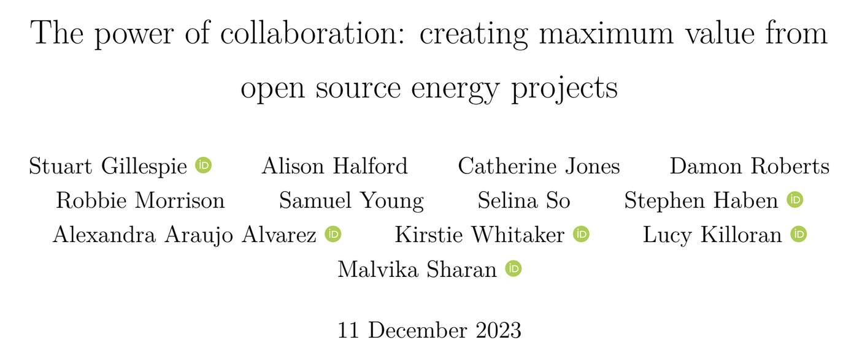
Case Study Series 2023
Slide deck developed for The Turing Way Practitioners Hub Partners, Logos taken from the respective organisations

Slide 7
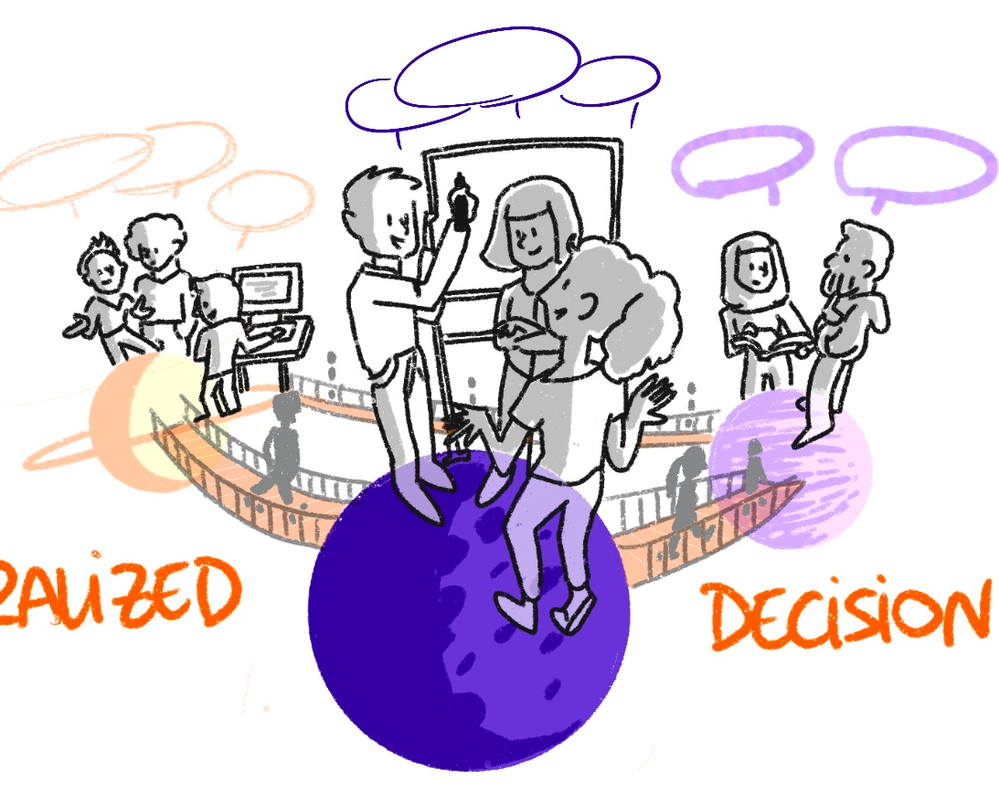
Practitioner Hub’s “Expert in Residence”
Recognising min 1 champion to represent partnering organisations in the Practitioners Hub (primary contact)
Budget allocated for professional services (workshops, training, consultation) and bursary (in person event at the Turing, travel cost)
Development and dissemination of case studies highlighting values and impacts of best practices in their org/sector
Additional support will be offered for SMEs towards their goals in cohort 2.
v
v
Slide deck developed for The Turing Way Practitioners Hub Partners, CC-BY 4.0 image by The Turing Way community and Scriberia.

Slide 8
Welcome to The Turing Way Practitioners Hub
Slide deck developed for The Turing Way Practitioners Hub Partners, CC-BY 4.0 image by Scriberia. DOI: 10.5281/zenodo.3332807

Slide 9























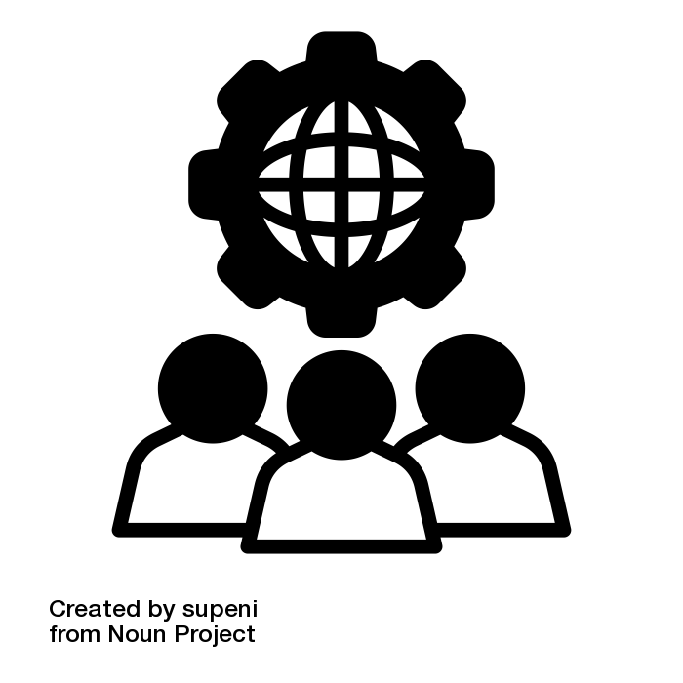







The Practitioners Hub Cohort of 2024!
AI & Digital Solutions
Healthcare Excellence
Creative industries
Environment & Ecology
Working in / with the public
Consulting & Professional services

Slide 10
The Practitioners Hub Cohort of 2024 - Company and EiR information
All company information and Experts in Residence (EiRs) details are (temporarily) shared in this slidedeck.
Check out the cohort details!
You can update your / your company information if needed.
Slide deck developed for The Turing Way Practitioners Hub Partners, some logos have yet to be confirmed from the company point of contact

Slide 11
Main focus areas of this cohort (as per the goals shared with us)
Group 1: Responsible Data Practices
Group 2: Data provenance and preservation
Group 3: Open practices in consulting
Group 4: AI/ML Integration - Safe AI
Group 5: AI/ML Integration - Cloud computing
Group 6: AI for Public engagement and Policy

Slide 12
Today’s breakout groups will be based on these themes!
Group 1: Responsible Data Practices
Suggested group: FTI Consulting, NHS England, BBC
Group 2: Data provenance and preservation
Suggested group: Archaeology Data Service, Dillmeadow Media, Intercultural roots, Think and Decide
Group 3: Open practices in consulting
Suggested group: Moonbility, Bays Consulting, Kaiasm Ltd
Group 4: AI/ML Integration - Safe AI
Suggested group: Royal Papworth Hospital NHS Foundation Trust, Co-Opts Ltd, Japeto, Higoe Ltd
Group 5: AI/ML Integration - Cloud computing
Suggested group: CEFAS, Digital Ecology, OpenSky Data Systems
Group 6: AI for Public engagement and Policy
Suggested group: Department of Digital Transformation of the State of Rio de Janeiro, RIBA, Ockana

Slide 13
Breakout discussion prompts
What are some ‘thorniest’ challenges that your organisation is currently dealing with?
What do you hope to get out of working within this cohort? Where do you see unique opportunities to engage with the cohort on shared goals and opportunities?
Please take some notes in the shared document - these will help us design some themed and small group events/sessions in the next months.

Slide 14
The Turing Way Practitioners Hub
Systematic approach for enhancing expertise, building strategic insight, and improving readiness for SMEs* to co-adopt AI and industry best practices, with a focus on open source, open data, and community.
Our goal is to enable organisations to lead innovative, community/user-centric, and ethical data science/AI business.
Slide deck developed for The Turing Way Practitioners Hub Partners, CC-BY 4.0 image by The Turing Way community and Scriberia.
* SMEs: Small and Medium-sized Enterprises

Slide 15
Practitioners Hub Cohort 2024 Curriculum
Knowledge Mapping
- Stakeholder mapping
- Systems design thinking (for building stakeholder engagement strategy)
AI opportunities
- AI readiness assessment (BridgeAI partners)
- Responsible Business Making Decision (Skills)
Open Source & Ethics for Innovation
- Open source for innovation
- Ethical framework
- Legal, governance and regulatory aspect
Roadmap Development
- AI strategy and roadmap
- Real world deployment
(TPS and RAM collaboration)
September
October
November/December
December/January
Goal Setting
Notes:
Tea platform: AI and data ethics
Mitigating bias in models, explainable data innovation tech (Turing Commons)
Responsible governance: use of platform by team members (framework agnostic)
Morning on ethics - putting into practice
Resources to use.

Slide 16
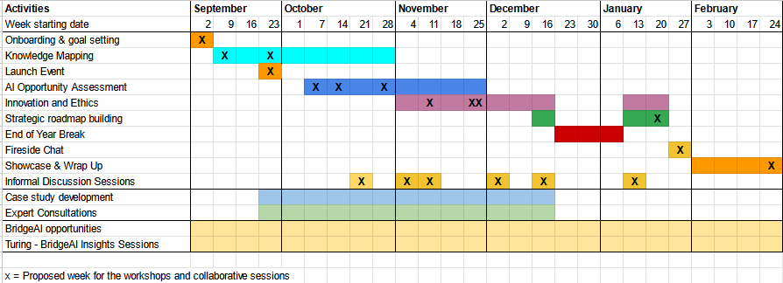
Practitioner's Hub Timeline
The majority of sessions will be scheduled Thursday PM UK time
Small group sessions are being planned based on your response

Slide 17
September and October Plans
Stakeholder Mapping: goals-oriented - 12 September 2024 (online)
Systems Thinking: engagement strategy - 24 September 2024 (hybrid)
Launch Event: session at The Alan Turing Institute - 24 September 2024 (hybrid)
AI-readiness Assessment: goals-oriented - 10 October (online)
Responsible Business Decision Making - 17 & 24 October (hybrid / online tbc)
Notes:
CTO advising/workshop on data

Slide 18
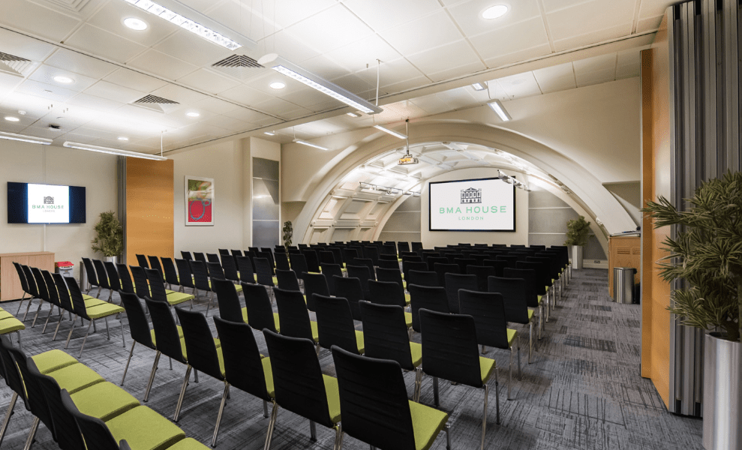
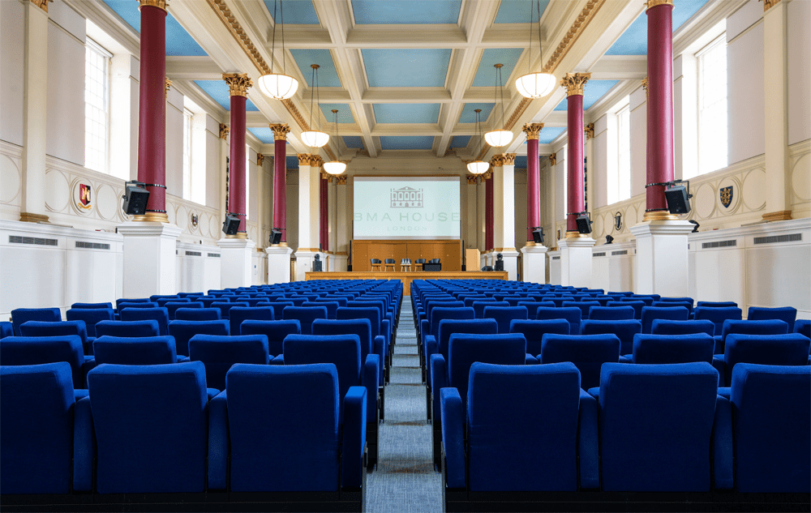
November: Event in London
Open and Ethical AI: Navigating Innovation with Regulation
Dates: 25-26 November
Location: BMA House, London
Registration info coming soon.
Travel bursary will be available on request!
Notes:
CTO advising/workshop on data

Slide 19
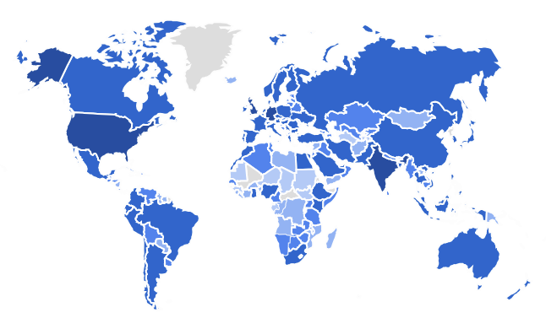
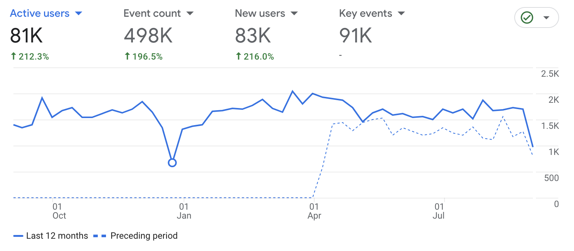






The Turing Way - Context
A flagship project for sharing, promoting and advancing best practices in data science across sectors with involvement of practitioners.
5 years, >300 Chapters, community resources
500 contributors, 6000+ monthly users globally
Referenced by many organisations, literature and policies across sectors
BridgeAI funding to engage organisations with open source / data / collaboration practices in their AI efforts
https://the-turing-way.org
Notes:
We have seen our project and community grow in the last four years.
We currently host over 250 sub-chapters across five guides.
In order to ensure that our community members are able to participate irrespective of their previous experience of working with the Open Source or data science community, we provide the resources, guidance, templates, training and pathways that they can use to stay involved in the community.
We have over 325 direct contributors on GitHub, where we develop our resources and 1000s of users. For example, our illustrations, which I have intensively used in my talk, have been downloaded nearly 10000 times.
We also maintain a social media presence and communicate about the project so that it can reach as many people as possible and we can bring new voices in. For a community that started at a grassroot level, we are very grateful to have these members working with us.

Slide 20

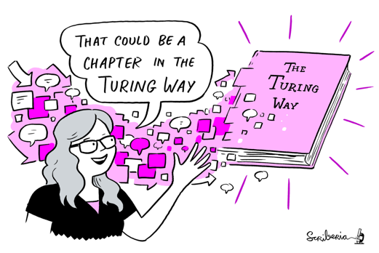
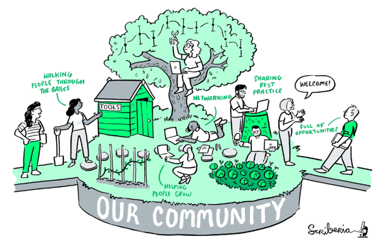
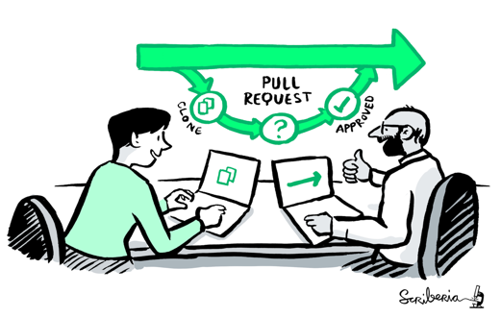


A Book
A Community
Book:
the- turing-way.netlify.app/
GitHub:
github.com/alan-turing-
institute/the- turing-way
Twitter:
twitter.com/turingway
Email:
theturingway@gmail.com
CC-BY 4.0, The Turing Way
An Open Source Project
A Culture of Collaboration
Notes:
The Turing Way is more than a Book.
A community where people come together to collaboratively write chapters, build and maintain resources, share their skills and ideas around best practices in data science and research.
We apply open source principles in the development and maintenance of this project.
And finally, it's built on the culture of collaboration, which is the process and the backbone of our project.

Slide 21

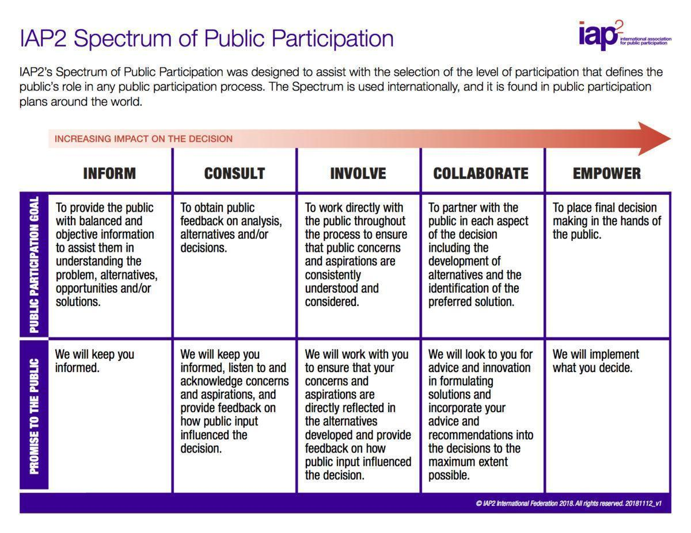
Practitioners Hub
This is us!!
Research Infrastructure Roles
Different kinds of data science roles
Training and outreach
Skill building, knowledge share
Localisation & Translation
Internationalisation
Environmental Data Science
Executable notebooks
Infrastructure Maintenance
Building and sharing open source
Different PathWAYs in The Turing Way
Book Dash and Community Events
Hackathon, collaborative events
Accessibility
Digital accessibility
Spectrum of Public Participation – Organizing Engagement. https://organizingengagement.org/models/spectrum-of-public-participation
Notes:
Here's an example of what this currently looks like in practice for The Turing Way - self organised groups collaborating and co-creating together on different topics and tasks which fit their interests and skills. Anyone can join one of these groups and the focus is on empowering community members to steward different aspects of the project.

Slide 22
The Turing Way Communications Channels
Please join Slack channel: #practitioners-hub-cohort-2024
This will be regular space to engage, hear from us and contact us
All Practitioners Hub events will be sent out to your calendar
We will also send updates via emails
Weekly announcements and other community-wide events are entirely optional for Practitioner Hub EiRs and members from their organisations.
But, we'd love to have you involved and engage in these spaces!

Slide 23
The Practitioners Hub Cohort of 2024!
AI & Digital Solutions
Healthcare Excellence
Creative industries
Environment & Ecology
Working in / with the public
Consulting & Professional services

Slide 24
Company and EiR information will be published soon!
Please share your company logo (if you haven’t already!) that we can add on our website: Shared drive
You can check and update your company and EiR information on this slidedeck (we will move this online next week)
If you / your colleague intending to join as EiR have not yet shared their information, please register: https://forms.office.com/e/anqebQRLRz
If you’d like to update anything else (beyond the slide deck) please reach out to us anytime!

Slide 25
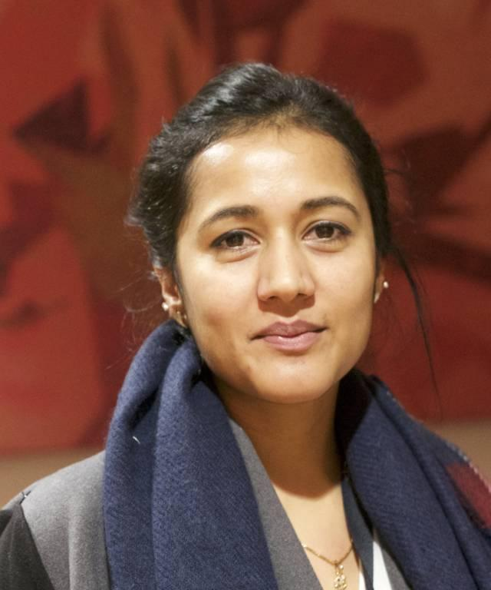
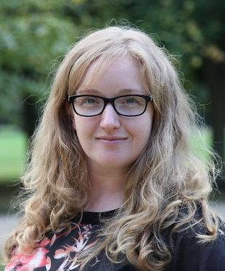

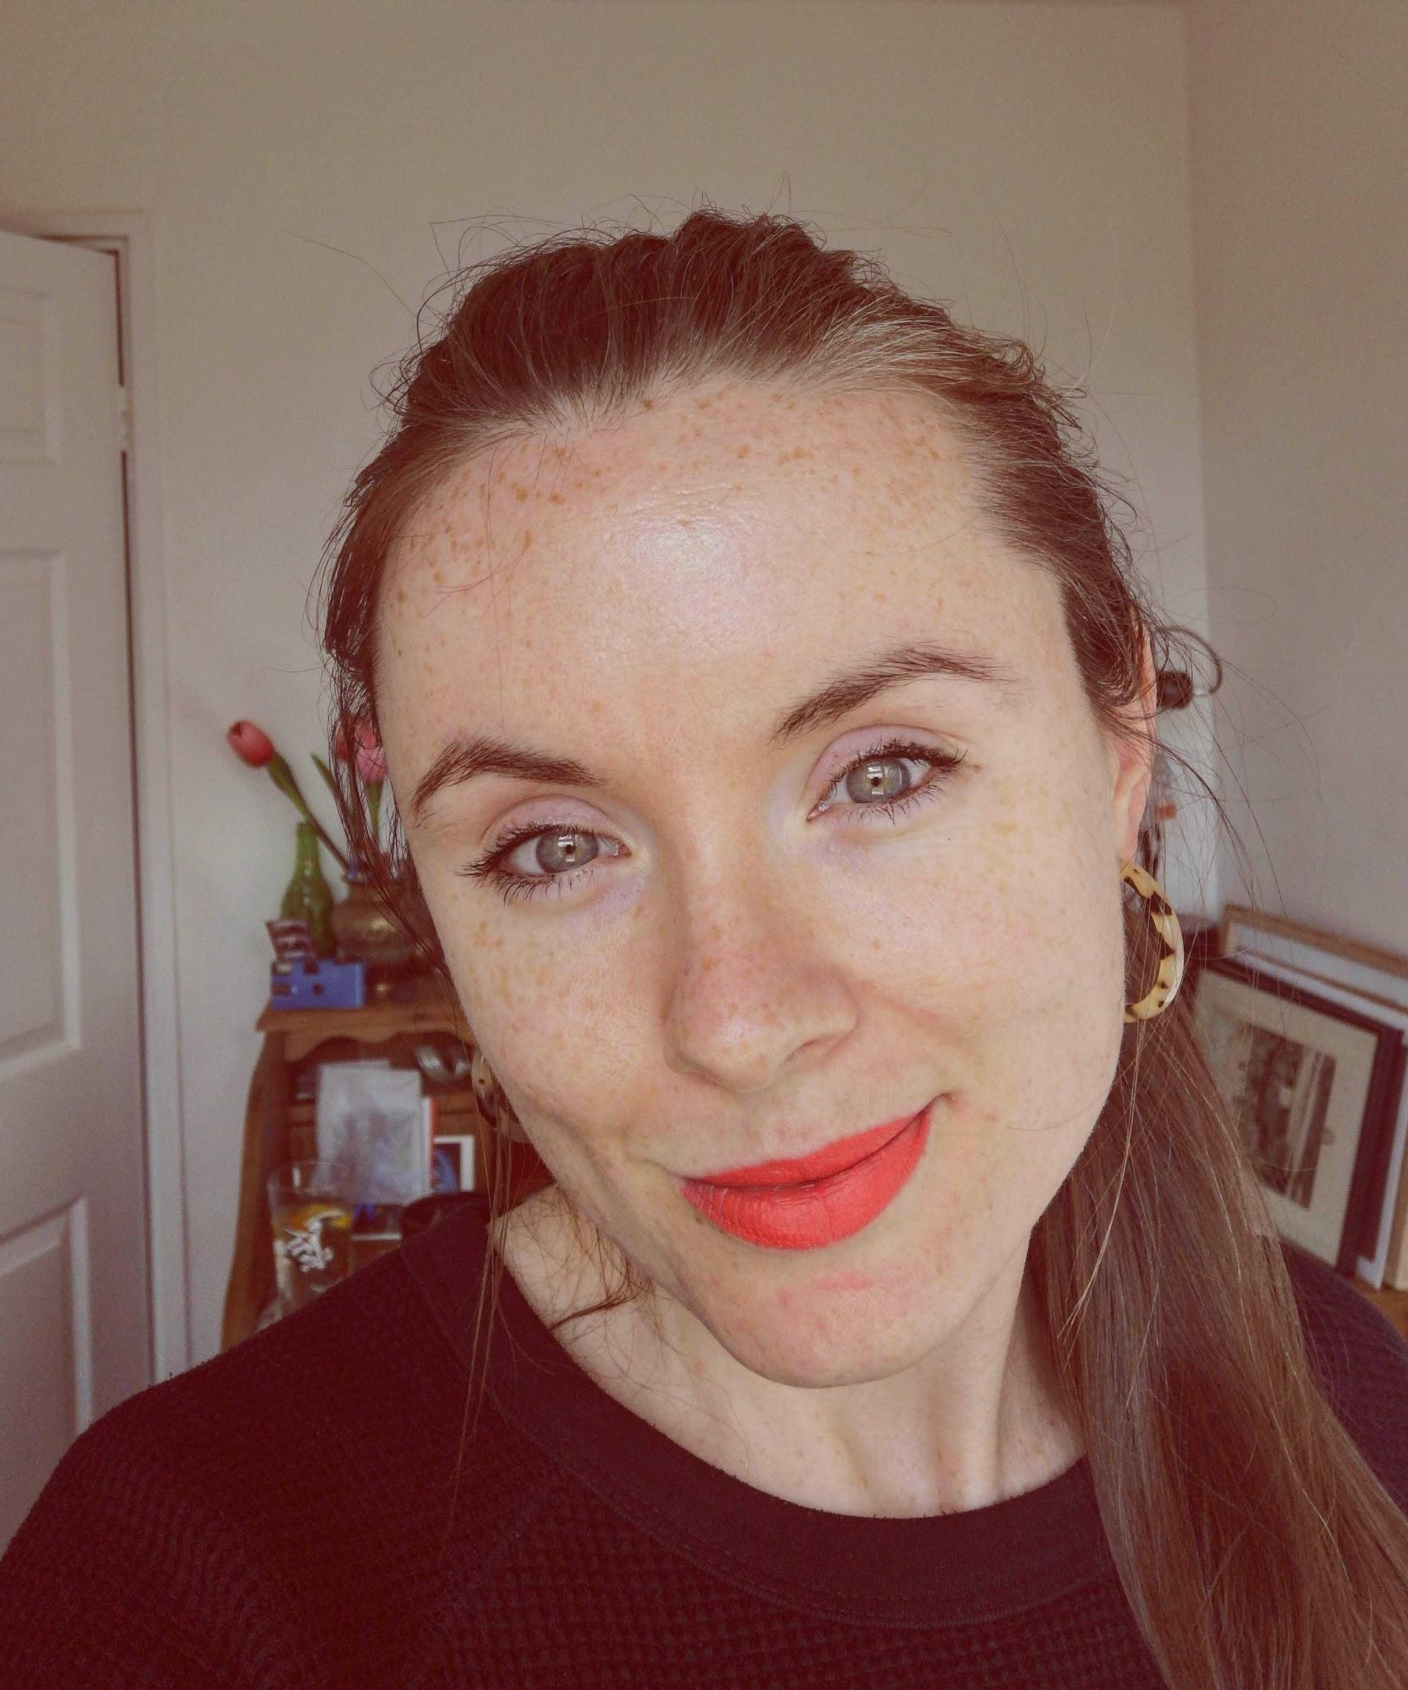
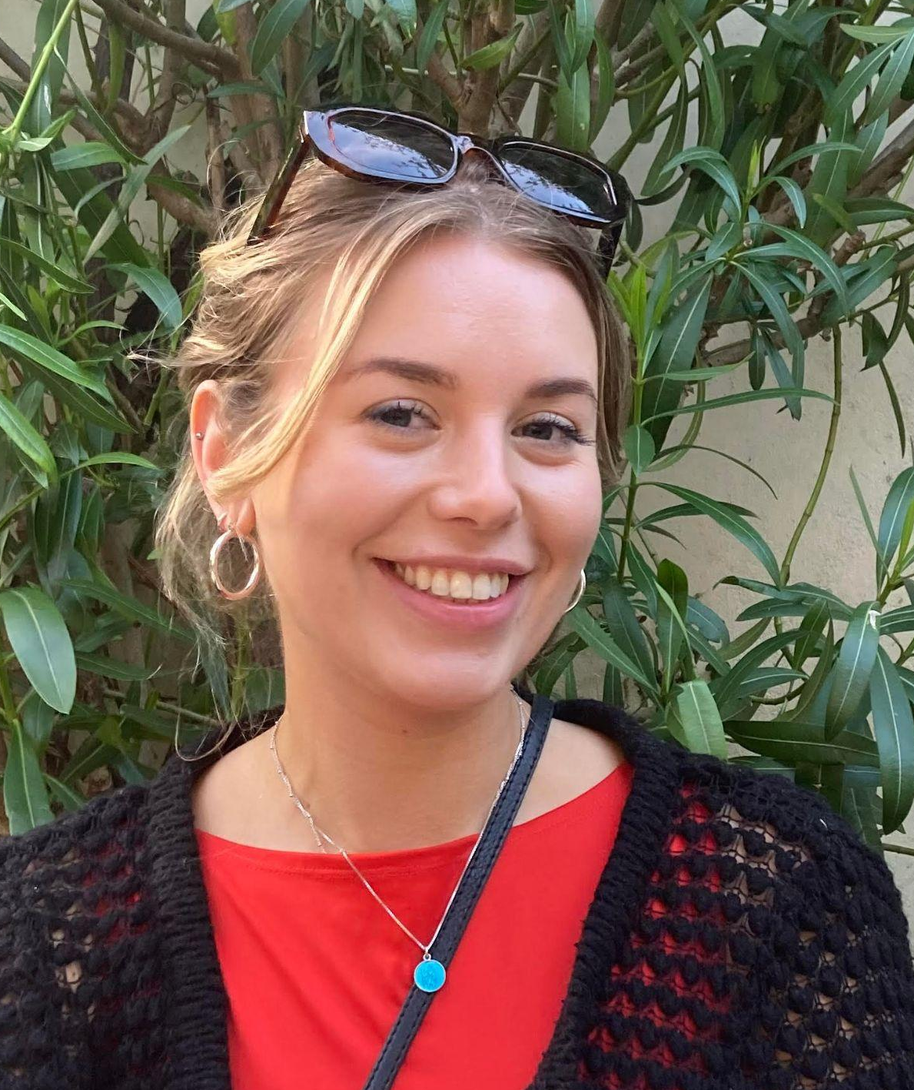
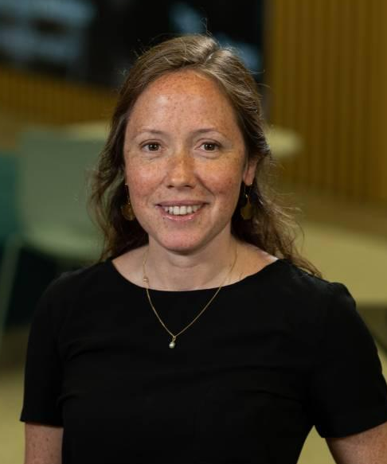
Practitioners Hub Team & Roles
Malvika Sharan
Kirstie Whitaker
Léllé Demertzi
TPS Senior Researcher, The Turing Way co-lead
TPS Programme Director, The Turing Way co-lead
Research Project Manager: The Turing Way
Arielle Bennett
Ella McCaffrey
Alexandra Araujo Alvarez
TPS Programme Manager
Project Manager Turing-BridgeAI
Senior Research Community Manager: Turing-BridgeAI

Slide 26

Questions?
Email Arielle Bennett (abennett@turing.ac.uk) and Malvika (msharan@turing.ac.uk)
Learn about The Turing Way and connect on slack: the-turing-way.start.page
Learn more about BridgeAI: iuk.ktn-uk.org/programme/bridgeai/

