Slide 1
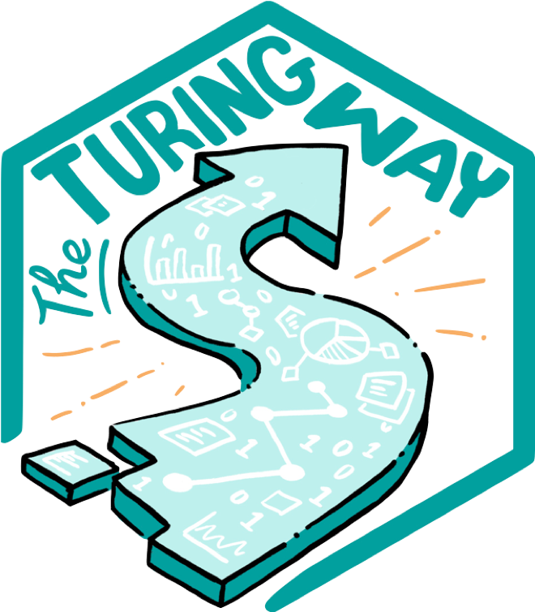
The Turing Way
Crediting contributions and supporting wider recognition of diverse data science roles
30 September 2024
Dr Emma Karoune (she/her)
@ekaroune, @turingway, CC-BY 4.0, DOI: https://doi.org/10.5281/zenodo.13838566
Notes:
10 mins - Career Paths and Recognition session
Tour of turing way and our work on recognition
Good afternoon everyone, I’m going to be speaking about the Turing way and how we enable contributors to be properly recognised for their contributions and also our work to support wider recognition of diverse data science roles

Slide 2

Dr Emma Karoune
Senior Researcher - Community Building - TPS/Health @The Alan Turing Institute
Core team member - The Turing Way
Co-lead - People in Data
Fellow - SSI Fellow & ELIXIR-UK
Committee member - Hidden REF
she/her/ ekaroune@turing.ac.uk/ @ekaroune / 0000-0002-6576-6053
Notes:
I’m Dr Emma Karoune.
And I’m a Senior Research Community Manager at the alan turing institute. I work in the tools, practices and systems programme, which is our cross-cutting open infrastructure programme.
I am a core team member of the turing way.
And until recently i have also been a research associate at historic england where I was leading a project on FAIR data implementation and I’m also very interested in open reference collections.

Slide 3
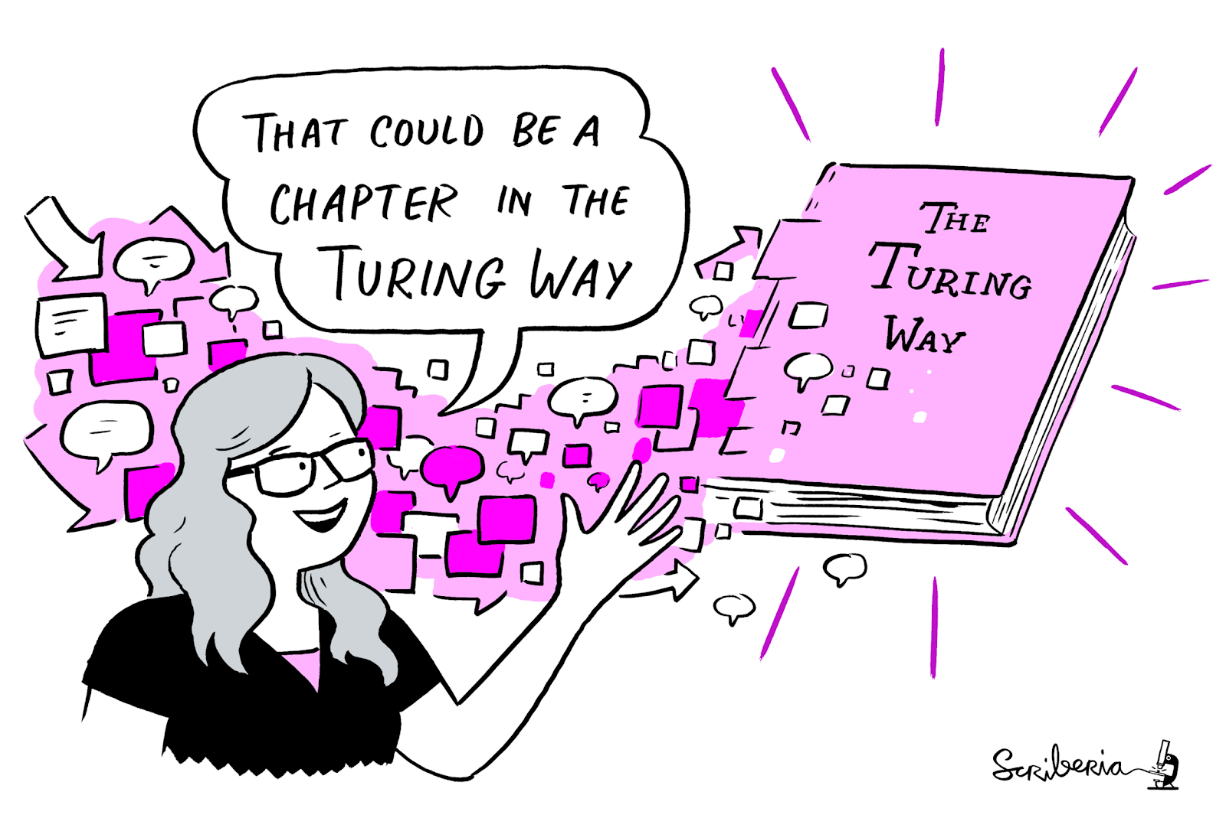
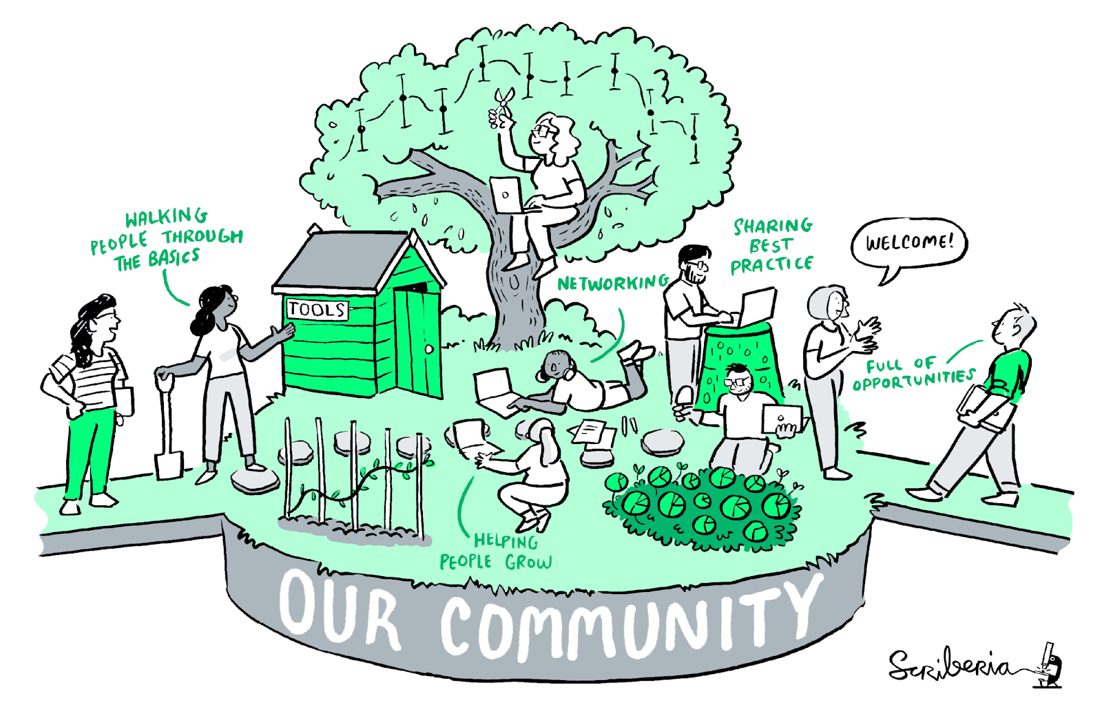
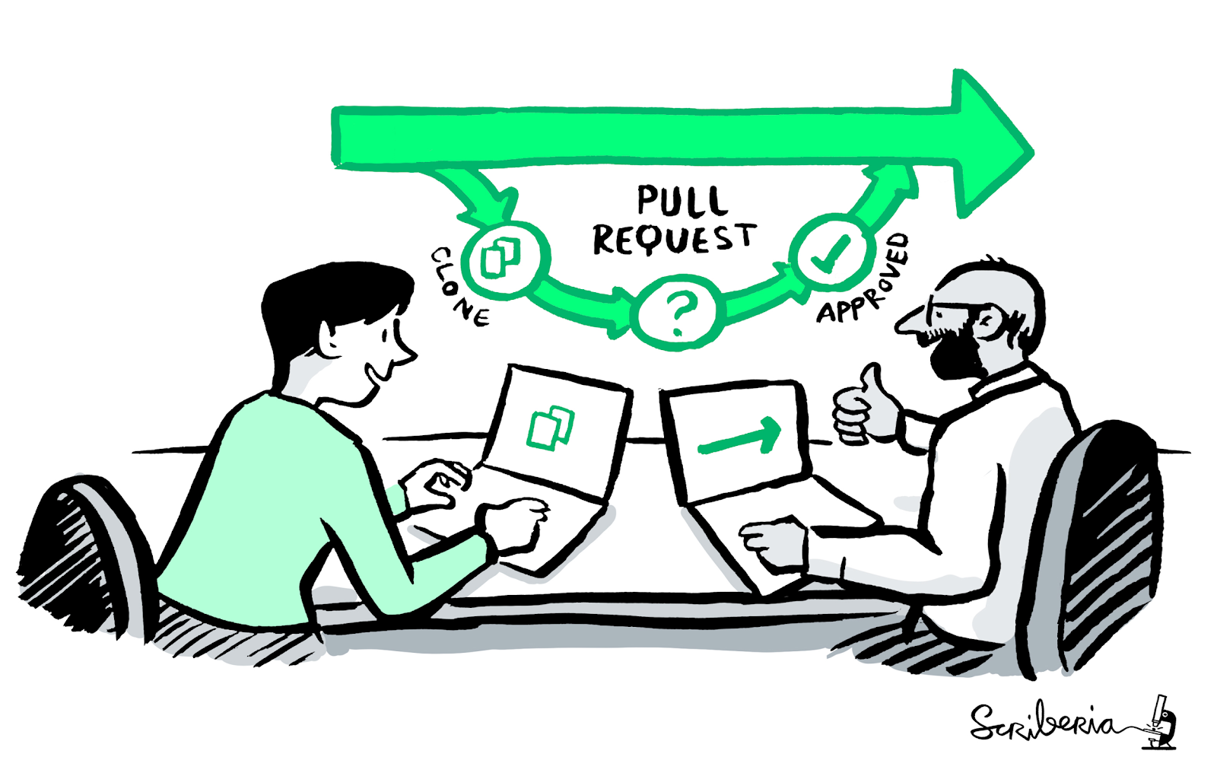
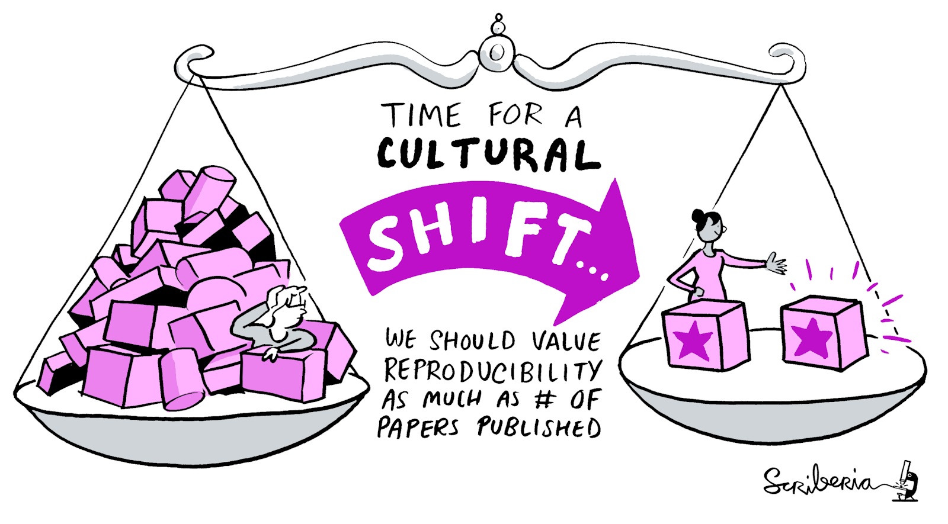
The Turing Way
An Open Source guide on Data Science
We involve and support a diverse community to make data science reproducible, ethical, collaborative and inclusive for everyone.
A book
A global community
An open-source project
A culture of collaboration
@ekaroune, @turingway, CC-BY 4.0, DOI: https://doi.org/10.5281/zenodo.13838566
Notes:
So what is the Turing Way.
It’s an open resource put together by our community of researchers and experts.
For us- its 4 things at once- its a book, a global community where people come together to collaboratively write chapters, build and maintain resources, share their skills and ideas around best practices in data science and research.
It’s somewhere where open source principles are applied in the development and maintenance of the project and it’s a collaboration- the process of collaboration is the backbone of our project.
The aim of our project is to make reproducible, collaborative, ethical and inclusive research too easy not to do.

Slide 4
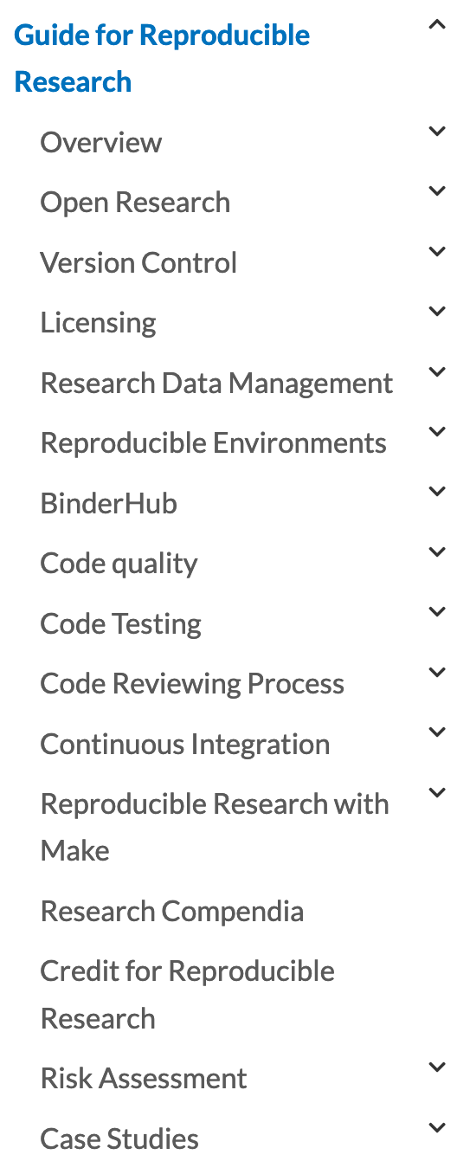
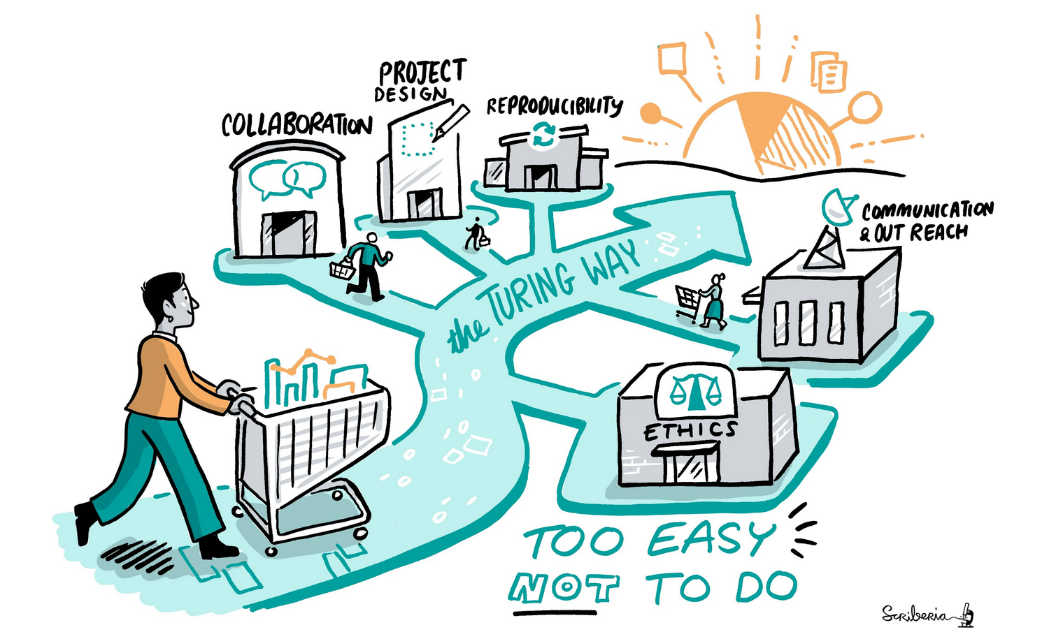
Guide for Reproducible Research
@ekaroune, @turingway, CC-BY 4.0, DOI: https://doi.org/10.5281/zenodo.13838566
Notes:
The Turing way started as a book on reproducibility initiated by Dr Kirstie Whitaker.
Contributors documented best practices, guidance and recommendations in chapters, describing various concepts and tools that can ensure the reproducibility aspects of data research.
These chapters include topics such as open research, version control, licensing, data management, code testing and reviewing, continuous integration and so on.
However, these data practices were not enough, as research also includes the way we communicate our work with others, how we design our project, and how efficiently we collaborate with each other.
All these while ensuring the highest ethical standards and research integrity in our research.

Slide 5
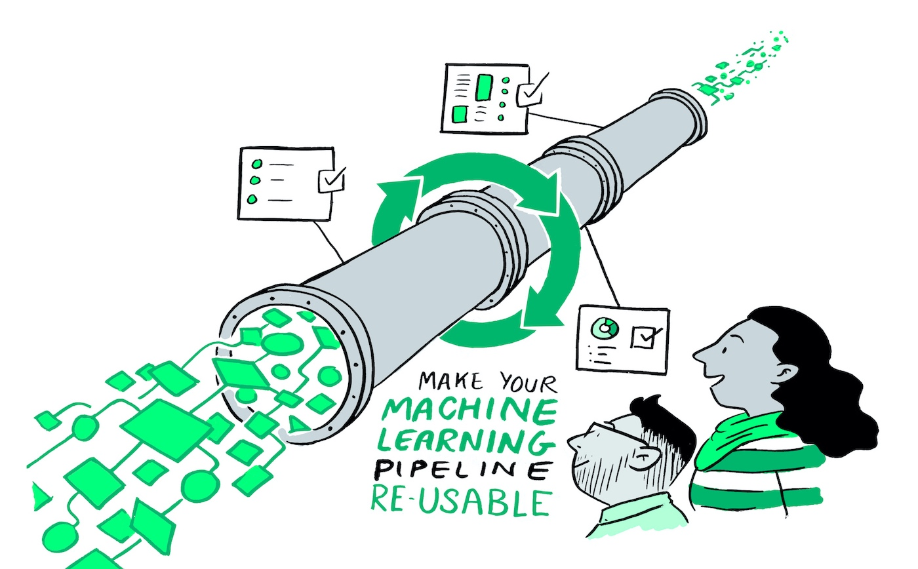
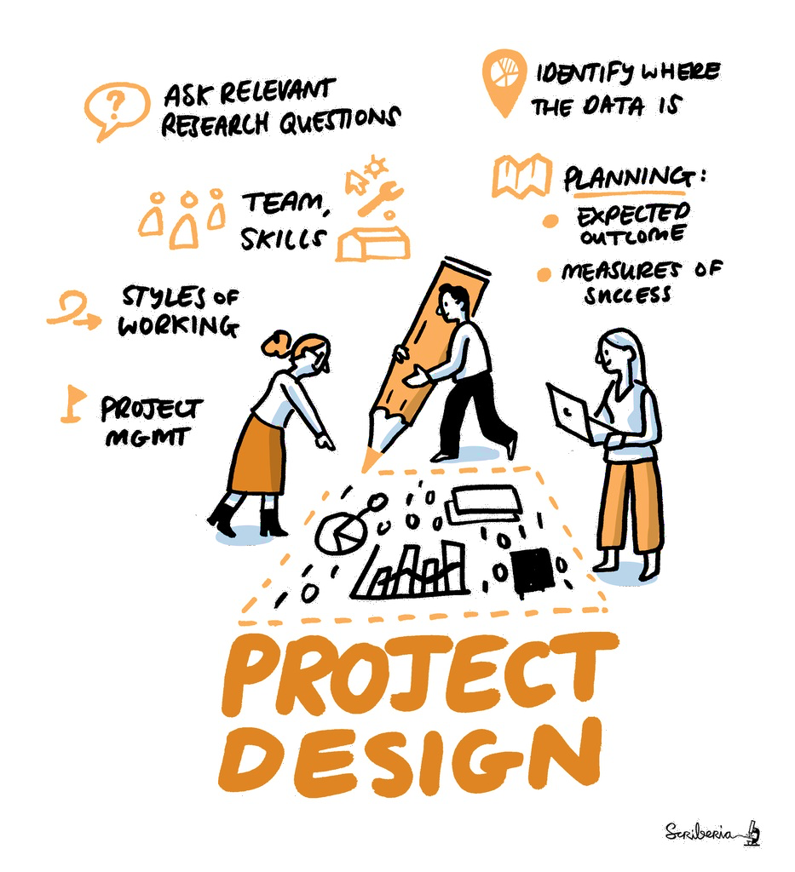
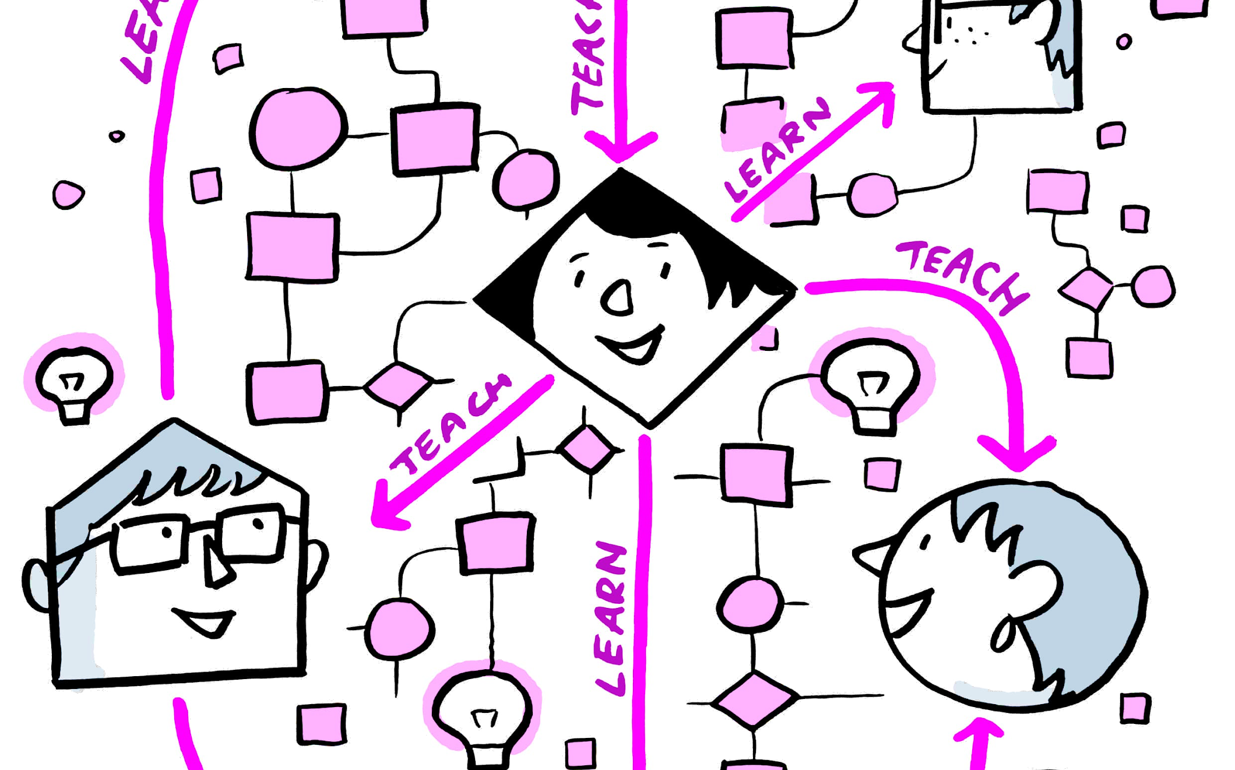
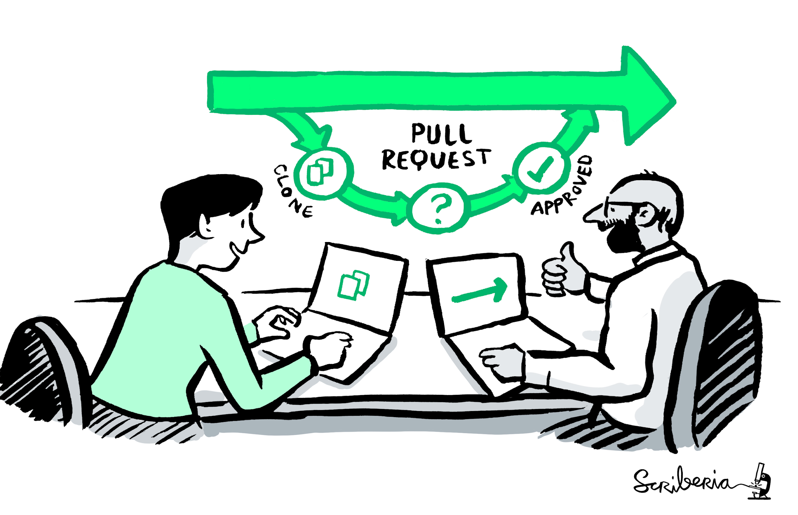
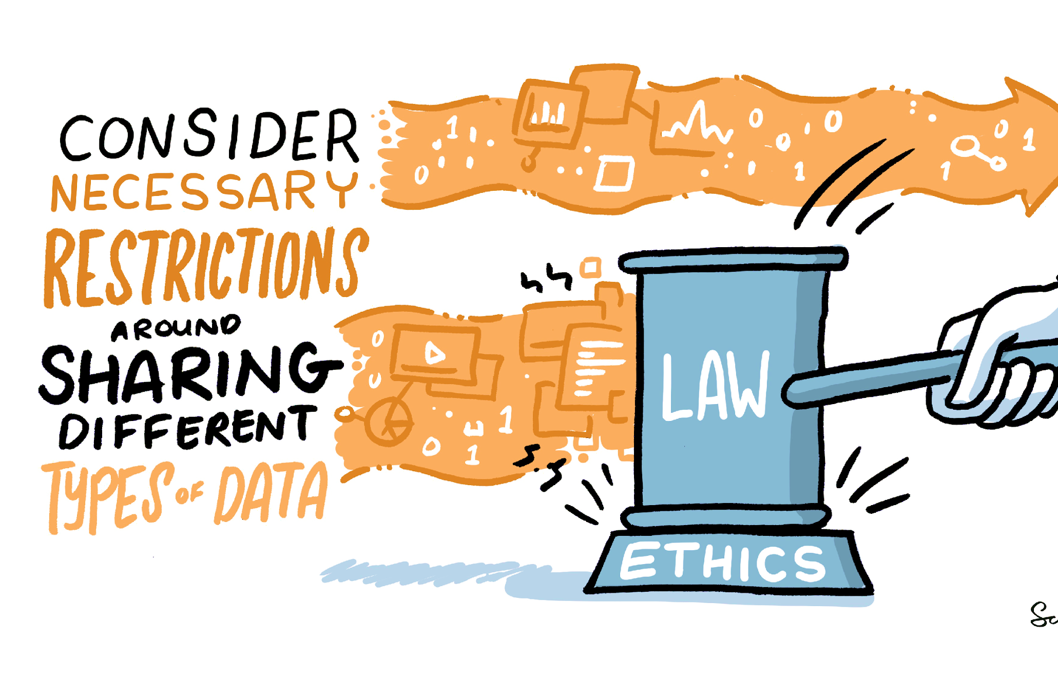
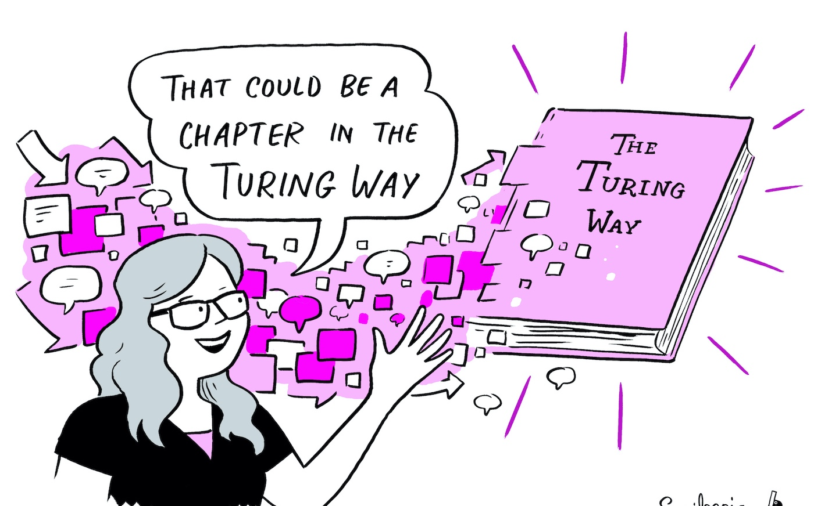
The Turing Way Guides
Reproducibility
Project design
Communication
Collaboration
Ethical research
Community handbook
@ekaroune, @turingway, CC-BY 4.0, DOI: https://doi.org/10.5281/zenodo.13838566
Notes:
Therefore, in order to accommodate all the requirements in research and data science, the project expanded to include four more guides: in addition to the guide for reproducible research, we have guides for project design, communication, collaboration and ethical research.
And we also have a community handbook to record all the community practices that we are developing and practising within the Turing Way so that it can be adopted by other open source communities.

Slide 6
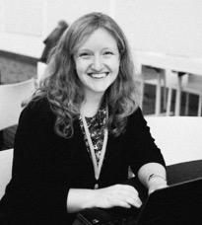
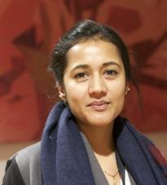





Project and Community Growth
~5 years
>313 chapters
Community resources, events, guidance, templates, training
498+ direct GitHub contributors and thousands of users
Kirstie Whitaker
Malvika Sharan
Director: Tools, Practices & Systems Programme (TPS)
TPS Senior Researcher: Open Research & Community
Anne Lee Steele
Lelle Demertzi
Community Manager,
The Turing Way
Project Manager
https://zenodo.org/record/3332807
Notes:
Over the last five years, we have produced over 313 chapters.
In order to ensure that our community members are able to participate irrespective of their previous experience of working with the Open Source or data science community, we provide the resources, guidance, templates, training and pathways that they can use to stay involved in the community.
The project is now co-lead by Malvika Sharan and we have a community manager, Anne, and a project manager, Lelle.
We have over 498 direct contributors on GitHub, where we develop our resources and we have 1000s of users. For example, our Scriberia illustrations, which I have intensively used in this talk, have been downloaded over 27,000 times.
We also maintain a social media presence and communicate about the project so that it can reach to as many people as possible and we can bring new voices in. For a community that started at a grassroot level, we are very grateful to have these members working with us.

Slide 7
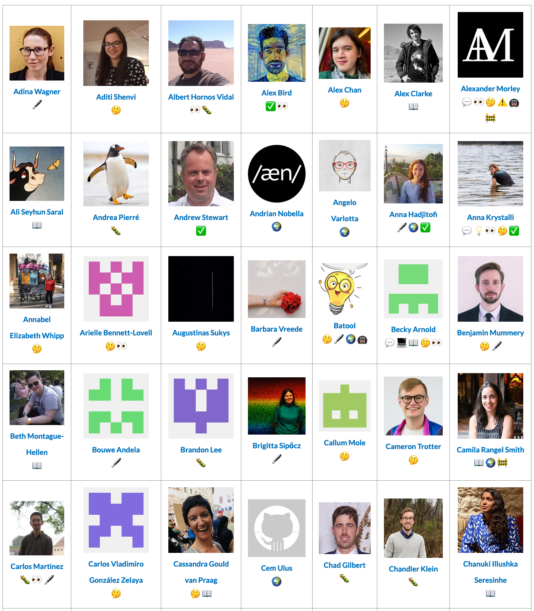
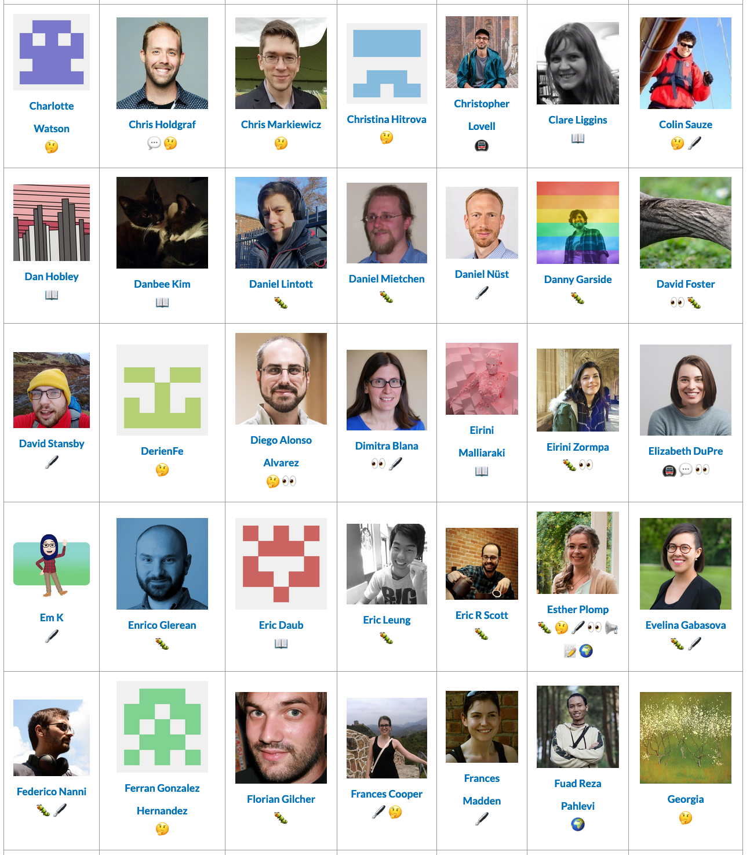
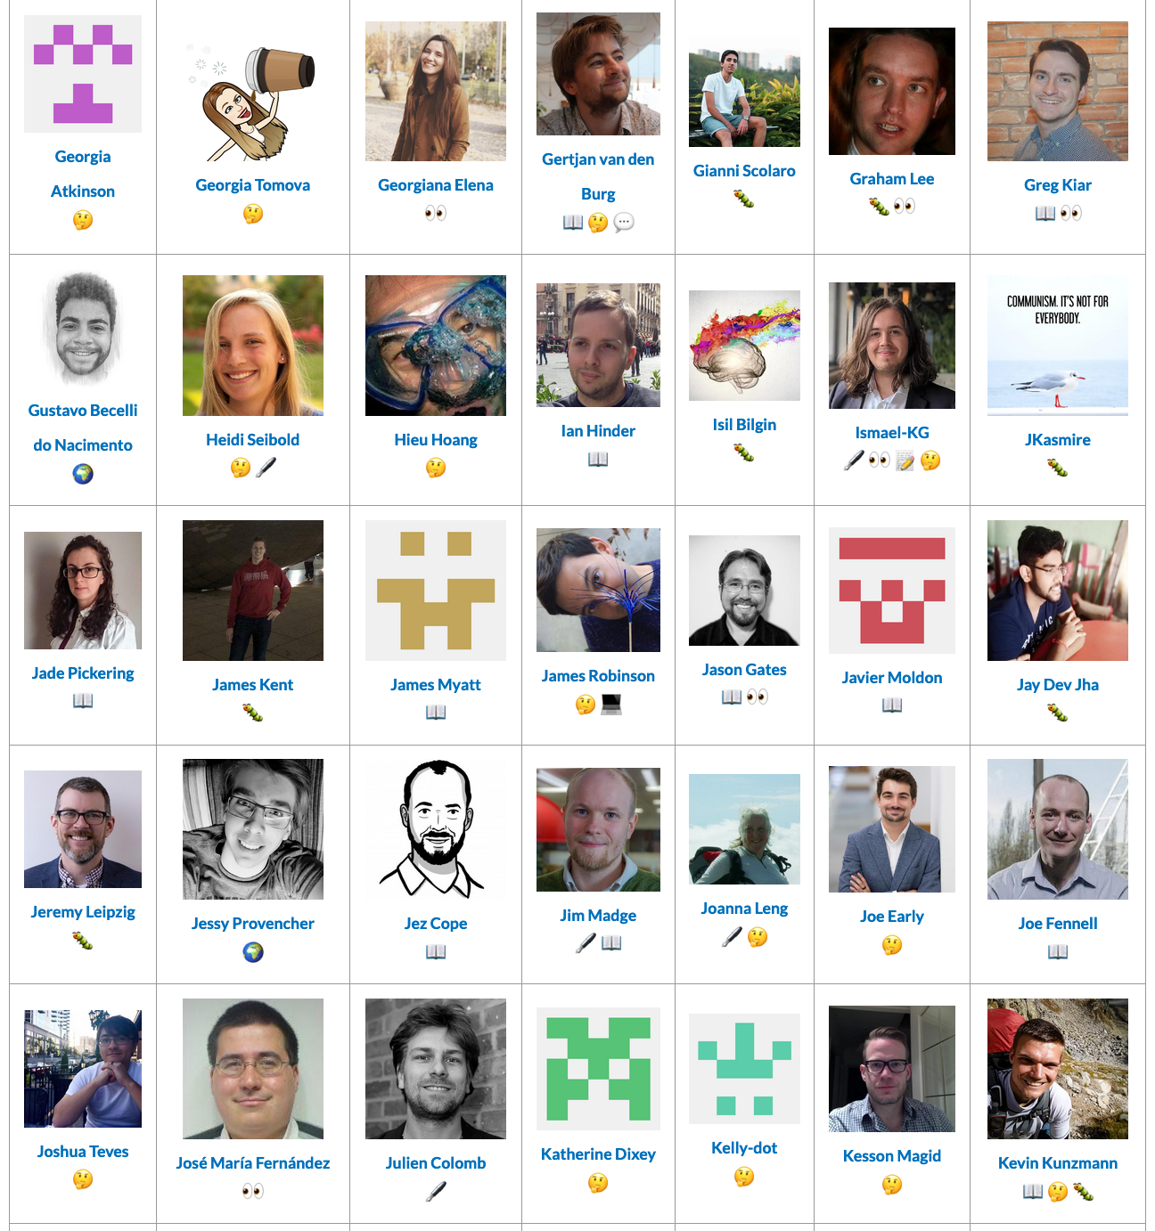
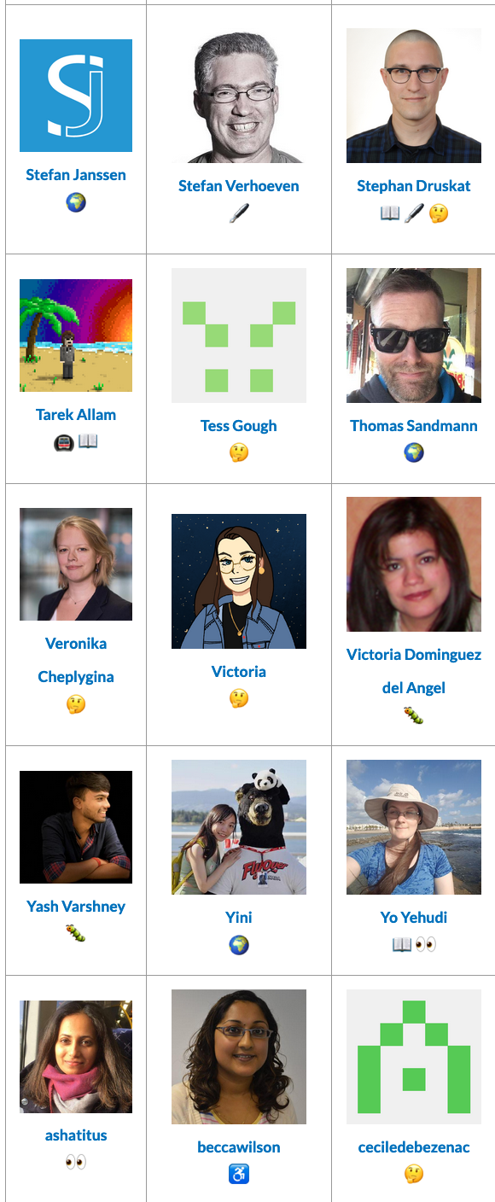
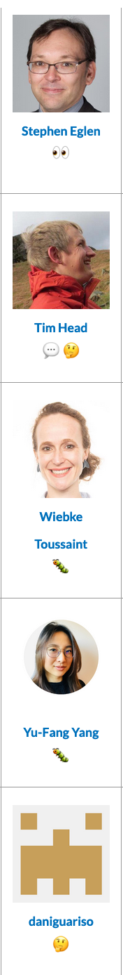
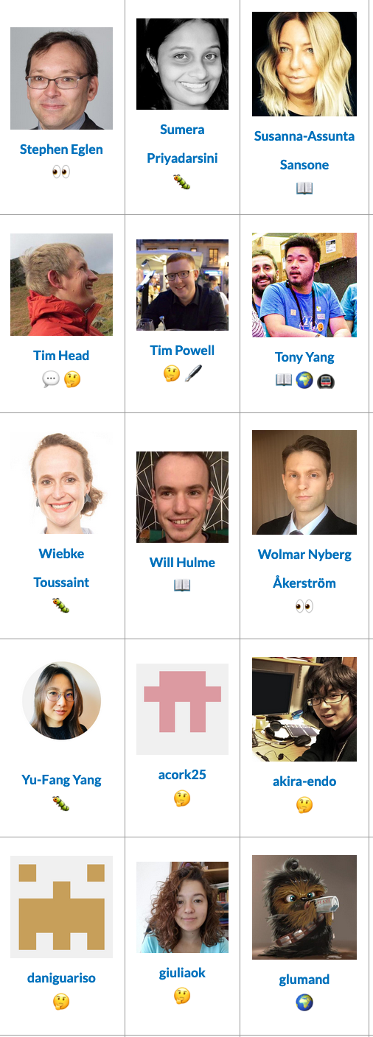
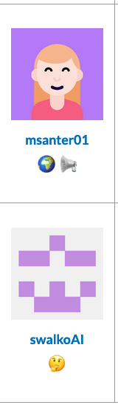
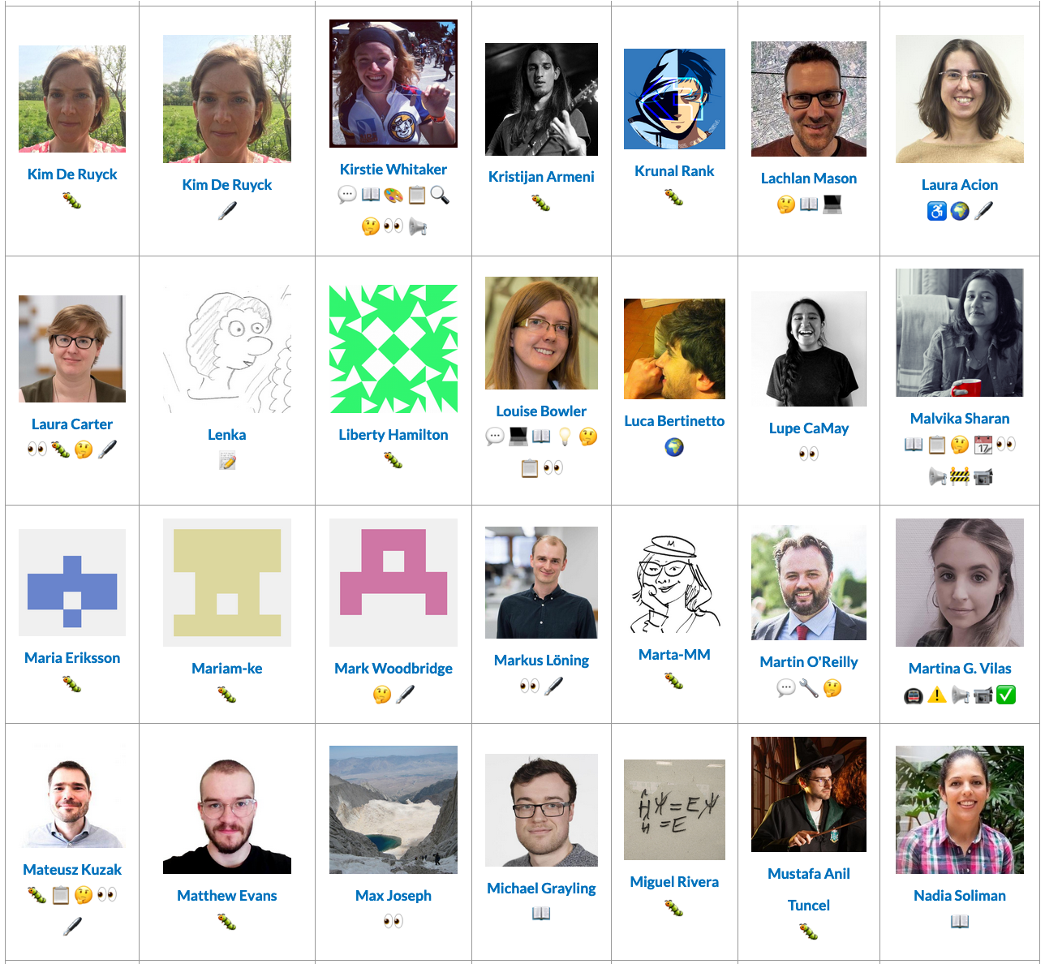
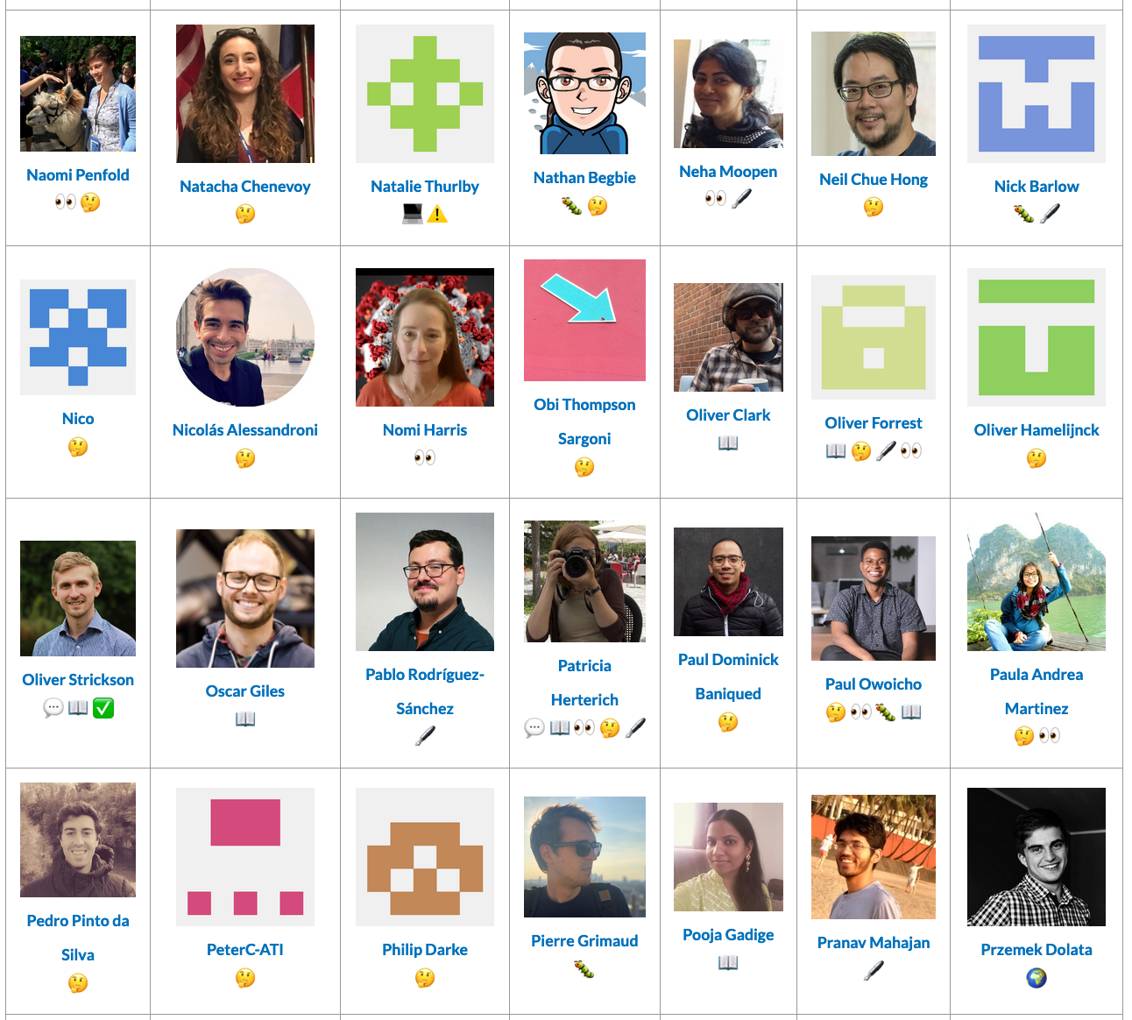
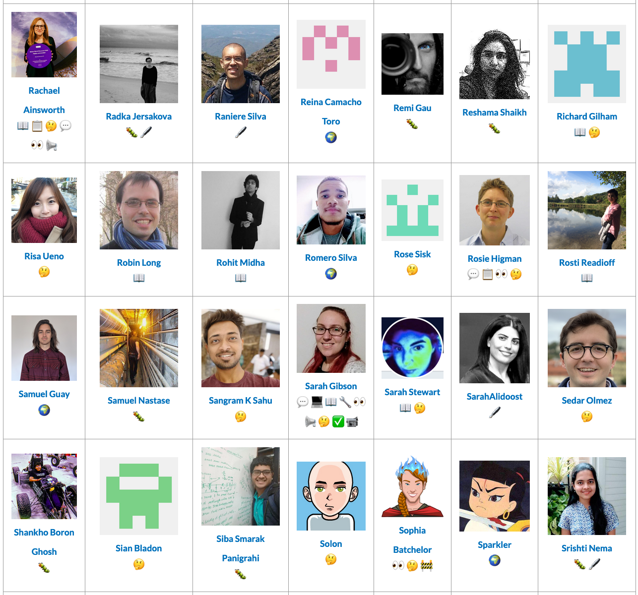
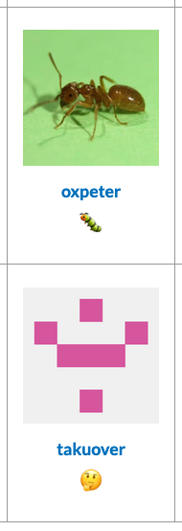


Thanks to our community of contributors & users!
Notes:
None of this work would be possible without our community of collaborators. So a big thanks to them all.
But how do we make sure that their contributions are properly recognised?

Slide 8
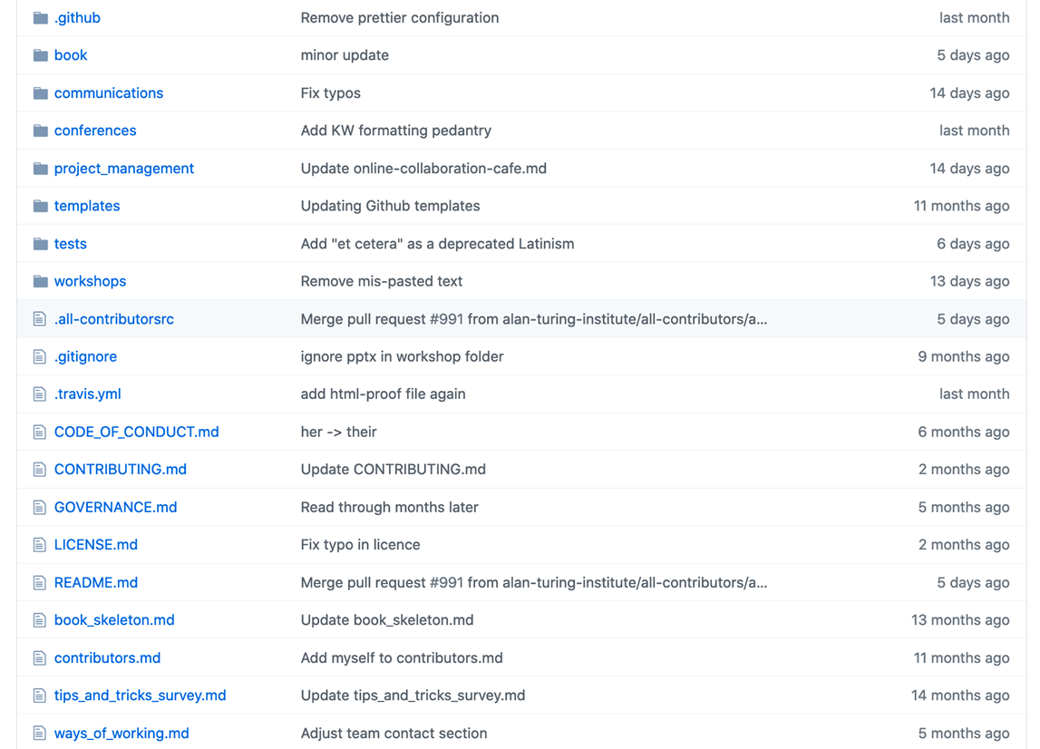

Open source infrastructure
GitHub:
https://github.com/the-turing-way/the-turing-way
@ekaroune, @turingway, CC-BY 4.0, DOI: https://doi.org/10.5281/zenodo.13838566
Notes:
First of all, our project is built and run through open source tools and infrastructure.
The open source nature of our project is important for providing access to our community but also to openly record and document contributions.
The project is completely coordinated, developed and maintained via a public repository on GitHub. This means that all contributions can be tracked in our repository.

Slide 9
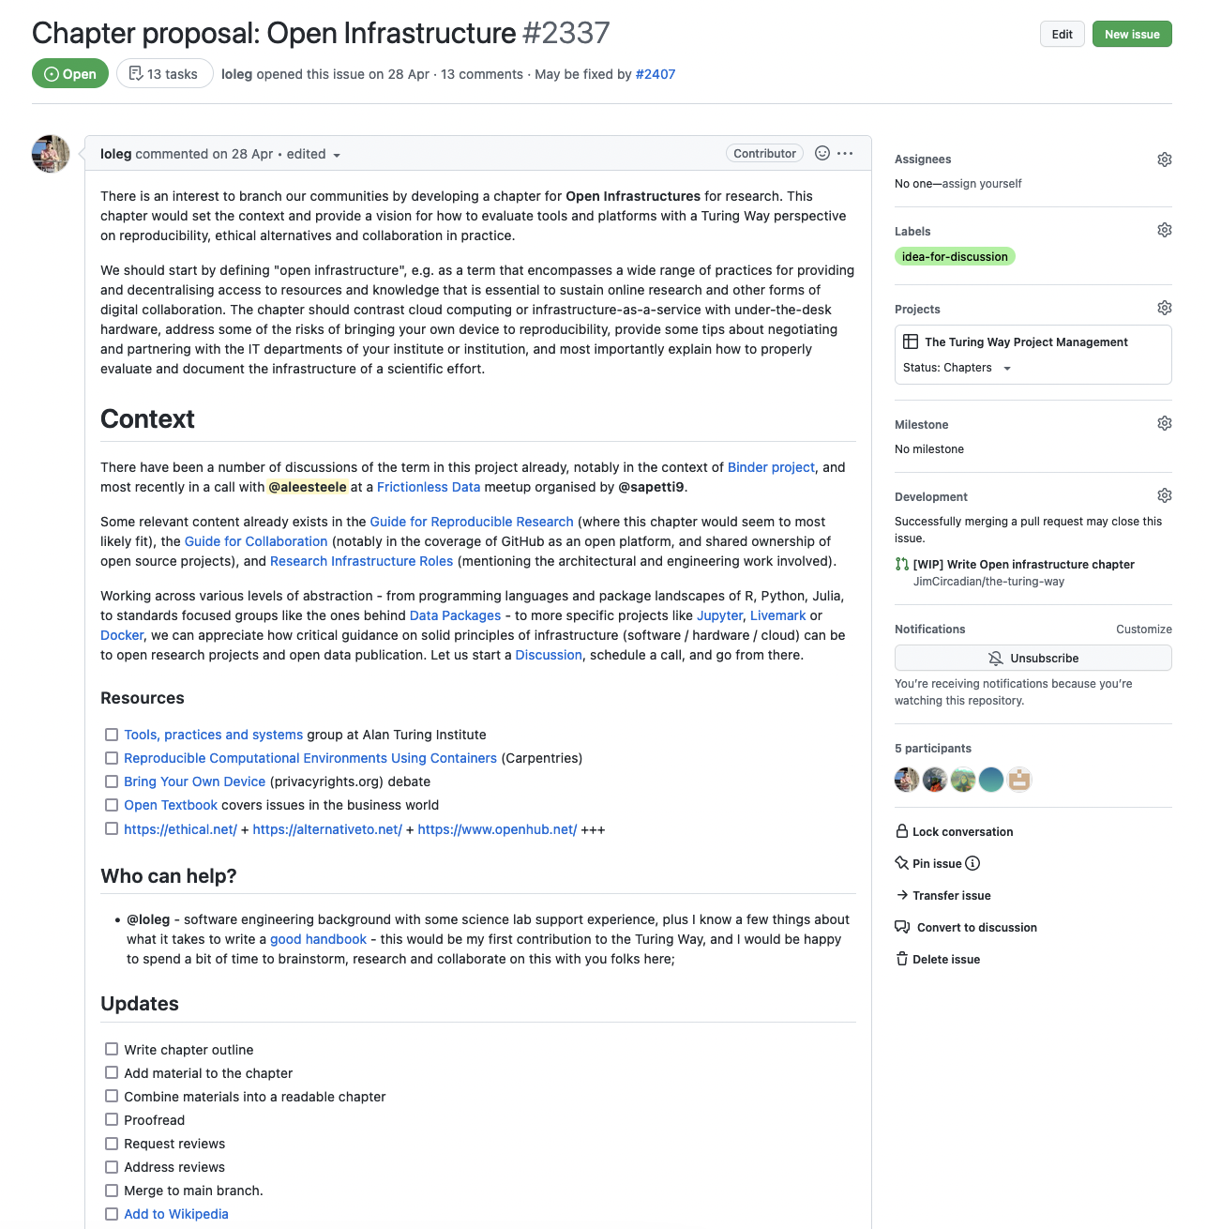
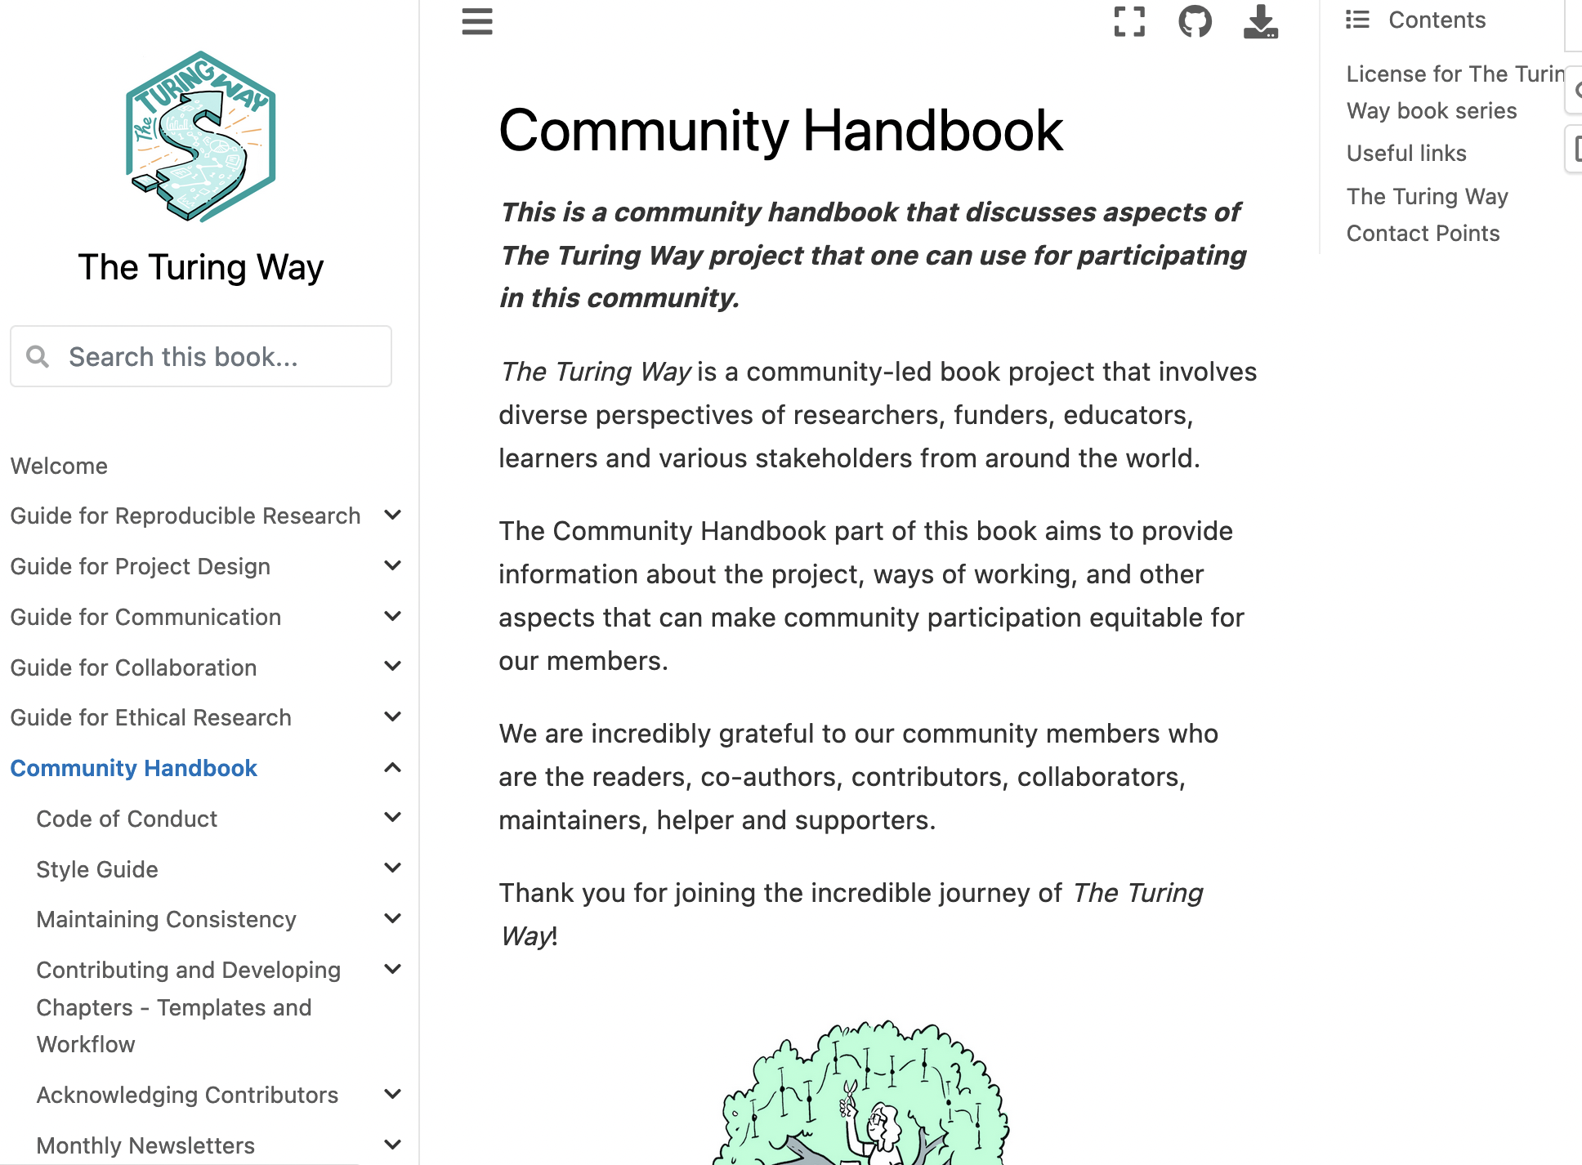
Documentation
@ekaroune, @turingway, CC-BY 4.0, DOI: https://doi.org/10.5281/zenodo.13838566
Notes:
As a project, we use a documentation first approach. All reports, proposals as well as list of contributors' names are posted transparently.
These are people who have contributed and would like to have their contributions documented.
This explicit approach to the running of our project makes it more accessible and inclusive to anyone that wants to contribute but also reuse and remix our approach for their own community.
We also enable people to over barriers to contribution by providing training and mentorship on tools we use such as Github and we also translate key documents and even the whole book into multiple languages to overcome the language barriers.

Slide 10
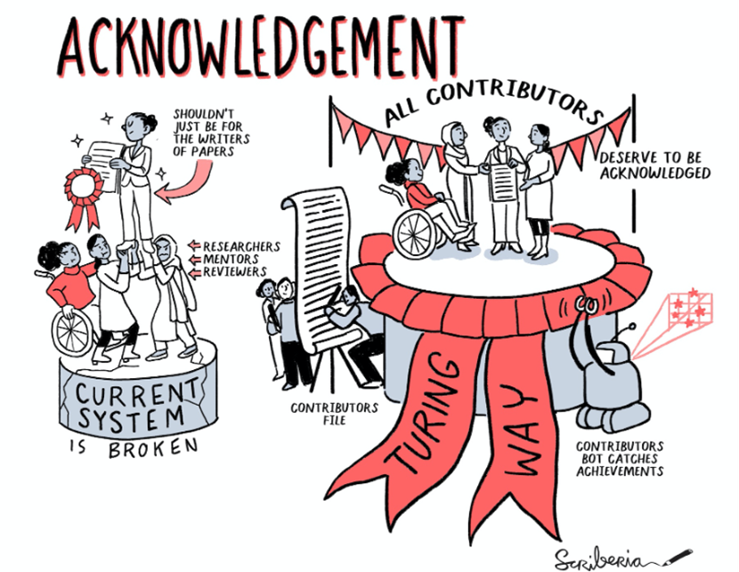
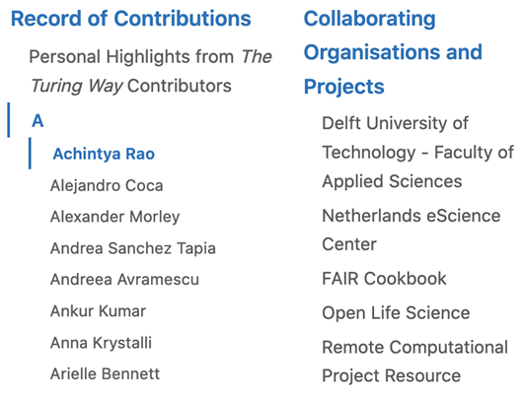
Recognition
Cite as: The Turing Way Community. (2021). The Turing Way: A handbook for reproducible, ethical and collaborative research (1.0.1). Zenodo. https://doi.org/10.5281/zenodo.5671094
@ekaroune, @turingway, CC-BY 4.0, DOI: https://doi.org/10.5281/zenodo.13838566
Notes:
We are committed to creating equitable opportunities for community leadership without trying to fit The Turing Way into a traditional credit system – and traditional incentives within academic institutions.
The Turing Way team employs a decentralised process that avoids individual authorship in favour of establishing shared ownership and agency in the project. We ensure that all contributions are fairly acknowledged, especially when their roles involve hidden labour in research that are often undertaken by members from marginalised communities in research and tech spaces.
The Turing Way book is attributed to The Turing Way community with each contributor listed as authors.
We provide a dedicated page in the book as a contributors’ record, that has dedicated links for all our contributors where they can highlight their personal work. They can share who they are, how people can learn more about them, and what kind of contributions they have made. They can write this in a way that's most meaningful for them.
Some contributors come into the Turing Way to build new skills, such as working with a version control system or community building. They can choose to work on a specific task that matches their interest. They can then update their contributors page describing how they achieved these skills and build evidence that can become part of their CV.

Slide 11


Formalising Research Infrastructure Roles
These roles carry out essential “glue work” of translating knowledge effectively by
involving diverse members through collaboration
promoting equitable, fair and ethical practices in research
identifying gaps or challenges as well as ways to fix them
When formalised and rewarded, people’s skills and contributions in research through traditionally invisible/hidden/undervalued work becomes valuable and recognisable by the system.
Stengers Isabelle., Another Science is Possible: A Manifesto for Slow Science. Polity Press (2016). | Eghbal.. N., “Roads and Bridges: The Unseen Labor Behind Our Digital Infrastructure. Ford Foundation (2016). | Olson, D., Meyerson, J., Parsons, M., Castro, J., Lassere, M., Wright, D., ... Acker, A.. Information Maintenance as a Practice of Care. https://doi.org/10.5281/zenodo.3236409. (2019)
Notes:
As well as enabling recognition in our own project, we are currently striving to promote and advocate for change in the professionalisation of a more diverse range of research roles.
We call these roles - research infrastructure roles, and greater recognition and professionalisation is needed for these roles across the whole research ecosystem.
People in these roles, which I would include myself in this group as I’m a research community manager which is not a traditional academic role, so this group carry out glue work that helps diverse community members collaborate, they promote equitable, fair and ethical practices in research and identify gaps and challenges and strive to solve them.
These roles are currently under-recognised and therefore they do not get the credit they deserve for the role they play in enabling impactful and sustainable research.

Slide 12
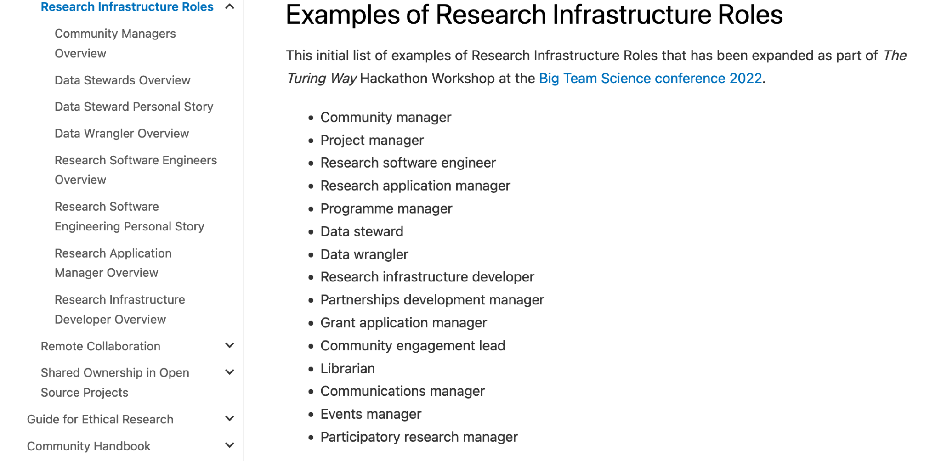
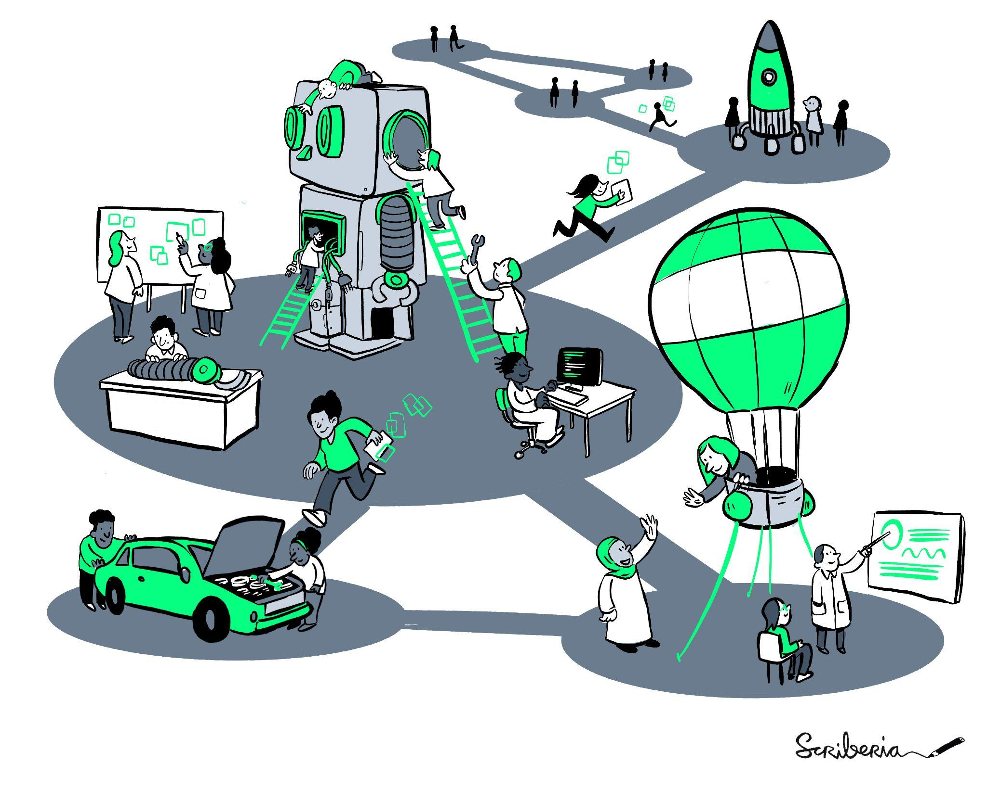
The Turing Way Guides
@turingway, https://the-turing-way.netlify.app/collaboration/research-infrastructure-roles.html, CC-BY 4.0 image by The Turing Way and Scriberia
@malvikasharan @turingway, DOI: 10.5281/zenodo.7258956
Notes:
In the Turing Way project, we are approaching this in a number of ways:
In our guide for collaboration, we are developing a chapter on research infrastructure roles which has a number of different roles already documented and some case studies about those roles.
So please do check it out and come and speak to us if you would like to contribute a new sub-chapter on another research infrastructure role.

Slide 13
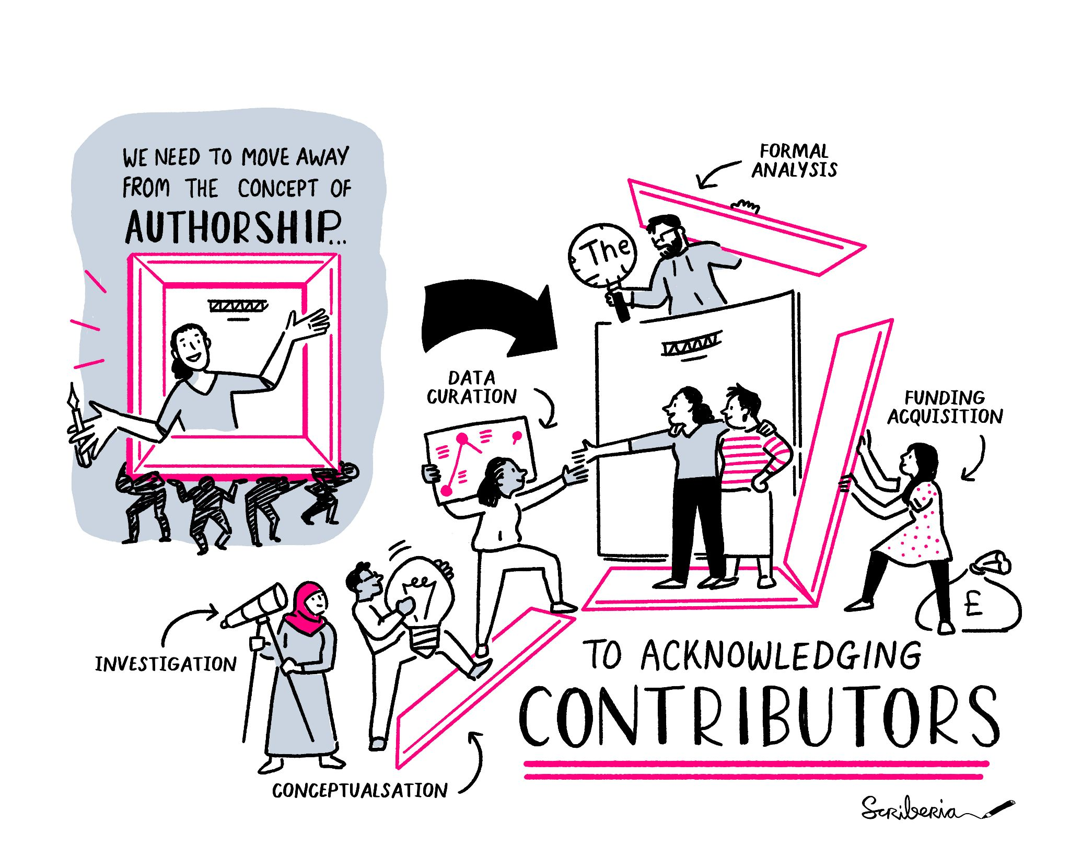
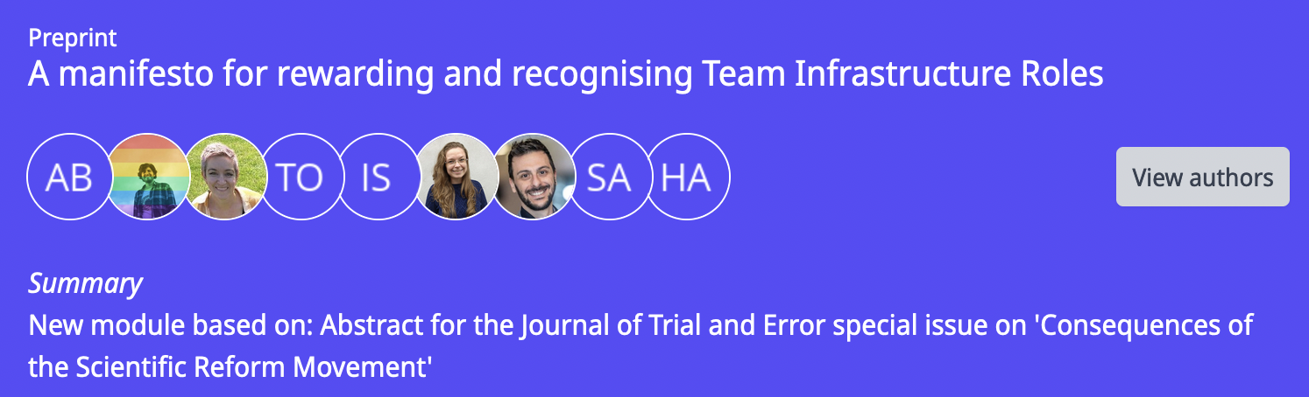
Policies / Guidelines for Open Leadership
Recognising all kinds of roles through recommendations & policies.
UK Research and Development Roadmap
Attract, retain, develop the talented, diverse people and teams. Ensure that our science, research, innovation system is responsive to our society
Towards better recognition for Research Infrastructure Specialists (Australia)
Professional staff become more valuable with experience and need to be rewarded as such – otherwise they will go elsewhere. Australian universities need to improve how they reward and recognise this important cohort of specialists, and the NCRIS Project Directors are calling for a change in how [Research Infrastructure] specialists are classified.
Preprint: A manifesto for rewarding and recognising Team Infrastructure Roles, doi.org/10.53962/knm3-bnvx https://www.gov.uk/government/publications/uk-research-and-development-roadmap - UK Reference, https://anff.org.au/news/towards-better-recognition-for-research-infrastructure-specialists - Australia Reference
Notes:
We also contribute to UK policy and write papers related to this topic such as the recent manifesto for rewarding and recognising team infrastructure roles written by many of our community members.

Slide 14
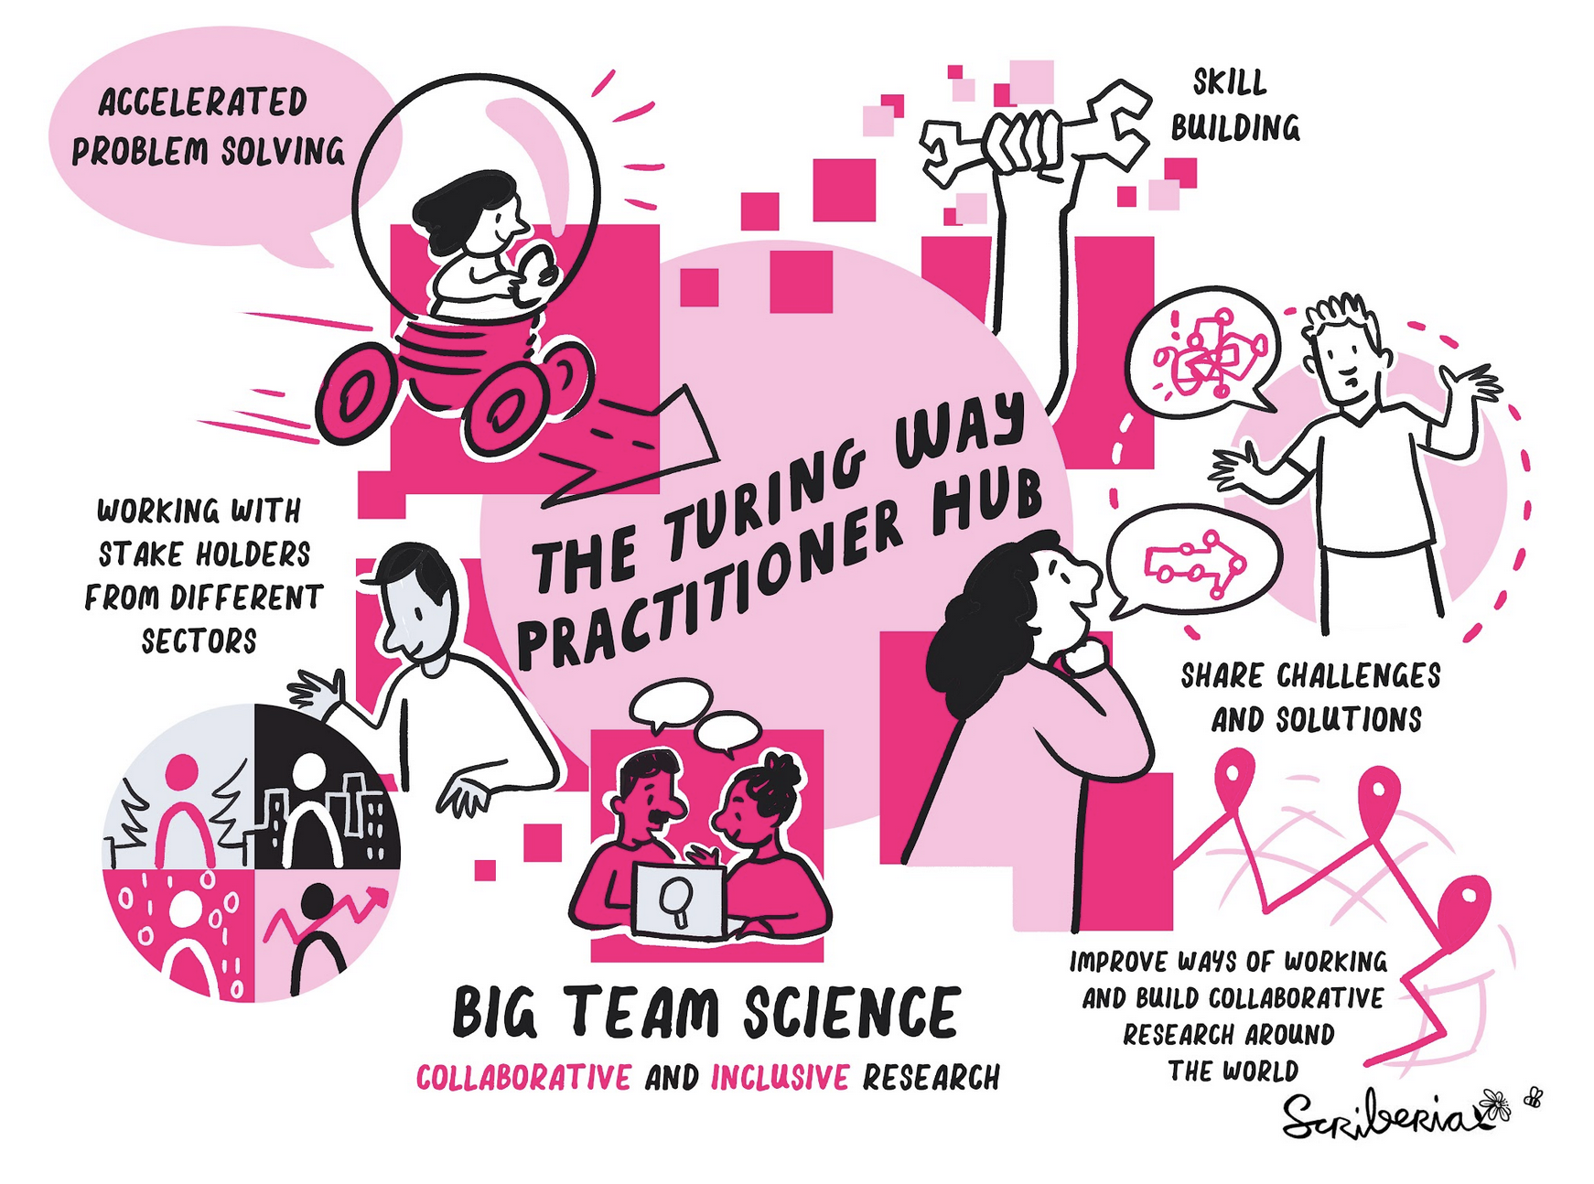
Broader Recognition for Research Infrastructure Roles
The Turing Way Practitioners Hub in close collaboration with UK orgs (government, industry, public sector)
The Turing’s Skill Policy Award for engaging with policy ecosystem - led by Dr. Emma Karoune
@ekaroune, @turingway, CC-BY 4.0, DOI: https://doi.org/10.5281/zenodo.13838566
Notes:
We are working on a number of initiatives including the turing way practitioners hub in which we are working in close collaboration with UK organisation to disseminate our resources and train people from these organisations in our ways of working and more generally in open research best practices.
I have been leading a project looking at the skills policy landscape for research infrastructure roles and we are writing several outputs that gather together existing skills frameworks and have developed new skills frameworks for some of these emerging roles. This is to inform policymakers of the current and future skills needs in the data science ecosystem and push for greater understanding and recognition for these roles.

Slide 15
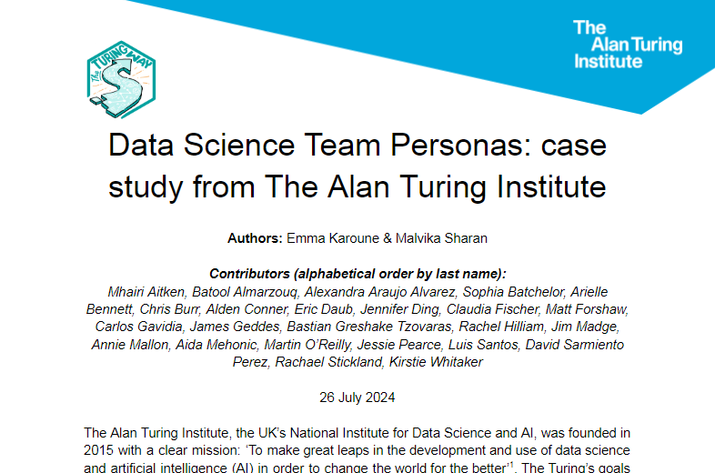
Case study: Turing data science team
Using BridgeAI framework
for umbrella Data science and AI Professional persona
Personas for all roles in our data science teams
Narrative around how we work together as a team
Input from across Turing’s teams
Karoune, E., & Sharan, M. (2024). Data Science Team Personas: case study from The Alan Turing Institute. Zenodo. https://doi.org/10.5281/zenodo.11658994
Roles included are:
Data Science Domain experts
Leadership role (Domain or Specialists)
Cross-cutting research infrastructure specialists
Research Data Scientists
Research Software Engineers
Research Computing Engineer
Research Community Managers
Research Application Managers
Data Wranglers
AI and Research Ethicists
Public engagement experts
Project/Programme Managers
Podcast - https://www.buzzsprout.com/1326658/14761258
Notes:
As part of our skills policy project, we have written a case study of turing data science teams that includes personas for all of the data science roles that we have at turing.
We have based the personas on those developed by Matt Forshaw as part of the Bridge AI framework.
This case study includes an overall umbrella persona for a data science and ai professional, the personas for the different roles in the data science team and also a narrative of how we work in a team. It is important to understand the different roles that exist in data science so that we can start to create competency frameworks and career pathways to enable more people to come into these types of roles.

Slide 16
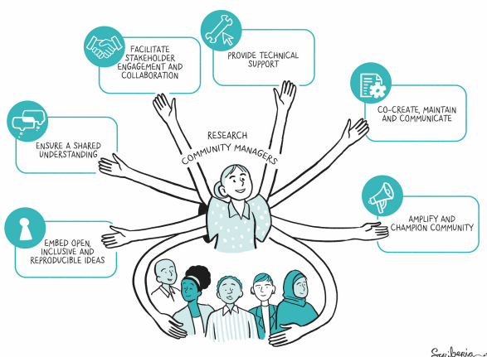
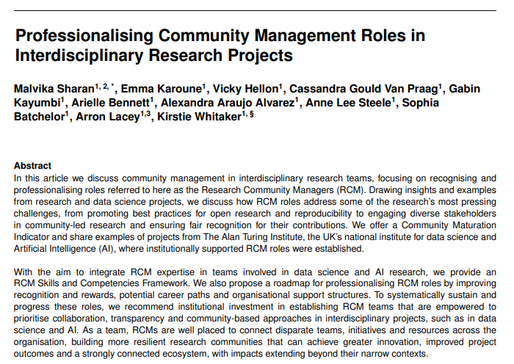
Research Community Management
Skills framework
Case studies
https://doi.org/10.48550/arXiv.2409.00108
Notes:
We have written a position paper on research community management. You can access the pre-print now.
This paper includes a detailed skills framework and other resources we have developed in our team of RCMs at Turing. There are also case studies demonstrating different implementation of research community management across different domains of data science. We have also proposed career pathways for this role.
This detailed study of this particular role helps to move it towards recognition and professionalisation by creating greater understanding and knowledge about the role and enabling others to consider becoming and RCM or organisations are better placed to create this role in their data science teams.

Slide 17


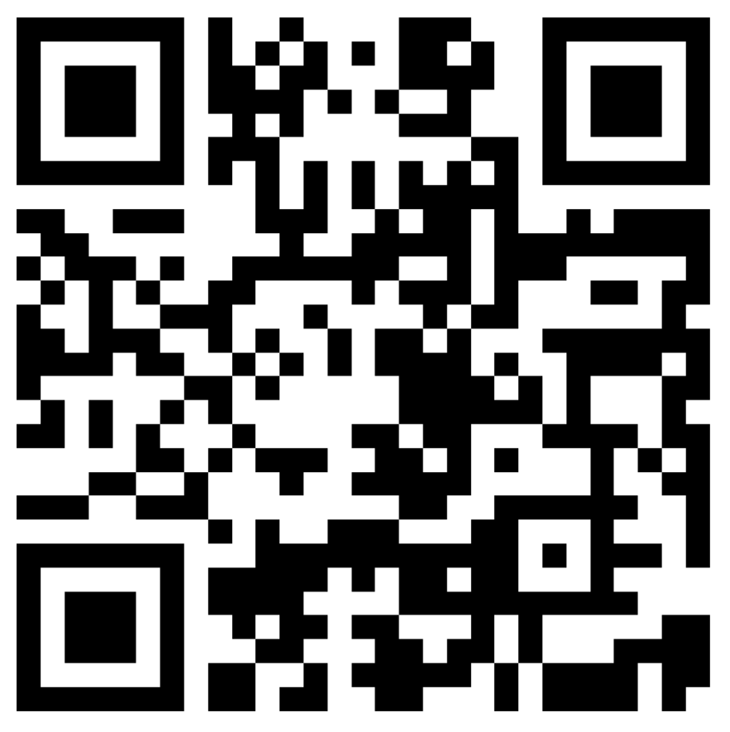
People in Data
Our 3yr programme aims to convene an open community of data professionals, which promotes a culture that values and prioritises data and recognises people that work in data roles as essential to research.
We need you!
Are you a data steward, data wrangler, researcher that works with data?
Come join us!
  Take our survey, connect with us and connect us with your communities.
Webpage
Contact form
& Survey
Funded by UKRI/EPSRC Research Technical Professionals scheme and led by the Turing’s Data for Research, Research Community Management and Skills Team’s.
Notes:
To further our work in this area, we have secured funding to convene a data professionals community - focusing on roles such as data stewards and data wranglers -in our new project People in data.
This is a 3 year programme to convene an open community of data professionals and promote a culture that values and priortises data and the people that work in data roles.
You can find out more on our webpage and please do fill in our contact form to connect with us.

Slide 18
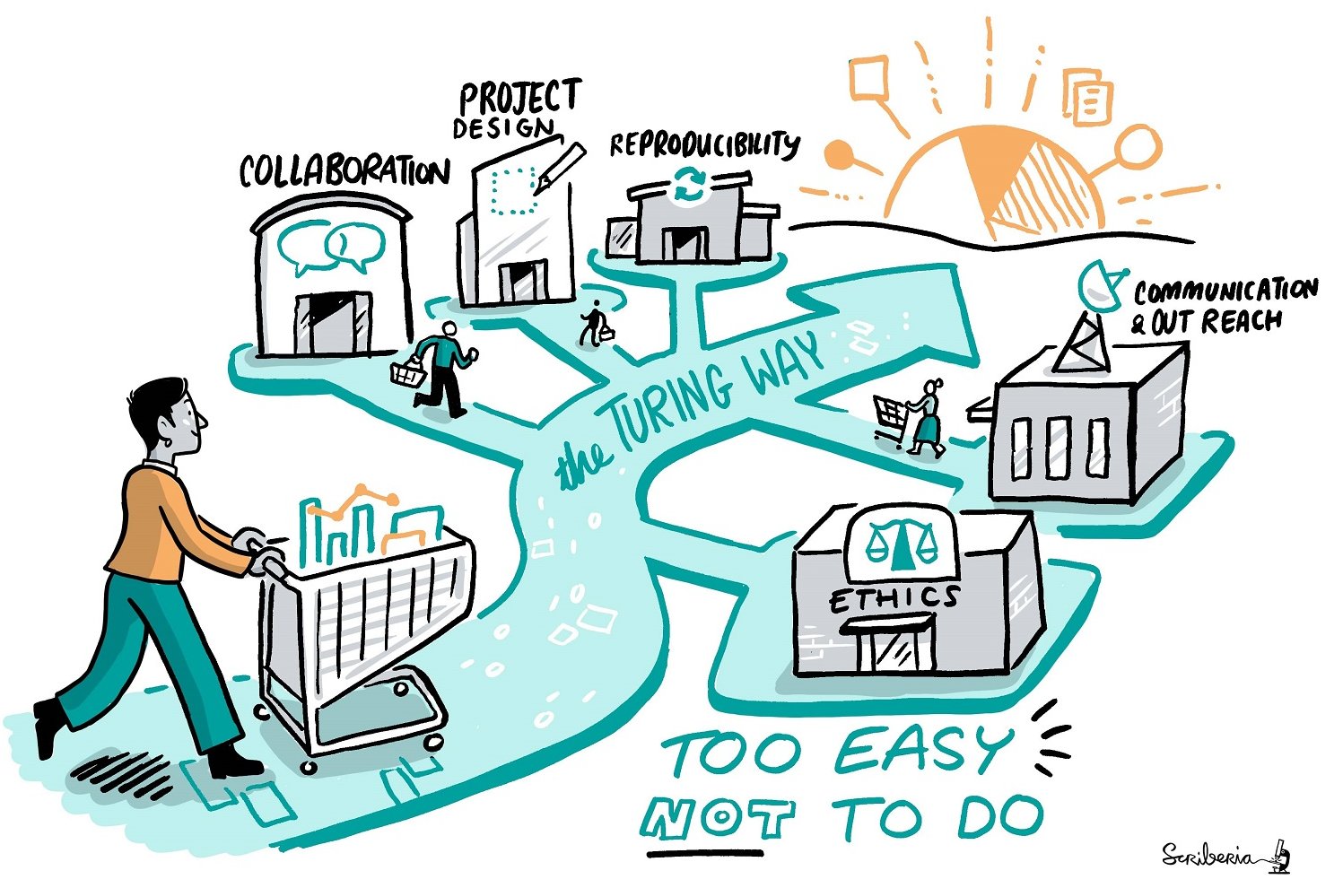
Connecting with The Turing Way Project
- Collaboration Cafes
    1st & 3rd Wednesdays (15:00 UTC)
- Fireside Chats
    Usually monthly
- More ways to connect
- Join our slack workspace
- Sign up to our newsletter
    https://the-turing-way.start.page/
@ekaroune, @turingway, CC-BY 4.0, DOI: https://doi.org/10.5281/zenodo.13838566
Notes:
There are multiple ways to connect with our project.
We host collaboration cafes and fireside chats every month.
We also have a slack workspace or sign up to our newsletter to find out more.
You can find details at the link on the slide - bit.ly/turingway.

Slide 19

Acknowledgements:
The Turing Way team, Kirstie Whitaker, Malvika Sharan, Anne Lee Steele, Alexandra Araujo Alvarez
The Turing Way community, contributors & collaborators
Book: the-turing-way.netlify.com
Twitter: twitter.com/turingway
Newsletter: tinyletter.com/TuringWay
Slack: tinyurl.com/jointuringwayslack
GitHub: github.com/alan-turing-institute/the-turing-way
Original artwork by Scriberia: https://doi.org/10.5281/zenodo.3332807
@ekaroune, @turingway, CC-BY 4.0, DOI: https://doi.org/10.5281/zenodo.13838566
Notes:
And lastly, thanks to the turing way team - Kirstie, Malvika, Anne and Alex.
And on this slide you can find lots of links to all our resources.
Thanks for listening.

