Slide 1
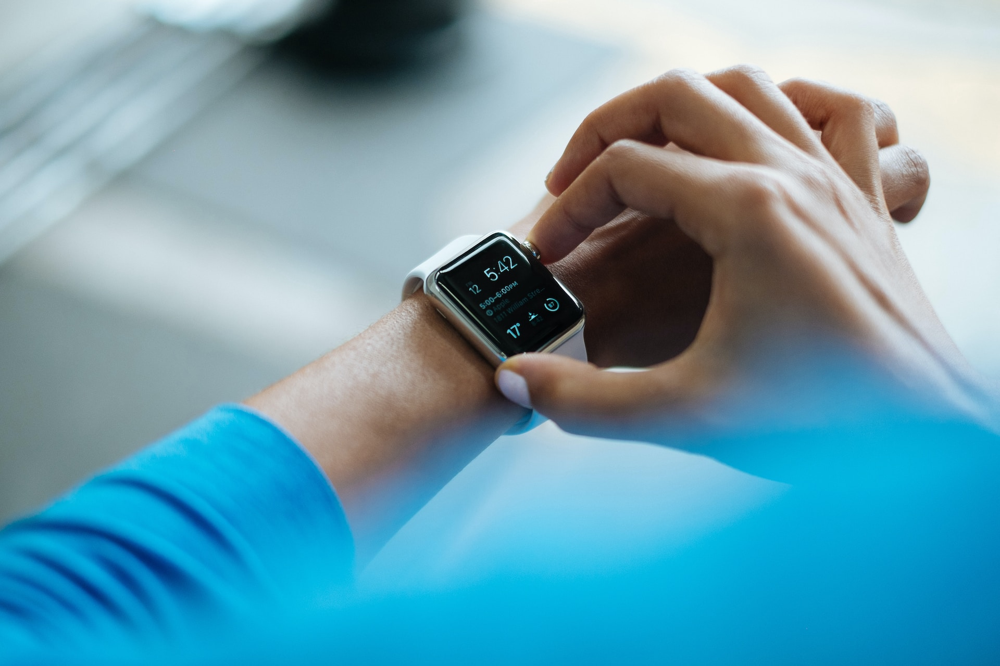
Equitable Photoplethysmography in Wearables: Accurate Data for All
Dr Peter H. Charlton
University of Cambridge
City, University of London
Photo by Luke Chesser on Unsplash

Slide 2
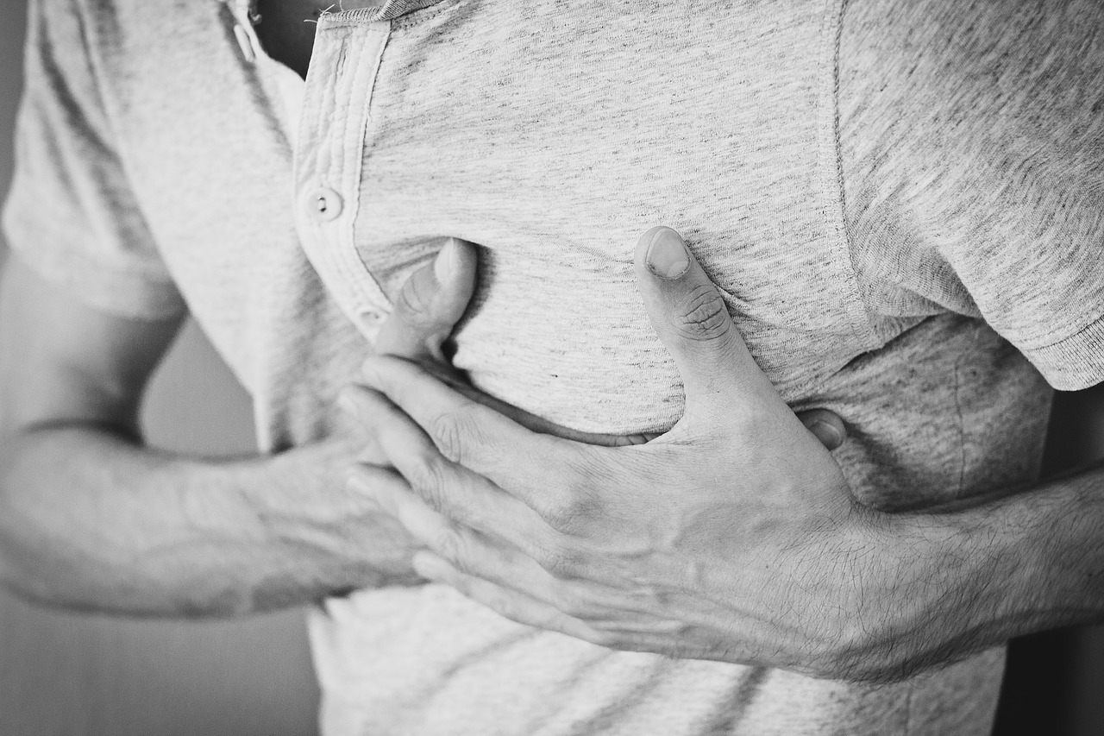
Undiagnosed disease in UK:
0.4
mill
atrial fibrillation
1.4
mill
obstructive sleep apnea
5.5
mill
hypertension
Public Health England, Atrial fibrillation prevalence estimates in England: Application of recent population estimates of AF in Sweden. 2015
Knauert M et al., Clinical consequences and economic costs of untreated obstructive sleep apnea syndrome. World J. Otorhinolaryngol. - Head Neck Surg, 2015.
British Heart Foundation, High blood pressure: How can we do better? 2018
Pexels, https://pixabay.com/photos/man-heartache-chest-pain-hurt-pain-1846050/ (Pixabay Licence)
Notes:
Several diseases remain widely undiagnosed in society, causing increased morbidity and
mortality:
- Atrial fibrillation is the most common arrhythmia and confers a fivefold increase in
stroke risk. Yet it is undiagnosed in approximately [click] 425,000 people in England [1].
- Obstructive sleep apnea is a sleep disorder which causes repeated cessations in breathing, and confers an increased risk of stroke, hypertension, and heart failure [2]. Yet it is undiagnosed in approximately [click] 1.4 million people in the UK [3].
- Hypertension, or high blood pressure, is a leading cause of disability and death [?]. Yet it is undiagnosed in approximately [click] 5.5 million people in England [?].

Slide 3
Photo by Luke Chesser on Unsplash

Slide 4

Notes:
To introduce myself [click], my name's Peter Charlton, and I'm a researcher in Bioinformatics. I develop techniques to analyse physiological signals, such as those acquired by consumer devices, to aid clinical decision making. I initially conducted my research here at St Thomas' Hospital in London, where I helped develop [click] Philips' wearable devices for hospital patients.

Slide 5

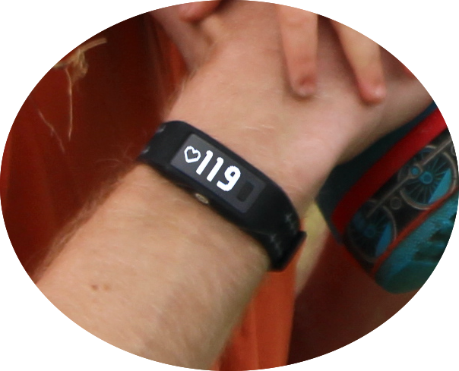
(artistic license – this heart rate is fictional)
Notes:
Since then, I've been working on developing data analysis techniques for use [click] with wearables in daily life. Through my work I aim to make devices as accurate as possible (unlike [click]
the heart rate of 119 bpm shown here), and as acceptable as possible ([click] preferably not involving cumbersome blood pressure cuffs or finger probes as shown here).

Slide 6
“Equity is the absence of unfair, avoidable or remediable differences among groups of people …”
World Health Organisation, ‘Healthy equity’, https://www.who.int/health-topics/health-equity, 2024. Accessed 24-Sept-2024.

Slide 7
“Equity is the absence of unfair, avoidable or remediable differences among groups of people …”
remediable: capable of being corrected
unfair: without favouritism or discrimination
[Oxford English dictionary]
groups of people: “… whether those groups are defined socially, economically, demographically, or geographically or by other dimensions of inequality (e.g. sex, gender, ethnicity, disability, or sexual orientation).”
World Health Organisation, ‘Healthy equity’, https://www.who.int/health-topics/health-equity, 2024. Accessed 24-Sept-2024.

Slide 8
Examples from signal processing algorithms:
“Equity is the absence of unfair, avoidable or remediable differences among groups of people …”
remediable: e.g. specifying constants which are not suitable across all groups
unfair: e.g. training an algorithm on a select group without accounting for other groups
avoidable: e.g. using a suboptimal algorithm when other algorithms would perform better across groups
World Health Organisation, ‘Healthy equity’, https://www.who.int/health-topics/health-equity, 2024. Accessed 24-Sept-2024.

Slide 9
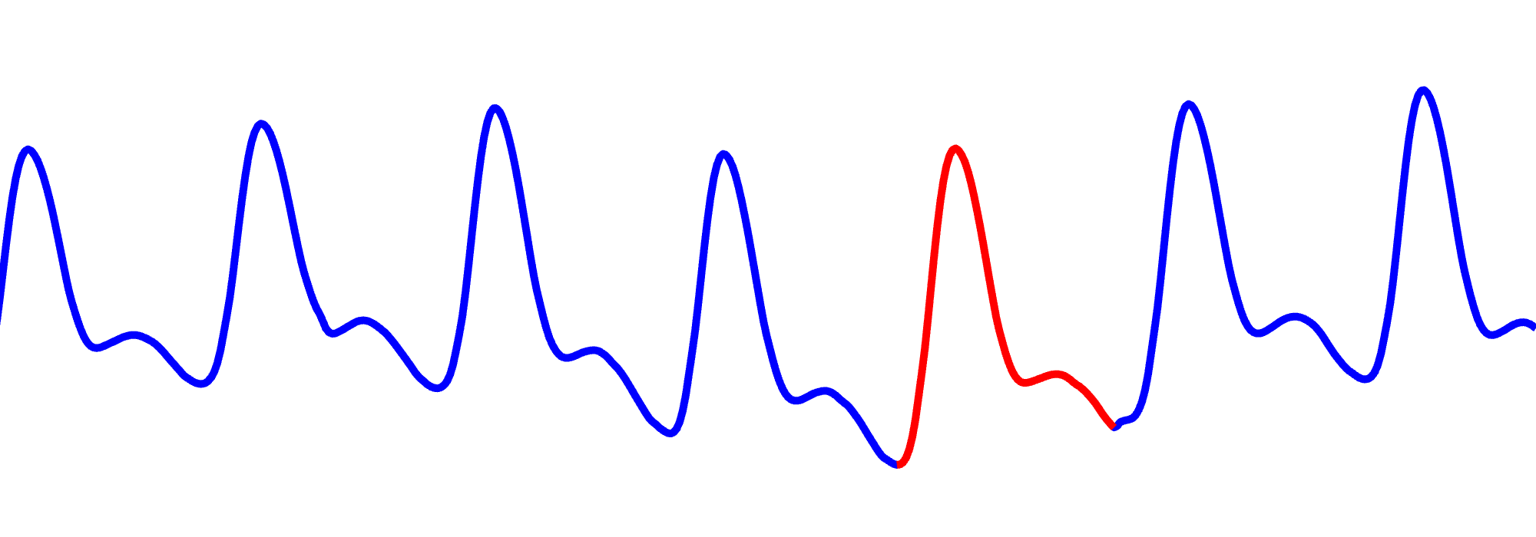
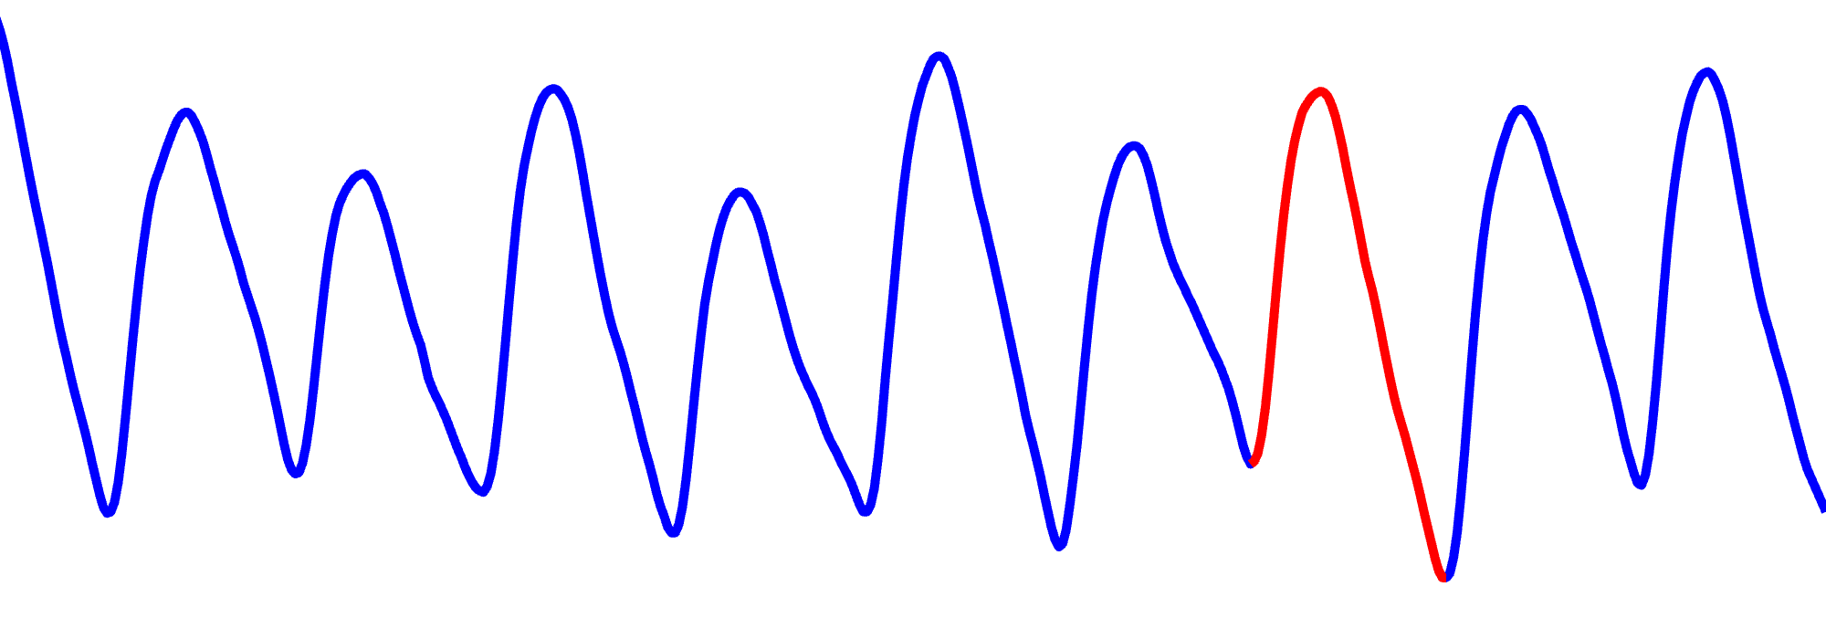
PPG beat detection:
Adult:
%% Assumptions
typical_heart_rate = 90; % in beats per minute
Heart rate: ~97 bpm
Neonate:
Heart rate: ~150 bpm
Charlton PH, ‘Photoplethysmography Beat detection Animation.gif’, Wikimedia Commons, 2024. ﻿ (CC BY 4.0). Data from the MIMIC-III waveform database [1,2,3] (ODbL 1.0). Selected based on [4]. [1] Moody, B. et al. (2020). MIMIC-III Waveform Database (version 1.0). PhysioNet. https://doi.org/10.13026/c2607m. [2] Johnson, A. E. W. et al. (2016). MIMIC-III, a freely accessible critical care database. Scientific Data, 3, 160035. [3] Goldberger, A. et al. (2000). PhysioBank, PhysioToolkit, and PhysioNet: Components of a new research resource for complex physiologic signals. Circulation. 101 (23), pp. e215–e220. [4] Bashar, S.K. et al. 2019. Noise Detection in Electrocardiogram Signals for Intensive Care Unit Patients. IEEE Access, 7, pp.88357-88368.

Slide 10
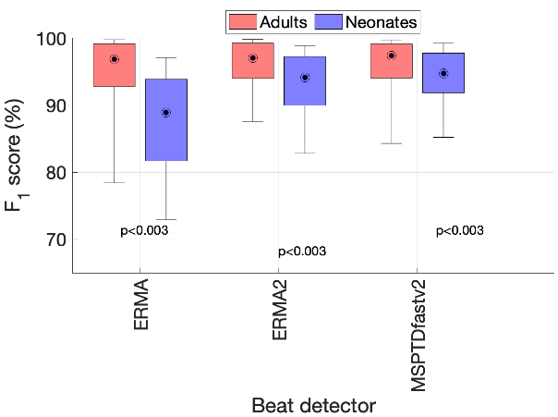
PPG beat detection:
%% Assumptions
typical_heart_rate = 90; % in beats per minute
(best performance)
(worse performance)
Anon
Alg

Slide 11
PPG beat detection:
%% Assumptions
typical_heart_rate = 90; % in beats per minute
“Equity is the absence of unfair, avoidable or remediable differences among groups of people …”
remediable: e.g. specifying constants which are not suitable across all groups
remediable: could we improve performance across groups by modifying this constant?
remediable: could we improve performance across groups by modifying this constant?
unfair: could we improve performance by re-training on diverse subjects?
unfair: e.g. training an algorithm on a select group without accounting for other groups
avoidable: could an alternative algorithm provide better performance across different groups?
avoidable: e.g. using a suboptimal algorithm when other algorithms would perform better across groups
World Health Organisation, ‘Healthy equity’, https://www.who.int/health-topics/health-equity, 2024. Accessed 24-Sept-2024.

Slide 12
PPG beat detection:
%% Assumptions
typical_heart_rate = 180; % in beats per minute
%% Assumptions
typical_heart_rate = 90; % in beats per minute
(best performance)
(worse performance)
Alternative Alg
Anon Alg
(90 bpm)
Anon Alg
(180 bpm)

Slide 13
PPG beat detection:
%% Assumptions
typical_heart_rate = 90; % in beats per minute
“Equity is the absence of unfair, avoidable or remediable differences among groups of people …”
remediable: could we improve performance across groups by modifying this constant?
remediable: could we improve performance across groups by modifying this constant?
unfair: algorithm was trained on adults to identify a typical heart rate of 90 bpm
avoidable: could use an alternative algorithm which performs better across different groups
World Health Organisation, ‘Healthy equity’, https://www.who.int/health-topics/health-equity, 2024. Accessed 24-Sept-2024.

Slide 14
PPG beat detection:
%% Assumptions
typical_heart_rate = 90; % in beats per minute
“Equity is the absence of unfair, avoidable or remediable differences among groups of people …”
remediable: could we improve performance across groups by modifying this constant?
remediable: could we improve performance across groups by modifying this constant?
unfair: algorithm was trained on adults to identify a typical heart rate of 90 bpm
avoidable: could use an alternative algorithm which performs better across different groups
World Health Organisation, ‘Healthy equity’, https://www.who.int/health-topics/health-equity, 2024. Accessed 24-Sept-2024.

Slide 15
PPG beat detection:
(best performance)
(worse performance)
Anon Alg
(90 bpm)
Anon Alg
(180 bpm)
Alternative Alg

Slide 16
“Equity is the absence of unfair, avoidable or remediable differences among groups of people …”
Many, many factors contribute to equity, e.g.
Performance of wearables
Acceptability of wearables
World Health Organisation, ‘Healthy equity’, https://www.who.int/health-topics/health-equity, 2024. Accessed 24-Sept-2024.

Slide 17

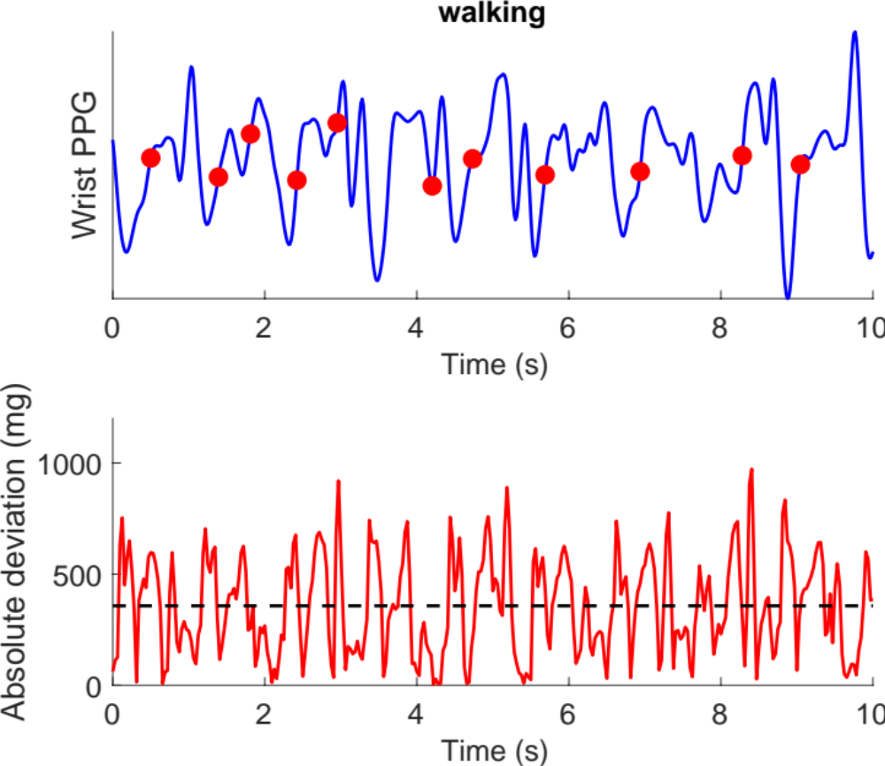
1. Introduction to wearables
2. Our contributions
3. Perspectives
Photo by Luke Chesser on Unsplash
Photo by Dario Valenzuela on Unsplash

Slide 18
1. Introduction to wearables
2. Our contributions
3. Perspectives
Photo by Luke Chesser on Unsplash
Photo by Dario Valenzuela on Unsplash

Slide 19
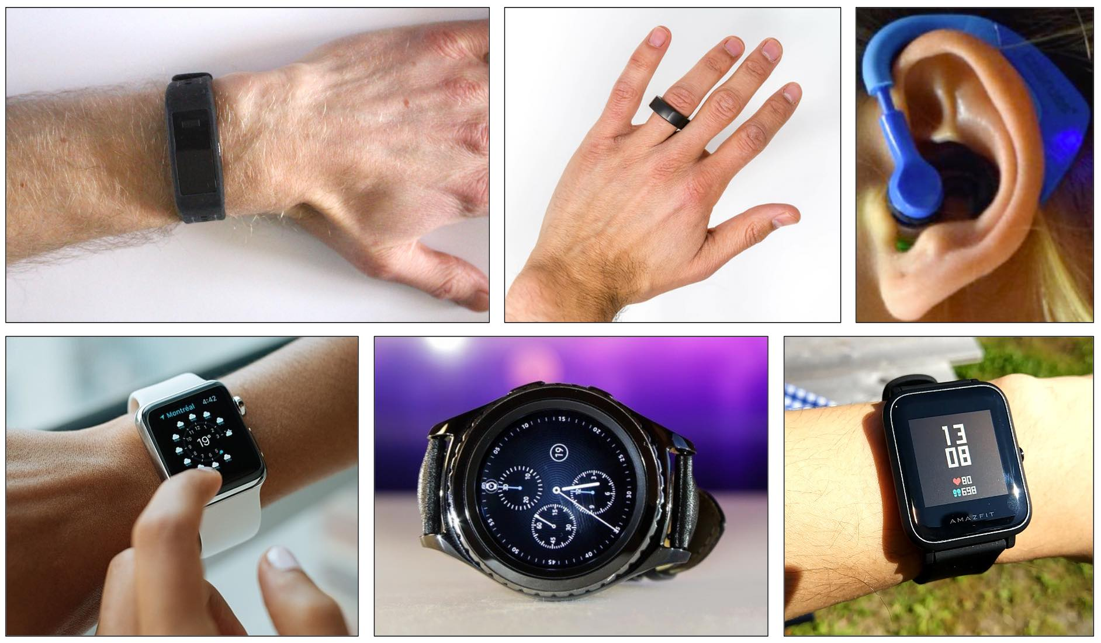
Source: Charlton et al. Individual images: P. Charlton under CC BY 4.0; cropped from image by Marco Verch (CC BY 2.0); cropped image from Passler et al. under CC BY 4.0; cropped from image by GEEK KAZU (CC BY 2.0); cropped from image by Pixels (Pixabay License); cropped from image by Luke Chesser (CC0 1.0).
Notes:
There are three key sensing technologies used here.
… Firstly, [click] electrocardiogram monitoring (or ECG for short). …

Slide 20
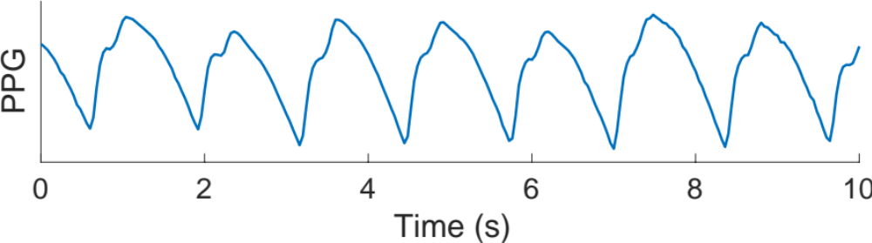
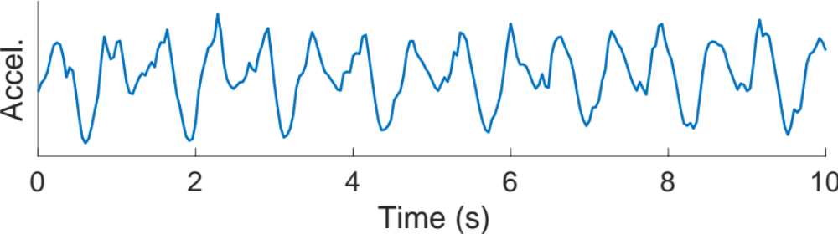
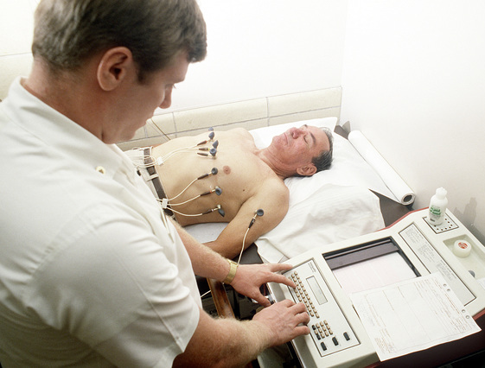
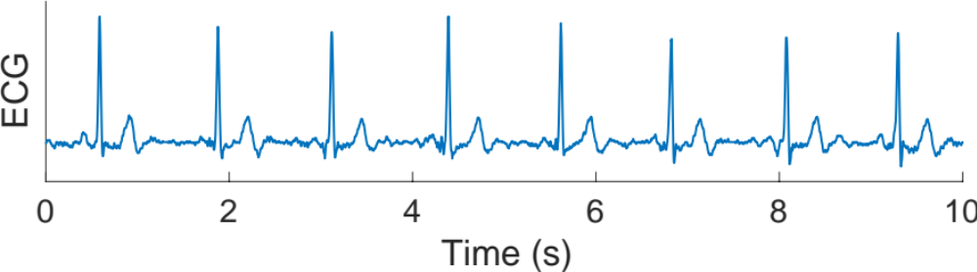
A Fitness tracker which acquires photoplethysmography (PPG) and accelerometry (Accel.) signals
Pulse waves used to:
- estimate heart rate
- identify an irregular pulse
Steps used to:
- estimate step count
Heart beats. Signal used to:
- estimate heart rate
- (potentially) diagnose
arrhythmias
A Smartwatch which acquires electrocardiography (ECG) and accelerometry (Accel.) signals
Peter H Charlton, https://doi.org/10.5281/zenodo.798234 (CC BY 4.0)
Source: NARA & DVIDS Public Domain Archive
Notes:
… Firstly, [click] electrocardiogram monitoring (or ECG for short). …
﻿The ECG is a measure of the electrical current generated by the heart each heartbeat [click]. It is acquired by measuring the voltage difference between two points on the body surface over time [click]. Traditionally, it has been measured on the chest, close to the heart. Recently, chest-patch devices have been developed which measure the ECG between two electrodes in close proximity. In addition, wrist-worn devices [click] have been developed which can measure the ECG between opposite arms. The ECG can be used to diagnose a range of heart conditions.
Secondly, photoplethysmography [click] (or PPG for short). The PPG is a measure of changes in blood volume over time in a bed of tissue. It is usually acquired by illuminating the skin with an LED, and measuring the intensity of light either transmitted through or reflected from the skin. The PPG is widely measured by pulse oximeters at the finger, but many wearables [click] now measure it at the wrist. The PPG is used in wearables primarily for heart rate monitoring [click], but can also be used to assess oxygen saturation and several other parameters.
Thirdly, accelerometers [click] are used to detect and quantify movements. Accelerometers measure acceleration and are widely incorporated into wearables as they are cheap and consumer little power. Accelerometry can be used to count steps [click], identify falls, and as a reference motion signal with which to either identify or remove the effects of motion from other signals.
The functionality of wearables is mainly determined by their sensor technologies, and the algorithms used to derive parameters from the sensor signals.
… This table [click] summarises the functionality of a few selected consumer wearables. …

Slide 21
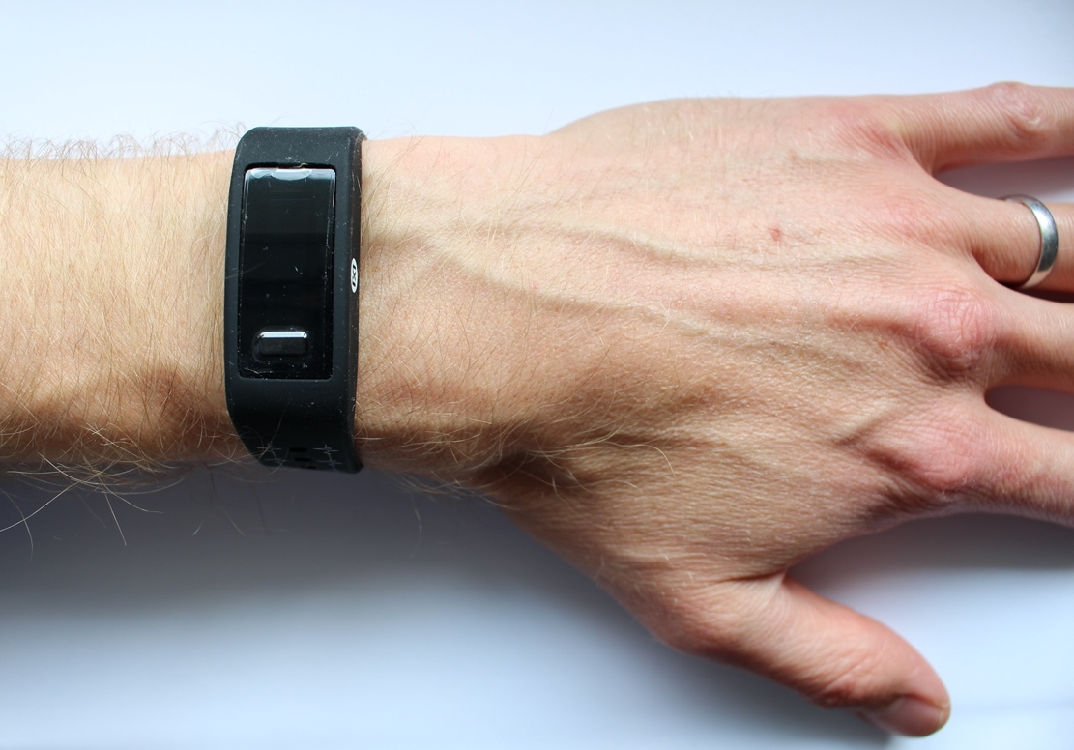
The Photoplethysmogram
Photoplethysmogram (PPG) Sensor
Wrist cross-section
Notes:
If you have a fitness tracker or smart watch you may have seen sensors on its underside, perhaps emitting red or green light. These are PPG sensors. I’ll use a cross-section [click] of the wrist to illustrate how a PPG signal is generated and captured. In this example a [click] green LED is used to illuminate the wrist. Some of the light is attenuated in the tissues, and some is reflected back towards the sensor. The level of reflected light is recorded by a [click] light sensor (in yellow). Here is [click] an example of the resulting PPG signal.
[click] The cross-section shows the pulsatile flow of arterial blood into the wrist with each heart beat. On the right, the signal increases and decreases with each heart beat, as the volume of arterial blood, which absorbs light, increases and decreases. This forms pulse waves – one for each heart beat.

Slide 22
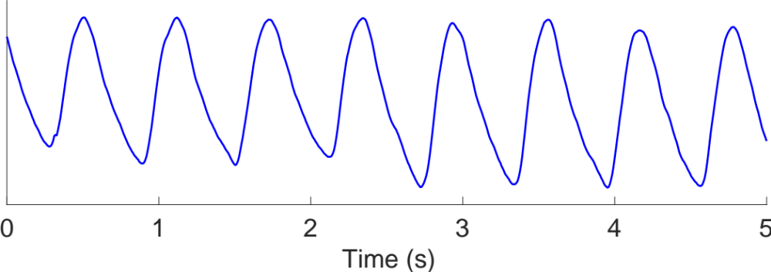
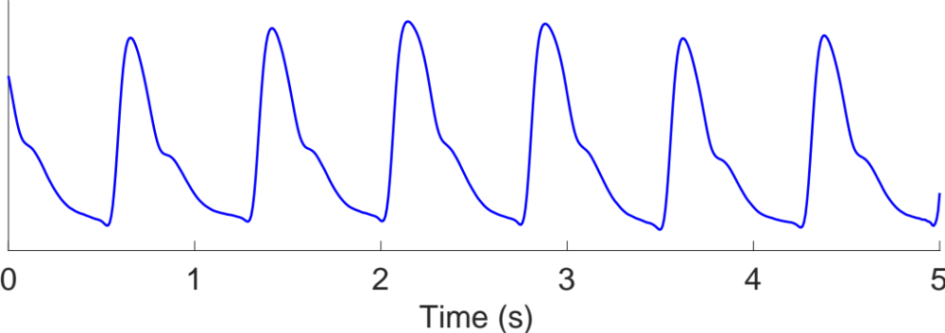
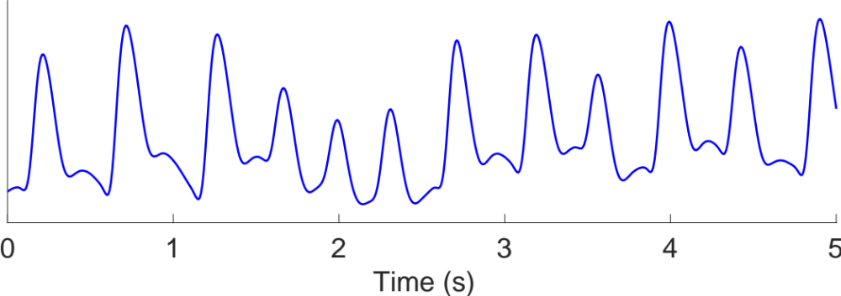
The Photoplethysmogram
Photoplethysmogram (heart rate = 100 bpm)
Slower heart rate (heart rate = 80 bpm)
Photoplethysmogram (PPG) Sensor
Atrial fibrillation (heart rate = 140 bpm)
Wrist cross-section
Notes:
[click] Heart rate: 100 bpm
[click] Heart rate: 60 bpm
[click] irregular rhythm
[click] irregular intervals
[click] varying pulse amplitudes
If you have a fitness tracker or smart watch you may have seen sensors on its underside, perhaps emitting red or green light. These are PPG sensors. I’ll use a cross-section [click] of the wrist to illustrate how a PPG signal is generated and captured. In this example a [click] green LED is used to illuminate the wrist. Some of the light is attenuated in the tissues, and some is reflected back towards the sensor. The level of reflected light is recorded by a [click] light sensor (in yellow). Here is [click] an example of the resulting PPG signal.
[click] The cross-section shows the pulsatile flow of arterial blood into the wrist with each heart beat. On the right, the signal increases and decreases with each heart beat, as the volume of arterial blood, which absorbs light, increases and decreases. This forms pulse waves – one for each heart beat.
[click] This PPG signal shows a heart rate of approximately 100 beats per minute. [click] Here is an example of a slower heart rate, still in sinus rhythm. Besides the heart rate, the signal is also greatly influenced by the [click] heart rhythm, since an irregular rhythm such as atrial fibrillation results in both [click] irregular beat-to-beat intervals and [click] varying pulse amplitudes. [click] Focusing in on a [click] single pulse wave [click]...

Slide 23
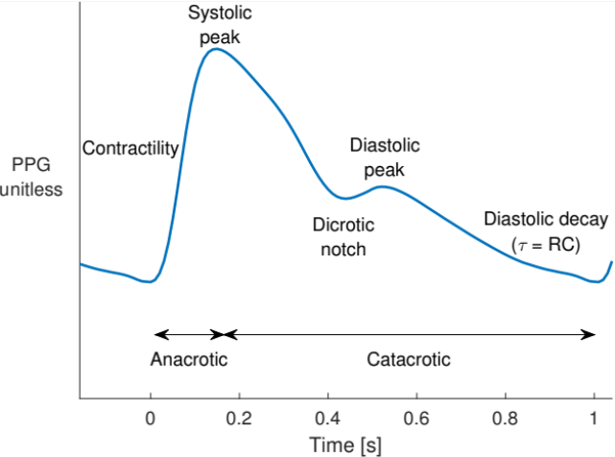
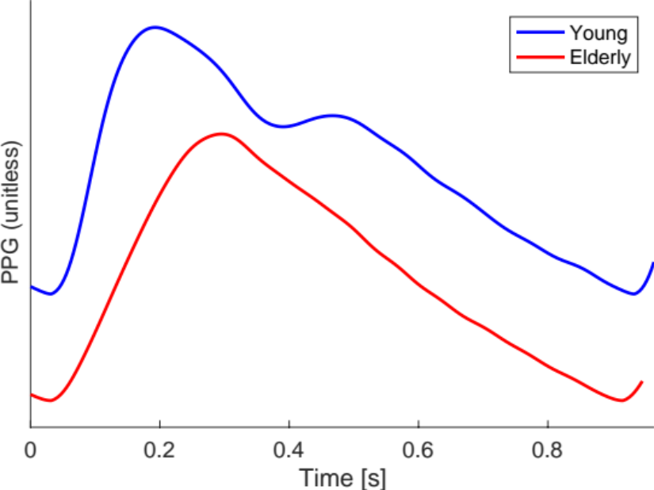
The Photoplethysmogram
Charlton PH et al., Wearable photoplethysmography for cardiovascular monitoring, Proc. IEEE, 2022. ﻿https://doi.org/10.1109/JPROC.2022.3149785 (CC BY 4.0)
Peter Charlton, PhD Thesis (CC BY 4.0)
Notes:
Features of single pulse wave
Marked changes, for instance between young and elderly individuals

Slide 24
Further Reading on Wearable Photoplethysmography
Broad overview:
Charlton P.H. et al., The 2023 wearable photoplethysmography roadmap, Phys Meas, 2023, https://doi.org/10.1088/1361-6579/acead2
Review article:
Charlton P.H. et al., Wearable Photoplethysmography for Cardiovascular Monitoring, Proc. IEEE, 2022, ﻿https://doi.org/10.1109/JPROC.2022.3149785
Textbook chapter:
Charlton P.H. and Marozas V., Wearable photoplethysmography devices, Photoplethysmography, 2021, ﻿https://doi.org/10.1016/B978-0-12-823374-0.00011-6

Slide 25
1. Introduction to wearables
2. Our contributions
3. Perspectives
Photo by Luke Chesser on Unsplash
Photo by Dario Valenzuela on Unsplash

Slide 26
If atrial fibrillation was adequately treated in England:
2,000
Lives saved p.a.
7,000
Strokes prevented
425,000
Additional diagnoses
Stroke Association, “State of the Nation,” 2017.
Public Health England, “Atrial fibrillation prevalence estimates in England …”, 2015.
Pexels, https://pixabay.com/photos/man-heartache-chest-pain-hurt-pain-1846050/ (Pixabay Licence)
Notes:
Source: https://www.stroke.org.uk/professionals/atrial-fibrillation-information-and-resources ; “It's estimated that if AF was adequately treated, around 7,000 strokes would be prevented and over 2,000 lives saved every year in England alone.”

Slide 27
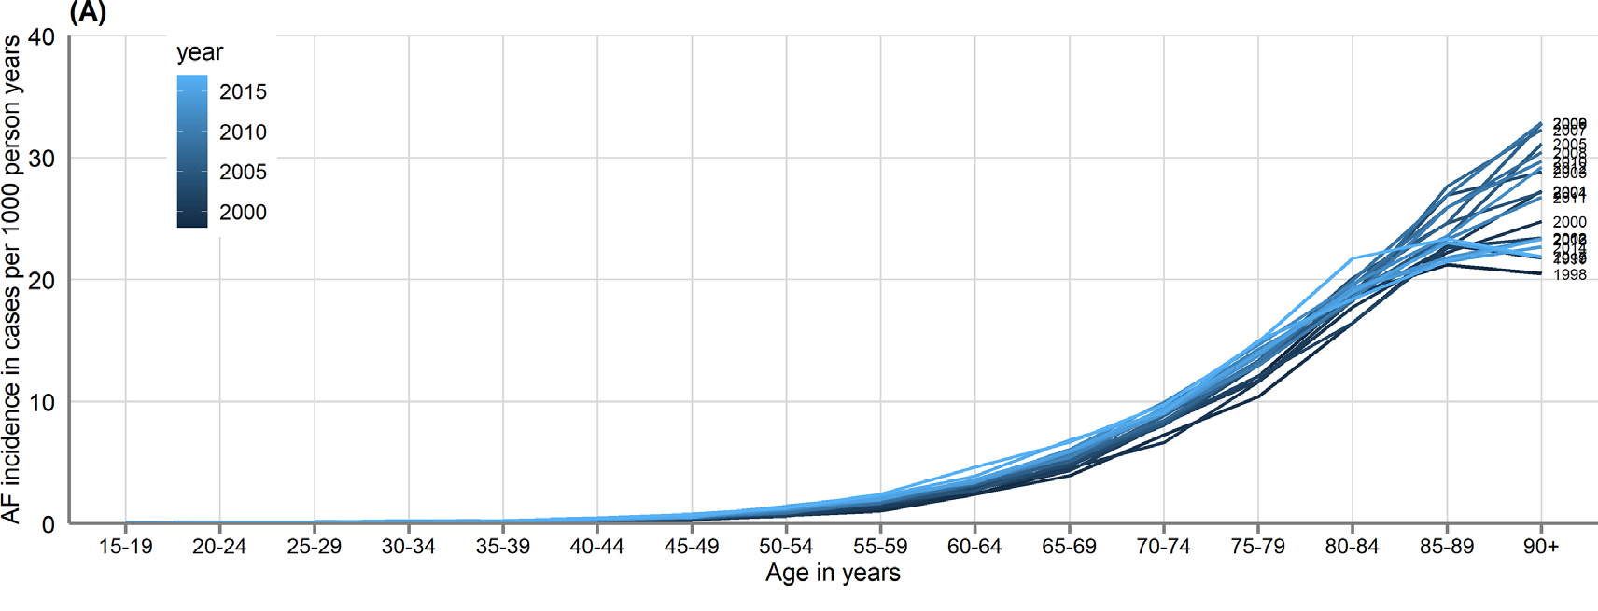
Target population and target setting
Older adults because:
AF incidence increases with age
From primary and secondary electronic health records of 3.4 million individuals in England
In daily life because:
AF can occur infrequently
Wu J et al., ‘Temporal trends and patterns in atrial fibrillation incidence: A population-based study of 3.4 million Individuals’, https://doi.org/10.1016/j.lanepe.2022.100395 (CC BY 4.0)
Notes:
NICE (2021) recommends offering anticoagulation “to people with atrial fibrillation and a CHA2DS2‑VASc score of 2 or above” (i.e. after detecting AF, all women ≥ 65 years, and all men ≥ 75 years).

Slide 28
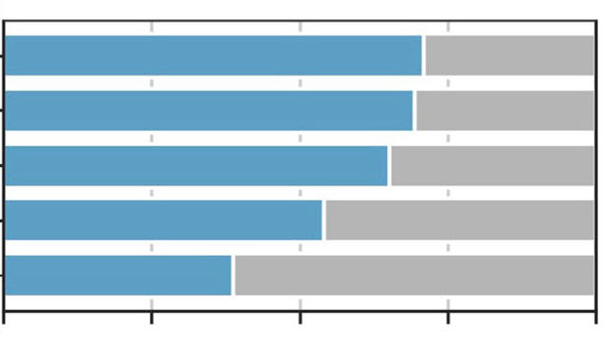
Smartwatch ownership
Not everyone has a smartwatch, particularly older adults
An electronic survey of 1,368 patient advisory group members:
18-25
26-41
Age
42-57
58-76
77+
0
25
50
75
100
Ownership Percentage (%)
Shandhi MH et al., ‘Assessment of ownership of smart devices and the acceptability of digital health data sharing’, https://doi.org/10.1038/s41746-024-01030-x (CC BY 4.0)

Slide 29

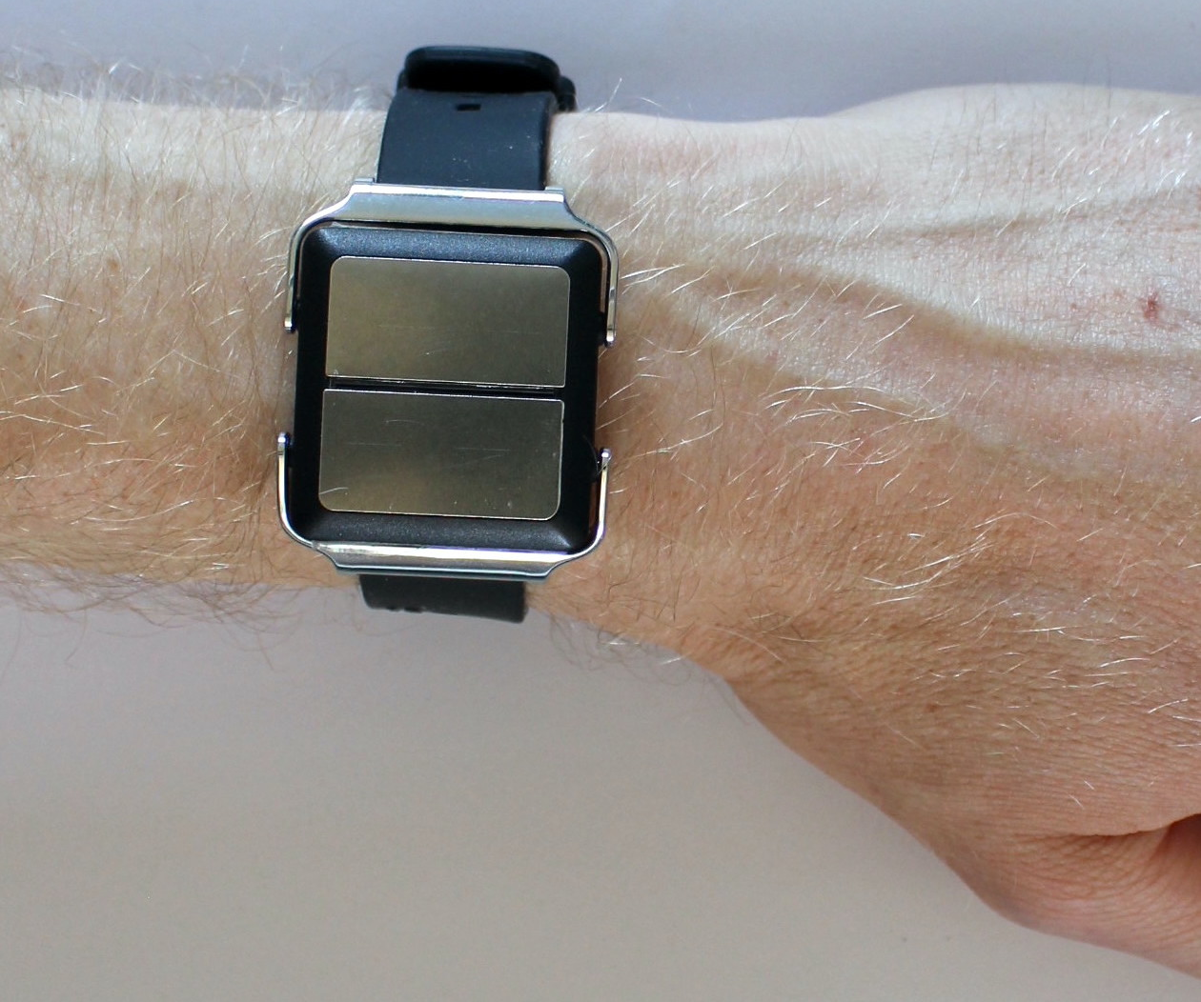

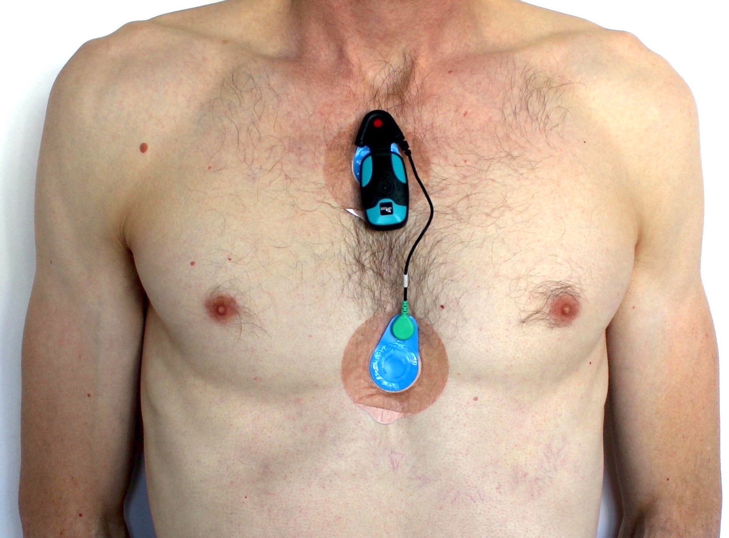
Aim: Assess performance and acceptability of wearables for detecting atrial fibrillation (AF)
Methods:
In 130 older adults, aged 65+, half of whom have AF
Two wrist-worn devices: smartwatch, wristband
Reference ECG chest patch
Questionnaire
Progress:
21 out of 130 participants to date.
The SAFER Wearables Study, NCT04715555

Slide 30
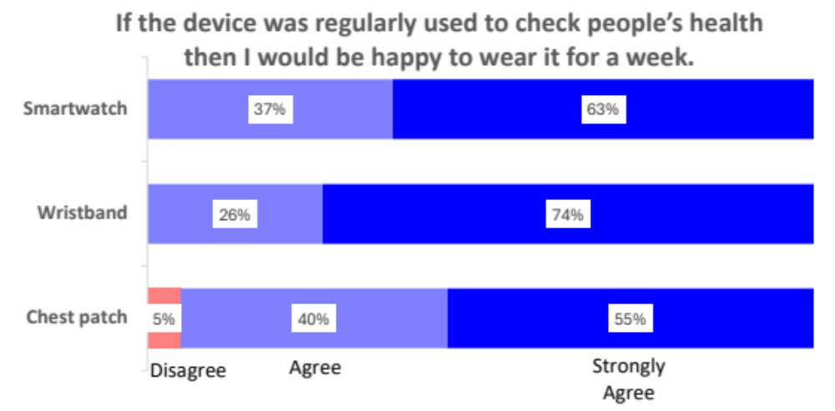
The SAFER Wearables Study, NCT04715555

Slide 31
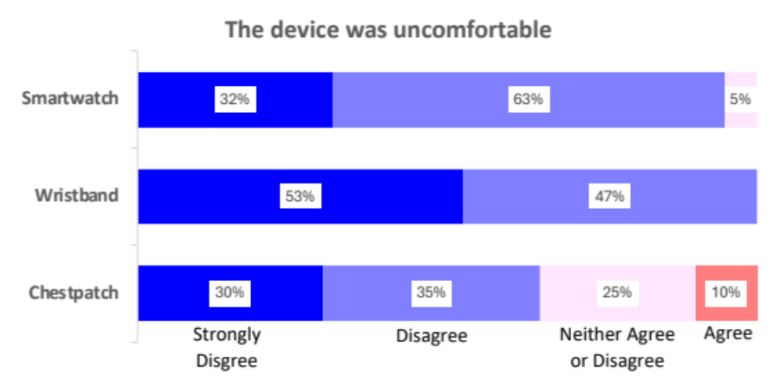
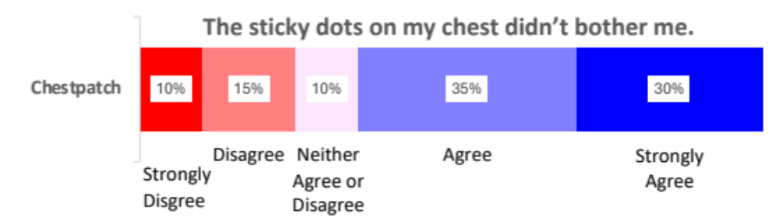
“looked as though I'd been attacked with an octopus with a round ring”
"I forget that's there”
The SAFER Wearables Study, NCT04715555

Slide 32
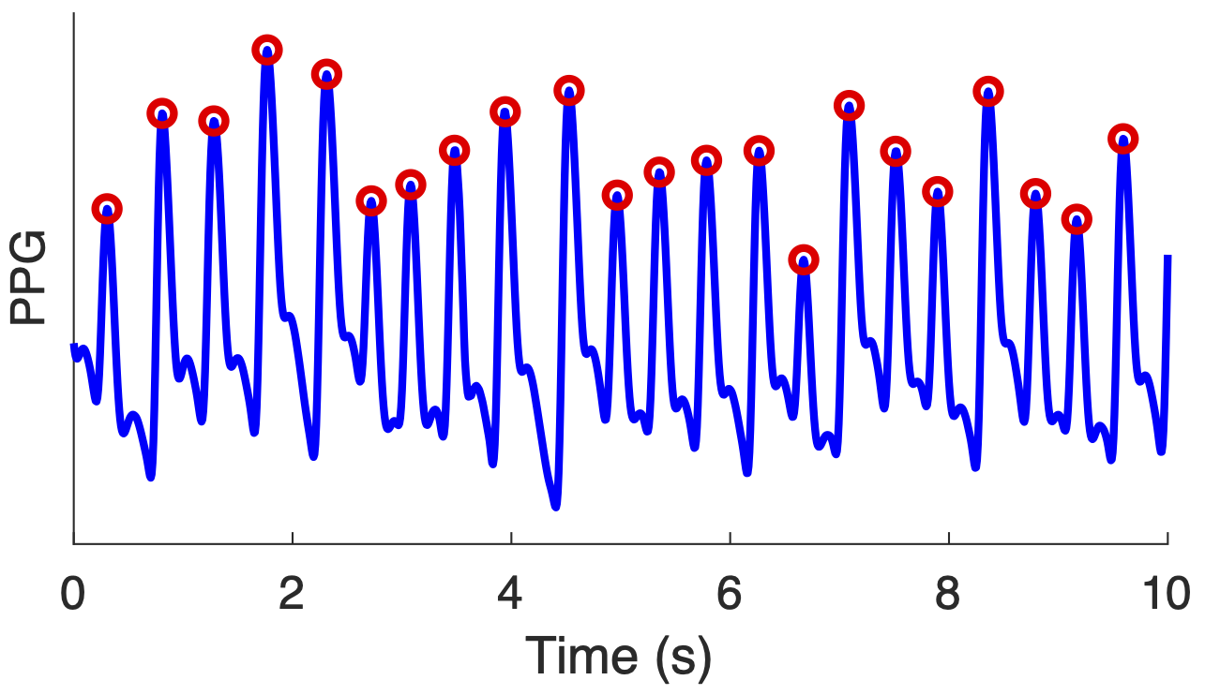
Benchmarking photoplethysmogram beat detectors
Aim: To identify the best algorithm to detect heart beats in photoplethysmography signals.
Methods:
Fifteen open-source beat detection algorithms
Assessed against electrocardiogram-derived heartbeats
On eight datasets.
Charlton PH et al., Detecting beats in the photoplethysmogram: benchmarking open-source algorithms, Phys Meas., 2022. https://doi.org/10.1088/1361-6579/ac826d (CC BY 4.0)

Slide 33
Benchmarking photoplethysmogram beat detectors
Charlton PH et al., Detecting beats in the photoplethysmogram: benchmarking open-source algorithms, Phys Meas., 2022. https://doi.org/10.1088/1361-6579/ac826d (CC BY 4.0)

Slide 34
Benchmarking photoplethysmogram beat detectors
Eight beat detectors performed well at rest in the absence of movement
F1 scores of >=90% on hospital data and wearable data
Charlton PH et al., Detecting beats in the photoplethysmogram: benchmarking open-source algorithms, Phys Meas., 2022. https://doi.org/10.1088/1361-6579/ac826d (CC BY 4.0)

Slide 35
Benchmarking photoplethysmogram beat detectors
Eight beat detectors performed well at rest in the absence of movement
F1 scores of >=90% on hospital data and wearable data
Their performance was poorer during exercise:
F1 scores of 55%–91%
Charlton PH et al., Detecting beats in the photoplethysmogram: benchmarking open-source algorithms, Phys Meas., 2022. https://doi.org/10.1088/1361-6579/ac826d (CC BY 4.0)

Slide 36
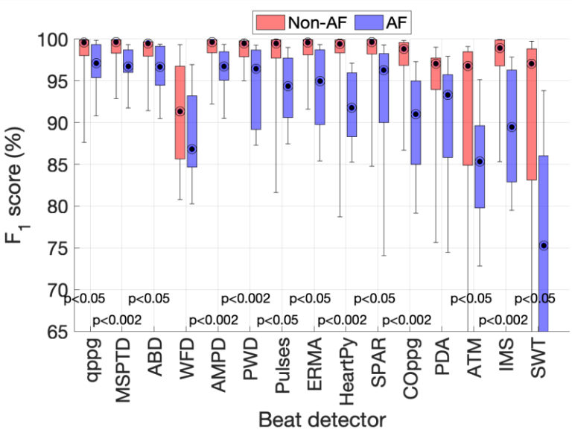
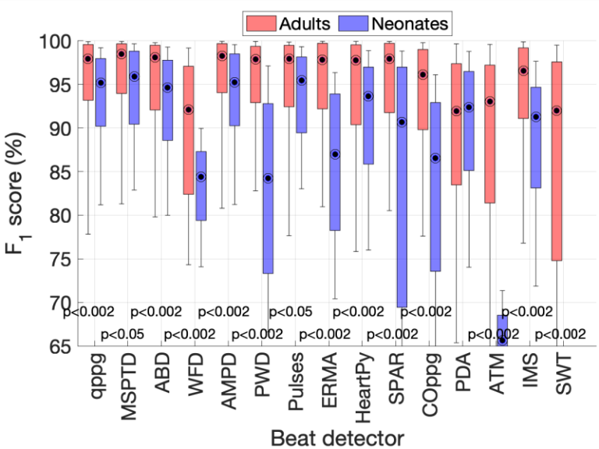
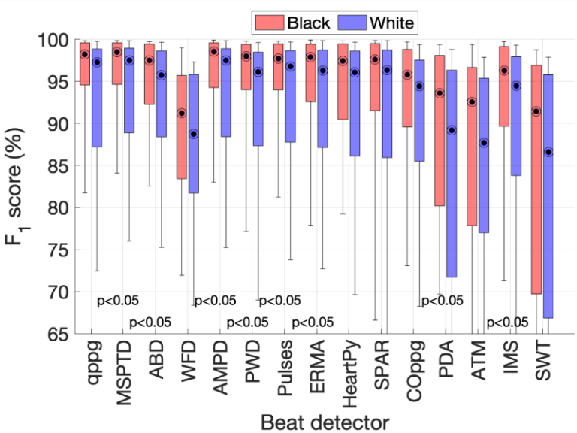
Benchmarking photoplethysmogram beat detectors
Eight beat detectors performed well at rest in the absence of movement
F1 scores of >=90% on hospital data and wearable data
Their performance was poorer during exercise:
F1 scores of 55%–91%
Performance was:
Poorer in AF
Poorer in neonates than adults
Not associated with ethnicity (Black compared with White)
Concluded that ‘MSPTD’ and ‘qppg’ performed best, although this is somewhat subjective.
Charlton PH et al., Detecting beats in the photoplethysmogram: benchmarking open-source algorithms, Phys Meas., 2022. https://doi.org/10.1088/1361-6579/ac826d (CC BY 4.0)

Slide 37
Using photoplethysmography to prompt single-lead ECG
Photo by Luke Chesser on Unsplash

Slide 38
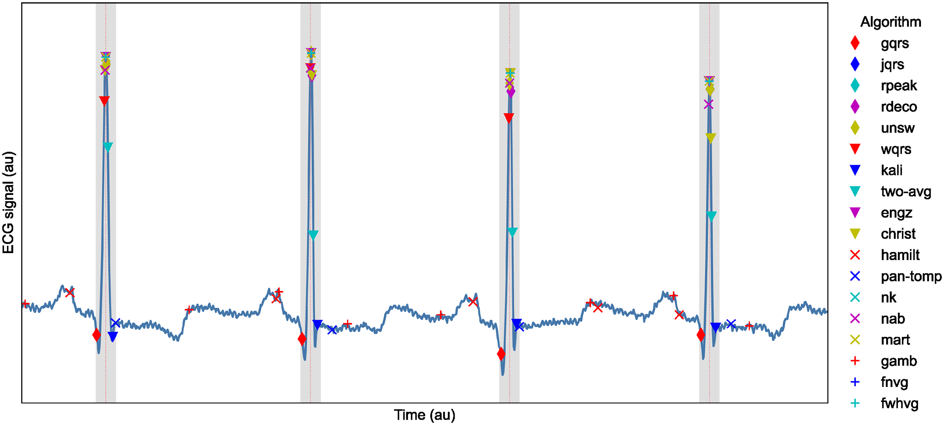
Benchmarking ECG beat detectors
Aim: To identify the best-performing open-source QRS detector for use with telehealth ECGs
Methods:
18 open-source beat detection algorithms
Assessed against manual annotations
On six datasets.
Performance expressed as F1-score (ranges from 0 to 1, with 1 being best).
Kristof F et al., QRS detection in single-lead, telehealth electrocardiogram signals: Benchmarking open-source algorithms, PLOS Digital Health, 2024. https://doi.org/10.1371/journal.pdig.0000538 (CC BY 4.0)

Slide 39
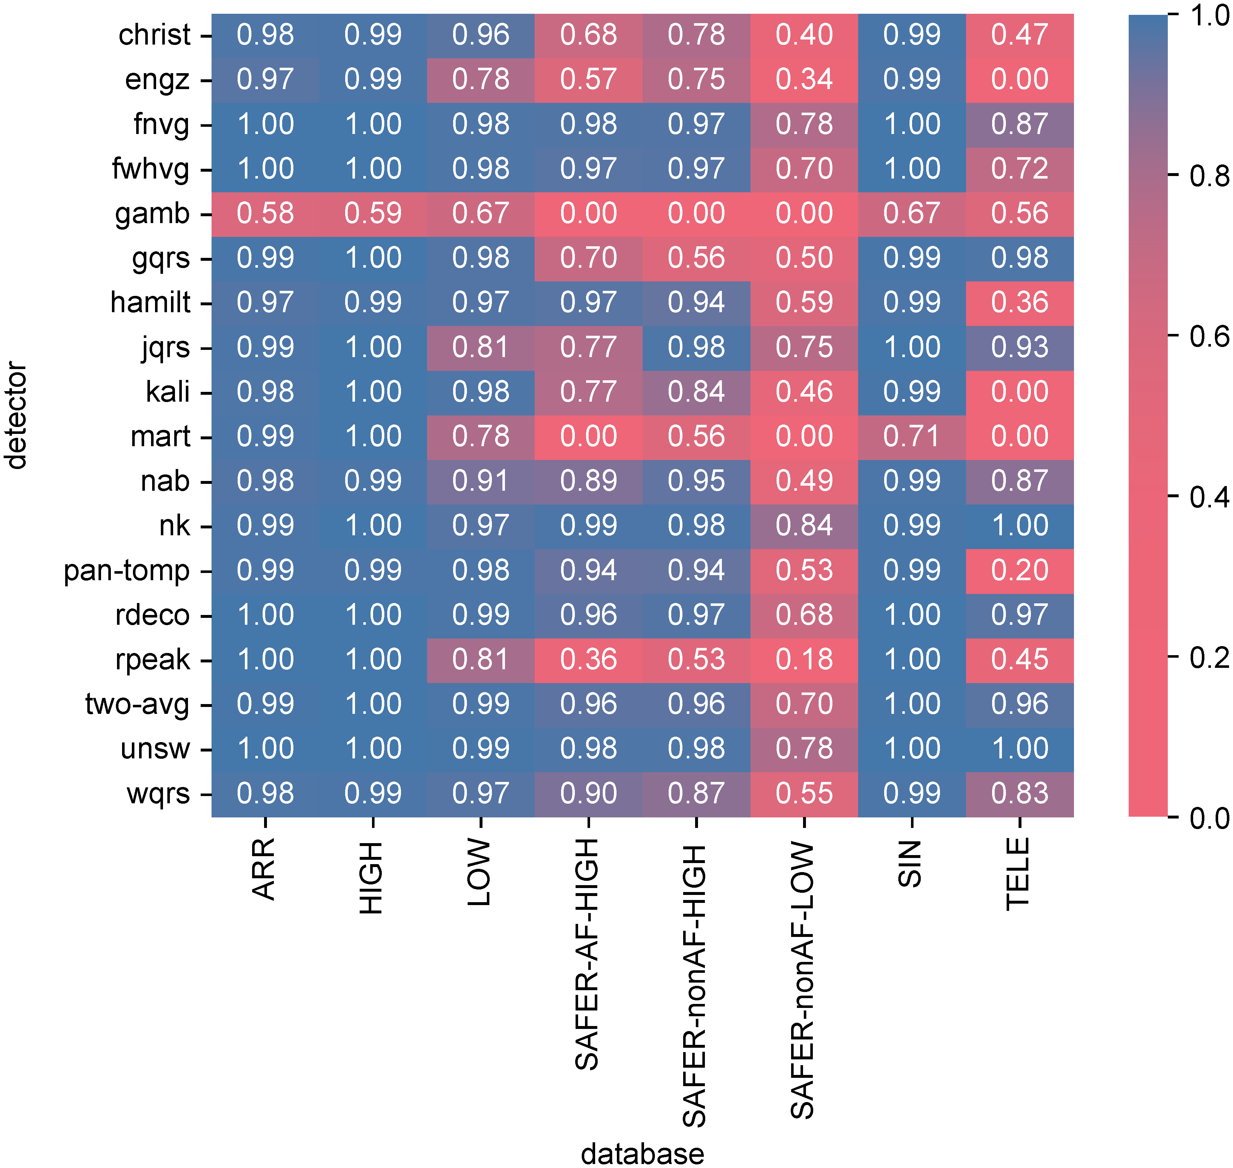
Benchmarking ECG beat detectors
Results:
Using ‘F1 score ≥0.96’ as the criteria for determining whether an algorithm performed well:
12 algorithms performed well on ECGs collected under clinical supervision.
Fewer performed well on telehealth ECGs:
  Five performed well on the TELE dataset
  Six performed well on high-quality SAFER data
  Performance was poorer on low-quality SAFER data.
Kristof F et al., QRS detection in single-lead, telehealth electrocardiogram signals: Benchmarking open-source algorithms, PLOS Digital Health, 2024. https://doi.org/10.1371/journal.pdig.0000538 (CC BY 4.0)

Slide 40
Respiratory rate (RR)
(breaths per minute)
Elevated RR
associated with:
Abnormal
24
20
Diagnosis of COVID-19
Intensive care admission with COVID-19
Normal
Death in hospital with COVID-19
12
9
Abnormal
kalhh, Pixabay, https://pixabay.com/illustrations/upper-body-lung-copd-disease-944557/
Royal College of Physicians, ‘National Early Warning Score (NEWS) 2: Standardising the assessment of acute-illness severity in the NHS’, 2017
DOI: 10.1016/S2589-7500(20)30274-0 ; ﻿DOI: 10.1001/jama.2020.6775
DOI: 10.1002/emp2.12350
DOI: ﻿10.1017/ice.2020.461
Notes:
RR, the number of breaths taken in a minute, is used in a range of clinical settings for diagnosis and prognosis. [click] Normal RRs lie between 12 and 20 breaths per minute. [click] Elevated RRs have been found to be associated with: [click] COVID-19 diagnosis; [click] admission to intensive care with COVID-19 [click]; and death in hospital with COVID-19. Consequently, it may be helpful to monitor RR to tackle COVID-19.

Slide 41
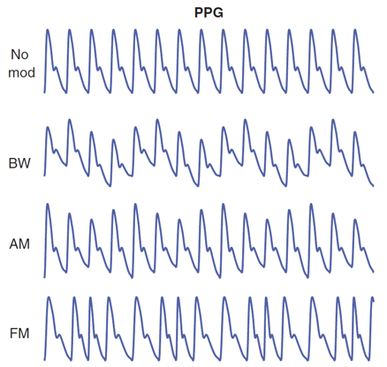
Structure of Algorithms
Extraction of Respiratory Signals
RR Estimation
Fusion of RR Estimates
RR
ECG or PPG
PPG
No mod
BW
AM
FM

Slide 42
Structure of Algorithms
Extraction of Respiratory Signals
RR Estimation
Fusion of RR Estimates
RR
ECG or PPG
PPG
No mod
BW
Identify fiducial points
AM
FM

Slide 43
Structure of Algorithms
Extraction of Respiratory Signals
RR Estimation
Fusion of RR Estimates
RR
ECG or PPG
PPG
No mod
Find baseline
BW
AM
FM

Slide 44
Structure of Algorithms
Extraction of Respiratory Signals
RR Estimation
Fusion of RR Estimates
RR
ECG or PPG
PPG
No mod
Find baseline
BW
AM
FM

Slide 45
Structure of Algorithms
Extraction of Respiratory Signals
RR Estimation
Fusion of RR Estimates
RR
ECG or PPG
PPG
No mod
BW
AM
Measure amplitudes and intervals
FM

Slide 46
Structure of Algorithms
Extraction of Respiratory Signals
RR Estimation
Fusion of RR Estimates
RR
ECG or PPG
PPG
No mod
Obtain respiratory signals
BW
AM
FM

Slide 47
Structure of Algorithms
Extraction of Respiratory Signals
RR Estimation
Fusion of RR Estimates
RR
ECG or PPG
PPG
No mod
breaths
BW
AM
FM

Slide 48
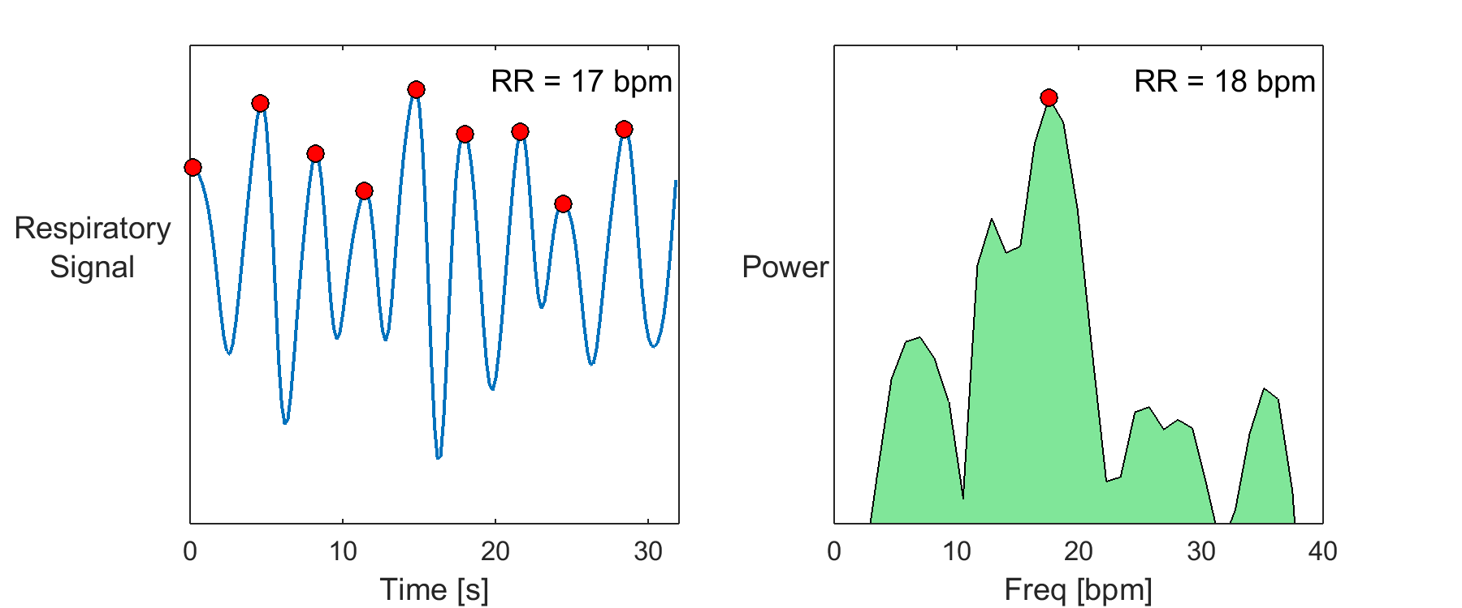
Structure of Algorithms
Extraction of Respiratory Signals
RR Estimation
Fusion of RR Estimates
RR
ECG or PPG
Source: Charlton PH. Zenodo, 2018. CC BY 4.0
Notes:
Ref = 20 bpm
Similar for step count

Slide 49
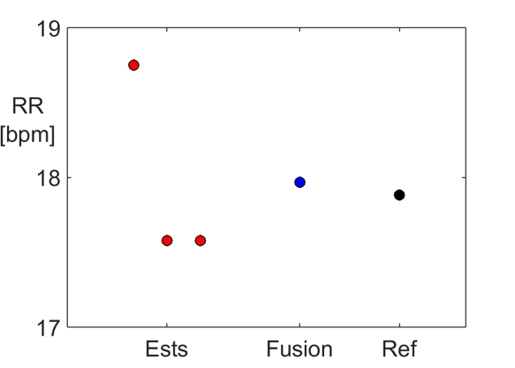
Structure of Algorithms
Extraction of Respiratory Signals
RR Estimation
Fusion of RR Estimates
RR
ECG or PPG
Source: Charlton PH. Zenodo, 2018. CC BY 4.0

Slide 50
Implementing Algorithms
Extraction of Respiratory Signals
RR Estimation
Fusion of RR Estimates
RR
ECG or PPG
BW
AM
FM
Peak amplitudes
Onset amplitudes
…
Fourier Transform
Autoregression
Peak detection
Zero-crossings
…
Smart Fusion
Temporal Fusion
…
Further reading:
Charlton PH et al., Breathing rate estimation from the electrocardiogram and photoplethysmogram: a review. IEEE Rev. Biomed. Eng. 2018, 11, 2–20. doi:10.1109/RBME.2017.2763681

Slide 51
Implementing Algorithms
Extraction of Respiratory Signals
RR Estimation
Fusion of RR Estimates
RR
ECG or PPG
BW
AM
FM
Peak amplitudes
Onset amplitudes
…
Fourier Transform
Autoregression
Peak detection
Zero-crossings
…
Smart Fusion
Temporal Fusion
…

Slide 52
Implementing Algorithms
Extraction of Respiratory Signals
RR Estimation
Fusion of RR Estimates
RR
ECG or PPG
BW
AM
FM
Peak amplitudes
Onset amplitudes
…
Fourier Transform
Autoregression
Peak detection
Zero-crossings
…
Smart Fusion
Temporal Fusion
…

Slide 53
Implementing Algorithms
Extraction of Respiratory Signals
RR Estimation
Fusion of RR Estimates
RR
ECG or PPG
BW
AM
FM
Peak amplitudes
Onset amplitudes
…
Fourier Transform
Autoregression
Peak detection
Zero-crossings
…
Smart Fusion
Temporal Fusion
…

Slide 54
Implementing Algorithms
Extraction of Respiratory Signals
RR Estimation
Fusion of RR Estimates
RR
ECG or PPG
BW
AM
FM
Peak amplitudes
Onset amplitudes
…
Fourier Transform
Autoregression
Peak detection
Zero-crossings
…
Smart Fusion
Temporal Fusion
…
14 techniques
12 techniques
5 techniques
370 algorithms

Slide 55
The winner…
Extraction of Respiratory Signals
RR Estimation
Fusion of RR Estimates
RR
ECG or PPG
BW
AM
FM
Peak amplitudes
Onset amplitudes
…
Fourier Transform
Autoregression
Peak detection
Zero-crossings
…
Smart Fusion
Temporal Fusion
…
… on young subjects
Charlton PH et al., An assessment of algorithms to estimate respiratory rate from the electrocardiogram and photoplethysmogram, Phys Meas., 2016. https://doi.org/10.1088/0967-3334/37/4/610

Slide 56
The strength of respiratory modulations
Extraction of Respiratory Signals
RR Estimation
Fusion of RR Estimates
RR
ECG or PPG
BW
AM
FM
Peak amplitudes
Onset amplitudes
…
Respiratory modulation | Strength (CC): Young adults | Strength (CC): Older adults
BW | 0.48 (0.35 − 0.56) | 0.49 (0.36 − 0.63)
AM | 0.48 (0.39 − 0.57) | 0.47 (0.35 − 0.57)
FM | 0.64 (0.50 − 0.73) | 0.38 (0.32 − 0.55)
Charlton PH et al., Extraction of respiratory signals from the electrocardiogram and photoplethysmogram: technical and physiological determinants, Phys Meas., 2017. https://doi.org/10.1088/1361-6579/aa670e

Slide 57
The (revised) winner…
Extraction of Respiratory Signals
RR Estimation
Fusion of RR Estimates
RR
ECG or PPG
BW
AM
FM
Peak amplitudes
Onset amplitudes
…
Fourier Transform
Autoregression
Peak detection
Zero-crossings
…
Smart Fusion
Temporal Fusion
…
Charlton PH, Continuous respiratory rate monitoring to detect clinical deteriorations using wearable sensors, PhD Thesis, 2017.

Slide 58
1. Introduction to wearables
2. Our contributions
3. Perspectives
Photo by Luke Chesser on Unsplash
Photo by Dario Valenzuela on Unsplash

Slide 59
Perspectives
Areas for inequity:
Many, many potential sources of inequity for wearables. See:
D. M. Kaplan, M. Greenleaf, and W. A. Lam, ‘Wear With Care: A Call for Empirical Investigations of Adverse Outcomes of Consumer Health Wearables’, Mayo Clinic Proceedings: Digital Health, vol. 1, no. 3, pp. 413–418, Sep. 2023, doi: 10.1016/j.mcpdig.2023.06.014.
Equity in academic research: Open science
In my academic role, I value sharing our work. e.g.

Slide 60
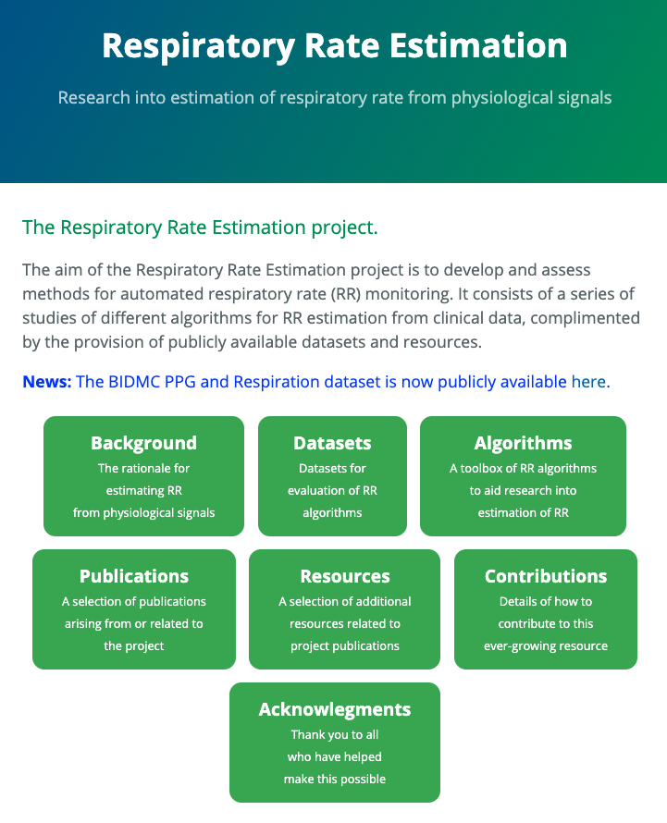
Open science
MATLAB Toolbox
Providing open-source toolboxes of algorithms
https://peterhcharlton.github.io/RRest

Slide 61
Open science
MATLAB Toolbox
Providing open-source toolboxes of algorithms
  Ease of use
https://peterhcharlton.github.io/RRest

Slide 62
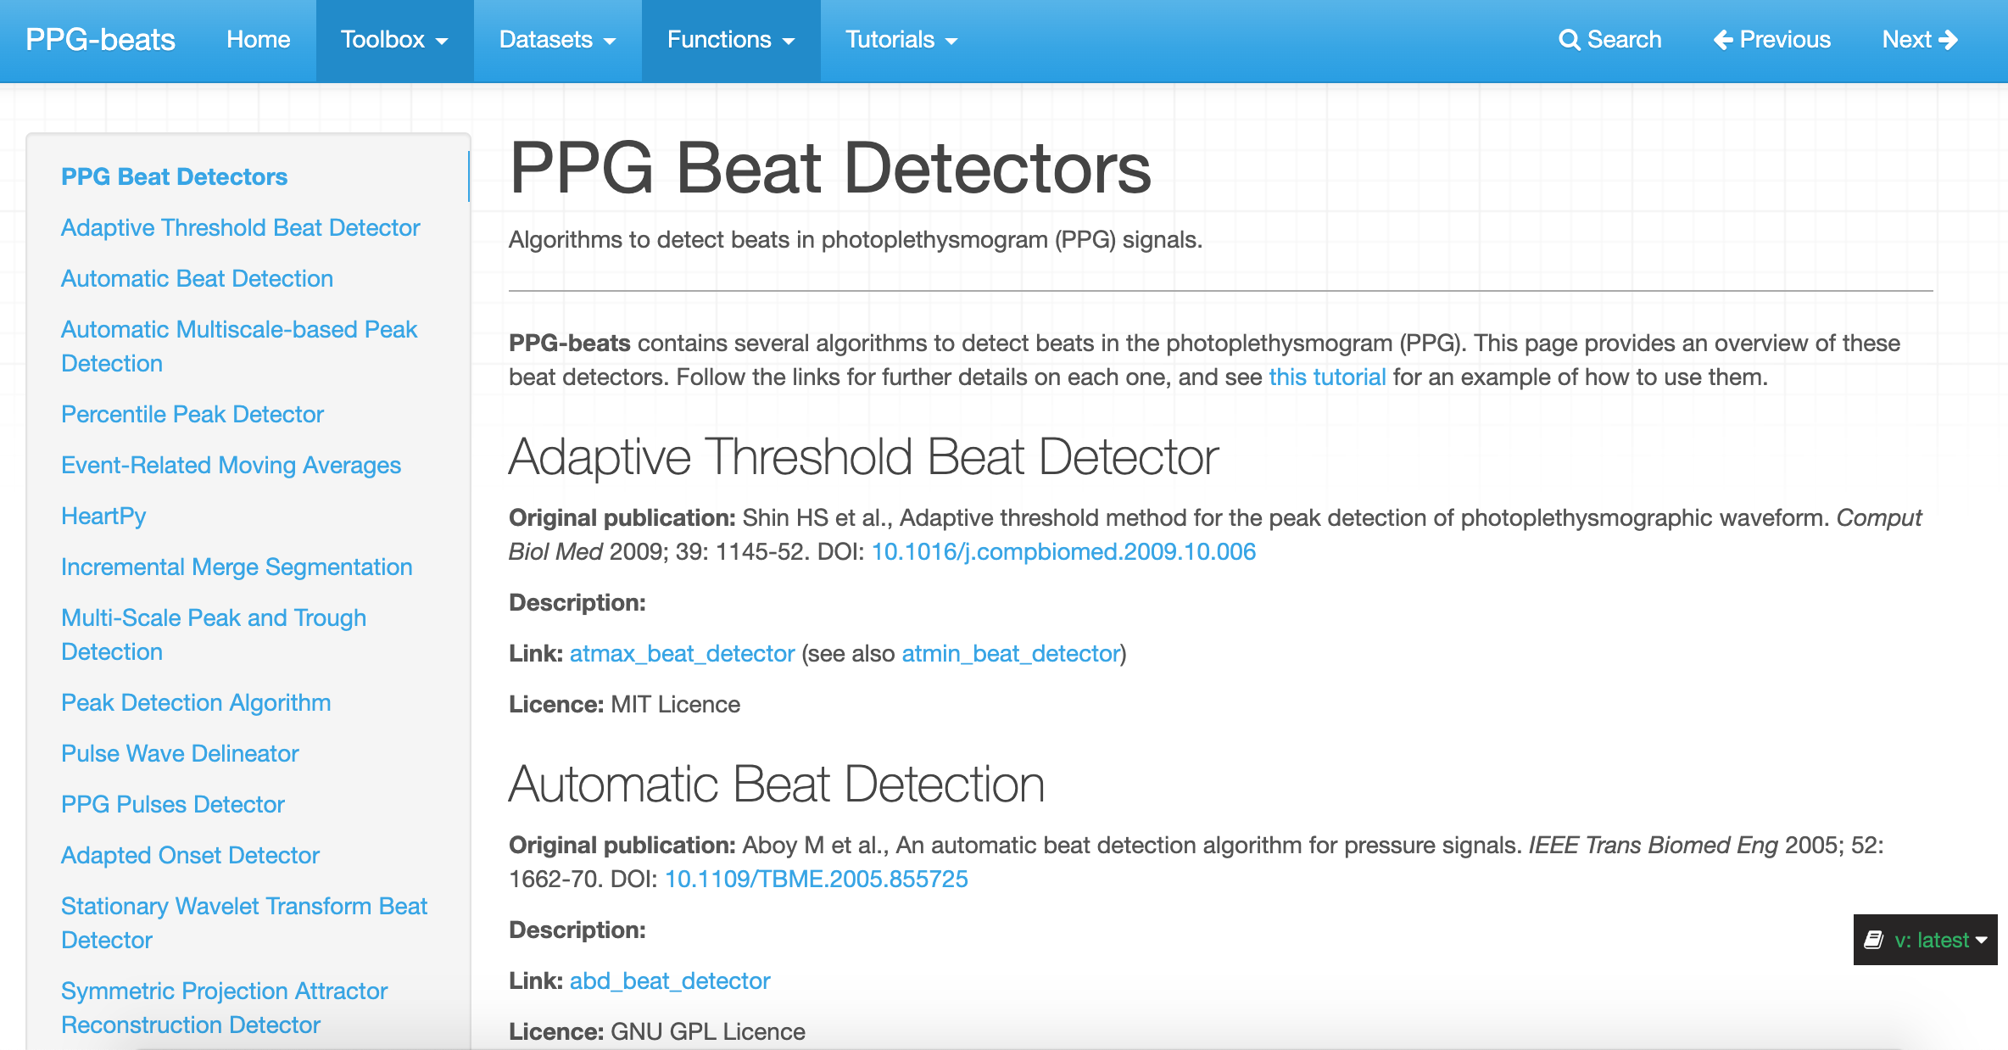
Open science
Providing open-source toolboxes of algorithms
  Ease of use
https://ppg-beats.readthedocs.io/
PPG-beats: Algorithms to detect heartbeats in photoplethysmogram (PPG) signals. https://ppg-beats.readthedocs.io/

Slide 63
Open science
Providing open-source toolboxes of algorithms
  Ease of use
  Programming language
https://ppg-beats.readthedocs.io/
PPG-beats: Algorithms to detect heartbeats in photoplethysmogram (PPG) signals. https://ppg-beats.readthedocs.io/

Slide 64
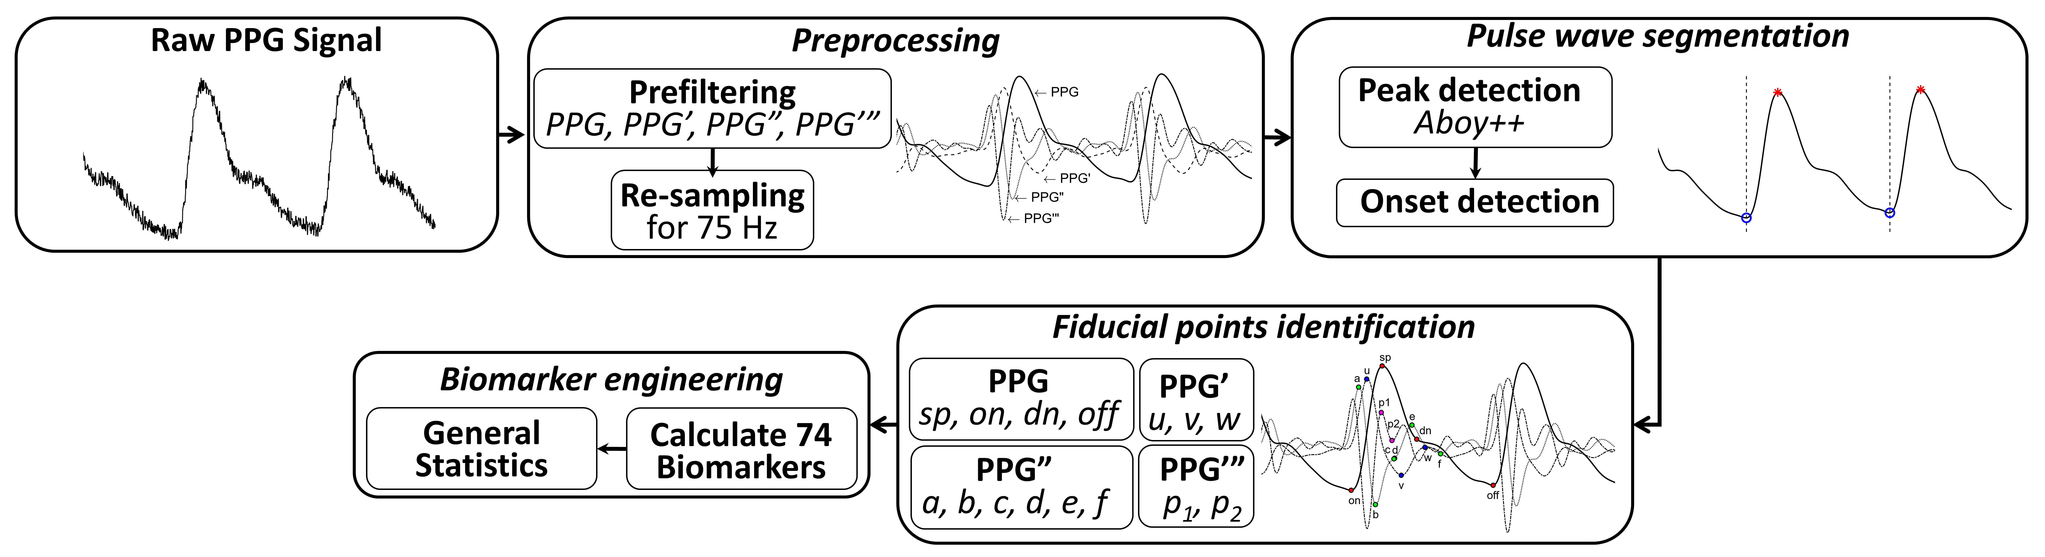
Open science
Providing open-source toolboxes of algorithms
  Ease of use
  Programming language
pyPPG toolbox
A toolbox for finger photoplethysmogram (PPG) analysis, including beat detection, fiducial point detection, and comprehensive assessment of standard biomarkers.
https://pyppg.readthedocs.io/
Goda MA et al., pyPPG: A Python toolbox for comprehensive photoplethysmography signal analysis, https://doi.org/10.1088/1361-6579/ad33a2 (CC BY 4.0)

Slide 65
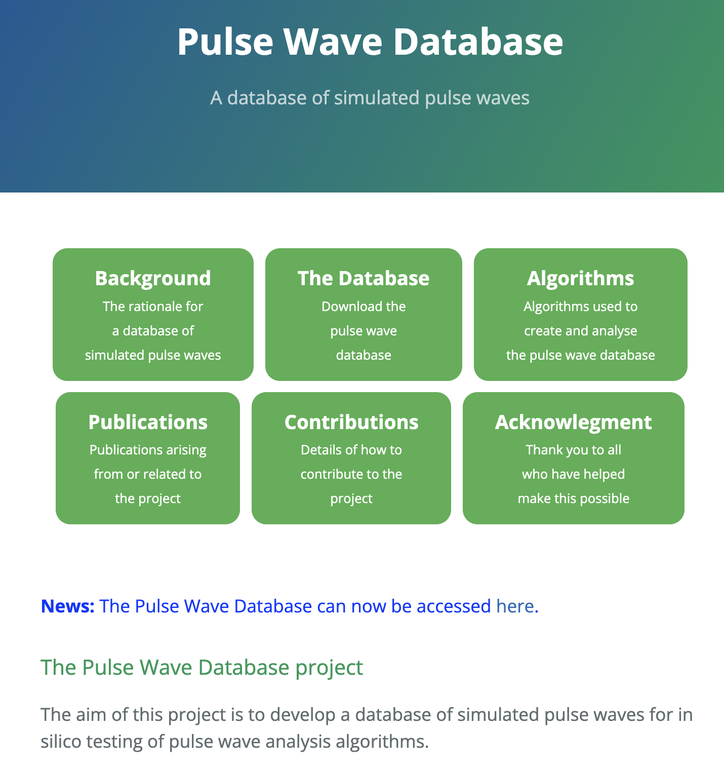
Open science
Providing open-source toolboxes of algorithms
  Ease of use
  Programming language
Providing open datasets
https://peterhcharlton.github.io/pwdb
Charlton PH et al., Modeling arterial pulse waves in healthy aging: a database for in silico evaluation of hemodynamics and pulse wave indexes, AJP Heart Circ, 2019.
https://doi.org/10.1152/ajpheart.00218.2019 (CC BY 4.0)

Slide 66

Open science
Providing open-source toolboxes of algorithms
  Ease of use
  Programming language
Providing open datasets
Reproducible research

Slide 67

Open science
Providing open-source toolboxes of algorithms
  Ease of use
  Programming language
Providing open datasets
Reproducible research
Educational resources
https://peterhcharlton.github.io/bsp-book/

Slide 68

Open science
Providing open-source toolboxes of algorithms
  Ease of use
  Programming language
Providing open datasets
Reproducible research
Educational resources
Open access publications
https://peterhcharlton.github.io

Slide 69

Open science: an example
qppg
MSPTD
Providing open-source toolboxes of algorithms
  Ease of use
  Programming language
Providing open datasets
Reproducible research
Educational resources
Open access publications
Openly available
GNU GPL Licence
Highly efficient
Openly available
MIT Licence
Less efficient
MSPTDfast
Photo by Dylan Gillis on Unsplash (Unsplash license)

Slide 70
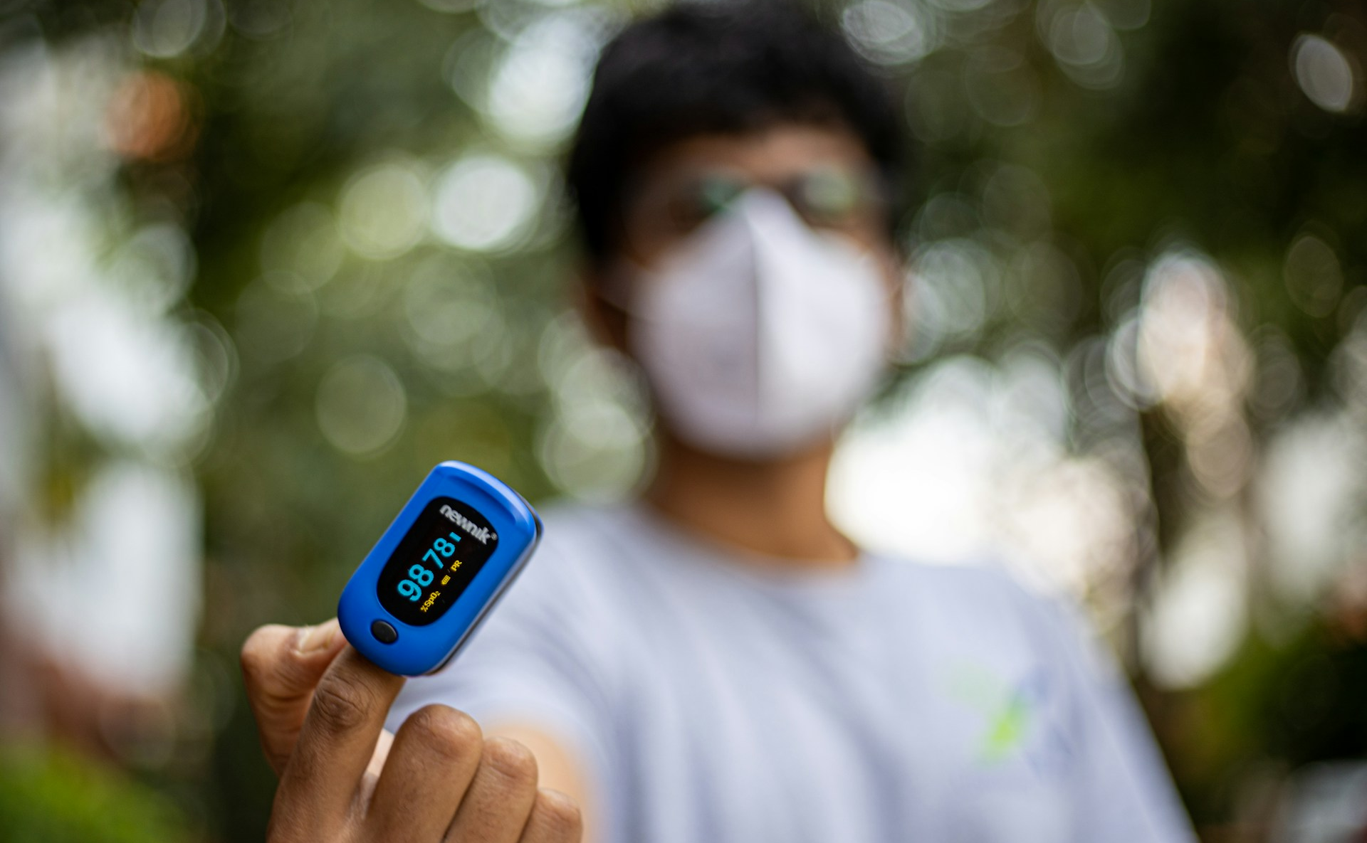

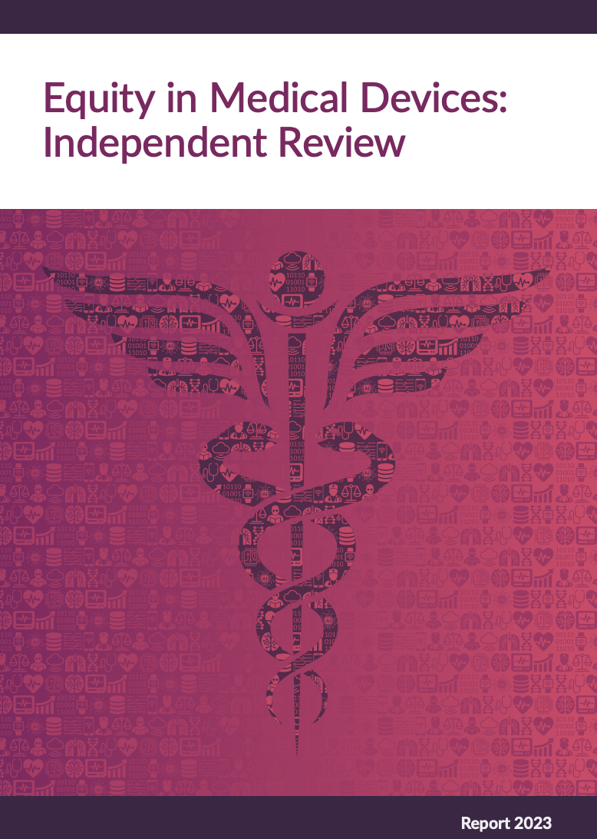
Sjoding MW et al., NEJM, 2020, https://doi.org/10.1056/NEJMc2029240
Equity in medical devices: independent review,,GOV.UK, 2024,
https://www.gov.uk/government/publications/equity-in-medical-devices-independent-review-final-report (OGL 3.0)
Photo by Syed Ali on Unsplash

Slide 71
Prof Jonathan Mant
Prof Panicos Kyriacou
The SAFER Research Team
University of Cambridge
City, University of London
King’s College London
British Heart Foundation
NIHR
EPSRC
With thanks to…
… and many, many others

Slide 72

Photoplethysmography is now widely used in wearable devices, with many potential applications.
Photoplethysmography-based wearables have shown great promise in certain applications such as detecting atrial fibrillation.
However, there is much work to do to ensure the potential benefits of photoplethysmography are available to all, making photoplethysmography-based devices as reliable as a climbing rope.
Sonia Sevilla, https://commons.wikimedia.org/wiki/File:Kamar_Zard_Buzhan_-_Nishapur_1.jpg (CC0 1.0)

Slide 73
Equitable Photoplethysmography in Wearables: Accurate Data for All
Dr Peter H. Charlton
https://peterhcharlton.github.io
pc657@cam.ac.uk
Slides available at: https://doi.org/10.5281/zenodo.13833790 (CC BY 4.0)
Photo by Luke Chesser on Unsplash

Slide 74
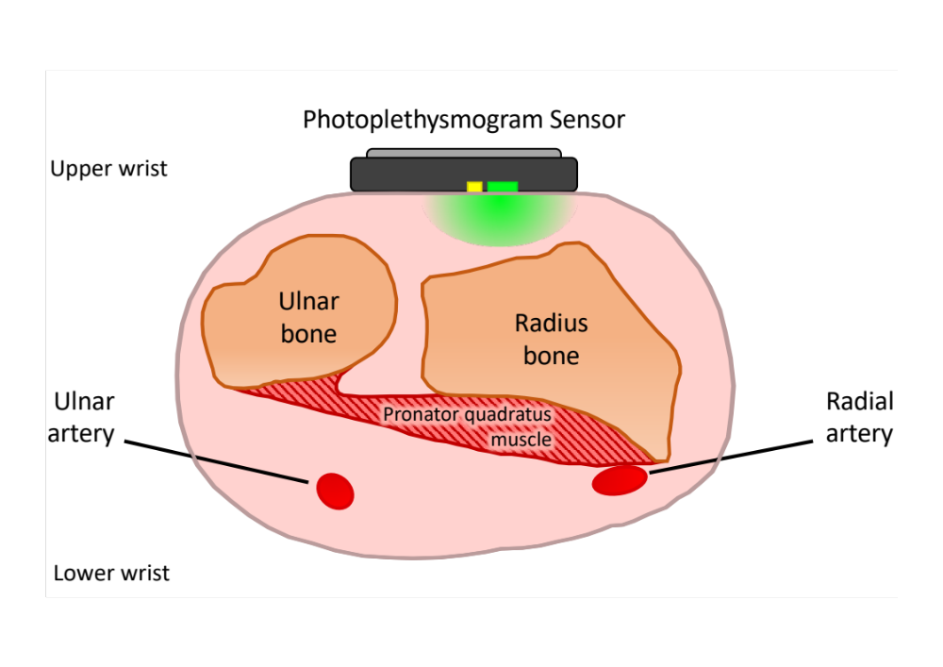
Wrist photoplethysmography: limitations
Photoplethysmogram (PPG) Sensor
Charlton PH et al., Wearable photoplethysmography for cardiovascular monitoring, Proc. IEEE, 2022. ﻿https://doi.org/10.1109/JPROC.2022.3149785 (CC BY 4.0)
Adapted from: ﻿H. Gray, Anatomy of the Human Body, W. H. Lewis, Ed., 2nd ed. New York, NY, USA: Lea and Febiger, 1918

Slide 75
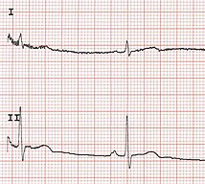
Single-lead ECG: limitations
Dry electrodes
Recorded without clinical supervision
Lead I
“Sinus P waves are usually most prominently seen in leads II and V1”
Meek S and Morris F, ‘ABC of clinical electrocardiography: Introduction. II—basic terminology’, https://doi.org/10.1136/bmj.324.7335.470
Peter Charlton, Wikimedia Commons, https://commons.wikimedia.org/wiki/File:12_lead_ECG.jpg (CC BY 4.0)

