Slide 1
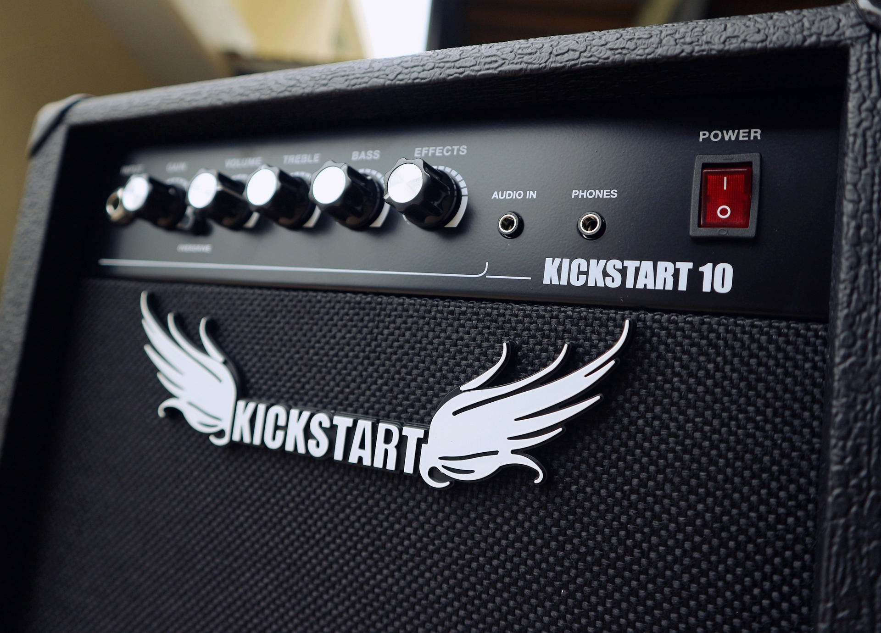

A toolkit for kickstarting a community
Reflections on building a post iPRES community of practice
Notes:
Reflections on building a local community

Slide 2
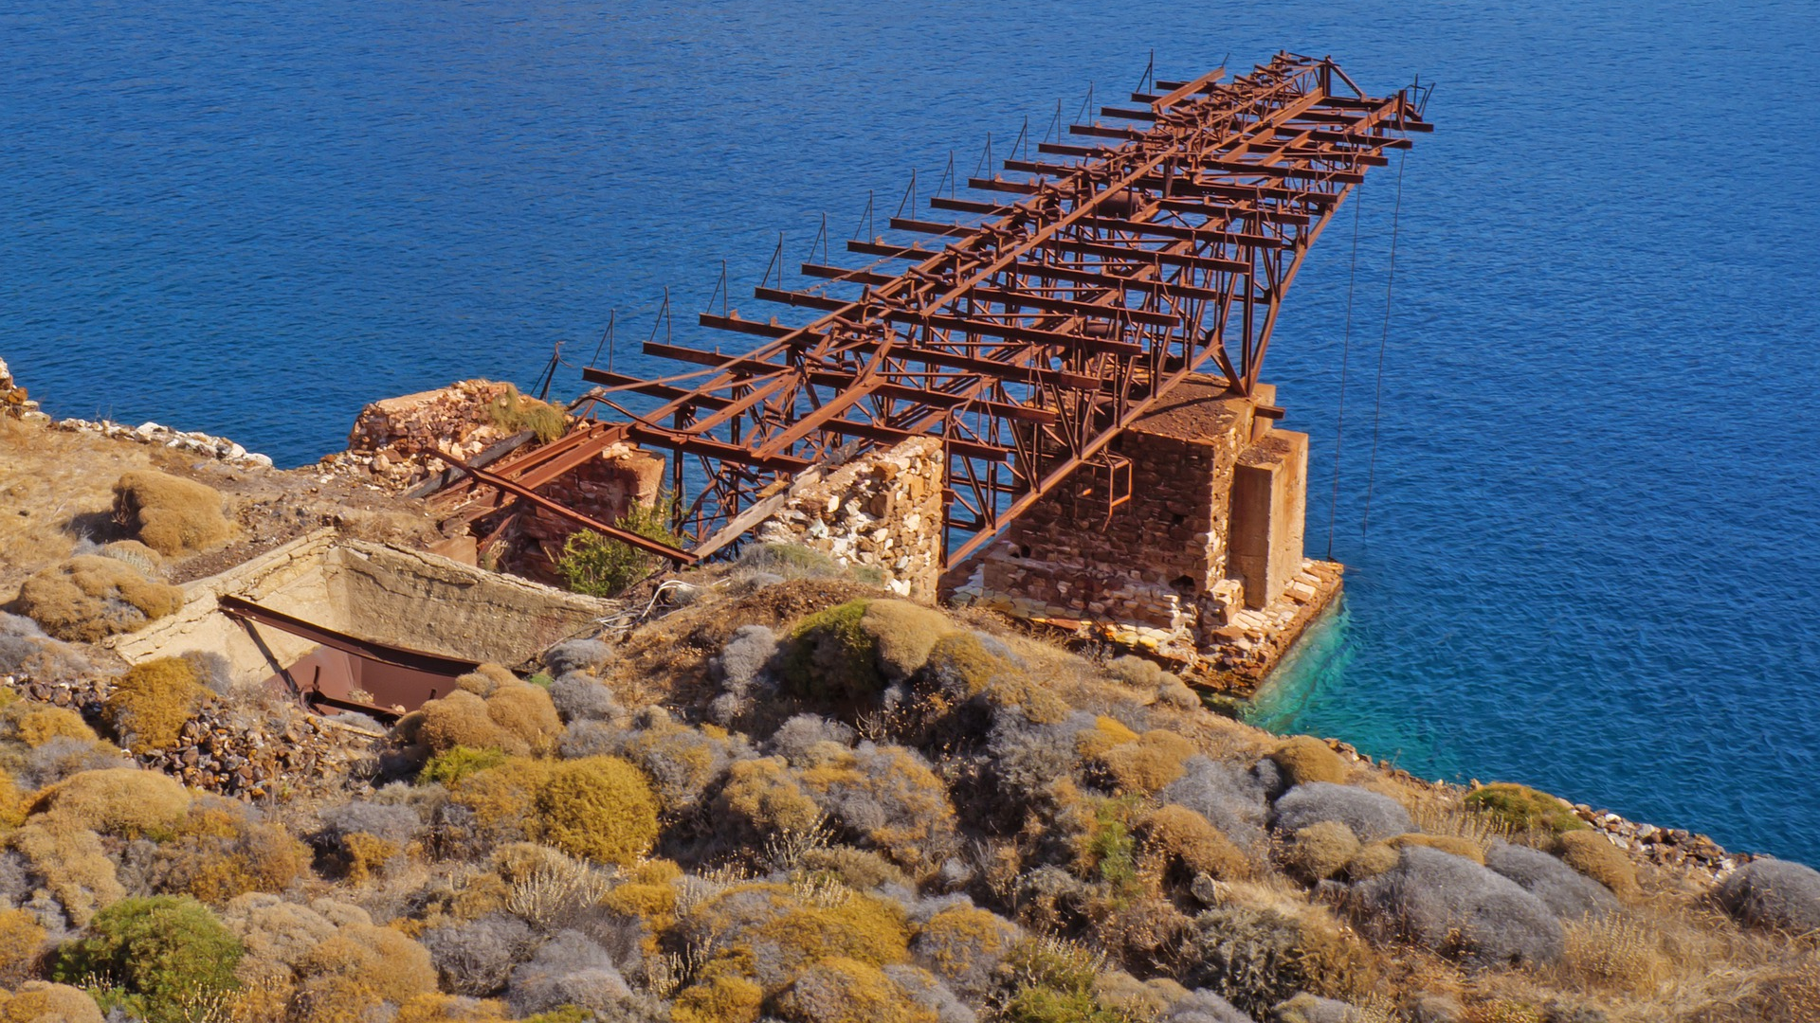
A legacy that lasts…

Slide 3
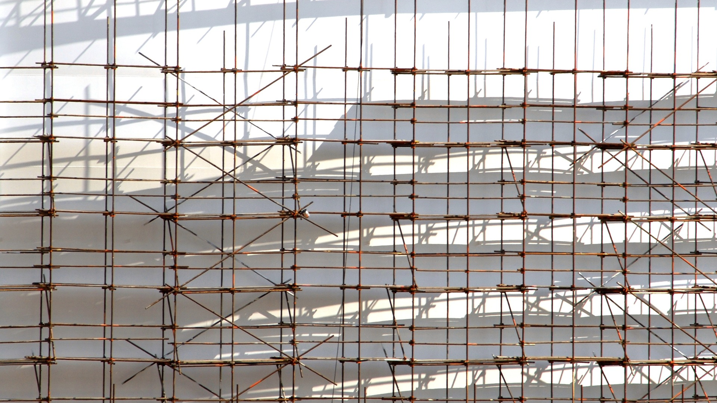
Build it and they will come…?

Slide 4
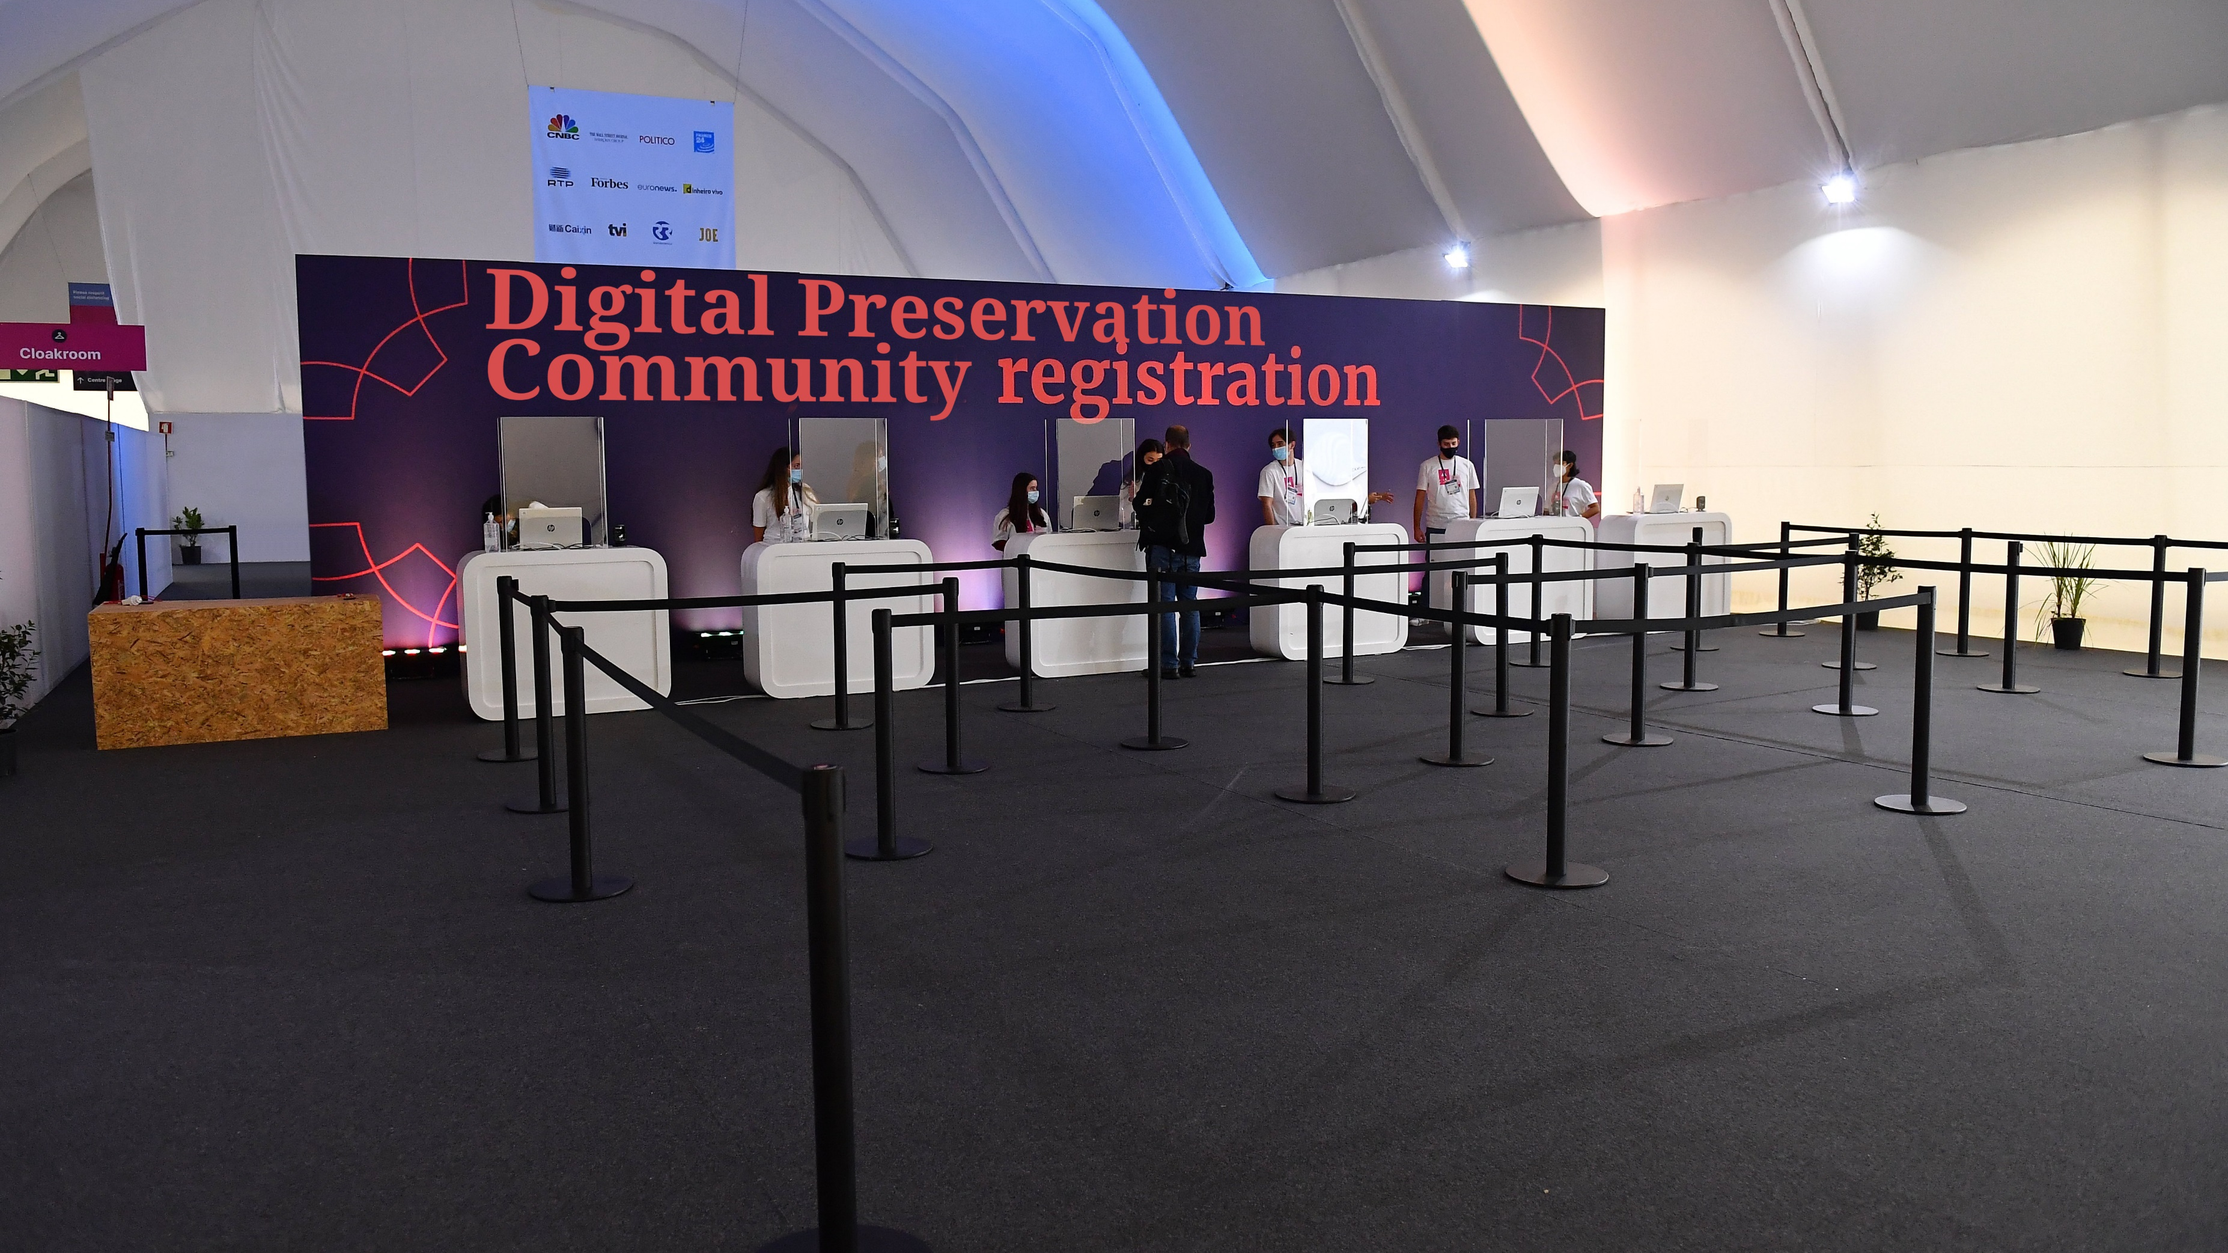
Notes:
Build it and they will come?

Slide 5

Notes:
People don’t know they have a problem. Initially, Advocacy and awareness raising are the biggest issues

Slide 6
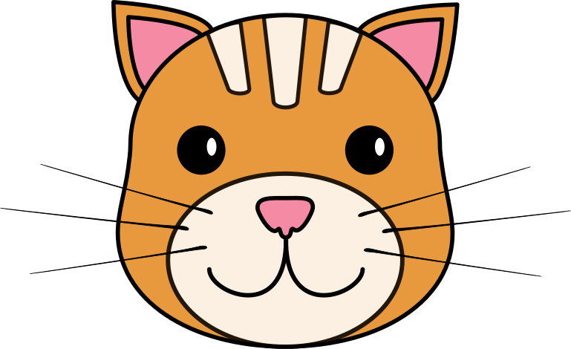

DPC RAM
DPC CAT
DPC Competency Audit Toolkit
DPC Rapid Assessment Model
Notes:
DPC Ral Excellent advocacy tool kit

Slide 7

Start 2 Preserve: Creating a Skills Development Resource
Workshop

Slide 8


Slide 9
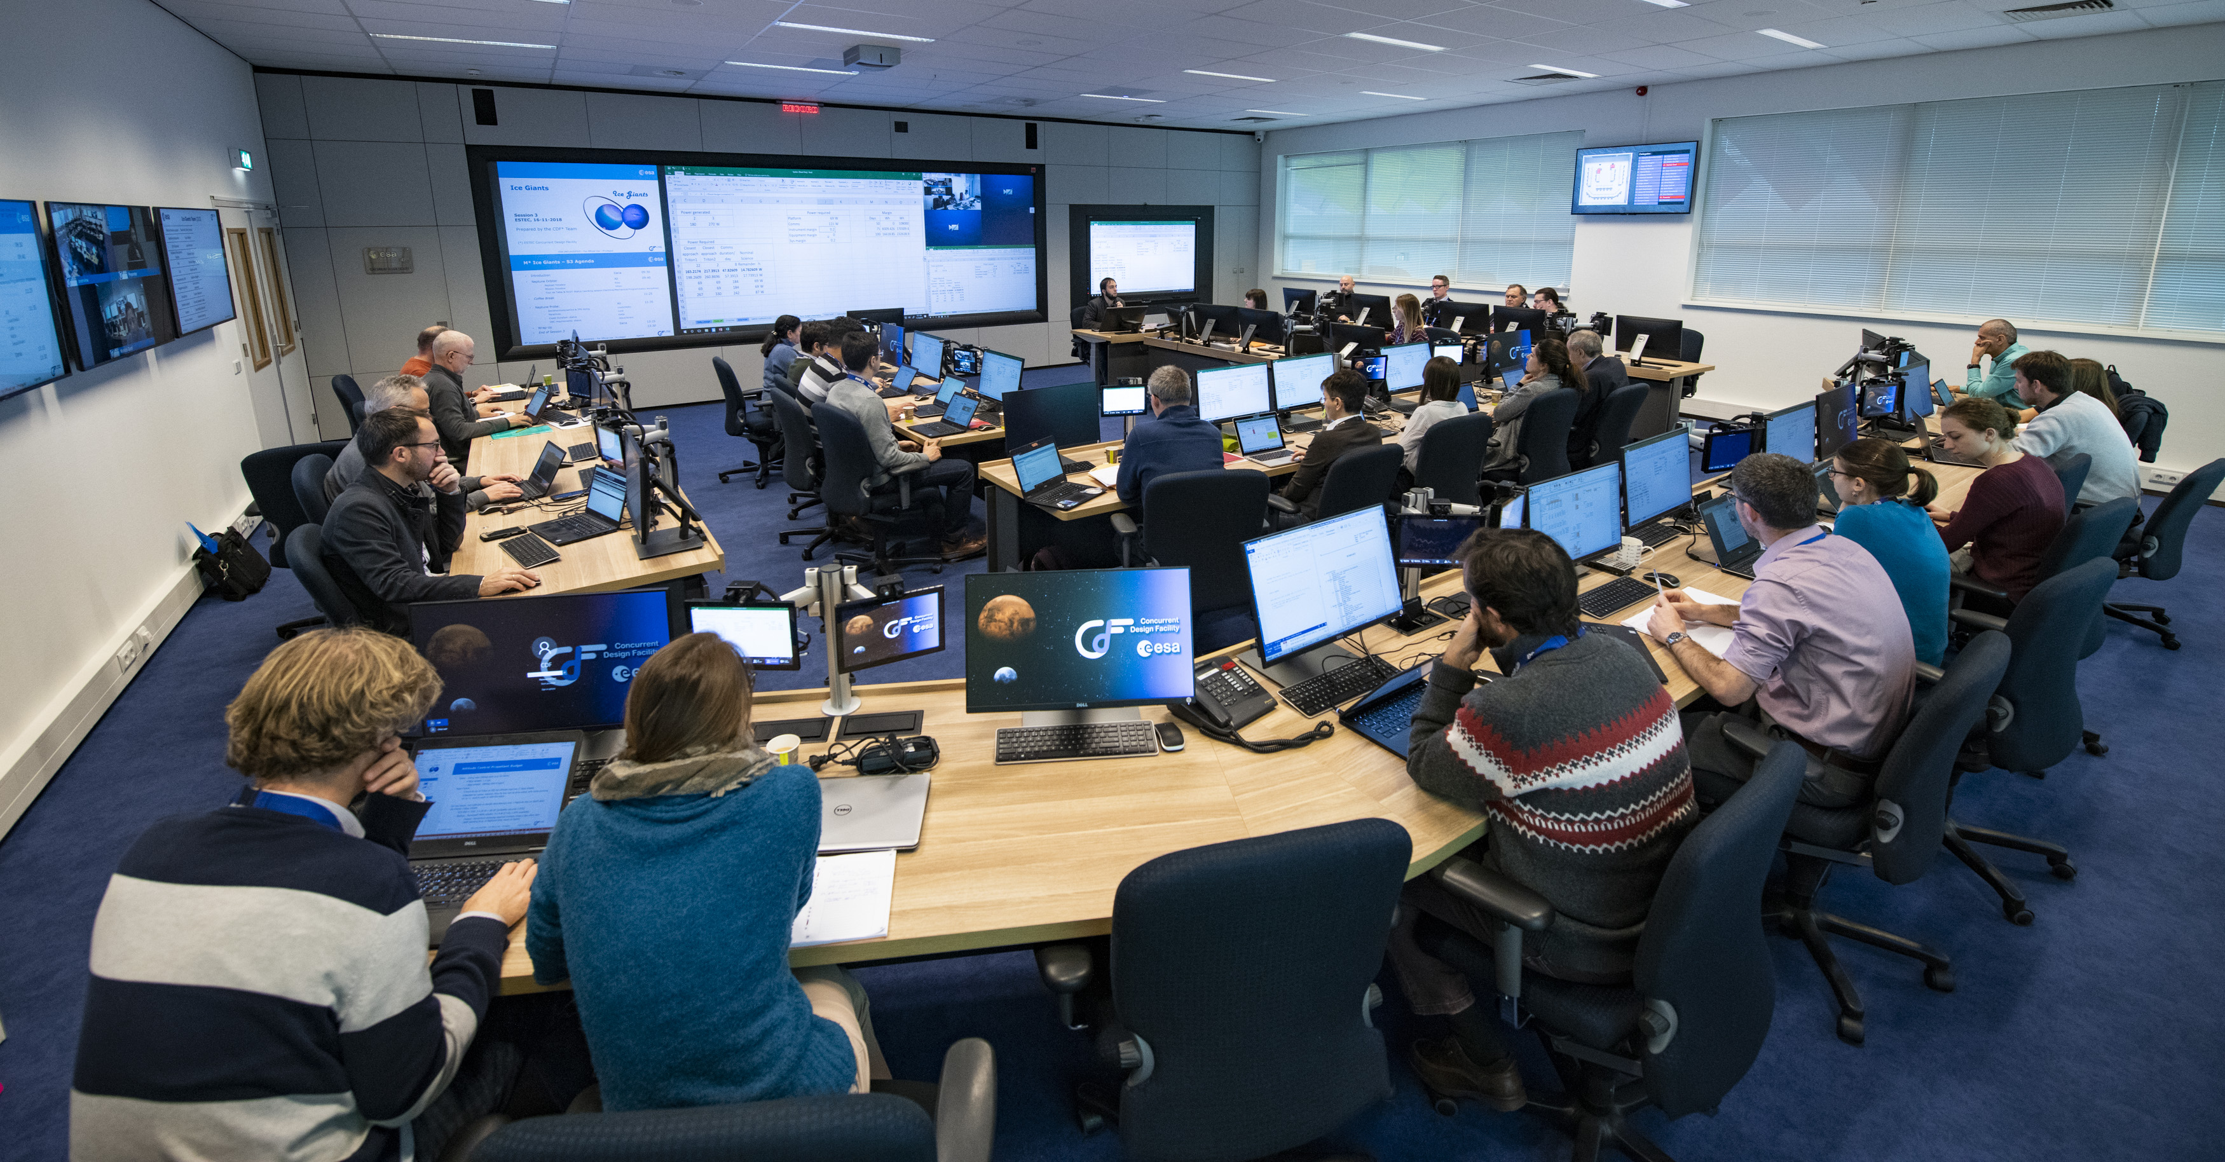
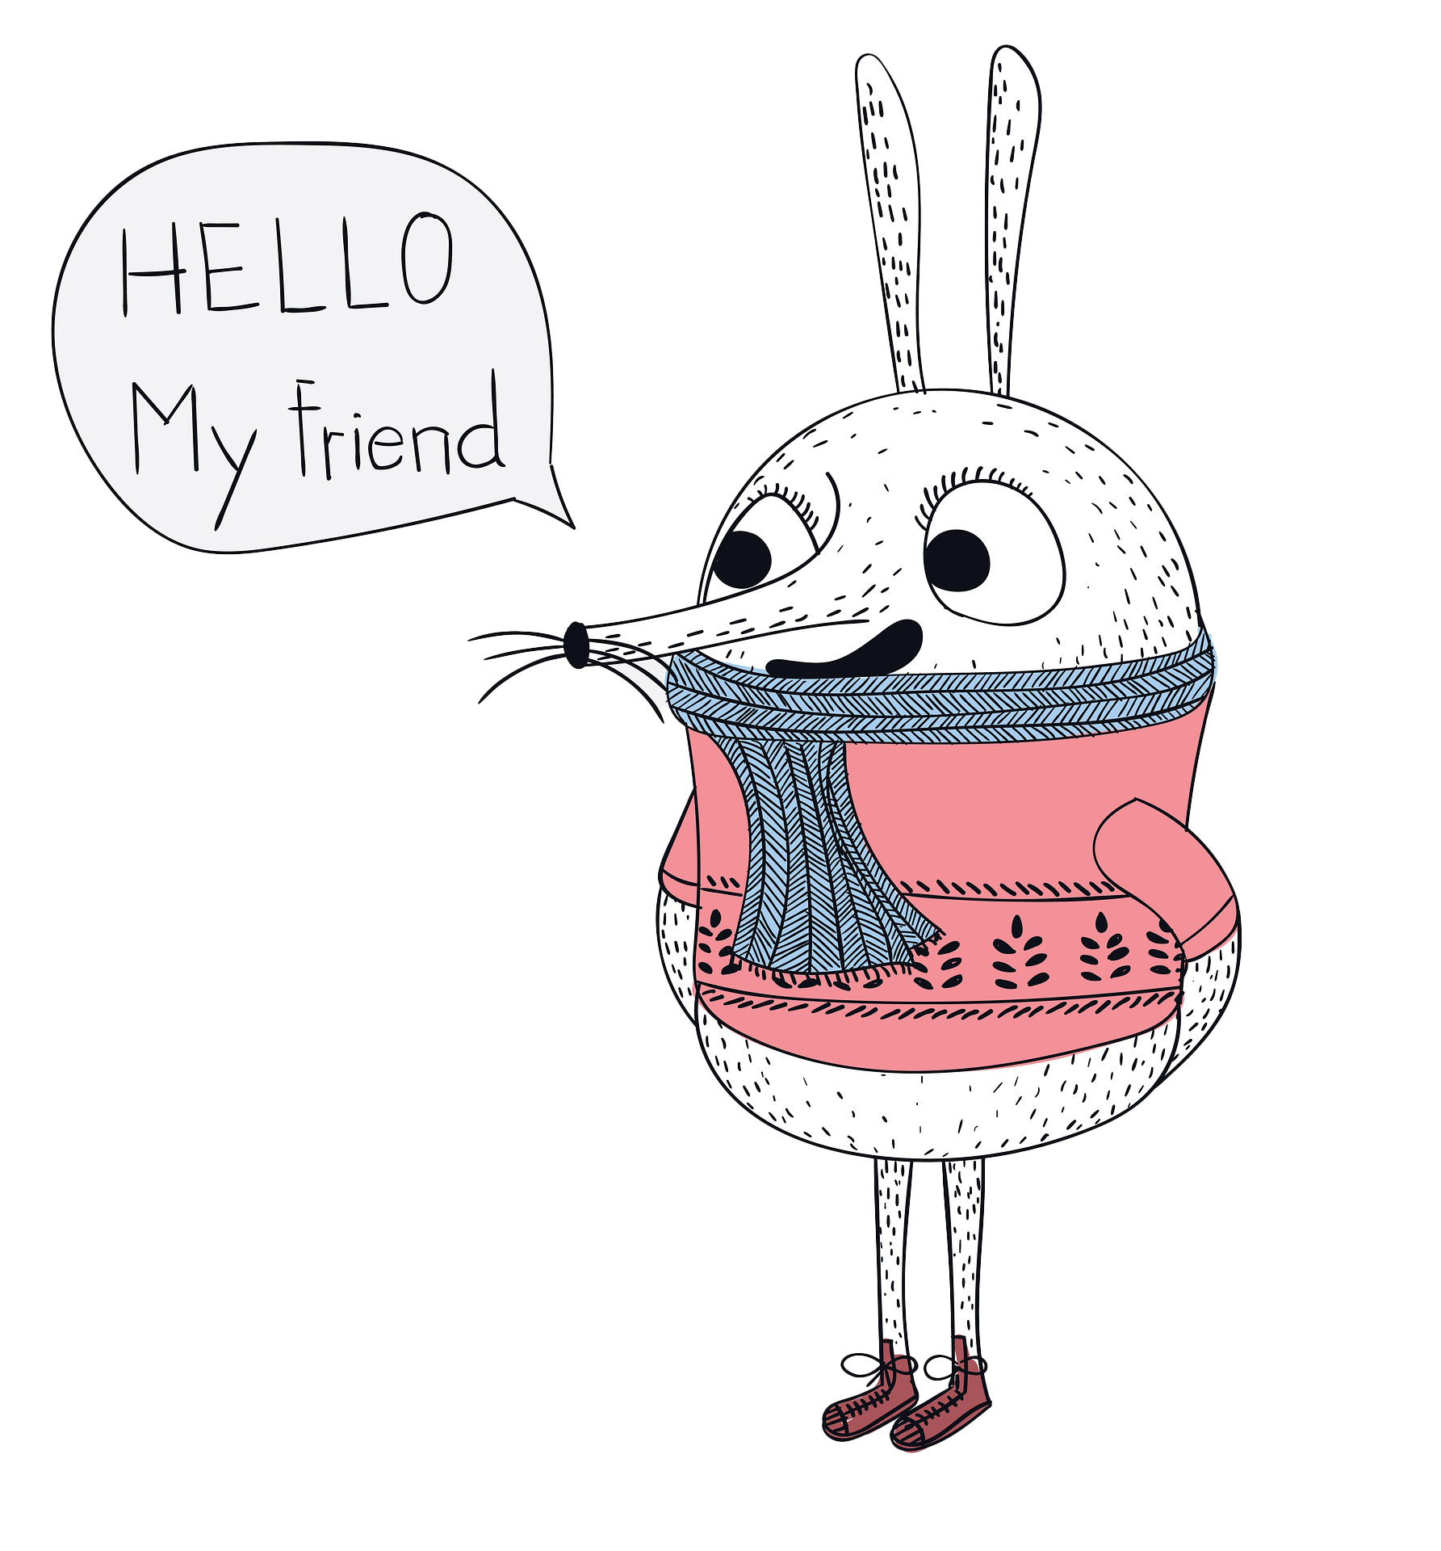
Notes:
IT is your friend

Slide 10



Slide 11

Notes:
Stealth infiltration of existing communities

Slide 12
Thank you…
Paul Stokes
paul.stokes@jisc.ac.uk
4 Portwall Lane, Bristol, BS1 6NB
T 0203 697 5860

Slide 13
Acknowledgements
Frogs - Image by Alexa from Pixabay
No - Image by Andrew Martin from Pixabay
Registration desk - Web Summit - Piaras Ó Mídheach, CC BY 2.0 , via Wikimedia Commons
Space capsule – NASA
Floppies - Image by PublicDomainPictures from Pixabay
Office - Image by Ronald Carreño from Pixabay
Hello - Image by Piyapong Saydaung from Pixabay
Computers desks - Concurrent Design Facility - European Space Agency - ESA–G. Porter, CC BY-SA 3.0 IGO, via Wikimedia Commons
Teaching - Image by Manfred Steger from Pixabay
Upside down - Handstand - Rowland Shaw, CC BY-SA 2.5 via Wikimedia Commons
Searching - Image by Meridy Scott from Pixabay
Image by Stadnik from Pixabay
Half bridge - Image by Andreas from Pixabay
Delta wing - Image by WikiImages from Pixabay
Kitten - Image by Aleš Háva from Pixabay
Hidden dog - Image by Vanessa SG from Pixabay

