Slide 1
Exploring Preservation of
Research Data and its Context through Case Studies
Akihiro Kameda^{*1}, Tamako Kitaoka^{*1} , Makoto Goto^{*1,2}
*1: National Institutes for the Humanities, Head Office, Japan
*2: National Museum of Japanese History, Japan
Notes:
Good [morning/afternoon], I’m Akihiro Kameda from the National Institutes for the Humanities in Japan. Today, I’ll be discussing the preservation of research data, focusing on two case studies from our work.
We’ll explore not just the preservation of data itself, but also the importance of context—how we manage data and its metadata for long-term access.

Slide 2
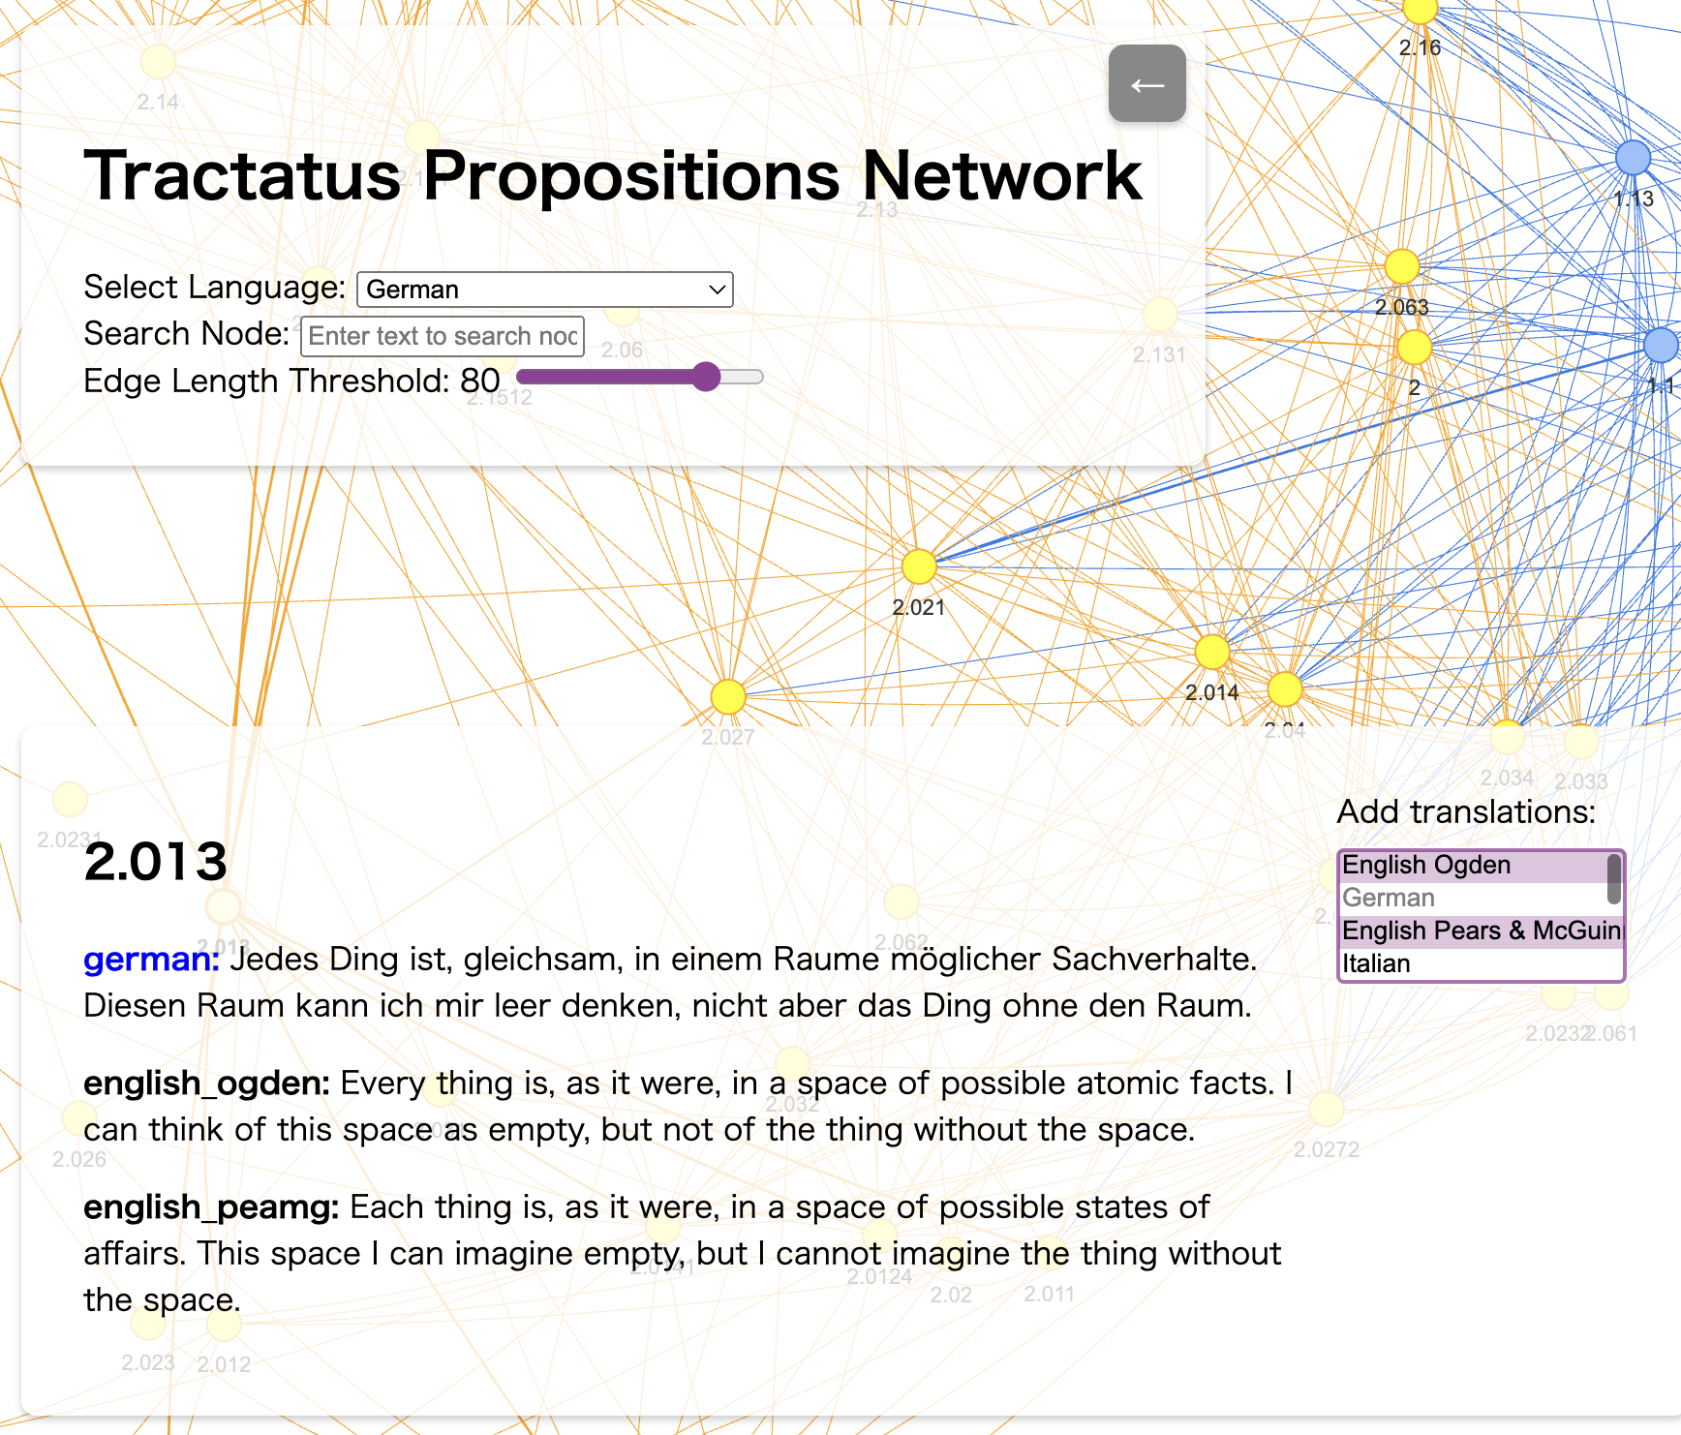
Two cases
1. Research Data of Digital Humanities
Analysis of Wittgenstein’s work
2. Digital Library of Historical Materials
Curated Linked Data and IIIF Images
Incorporating the translation of
Standards of Professional Conduct
as part of the broader contextual framework.
Notes:
Our first case is a digital humanities project focused on analyzing Wittgenstein’s work and related research. The challenge here involved preserving data that was partially under copyright protection, managing obsolete code from visualization tools and updating it, as well as documenting the interpretation process through digital hermeneutics.

Slide 3
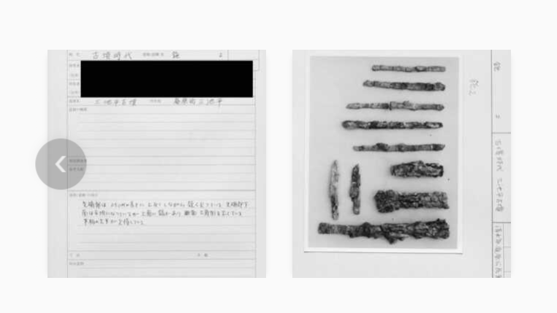
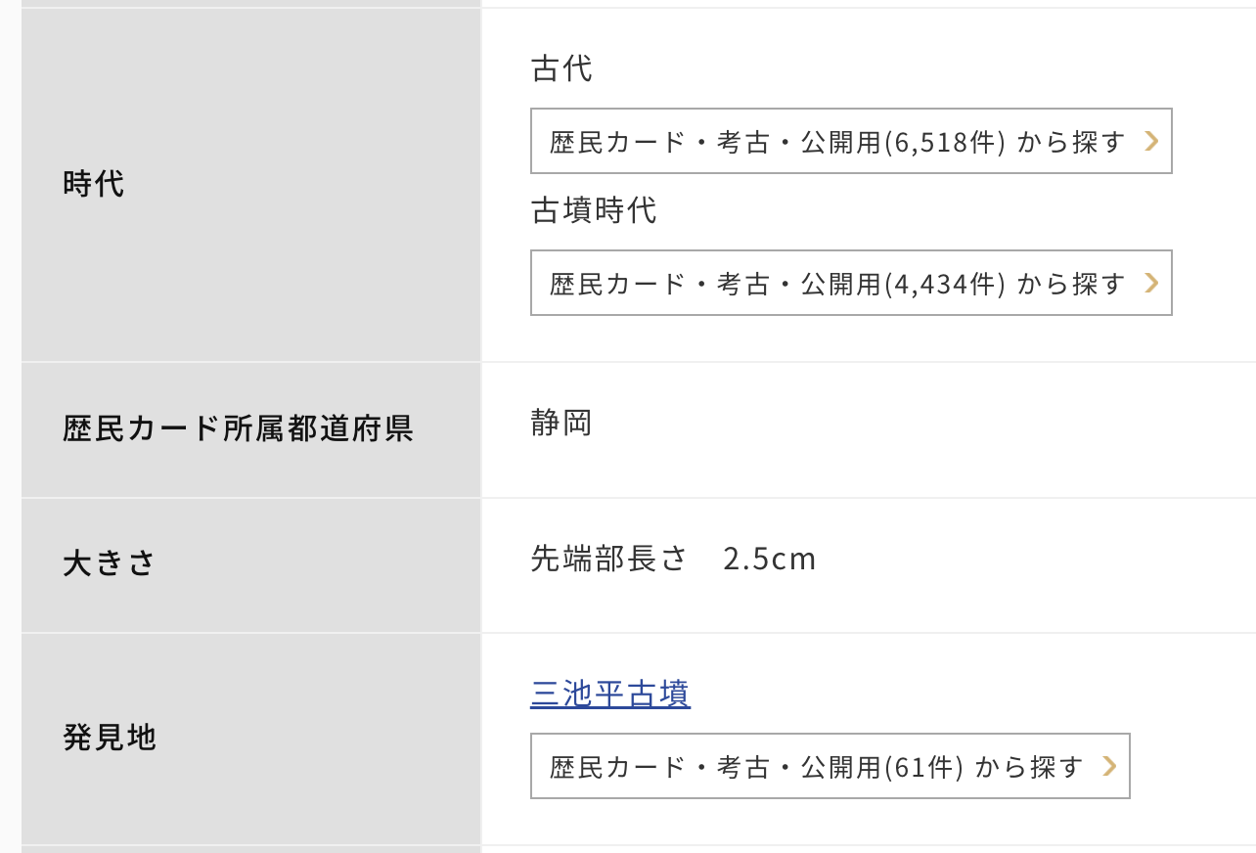
Two cases
1. Research Data of Digital Humanities
Analysis of Wittgenstein’s work
2. Digital Library of Historical Materials
Curated Linked Data and IIIF Images
Incorporating the translation of
Standards of Professional Conduct
as part of the broader contextual framework.
Notes:
The second case focuses on a digital library of historical materials, where we implemented linked data and IIIF images. This infrastructure was developed as part of a project aimed at promoting public history. As part of this effort, the translation of the Standards of Professional Conduct was regarded as a key context, as it reflects the ideal positioning and roles of professionals in their engagement with the public.

Slide 4
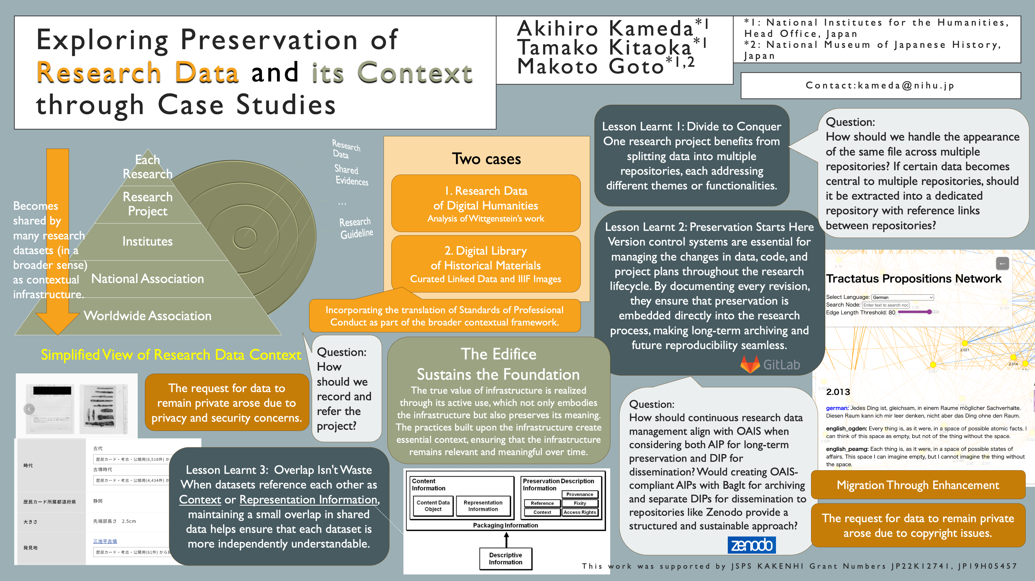
Notes:
This poster covers various key points, focusing on three main areas: the requirements that emerged through practical implementation, the lessons learnt as we addressed these requirements, and the unresolved challenges and questions that remain. I’ll briefly explain each of these as we move through the presentation.

Slide 5
Requirements
Migration through enhancement
Remain the data private
Describe contexts more
Notes:
Three key requirements emerged from these cases: the need for migration through enhancement, handling data privacy, and ensuring that the context of the data is properly described to future researchers.
Preserving not only the data itself but also its context is essential for long-term sustainability.

Slide 6
Lesson learnt
Divide to Conquer
Overlap Isn't Waste
Preservation Begins at Project Launch
Notes:
From our work, we’ve learned three key lessons.
First, 'Divide to Conquer'—splitting projects into multiple repositories helps manage different themes and functionalities.
Second, 'Preservation Starts at Project Launch.' By embedding version control and documentation from the beginning, we ensure seamless long-term archiving.
Finally, 'Overlap Isn’t Waste.' Maintaining small overlaps in shared data, even when referencing each other, enhances independent understanding and resilience."

Slide 7
Questions
How should we record and refer the project?
How should we handle the appearance of the same file across multiple repositories?
How should we position tools and formats like Zenodo, GitLab, and BagIt in the OAIS framework, considering differences between AIP and DIP?
Notes:
We’ve identified a couple of key questions that remain unresolved. First, how should we record and refer to the project itself, ensuring consistent identification and accessibility across various systems? Second, how should we manage the same file appearing across multiple repositories? And finally, how should we position tools and formats like Zenodo, GitLab, and BagIt in the OAIS framework, considering the differences between AIP and DIP?
These questions reflect the new challenges that have emerged through practical applications of what we’ve learned, shedding light on the evolving complexities of research data preservation.

Slide 8
Exploring Preservation of
Research Data and its Context through Case Studies
Akihiro Kameda^{*1}, Tamako Kitaoka^{*1} , Makoto Goto^{*1,2}
*1: National Institutes for the Humanities, Head Office, Japan
*2: National Museum of Japanese History, Japan
Contact: kameda@nihu.jp
Notes:
If you’d like to continue the conversation or discuss any of these questions further, please come visit my poster presentation! Thank you.

