Slide 1
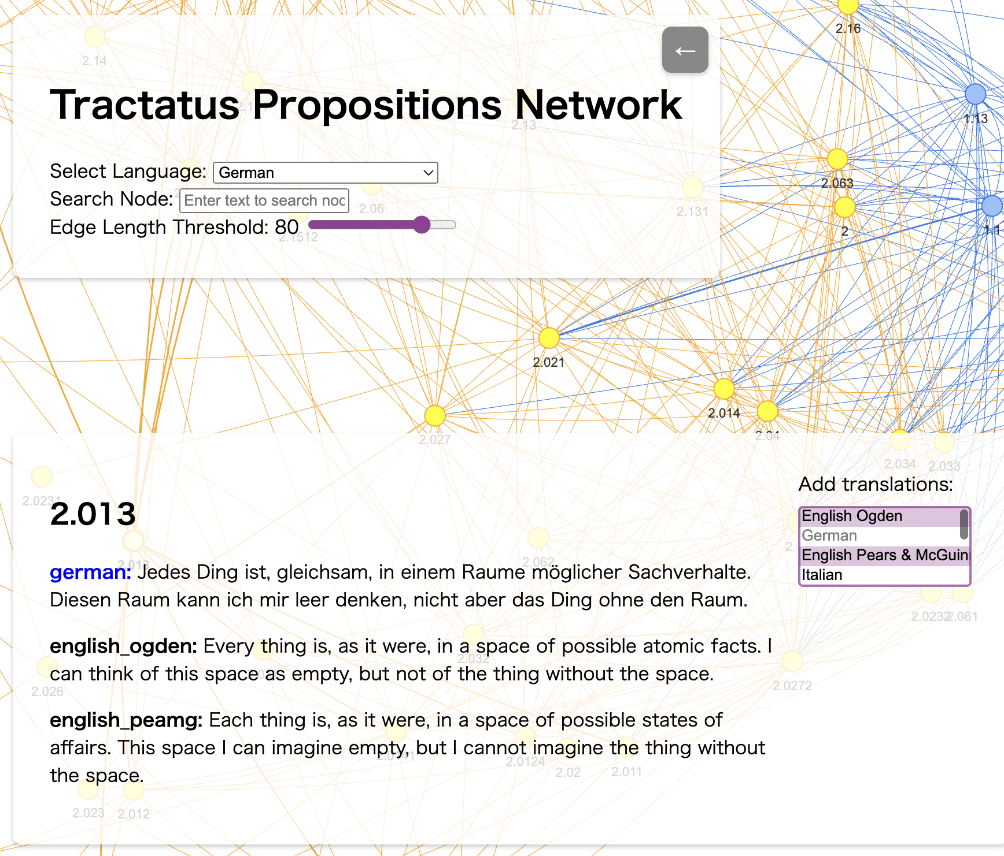
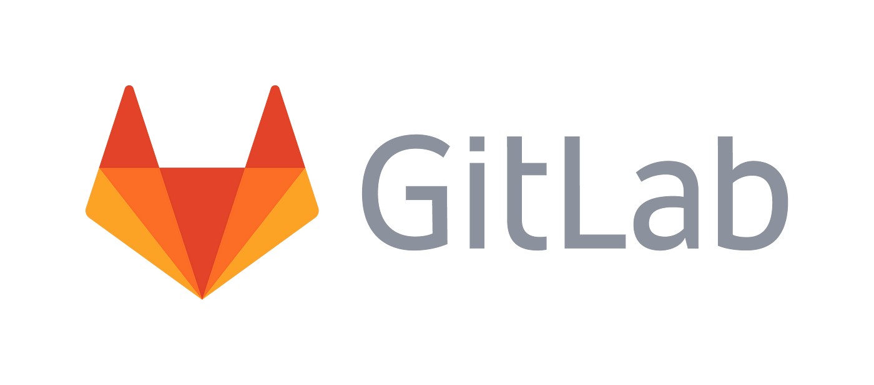
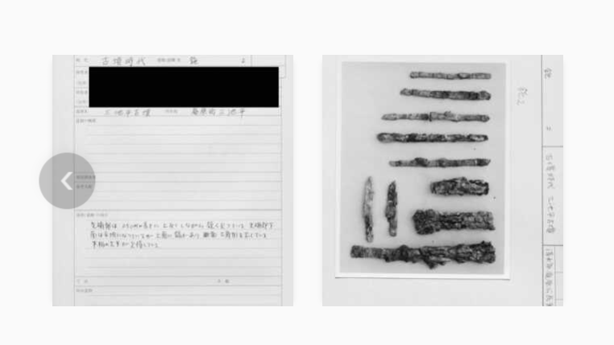
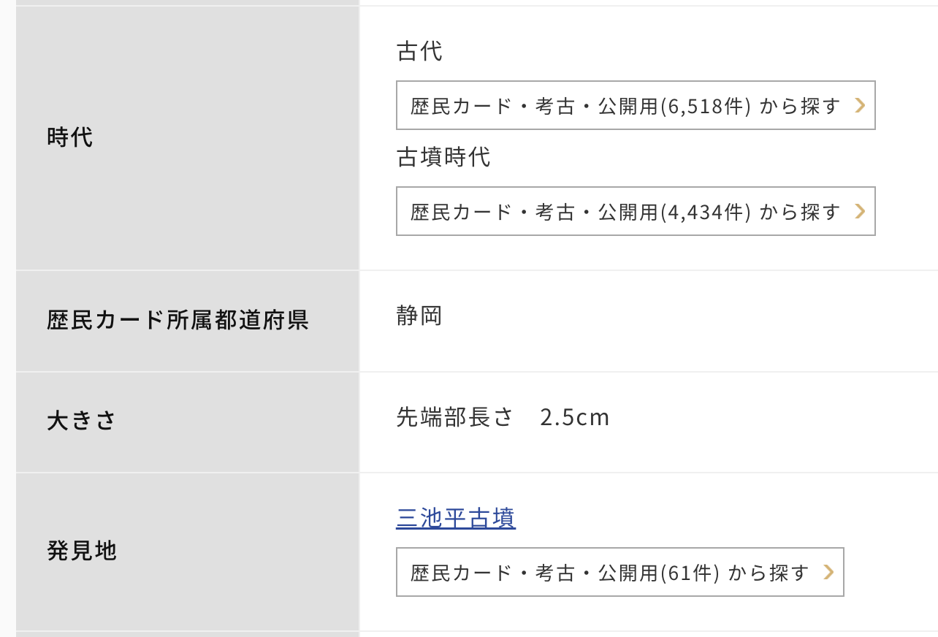
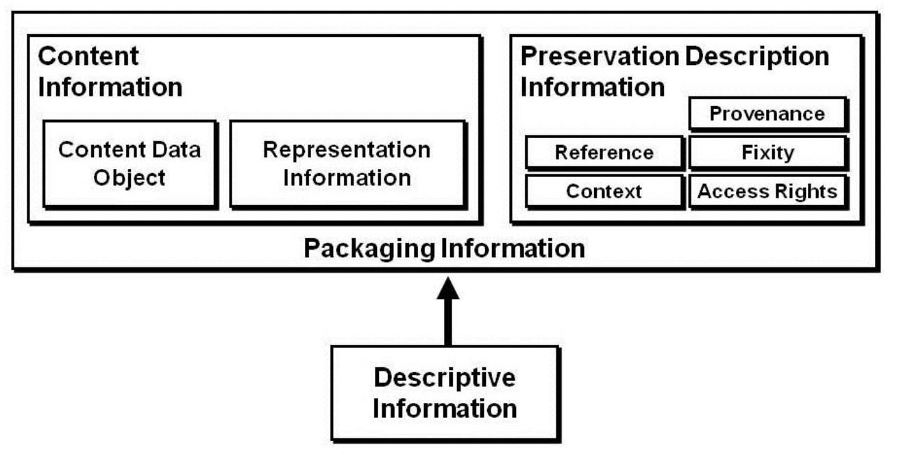

Exploring Preservation of
Research Data and its Context through Case Studies
Akihiro Kameda^{*1}
Tamako Kitaoka^{*1}
Makoto Goto^{*1,2}
*1: National Institutes for the Humanities, Head Office, Japan
*2: National Museum of Japanese History, Japan
Contact:kameda@nihu.jp
Research Data
Shared Evidences
…
Research Guideline
Lesson Learnt 1: Divide to Conquer
One research project benefits from splitting data into multiple repositories, each addressing different themes or functionalities.
Question:
How should we handle the appearance of the same file across multiple repositories? If certain data becomes central to multiple repositories, should it be extracted into a dedicated repository with reference links between repositories?
Two cases
Worldwide Association
National Association
Each Research
Research Project
Institutes
1. Research Data
of Digital Humanities
Analysis of Wittgenstein’s work
Becomes shared by many research datasets (in a broader sense) as contextual infrastructure.
Lesson Learnt 2: Preservation Starts Here
Version control systems are essential for managing the changes in data, code, and project plans throughout the research lifecycle. By documenting every revision, they ensure that preservation is embedded directly into the research process, making long-term archiving and future reproducibility seamless.
2. Digital Library
of Historical Materials
Curated Linked Data and IIIF Images
Incorporating the translation of Standards of Professional Conduct as part of the broader contextual framework.
Simplified View of Research Data Context
Question:
How should we record and refer the project?
The Edifice
Sustains the Foundation
The true value of infrastructure is realized through its active use, which not only embodies the infrastructure but also preserves its meaning. The practices built upon the infrastructure create essential context, ensuring that the infrastructure remains relevant and meaningful over time.
The request for data to remain private arose due to privacy and security concerns.
Question:
How should continuous research data management align with OAIS when considering both AIP for long-term preservation and DIP for dissemination? Would creating OAIS-compliant AIPs with BagIt for archiving and separate DIPs for dissemination to repositories like Zenodo provide a structured and sustainable approach?
Lesson Learnt 3: Overlap Isn't Waste
When datasets reference each other as Context or Representation Information, maintaining a small overlap in shared data helps ensure that each dataset is more independently understandable.
Migration Through Enhancement
The request for data to remain private arose due to copyright issues.
This work was supported by JSPS KAKENHI Grant Numbers JP22K12741, JP19H05457

