Slide 1
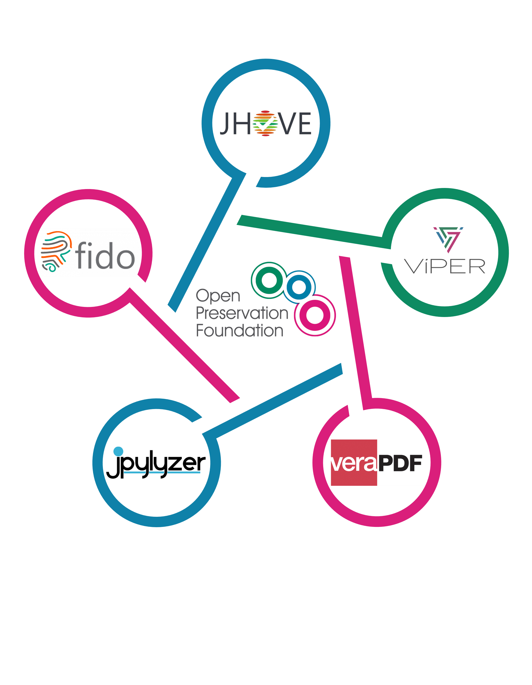


















Home
The Open Preservation Foundation Family Tree
?
You?
?
?
Carl Wilson—carl@openpreservation.org
Julie Allen—julie.allen@openpreservation.org
Paul Stokes—paul.stokes@jisc.ac.uk
Remco van Veenendaal—Remco.van.Veenendaal@nationaalarchief.nl
Yannick Grandcolas—yannick.grandcolas@bnf.fr
?
Home
Donate
?
?
?
https:/openpreservation/.org
https://openpreservation.org/donate/
Audio Commentary
(use your phone to hear it)
Each slide has its own commentary
This poster is interactive.
Hover/Click to find out more about each item on the poster
中文
English
Nederlands
中文
English
Nederlands
https://jmp.sh/lUZfxxce
Français
https://jmp.sh/b2qjBCXu
Español
https://jmp.sh/NLYhlFG6
https://jmp.sh/lUZfxxce
Français
https://jmp.sh/b2qjBCXu
Español
https://jmp.sh/NLYhlFG6
https://jmp.sh/jY4JzgcJ
https://jmp.sh/8q0BdIWW
https://jmp.sh/jY4JzgcJ
https://jmp.sh/8q0BdIWW
Scan icon by Ranah Pixel Studio from Noun Project - https://thenounproject.com/browse/icons/term/scan - (CC BY 3.0)
Audio icon by Oh Rian from Noun Project - https://thenounproject.com/browse/icons/term/audio - (CC BY 3.0)
QR Code by da hye ahn from Noun Project - https://thenounproject.com/browse/icons/term/qr-code - (CC BY 3.0)

Slide 2
Home - hidden
The Open Preservation Foundation Family Tree
?
You?
?
?
Carl Wilson—carl@openpreservation.org
Julie Allen—julie.allen@openpreservation.org
Paul Stokes—paul.stokes@jisc.ac.uk
Remco van Veenendaal—Remco.van.Veenendaal@nationaalarchief.nl
Yannick Grandcolas—yannick.grandcolas@bnf.fr
?
Home
Donate
?
?
?
https:/openpreservation/.org
https://openpreservation.org/donate/
中文
English
Nederlands
https://jmp.sh/lUZfxxce
Français
https://jmp.sh/b2qjBCXu
Español
https://jmp.sh/NLYhlFG6
https://jmp.sh/jY4JzgcJ
https://jmp.sh/8q0BdIWW

Slide 3
Hover-Vendors
The Open Preservation Foundation Family Tree
?
You?
?
?
Carl Wilson—carl@openpreservation.org
Julie Allen—julie.allen@openpreservation.org
Paul Stokes—paul.stokes@jisc.ac.uk
Remco van Veenendaal—Remco.van.Veenendaal@nationaalarchief.nl
Yannick Grandcolas—yannick.grandcolas@bnf.fr
?
Home
Donate
?
?
?
https:/openpreservation/.org
https://openpreservation.org/donate/
OPF 產品直接或間接用於所有這些供應商的數位保存解決方案。
OPF products are used either directly or indirectly in digital preservation solutions from all of these vendors.
OPF-producten worden direct of indirect gebruikt in digitale bewaaroplossingen van al deze leveranciers.
Les produits OPF sont utilisés directement ou indirectement dans les solutions de préservation numérique de tous ces fournisseurs.
Los productos OPF se utilizan directa o indirectamente en soluciones de preservación digital de todos estos proveedores.
中文
English
Nederlands
https://jmp.sh/lUZfxxce
Français
https://jmp.sh/b2qjBCXu
Español
https://jmp.sh/NLYhlFG6
https://jmp.sh/jY4JzgcJ
https://jmp.sh/8q0BdIWW

Slide 4
Hover-OPF
The Open Preservation Foundation Family Tree
?
You?
?
?
Carl Wilson—carl@openpreservation.org
Julie Allen—julie.allen@openpreservation.org
Paul Stokes—paul.stokes@jisc.ac.uk
Remco van Veenendaal—Remco.van.Veenendaal@nationaalarchief.nl
Yannick Grandcolas—yannick.grandcolas@bnf.fr
?
Home
Donate
?
?
?
https:/openpreservation/.org
https://openpreservation.org/donate/
Description: Global not-for-profit membership organisation working to advance shared standards and solutions for the long-term preservation of digital content.
中文
English
Nederlands
https://jmp.sh/lUZfxxce
Français
https://jmp.sh/b2qjBCXu
Español
https://jmp.sh/NLYhlFG6
https://jmp.sh/jY4JzgcJ
https://jmp.sh/8q0BdIWW

Slide 5





Detail-OPF
The Open Preservation Foundation Family Tree
?
You?
?
?
Carl Wilson—carl@openpreservation.org
Julie Allen—julie.allen@openpreservation.org
Paul Stokes—paul.stokes@jisc.ac.uk
Remco van Veenendaal—Remco.van.Veenendaal@nationaalarchief.nl
Yannick Grandcolas—yannick.grandcolas@bnf.fr
?
The Open Preservation Foundation’s goal is to build on collaborative, practical approaches to advance digital preservation. Working to enable shared solutions for effective and efficient digital preservation, we lead a collaborative effort to create, maintain and develop the reference set of sustainable, open source digital preservation tools and supporting resources.
OPF maintains a number of opensource digital preservation tools that address common digital preservation challenges. Together, they form a reference toolset for digital preservation which can be adapted for use in different organisational workflows. Our current tools are mainly used in the pre-ingest and ingest stages of preservation, but our toolset is constantly evolving in response to the needs of our members.
Our tools are widely adopted by the community, and can be used as stand-alone tools, as part of a bespoke digital preservation workflow, or can be found embedded in several leading commercial solutions.
?
?
?
Home
Donate
https:/openpreservation/.org
https://openpreservation.org/donate/
Description: Global not-for-profit membership organisation working to advance shared standards and solutions for the long-term preservation of digital content.
中文
English
Nederlands
中文
English
Nederlands
https://jmp.sh/lUZfxxce
https://jmp.sh/b2qjBCXu
https://jmp.sh/NLYhlFG6
https://jmp.sh/ypH2Uy3x
https://jmp.sh/mttiRk15
https://jmp.sh/BieqbklL
Français
Español
Français
Español
https://jmp.sh/jY4JzgcJ
https://jmp.sh/8q0BdIWW
https://jmp.sh/PzY33FGg
https://jmp.sh/qHhTvzw7

Slide 6
Hover-Jhove
The Open Preservation Foundation Family Tree
?
You?
?
?
Carl Wilson—carl@openpreservation.org
Julie Allen—julie.allen@openpreservation.org
Paul Stokes—paul.stokes@jisc.ac.uk
Remco van Veenendaal—Remco.van.Veenendaal@nationaalarchief.nl
Yannick Grandcolas—yannick.grandcolas@bnf.fr
?
Home
Donate
?
?
?
https:/openpreservation/.org
https://openpreservation.org/donate/
Description: Opensource extensible framework for identification, validation, and characterisation
Latest release: 1.30 Release (June, 2024)
Downloads: 3,556
中文
English
Nederlands
https://jmp.sh/lUZfxxce
Français
https://jmp.sh/b2qjBCXu
Español
https://jmp.sh/NLYhlFG6
https://jmp.sh/jY4JzgcJ
https://jmp.sh/8q0BdIWW

Slide 7





Detail-Jhove
The Open Preservation Foundation Family Tree
?
You?
?
?
Carl Wilson—carl@openpreservation.org
Julie Allen—julie.allen@openpreservation.org
Paul Stokes—paul.stokes@jisc.ac.uk
Remco van Veenendaal—Remco.van.Veenendaal@nationaalarchief.nl
Yannick Grandcolas—yannick.grandcolas@bnf.fr
?
JHOVE is implemented as a Java application and is usable on any Unix, Windows, or OS X platform with appropriate Java installation.
It is available in three forms:
Command line Tool – used by researchers and practitioners / embedded in DP workflows.
Desktop GUI – file at a time interface, aimed at general users wanting to try JHOVE.
JHOVE API – used by developers embedding JHOVE in their own projects.
OPF adopted JHOVE in 2015. The original JHOVE project was a collaboration between JSTOR and Harvard University Library with funding from the Andrew W. Mellon Foundation for the Electronic-Archiving Initiative.
Home
Donate
?
?
?
https:/openpreservation/.org
https://openpreservation.org/donate/
Description: Opensource extensible framework for identification, validation, and characterisation
Latest release: 1.30 Release (June, 2024)
Downloads: 3,556
中文
English
Nederlands
中文
English
Nederlands
https://jmp.sh/lUZfxxce
https://jmp.sh/b2qjBCXu
Español
https://jmp.sh/NLYhlFG6
https://jmp.sh/t0YrSZDq
Français
https://jmp.sh/NN7X3uDK
https://jmp.sh/tJmuVSrm
Français
Español
https://jmp.sh/jY4JzgcJ
https://jmp.sh/8q0BdIWW
https://jmp.sh/omQvrCyW
https://jmp.sh/xZNgIlFH

Slide 8
Hover - viper
The Open Preservation Foundation Family Tree
?
You?
?
?
Carl Wilson—carl@openpreservation.org
Julie Allen—julie.allen@openpreservation.org
Paul Stokes—paul.stokes@jisc.ac.uk
Remco van Veenendaal—Remco.van.Veenendaal@nationaalarchief.nl
Yannick Grandcolas—yannick.grandcolas@bnf.fr
?
Home
Donate
?
?
?
https:/openpreservation/.org
https://openpreservation.org/donate/
Description: Opensource, easy-to-install virtual machine running open-source preservation tools with graphical user interfaces
Latest release: 1.2 Release (June, 2024)
Downloads: 2,119
中文
English
Nederlands
https://jmp.sh/lUZfxxce
Français
https://jmp.sh/b2qjBCXu
Español
https://jmp.sh/NLYhlFG6
https://jmp.sh/jY4JzgcJ
https://jmp.sh/8q0BdIWW

Slide 9





Detail - viper
The Open Preservation Foundation Family Tree
?
You?
?
?
Carl Wilson—carl@openpreservation.org
Julie Allen—julie.allen@openpreservation.org
Paul Stokes—paul.stokes@jisc.ac.uk
Remco van Veenendaal—Remco.van.Veenendaal@nationaalarchief.nl
Yannick Grandcolas—yannick.grandcolas@bnf.fr
?
ViPER is an open-source, easy-to-install virtual machine running popular open-source preservation tools with graphical user interfaces. These include:
DROID,
HandBrake,
JHOVE,
MediaInfo,
Tika, and
veraPDF.
Archiving digital collections has a number of requirements—(pre-)ingest, validation, checking file type, etc. In this VRE, you can research these tools before using them in your production environment.
ViPER is a project from the Dutch Digital Heritage Network, developed and safeguarded by the Open Preservation Foundation (OPF) in collaboration with the National Archives of the Netherlands (NA)
Home
Donate
?
?
?
https:/openpreservation/.org
https://openpreservation.org/donate/
Description: Opensource, easy-to-install virtual machine running open-source preservation tools with graphical user interfaces
Latest release: 1.2 Release (June, 2024)
Downloads: 2,119
中文
English
Nederlands
中文
English
Nederlands
https://jmp.sh/lUZfxxce
Français
https://jmp.sh/b2qjBCXu
Español
https://jmp.sh/NLYhlFG6
https://jmp.sh/51QZtixN
https://jmp.sh/QtHmwSxv
https://jmp.sh/kZKviNlO
Français
Español
https://jmp.sh/jY4JzgcJ
https://jmp.sh/8q0BdIWW
https://jmp.sh/fQqCk7y5
https://jmp.sh/d9i7SE0V

Slide 10
Hover - Vera
The Open Preservation Foundation Family Tree
?
You?
?
?
Carl Wilson—carl@openpreservation.org
Julie Allen—julie.allen@openpreservation.org
Paul Stokes—paul.stokes@jisc.ac.uk
Remco van Veenendaal—Remco.van.Veenendaal@nationaalarchief.nl
Yannick Grandcolas—yannick.grandcolas@bnf.fr
?
Home
Donate
?
?
?
https:/openpreservation/.org
https://openpreservation.org/donate/
Description: Complete opensource PDF/A validator
Latest release: 1.26 Release (May, 2024)
Downloads: 39,169
中文
English
Nederlands
https://jmp.sh/lUZfxxce
Français
https://jmp.sh/b2qjBCXu
Español
https://jmp.sh/NLYhlFG6
https://jmp.sh/jY4JzgcJ
https://jmp.sh/8q0BdIWW

Slide 11





Detail - Vera
The Open Preservation Foundation Family Tree
?
You?
?
?
Carl Wilson—carl@openpreservation.org
Julie Allen—julie.allen@openpreservation.org
Paul Stokes—paul.stokes@jisc.ac.uk
Remco van Veenendaal—Remco.van.Veenendaal@nationaalarchief.nl
Yannick Grandcolas—yannick.grandcolas@bnf.fr
?
VeraPDF is the first complete open source PDF/A validator, covering all parts of the PDF/A standard.
It has four components:
An implementation checker
A policy checker
A reporter
A metadata fixer
The software is accompanied by a comprehensive, atomic test corpus, covering each clause in the PDF/A specifications.
VeraPDF is implemented as a Java application and is usable on any Unix, Windows, or OS X platform with appropriate Java installation
VeraPDF was originally developed with funding from the PREFORMA project (2014-2017). In 2018, it was a finalist for the Digital Preservation Awards 2018 in the Software Sustainability Institute’s Award for Research and Innovation.
Home
Donate
?
?
?
https:/openpreservation/.org
https://openpreservation.org/donate/
Description: Complete opensource PDF/A validator
Latest release: 1.26 Release (May, 2024)
Downloads: 39,169
中文
English
Nederlands
中文
English
Nederlands
https://jmp.sh/lUZfxxce
Français
https://jmp.sh/b2qjBCXu
Español
https://jmp.sh/NLYhlFG6
https://jmp.sh/YxIroOxG
https://jmp.sh/y3ldNcno
https://jmp.sh/vfyWnR0q
Français
Español
https://jmp.sh/jY4JzgcJ
https://jmp.sh/8q0BdIWW
https://jmp.sh/9xayUAHl
https://jmp.sh/m3Mh3fNQ

Slide 12
Hover - jpylyzer
The Open Preservation Foundation Family Tree
?
You?
?
?
Carl Wilson—carl@openpreservation.org
Julie Allen—julie.allen@openpreservation.org
Paul Stokes—paul.stokes@jisc.ac.uk
Remco van Veenendaal—Remco.van.Veenendaal@nationaalarchief.nl
Yannick Grandcolas—yannick.grandcolas@bnf.fr
?
Home
Donate
?
?
?
https:/openpreservation/.org
https://openpreservation.org/donate/
Description: Opensource validator and feature extractor for JP2 images
Latest release: 2.2 Release (January, 2024)
Downloads: 6,115
中文
English
Nederlands
https://jmp.sh/lUZfxxce
Français
https://jmp.sh/b2qjBCXu
Español
https://jmp.sh/NLYhlFG6
https://jmp.sh/jY4JzgcJ
https://jmp.sh/8q0BdIWW

Slide 13





Detail - jpylyzer
The Open Preservation Foundation Family Tree
?
You?
?
?
Carl Wilson—carl@openpreservation.org
Julie Allen—julie.allen@openpreservation.org
Paul Stokes—paul.stokes@jisc.ac.uk
Remco van Veenendaal—Remco.van.Veenendaal@nationaalarchief.nl
Yannick Grandcolas—yannick.grandcolas@bnf.fr
?
Jpylyzer is an opensource validator and feature extractor for JP2 images. JP2 is the still image format that is defined by Part 1 of the JPEG 2000 image compression standard (ISO/IEC 15444-1).
Jpylyzer parses a file and runs its contents against a large number of tests, each of which is based on the requirements and restrictions that are defined by the standard. If a file fails one or more tests, this implies that it does not conform to the standard, and is not a valid JP2.
The development of jpylyzer was partially funded by the EU FP7 project, SCAPE (SCAlabable Preservation Environments).
Home
Donate
?
?
?
https:/openpreservation/.org
https://openpreservation.org/donate/
Description: Opensource validator and feature extractor for JP2 images
Latest release: 2.2 Release (January, 2024)
Downloads: 6,115
中文
English
Nederlands
中文
English
Nederlands
https://jmp.sh/lUZfxxce
Français
https://jmp.sh/b2qjBCXu
Español
https://jmp.sh/NLYhlFG6
https://jmp.sh/vIGLuSe6
Français
https://jmp.sh/Zg5cMu7C
Español
https://jmp.sh/hEzHApMg
https://jmp.sh/jY4JzgcJ
https://jmp.sh/8q0BdIWW
https://jmp.sh/lOygFR84
https://jmp.sh/cwBu4eFo

Slide 14
Hover - fido
The Open Preservation Foundation Family Tree
?
You?
?
?
Carl Wilson—carl@openpreservation.org
Julie Allen—julie.allen@openpreservation.org
Paul Stokes—paul.stokes@jisc.ac.uk
Remco van Veenendaal—Remco.van.Veenendaal@nationaalarchief.nl
Yannick Grandcolas—yannick.grandcolas@bnf.fr
?
Home
Donate
?
?
?
https:/openpreservation/.org
https://openpreservation.org/donate/
Description: Opensource command-line tool to identify the file formats of digital objects
Latest release: 1.61 Release (December, 2022)
Downloads: 37,419
中文
English
Nederlands
https://jmp.sh/lUZfxxce
Français
https://jmp.sh/b2qjBCXu
Español
https://jmp.sh/NLYhlFG6
https://jmp.sh/jY4JzgcJ
https://jmp.sh/8q0BdIWW

Slide 15





Detail - fido
The Open Preservation Foundation Family Tree
?
You?
?
?
Carl Wilson—carl@openpreservation.org
Julie Allen—julie.allen@openpreservation.org
Paul Stokes—paul.stokes@jisc.ac.uk
Remco van Veenendaal—Remco.van.Veenendaal@nationaalarchief.nl
Yannick Grandcolas—yannick.grandcolas@bnf.fr
?
fido (Format Identification for Digital Objects) is an opensource command-line tool to identify the file formats of digital objects.
The software is written in Python and is designed to be run from the command line. FIDO utilises the PRONOM format registry, which is maintained by The National Archives UK.
It is well suited for quickly returning the PRONOM identifiers from single files or batches of files.
Originally developed by Adam Farquhar of British Library in 2010, OPF took stewardship of Fido in 2015.
Home
Donate
?
?
?
https:/openpreservation/.org
https://openpreservation.org/donate/
Description: Opensource command-line tool to identify the file formats of digital objects
Latest release: 1.61 Release (December, 2022)
Downloads: 37,419
中文
English
Nederlands
中文
English
Nederlands
https://jmp.sh/lUZfxxce
Français
https://jmp.sh/b2qjBCXu
Español
https://jmp.sh/NLYhlFG6
https://jmp.sh/IQmJkrBr
Français
https://jmp.sh/Fkw34yER
Español
https://jmp.sh/SWUsRAdc
https://jmp.sh/jY4JzgcJ
https://jmp.sh/8q0BdIWW
https://jmp.sh/uont0jST
https://jmp.sh/CKGF0Lmy

