Slide 1
Constructing a Preservation Technical Registry by Leveraging Community Best Practices
Wang Lu，Kong Beibei, Wu Zhenxin, Zhang Zhixiong
National Science Library, Chinese Academy of Sciences

Slide 2
Motivation
NDPP is the Chinese National Digital Preservation Program for scientific and technology literature
  consists of 6 distributed repositories, holds O(10⁸) objects and O(10⁹) files
The next generation DPS is designed for large-scale, diverse scientific resources and aims at functional extensibility, performance scalability, and compliance with domain standards and best practices
An accurate, machine-readable, and continuously updated technical registry is a necessity for preservation repositories at our scale
  to drive the automatic ingest workflow and post-ingest technical risk management

Slide 3
External Registries
 | Entry Type （#） | Information Item | URL of external source | Risk Factors (#) |  | Risk Level(#) | Risk Value | Action Plan | Action Tool | Update | Access protocol
TNA’s PRONOM | Format （2400+） | Name, PRONOM ID，Extensions, Signature File,Classification |  | PUID x-PUID |  |  |  |  |  | 4 times/year in batch | HTTP
NARA’s Preservation Framework | Format (700+) | Name，Extensions，MIME Type, PRONOM ID | Specification/Standard, LOC FDD, Wikidata, ArchiveTeam, ForensicsWiki … | Disclosure， Adoption, Transparency, Self Documentation, Hardware dependency, Software dependency, Impact of Patent, Technical protection, Age, Prevalence, Feasibility | 5 5 7 5 2 4 4 5 2 1 1 | √（3） | √ | √ |  | 4 times/year in batch | git
 | Format group (12) | Name, significant Property, Preferred/Acceptable Transfer Format， Format for public access, Format for reference
DPC Bit List | Entry(87) | Species, description, trends, risk factors, Case Studies or Examples, Comment |  | Significance, Loss Impact, Inevitability of Loss, Imminence of Action |  | √（5） |  |  |  | 1 time/year in batch | HTTP
Archivematica‘s FPR | Format(1582), Format group(30) Action(39), external tool(16) | Description, Version PRONOM ID, Format Name |  |  |  |  |  | √ | √ | with version release in batch | git
Wikidata for Digital Preservation | Format(70305), PRONOM Format(2247), Signature(9462), Emulators(303), File system(190) |  |  |  |  |  |  |  |  | Item | SPARQL
COPTR | Action Tool(612) |  | Description, Lifecycle Stages, Function, Content type, URL, History |  |  |  |  |  |  | by Item | HTTP
EaaSI’s Sandox | Emulator |  |  |  |  |  |  | √ | √ | by Item | HTTP

Slide 4
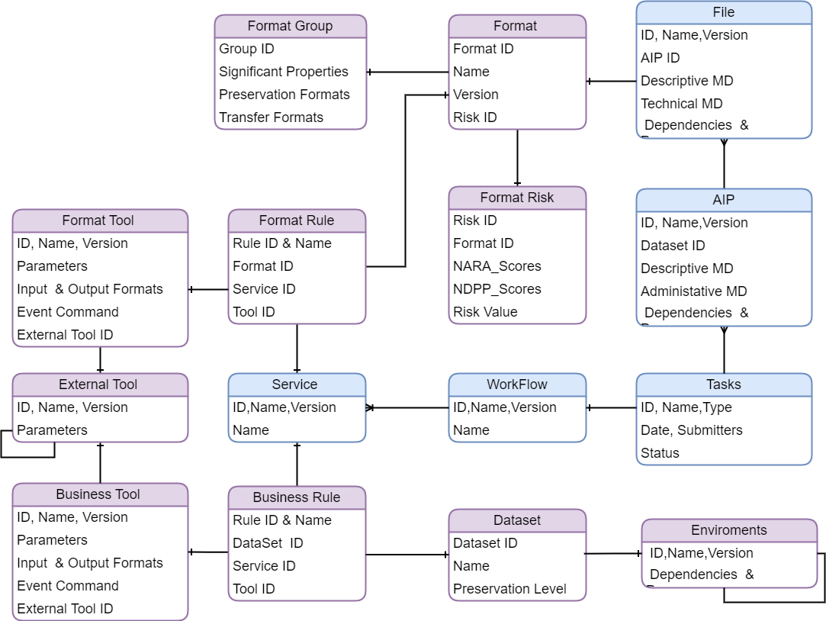
The Data Model and Risk Formula
Format Risk Score = Original_Score xOriginal_Weight
+ Priority_Score x (1-Original_Weight)
Original Score is calculated by sum of 9 risk factor scores :
  9 factors, 37 sub factors from NDPP risk matrix
  For each subfactor,
  factor_value= NARA_score + NDPP_score
  NARA_score is fetched and updated
  NDPP_score needs to be updated manually，default=0
  Value ranges are inherited from NARA
  Original_Weight is set by administrator, currently=0.5
Priority Score is calculated by sum of two factor scores:
  Ratio of NDPP Node Holdings
  Availability of migration action to low risk format
Value ranges are inherited from NARA

Slide 5
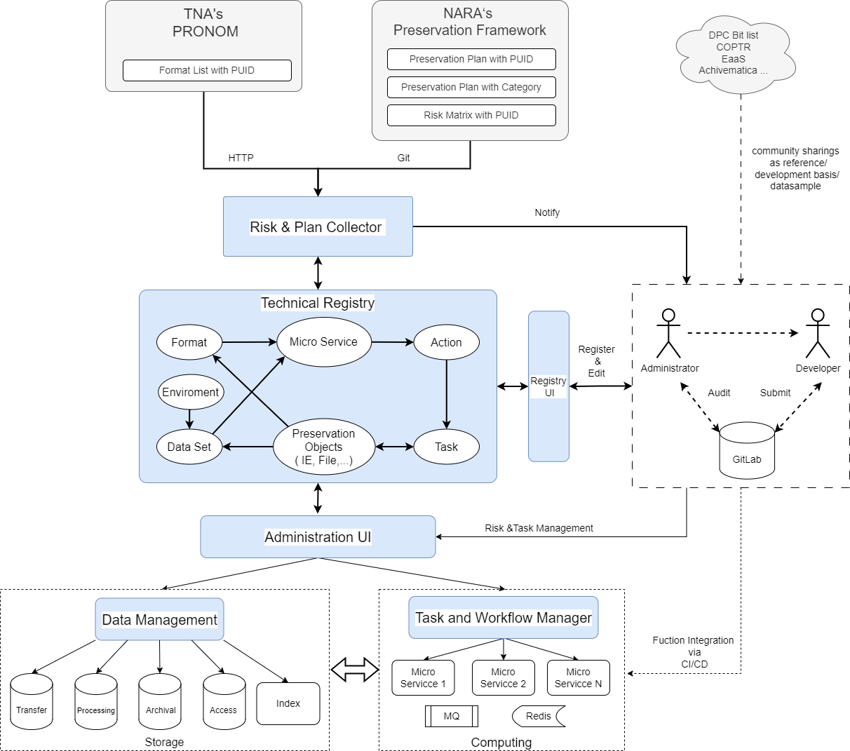
Implementation
Risk & Plan collector is a monthly running task
  Create new entry in format table with new creation of PRONOM list
  Update NARA original risk score and risk weight
  Sent notifications of updates to administrators
Administration UI
  Input of NDPP risk score
  Registration of new tools and environments
  Registration of relationships among plugins, environments micro services and format /dataset
  Updates of the registry
  Display high-risk objects, dataset, formats list ranking by technical risk value
  Management of migration tasks

Slide 6
Results and Suggestions
The registry has been synced with the latest PRONOM and NARA list
  2400 format entries, 700 format risk entries, 12 format group entries
Development of business tool and risk tool is prioritized by the ratio of related resources in current digital preservation system of NDPP
  Since the migration between two system has not started, currently the development is driven by sample dataset
  28 business tool and 40 format tool has been developed and registered
Emulation, as a preservation strategy, is more energy efficient than format migration
  Community registries on emulation is less mature than those of format, format risk and preservation tools
  Hope the “Registries of Good Practice” will put forward cooperation and know-how sharing in this direction

Slide 7
Thank you! wanglu2023@mail.las.ac.cn

