Slide 1
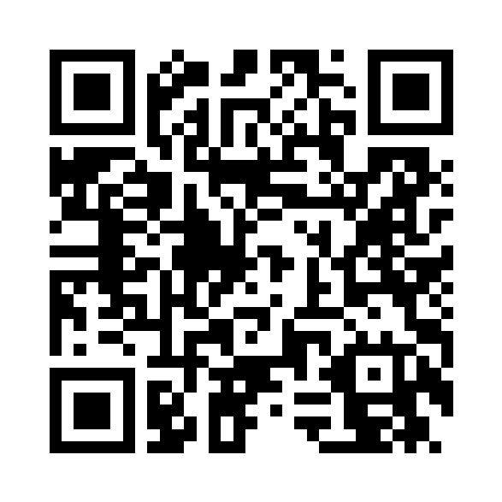

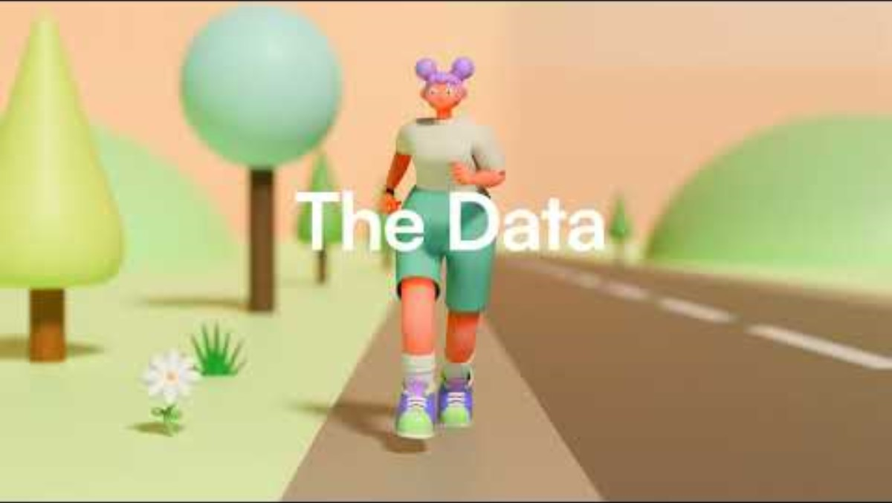
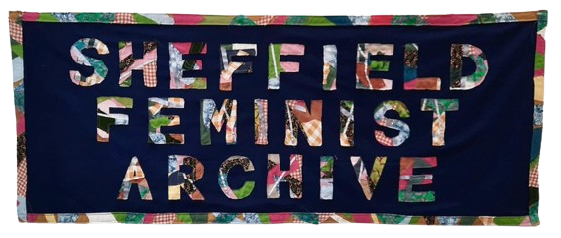
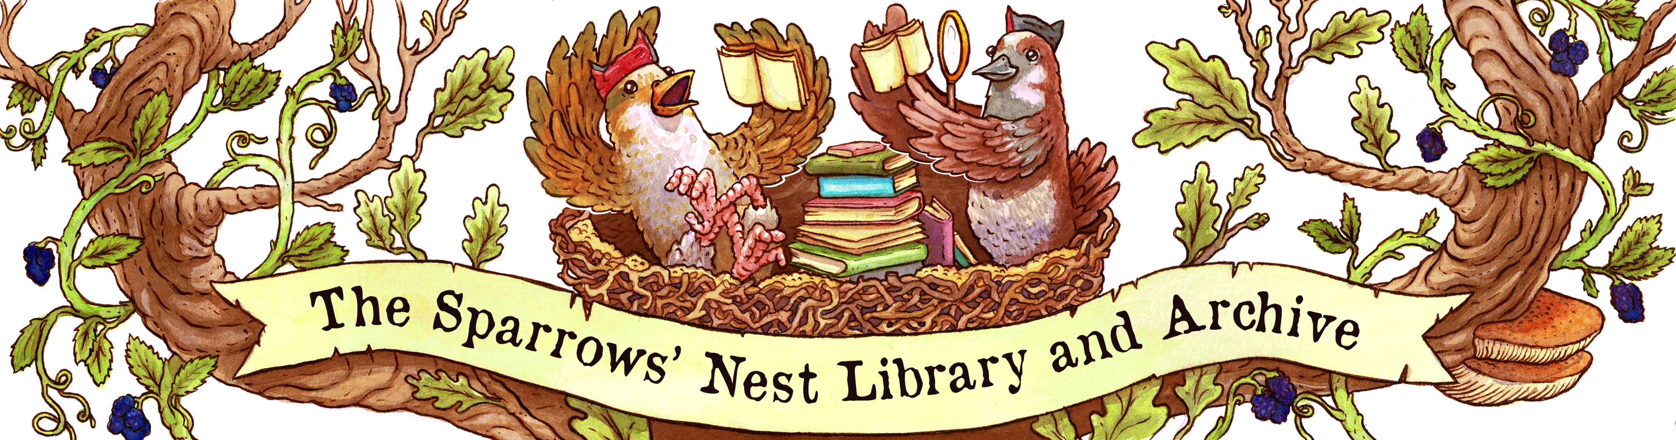

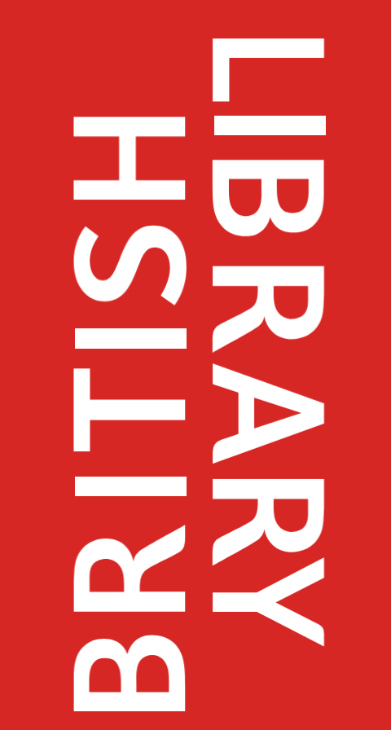



Democratizing digital preservation skills
in personal digital archives and
activist community web archives
Information School
Dr Lee Pretlove and Dr Bethany Aylward
There is a need to empower more individuals and activist communities to start preserving digital content
Using existing educational resources and capacity building practices could be the place to start.
Anonymously reflect on questions with the QR code to develop democratized digital preservation further.
Drawing on empirical research findings from two research projects, this poster calls on digital preservation community educators and policymakers to include individuals and community groups when developing “start 2 preserve” initiatives.
Self-tracking personal digital archives
Activist community web archives
This project used mobile and virtual data collection methods to research eight runners who used digital self-tracking records to create personal confidential, digital archives of their running history. Data was analysed using situational analysis (Clarke et al., 2018).
This project used interviews and participant diaries to understand the engagement of UK activist-archives with web archiving. Research also collected data from Documenting the Now, the UK Web Archive and the Community Archives and Heritage Group.
Participants’ thoughts
More participants’ thoughts
There is a concerning reliance on third-party platforms for personal digital activity data. Learning digital preservation skills would be useful for runners who cared about their digital running records particularly preventing loss at the hands of third-party control.
We found web archiving skills and capacity gaps for activist-archives, even those that had qualified archivists working for them. Participants were unaware of existing mechanisms of support and unsure where to seek help.
Dr Lee Pretlove l.j.pretlove@sheffield.ac.uk and Dr Bethany Aylward b.aylward@sheffield.ac.uk
Information School, The University of Sheffield, Floor C, The Wave, 2 Whitham Road, Sheffield, S10 2AH, United Kingdom

Slide 2

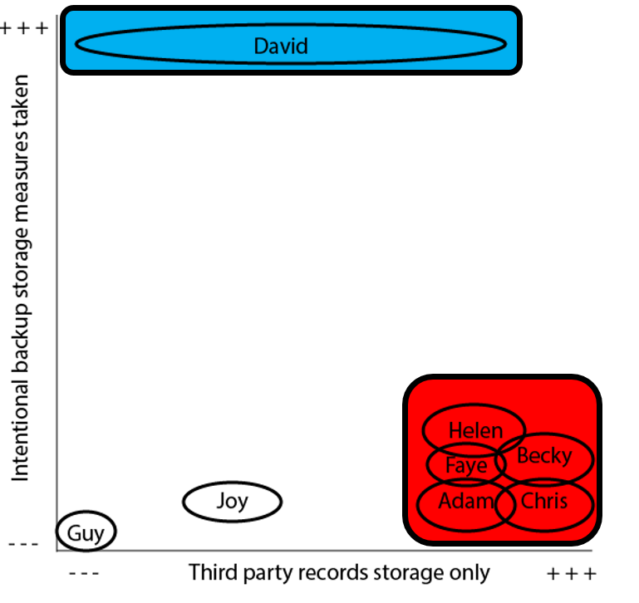
Democratizing digital preservation skills
in personal digital archives and
activist community web archives
Information School
Dr Lee Pretlove and Dr Bethany Aylward
Self-tracking personal digital archives
Activist community web archives
Return to first screen
Perception, selection, and storage of digital running data
Practical barriers to web archiving
“[Data] pings straight onto Strava” (Becky).
“Preserving websites is beyond our capabilities as an organization, it’s as simple as that. It’s really complicated […] I know some people are really intimidated by digital preservation. And I don’t think I am intimidated by it, but I know I need to dedicate a lot of time to build my skills and understanding” (P1, AIU, interview).
Storage and intentional backup measures
“I still back everything up three times as a sort of daily file history backup, there’s a monthly backup to hard disk and a three-monthly in me fire safe. Not just that, it’s more for professional stuff as well, but I’ve never actually backed up my Strava data because that’s not me prime record, it’s interesting” (David).
Ethical web archiving concerns
“We looked at Facebook… but also the effect of Brexit on copyright and data protection and making sure that people within community archives were aware of it, what does this mean for you, what does this mean for us. And making people aware of what Facebook does with their information. Why is it free? What’s the payoff?” (P2, CAHG Scotland, interview).
“[Brewster Kale] doesn’t try to partner with an organization, he doesn’t run around asking for permission for each step, just starts moving on it” (P3, IA, interview).
Sense of achievement and history
“it’s a record, isn’t it of my journey in running, I suppose, isn’t it? It’s nice sometimes to sort of look back, and especially when you say you’ve got a race coming up and you want to compare to how you ran last time, or last year, you can then kind of look at your splits and your times and then it’s quite nice, as a, it’s like a keepsake isn’t it of your history” (Chris).
Dr Lee Pretlove l.j.pretlove@sheffield.ac.uk and Dr Bethany Aylward b.aylward@sheffield.ac.uk
Information School, The University of Sheffield, Floor C, The Wave, 2 Whitham Road, Sheffield, S10 2AH, United Kingdom

