Slide 1

Expanding Horizons for Digital Storage in Research Libraries: Navigating the Zettabyte Era
Jon Shaw, Vanderbilt University, Nashville, Tennessee, USA
Brigitte Weinsteiger, University of Pennsylvania, Philadelphia, Pennsylvania, USA
IPRES, 2024

Slide 2

Data Deluge

Slide 3


Volume of data/information created, captured, copied, and consumed worldwide from 2010 to 2020, with forecasts from 2021 to 2025 (in zettabytes)
Amount of data created, consumed, and stored 2010-2020, with forecasts to 2025
Note(s): Worldwide; 2010 to 2020
Further information regarding this statistic can be found on page 8.
Source(s): IDC; Seagate; Statista estimates; ID 871513

Slide 4
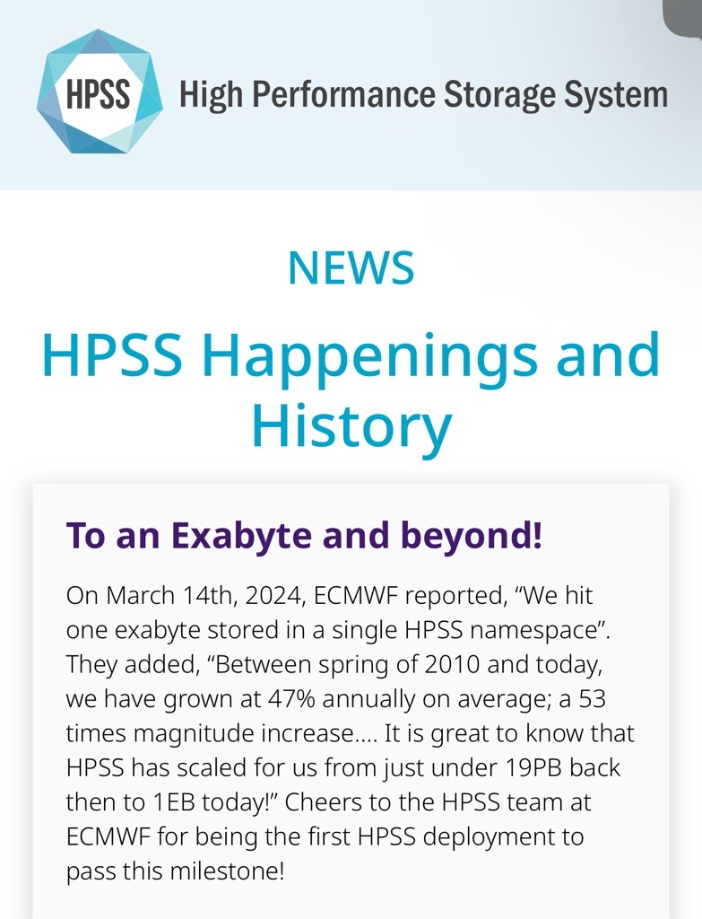

Slide 5

Decisions at the Digital Crossroads

Slide 6

Emerging Tech

Slide 7
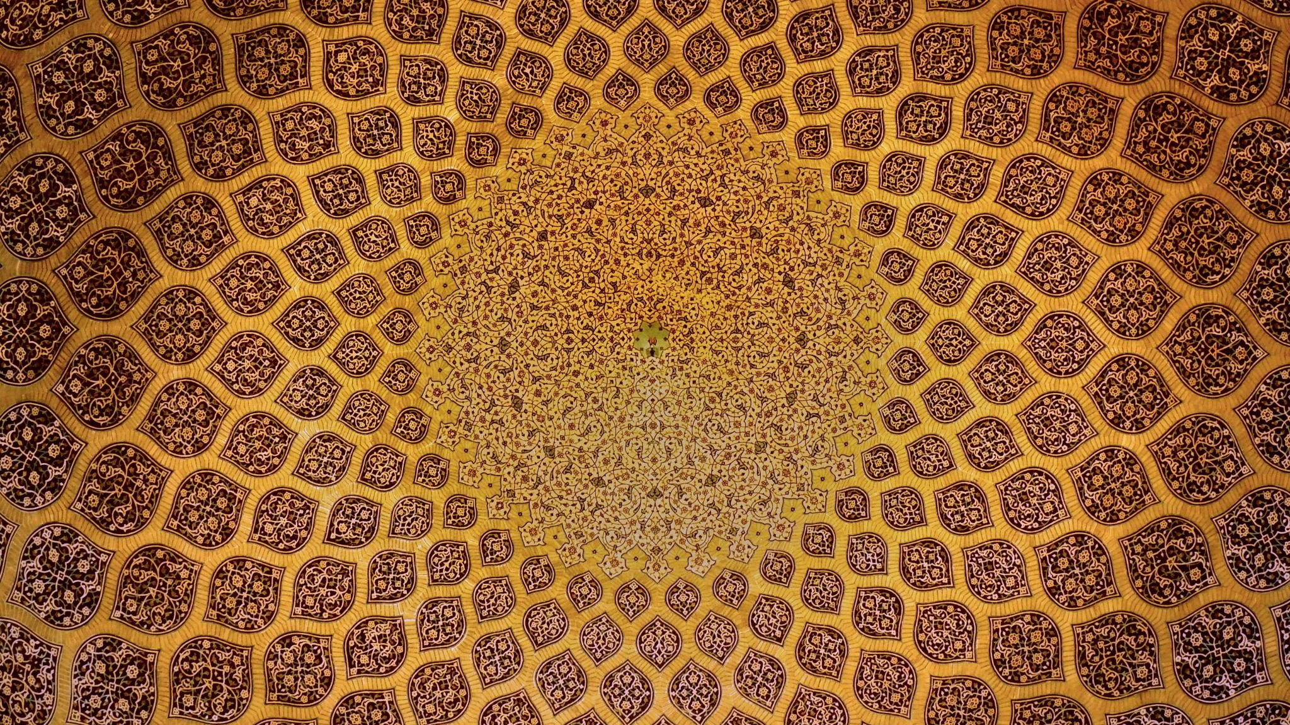
Beyond Boundaries: Collaborative Solutions for Cultural Preservation
Notes:
research libraries' critical role in preservation of contemporary cultural heritage

