Slide 1
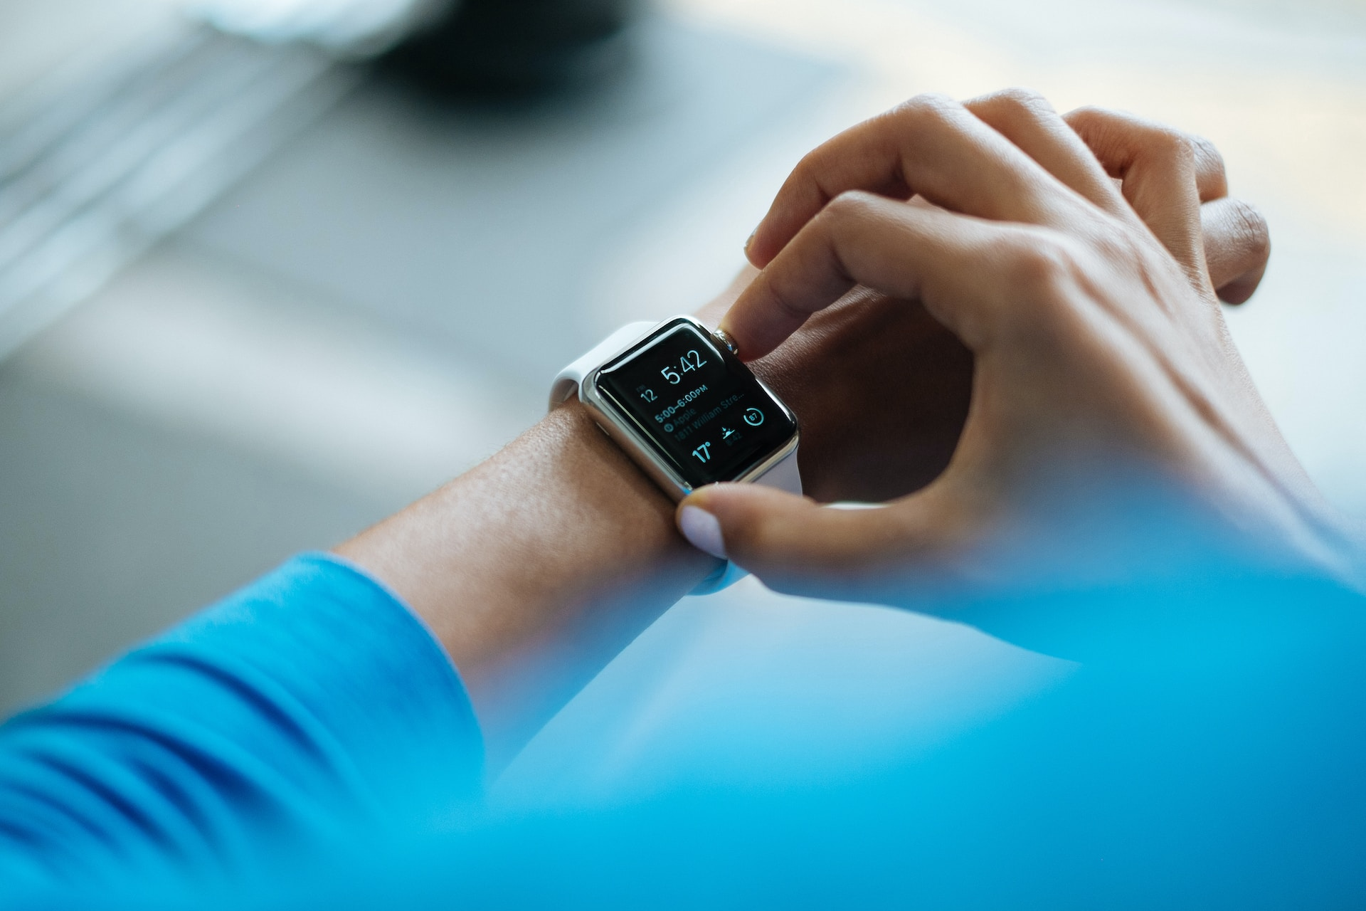
The acceptability of wearables for atrial fibrillation screening: Interim analysis of the SAFER Wearables Study
Dr Peter H. Charlton
University of Cambridge
City, University of London
Recorded in preparation for the
2024 Computing in Cardiology Conference.
Photo by Luke Chesser on Unsplash

Slide 2

If atrial fibrillation was adequately treated in England:
2,000
Lives saved p.a.
7,000
Strokes prevented
425,000
Additional diagnoses
Stroke Association, “State of the Nation,” 2017.
Public Health England, “Atrial fibrillation prevalence estimates in England …”, 2015.
Pexels, https://pixabay.com/photos/man-heartache-chest-pain-hurt-pain-1846050/ (Pixabay Licence)
Notes:
Source: https://www.stroke.org.uk/professionals/atrial-fibrillation-information-and-resources ; “It's estimated that if AF was adequately treated, around 7,000 strokes would be prevented and over 2,000 lives saved every year in England alone.”

Slide 3
Photo by Luke Chesser on Unsplash

Slide 4

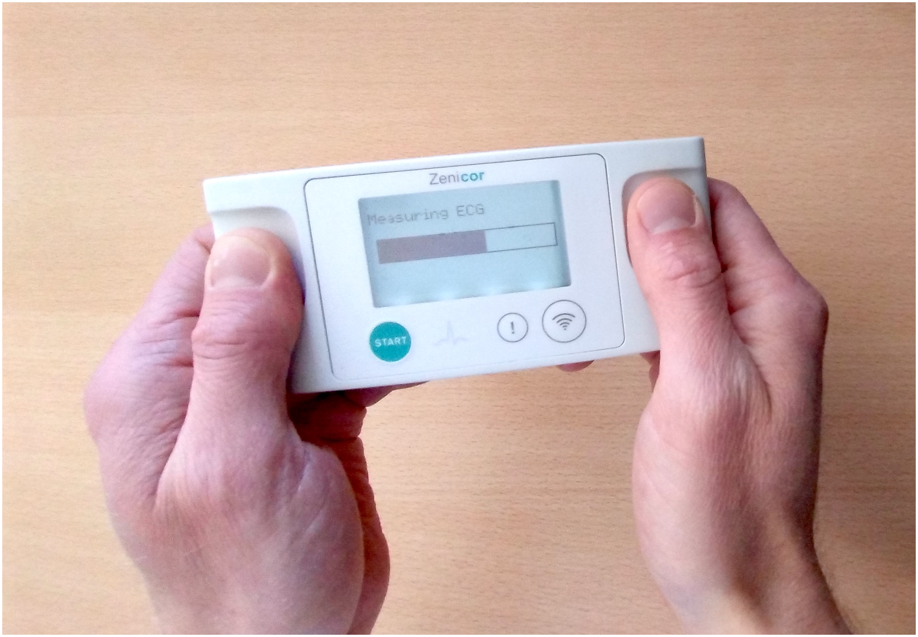
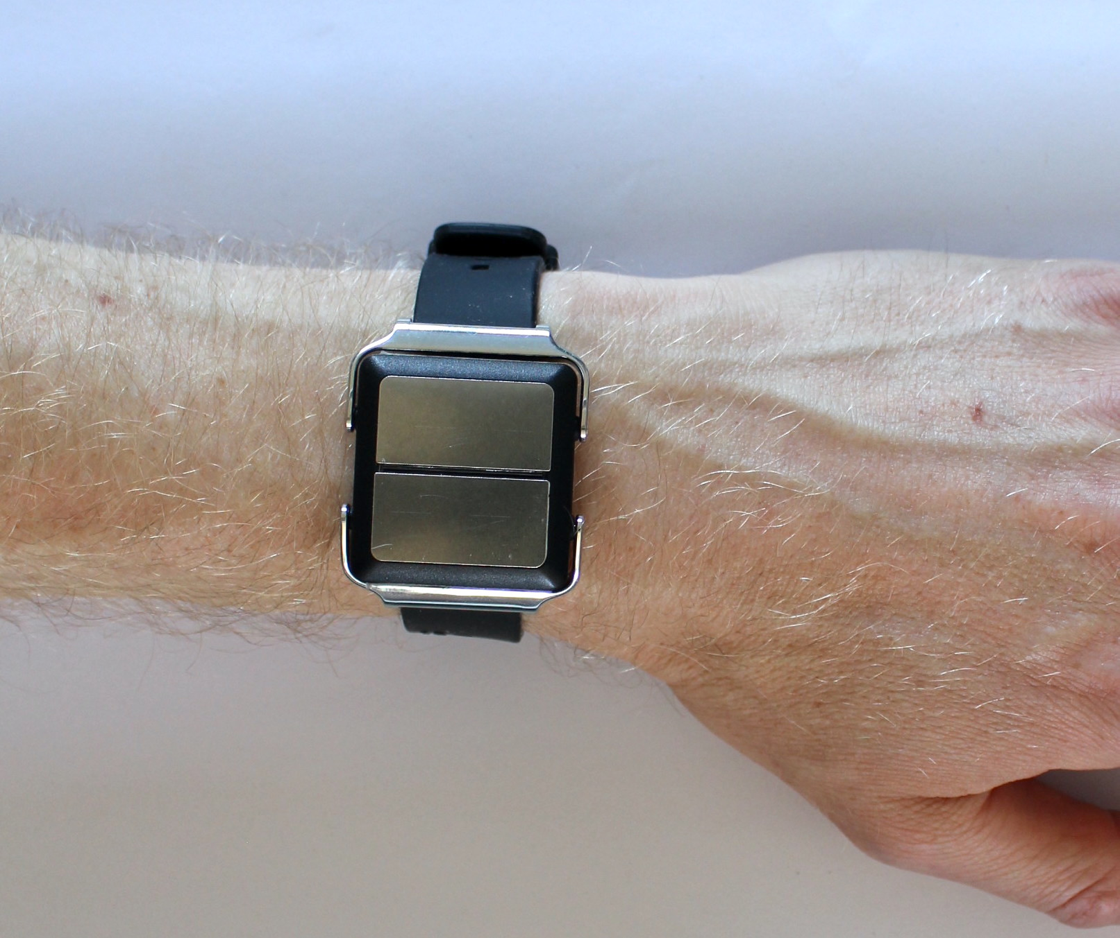
Kristof F et al., QRS detection in single-lead, telehealth electrocardiogram signals: Benchmarking open-source algorithms, PLOS Digital Health, 2024. https://doi.org/10.1371/journal.pdig.0000538 (CC BY 4.0)

Slide 5

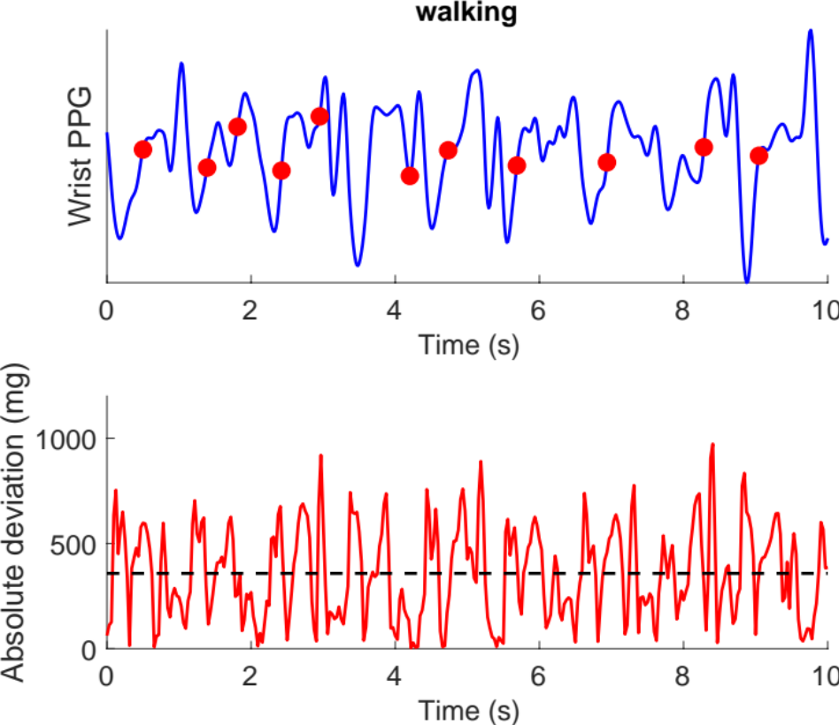
Detecting atrial fibrillation in daily life
1. Background
2. Acceptability in older adults
3. Next Steps
Photo by Luke Chesser on Unsplash
Photo by Dario Valenzuela on Unsplash

Slide 6
Detecting atrial fibrillation in daily life
1. Background
2. Acceptability in older adults
3. Next Steps
Photo by Luke Chesser on Unsplash
Photo by Dario Valenzuela on Unsplash

Slide 7
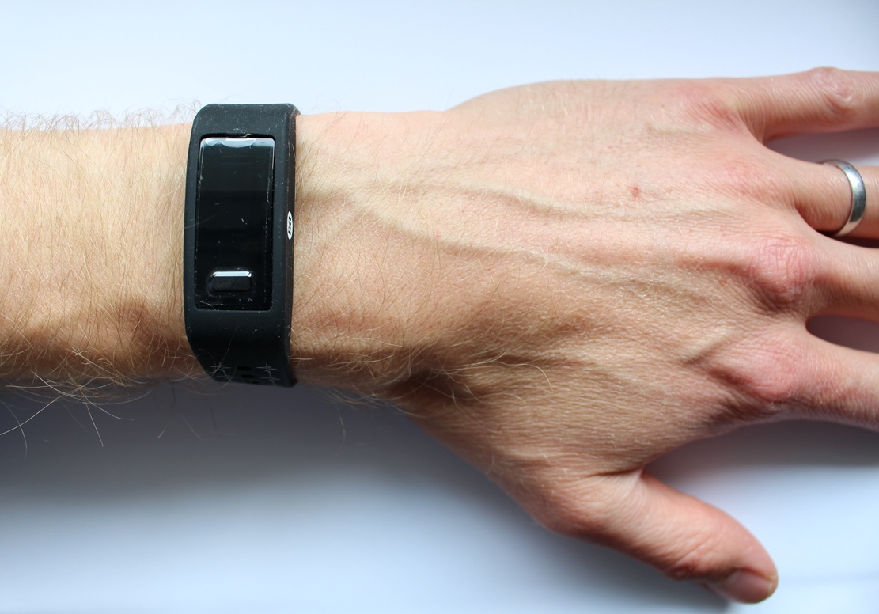
The Photoplethysmogram
Photoplethysmogram (PPG) Sensor
Wrist cross-section
Notes:
If you have a fitness tracker or smart watch you may have seen sensors on its underside, perhaps emitting red or green light. These are PPG sensors. I’ll use a cross-section [click] of the wrist to illustrate how a PPG signal is generated and captured. In this example a [click] green LED is used to illuminate the wrist. Some of the light is attenuated in the tissues, and some is reflected back towards the sensor. The level of reflected light is recorded by a [click] light sensor (in yellow). Here is [click] an example of the resulting PPG signal.
[click] The cross-section shows the pulsatile flow of arterial blood into the wrist with each heart beat. On the right, the signal increases and decreases with each heart beat, as the volume of arterial blood, which absorbs light, increases and decreases. This forms pulse waves – one for each heart beat.

Slide 8
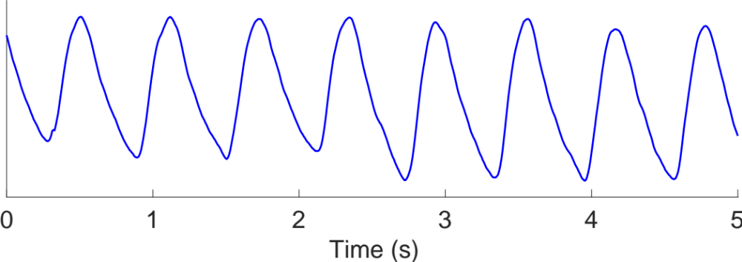
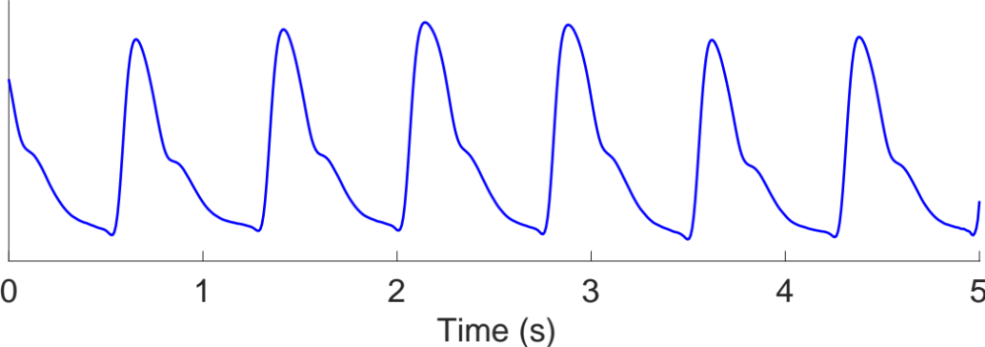
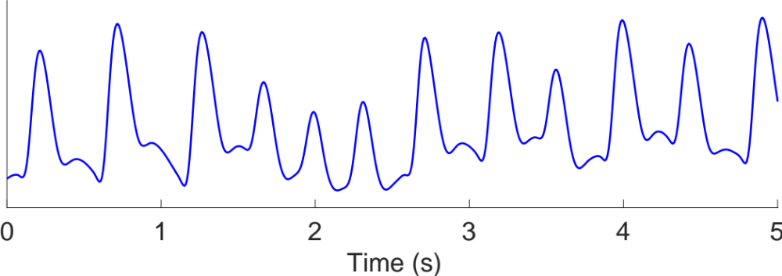
The Photoplethysmogram
Photoplethysmogram (heart rate = 100 bpm)
Slower heart rate (heart rate = 80 bpm)
Photoplethysmogram (PPG) Sensor
Atrial fibrillation (heart rate = 140 bpm)
Wrist cross-section
Notes:
[click] Heart rate: 100 bpm
[click] Heart rate: 60 bpm
[click] irregular rhythm
[click] irregular intervals
[click] varying pulse amplitudes
If you have a fitness tracker or smart watch you may have seen sensors on its underside, perhaps emitting red or green light. These are PPG sensors. I’ll use a cross-section [click] of the wrist to illustrate how a PPG signal is generated and captured. In this example a [click] green LED is used to illuminate the wrist. Some of the light is attenuated in the tissues, and some is reflected back towards the sensor. The level of reflected light is recorded by a [click] light sensor (in yellow). Here is [click] an example of the resulting PPG signal.
[click] The cross-section shows the pulsatile flow of arterial blood into the wrist with each heart beat. On the right, the signal increases and decreases with each heart beat, as the volume of arterial blood, which absorbs light, increases and decreases. This forms pulse waves – one for each heart beat.
[click] This PPG signal shows a heart rate of approximately 100 beats per minute. [click] Here is an example of a slower heart rate, still in sinus rhythm. Besides the heart rate, the signal is also greatly influenced by the [click] heart rhythm, since an irregular rhythm such as atrial fibrillation results in both [click] irregular beat-to-beat intervals and [click] varying pulse amplitudes. [click] Focusing in on a [click] single pulse wave [click]...

Slide 9
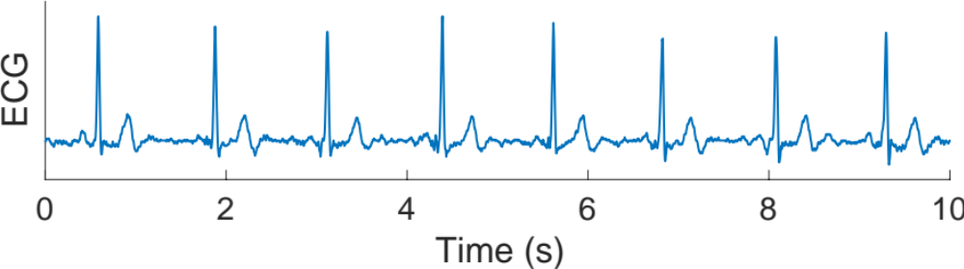
Single-lead ECG

Slide 10
Using photoplethysmography to prompt single-lead ECG
Photo by Luke Chesser on Unsplash

Slide 11
Detecting atrial fibrillation in daily life
1. Background
2. Acceptability in older adults
3. Next Steps
Photo by Luke Chesser on Unsplash
Photo by Dario Valenzuela on Unsplash

Slide 12
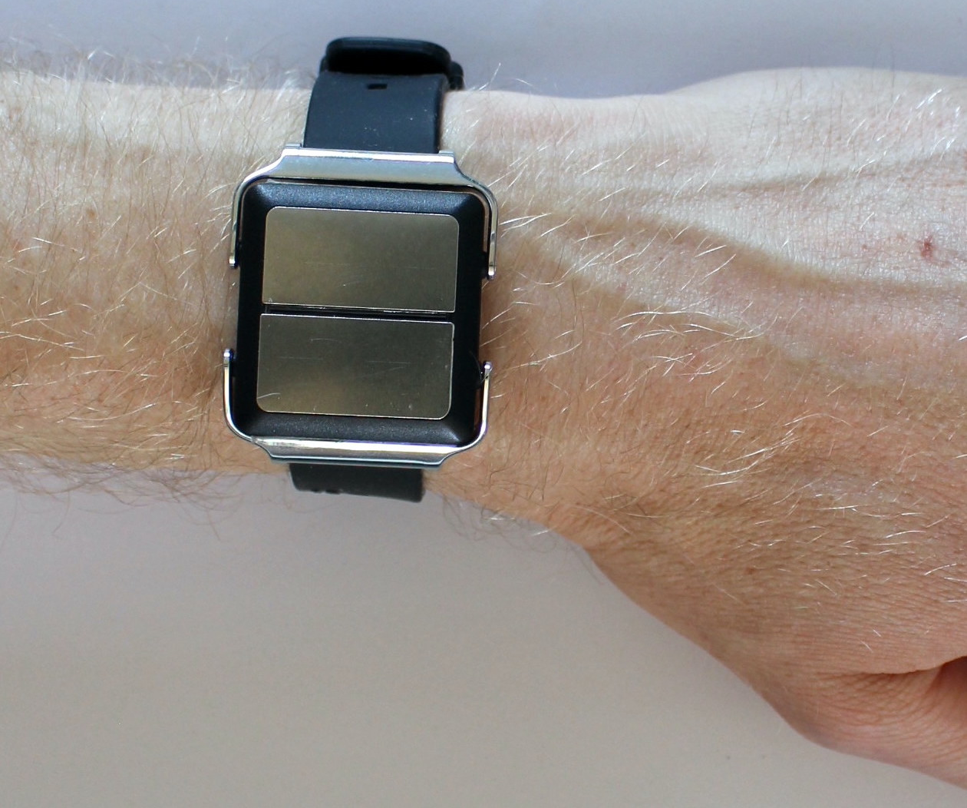
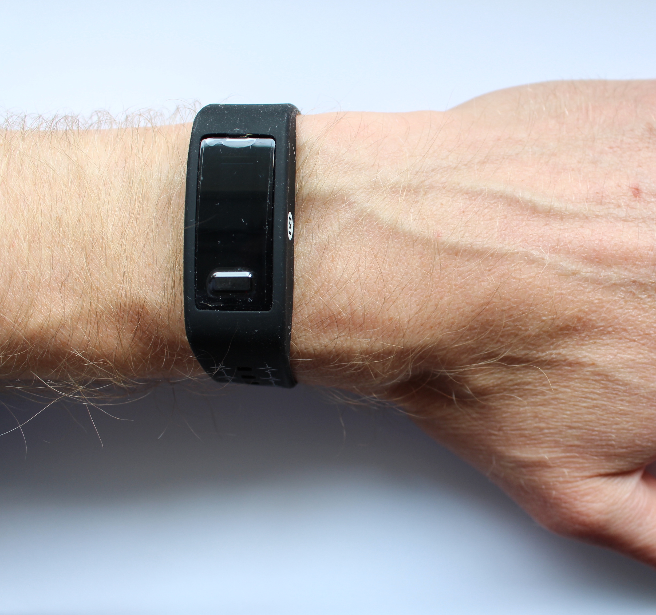
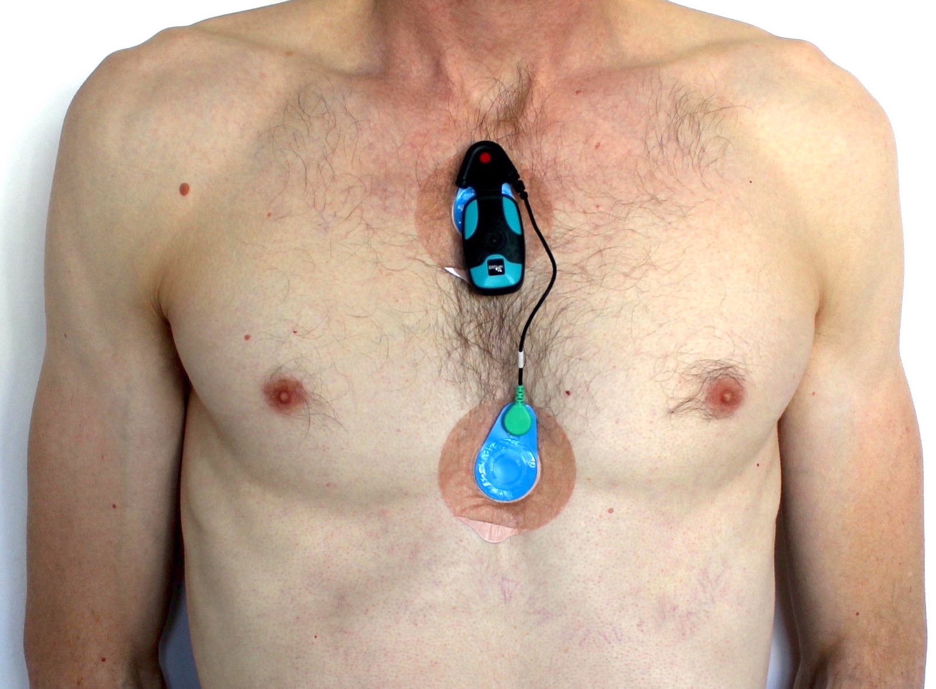

Aim: To identify factors influencing the acceptability of wearables in older adults.
Methods:
In 130 older adults, aged 65+, half of whom have AF
Devices delivered by mail, and instructions provided via leaflet and telephone call.
Asked to wear three devices for one week.
Two wrist-worn devices:
  PulseOn Arrhythmia Monitor: Continuous PPG. Vibrated 4 times per day and upon irregular pulse to prompt ECG recording.
  PulseOn OHR (Optical Heart Rate Tracker): Intermittent PPG
Reference ECG chest patch:
  Bittium Faros 180 chest patch: Continuous ECG
Questionnaire provided formal feedback
Informal feedback collected via telephone calls.
Progress:
21 out of 130 participants to date.
The SAFER Wearables Study, NCT04715555

Slide 13
Results:
Recruitment and participation
75 potential participants invited
42 consented to take part (56%)
21 had taken part at the time of this analysis
Device removals
Removals:
5 (24%) removed Faros 180 due to skin irritation
4 (19%) removed PulseOn OHR (3 due to battery running out, 1 due to skin irritation)
1 (5%) removed PulseOn Arr due to night-time vibrations
The SAFER Wearables Study, NCT04715555

Slide 14
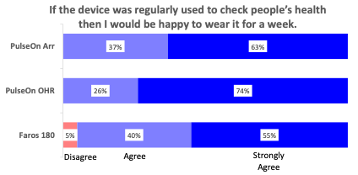
Results:
Feedback
Most respondents would be happy to wear any device for a week:
The SAFER Wearables Study, NCT04715555

Slide 15
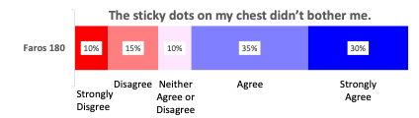
Results:
Feedback
But the chest electrodes irritated participants, with 8 (38%) participants reporting irritation during telephone calls.
“looked as though I'd been attacked with an octopus with a round ring”
"I forget that's there”
Other issues:
Faros 180: electrodes detached, form factor used not suitable for women.
PulseOn Arr: night-time vibrations.
PulseOn OHR: battery running out.
The SAFER Wearables Study, NCT04715555

Slide 16
Discussion:
Possible strategies to improve acceptability:
Use different chest patch electrodes or locations.
Inform participants that accidental activation of PulseOn Arr can produce night-time vibrations.
Limitations:
One-week duration
Devices worn simultaneously
The SAFER Wearables Study, NCT04715555

Slide 17
Detecting atrial fibrillation in daily life
1. Background
2. Acceptability in older adults
3. Next Steps
Photo by Luke Chesser on Unsplash
Photo by Dario Valenzuela on Unsplash

Slide 18
Next Steps:
Complete SAFER Wearables Study:
Target recruitment: 130 participants (65 AF, 65 non-AF)
Assess performance of wearables for detecting AF.
Improve the reliability of AF diagnoses based on single-lead ECGs acquired from wrist-worn and handheld devices:
Guidelines state that AF diagnoses should be made based on manual interpretation of ECGs.
However, we have recently observed that when screening for AF using handheld ECG devices in SAFER: for every 100 participants diagnosed with AF by two cardiologists, the cardiologists would disagree on the diagnosis of a further 70 participants.
See: K. Hibbitt et al., ‘Reliability of single-lead electrocardiogram interpretation to detect atrial fibrillation: insights from the SAFER feasibility study’, EP Europace, vol. 26, no. 7, p. euae181, 2024, doi: 10.1093/europace/euae181.
The SAFER Wearables Study, NCT04715555

Slide 19
With thanks to…
Justinas Bacevicius
Timothy Bonnici
James Brimicombe
Cheryl Chapman
Andrew Dymond
Miranda Van Emmenis
Vaidotas Marozas
Andrius Rapalis
Kate Williams
Panicos Kyriacou
Jonathan Mant
The SAFER Research Team
University of Cambridge
City, University of London
King’s College London
British Heart Foundation
NIHR
EPSRC
… and many others

Slide 20

Wearable devices were tolerated for one week by older adults.
However, the chest patch’s electrodes caused skin irritation leading to some participants removing it.
There is much work to be done to optimise acceptability and performance, and make wearables as reliable as a climbing rope.
Sonia Sevilla, https://commons.wikimedia.org/wiki/File:Kamar_Zard_Buzhan_-_Nishapur_1.jpg (CC0 1.0)

Slide 21
The acceptability of wearables for atrial fibrillation screening: Interim analysis of the SAFER Wearables Study
Dr Peter H. Charlton
https://peterhcharlton.github.io
pc657@cam.ac.uk
Slides available at: https://doi.org/10.5281/zenodo.13692217 (CC BY 4.0)
Material reproduced from the preprint of the same name under CC BY 4.0 .
Photo by Luke Chesser on Unsplash

Slide 22
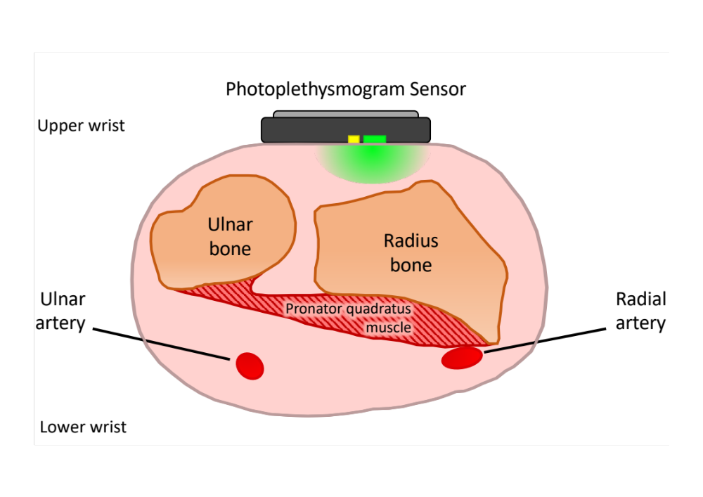
Wrist photoplethysmography: limitations
Photoplethysmogram (PPG) Sensor
Charlton PH et al., Wearable photoplethysmography for cardiovascular monitoring, Proc. IEEE, 2022. ﻿https://doi.org/10.1109/JPROC.2022.3149785 (CC BY 4.0)
Adapted from: ﻿H. Gray, Anatomy of the Human Body, W. H. Lewis, Ed., 2nd ed. New York, NY, USA: Lea and Febiger, 1918

Slide 23
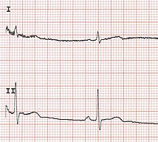
Single-lead ECG: limitations
Dry electrodes
Recorded without clinical supervision
Lead I
“Sinus P waves are usually most prominently seen in leads II and V1”
Meek S and Morris F, ‘ABC of clinical electrocardiography: Introduction. II—basic terminology’, https://doi.org/10.1136/bmj.324.7335.470
Peter Charlton, Wikimedia Commons, https://commons.wikimedia.org/wiki/File:12_lead_ECG.jpg (CC BY 4.0)

Slide 24
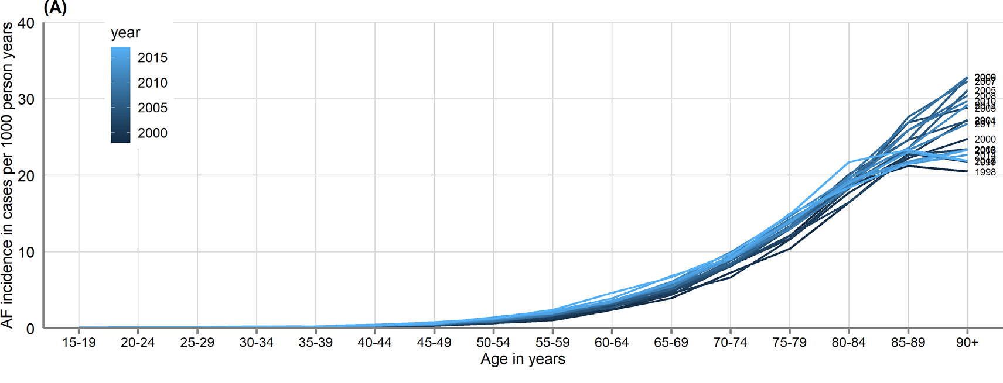
Older adults because:
AF incidence increases with age
From primary and secondary electronic health records of 3.4 million individuals in England
In daily life because:
AF can occur infrequently
Wu J et al., ‘Temporal trends and patterns in atrial fibrillation incidence: A population-based study of 3.4 million Individuals’, https://doi.org/10.1016/j.lanepe.2022.100395 (CC BY 4.0)
Notes:
NICE (2021) recommends offering anticoagulation “to people with atrial fibrillation and a CHA2DS2‑VASc score of 2 or above” (i.e. after detecting AF, all women ≥ 65 years, and all men ≥ 75 years).

Slide 25
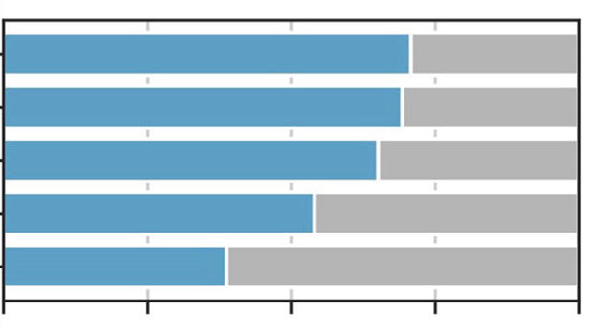
Smartwatch ownership
Not everyone has a smartwatch, particularly older adults
An electronic survey of 1,368 patient advisory group members:
18-25
26-41
Age
42-57
58-76
77+
0
25
50
75
100
Ownership Percentage (%)
Shandhi MH et al., ‘Assessment of ownership of smart devices and the acceptability of digital health data sharing’, https://doi.org/10.1038/s41746-024-01030-x
(CC BY 4.0)

